Slide 1
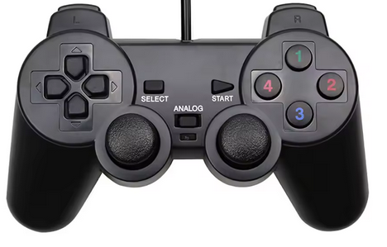
Identificar
Armar
Despegar
RTL
Loiter
Guided
Land
Yaw
Roll
Throttle
Pitch

Slide 2
Button[4]
Button[5]
Button[6]
Button[7]
Button[8]
Button[9]
Button[0]
Hats[0]
Button[3]
(0,1)
(1,0)
(-1,0)
(0,-1)
Button[1]
Button[2]
-1
-1
Button[11]
Button[10]
Axis[0]
-1
1
-1
1
Axis[3]
1
1
Axis[1]
Axis[2]

Slide 3
Buttons
Axis
Hats

Slide 4
Rotar
Izquierda/derecha
Arriba/abajo
Adelante/atrás

