Slide 1
Esoteric Programming Languages
A deep dive into the madness of the programmer’s mind.

Slide 2
What is an Esoteric programming language?
An esoteric programming language (ess-oh-terr-ick), or esolang, is a computer programming language designed to experiment with weird ideas, to be hard to program in, or as a joke, rather than for practical use.
weird
hard
joke
no use

Slide 3
Why?
Minimalism
Themed
New concepts
Jokes
Obfuscation
To let it go, to be free is to be weird

Slide 4
"A language that doesn't affect the way you think about programming is not worth knowing."
- Alan J. Perlis

Slide 5
Minimalism
Minimalism in one or more:
Instruction count
Code
Complexity
...

Slide 6
brainfuck
Created in 1993, Urban Müller
Goal: make the smallest compiler possible (Amiga OS 2.0) (240 byte)
57 byte (X86 interpreter)
261+ deriatives

Slide 7
Commands
>>[-]<<[->>+<<]
Command | Description
> | Move the pointer to the right
< | Move the pointer to the left
+ | Increment the memory cell at the pointer
- | Decrement the memory cell at the pointer
. | Output the character signified by the cell at the pointer
, | Input a character and store it in the cell at the pointer
[ | Jump past the matching ] if the cell at the pointer is 0
] | Jump back to the matching [ if the cell at the pointer is nonzero

Slide 8
Hello world - DEMO
1 +++++ +++ Set Cell #0 to 8 2 [ 3 >++++ Add 4 to Cell #1; this will always set Cell #1 to 4 4 [ as the cell will be cleared by the loop 5 >++ Add 4*2 to Cell #2 6 >+++ Add 4*3 to Cell #3 7 >+++ Add 4*3 to Cell #4 8 >+ Add 4 to Cell #5 9 <<<<- Decrement the loop counter in Cell #1 10 ] Loop till Cell #1 is zero 11 >+ Add 1 to Cell #2 12 >+ Add 1 to Cell #3 13 >- Subtract 1 from Cell #4 14 >>+ Add 1 to Cell #6 15 [<] Move back to the first zero cell you find; this will 16 be Cell #1 which was cleared by the previous loop 17 <- Decrement the loop Counter in Cell #0 18 ] Loop till Cell #0 is zero
25 >>. Cell #2 has value 72 which is 'H' 26 >---. Subtract 3 from Cell #3 to get 101 which is 'e' 27 +++++ ++..+++. Likewise for 'llo' from Cell #3 28 >>. Cell #5 is 32 for the space 29 <-. Subtract 1 from Cell #4 for 87 to give a 'W' 30 <. Cell #3 was set to 'o' from the end of 'Hello' 31 +++.----- -.----- ---. Cell #3 for 'rl' and 'd' 32 >>+. Add 1 to Cell #5 gives us an exclamation point 33 >++. And finally a newline from Cell #6

Slide 9
Algoritms – move value to right by 2
>>[-]<<[->>+<<]
Code: Pseudo code:
>> Move the pointer to cell2
[-] Set cell2 to 0
<< Move the pointer back to cell0
[ While cell0 is not 0
- Subtract 1 from cell0
>> Move the pointer to cell2
+ Add 1 to cell2
<< Move the pointer back to cell0
] End while
Algorithms

Slide 10
Constants - 93
++++++++++ ++++++++++ ++++++++++ ++++++++++ ++++++++++ ++++++++++ ++++++++++ ++++++++++ ++++++++++ +++ (93, 0)
+++++[>++++++<-]>+[<+++>-]< (27, 2) non-wrapping
>+++>+[>++[-<++++++>]<<]> (25, 4) non-wrapping
>+>+>+[++>[-<+++++>]<<]> (24, 5) non-wrapping
>-->+[>+++[-<+++++>]<<]> (24, 4) non-wrapping (soft)
>+>-->+[>+[-<++++>]<<]> (23, 5) non-wrapping (soft)
->>>>>+[>+[-<++>]<<+]> (22, 7) non-wrapping (soft)
-[>+<---]>++++++++ (18, 2) wrapping
-->+[[+++>]<+<]> (16, 3) wrapping
-[+>+[<]>++++]> (15, 6) wrapping

Slide 11
Themed
Get a theme and hide the code
Understandable by ”normies” (mostly)

Slide 12
Chef
Chef is a programming language in which programs look like recipes.
Goals:
Program recipes should not only generate valid output, but be easy to prepare and delicious.
Recipes may appeal to cooks with different budgets.
Recipes will be metric, but may use traditional cooking measures such as cups and tablespoons.

Slide 13
Hello World Souffle. A ton of food for a brute.
Ingredients.
72 g haricot beans
101 eggs
108 g lard
111 cups oil
32 zucchinis
119 ml water
114 g red salmon
100 g dijon mustard
33 potatoes
Method.
Put potatoes into the mixing bowl.
Put dijon mustard into the mixing bowl.
Put lard into the mixing bowl.
Put red salmon into the mixing bowl.
Put oil into the mixing bowl.
Put water into the mixing bowl.
Put zucchinis into the mixing bowl.
Put oil into the mixing bowl.
Put lard into the mixing bowl.
Put lard into the mixing bowl.
Put eggs into the mixing bowl.
Put haricot beans into the mixing bowl.
Liquefy contents of the mixing bowl.
Pour contents of the mixing bowl into the baking dish.
Serves 1.

Slide 14
The cake is a lie
Cake with Chocolate sauce

Slide 15
Shakespear
Goals:
Beautiful source code that resembled Shakespeare plays
No fancy data or control structures, just basic arithmetic and gotos
Expressiveness of BASIC
User-friendliness of assembly language

Slide 16
The Infamous Hello World Program.
Romeo, a young man with a remarkable patience.
Juliet, a likewise young woman of remarkable grace.
Ophelia, a remarkable woman much in dispute with Hamlet.
Hamlet, the flatterer of Andersen Insulting A/S.

Slide 17
Act I: Hamlet's insults and flattery. Scene I: The insulting of Romeo.
[Enter Hamlet and Romeo]
Hamlet:
You lying stupid fatherless big smelly half-witted coward!
You are as stupid as the difference between a handsome rich brave
hero and thyself! Speak your mind!
You are as brave as the sum of your fat little stuffed misused dusty
old rotten codpiece and a beautiful fair warm peaceful sunny summer's
day. You are as healthy as the difference between the sum of the
sweetest reddest rose and my father and yourself! Speak your mind!
Source

Slide 18
New concept
Make something new
Try someting else

Slide 19
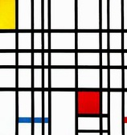
Piet
Goal:
A programming language which looks like an abstract painting.
The language is named after Piet Mondrian.
Stack based

Slide 20
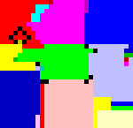

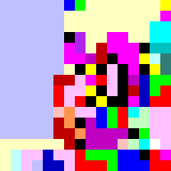


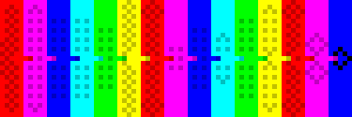
Samples

Slide 21
Colors and commands
#FFC0C0 light red | #FFFFC0 light yellow | #C0FFC0 light green | #C0FFFF light cyan | #C0C0FF light blue | #FFC0FF light magenta
#FF0000 red | #FFFF00 yellow | #00FF00 green | #00FFFF cyan | #0000FF blue | #FF00FF magenta
#C00000 dark red | #C0C000 dark yellow | #00C000 dark green | #00C0C0 dark cyan | #0000C0 dark blue | #C000C0 dark magenta
#FFFFFF white |  |  | #000000 black
 | Lightness change
Hue change | None | 1 Darker | 2 Darker
None |  | push | pop
1 Step | add | subtract | multiply
2 Steps | divide | mod | not
3 Steps | greater | pointer | switch
4 Steps | duplicate | roll | in(number)
5 Steps | in(char) | out(number) | out(char)

Slide 22
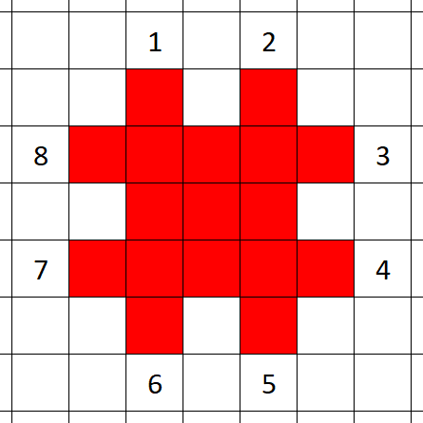

Direction pointer, codel chooser
DP | CC | Codel chosen
right | left | Uppermost (3)
 | right | Lowermost (4)
down | left | Rightmost (5)
 | right | Leftmost (6)
left | left | Lowermost (7)
 | right | Uppermost (8)
up | left | Leftmost (1)
 | right | Rightmost (2)

Slide 23
Piet
IDE
program

Slide 24
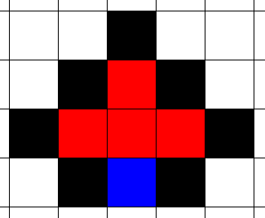
Termination

Slide 25
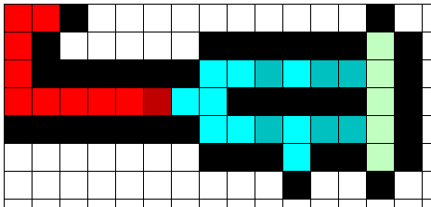
If

Slide 26
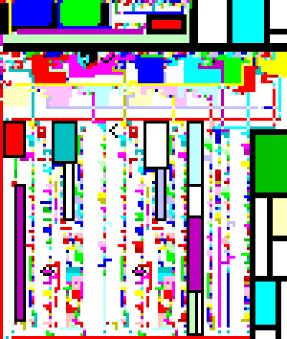
Brainfuck interpreter

Slide 27
Jokes
Fun, fun, fun...

Slide 28
INTERCAL
Compiler Language With No Pronounceable Acronym
1972 (same year as C, Smalltalk, Prolog)
ASCII
$ substituted for ¢ (represent[ing] the increasing cost of software in relation to hardware)
? was substituted for ⊻ (correctly express the average person's reaction on first encountering exclusive-or)
Has to be slower than anything else
Caution! Under no circumstances confuse the mesh with the interleave operator, except under confusing circumstances!
Single and double quotes are 'sparks' and "rabbit ears"

Slide 29
INTERCAL
DO
COME FROM (line)
PLEASE
GIVE UP
DO ,1 <- #13
PLEASE DO ,1 SUB #1 <- #238
DO ,1 SUB #2 <- #108
DO ,1 SUB #3 <- #112
DO ,1 SUB #4 <- #0
DO ,1 SUB #5 <- #64
DO ,1 SUB #6 <- #194
DO ,1 SUB #7 <- #48
PLEASE DO ,1 SUB #8 <- #22
DO ,1 SUB #9 <- #248
DO ,1 SUB #10 <- #168
DO ,1 SUB #11 <- #24
DO ,1 SUB #12 <- #16
DO ,1 SUB #13 <- #162
PLEASE READ OUT ,1
PLEASE GIVE UP

Slide 30
Rockstar
Goals:
To really confuse recruiters, someone should make a programming language called Rockstar.
Create a language that works as a ’90s rock song.
Give the programmer an unprecedented degree of poetic license when it comes to the composition and structure of their programs.

Slide 31
Hello world
Say "Hello World"

Slide 32
FizzBuzz
Midnight takes your heart and your soul
While your heart is as high as your soul
Put your heart without your soul into your heart
Give back your heart
Desire is a lovestruck ladykiller
My world is nothing
Fire is ice
Hate is water
Until my world is Desire,
Build my world up
If Midnight taking my world, Fire is nothing and Midnight taking my world, Hate is nothing
Shout "FizzBuzz!"
Take it to the top
If Midnight taking my world, Fire is nothing
Shout "Fizz!"
Take it to the top
If Midnight taking my world, Hate is nothing
Say "Buzz!"
Take it to the top
Whisper my world
Youtube

Slide 33
FizzBuzz
Desire is a lovestruck ladykiller
My world is nothing
Fire is ice
Hate is water
Until my world is Desire,
Build my world up
If Midnight taking my world, Fire is nothing
and Midnight taking my world, Hate is nothing
Shout "FizzBuzz!"
Take it to the top
desire = 100
my_world = 0
fire = 3
water = 5
while my_world != desire
my_world++
if Midnight(my_world, fire) == 0
&& Midnight(my_world, ice) == 0
print("FizzBuzz")
continue
Notes:
1:55-

Slide 34
FizzBuzz
Midnight takes your heart and your soul
While your heart is as high as your soul
Put your heart without your soul into your heart
Give back your heart
method Midnight(your_heart, your_soul)
while (your_heart >= your_soul)
your_heart = your_heart - your_soul
return your_heart
Notes:
0:34-1:11

Slide 35
Obfuscation
Hard to read

Slide 36
Unreadable
'"X | Print X as a Unicode character and return X.
'""X | Return X + 1.
'""" | Return 1.
'""""XY | Do both X and Y and return what Y returned.
'"""""XY | Do Y while X is not 0 and return the last result.
'""""""XY | Set variable number X to Y and return Y.
'"""""""X | Return the value of variable X, or 0 if the variable has never been assigned.
'""""""""X | Return X - 1.
'"""""""""XYZ | If X is not 0 do Y else do Z. Return what Y/Z returned.
'"""""""""" | Return a single Unicode character which has been read from stdin, or -1 if stdin is exhausted.

Slide 37
Malbolge
(=<`#9]~6ZY327Uv4-QsqpMn&+Ij"'E%e{Ab~w=_:]Kw%o44Uqp0/Q?xNvL:`H%c#DD2^WV>gY;dts76qKJImZkj
Created by Ben Olmstead in 1998, named after the eighth circle of hell in Dante's Inferno, the Malebolge.

Slide 38
Rules of hell
Ternary (0,1,2)
3 registers:
a (accumulator) standard IO
c (code pointer)
d (data pointer), also incremented after every instruction by 1
Memory 59049 (3¹⁰)
Wraps
Stores code and data
Inits empty memory after load with [m] = crz [m - 2] [m - 1]

Slide 39
Instructions of hell
Value of ([c] + c) % 94 | Instruction represented | Explanation
4 | jmp [d] | Copies the value at [d] to c. Note that c will still be incremented after execution of this instruction, so the next instruction to be executed will be the one at [d] + 1 (modulo 59049).
5 | out a | Prints the value of a, as an ASCII character, to the screen.
23 | in a | Inputs a character, as an ASCII code, into a. Newlines or line feeds are both code 10. An end-of-file condition is code 59048.
39 | rotr [d] mov a, [d] | Rotates the value at [d] by one ternary digit to the right (0002111112 becomes 2000211111). Stores the result both at [d] and in a.
40 | mov d, [d] | Copies the value at [d] to d.
62 | crz [d], a mov a, [d] | Does the crazy operation (see below) with the value at [d] and the value of a. Stores the result both at [d] and in a.
68 | nop | Does nothing.
81 | end | Ends the Malbolge program.
Any other value | does the same as 68: nothing. These other values are not allowed in a program while it is being loaded, but are allowed afterwards.
([c] + c) % 94
Encipherment
[c] = enc(c % 94)
crz |  | Input 2
 |  | 0 | 1 | 2
Input 1 | 0 | 1 | 0 | 0
 | 1 | 1 | 0 | 2
 | 2 | 2 | 2 | 1

Slide 40
This is serious stuff… science and all.
Paradigm
Functional, String-rewriting, Object-oriented, Declarative, Cellular automata, Turing tarpits
Determinism
Deterministic, Non-deterministic, Probabilistic
Memory
Variable, Dynamic memory, Cell, Stack, Queue, Deque (double-ended queue)
Computational class
Turing complete, Total, Push-down automata, Linear bounded automata, Finite state automata, Uncomputable, Unknown

Slide 41
This is serious stuff… better pipeline.
https://esolangs.org/
https://hub.docker.com/u/esolang/
https://github.com/topics/esolang

Slide 42
Conway's Game of Life
Any live cell with two or three live neighbours survives.
Any dead cell with three live neighbours becomes a live cell.
All other live cells die in the next generation. Similarly, all other dead cells stay dead.
Patterns Youtube

Slide 43
Thanks
Q/A

