Slide 1

PRNTR
THE MEMECOIN COURSE
Front-run narratives, find the wallets that keep winning, copy them with a bot, and move the profits into a system that pays you.
Part of the PRNTR 1-on-1 Mentorship. Education only, not financial advice.
Notes:
Cover. Course name and promise.

Slide 2




START HERE
How this course works
Lessons 1–2: safety and the game
Wallets that can't take your savings with them, and how memecoin money is really made and lost.
The promise
Not that you'll win every coin. Most lose. You'll lose small on the losers, take real money off the winners, and move it somewhere safer every time.
Lessons 3–5: narratives, events and attention
Spot the theme the market is about to care about, front-run dated events, and get in before the crowd.
Lessons 6–7: find and vet the wallet
DEX Screener's top traders, FOMO transaction patterns, and what they hold right now.
Lessons 8–12: copy, size, profit, the loop, a case study
Copy with a bot, size small, take profit, move it into leverage, then see it all in a real trade.
Notes:
Overview of the 12 lessons. Lesson 4 is front-running events, Lesson 11 the money loop into leverage, Lesson 12 the NVIDIA × HUNG case study.

Slide 3
THE HONEST WARNING
Read this before you start
Most
Never
Small
memecoins go to zero. Some are built to steal from buyers.
use money you need for rent, bills or your family.
size on every single trade. That's what keeps you in the game.
This course is education, not financial advice. Past results, including mine, don't guarantee future results.
Notes:
Risk framing before anything else. Keeps students and your name safe.

Slide 4
01
Wallets and security
Set up three wallets so a scam, a bad bot or a mistake can never reach the money you keep.

Slide 5
LESSON 1
The three-wallet setup
Vault
Trading wallet
Bot wallet
Your savings and profits. Hardware wallet if you can. Never connects to a site, never goes near a bot. You only send money in.
For hand trades on DEXs. Holds only this week's trading money. Connects to sites, so treat it as exposed.
Created inside the copy-trading bot. The bot holds its key, so only fund what you're willing to lose. Withdraw profits often.
Notes:
Why three wallets: each layer limits the damage of a drain or a bad bot.

Slide 6




LESSON 1
Scams to spot before you buy
Honeypots
You can buy but can't sell. Check that other wallets have sold successfully.
Unlocked liquidity / dev holding a lot
The creator can pull the money or dump a big bag on you.
Bundled and sniped launches
A few wallets bought most of the supply in the first block. They're the exit.
Drainer links and fake airdrops
Never sign a transaction you don't understand. Never connect your vault.
Notes:
These are the traps. The next slide is the check that catches most of them.

Slide 7
LESSON 1
The PRNTR safety check: under 2 minutes
1
2
3
4
5
Run a free scanner
Check it can be sold
Check the holders
Check the liquidity
Any red flag: skip
Solana: RugCheck. Other chains: a honeypot checker such as Honeypot.is or Token Sniffer.
On DEX Screener, other wallets have sold, not only bought.
No single wallet, and not the creator, holds a big share of the supply.
Liquidity locked or burned, and deep enough for your exit.
There's always another coin. A skipped trade costs nothing.
Notes:
Scanners catch the obvious traps. They don't make a coin safe, so size small anyway.

Slide 8
02
How memecoin money is made
The life cycle of a coin, and where in it the money changes hands.

Slide 9
LESSON 2
The life of a memecoin
1
2
3
4
5
Launch
Early attention
The narrative spreads
Peak
Bleed
Creator, snipers and insiders get the first supply.
Smart wallets and early callers buy. Volume starts rising.
X, Telegram, trending lists. New buyers pile in. Price runs.
Everyone is talking about it. Early buyers are selling into them.
Volume dries up. Late buyers hold the bag.
Notes:
Our money is made by buying in stage 2 and selling into stages 3 and 4.

Slide 10
LESSON 2
Where you want to be
Buy here: stage 2
Sell here: stages 3–4
After launch chaos settles and before the crowd arrives. Real wallets are buying, volume is rising, the narrative is just starting to spread.
Into the crowd. When your timeline is full of it and strangers are asking about it, you're selling to them, not buying from them.
Notes:
The core rule: get in before the crowd, get out into the crowd.

Slide 11
03
Finding and front-running narratives
A narrative is the story the market is about to care about. Find it early and the coins come to you.

Slide 12






LESSON 3
What a narrative is
A theme that pulls attention, and money, to a group of coins at the same time.
Tech
AI agents, new apps
Politics and news
Elections, viral headlines
Celebrity and culture
A post, a meme, a moment
Scheduled events
Launches, listings, big days
Animal and meme metas
The next dog, cat, frog
New platforms
A new launchpad or chain trend

Slide 13
LESSON 3
The three narratives that move the most
Presidential and politics
Elon Musk
Anything AI
Elections, candidates, nicknames and viral moments from the campaign trail. The biggest attention waves in memecoins.
One post can create a coin and move it in minutes. Watch what he posts, names and jokes about.
New AI tools, agents, launches and headlines. The meta comes back with every big AI story.
Notes:
These three keep producing the biggest PRNTR memecoin moves. Check all three every day.

Slide 14




LESSON 3
Where narratives start
News accounts on X
Breaking-news accounts such as Watcher Guru. A headline can become a coin within minutes, so news is the first place to look.
Telegram groups and callers
Where coins get shared first. Track which callers are early, not loud.
Trending on DEX Screener and launchpads
New themes show up as several coins with the same idea trending at once.
The news and the calendar
A big event coming up is a narrative you can see before it happens.
Notes:
News first: the headline is the narrative. Then check where the coins are being shared.

Slide 15
LESSON 3
How to front-run a narrative
1
2
3
4
5
Spot the theme
Find the leader
Check it fast
Enter small
Sell into the crowd
Two or three coins on the same idea start moving on the same day.
The first coin with real volume and real holders is usually the one the crowd buys.
Scam checks, liquidity, holders. Under two minutes.
Before the big accounts post about it. Size it so a zero doesn't hurt.
When the timeline catches on, you take profit.
Notes:
The playbook: be early to the theme, pick the leader, size small, sell into attention.

Slide 16
04
Front-running the calendar
The biggest narratives are on the calendar months ahead: elections, the Super Bowl, the World Cup. Find the first coin named after the event while it's worth almost nothing.

Slide 17


LESSON 4
Why events are easy to front-run
The date is public
Everyone knows when the Super Bowl, an election or a World Cup final happens. You don't have to guess when attention arrives.
The crowd searches the name
On the day, new buyers type the event's name into Pump.fun or FOMO and buy what they find. Very often that's the first coin made with that name.
The OG gets the attention
In memecoins, "the original" is part of the story. The first coin with the name is the one people screenshot, share and pile into.
You get in before anyone cares
Months early, the OG can sit at a few thousand dollars in market cap. A few dollars buys a real share of the supply.
Notes:
Events are narratives with a known date. That's the edge: you can be early on purpose.

Slide 18
LESSON 4
How an event coin moves
Months before
Weeks before
The day itself
After
Quiet. The OG sits at a few $K market cap. You buy small.
Talk starts on X and Telegram. Early wallets add.
Search volume spikes. The crowd buys the name. This is where you sell.
Attention moves on. Most event coins fade fast.
You buy in the first column and sell in the third. You never need to be right about who wins the game or the election, only that people will care on the day.
Notes:
The trade is on attention, not on the outcome of the event.

Slide 19
LESSON 4
Events that already played out
2024 US presidential election
"PolitiFi" became its own narrative: coins named after candidates, nicknames and slogans ran for months before election day.
The Super Bowl (every February)
Team names, the halftime show, the ads and viral moments all get coins, before and during the game.
FIFA World Cup 2022 and 2026
Country names, star players, mascots and the final. Each match day brings a new wave of searches.
Paris Olympics 2024
Athletes and viral moments became coins within minutes, and early holders sold into the attention.
Bitcoin halving, April 2024
A dated crypto event. Halving-themed coins moved in the weeks before it.
Holidays: Halloween, Thanksgiving, Christmas, New Year
The same idea every year. The calendar never changes.
Notes:
Each of these produced event coins. The pattern repeats every year.

Slide 20
LESSON 4
The calendar ahead
Nov 2026
GTA VI release
Dec 2026
Christmas, New Year
Feb 2027
Super Bowl LXI, Grammys
Mar 2027
The Oscars
Jun–Jul 2027
FIFA Women's World Cup, Brazil
Oct–Nov 2027
Cricket and Rugby World Cups
2028
Bitcoin halving (around April)
Jul 2028
Los Angeles Olympics
Nov 2028
US presidential election
Every year
Halloween, Thanksgiving, big product launches
Dates move. Confirm each one the week before you trade it.
Notes:
Keep this calendar in your sheet and update it every month.

Slide 21
LESSON 4
Build your search list for each event
Write down every name people will type
Keep it in one sheet
The event: SUPERBOWL, WORLDCUP
The short form: SB61, WC2027
The teams, countries, players, candidates
The mascot, the slogan, the meme of the moment
The nickname the internet uses, not the official one
One row per event: date, search names, the OG coin you found, its contract address, market cap when you bought, your supply %, and the week you plan to sell.
Review it every Sunday. New names appear as the event gets closer.
Notes:
The list is the work. The more names you check, the more OGs you find before the crowd.

Slide 22
LESSON 4
Searching an event on Pump.fun and FOMO
1
2
3
4
5
Search the name
Sort by oldest
Open the first one
Confirm on-chain
Buy small
Type each name from your list into FOMO first, then into Pump.fun.
Look for the earliest-created coin with that exact name or ticker.
Check when it was created, who created it and who holds it.
Paste the contract into a Solana explorer and check the creation time matches.
A few dollars. Note the market cap and your % of supply in your sheet.
Notes:
FOMO first, then Pump.fun. The first clean coin with the exact name is the one you want.

Slide 23
LESSON 4
Is it really the OG?
Signs it's the original
Signs to walk away
Created before every other coin with that name
The name and ticker match the event exactly
The creator doesn't hold a big share of supply
It wasn't bought up by a few wallets in the first seconds
Other holders are spread out, not one whale
A later copy with more holders is clearly the one people chose
The creator sold early or holds most of the supply
Bundled launch: a few wallets took most of it at once
The name is close but not the one people will search
It can't be sold (check others have sold)
Notes:
Copycats will appear with the same name. That's normal. You want the first one that's clean.

Slide 24
LESSON 4
The math: your share of the supply
$15 at $3K
If the coin reaches | 0.5% is worth
$100K | $500
$500K | $2,500
$1M | $5,000
$2M | $10,000
$3M | $15,000
market cap buys 0.5% of the supply. Your share = what you put in ÷ the market cap.
To turn $10–15 into $10,000–15,000, the coin has to reach about $2M–$3M. At $500K, 0.5% is worth $2,500. Fees and slippage reduce these a little.
Notes:
Use this slide so students understand supply %. The example numbers are for teaching; most event coins never reach these levels.

Slide 25
LESSON 4
Rinse and repeat: the event portfolio
20 events
19 zeros
1 hit
a few dollars on the OG of each
That's normal. Each one only cost a few dollars.
can pay for all of them many times over
Same small amount on every event coin, never more because you "feel sure"
Set a reminder for the week of the event: sell into the attention, before the day ends
Take your starting money out as soon as it multiplies, let a small part ride
Profits go into the money loop (Lesson 11), never back into one big bet
Notes:
This is a numbers game. It works because the losers are tiny and the winners are big.

Slide 26



LESSON 4
Find traders who already do this
Look at who holds the OGs
Open the event coins you found. Wallets that bought months early and hold a real share are often event front-runners.
Check their past events
Did they hold last year's Super Bowl or election coins early, and sell into the day? That's the pattern you want.
Watch what they hold now
Their current low-market-cap holdings show you the next events they're positioned for (Lesson 7).
Copy them
Add the best ones to your copy bot (Lesson 8), sized small, so you're in when they buy the next OG.
Notes:
You don't have to find every event yourself. Find the people who already do it well.

Slide 27
LESSON 4
What goes wrong with event coins
Crowd picks another
It dies before the day
You can't get out
A later copy, a celebrity's coin or an "official" one can take all the attention. The OG isn't guaranteed to win.
Months is a long time. Many event coins lose their community long before the event.
Tiny coins have little liquidity. Selling a big share can crash the price. Sell in pieces, early.
Notes:
Set expectations honestly so students size small.

Slide 28
05
Reading attention
Hype leaves fingerprints in the numbers. Learn to tell real momentum from a fake pump.

Slide 29
LESSON 5
Real momentum vs a fake pump
Real momentum
Fake pump
Holders growing steadily
Volume rising with price
Many different wallets buying
Mentions growing from different accounts
Buys and sells both healthy
A few wallets doing most of the volume
Holders flat while price jumps
Same-block buys at launch (bundles)
The same accounts posting it over and over
Dev or top wallets holding a big share

Slide 30
LESSON 5
The PRNTR entry rules
<$20K
50% at 3x
Moon bag
market cap when you get in
sold to take your risk off the table
the other 50% rides for the full move
Early, small, and the risk comes out at 3x. After that the trade can only cost you profit, never your money.
Notes:
The PRNTR entry: under $20K market cap, half out at 3x, the rest is the moon bag.

Slide 31

LESSON 5
When to skip: "I'm too late"
The big accounts have already posted it and the price has already run several times
Volume is falling while price is still near the top
The early wallets you'd copy are already selling
You can't explain why the next buyer would pay more than you
You feel you have to get in now. That feeling is the signal to wait.
Notes:
Most of the losses in memecoins come from buying late. Skipping is a skill.

Slide 32
06
Finding the trader's wallet
Use a coin they already won on to find their wallet on DEX Screener.

Slide 33
LESSON 6
Find the wallet behind a winning trade
1
2
3
4
5
Pick a coin that ran
Open it on DEX Screener
Open "Top Traders"
Pick the early winners
Copy the address
One that already went up a lot, or the coin a trader you follow is in.
Search the coin, open its pair page.
It lists wallets ranked by profit on that coin: what they bought, sold and made.
Wallets that bought early and sold well, not the ones that only bought.
Click the wallet and copy it. Now check it (Lesson 7).
Notes:
Top Traders shows who already won on a coin. Next: how to find one specific trader.

Slide 34
LESSON 6
Finding a specific trader you want to copy
1
2
3
4
5
Note what they bought
Open DEX Screener
Go to the Transactions tab
Match the token amount
Do your own checks
The coin, how many tokens they hold, and the market cap they got in at.
Search the coin and open its chart.
Scroll back to the time and market cap of their entry.
Find the buy with the same number of tokens at that market cap. That's the wallet.
Confirm it on a second coin they're in before you trust it.
Notes:
Match the token amount and the entry market cap on DEX Screener's Transactions tab, then confirm on a second coin.

Slide 35
07
Checking a wallet before you copy it
One lucky trade proves nothing. Here's how to tell skill from luck, insiders and bots.

Slide 36


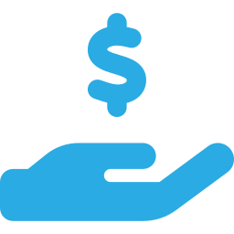

LESSON 7
The wallet checklist
A real track record
Dozens of trades, not one or two. Profitable across many coins over weeks.
Use a wallet tracker
Add the wallet to the Ray wallet tracker (RayBot on Telegram) to follow every buy and sell live, and keep its history.
Buys early, but not insider-early
Buying in the very first block or seconds of launch often means sniper, insider or dev.
Sells well, not only buys well
Takes profit on the way up instead of riding coins back to zero.
Sizes it can copy
Trade sizes you can follow without moving the price yourself.
Notes:
PRNTR minimum: the ladder pattern on most trades, and profit spread across many different coins, not one lucky hit.

Slide 37
LESSON 7
Read their pattern on FOMO
Consistent: copy this
B
S
S
S
S
S
B
S
S
S
S
B
S
S
S
S
S
S
Open the trader on FOMO, then the Transactions tab. One or two buys, then six or seven sells: a ladder. They enter once and take profit in pieces. Clean patterns mean a calculated system.
Scattered: skip this
B
S
B
B
B
B
B
S
S
B
S
B
B
S
B
B
S
B
Random buys and sells: one in, one out, five in, two out. No pattern usually means no plan and no edge. That's gambling, not a system.
Notes:
Open the trader on FOMO, then the Transactions tab. Patterns across crypto point to a great trader; sporadic trading points to a gambler.

Slide 38
LESSON 7
Check what they're holding right now
1
2
3
4
5
Open their holdings
Low market cap?
Big share of supply?
Does the narrative fit?
All four: buy small
On FOMO or a wallet tracker, see every coin they hold now.
Coins still small, so there's room to grow.
They hold a real % of it, so they're committed.
An upcoming event or the current meta. It should make sense in one sentence.
Same small size as always, and add it to your sheet.
Notes:
A consistent trader's current low-cap holdings are a shortlist made for you. Every box still has to be ticked.

Slide 39

LESSON 7
Red flags: drop the wallet
Most of its profit came from one coin
Buys in the same block as the launch, every time (sniper or insider)
Trades in a group: the same coins at the same second as other wallets (a bundle or cabal)
Huge win rate on tiny trades, losses on big ones
Dormant for weeks, then suddenly active
Holds coins to zero instead of selling
Notes:
If a wallet fails any of these, don't copy it.

Slide 40
LESSON 7
When to stop following a wallet
1
2
3
4
Track it
Review weekly
Cut losers
Replace it
Keep a sheet: every wallet you copy, the trades and the result.
Is it still profitable over its last 20 trades?
Three bad weeks in a row, or a big change in style: remove it.
Find a new wallet from this week's best narrative.
Notes:
Wallets go cold. Traders change. Your list needs maintenance.

Slide 41
08
Copy trading with a bot
Put the wallet into a copy-trading bot so you buy when they buy, within seconds.

Slide 42
LESSON 8
Setting up the copy bot
1
2
3
4
5
Open the bot
Make a bot wallet
Fund it small
Add the target
Set your rules
Odin for Solana copy trading. Maestro for the other chains: Ethereum, Tron and more.
Create a new wallet in the bot. Never import your vault.
Only what you're willing to lose.
Paste the wallet address you vetted into copy trading.
Amount per trade, slippage, priority fee, sells (next slide).
Notes:
Odin on Solana, Maestro everywhere else. Always a fresh bot wallet, funded small.

Slide 43




LESSON 8
The settings that matter
Fixed amount per copy
The same small amount on every trade, whatever the wallet buys. You're copying the idea, not their size.
Slippage and priority fee
High enough to get filled fast, low enough that you don't overpay on every trade.
Copy sells, or your own exits
Either sell when they sell, or use your own take-profit ladder (Lesson 10).
Protection settings
Anti-rug or MEV protection, a max buy price, a blacklist of coins you won't touch.

Slide 44
LESSON 8
Starting settings
1–2%
15–25%
50% @ 3x
of your portfolio per copy trade
slippage on small, fast coins to start with
copy their buys, take your own exits
These are starting points. Lower the slippage and priority fee as you see what fills, and never raise the size to chase a loss.
Notes:
Start here and adjust. Size stays at 1–2% no matter what.

Slide 45
LESSON 8
Copy trading: what goes wrong
You're last in
They exit, you don't
The bot holds your key
Even fast bots buy after the wallet does. On tiny coins that gap can be the whole move.
If you don't copy sells or use a ladder, you can hold after they've left.
A bot is a hot wallet. Keep its balance small and withdraw profits to your vault often.
Notes:
Set expectations: copy trading has real costs and risks, so the rules matter.

Slide 46
09
Sizing
Small, fixed bets are what let you survive the coins that go to zero.

Slide 47
LESSON 9
The sizing rules
1–2%
Max 10
Stop
of your portfolio risked per trade
open positions at once
for the day after a set loss
Your memecoin money is itself only a slice of what you have. The vault never funds it.
Notes:
1–2% per trade is the PRNTR rule. Max 10 positions and a daily stop are the guardrails that protect it.

Slide 48
10
Taking profit on the way up
The money is made when you sell, not when the chart goes up.

Slide 49
LESSON 10
A take-profit ladder
Full gain
Moon bag
Sell the moon bag into the crowd.
3x
The other 50% rides.
Buy
Sell 50%. Your risk is off the table.
Under $20K market cap, 1–2% size.
Notes:
The PRNTR ladder: half out at 3x, the moon bag rides for the full gain.

Slide 50
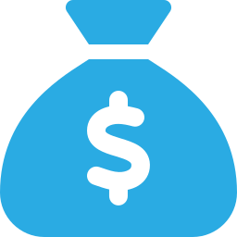



LESSON 10
The profit rules
Half out at 3x
Once 50% is sold at 3x, the trade can no longer cost you money.
A time limit
If a coin does nothing for a set time, sell and move on.
No "it's going to 100x"
The plan is made before you buy. You follow it.
Profits leave the bot
Move profits to the vault or the next step of the loop, every week.
Notes:
Most memecoin traders give their gains back. These rules stop that.

Slide 51
11
The money loop
How memecoin profits turn into leverage trading, a safe stack, and a monthly income.

Slide 52
LESSON 11
Where the profit goes
Memecoins
Copy trading, small size
take profit, fund the account
Leverage
The PRNTR system, fixed risk
a small slice back in
pay yourself
Safe stack
Profits you keep and pay yourself from
Notes:
The loop: money moves from the riskiest place to safer ones every time. Nothing goes back in to win back a loss.

Slide 53
LESSON 11
A split you can start with
50%
30%
20%
of memecoin profit to the safe stack
to the leverage account
stays for memecoins
Move funds to an exchange, never from the vault to a bot
Pay yourself a fixed amount each month from the safe stack
Never move money back in to win back a loss
Notes:
A split to start with. Adjust it to your goals, but always move profit away from the riskiest place first.

Slide 54
12
Case study: NVIDIA × HUNG
The PRNTR Crossover: read a big stock's chart, then trade the memecoin wave its news creates.

Slide 55
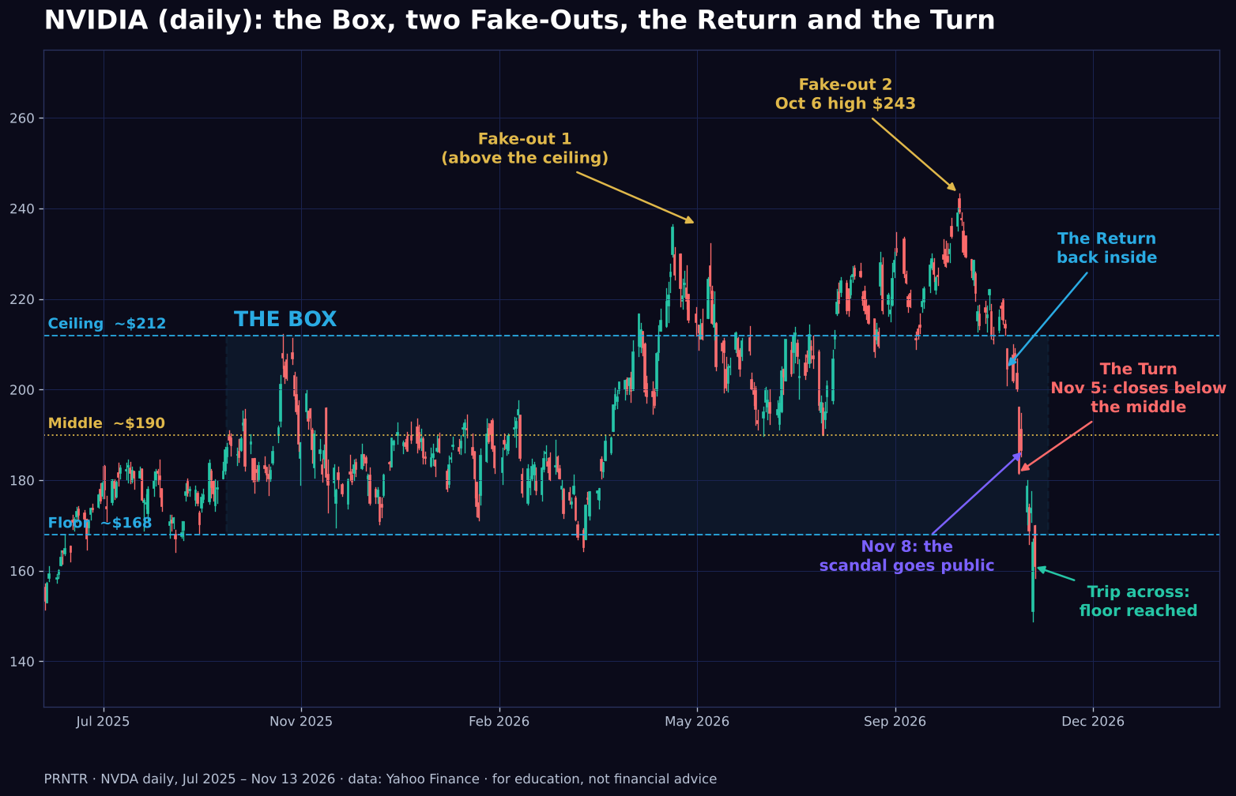
LESSON 12
The chart turned before the news
The Box
NVIDIA ranged between ~$168 and ~$212 for a year. Middle ~$190.
Two Fake-Outs
Above the ceiling in May and on Oct 6 ($243). Breakout buyers got trapped.
The Return and the Turn
Back inside by Oct 30. Nov 5 closed at $181.60, below the middle.
Then the news
The email to staff went public on Nov 8, three days after the Turn.
Notes:
The point: the chart showed the buyers had stopped defending NVIDIA before anyone knew why. Never say we 'knew' about the scandal.

Slide 56
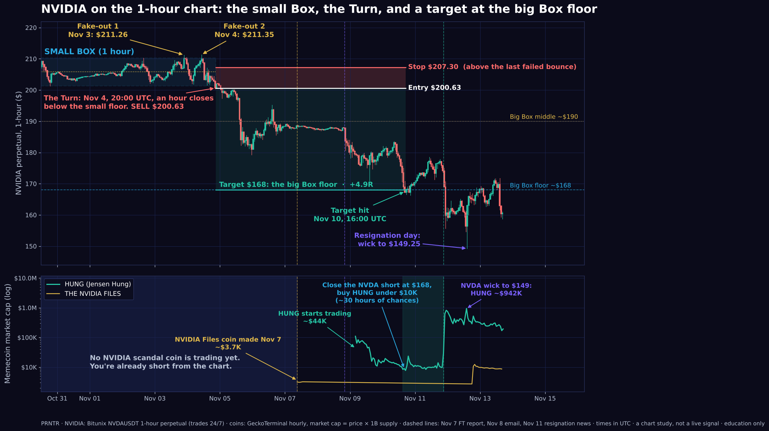
LESSON 12
Zoom in: the 1-hour Turn
Small Box
Floor $201.32, ceiling $210.28, two Fake-Outs above it on Nov 3 and Nov 4.
Sell $200.63
Nov 4, 20:00 UTC: the first hour closes below the small floor.
Stop $207.30
Just above the last failed bounce. Highest price after entry: $202.25.
Target $168, +4.9R
The big Box floor. Hit Nov 10, 16:00 UTC.
Notes:
Hand-marked with the PRNTR rules on the 24/7 NVIDIA perpetual. It's a chart study, not a signal the bot sent. Example only: $1,000 at 5x would have been about +$813 at the target, or about -$166 at the stop. Notice the coin panel: when you'd have sold NVIDIA, no scandal coin existed yet.

Slide 57
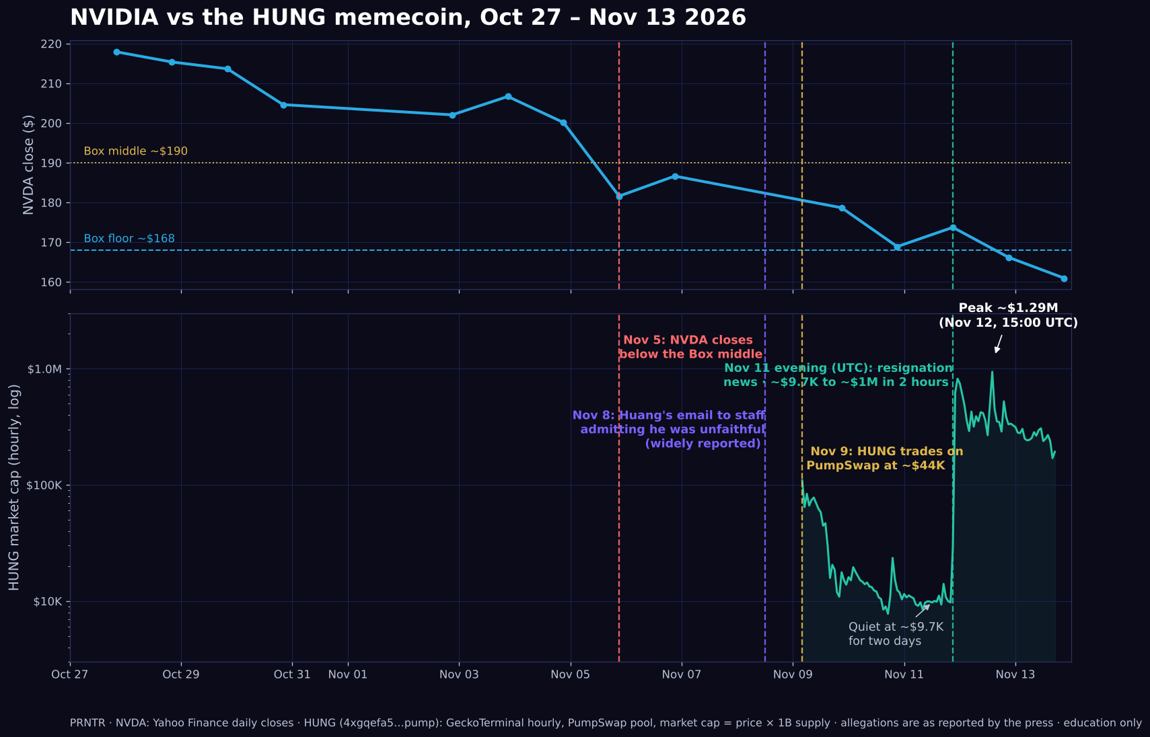
LESSON 12
The coin, on the same clock
Nov 9
HUNG starts trading around $44K, then fades.
Nov 10–11
Quiet at ~$9.7K for two days. Most people gave up.
Nov 11, evening UTC
Resignation news: ~$9.7K to ~$1M in about two hours.
Nov 12
Peak ~$1.29M. Now ~$193K.
Notes:
$10 at ~$9.7K is about 0.1% of supply, about $1,330 at the peak. Selling at $600K–$800K turns it into about $600–$800. Nobody sells the top.

Slide 58
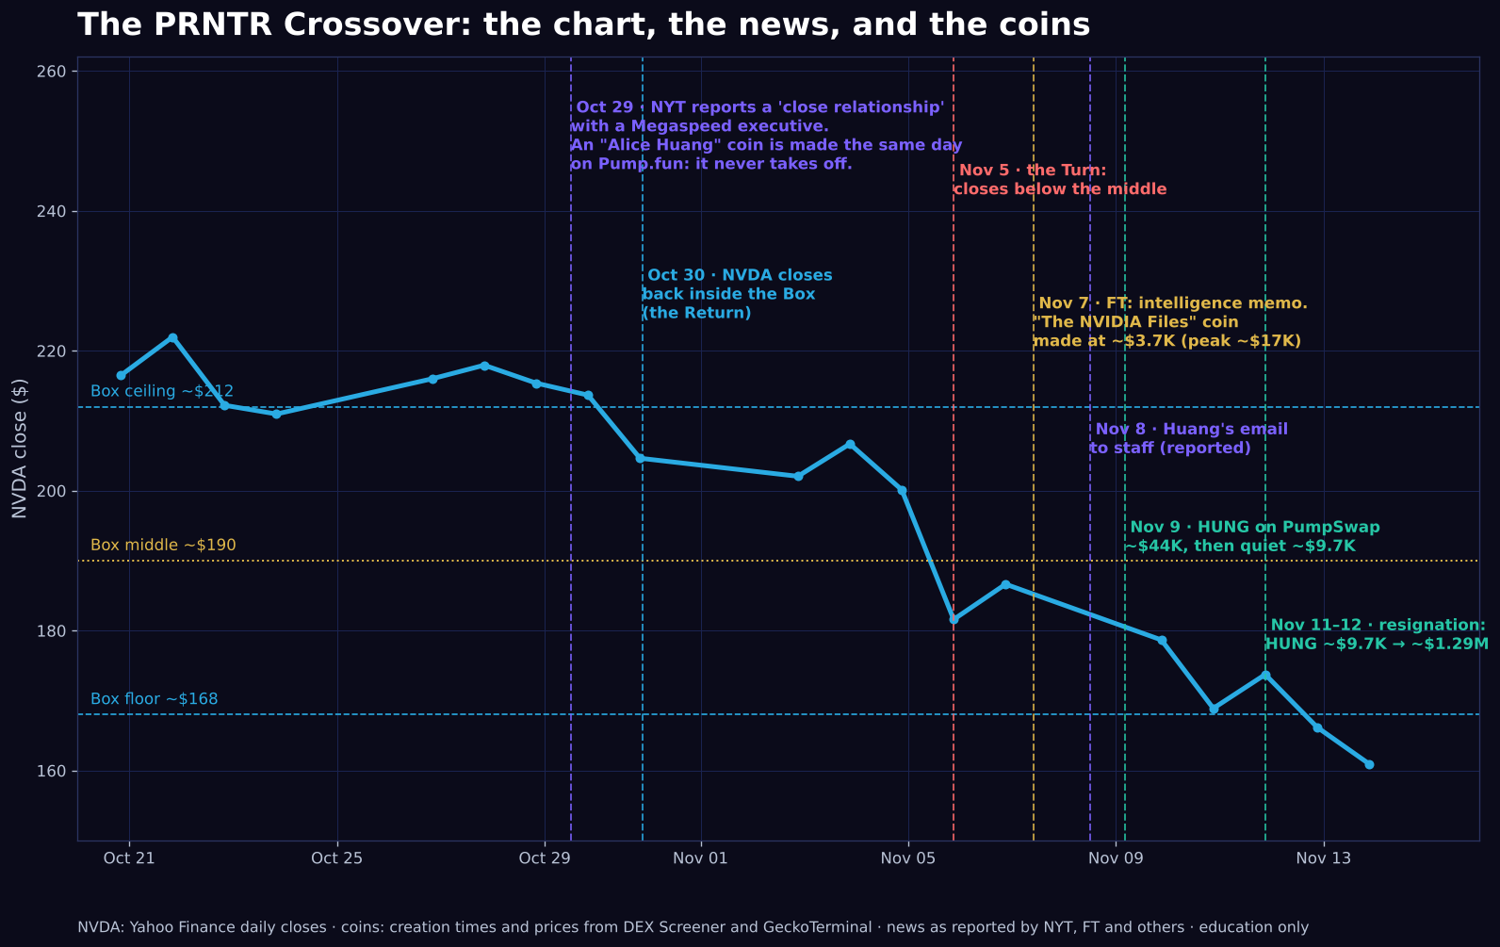
LESSON 12
Could we have seen the news coming?
Oct 29
The NYT reports a 'close relationship' with a Megaspeed executive. An 'Alice Huang' coin appears the same day.
Nov 7
The FT reports an intelligence memo. 'The NVIDIA Files' coin is made at ~$3.7K.
Nov 8 → Nov 12
The email, more reports, the resignation.
The lesson
The story leaked in pieces for two weeks. Each piece was a chance to be early.
Notes:
Use 'reported' for everything beyond his own email. The spy part is an allegation.

Slide 59
LESSON 12
Catching the coins earlier
1
2
3
4
5
Watch the Turns
Alert on the names
Search the same hour
Buy in the quiet
Sell the 2nd headline
Keep a list of big names. When one makes its Turn, watch its news daily.
Google Alerts and an X list: the CEO, nicknames, people and companies in the story.
Every new name goes straight into Pump.fun and FOMO. Sort by oldest, check it's the OG.
The cheapest entry is between headlines, when the coin has gone quiet.
HUNG moved on the resignation, not the first story. Sell into that attention.
Notes:
This is the PRNTR Crossover playbook in five steps.

Slide 60
LESSON 12
Both trades, one story, step by step
Time (UTC) | NVIDIA: the short | The coins
Nov 4, 20:00 | The 1-hour Turn. Sell $200.63, stop $207.30, target $168. | None exist yet. Set alerts on every name in the story (Alice Huang, Megaspeed).
Nov 7, 09:00 | In profit, around $188. | FT report. 'The NVIDIA Files' made at ~$3.7K. A few dollars at most (it peaked ~$17K).
Nov 8, 20:00 | Email news: $187.88 to $180.67 in one hour. | Search Huang, Jensen, Hung on Pump.fun and FOMO.
Nov 9, 04:00 | Around $179. | HUNG appears at ~$44K. Don't chase. Watch it.
Nov 10, 16:00 | Target $168 hit. Close it: +4.9R. | HUNG is under $10K (low ~$7.8K). Buy with a slice of the profit.
Nov 11, 21:00 | Done. | Resignation: ~$9.7K to ~$995K in two hours. Sell in pieces at $600K–$800K.
Example: $1,000 at 5x on the short makes about $813. Put $50 of it into HUNG at ~$9K (about 0.55% of the supply) and selling at $700K pays about $3,900. HUNG only traded $50–$160 an hour while it was quiet, so buy small or you'll move the price yourself.
Notes:
The short pays for the coin. A put option does the same job as the short (it gains when NVIDIA falls, and you can only lose what you paid for it), but you have to choose the strike and expiry. These numbers are for the perpetual short, not a put.

Slide 61
LESSON 12
The honest scorecard
Worked
Didn't
So
The 1-hour Turn sold at $200.63, well before the news. HUNG went ~100x off its quiet price on the second headline.
The Oct 29 'Alice Huang' coin died. 'The NVIDIA Files' only went from ~$3.7K to ~$17K. The first 'HUNG' from June went nowhere.
First isn't always the winner. Spread a few dollars across the story's coins, and size up only on the one getting real volume and holders.
Notes:
Keep it honest: one big winner, several small losers. That's the game.

Slide 62
SUMMARY
The 10 rules
1
Three wallets. The vault never touches a bot.
6
Drop insider, sniper and bundled wallets.
2
Scam-check every coin before you buy.
7
Fixed small size on every copy.
3
Get in before the crowd, sell into it.
8
Initials out at 2x, then a ladder.
4
Pick the narrative's leader, not the copies.
9
Profits leave the bot every week.
5
Copy wallets with a long record, not one big win.
10
Nothing goes back in to win back a loss.
Notes:
One-slide summary for students to screenshot.

Slide 63
Want help doing this live?
In the 1-on-1 mentorship we find narratives, vet wallets and set up your copy bot together, then connect it to the leverage system and the money loop.
prntr-ai.onrender.com/apply.html
Notes:
Close with the mentorship call to action. Update the link when the domain is connected.

