Slide 1
Improving Datacenter Performance and Robustness with Multipath TCP
Presentator: Qingguo Xu
Original reporter: Costin Raiciu
I slightly modify the original slide.

Slide 2
Outline
Multipath TCP
  MPTCP operate at the transport layer
Motivation
  Try to improve the performance of Datacenter
Contribution
  Multipath Transport
  What do the benefits depend on
  What is an optimal datacenter topology for multipath transport
Summary

Slide 3
Data Center Networking Today
Resource Allocation
TCP
Path Selection
Random load balancing
Routing
OSPF, VLANs, TRILL
Topology
FatTree, VL2, BCube,
multi-rooted tree
Notes:
Show multiple paths between servers
Say that network is rearrangeably non blocking
Clos

Slide 4
Data Center Networking Tomorrow
Resource Allocation
TCP
Multipath
TCP
Path Selection
Random load balancing
Routing
OSPF, VLANs, TRILL
Topology
FatTree, VL2, BCube,
multi-rooted tree
Notes:
Show multiple paths between servers
Say that network is rearrangeably non blocking
Clos

Slide 5
Motivation
Datacenter apps are distributed across thousands of machines
Want any machine to play any role
To achieve this:
Use dense parallel datacenter topologies
Map each flow to a path
Problem:
Naïve random allocation gives poor performance
Improving performance adds complexity
This is the wrong place to start

Slide 6
Contributions
Multipath topologies need multipath transport
Multipath transport enables better topologies

Slide 7
To satisfy demand, modern datacenters provide many parallel paths
Traditional Topologies are tree-based
  Poor performance
  Not fault tolerant
Shift towards multipath topologies: FatTree, BCube, VL2,
Cisco, EC2
…

Slide 8
Fat Tree Topology [Fares et al., 2008; Clos, 1953]
K=4
Aggregation Switches
1Gbps
K Pods with
K Switches
each
1Gbps
Racks of
servers
Notes:
Show multiple paths between servers
Say that network is rearrangeably non blocking
Clos

Slide 9
Fat Tree Topology [Fares et al., 2008; Clos, 1953]
K=4
Aggregation Switches
K Pods with
K Switches
each
Racks of
servers
Notes:
Show multiple paths between servers
Say that network is rearrangeably non blocking
Clos

Slide 10
Collisions
Notes:
Show multiple paths between servers
Say that network is rearrangeably non blocking
Clos

Slide 11
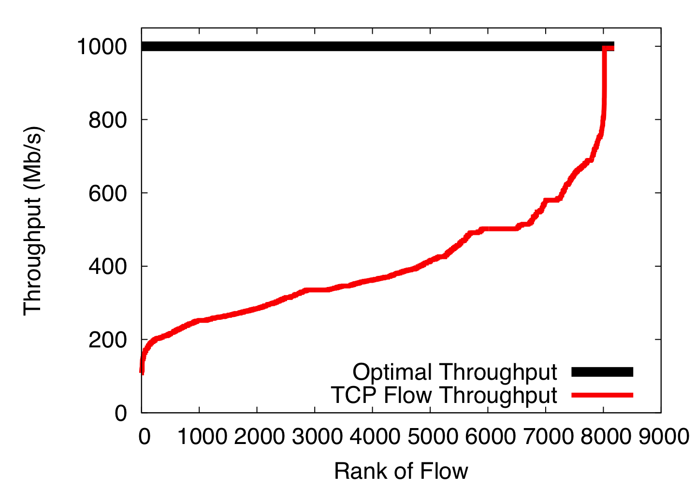
Single-path TCP collisions reduce throughput

Slide 12
Collision

Slide 15
Not fair

Slide 16
Not fair

Slide 17




Slide 19
No matter how you do it,
mapping each flow to a path is the wrong goal

Slide 20
Instead, we should pool capacity from different links

Slide 21
Instead, we should pool capacity from different links

Slide 22
Instead, we should pool capacity from different links

Slide 23
Instead, we should pool capacity from different links

Slide 24
Multipath Transport

Slide 25
Multipath Transport can pool datacenter networks
  Instead of using one path for each flow, use many random paths
  Don’t worry about collisions.
  Just don’t send (much) traffic on colliding paths

Slide 26
Multipath TCP Primer [IETF MPTCP WG]
MPTCP is a drop in replacement for TCP
MPTCP spreads application data over multiple subflows

Slide 27
Multipath TCP: Congestion Control [NSDI, 2011]

Slide 28
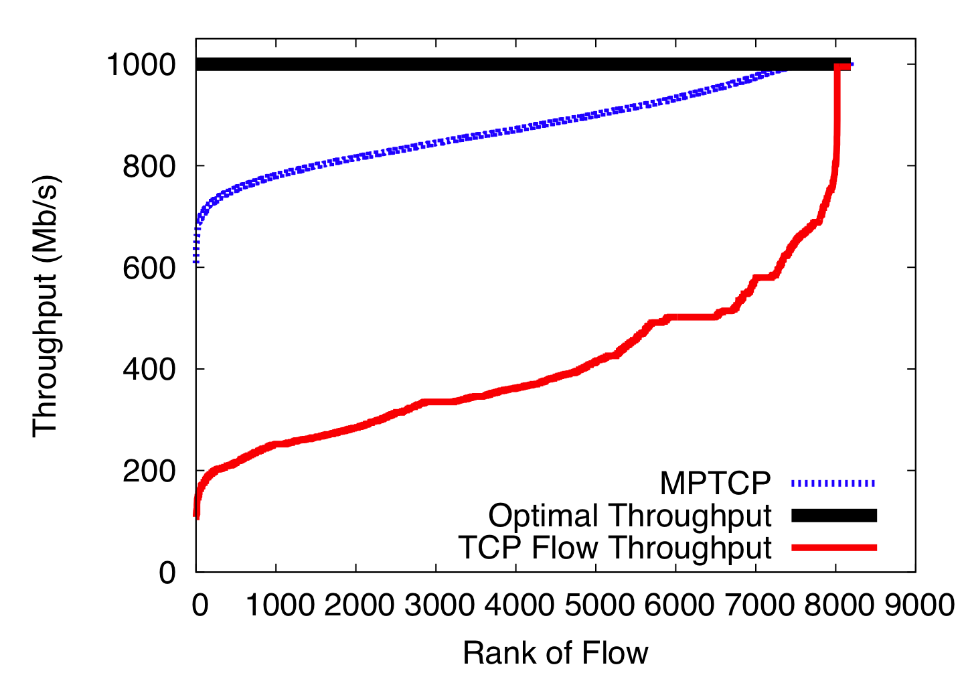
MPTCP better utilizes the FatTree network
Notes:
Fairness matters for apps!

Slide 29
MPTCP on EC2
Amazon EC2: infrastructure as a service
  We can borrow virtual machines by the hour
  These run in Amazon data centers worldwide
  We can boot our own kernel
A few availability zones have multipath topologies
  2-8 paths available between hosts not on the same machine or in the same rack
  Available via ECMP

Slide 30
Amazon EC2 Experiment
40 medium CPU instances running MPTCP
For 12 hours, we sequentially ran all-to-all iperf cycling through:
  TCP
  MPTCP (2 and 4 subflows)

Slide 31
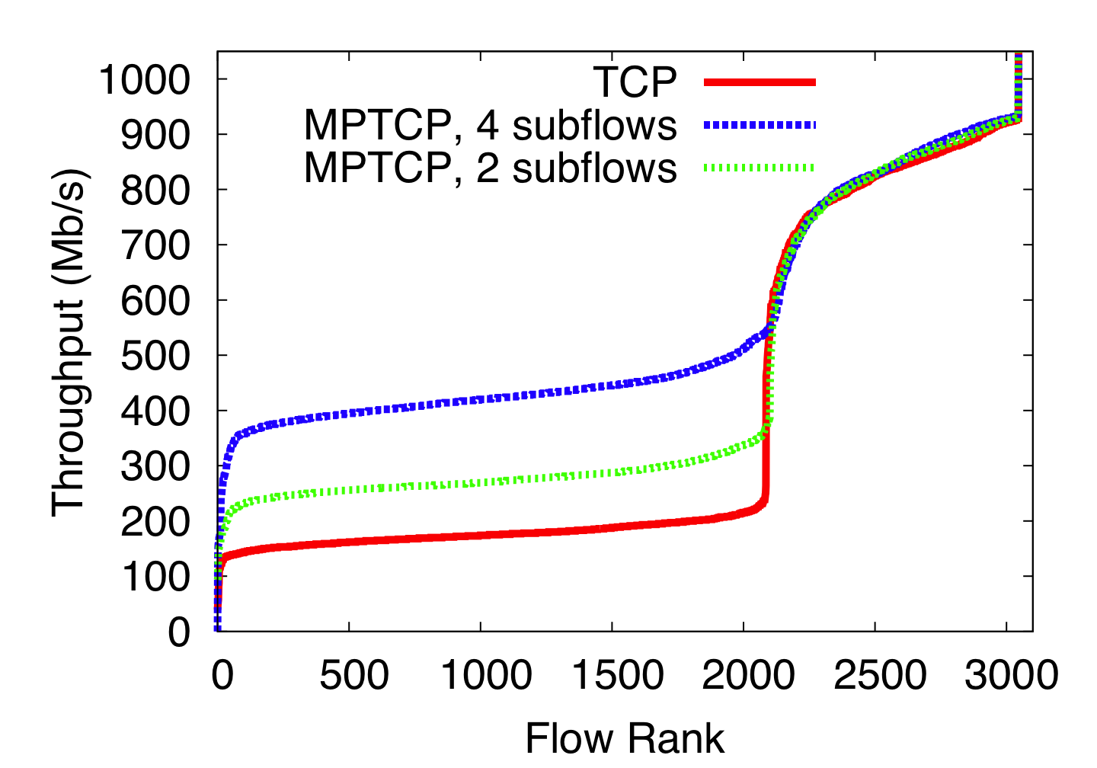
MPTCP improves performance on EC2
Same
Rack

Slide 32
What do the benefits depend on?

Slide 33
How many subflows are needed?
How does the topology affect results?
How does the traffic matrix affect results?

Slide 34
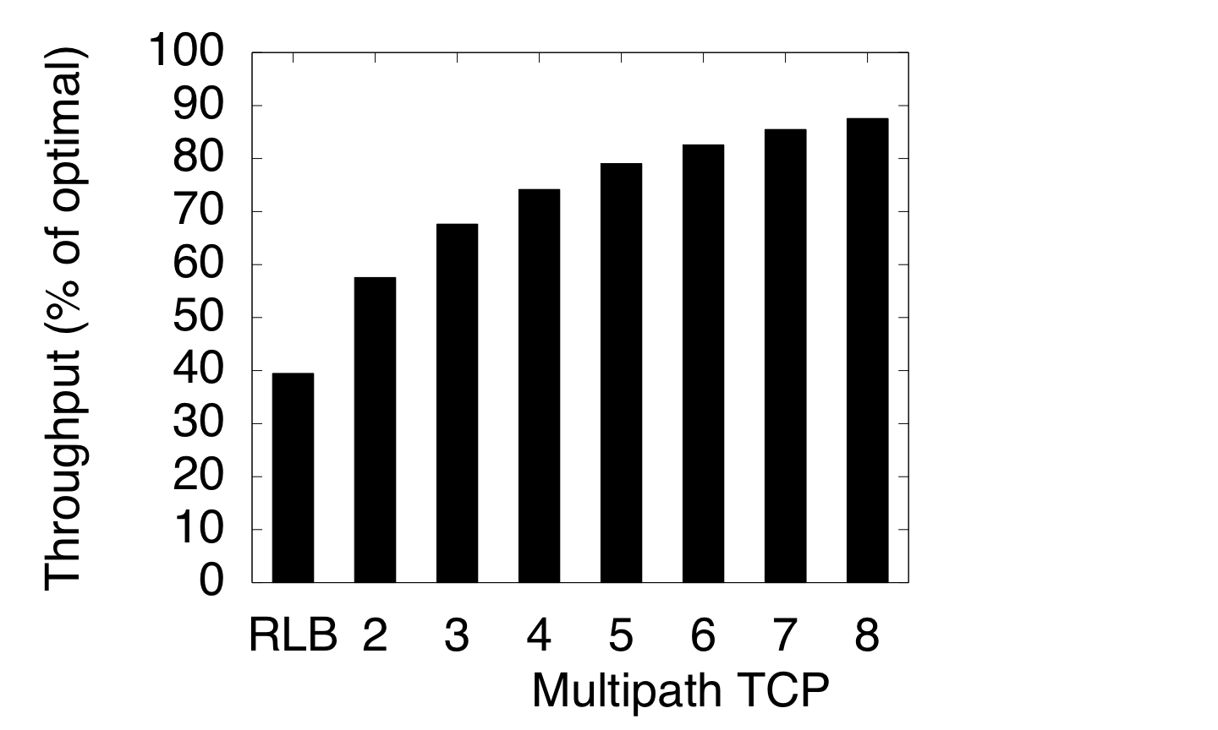
At most 8 subflows are needed
Total Throughput
TCP

Slide 35
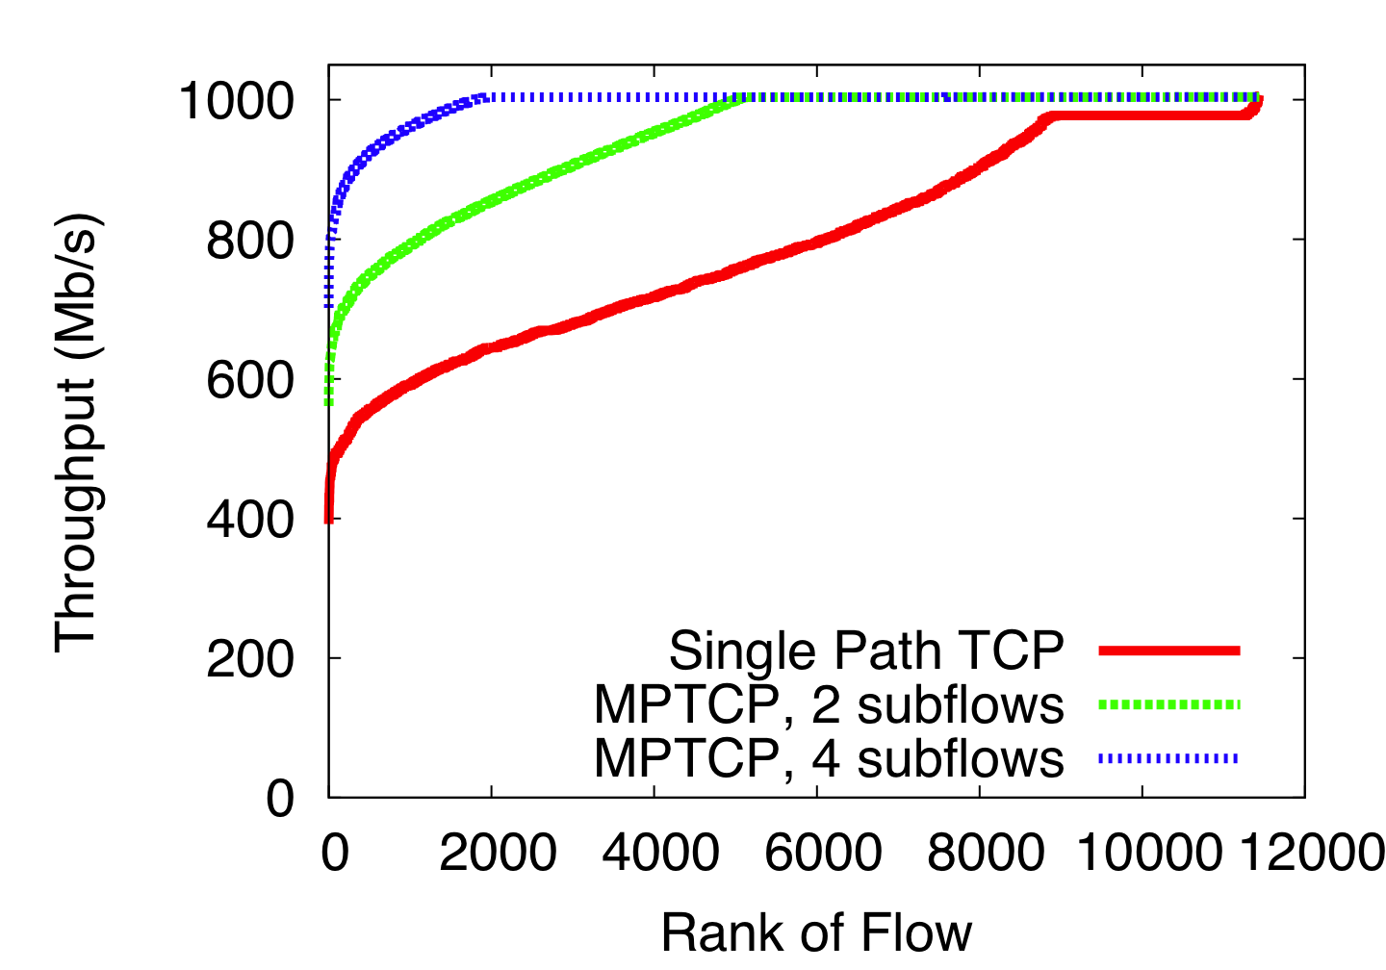
MPTCP improves fairness in VL2 topologies
VL2
Fairness is important:
Jobs finish when the slowest worker finishes

Slide 36
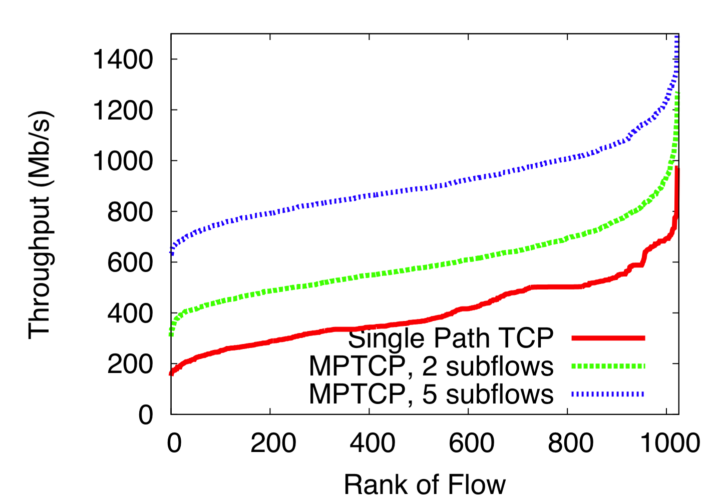
MPTCP improves throughput and fairness in BCube
BCube

Slide 37
Oversubscribed Topologies
To saturate full bisectional bandwidth:
  There must be no traffic locality
  All hosts must send at the same time
  Host links must not be bottlenecks
It makes sense to under-provision the network core
  This is what happens in practice
  Does MPTCP still provide benefits?

Slide 38
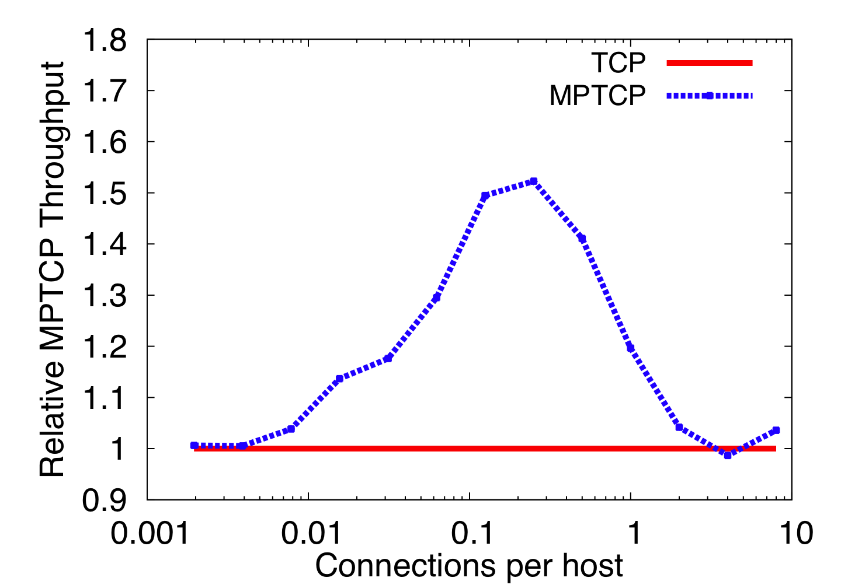
Performance improvements depend on traffic matrix
Underloaded
Overloaded
Sweet Spot
Increase Load

Slide 39
What is an optimal datacenter topology for multipath transport?

Slide 40
  In single homed topologies:
  Hosts links are often bottlenecks
  ToR switch failures wipe out tens of hosts for days
Multi-homing servers is the obvious way forward
Notes:
Show multiple paths between servers
Say that network is rearrangeably non blocking
Clos

Slide 41
Fat Tree Topology
Notes:
Show multiple paths between servers
Say that network is rearrangeably non blocking
Clos

Slide 42
Fat Tree Topology
Upper Pod
Switch
ToR Switch
Servers

Slide 43
Dual Homed Fat Tree Topology
Upper Pod
Switch
ToR Switch
Servers

Slide 44
Is DHFT any better than Fat Tree?
Not for traffic matrices that fully utilize the core
Let’s examine random traffic patterns
  Other TMs in the paper

Slide 45
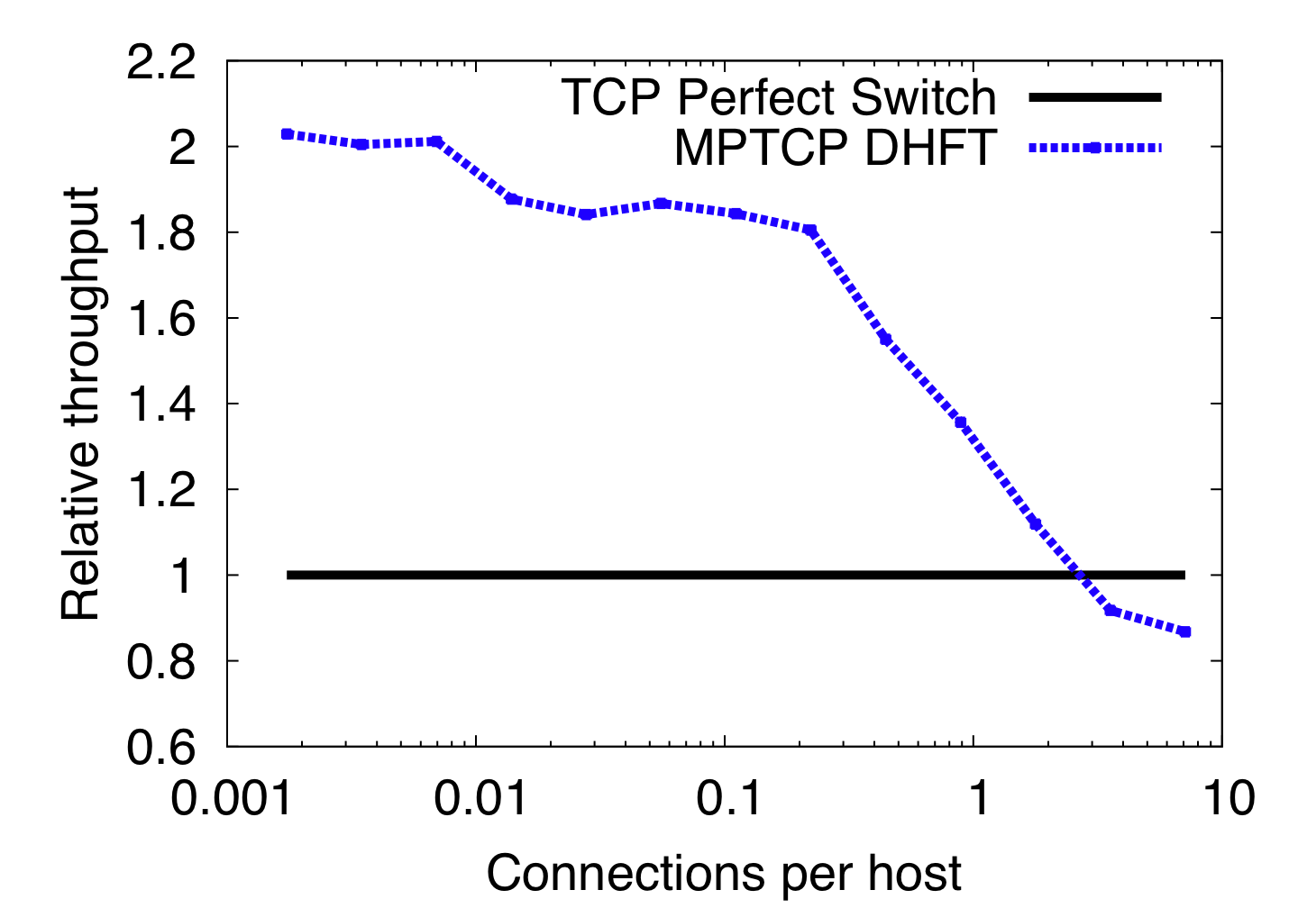
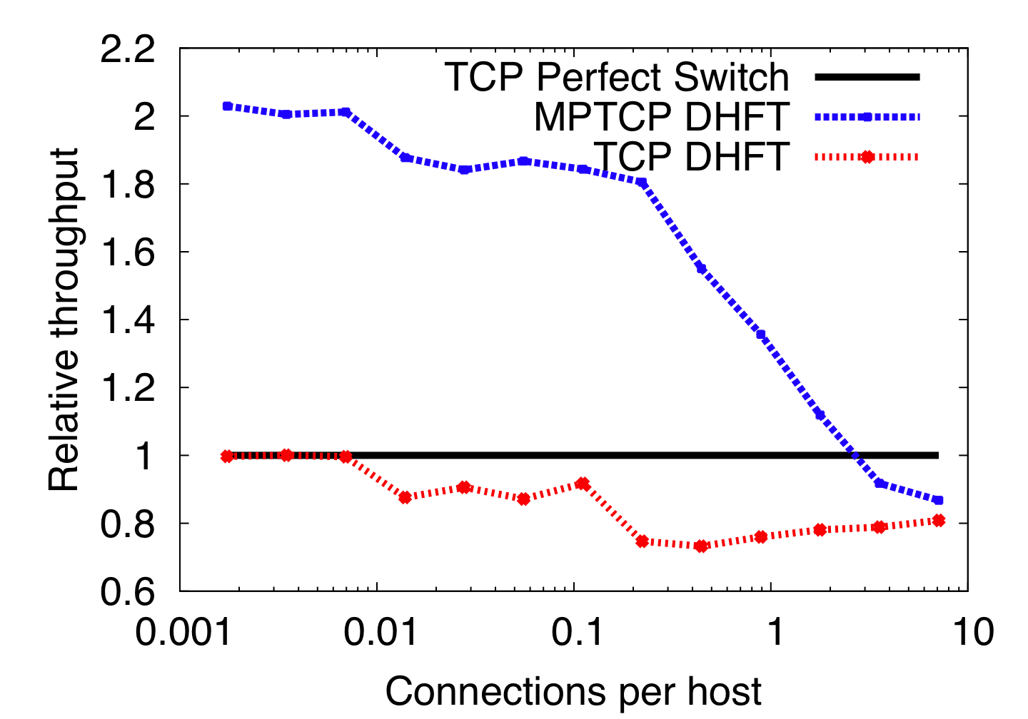
DHFT provides significant improvements when core is not overloaded
Core Overloaded
Core Underloaded

Slide 46
Summary
“One flow, one path” thinking has constrained datacenter design
  Collisions, unfairness, limited utilization
Multipath transport enables resource pooling in datacenter networks:
  Improves throughput
  Improves fairness
  Improves robustness
“One flow, many paths” frees designers to consider topologies that offer improved performance for similar cost

Slide 47
Effect of MPTCP on short flows
Flow sizes from VL2 dataset
MPTCP enabled for long flows only (timer)
Oversubscribed Fat Tree topology
Results:
  TCP/ECMP
  Completion time: 79ms
  Core Utilization: 25%
  MPTCP
  97ms
  65%

Slide 48
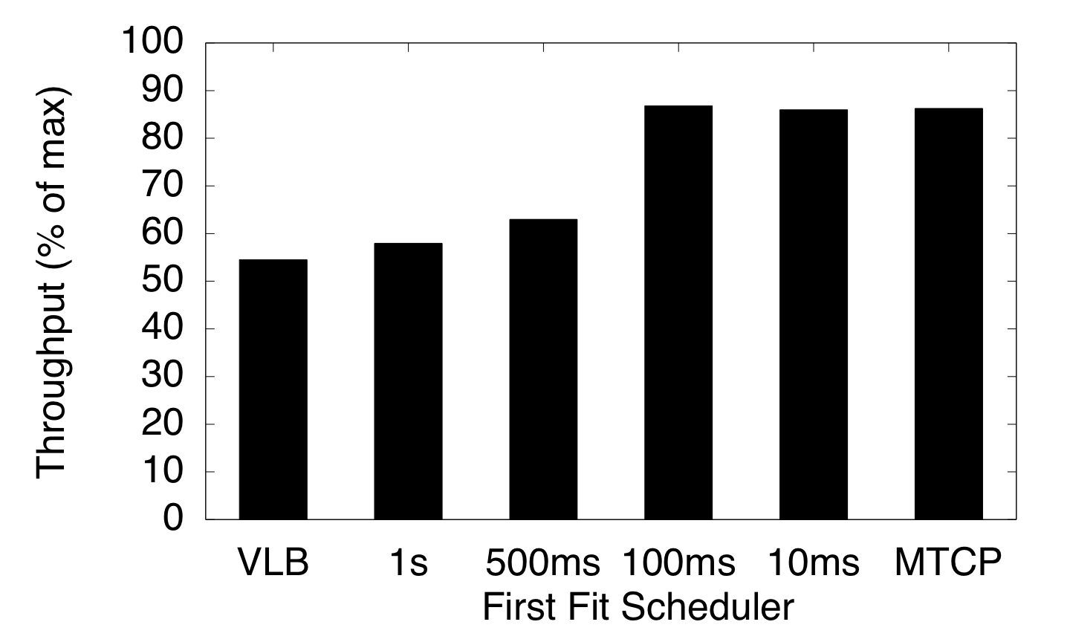
MPTCP vs Centralized Dynamic Scheduling
Centralized Scheduling MPTCP
Infinite
Scheduling Interval
Notes:
Animate tough part of the graph

Slide 49
Centralized Scheduling: Setting the Threshold
Throughput
Hope
1Gbps
17% worse than multipath TCP
App Limited
100Mbps

Slide 50
Centralized Scheduling: Setting the Threshold
Throughput
1Gbps
21% worse than multipath TCP
100Mbps
App Limited
Hope

Slide 51
Centralized Scheduling: Setting the Threshold
Throughput
1Gbps
51%
500Mbps
17%
100Mbps
45%
21%

Slide 52
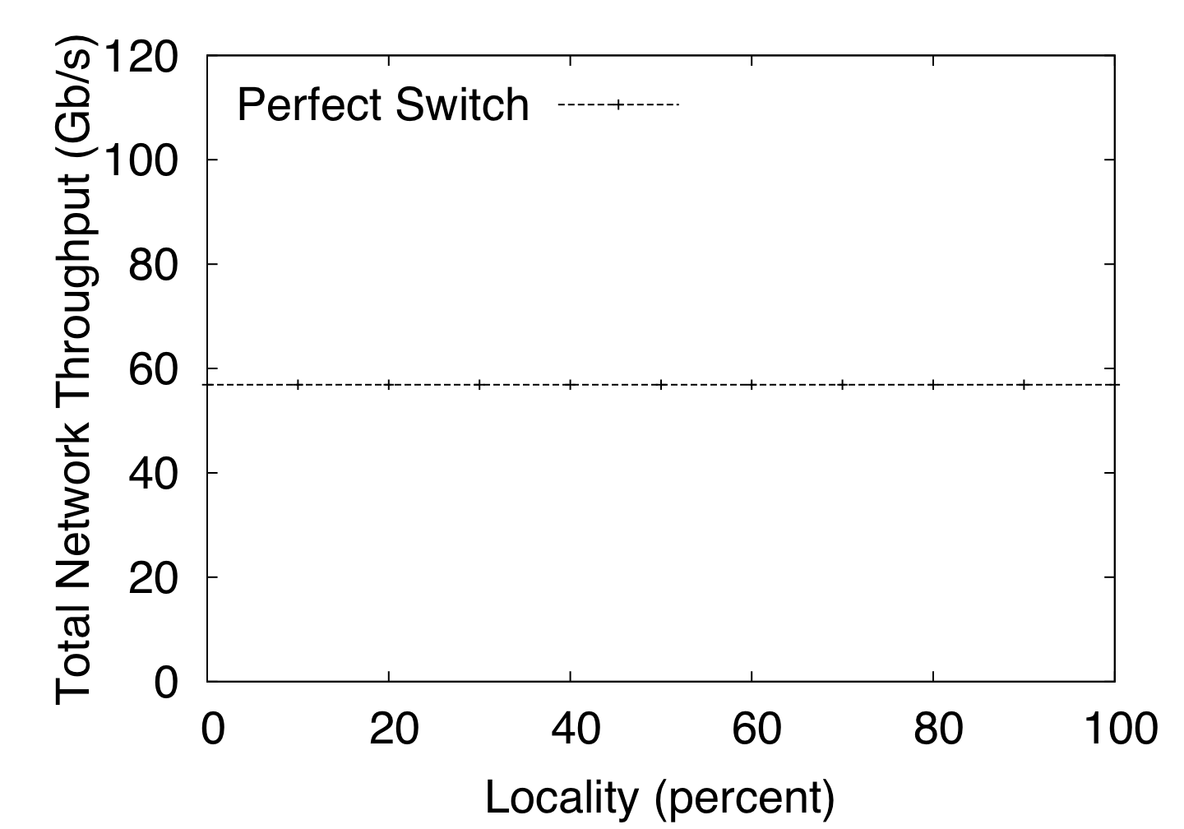
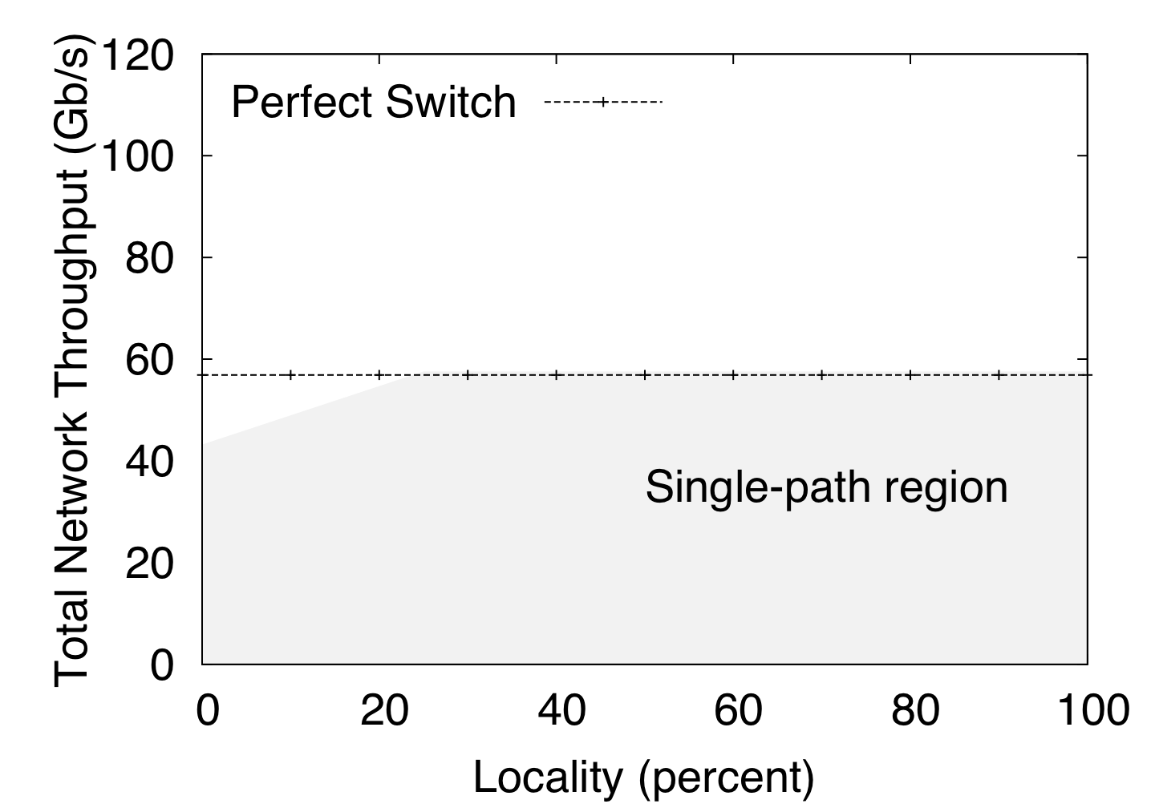
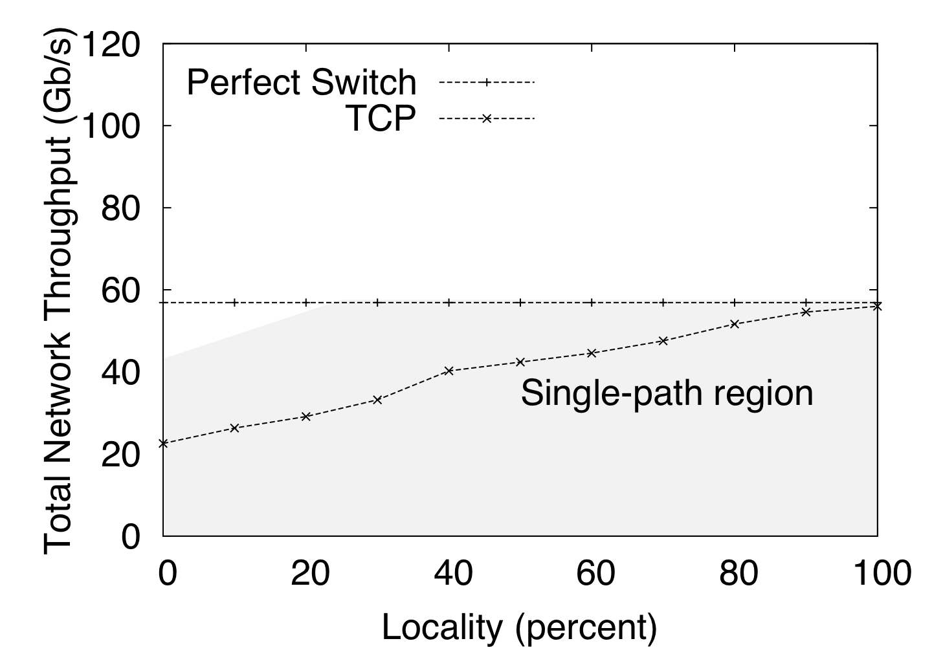
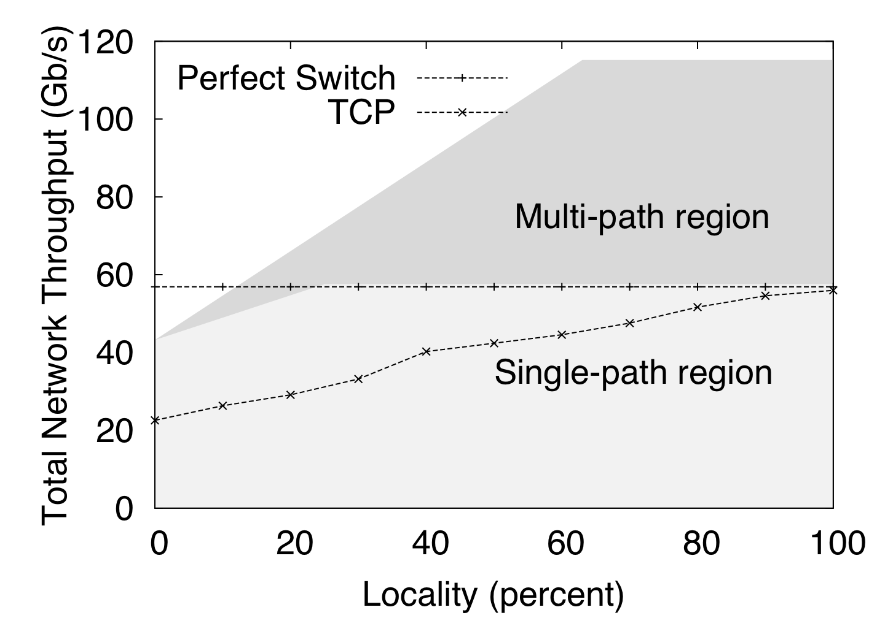
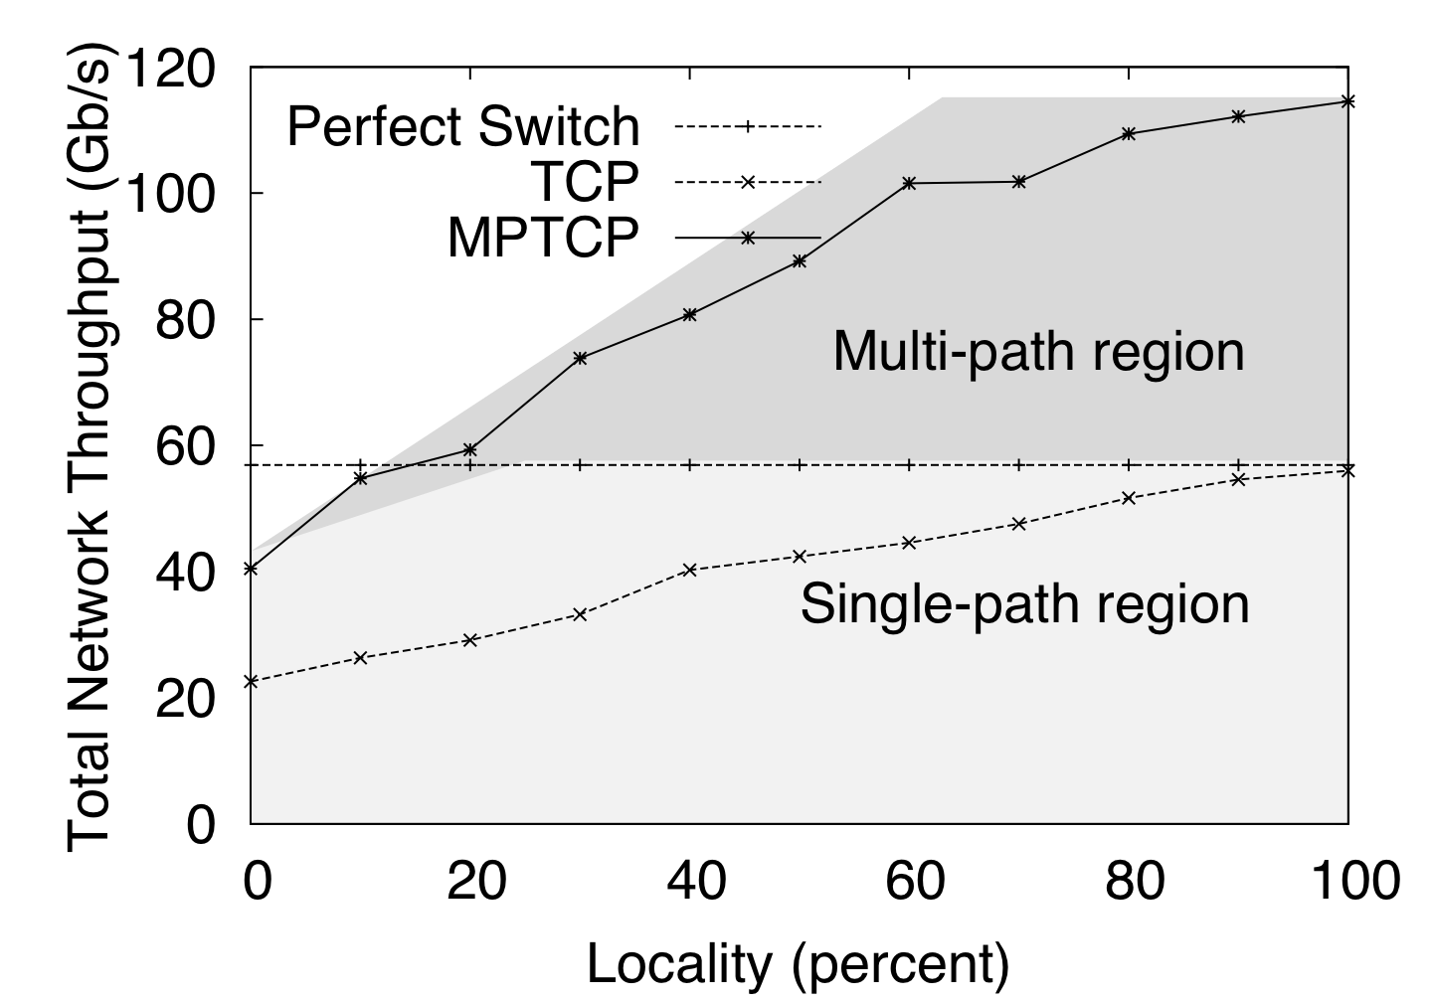
Effect of Locality in the Dual Homed Fat Tree

Slide 53
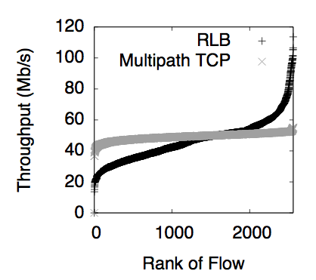
Overloaded Fat Tree: better fairness with Multipath TCP

Slide 54
VL2 Topology [Greenberg et al, 2009, Clos topology]
10Gbps
10Gbps
…
20 hosts

Slide 55
BCube Topology [Guo et al, 2009]
BCube (4,1)

