Slide 1

Private Placement Infrastructure Built for RIAs
Confidently evaluate, design, implement, and monitor
private placement solutions – All in one platform
Schedule a Demo
Model the Impact
Advisor-Led I Carrier-Aligned I Client-Focused
Insurance + Investment, Reimagined
The most powerful wealth strategies emerge when insurance and investments work together.
For too long, these strategies have operated in separate worlds. Advisure brings them together - intelligently, intentionally, and with institutional precision.
Our technology simplifies complexity, removes friction, and brings clarity to every step – Empowering RIAs to deliver smarter, more comprehensive advice.
The Result
True integration X NOT coordination
Structural Alpha X NOT incremental improvement
End-to-end execution X NOT fragmented oversight
This is the future of wealth management
Integrated, transparent, and built for advisors who lead
Quick snipit of why private placement – leaving people wanting to learn more – should direct to a full page dedicated to explaining Private Placement
Why Advisure?
One Platform. Start to Finish.
Why Private Placement?
Better Structure. Better Outcomes.
Traditional portfolios are built for pre-tax returns. Private placement is built for after-tax efficiency.
By reducing tax drag and enabling long-term compounding inside an optimized structure, private placement helps accredited investors pursue stronger, more durable outcomes.
Advisure helps RIAs deliver private placement solutions without adding operational burden.
We simplify implementation, align all stakeholders, and provide ongoing oversight — so advisors can stay focused on client relationships and outcomes.
Quick snipit of why Advisure – leaving people wanting to learn more – should direct to a full page dedicated to explaining why us, how our platform works, etc. (could also navigate to about page, but would need to change the CTA
Learn More About Private Placement
Explore the Advisure Platform
Deliver Better After-Tax Outcomes — With Less Complexity.
Whether you're exploring private placement for the first time or looking to scale an existing strategy, Advisure gives you the infrastructure to implement institutional solutions with clarity and confidence.

Slide 2

Quantify the Tax Advantage of PPLI
Estimate how tax efficiency shifts long-term performance
for high-net-worth portfolios using PPLI.
Portfolio Assumptions
Private Placement Life Insurance (PPLI) can materially reduce tax drag on high-income, high-turnover strategies. This tool helps you estimate the potential impact of a PPLI structure versus a traditional taxable portfolio — across different time horizons and return assumptions.
Use it to illustrate to clients how tax-aware structures can enhance after-tax compounding.
Initial Investment
<Slider $1m to 50m>
Time Horizon
<Slider 1y to 50y>
Annual Rate of Return
<Slider 0% to 100%>
PPLI Allocation
<Slider 0% to 100%>
Static Unchangeable assumptions
Tax rates
Underlying costs
Stock/bond allocations
Activity and rebalancing
Traditional
$XX.XXM
PPLI Enhanced
$XX.XXM
Tax Savings
+ $XX.XXM
Illustrative only. Assumptions are simplified to provide a directional estimate. Full scenario modeling and implementation analysis are available through the Advisure platform.
Ready to unlock the full power of Private Placement?
Get advanced scenario models, implementation support start to finish, and post issue monitoring with the Advisure platform.
Schedule a Demo
Learn More About Private Placement

Slide 3
Our Partners
Strategic collaborations with leading carriers, asset managers, and service providers — all aligned
to deliver private placement solutions with clarity, transparency, and execution precision.
Logo
Logo
Logo
Logo
Logo
Logo
Logo
Logo
Partnering to Deliver Institutional-Grade Outcomes
At Advisure, we don’t just list logos — we integrate partner capabilities into our platform so advisors can:
Access carrier support without operational friction
Leverage institutional asset strategies with private insurance structures
Streamline implementation and monitoring across stakeholders
Provide best-in-class reporting and oversight to clients
These partnerships form the backbone of a transparent, scalable infrastructure for RIAs.
Carrier Coordination
Institutional Asset Access
Structured oversight
Align insurance carriers with portfolio design
Enable alternative and private market exposure
Continuous monitoring and reporting

Slide 4
About Advisure
Redefining How Insurance and Investment Work Together
Why Advisure Exists
Private placement strategies can deliver meaningful after-tax advantages — but historically they’ve been fragmented, opaque, and difficult to scale.
Execution has required navigating disconnected carriers, investment managers, documentation processes, and reporting systems. The strategy was institutional. The workflow was not.
Advisure was built to eliminate that fragmentation.
We unify insurance structuring, institutional investment integration, carrier coordination, and ongoing oversight into a single, advisor-centric platform — designed for clarity, precision, and scalability, enabling:
Integrated strategy design — not isolated product overlay
Streamlined implementation across stakeholders
Institutional investment alignment
Transparent oversight and reporting
Private placement, delivered with institutional infrastructure — without institutional complexity.
Our Mission
Our mission is to unify investment advisory and insurance into a single, integrated wealth infrastructure.
We empower advisors to deliver institutional-quality investment strategies to accredited and qualified investors through technology that simplifies education, enhances decision-making, and streamlines implementation. By reducing complexity and friction, we seek to improve risk-adjusted and after-tax outcomes for high-net-worth individuals, their advisors, and insurance partners alike.
Our Vision
Our vision is to become the trusted infrastructure through which advisors deliver the most sophisticated, tax-efficient wealth solutions in the industry.
We believe the future of wealth management is integrated, transparent, and advisor-led — where structure and strategy work together to produce superior long-term outcomes.
Consider having a separate Advisure page describing everything more in-depth
The Advisure Approach
A repeatable process for private placement execution — start to finish
Structural Design
Build the optimal insurance + investment architecture aligned to client objectives, portfolio strategy, and carrier requirements.
Implement & Coordinate
Streamline carrier workflows, documentation, and execution — reducing friction and eliminating fragmented handoffs.
Oversight & Reporting
Monitor structure, performance, and ongoing compliance — with institutional-grade reporting for advisors and clients.
Evaluate & Model
Quantify the after-tax impact and determine where private placement creates meaningful structural advantage.
How Advisure Works with RIAs
Advisure operates as a behind-the-scenes structural partner to RIAs.
You remain the primary relationship owner and investment lead. We provide the infrastructure and execution support to evaluate, design, implement, and monitor private placement strategies — without adding operational burden to your firm.
Our role is to simplify complexity, align stakeholders, and deliver institutional-grade implementation through a streamlined platform.
Consider maybe including this in RIA experience page?
Graphic Placeholder
The Result:
Better client outcomes, deeper relationships, and a more differentiated practice

Slide 5
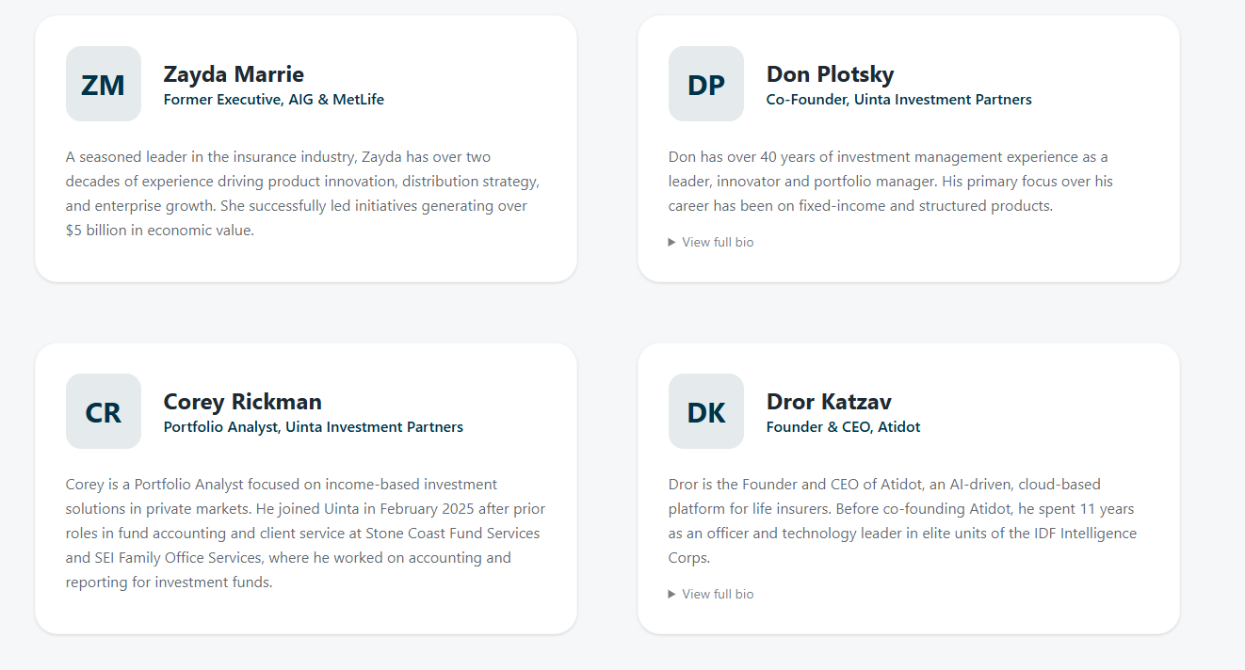
Our Philosophy
About Advisure continued
“ Structure is Strategy”
We believe:
Structure rivals' strategy
Better decisions come from better tools
Long-term outcomes beat short-term optimization
Private placement should be evaluated, not sold
PPLI and PPVA are not defaults or replacements for traditional planning tools. They are powerful structures that require careful evaluation, thoughtful design, and ongoing oversight. Advisure was built to support exactly that process.
Our Leadership
Our team blends deep expertise from insurance, investment management, and technology.

Slide 6
Private Placement: Structural Tax Efficiency for Complex Portfolios
Private placement integrates insurance architecture with institutional investment strategies — reducing tax drag and improving long-term after-tax compounding for accredited investors.
What is Private Placement Life Insurance (PPLI)?
Private Placement Life Insurance is a life insurance structure designed for accredited investors that can hold institutional-quality investment strategies within a tax-advantaged insurance wrapper.
It enables long-term compounding with reduced tax drag — particularly for portfolios with high income, high turnover, or alternative exposure.
Why Structure Matters
In taxable portfolios, taxes create drag that compounds over time — reducing after-tax performance.
Private placement changes the structure in which returns compound.
Key idea: Tax efficiency isn’t incremental. It’s architectural.
Who Private Placement Is Best Suited For
Private placement is most relevant for:
Accredited investors and high-net-worth clients
Long time horizons (10+ years)
High tax environments (federal + state)
Alternative-heavy or high-turnover strategies
Clients seeking long-term tax-aware compounding
Three Drivers of the Private Placement Advantage
Reduced Tax Drag
Minimize ongoing taxation that erodes compounding.
Structural Flexibility
Align insurance architecture with portfolio strategy.
Institutional Strategy Integration
Access and implement sophisticated investment approaches in a more efficient structure.
How RIAs Use Private Placement
Private placement is often used to complement:
Core taxable portfolios
Alternative allocations
Income-heavy strategies
Long-term growth strategies
Multi-generational planning objectives
What Private Placement Is Not
Private placement is not:
A retail insurance product
A commission-driven sales strategy
A one-size-fits-all solution
A replacement for portfolio management
Why Execution Matters
Private placement is powerful — but implementation has historically been:
Fragmented
Operationally heavy
Difficult to coordinate across stakeholders
Hard to monitor transparently

Slide 7
“Advisure Platform” (would add to menu bar)
Advisure Platform
Overview & How It Works
Overview
The Advisure Platform is a unified, tech-enabled infrastructure designed to streamline the delivery of private placement solutions for Registered Investment Advisors (RIAs). It brings structural design, implementation workflows, and ongoing monitoring into one modern, digital advisor workspace.
At its core, the platform helps advisors go from initial evaluation to ongoing oversight without fragmentation — replacing manual coordination with an integrated, transparent workflow.
Purpose & Philosophy
The platform is built around three core pillars:
These pillars create a repeatable, scalable process that empowers advisors to deliver complex solutions with confidence
How the Advisure Platform Works
Platform Benefits
Scalable Execution Eliminates fragmented carrier workflows by
centralizing design, application, and tracking.
Operational Transparency Pending Cases and dashboards provide real-time
visibility into every client engagement.
Data-Driven Conversations Illustrations and policy information empower
advisors to explain structural value with data.
Enhanced Client Service Ongoing oversight tools help advisors stay
proactive with client's post-implementation.
Sophisticated Design
Customized structural planning that aligns insurance architecture with institutional investment strategies.
Streamlined Implementation
Centralized workflows for carrier coordination, underwriting, and documentation — reducing friction and operational burden.
Ongoing Oversight
Active monitoring and reporting to ensure the structure continues to achieve client objectives and stays compliant over time.
Case Intake
Advisors begin by creating or importing a case. A pipeline summary shows pods of pending cases with clear action items.
Structural Illustration
Using the illustration tool, advisors define design parameters and produce illustrations that help explain structural outcomes to clients.
Application Submission
Once a design is finalized, advisors proceed to the digital e-app to start electronic policy submission.
Policy Tracking & Management
Issued policies and their documentation are accessible in Policy Management, helping advisors monitor performance and compliance.
Advisure Tools
E-Application
Modeling
Illustration
Workflow Management
Policy Management

