Slide 1
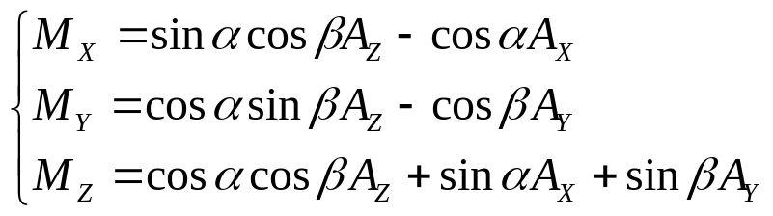
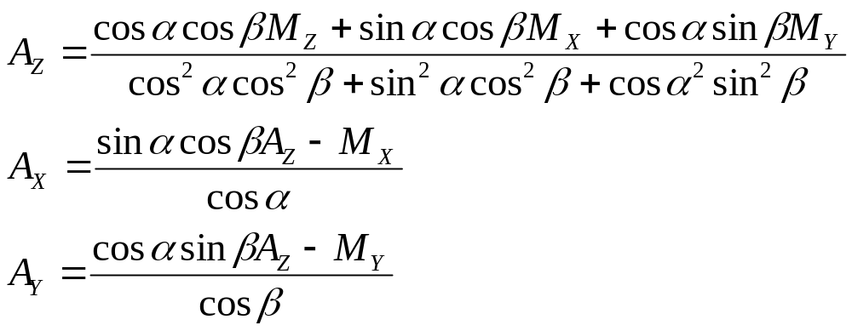
Z
M_{Z}
M_{X}
X
α
M_{X}, M_{y}, M_{z}: Acceleration measured on quad’s axes
α : Pitch angle
β : Roll angle
A_{X}, A_{y}: Acceleration on earth X and Y axes
A_{Z}: Acceleration on earth Z axis (incl. 1G)

