Slide 1
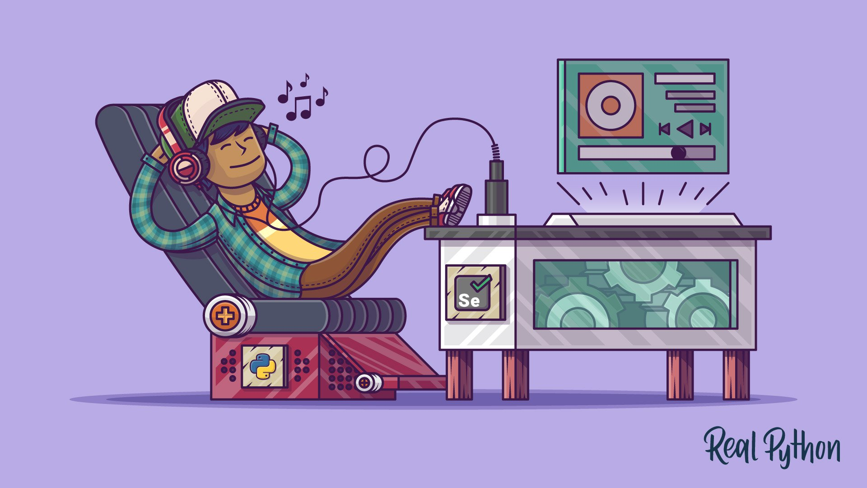

Testing with…

Slide 2
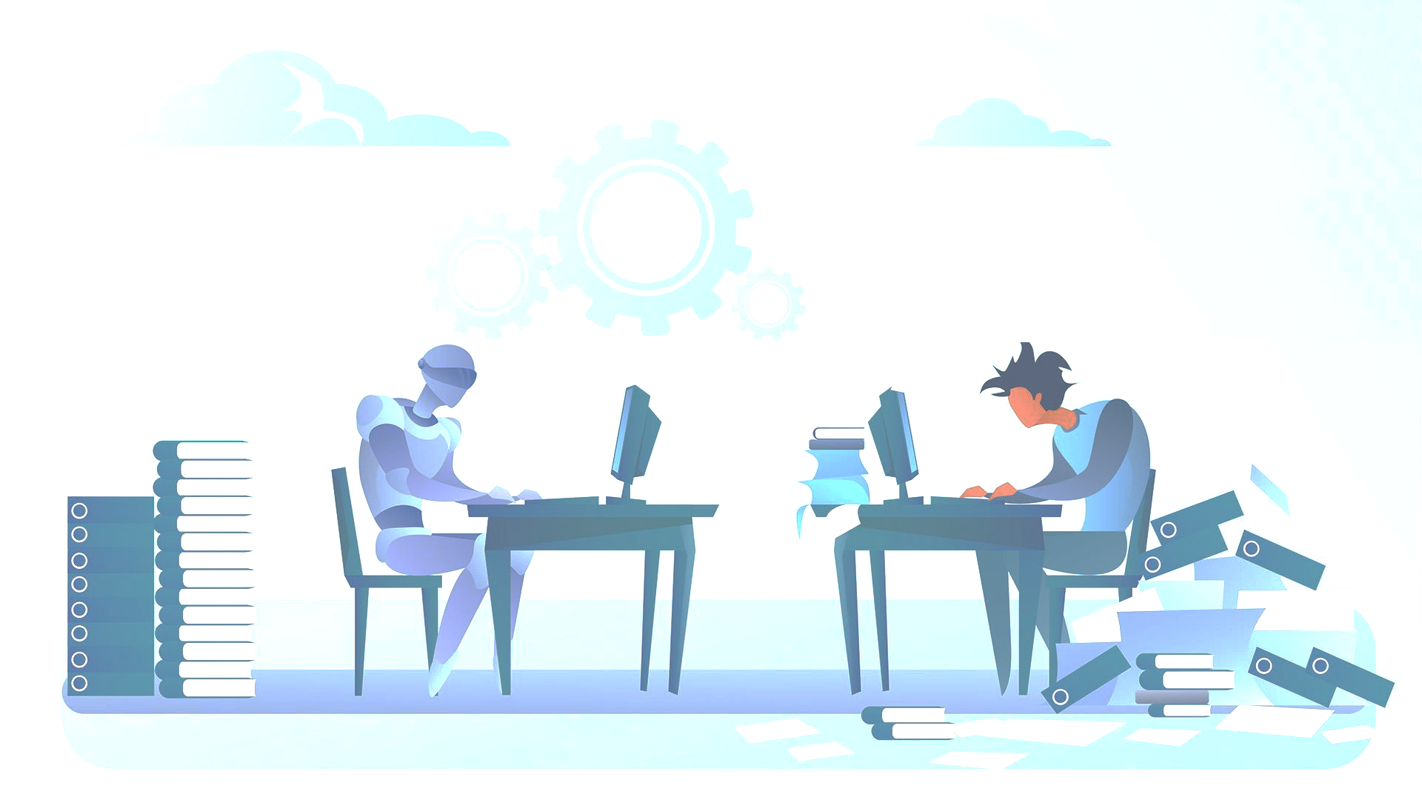
Why testing ?
“testable code” == small one-job functions.
Others can know if your code *really* works.
Refactor the code, without breaking other parts of the software.
Collaborate with others: change the code-base, reliably.
Don’t have to spend the time manually testing the code.
Tests provide documentation for what your code is actually meant to do.
It makes deployments a snap – allowing Continuous Integration.

Slide 3
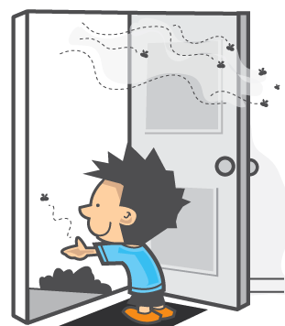
You shall test …
When you have many features (>10 or > 2 modules).
When the code is complex (many interdependencies).
When you collaborate on the same code-base.
When you find a bug.
When you want continues-integration environment.
When you are too lazy to document the code.
Whenever possible ( ;-) ).

Slide 4
UNIT testing
# /app.py
def list_files_from_dir(path):
'''list files from path and send it '''
import os
files = [f for f in os.listdir(path)]
return files

Slide 5
UNIT testing
# /app.py
def list_files_from_dir(path):
'''list files from path and send it '''
import os
files = [f for f in os.listdir(path)]
return files
#/tests/test_functions.py
def test_list_files_from_dir():
files = list_files_from_dir(PATH)
assert len(files) > 0
assert os.path.isfile(files[0])

Slide 6
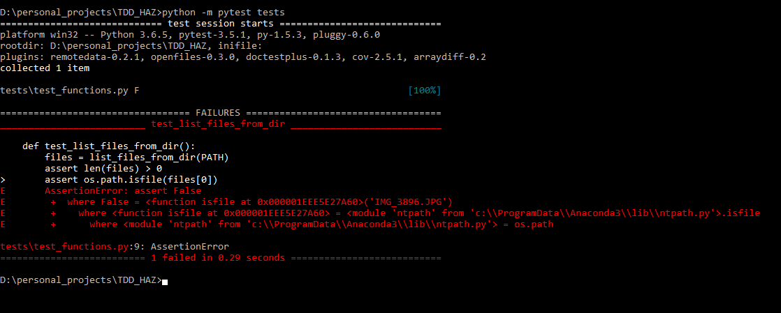
UNIT testing

Slide 7
UNIT testing
# /app.py
def list_files_from_dir(path):
'''list files from path and send it '''
import os
files = [path + f for f in os.listdir(path)]
return files

Slide 8
UNIT testing
D:\personal_projects\TDD_HAZ>python -m pytest tests
============================= test session starts =============================
platform win32 -- Python 3.6.5, pytest-3.5.1, py-1.5.3, pluggy-0.6.0
rootdir: D:\personal_projects\TDD_HAZ, inifile:
plugins: remotedata-0.2.1, openfiles-0.3.0, doctestplus-0.1.3, cov-2.5.1, arraydiff-0.2
collected 1 item
tests\test_functions.py . [100%]
========================== 1 passed in 0.23 seconds ===========================
D:\personal_projects\TDD_HAZ>

Slide 9
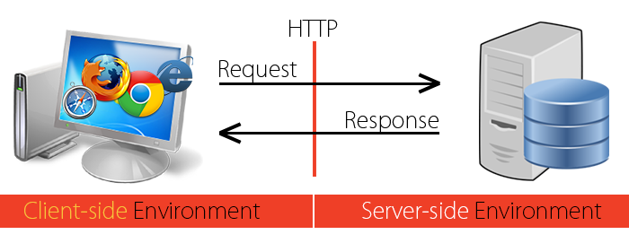
API testing

Slide 10
UI / JS testing

Slide 11
Regression testing

Slide 12
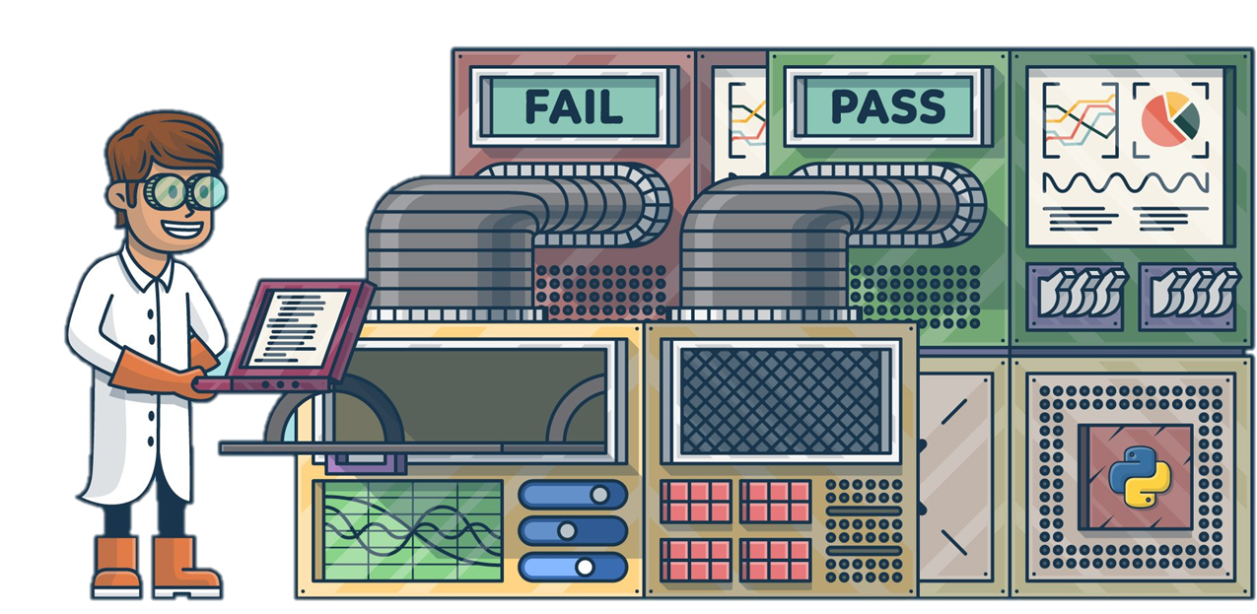
Best practices - pytest
One thing, one test
Tests should be independent
Test for edge cases (valueErrors, types …)
Test coverage
Use pytest since it less verbose (assert vs. self.assertEqual etc.)
Fixtures are your friend!
Handle repetitive tests with @pytets.parametrize

Slide 13
