Slide 1
Try arca’s unique no-SMS service
get it all in one click!
How?

Slide 2


Introducing arca
Arca TM Let Your Kids Play Safely
Get started
today!
Authorizations for kids
Online shopping has never been so easy!
Peace of mind for parents
For teens and kids
For Parents
Pay nothing in advance
Tired of going to the store for a new prepaid card?
Or buying bulks of coins you don’t really need?
Learn how we get you instant cash in one click
We check every purchase your kids make so that you won’t have to
Do you know what your kids are doing online, and where your money goes to?
arca lets you define what you want to let your kids spend on and how much.
We check every purchase attempt as it happens and authorize only ones that meet your requirements.
Learn how we protect your kids’ purchases
Get instant parental authorization
Never stop the game again to ask for permission.
Don’t stop your parents and wait for their answer.
Learn how we get instant parental authorization

Slide 3
Introducing arca
mobile
arca
TM
Simply Safer !
Get started
today!
Authorizations for kids
Online shopping has never been so easy!
Peace of mind for parents
For teens and kids
For Parents
Pay nothing in advance
Tired of going to the store for a new prepaid card?
Or buying bulks of coins you don’t really need?
Learn how we get you instant cash in one click
We check every purchase your kids make so that you won’t have to
Do you know what your kids are doing online, and where your money goes to?
arca lets you define what you want to let your kids spend on and how much.
We check every purchase attempt as it happens and authorize only ones that meet your requirements.
Learn how we protect your kids’ purchases
Get instant parental authorization
Never stop the game again to ask for permission.
Don’t stop your parents and wait for their answer.
Learn how we get instant parental authorization

Slide 4
Introducing arca
mobile
arca
TM
Simply Safer !
Get started
today!
Authorizations for kids
Online shopping has never been so easy!
Peace of mind for parents
For teens and kids
For Parents
Never stop the game again!
Tired of going to the store for a new prepaid card?
Or buying bulks of coins you don’t really need?
Learn how we get you instant cash in one click
We check every purchase your kids make so that you won’t have to
Do you know what your kids are doing online, and where your money goes to?
arca lets you define what you want to let your kids spend on and how much.
We check every purchase attempt as it happens and authorize only ones that meet your requirements.
Learn how we protect your kids’ purchases
Get instant parental authorization!
Never stop the game again to ask for permission.
Don’t stop your parents and wait for their answer.
Learn how we get instant parental authorization

Slide 5
arca
TM
Get started
today!
Simply Safer
Authorizations for kids
Online shopping has never been so easy!
Peace of mind for parents
For teens and kids
For Parents
Never pay anything in advance!
Tired of going to the store for a new prepaid card?
Or buying bulks of “coins” you don’t really need?
Learn how we get you cash in one click
We check every purchase your kids make so that you won’t have to.
Do you know what your kids are doing online, and where your money goes to?
arca lets you define what you want to let your kids spend on and how much.
We check every purchase as it happens and authorize only those that meet your requirements.
Learn how we protect your kids and wallet
Never run around for permissions!
Hate stopping the game to ask for permission?
Never waste your time or your parents’ again.
Learn how we get instant authorization

Slide 6
Get started
today!
arca
TM
Simply Safer
Authorizations for kids
Thanks for joining us!
Peace of mind for parents
arca is all about making online shopping a safer, more enjoyable experience.
We follow your rules 24 by 7 to provide a hassle-free experience to your dear ones and some peace of mind to you.
So take a moment and let us know what your preferences are.
Or get our iPhone app, and we’ll just learn them as we go along…
Enjoy!

Slide 7
Get started
today!
arca
TM
Simply Safer
Authorizations for kids
Welcome to arca!
Peace of mind for parents

Slide 8
Get started
today!
arca
TM
Authorizations for kids
Peace of mind for parents
Follow these steps and get it in seconds
Simply Safer
Try arca’s unique no-SMS service
get it all in one click!
get it all in one click!
Try our new no-SMS service
How?

Slide 9
Get started
today!
arca
TM
Simply Safer
Authorizations for kids
Thanks for joining us!
Peace of mind for parents
arca is all about making online shopping a safer, more enjoyable experience.
We follow your rules 24 by 7 to provide your dear ones a hassle-free experience and yourself a peace of mind.
So take a moment and let us know what your preferences are.
Or get our iPhone app, and we’ll just learn them as we go along…
Enjoy!

Slide 10
arca is all about making online shopping safer and more fun.
We follow your rules 24 by 7 to provide you with that unprecedented peace of mind that no other service can offer.
To start enjoying hassle-free online experience just let us know what your rules are on these pages.
Or leave it to us. Use our mobile app and we will gradually learn your preferences ourselves.
Enjoy!

Slide 11

Notes:
http://www.dadcando.com/Making/Craft/Images/origami-money-box-1-1000.jpg

Slide 12

Notes:
http://www.dadcando.com/Making/Craft/Images/origami-money-box-1-1000.jpg

Slide 13
Welcome to arca!
Your purchase is two clicks away.
Follow these simple steps and get instant cash in seconds.

Slide 14
New

Slide 15

arca
TM
New Way To Pay

Slide 16
arca
TM
Way To Pay

Slide 17

arca
TM
online
Let your kids play… safe

Slide 18
arca
TM
mobile
Let your kids play… safe

Slide 19
arca
TM
mobile
Let your kids play… safe

Slide 20
arca
TM
mobile
Let your kids play… safe

Slide 21
The original good one (gray_dark)
arca
TM
mobile
Let your kids play… safe

Slide 22
arca
TM
mobile
Let your kids play… safe

Slide 23
Not sure what your policy is?
Don’t worry!
Whenever arca is not sure, it will simply ask you.
While arca learns your preferences you will go about doing what you do knowing that someone really follows your rules, protecting the ones your care about and maintaining your budget.
arca
TM
mobile

Slide 24
Not sure what your policy is?
Don’t worry.
Whenever arca is not sure, it simply asks you!
While arca learns your preferences you go about doing what you do knowing that someone really follows your rules, protecting the ones your care about and maintaining your budget.
Not sure what your policy is?
Don’t worry.
Whenever arca is not sure, it simply asks you!
While arca learns your preferences you go about doing what you do knowing that someone really follows your rules, protecting the ones your care about and maintaining your budget.

Slide 25
Not sure what your policy is?
Don’t you worry.
When arca is not sure, it simply asks you!
arca learns your preferences so you can keep your busy life knowing we follow your rules.

Slide 26
Not sure what your policy is?
Don’t you worry.
When arca is not sure, it simply asks you!
arca learns your preferences so you can keep your busy life knowing we follow your rules.

Slide 27


arca
TM
mobile

Slide 28
arca
TM
mobile
Let your kids play… safe

Slide 29
arca
TM
mobile
Let your kids play… safe

Slide 30




arca
TM
mobile

Slide 31
arca
TM
mobile

Slide 32
arca
TM
mobile

Slide 33
arca
Let your kids play… safe
TM
mobile

Slide 34



Slide 35
Let your kids play… safe
arca
TM
mobile
Top 3 Shops

Slide 36





Let your kids play… safe
arca
TM
mobile
Top 3 Shops

Slide 37
arca
TM
mobile

Slide 38
arca
TM
mobile
Let your kids play… safe

Slide 39
Be on top of things
Ever wondered what your kids are doing online?
Want to let your kids enjoy online purchasing, but just don’t have the time to check every single item?
You’ve come to the right place!

Slide 40
Get on top of things
Ever wondered what your kids are doing online?
Want to let your kids buy but just don’t have the time to check every single purchase?
You’ve come to the right place!

Slide 41

arca
TM
Let your kids play… safe

Slide 42

Welcome to arca!
Ever wondered what your dear ones do online? Are you in control of where your money goes?
We check every purchase so you won’t have to.
Set your targets and leave the rest to arca.
We follow your rules and make sure every purchase is safe. If we’re not sure we’ll ask you.
Currently selected template for notification and marketing messages on the iphone

Slide 43
Choose how you want to save
Arca bills your credit card once a month only, saving you $0.30 on each transaction.
Or bill it to your mobile phone bill, and save up to 10% with arca’s unique No-Fee service.
Currently selected template for notification and marketing messages on the iphone

Slide 44
arca
TM
mobile
Currently selected template for notification and marketing messages on the iphone

Slide 45
Simply Safer !
arca
TM
mobile
Currently selected template for notification and marketing messages on the iphone

Slide 46
Not sure what your policy is?
Don’t worry. We will simply ask you.
While we learn your preferences you can go on with your life knowing we follow your rules.
Currently selected template for notification and marketing messages on the iphone

Slide 48
Not sure what your policy is?
Don’t worry. We will simply ask you.
Every time we submit a purchase to your approval, we take the opportunity to check your preferences.
That way, you don’t have to worry about “rules”, and we won't have to bother you with too many questions .
So go on with your life. arca follows your rules, helping you protect the ones you care about.

Slide 51
arca
Authorized by
TM
?
arca
Unauthorized by
TM
?

Slide 52
?

Slide 53
?

Slide 54
Not sure what your policy is?
Don’t worry. We will simply ask you.
Every time we submit a purchase to your approval, we take the opportunity to check your preferences.
That way, you don’t have to worry about “rules”, and we won't have to bother you with too many questions .
So go on with your life. arca follows your rules, helping you protect the ones you care about.

Slide 55

Not sure what your policy is?
Don’t worry. We will simply ask you.
Every time we submit a purchase to your approval, we take the opportunity to check your preferences.
That way, you don’t have to worry about “rules”, and we won't have to bother you with too many questions .
So go on with your life. arca follows your rules, helping you protect the ones you care about.

Slide 56
Not sure what your policy is?
You don’t have to define a thing!
Every time we submit a purchase to your approval, we take the opportunity to check for your preferences.
That way, you don’t have to worry about “rules”, and we won't have to bother you with too many questions.
So go on with your life and let us follow your rules, helping you protect the ones you care about.
Chosen.

Slide 57
Does arca decide
for me?
Never. arca merely follows your rules.
The idea is to save you time and headache, while keeping your dear ones safe and your budget reasonable.
Just let us ask you for your preferences. Or change them any time you wish.
Chosen.

Slide 58
Does arca decide
for me?
Quite the opposite. arca follows your rules. It only saves you time and headache.
Constantly on the watch, it keeps your dear ones secure and none the less – your budget.
Chosen.

Slide 59
Need any help?
Our team will only be happy to
assist you!
Give us a call now at (618) 123 4567 and let us know how we can help.
Or email us at support@arca.com, specifying the query in question.
Please visit our web site at www.arca.com for more information.
The arca team.
Chosen.

Slide 60
Not sure what your policy is?
Don’t worry. We will simply ask you.
Every time we ask you for a purchase approval, we check your preferences as well.
That way, we won't have to ask you so many question later on.
You can go about your daily life knowing arca follows your rules, helping you protect the ones you care about.
Currently selected template for notification and marketing messages on the iphone

Slide 61


=
Dislike
Like
If!
Don’t

Slide 62


Like
Dislike
Don’t
Dislike
Dislike
Dislike
Like
Like

Slide 63
screenshots

Slide 64
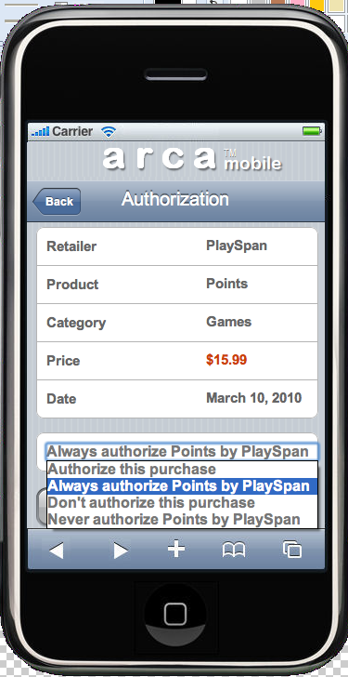
Learning the payer’s preferences

Slide 65
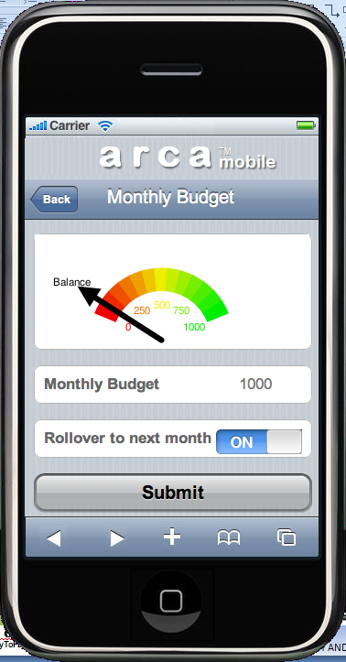
Learning the payer’s preferences

Slide 66
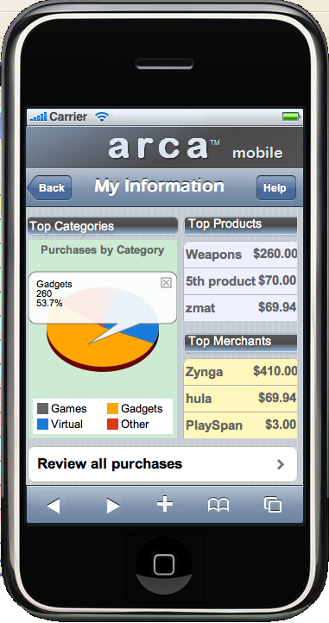

Slide 67
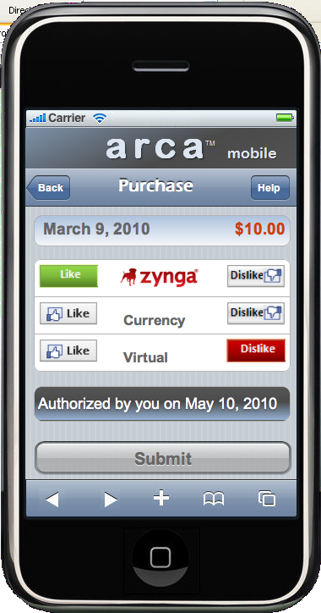

Slide 68
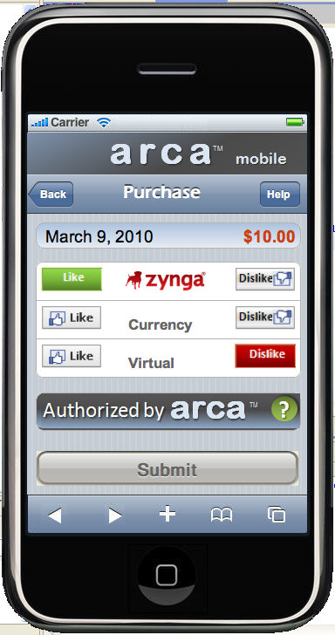

Slide 69
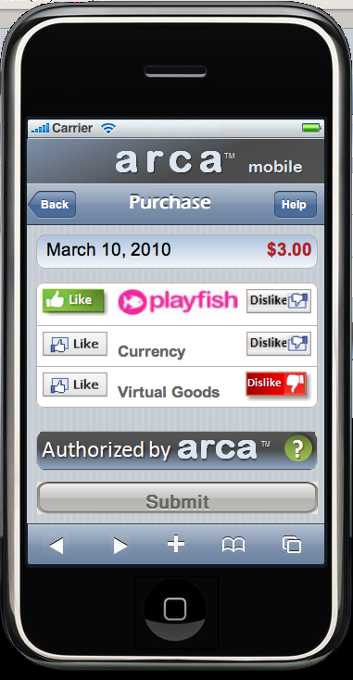

Slide 70
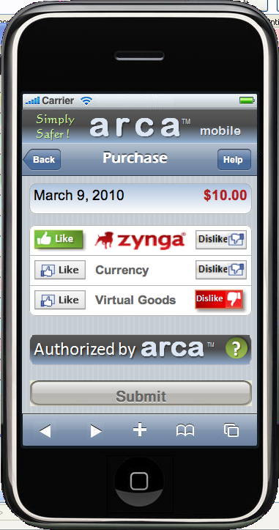

Slide 71
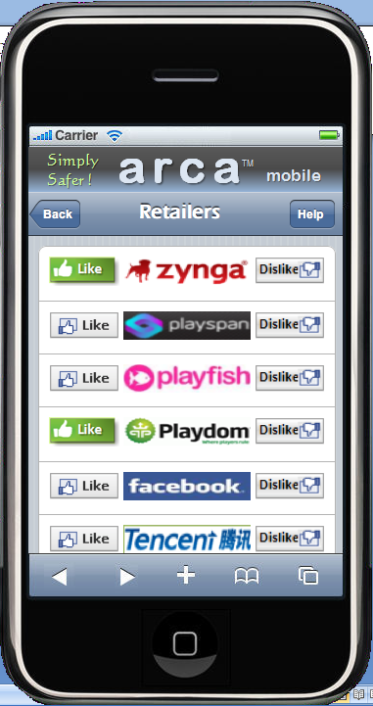

Slide 72
