Slide 1
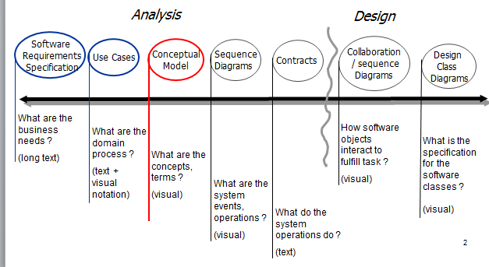
Analysis and Design

Slide 2
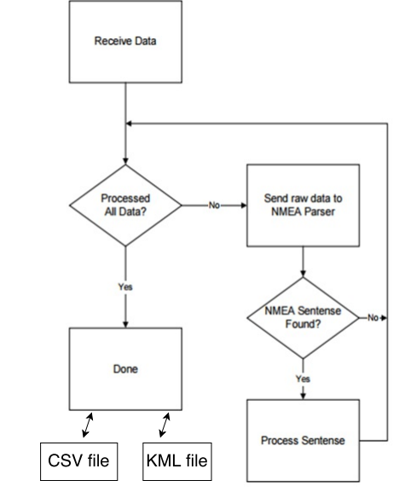
Concepts - a graphical representation
Each time the
computer receives
data it will send it to
the NMEA parser.
Later we get CSV
files(Excel) and KML files (xml).

Slide 3
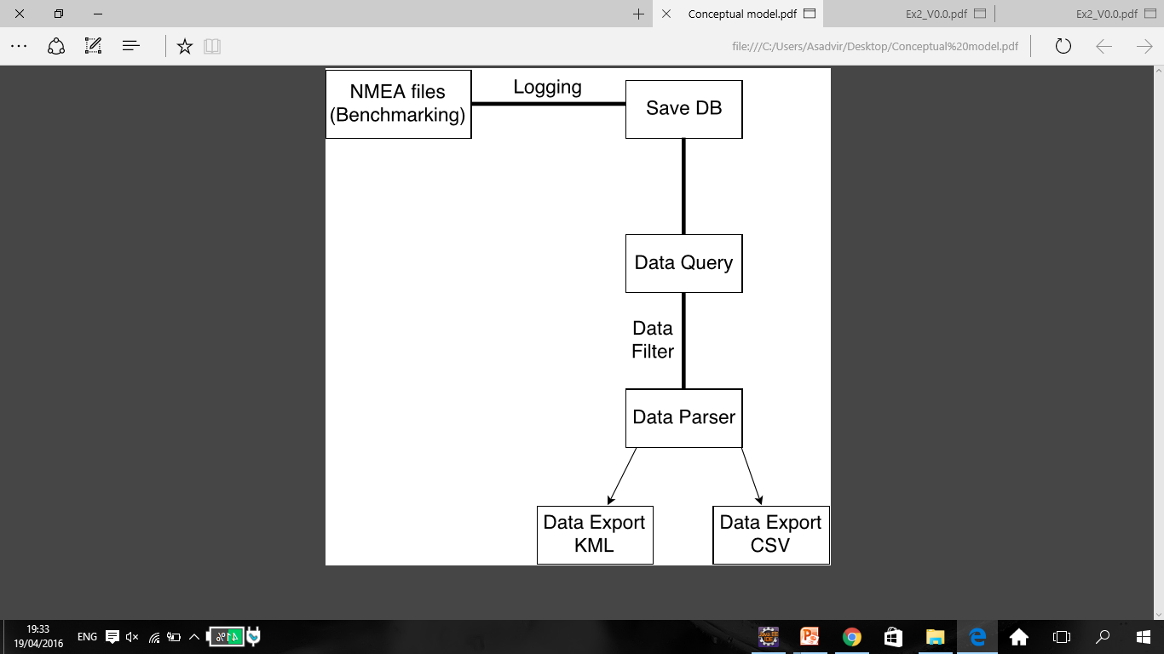
Conceptual Model

Slide 4
Use cases - 1
Use Case: captures NMEA data streams.
Actors: Client, System
Description:
Client loads the file to the system.

Slide 5
Use cases - 2
Use Case: Save data as DB.
Actors: System
Description: Save data as DB by mysql.

Slide 6
Use cases - 3
Use Case: Process data using parser of NMEA files to CSV/KML.
Actors: System
Description:
Production of KML, and CSV files. Client
querying on DB.

Slide 7
Use cases - 4
Use Case: Display data to user.
Actors: System, Client
Description:
KML/CSV divided by Timeline.

Slide 8
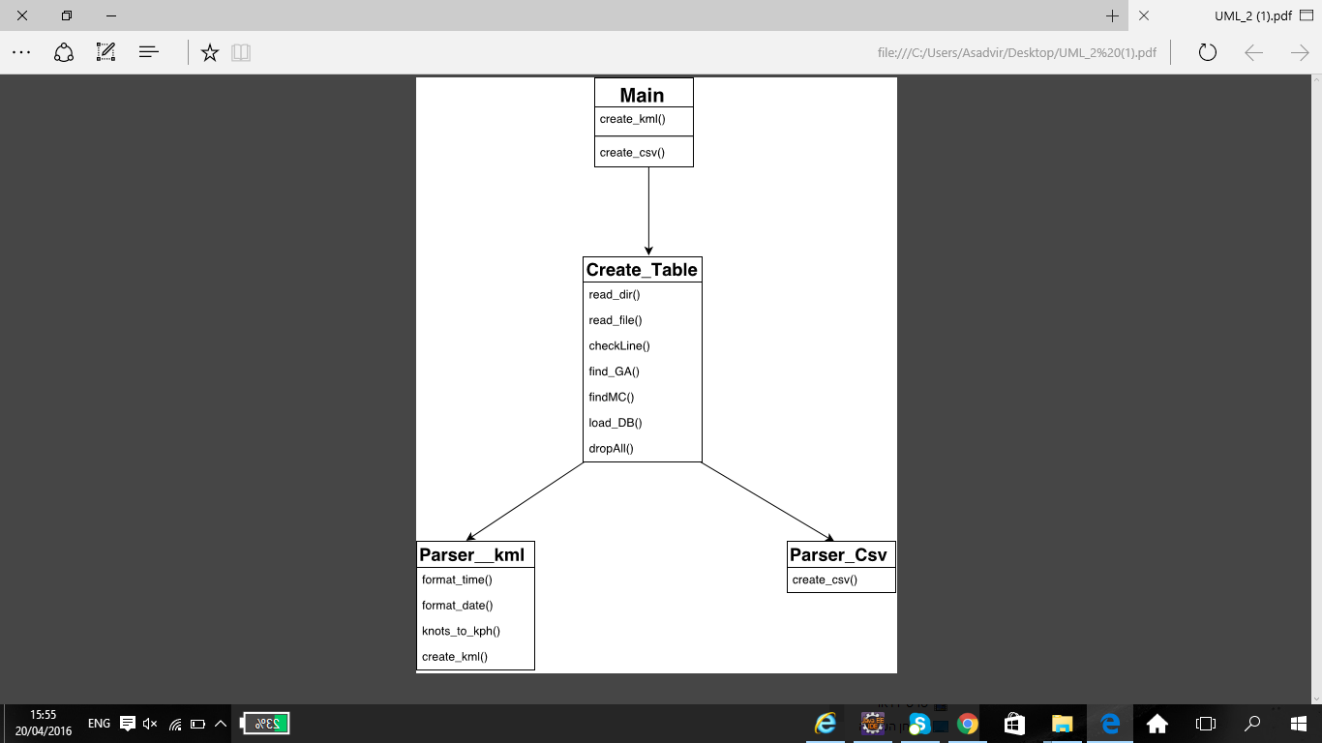
UML

