Slide 1
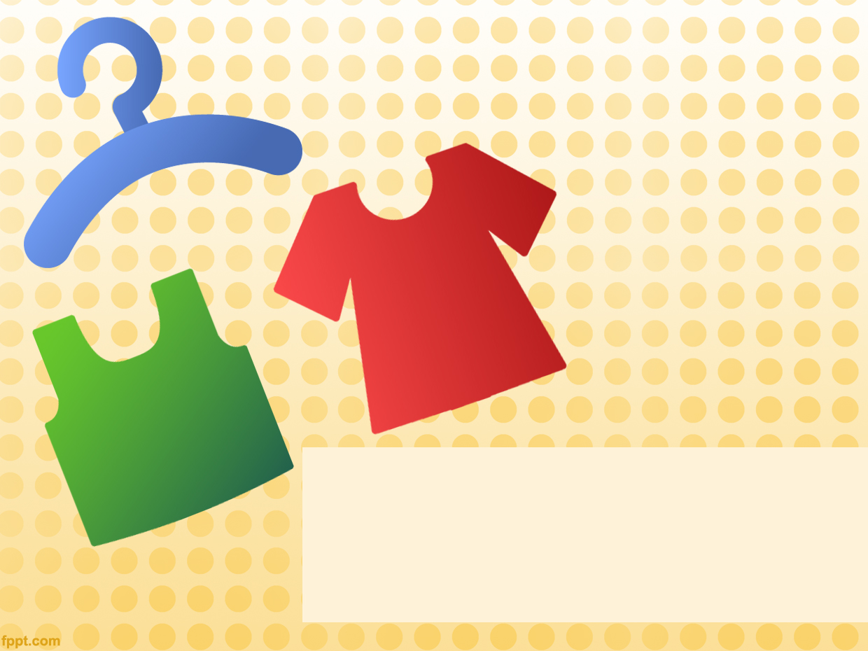
ClothApp
Nelly, Nir, Dror, Mali

Slide 2
The Use Case
A shopper would like to find a specific item, for example: a black dress, size M up to 100 NIS. Our app offers a search engine for clothes from multiple clothes shops. Choose the clothing item you like….

Slide 3
Planned Features – Milestone 1
UI to filter fashion items
  Gender
  Type (e.g. t-shirt, dress)
  Color
  Size
Simulating one clothing shop indexed in a datastore

Slide 4
Planned Features – Milestone 2
Indexing one clothing shop
Improve and expand UI to support filter by:
  Price
  Sub-type (e.g. mini / midi / maxi dress)
  Composition (e.g. cotton / wool)
Items wishlist (Google account integration)
Sales and discounts
Nice to have

Slide 5
Planned Features – Milestone 3
Indexing a second clothing shop
Responsive UI
Location based direction to the shop
Nice to have

Slide 6
Future Plans
Additional indexed shops
Shops and items rating
Native mobile app
Price decrease notifications

Slide 7
High Level Architecture
Server Side
  Google AppEngine / Dedicated server (PHP)
  Database (MySQL / AppEngine Datastore)
    Items and stores , users (google accounts) and whishlists
  Periodic indexing
Client Side
  Web application – JS, AJAX, HTML, CSS, Angular, Location API
Nice to have

Slide 8
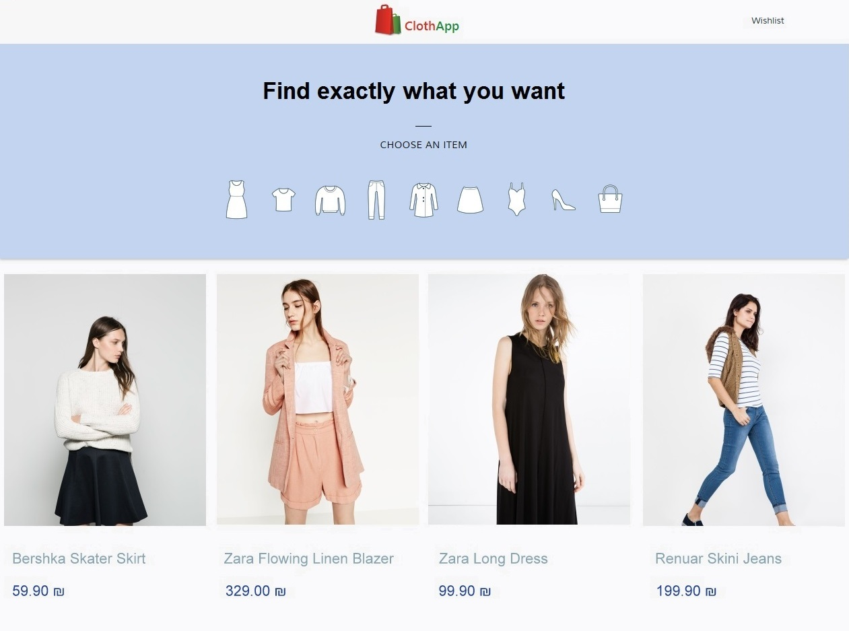
Mockups

Slide 9
