Slide 1
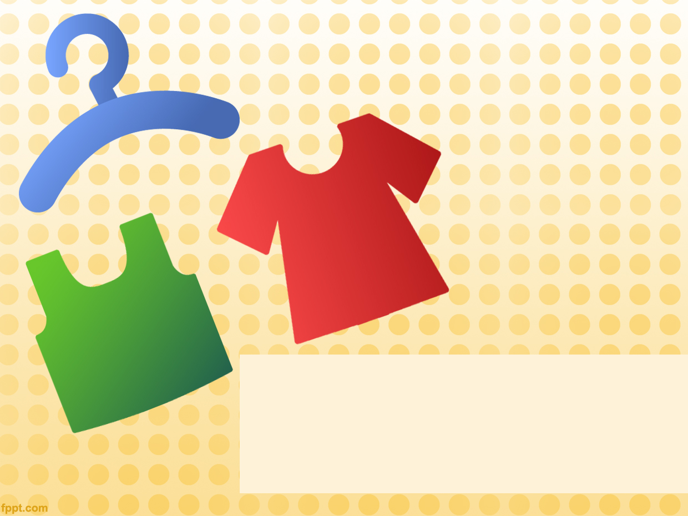
ClothApp
Milestone 1
Dror, Mali, Nelly, Nir

Slide 2
The Use Case
A shopper would like to find a specific item, for example: a black dress, size M up to 100 NIS. Our app offers a search engine for clothes from multiple clothes shops. Choose the clothing item you like….

Slide 3
Accomplishments
Apache web server with PHP support and MySQL DB – up and running
Partially indexed shop – Castro
  Gender, Type, SubType, Name, Link, Price, Image
PHP script for fetching items by specific filters (DB->json)

Slide 4
Accomplishments– cont.
A Web UI built with Angular, HTML, CSS
  Grid View with item name, price and more
  Filter by existing data
Responsive Design

Slide 5

Team Work
1 member for environment stuff and server side tasks (indexing, filter in server side)
Others were assigned to build the WEB UI
  Learning HTML, CSS
  Learning angular and JS from scratch

Slide 6
Difficulties
Castro returns price in Euros since our server is located in Germany
  Overcome by sending a cookie specifying our preferred currency and location
Finding the best page for indexing with minimal ambiguous HTML
  We found a sitemap! (XML containing all items)

Slide 7
Difficulties - Cont
Some team members were developing web for the first time
All of us were new to angular
Regex can be tricky [and greedy ;) ]
Time constraints
  Two members had an exam during the milestone

Slide 8
Easy Stuff
Server ramp up (DB, apache, etc.)
PHP language
In both we had some experience

Slide 9

Live Demo

Slide 10
Planned Features – Milestone 2
Completing Castro Indexing
Indexing another clothing shop
Improve and expand UI to support filter by:
  Size
  Color
Items wishlist (Google account integration)
Infinite scrolling
Real users trial
Nice to have

Slide 11
Planned Features – Milestone 3
Indexing a third clothing shop
Responsive UI – cont.
Location based direction to the shop
Nice to have

Slide 12
Future Plans
Additional indexed shops
Shops and items rating
Native mobile app
Price decrease notifications

