Slide 1
TRAVEL NORTHERN TAIWAN - GIS
107-CSIE-S016
四資三 104590021 陳立宭
四資三 104590049 邱嘉香
四資三 104590050 林大衛
指導老師：劉傳銘

Slide 2
Table of contents
Motivation
System structure
Functionalities
Trip planning
Display local information
Budget planning
Display of weather
Comparison with other apps
Conclusion

Slide 3
Motivation
Show up-to-date information about Northern Taiwan
Create a convenient travel guide for first-time travelers
Promote tourism to other regions of Northern Taiwan

Slide 4
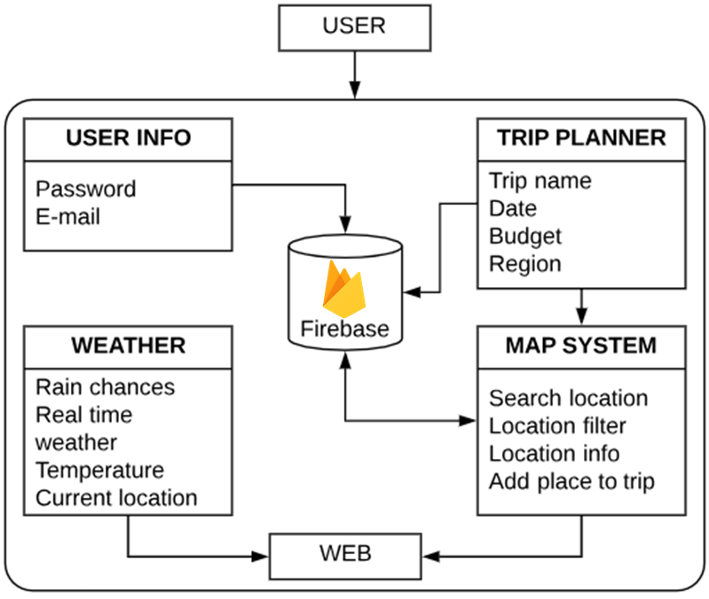
System structure
User information, including the custom made itineraries will be saved in firebase
The user will also be able to check the current weather of the places of interest
Itineraries will be made according to user’s places of interest

Slide 5


Functionalities
Let the user sign up and sign in
Multiple languages support such as English, Spanish, Simplified Chinese and Traditional Chinese
Search places according to the user’s interests
Bookmark places of interest
Customize itineraries
Display the weather of the region of interest
Record budget and expenses during trip

Slide 6
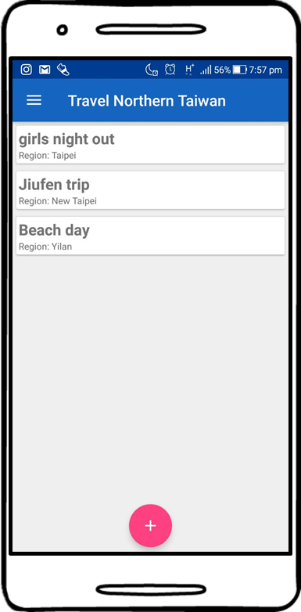
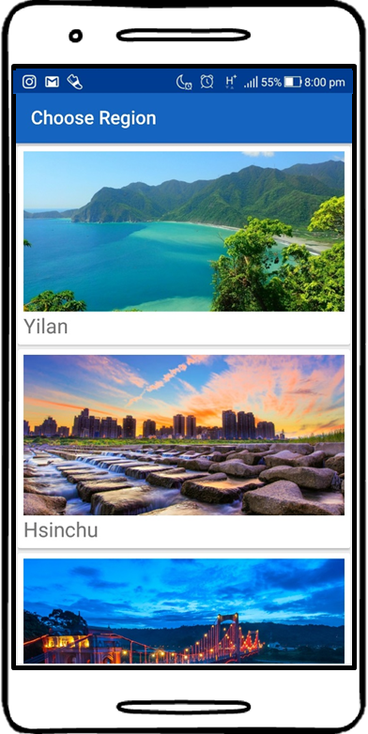
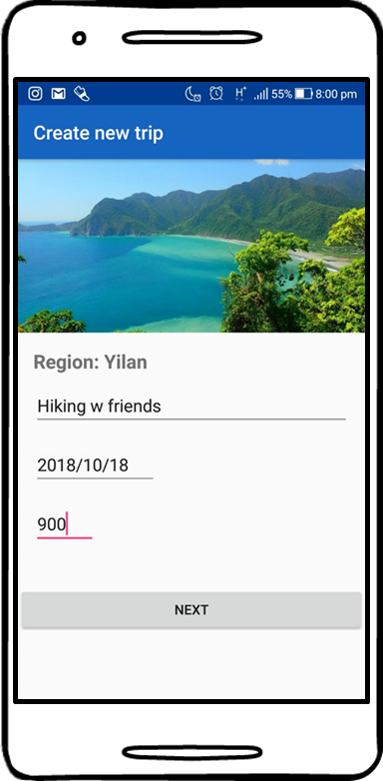
Trip planning (Interface)
Choose the region you want to visit
Name your plan and set the details
Create a new plan

Slide 7
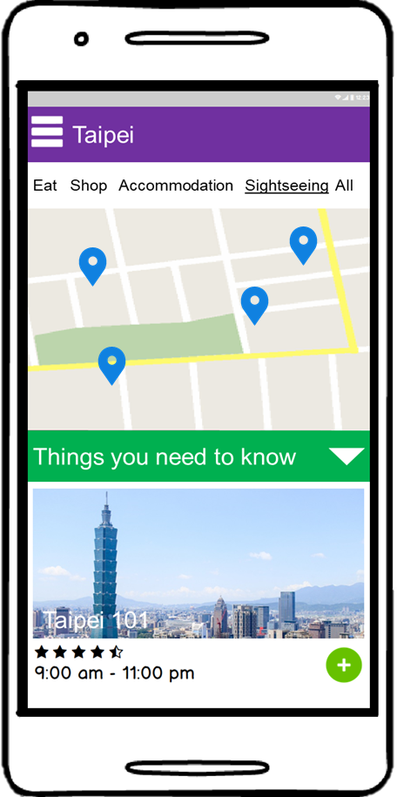
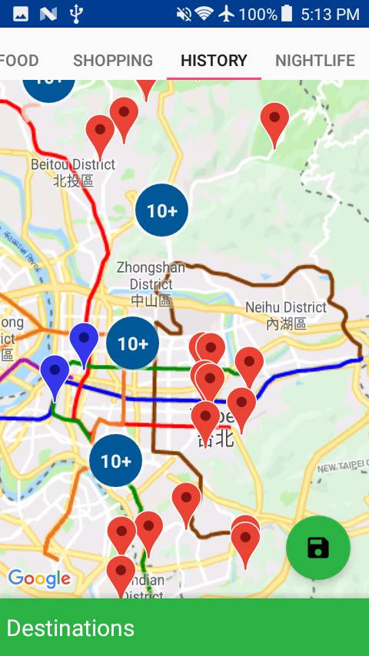
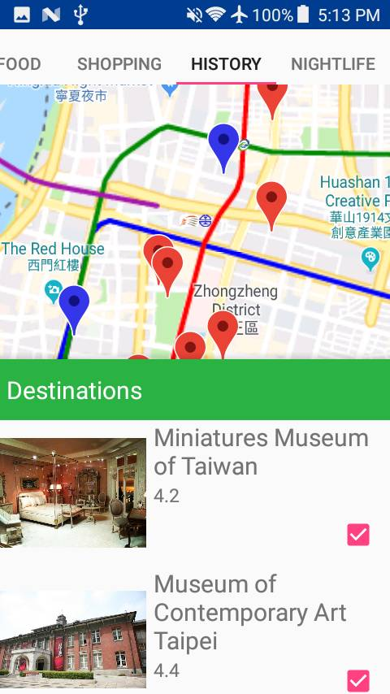
Trip planning (Interface)
Choose the type of location that you are interested in
See the location of every place of the type selected
See information about the places of interest marked in the map and add them to your itinerary if you wish

Slide 8
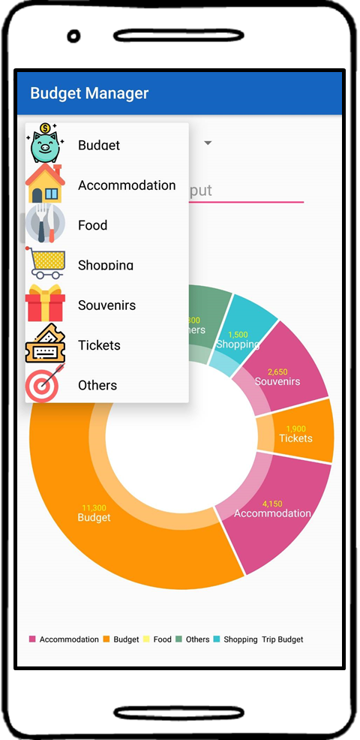
Budget planning
API：MPAndroidChart
Set travel budget
Show user’s remaining amount

Slide 9
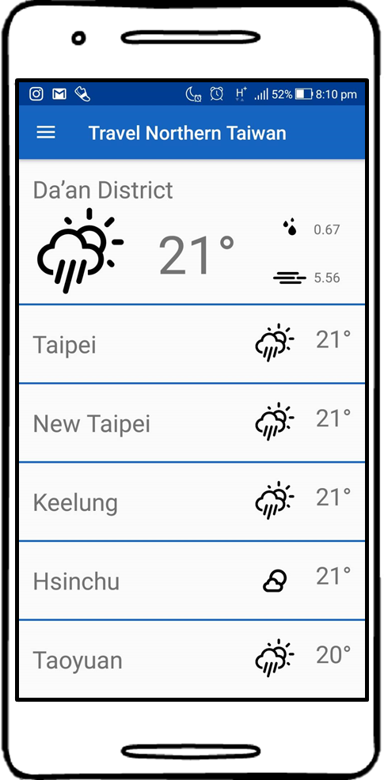
Display of weather
API：Dark Sky API
Functionality: Display today’s weather
Display weather forecast
Check the weather

Slide 10
Comparison with other APPs
 | Travel Northern Taiwan | Google Trips
Budget management | ✓ | X
Trip notes | ✓ | X
Itinerary planning | ✓ | ✓
Accommodation information | ✓ | X
Discounts offered to users | X | ✓
Bookings management | X | ✓
Weather forecast | ✓ | X
Download offline itinerary | X | ✓

Slide 11
Conclusion
We hope to provide most of the information and functionalities that a tourist would want to access. Hence, the user won’t be in need to download many applications when traveling, since everything needed will be provided by us.

Slide 12
Thanks for your attention

