Slide 1
Kanban board: Project Review
Team #7
邱嘉香 | 104590049
林大衛 | 104590050
陳立宭 | 104590021
林育成 | 104590023
王奕翔 | 104590002

Slide 2
Table of contents
Team meeting
WBS
Task assignments
Task scheduling
System requirements
System block diagram
Demo prototype

Slide 3
Team meeting
One or two weekly meetings
Usually on Tuesdays and/or Saturdays
Week No. | Date | Duration | Content
4 | 10/02 | 40 min | PEP report
4 | 10/06 | 1 h | Confirm which tools are going to be used
5 | 10/09 | 1 h | Define the subsystems for the project Final touch up for the PEP report
6 | 10/20 | 1 h | SRS report
7 | 10/24 | 1 h | Kanban UI
8 | 10/30 | 1 h | Mid project review
9 | 11/06 | 1 h | System development tasks

Slide 4
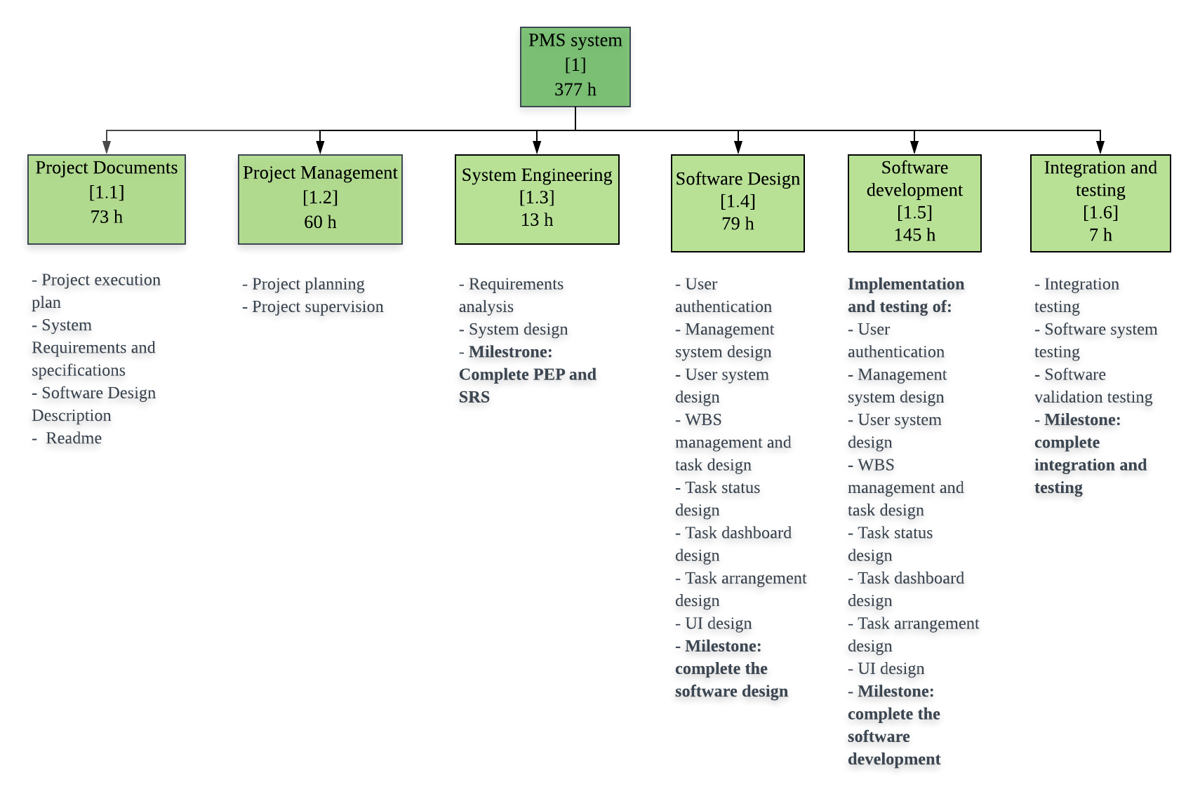
WBS

Slide 5
Task assignment
The documents are discussed together
Each person writes a section and one joins the content
Tasks are assigned depending on the member’s skills
Member | PEP | SRS | System development
邱嘉香 | Project planning and milestone checking, join the content | Introduction, glossary, join the content | Back-end
林大衛 | Project planning and milestone checking, Personnel | Project Dashboard Management System, glossary | Front-end
陳立宭 | Resources, Data management plan | Project Group Management System, glossary | Front-end
林育成 | Measurement and analysis plan, PPQA plan | Account Management System, glossary | System testing
王奕翔 | Risk management, Configuration management plan | Project Management System | System testing

Slide 6
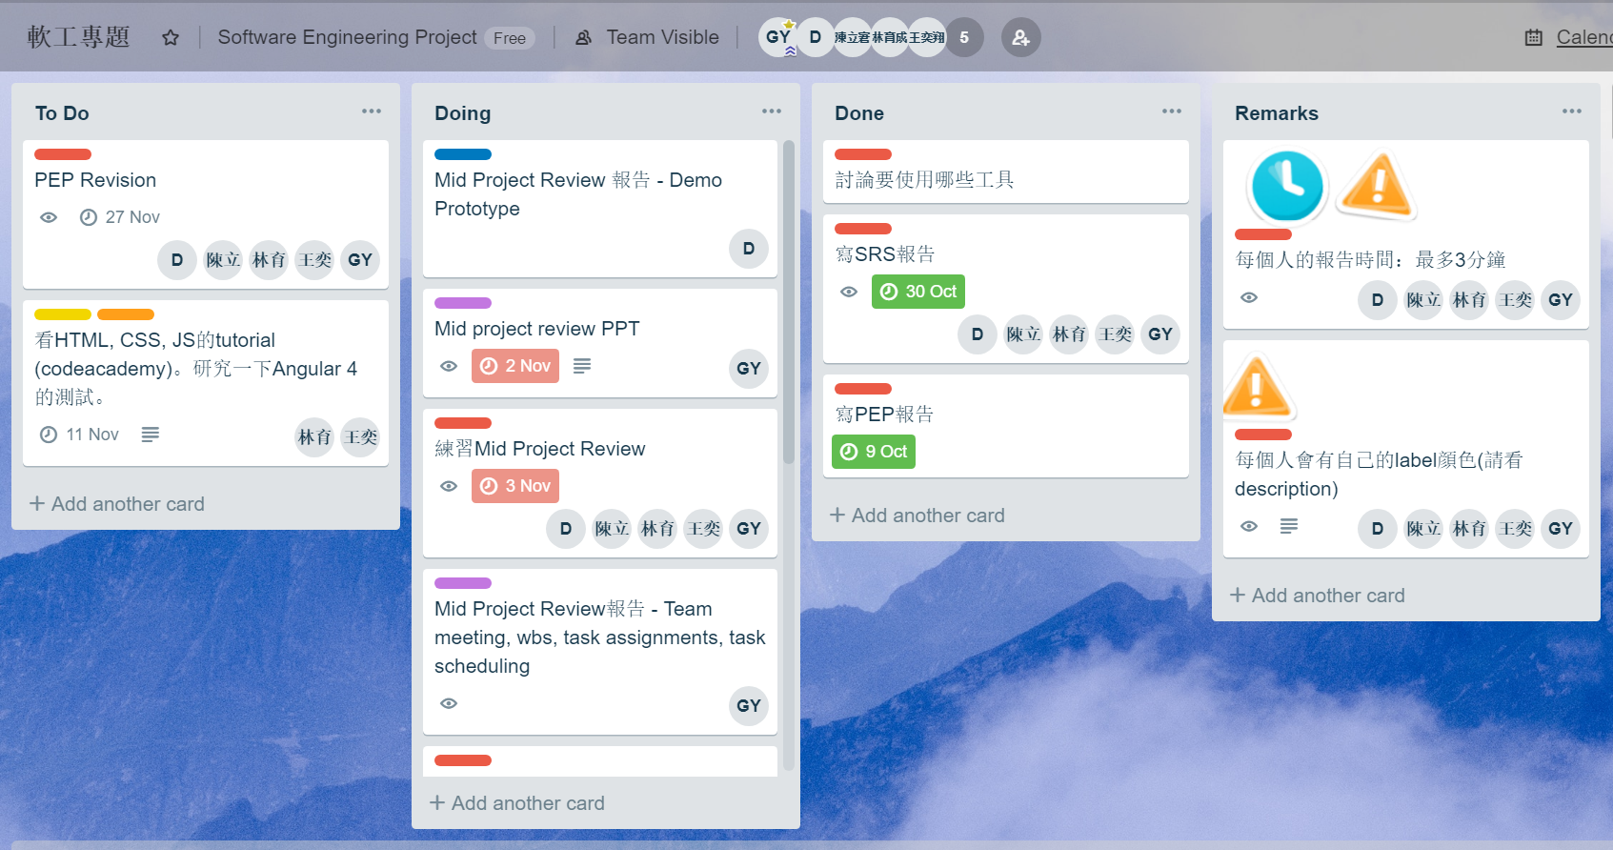
Task scheduling
We are using Trello to keep a schedule of the tasks to be done
Trello will notify by email when there’s a new task or when a deadline is approaching

Slide 7
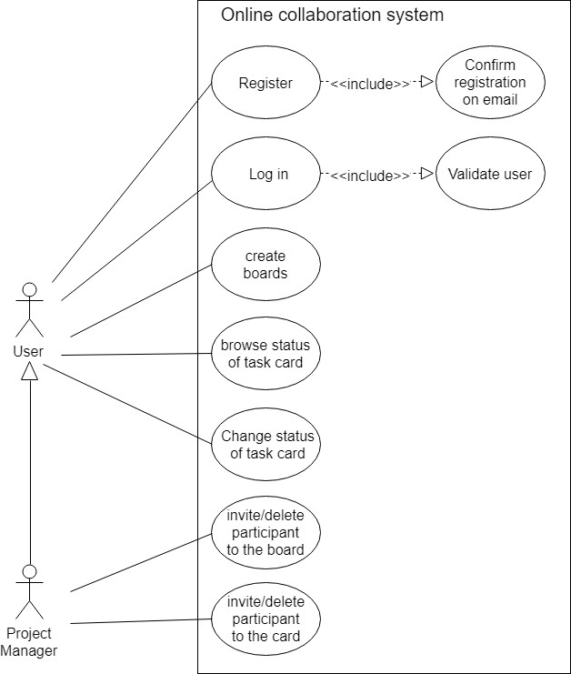
System requirements

Slide 8
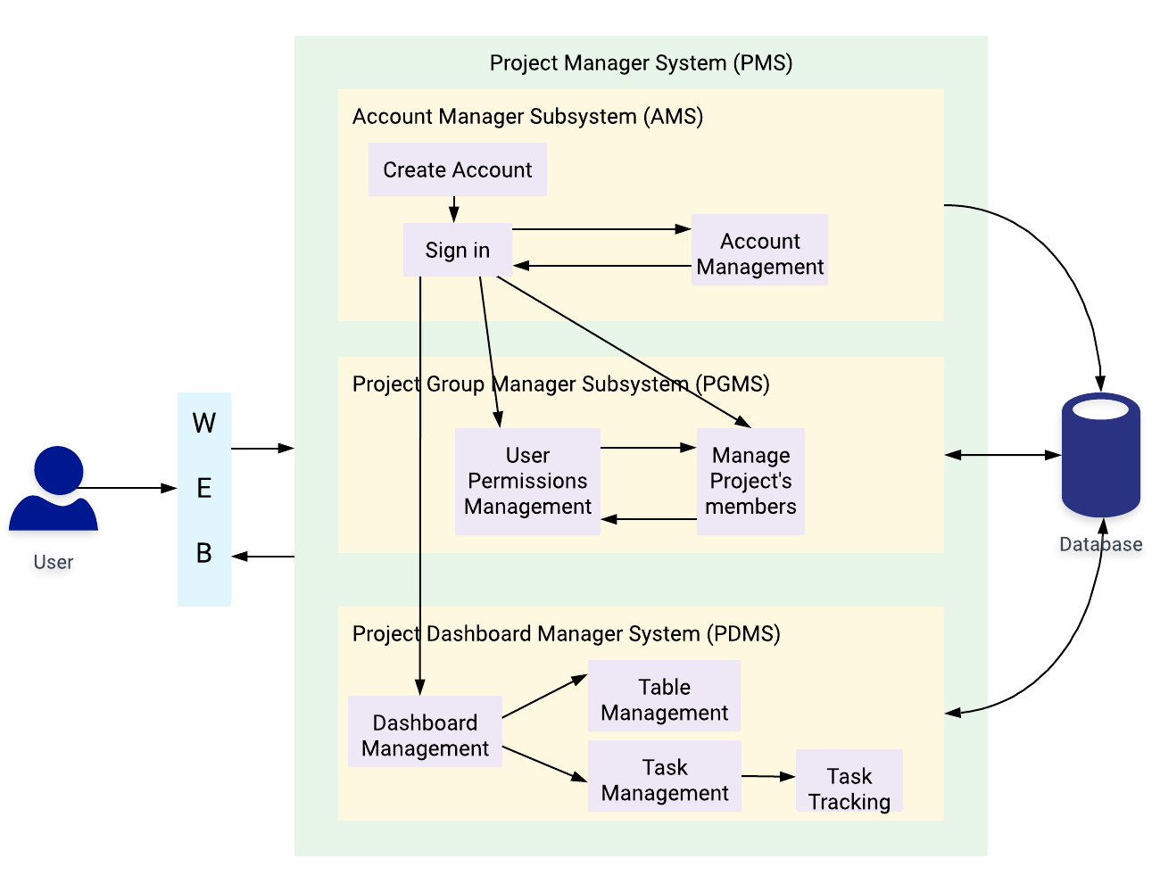
System block diagram

Slide 9
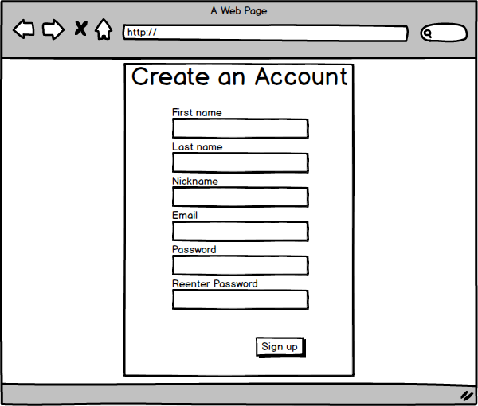
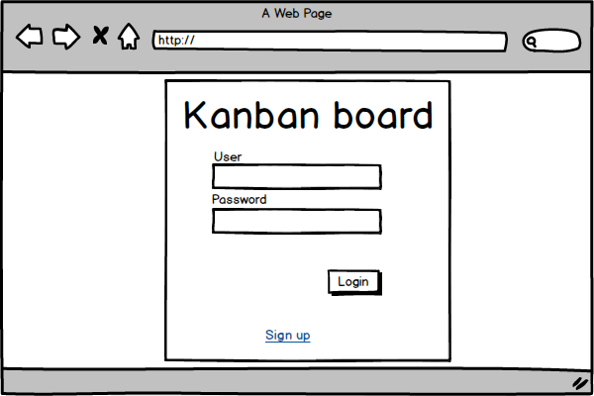
Protype

Slide 10
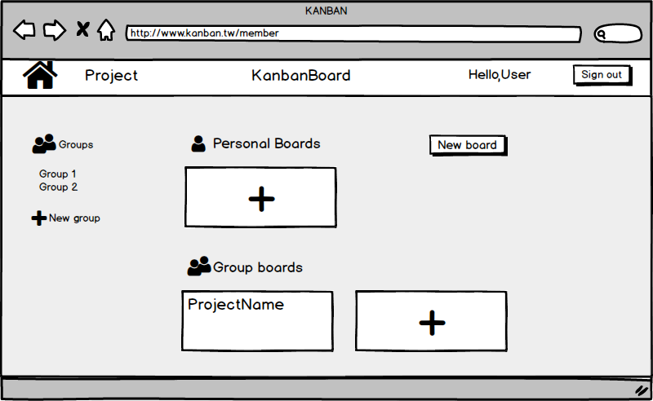
Protype (cont.)

Slide 11
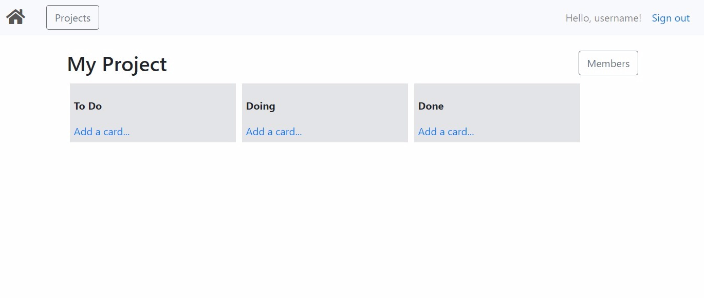
Protype (cont.)

Slide 12
Thanks for your attention

