Slide 1
Pr37T`/
|>R()tEc7e|)
p4$5\/\/0Rc|s_
natalia_walls
sami_elakhras
deautaun_ross
Notes:
Fun formatting! In places it may be a little hard to read. I would pull it up on the projector in one of the classrooms, then sit in the back row and see how it looks. You may need to adjust font sizes.

Slide 2
target_audience
online users, employees, or students
concerned about password stealing
literally anybody that uses a password

Slide 3
about_the_data
top 200 most common passwords from 49 countries
9800 rows (4255 unique passwords)
collected from 350 million users
attributes:
password length
required time to crack password
count of people that use passwords
whether password uses upper/lowercase, symbols, numbers
how many wordlists the password is in
Notes:
Color highlighting (green) is really nice

Slide 4
question/outline
"how to make a secure password that is also memorable?"
using our dataset, we will:
analyze characteristics of weak passwords
assess popularity of passwords using wordlists
address password memorability
Notes:
This slide has a ton going on. Maybe split it up into three slides? Or do something so that not everything is showing up all at once.

Slide 5
weak_password_characteristics
keyboard/language patterns, character length
determine composition of character types (upper, lower, etc.)
use brute-force cracking to help determine password strength

Slide 6
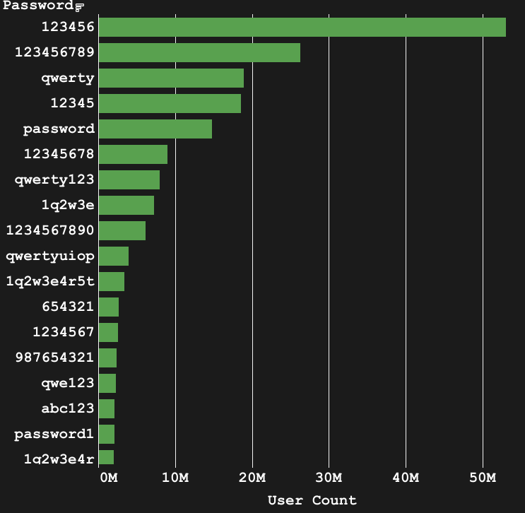
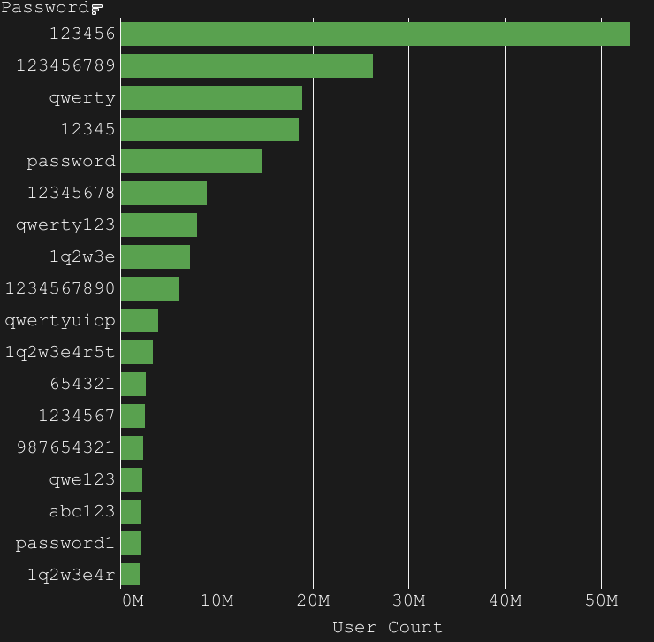
weak_password_characteristics_1/4
keyboard patterns are the most common password choice
numeric patterns could also count, like "123..."
hybrid passwords can contain multiple of these patterns
literal words are also very common
"password" is globally the most common word used as a password
Notes:
Really like the color highlighting. Making the bars the same color might be nice too. Not sure if that would make it too busy though.

Slide 7
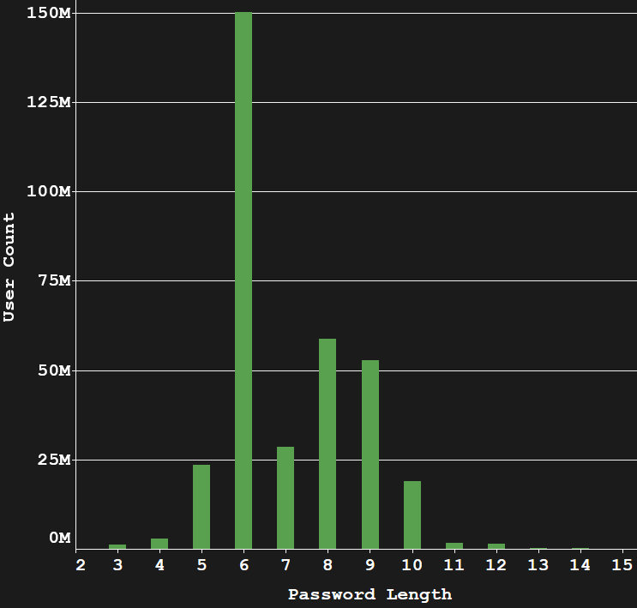
weak_password_characteristics_2/4
most weak passwords range from 6 to 9 characters in length
of course, less than 6 characters is also bad

Slide 8
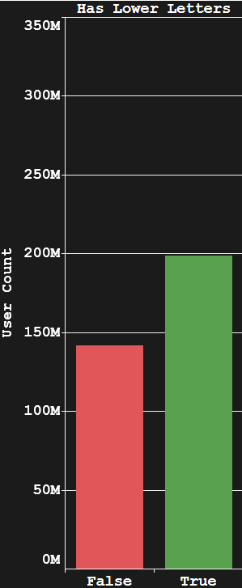
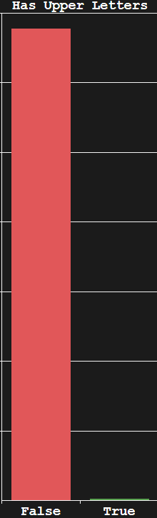
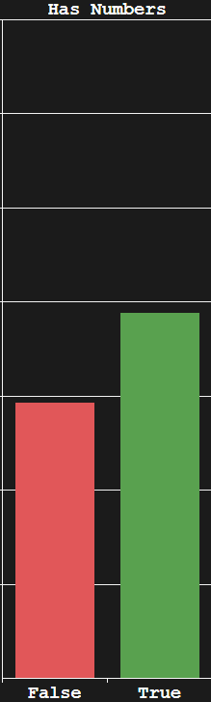
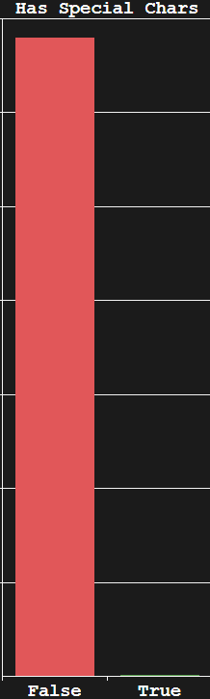
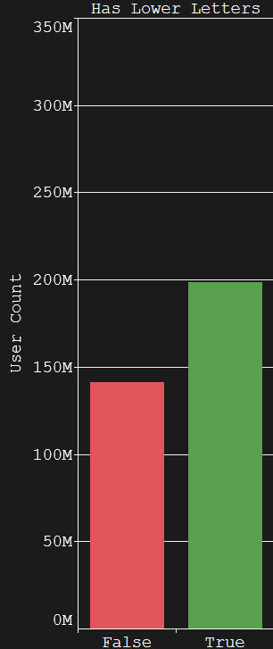
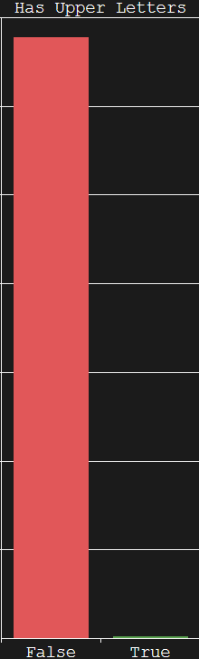
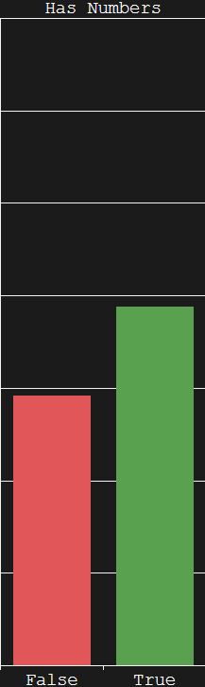
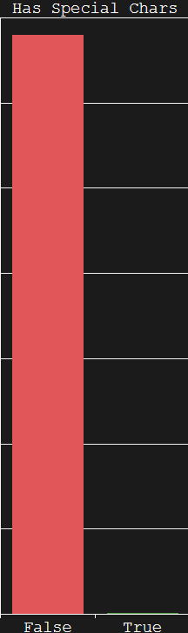
weak_password_characteristics_3/4
most passwords contain lowercase letters and numbers
41% had lower letters only
40% had numbers only
14% had both lower letters and numbers
almost no passwords contain uppercase or special characters
less than 2% combined
note that 14 + 41 + 40 = 95, that's because 5% of passwords do have various combinations of the 4 character categories
Notes:
Very worried about font sizes here. The labels on the graph, as well as the text at the bottom will almost certainly be hard to read from the back. Also, why is the thing at the bottom so small? Is it because it’s not important? If so, why include it?

Slide 9
charset
uppercase, lowercase, numbers, special characters are all charsets.
they all have their own sizes:
uppercase: 26
lowercase: 26
numbers: 10
special: 31
the more character types you use, the larger a password charset becomes.
Notes:
Define charset.

Slide 10
brute_forcing_method
to brute force a password:
you need to try every single combination of characters in a charset
most passwords have a reduced charset (only numbers or only letters)
the general formula is:
charset_size ^ password_length
brute forcing becomes harder as these two numbers increase.
to maximize charset_size, use all four character categories (93 possible characters)
Notes:
Define charset.

Slide 11
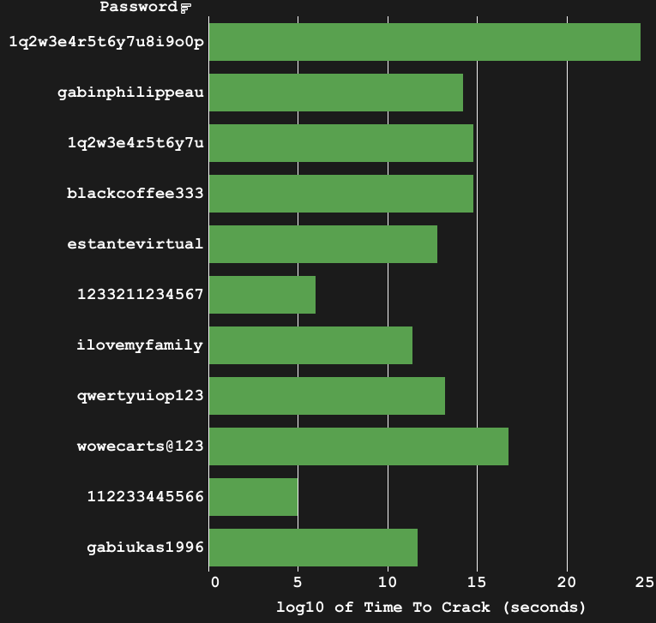
weak_password_characteristics_4/4
notice how the larger your charset is (for passwords of the same size), the longer it takes to crack.
"112233445566" and "gabiukas1996" both have the same length, but the latter takes 7 orders of magnitude longer to crack
"1q2w3e4r5t6y7u8i9o0p" is very secure against brute force attacks, but its length would make it hard to memorize (if it wasn't a common pattern, which makes it weak against wordlists)
10^5 = ~28 hours
10^10 = ~317 years
10^15 = ~31.7 million years
Notes:
Either mention how long something like 10^20 seconds is (in days/months/years), or show the graph in days/months/years. Obviously we all can think about something like 10 seconds, 100 seconds, etc. But once it gets big like 10^10 seconds, I can’t easily conceptualize how long that is without pulling out a calculator.

Slide 12
dashboard

Slide 13
popularity_using_wordlists
how using wordlists can speed up password cracking
tradeoffs by using wordlists
possible weaknesses

Slide 14
using_wordlists_1/3
a wordlist is a text file that contains a password on each new line.
they can range from a few megabytes to several terabytes.
brute force is an inefficient method of cracking longer passwords.
ex. "1q2w3e4r5t6y7u8i9o0p":
it would take 100 billion years to brute force
it would take a few hours (given your wordlist had the password in it)
wordlists are useful, but they can't contain all passwords, so there's a tradeoff of storage space.

Slide 15
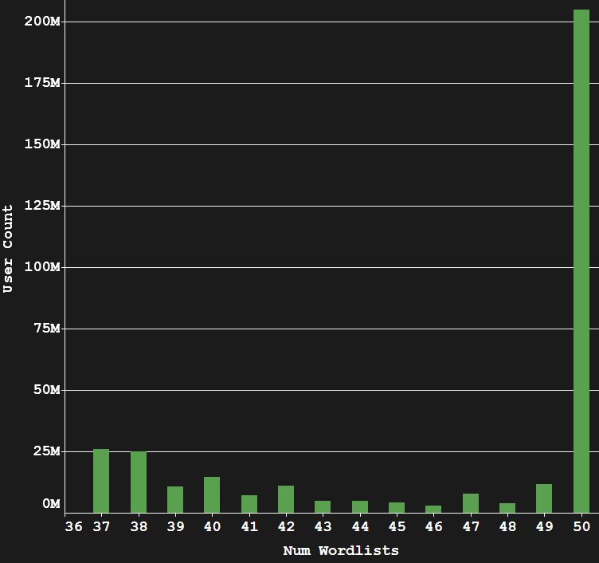
using_wordlists_2/3
gathered top 50 wordlists from weakpass (~500 GB) to find out how "popular" a password is.
most users use passwords that are in all 50 wordlists
note that 37 is the lowest value because most of these wordlists get their passwords from the same source and are subsets of larger wordlists

Slide 16
using_wordlists_3/3
while "1q2w3e4r5t6y7u8i9o0p" would take a few hours to crack using a wordlist, how likely is it that any wordlist would contain this password?
the password above was found in 37/50 wordlists (74% likely)
this means that the password above is extremely insecure.
you can mitigate wordlist attacks by making your passwords unique but memorable.

Slide 17
password_memorability
increasing password length without extra memorization
wordlist cracking mitigation methods
examples of secure passwords

Slide 18
memorable_passwords_1/3
"1q2w3e4r5t6y7u8i9o0p" is a long password, but it's easy to remember because it's a simple pattern.
how do you balance using common patterns/words with security?
you can try making composite characters:
y = `/
h = |-|
w = \/\/
d = |) or </
o = ()
b = |3 or \>
n = |\|

Slide 19
memorable_passwords_2/3
you can also use uncommon keyboard patterns like:
"/z'a]q.x;s[w"
"1zm02xn93cb84vv6"
"pzqmoxwnicebuv"
of course, just using these patterns without modifications is insecure.

Slide 20
memorable_passwords_3/3
by using these two methods, it is possible to create a password that is both hard to brute force and hard to crack using a wordlist.
here are some examples:
"p4$5\/\/0Rc|s_": 3.620439e+20 seconds, 0/50 wordlists
"5er3|\||)1/>I7`/": 3.131318e+24 seconds, 0/50 wordlists
you can even reduce charset, but use a passphrase:
"7h15 15 4 5up3r l0ng p455w0rd": 9.040018e+45 seconds, 0/50 wordlists

Slide 21
conclusion
a strong, memorable password has:
a password length in the double digits
a mix of special characters, digits, and both alphabet cases
uncommon patterns that aren't found in wordlists as often
optional use of composite characters
increases length while allowing for easier memorability
optional use of passphrases
exchanges charset size for easier memorability
charset size reduction not mandatory

Slide 22
thank_you
t|-|A|\||<_`/0|_|

Slide 23
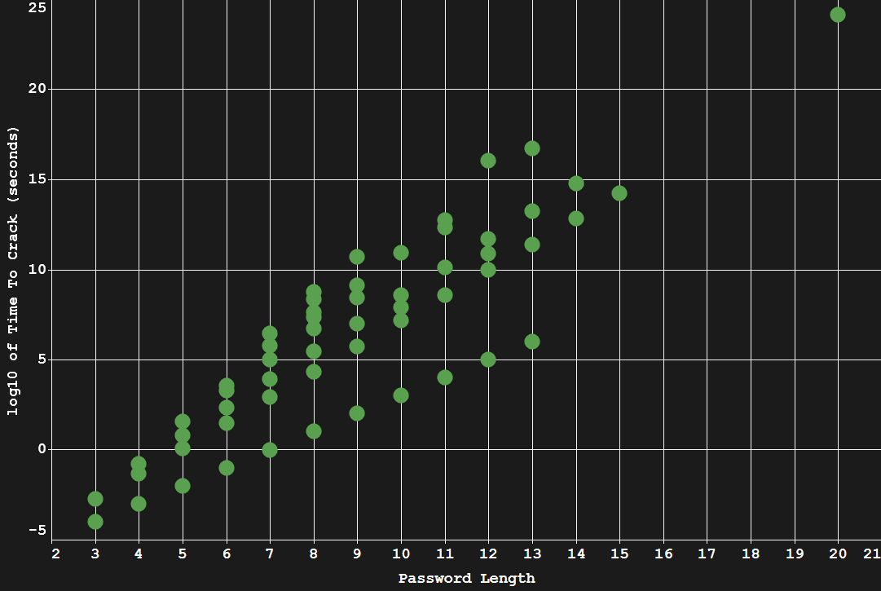

Slide 24
DBIR
Over 10% breaches due to password attacks
Over 80% stolen
53% of breaches due to default or shared Passwords
This means over 63% of incidents due to Password weakness
Notes:
Password can be brute forced, and leading to multiple stolen credentials used
Default passwords can be cracked in

Slide 25
Take Home
Weak passwords are short in length
Weak passwords are uniform
Weak Passwords contain words phrases or keyboard patterns E
Default Passwords are weak passwords E
Shared Passwords are weak passwords (multiple accounts) E

Slide 26
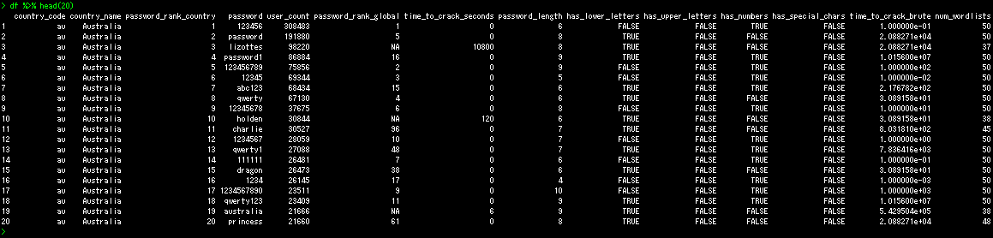

Slide 27
