Slide 1
New Experiences Enhance Coordinated Neural Activity in the Hippocampus

Slide 2
Motivation
LTP in Hippocampus is required for memory
LTP requires precise timing
Two candidates: theta sequence compression, ripple replay
However,
  Both occur in highly familiar environments
  No-one has compared activity in novel vs. familiar environments
  Spatial activity is more variable in novel environment (Frank et al, 2004)
Is neural activity during learning more conducive to induce Hebbian synaptic plasticity?

Slide 3
Experiment
75cm
Recordings from 6 tetrodes in CA1

Slide 4
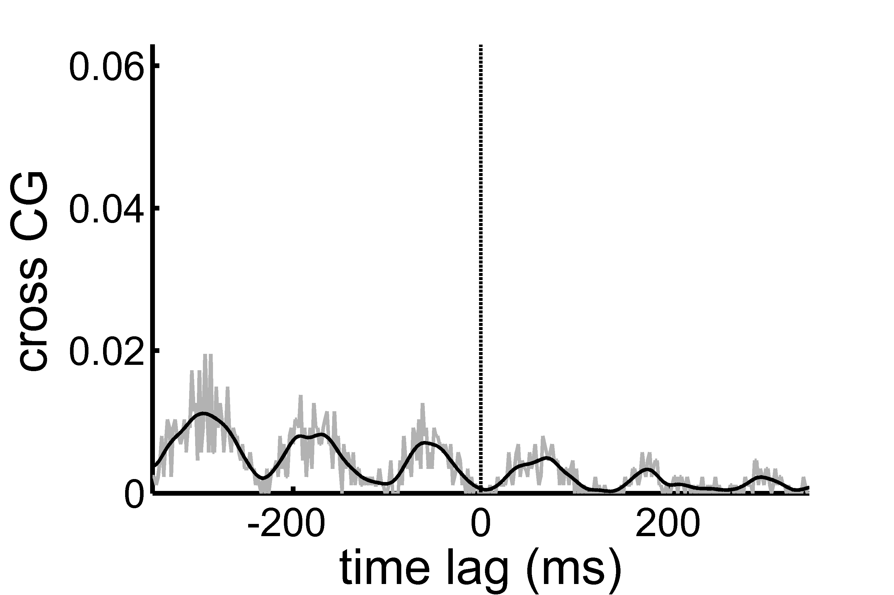
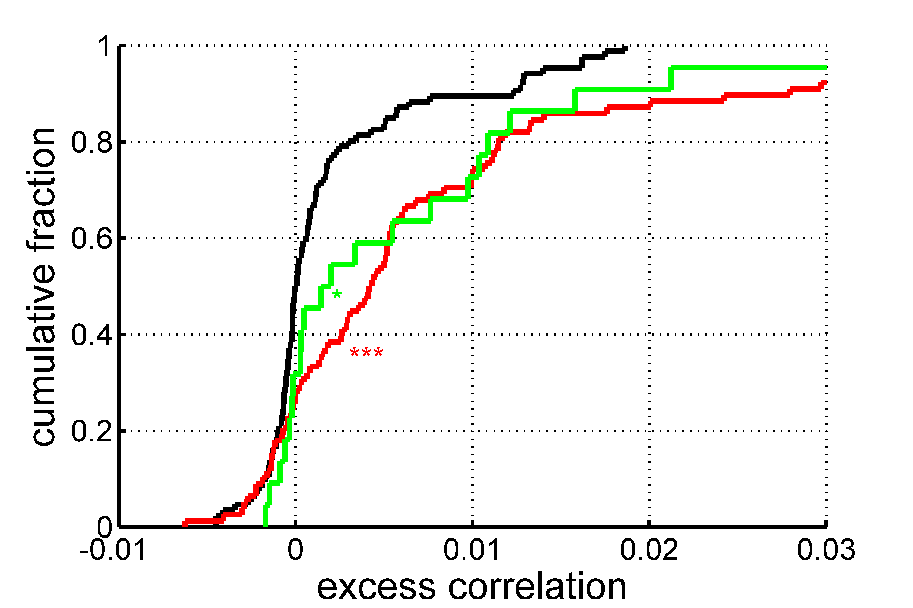
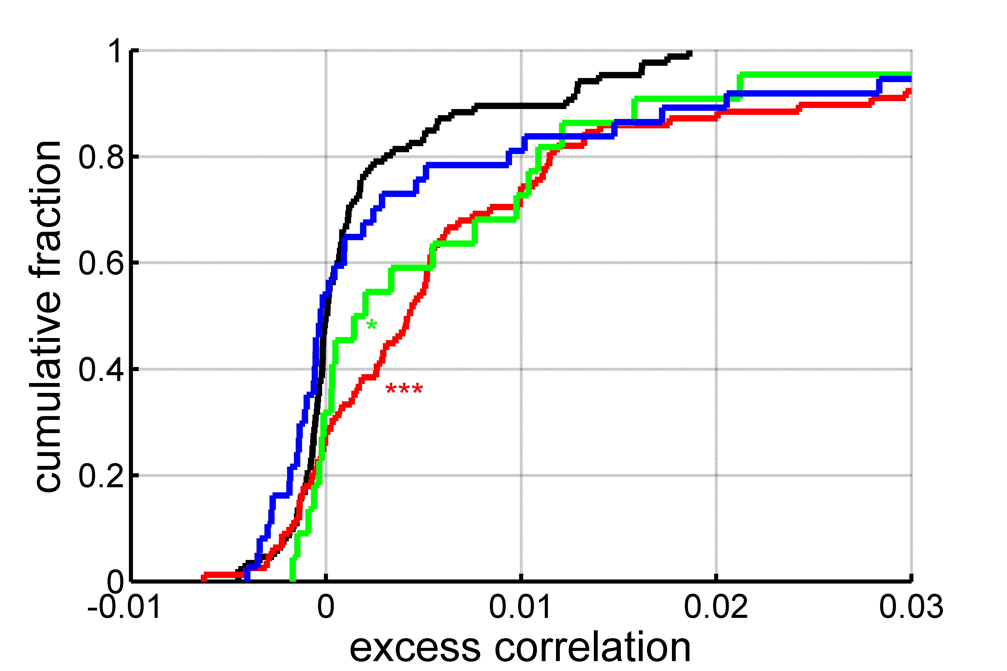
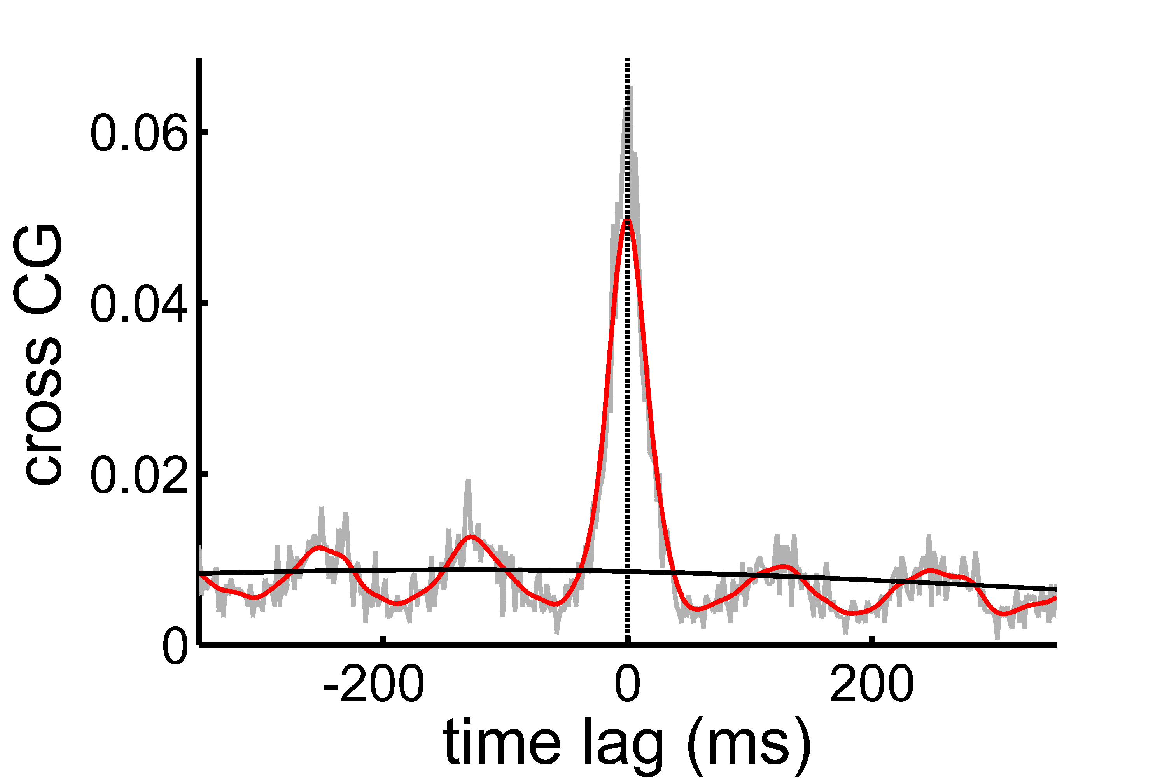
Excess correlation at zero lag
familiar arm
fam arm
day 1
day 2
day 3
novel arm, day 1

Slide 5
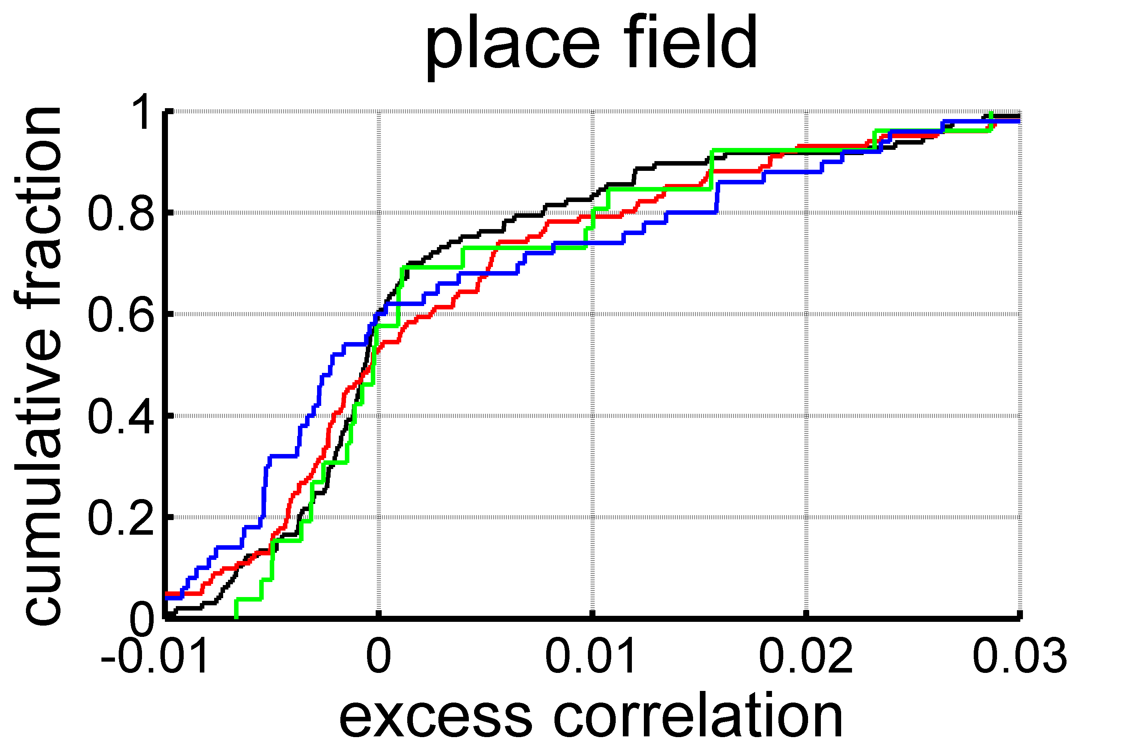
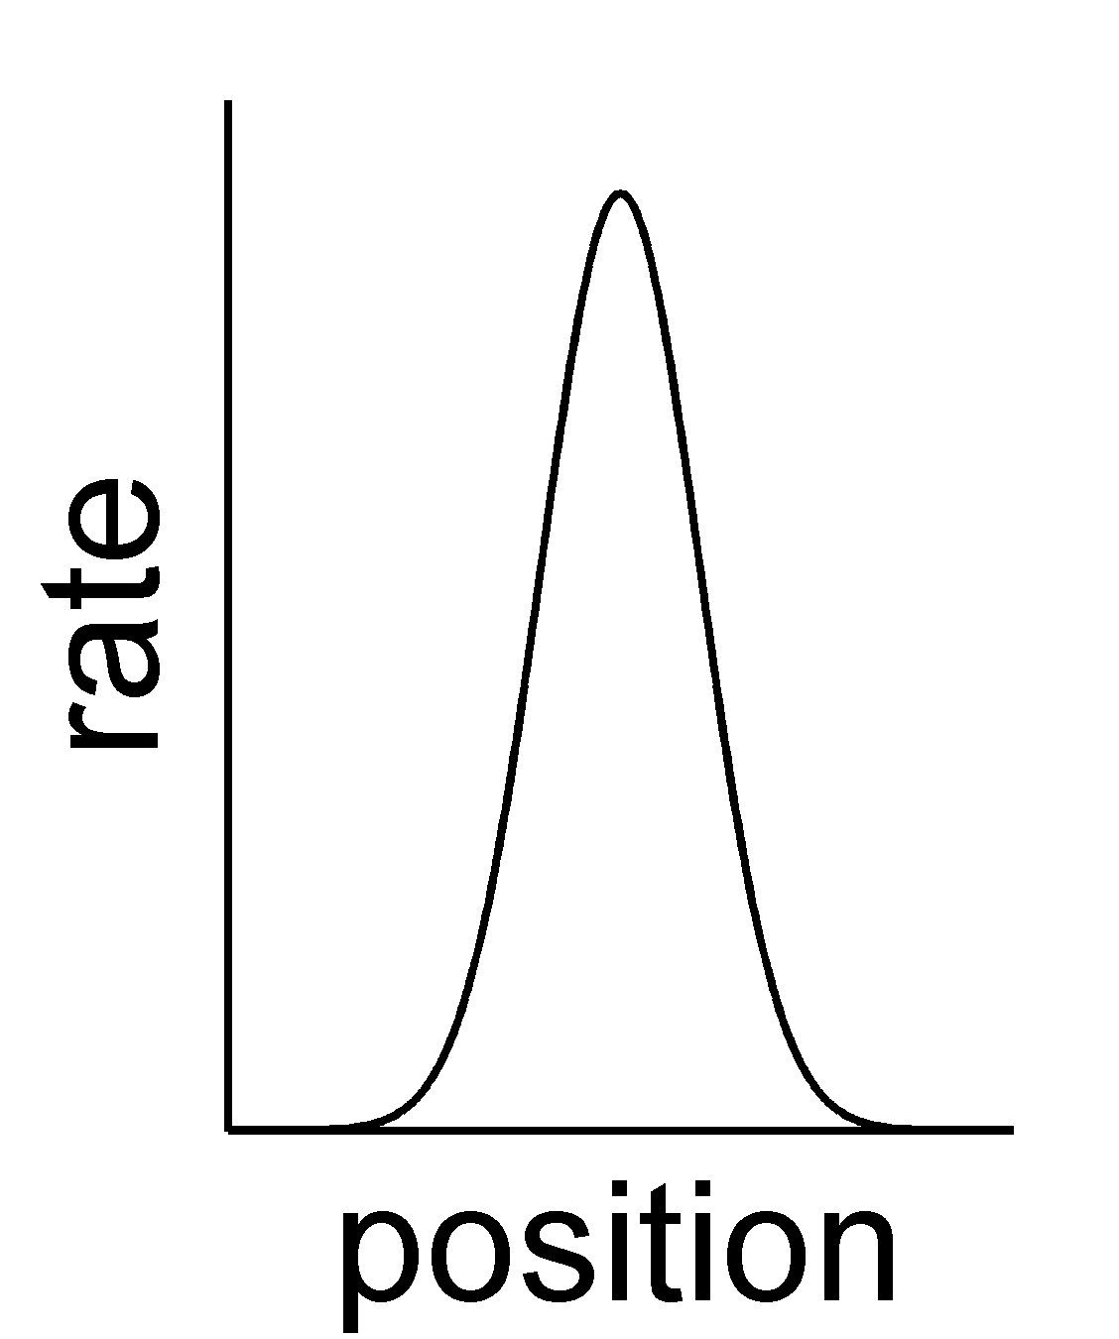
Origin of difference in excess correlation (1)
fam.
day 1
day 2
day 3

Slide 6
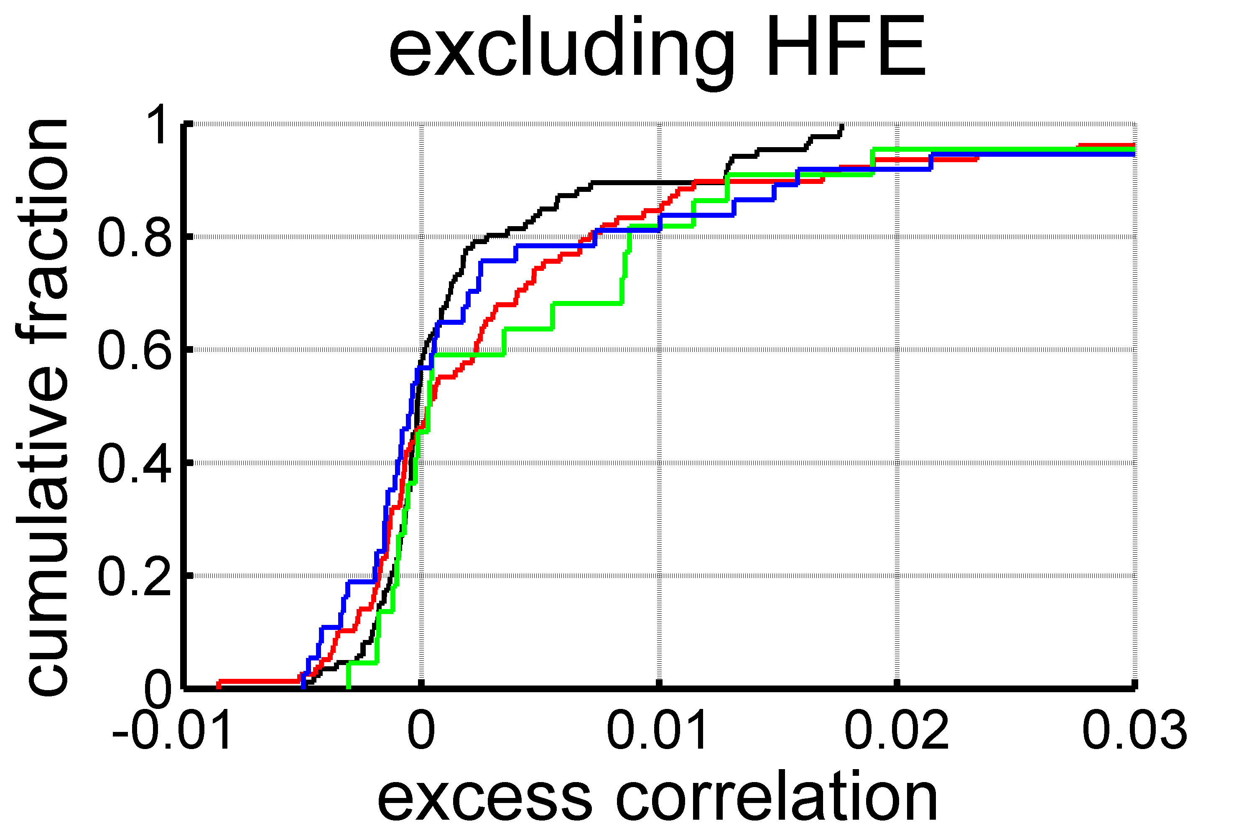
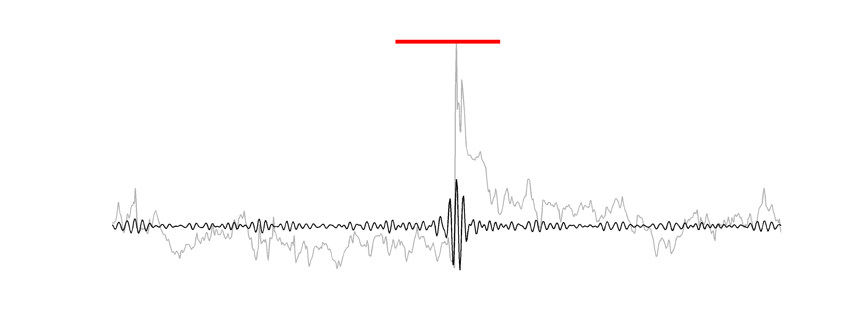
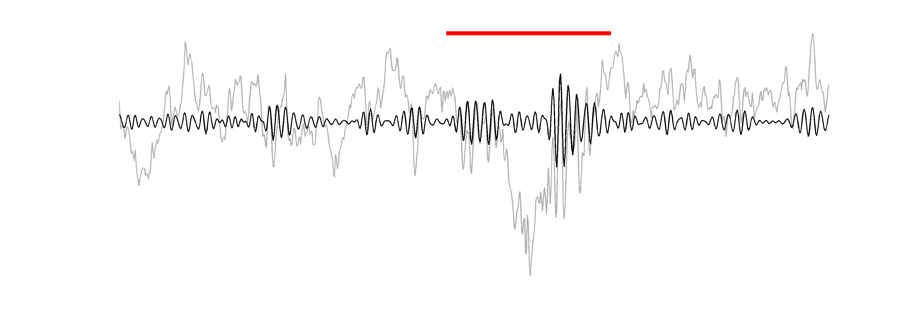
Origin of difference in excess correlation (2)
High frequency events (HFEs)
80 ms
fam.
day 1
day 2
day 3
HFEs take up < 1.8% of session time

Slide 7
High amplitude ripples are not enough
Notes:
rank-sum test: 6SD p=0.016; 3SD p=0.58

Slide 8
HFEs were coherent across tetrodes
other tetrode peak amplitude
reference tetrode peak amplitude

Slide 9
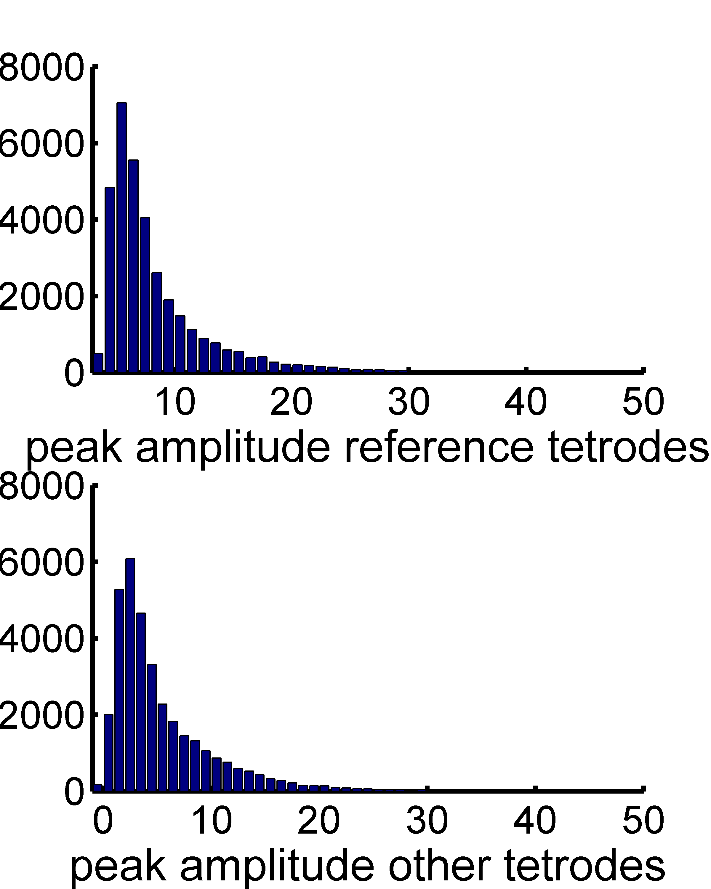
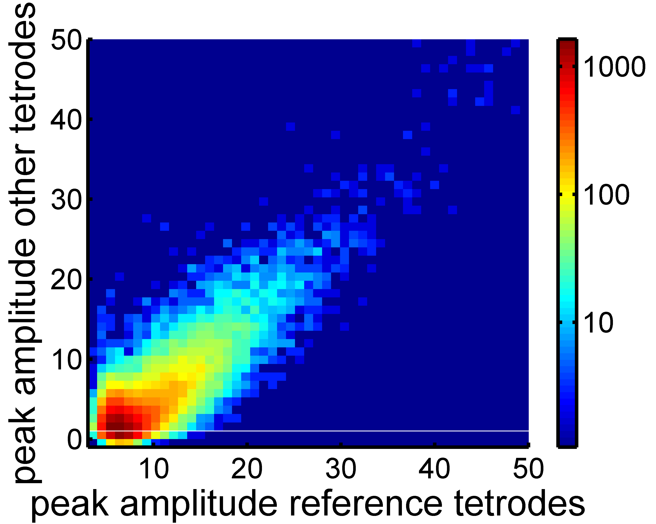
Lack of segregated classes of HFEs

Slide 10
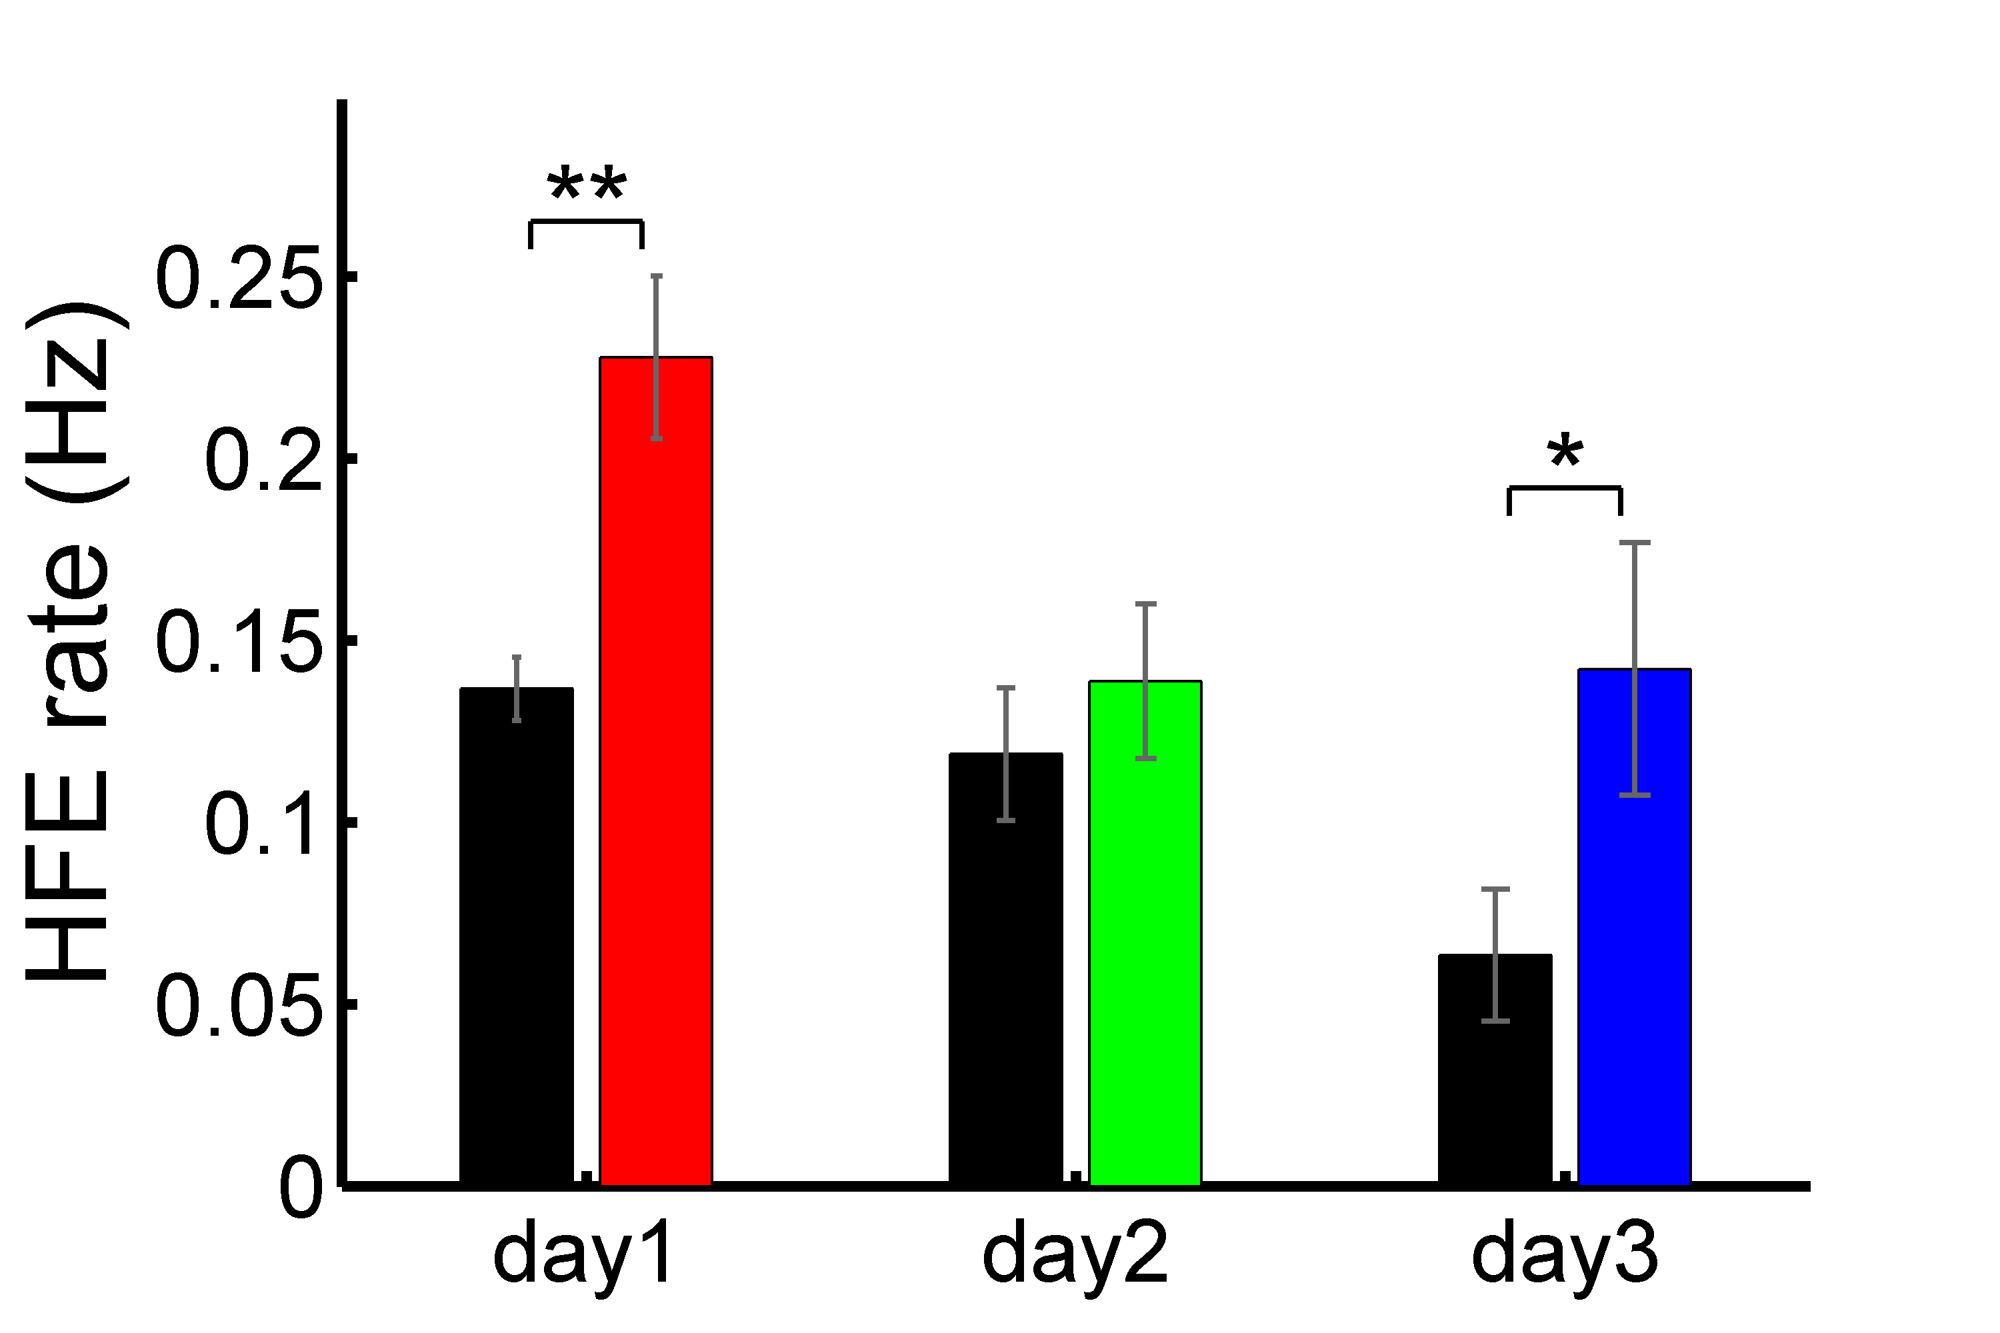
More HFE on novel arm
Notes:
[explain how ripple rate was calculated]

Slide 11
More spikes/ HFE

Slide 12
Novel arm cells more active during HFE
Notes:
E.g. on day1 novel arm cells are 2.6 times more likely to be active
It is as if novel arm cells were somehow tagged…

Slide 13
Spikes per activation remains constant

Slide 14
Pairs of novel arm cells are more co-active
Notes:
co-active: pairs of cells are both active during the same ripple
E.g. day 1 novel arm pairs are 6 times more likely to be co-active

Slide 15
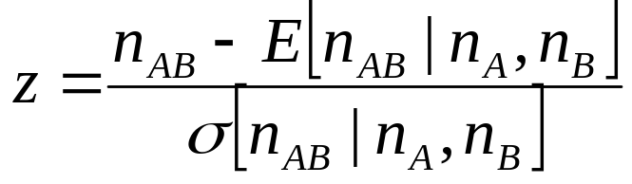
Coordination of cell pairs
HFE
N
cell A
||
|
n_{A}
cell B
|
|| |
|
n_{B}
A & B
✓
✓
n_{AB}
A & B activity independent
coincident events →
To compare pairs with different activity levels

Slide 16
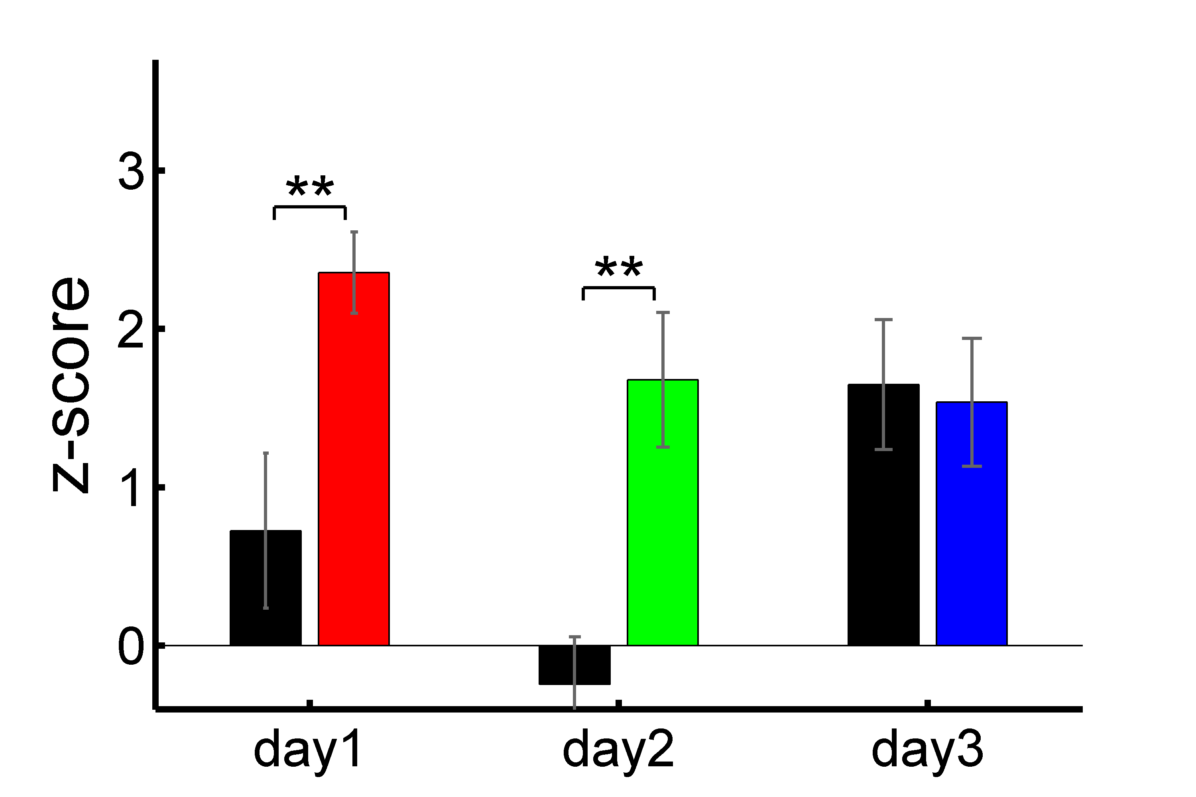
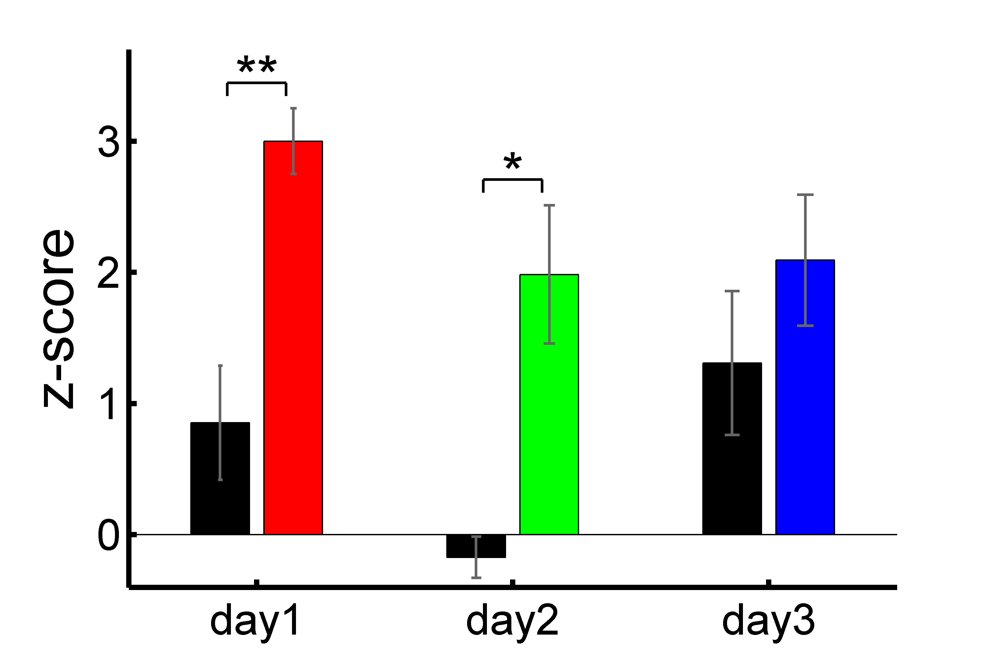
Pairs of novel arm cells are more coordinated

Slide 17
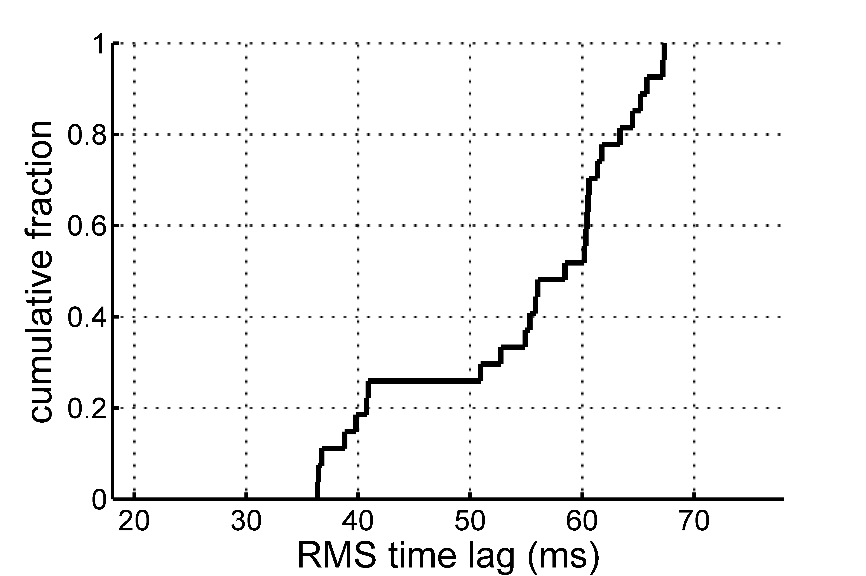
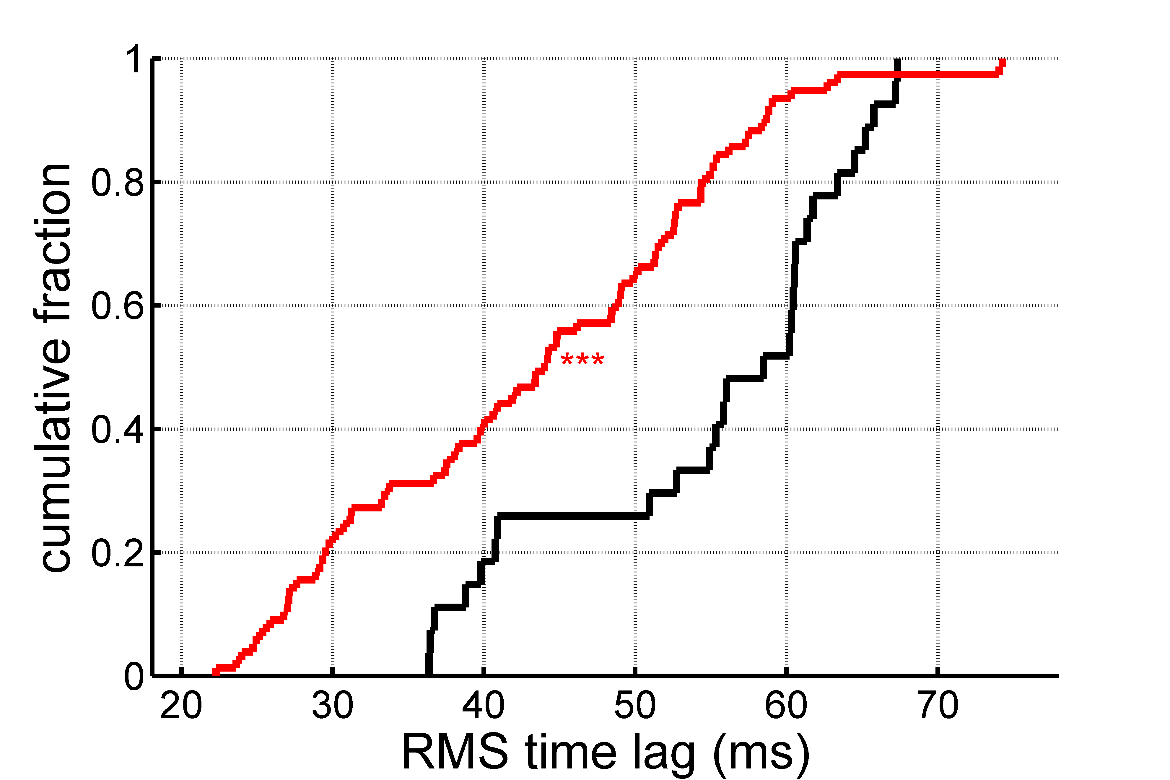
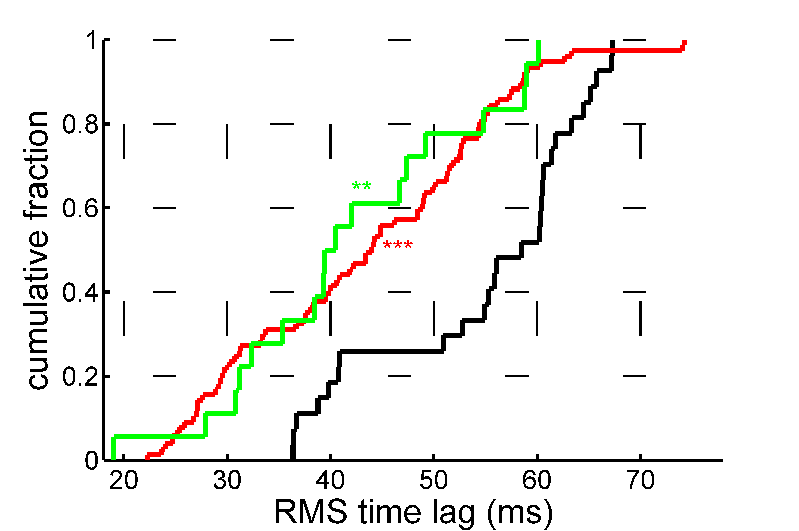
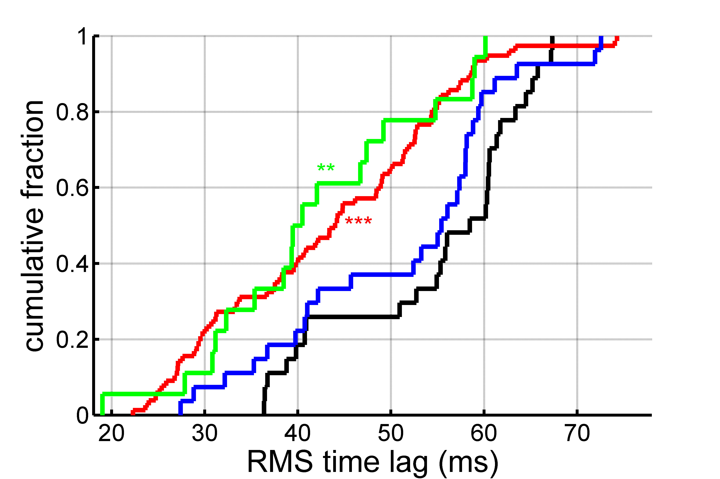
Spike timing during HFE
fam arm
day 1
day 2
day 3
Notes:
[cross-correlation between two cells]
RMS time lags, top: 41ms, bottom: 27ms

Slide 18
Neural activity within HFE during learning is consistent synaptic plasticity rules
What about spatial activity?

Slide 19
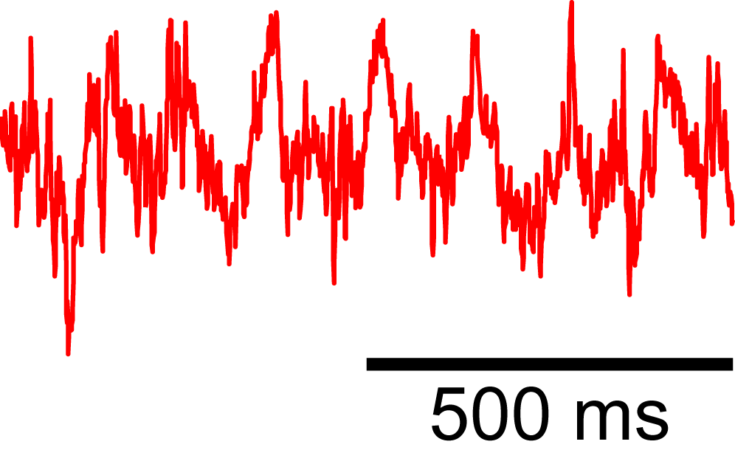
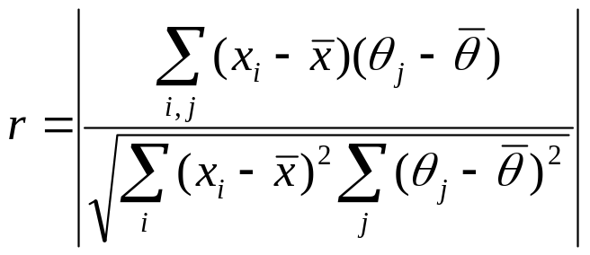
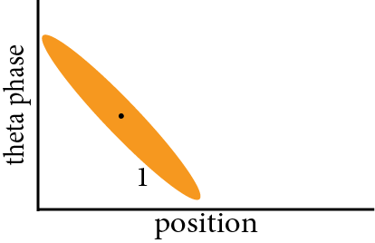
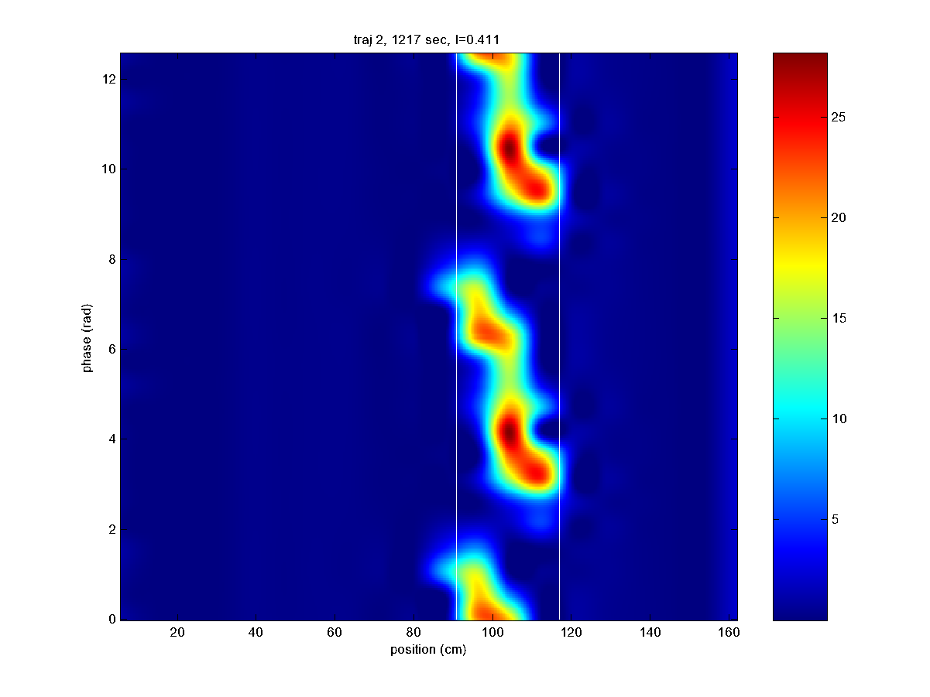
Theta phase precession
~ 8 Hz
running dir
Adaptive filtering (Brown et al., 2001; Frank et al., 2002)
Notes:
[this has been seen in fam./ now we look at novel]

Slide 20
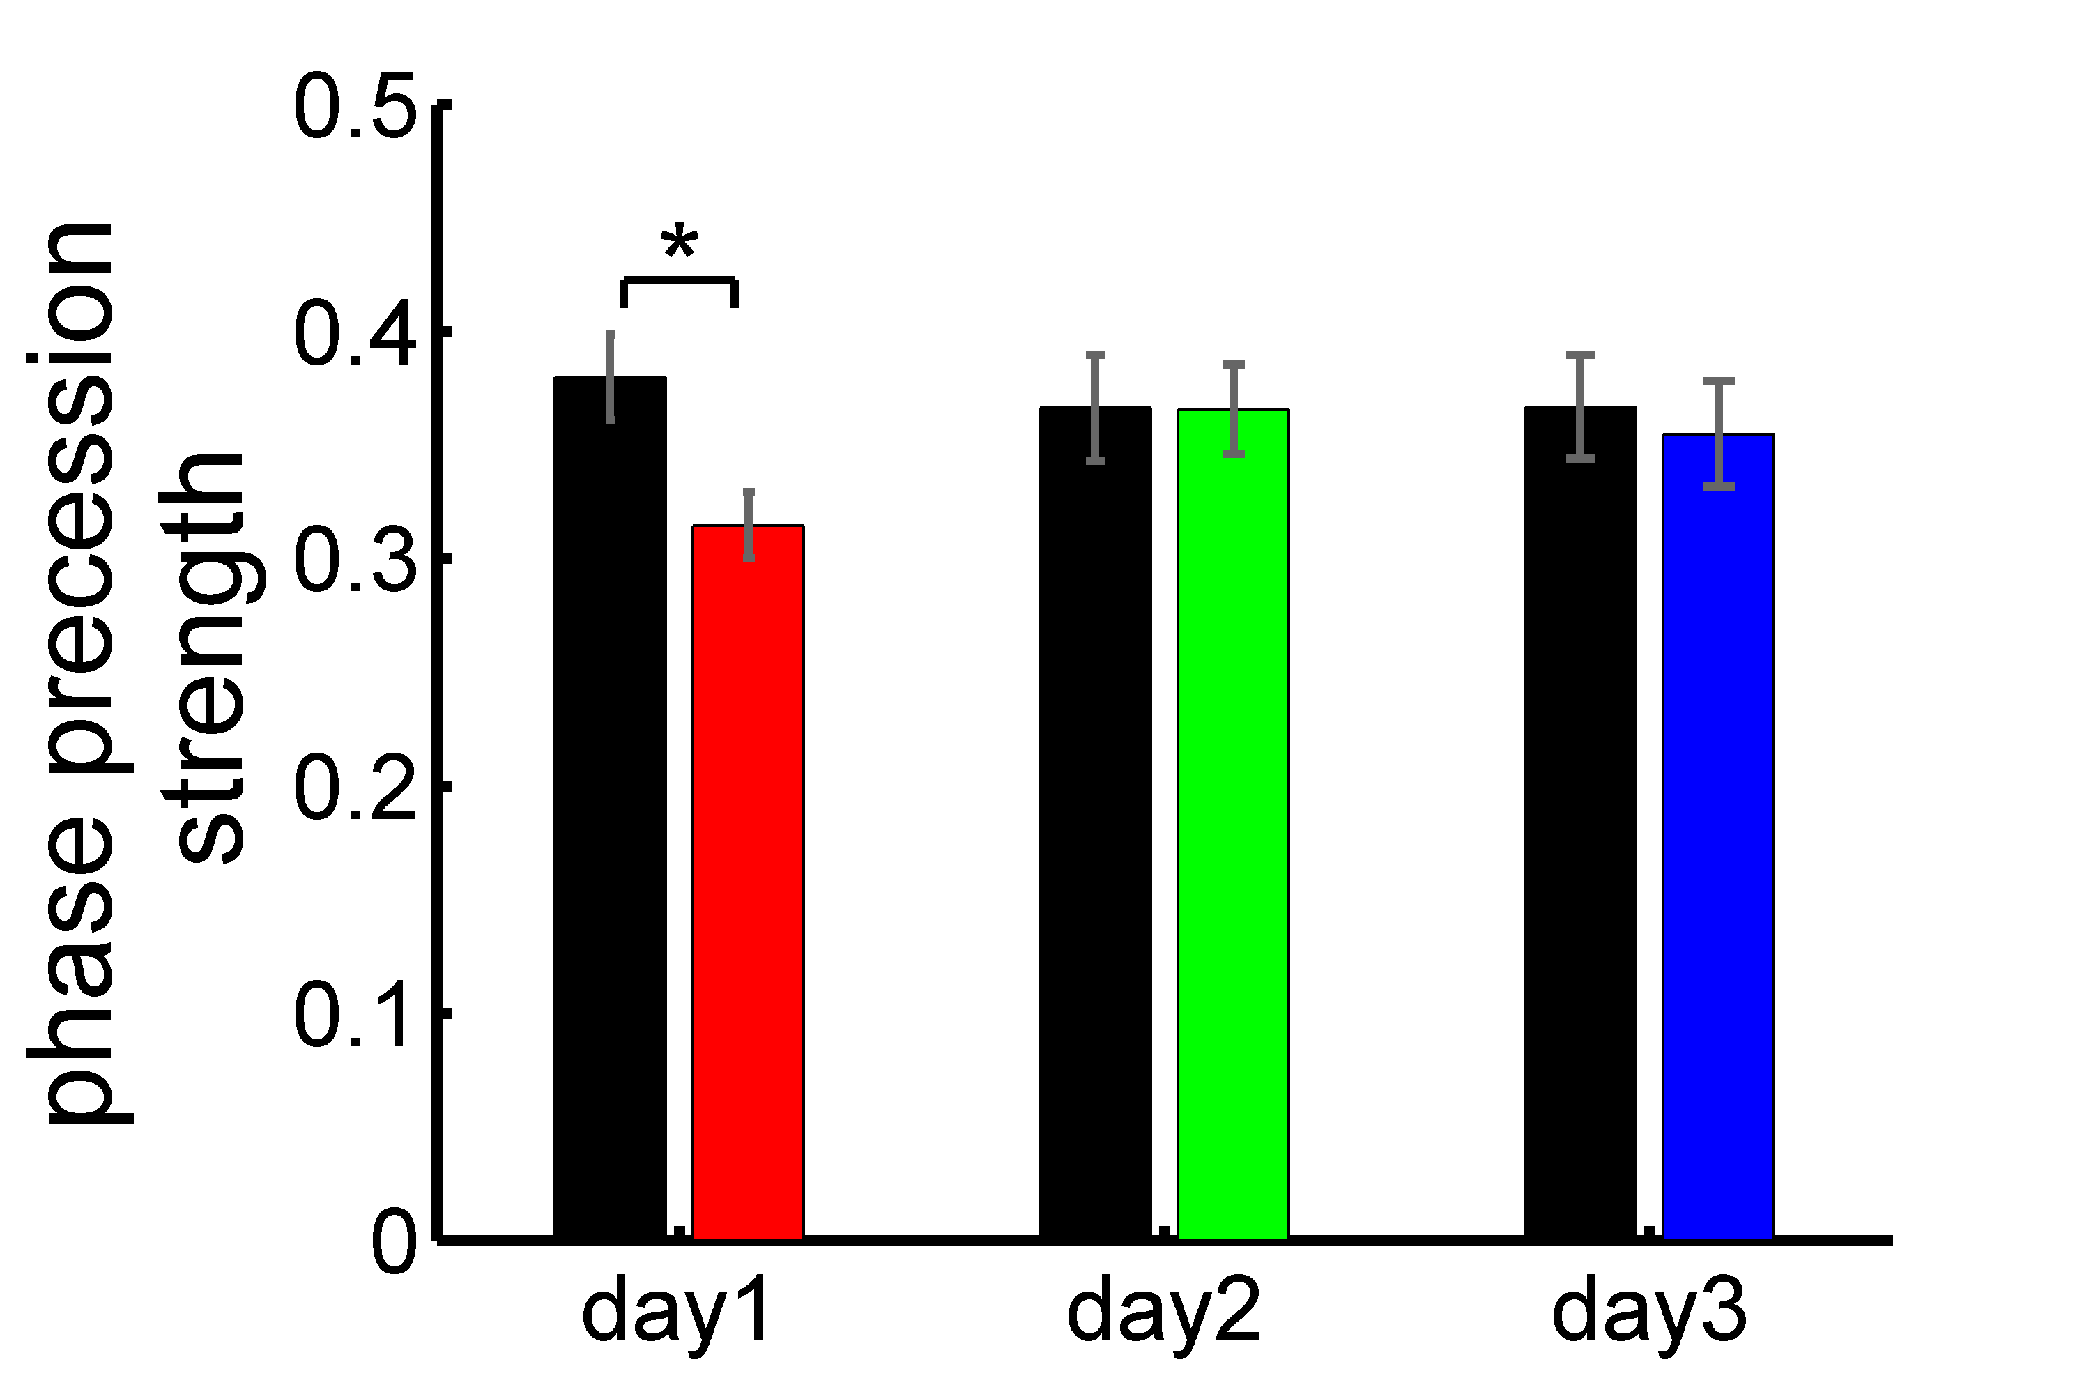
Phase precession in novel and familiar arms

Slide 21
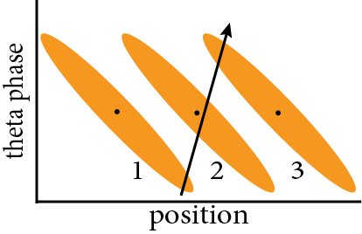
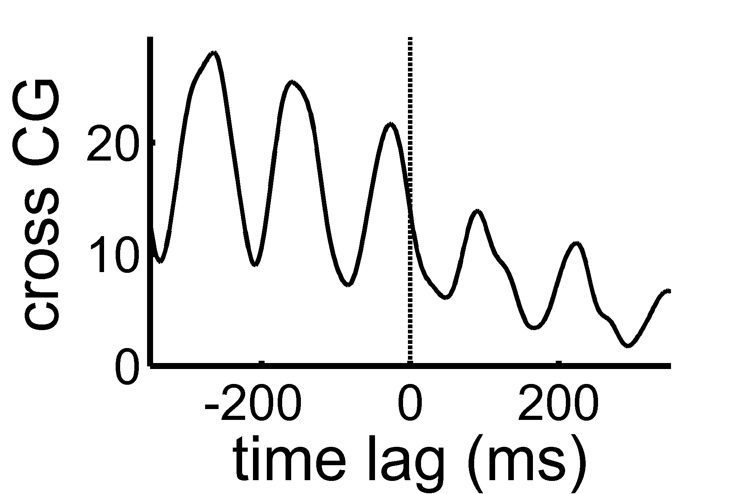
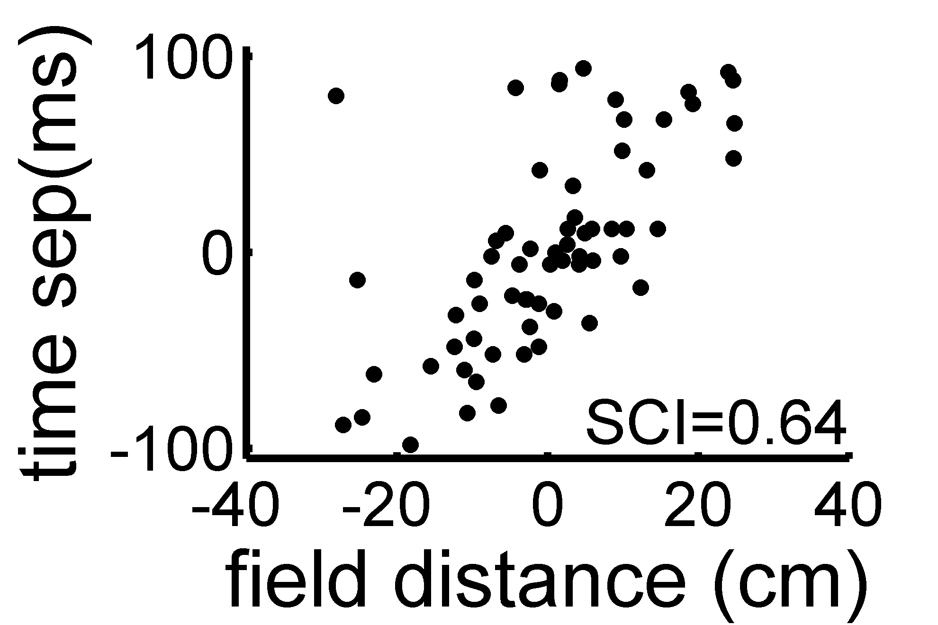
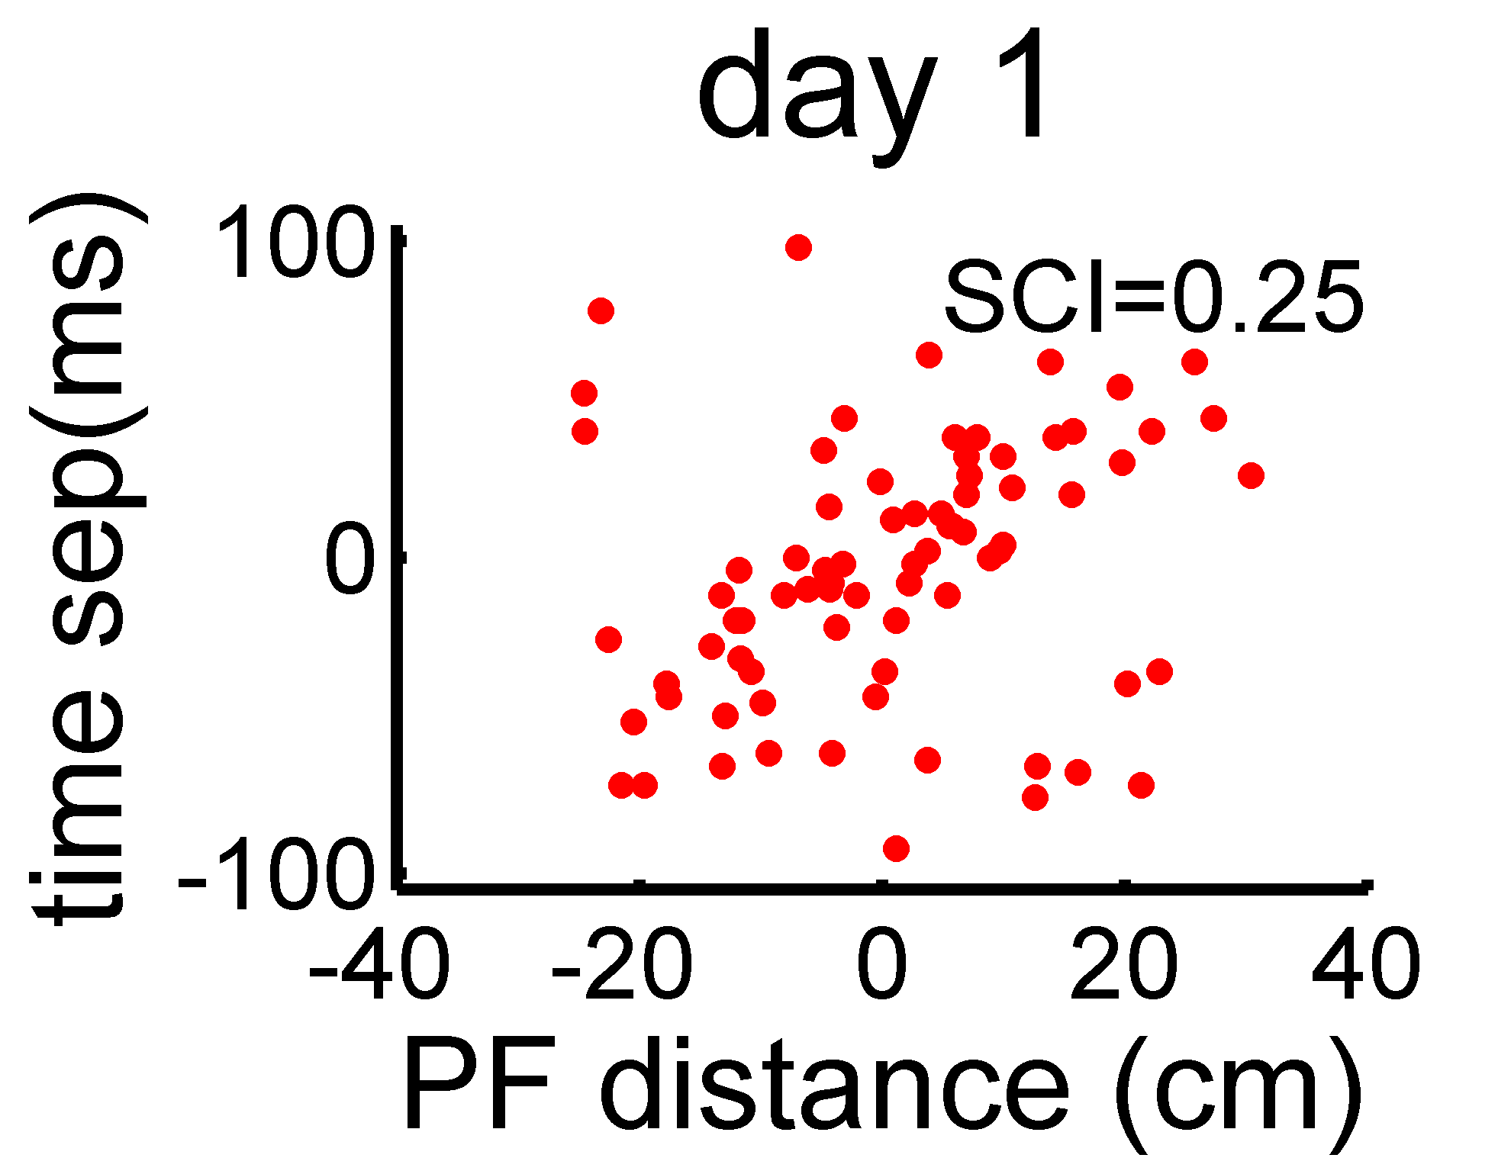
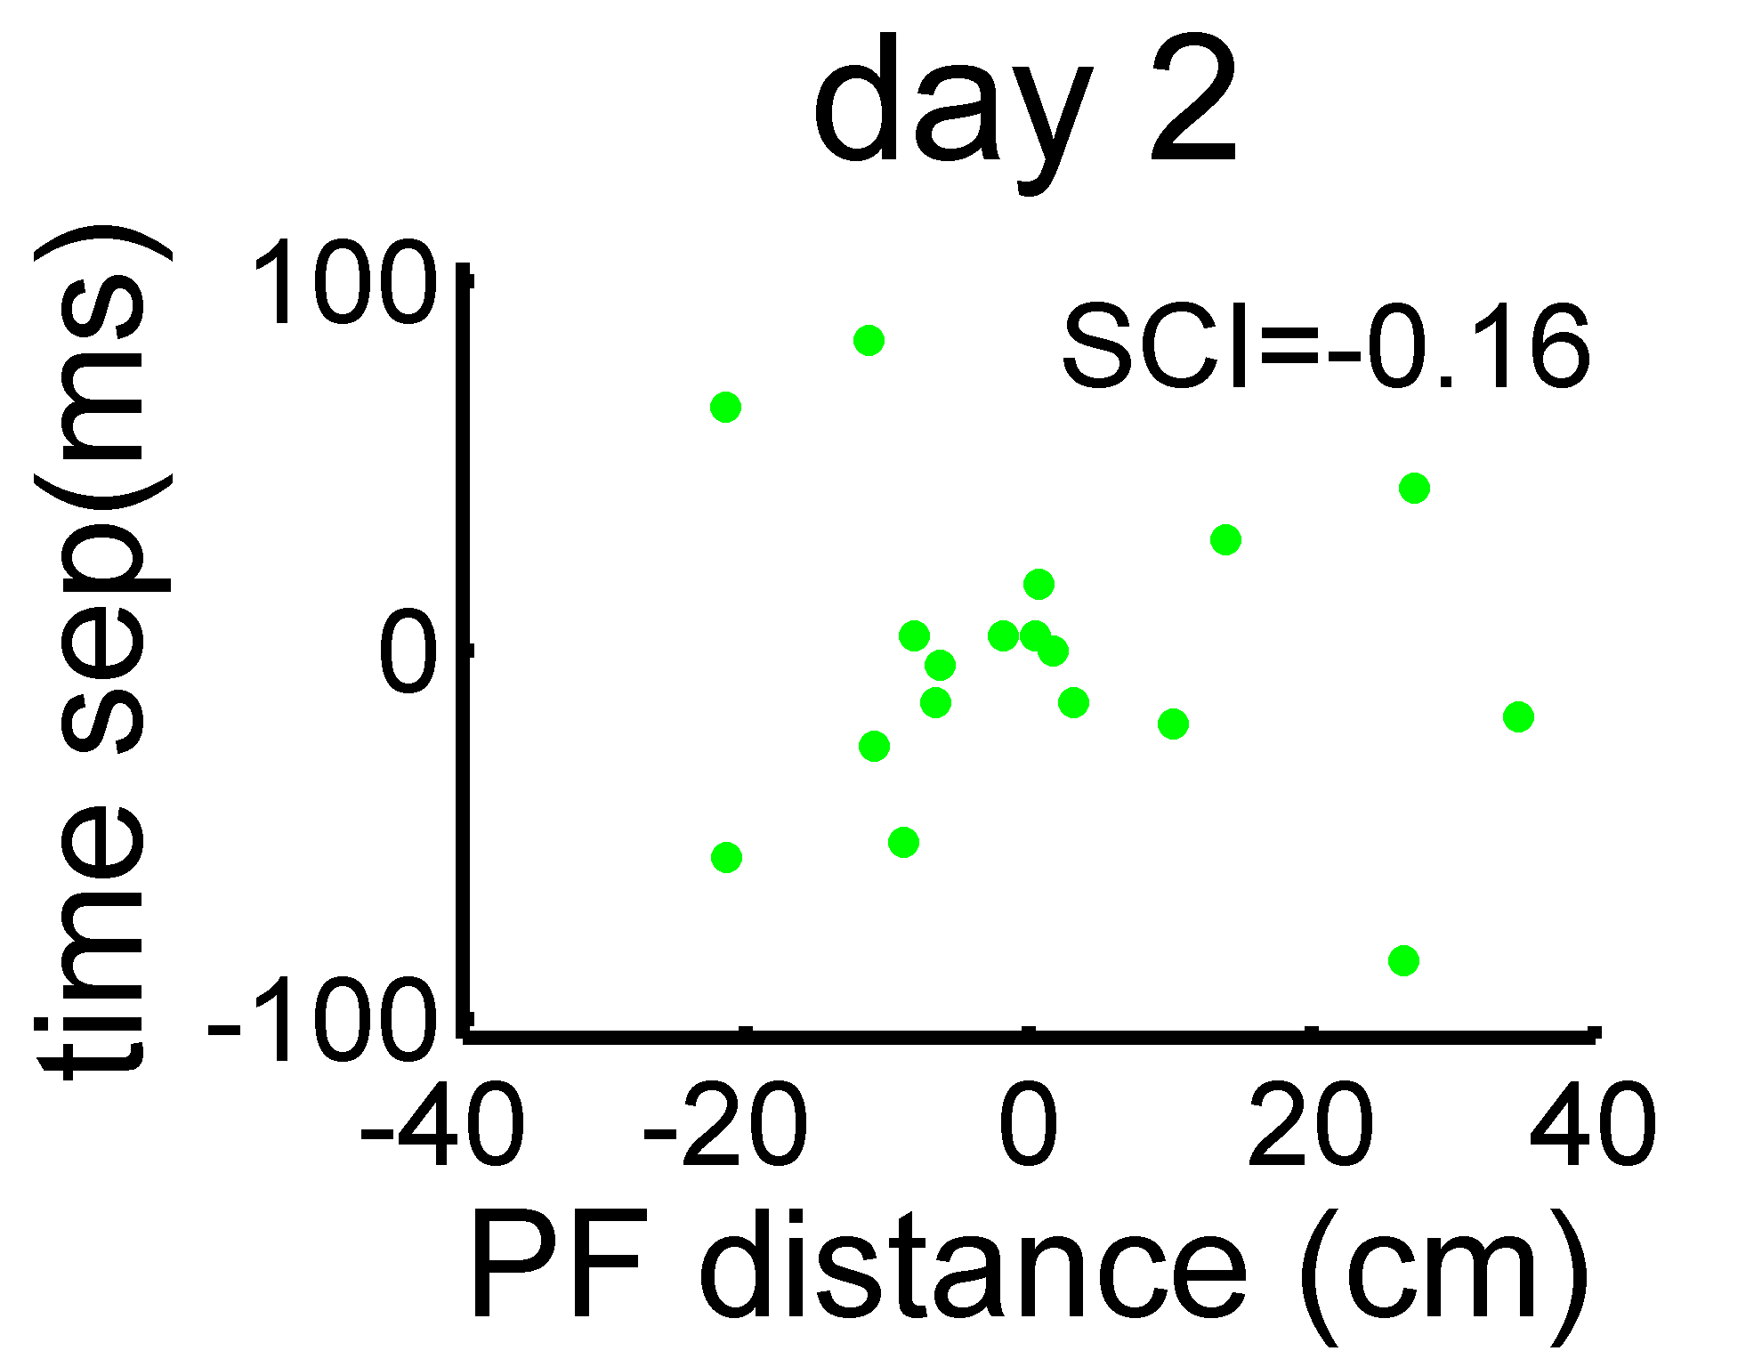
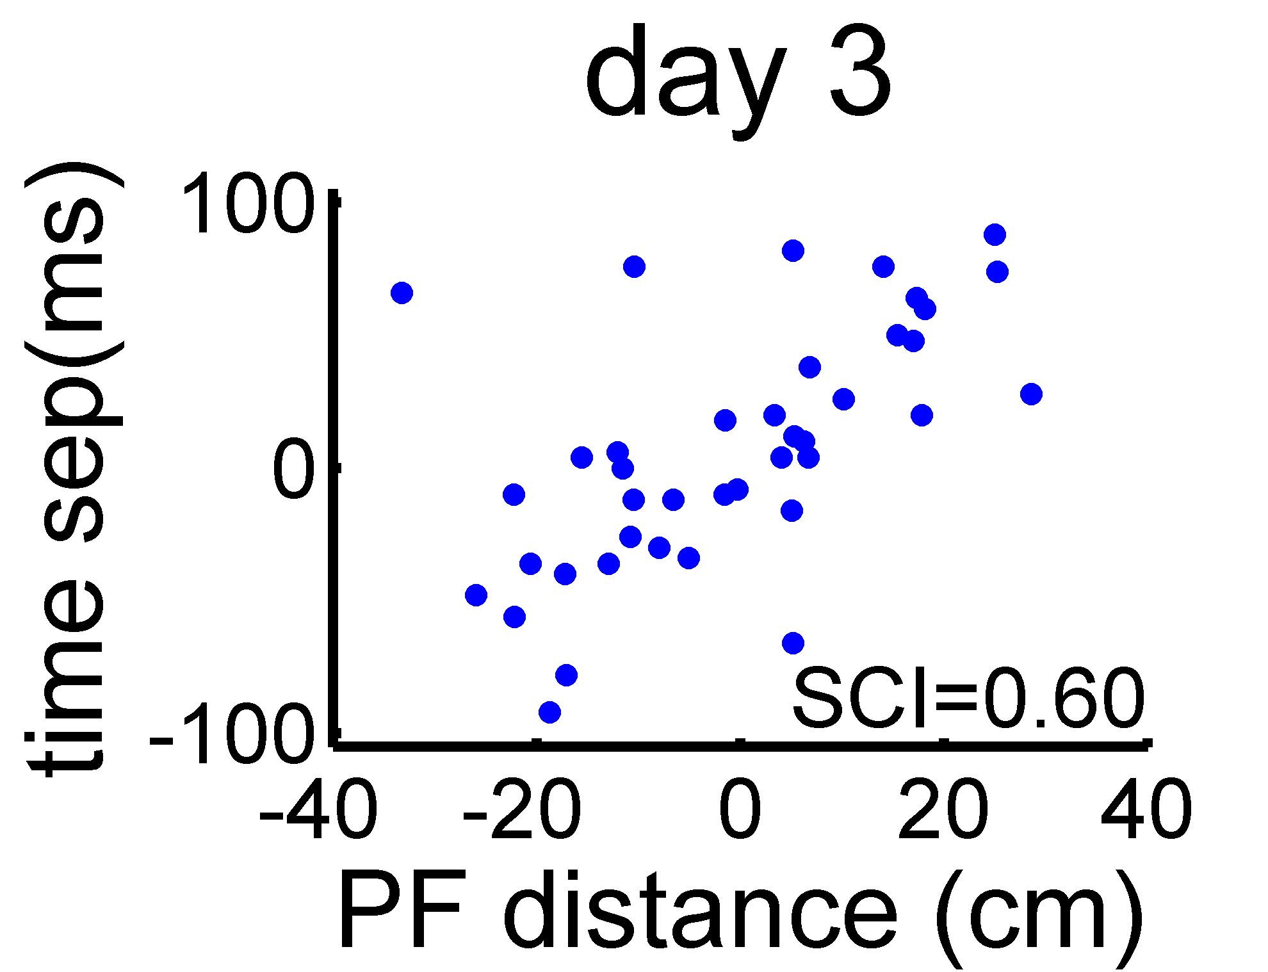
Sequence compression index (SCI)
fam. arm
Notes:
“Follow analysis developed by Dragoi&Buzsaki”
fam arm vs. novel arm: day 1, p = 0.003; day 2, p = 0.001; day 3, p=0.70.

Slide 22
Conclusions
During learning
neural activity is more correlated consistent with synaptic plasticity rules
during HFE spiking is more precisely coordinated
while spatial activity is not

Slide 23
the end

Slide 24
Lab members and collaborators
UCSF
Loren Frank
Margaret Carr
Yuri Dabaghian
Mattias Karlsson
Caleb Kemere
Steven Kim
Ana Nathe
Annabelle Singer
Massachusetts General Hospital
Emery Brown
Uri Eden
Victor Solo
Harvard University
Garrett Stanley
Mark Baxter
Timothy Warren

Slide 25
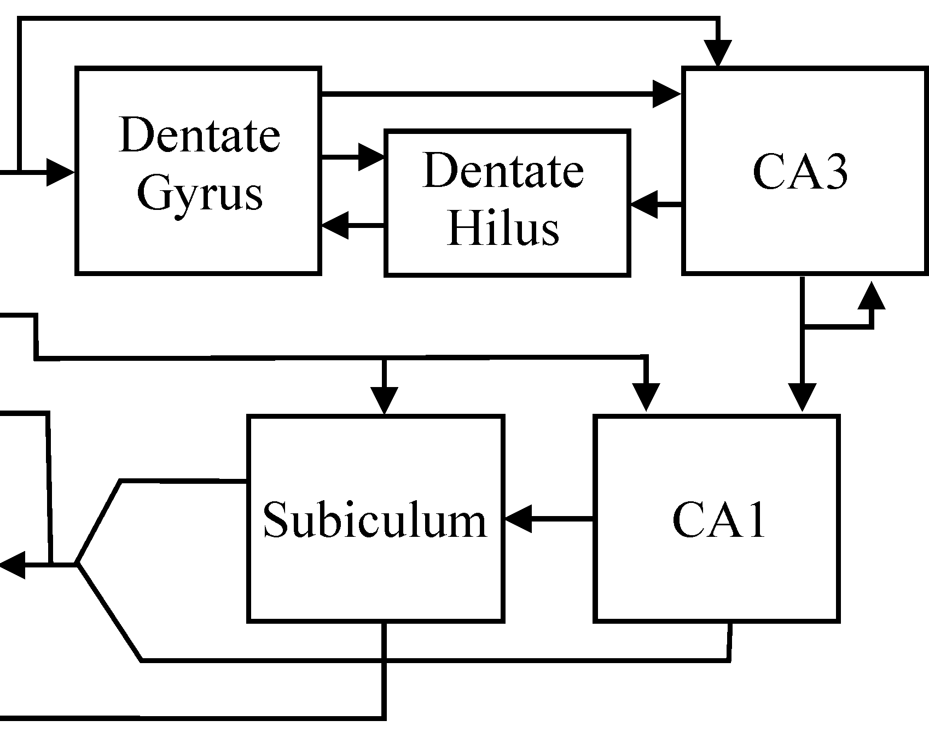
Proposed model
Ripples are initiated in CA3
One-shot learning in CA3 → LTP
Inducing LTP leads to ripples
Spiking during ripples like LTP induction protocol
Ripples drive LTP in CA1 and downstream

Slide 26
Patient HM
H.M.
Control
Surgery in 1953 for intractable epilepsy
(Scoville & Milner, 1957)
Bilateral lesions:
  hippocampus
  entorhinal cortex
  and amygdala
No episodic memory
Corkin et. al. (1997) J. Neurosci.
Notes:
William Scoville, Brenda Milner (1957) Loss of recent memory after bilateral hippocampal lesions. Journal of Neurology, Neurosurgery and Psychiatry, 20, 11–21

Slide 27
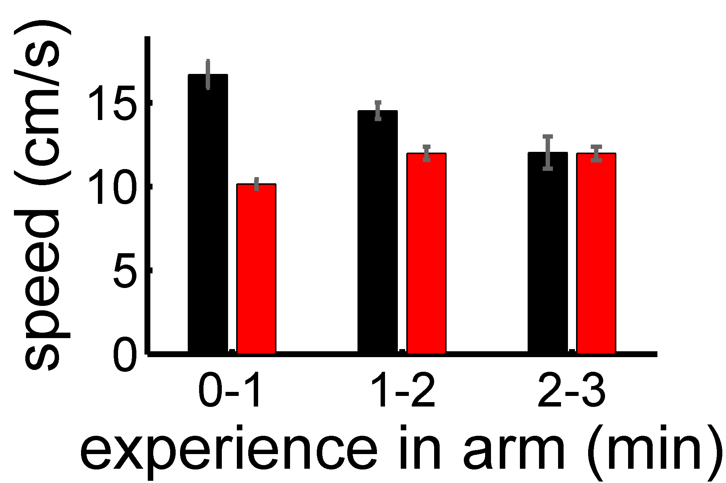
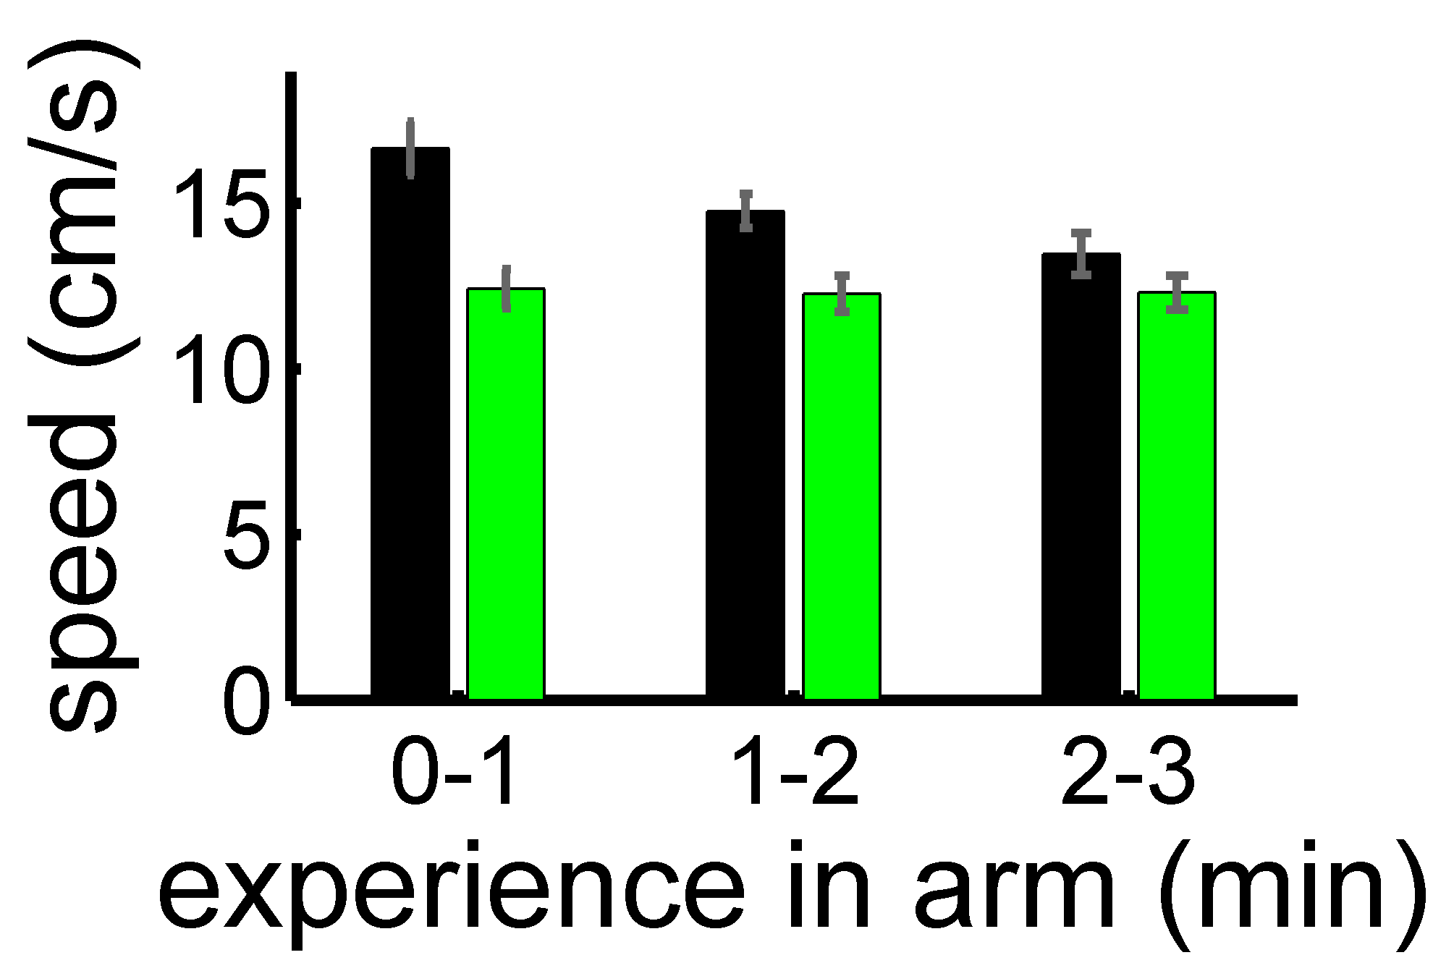
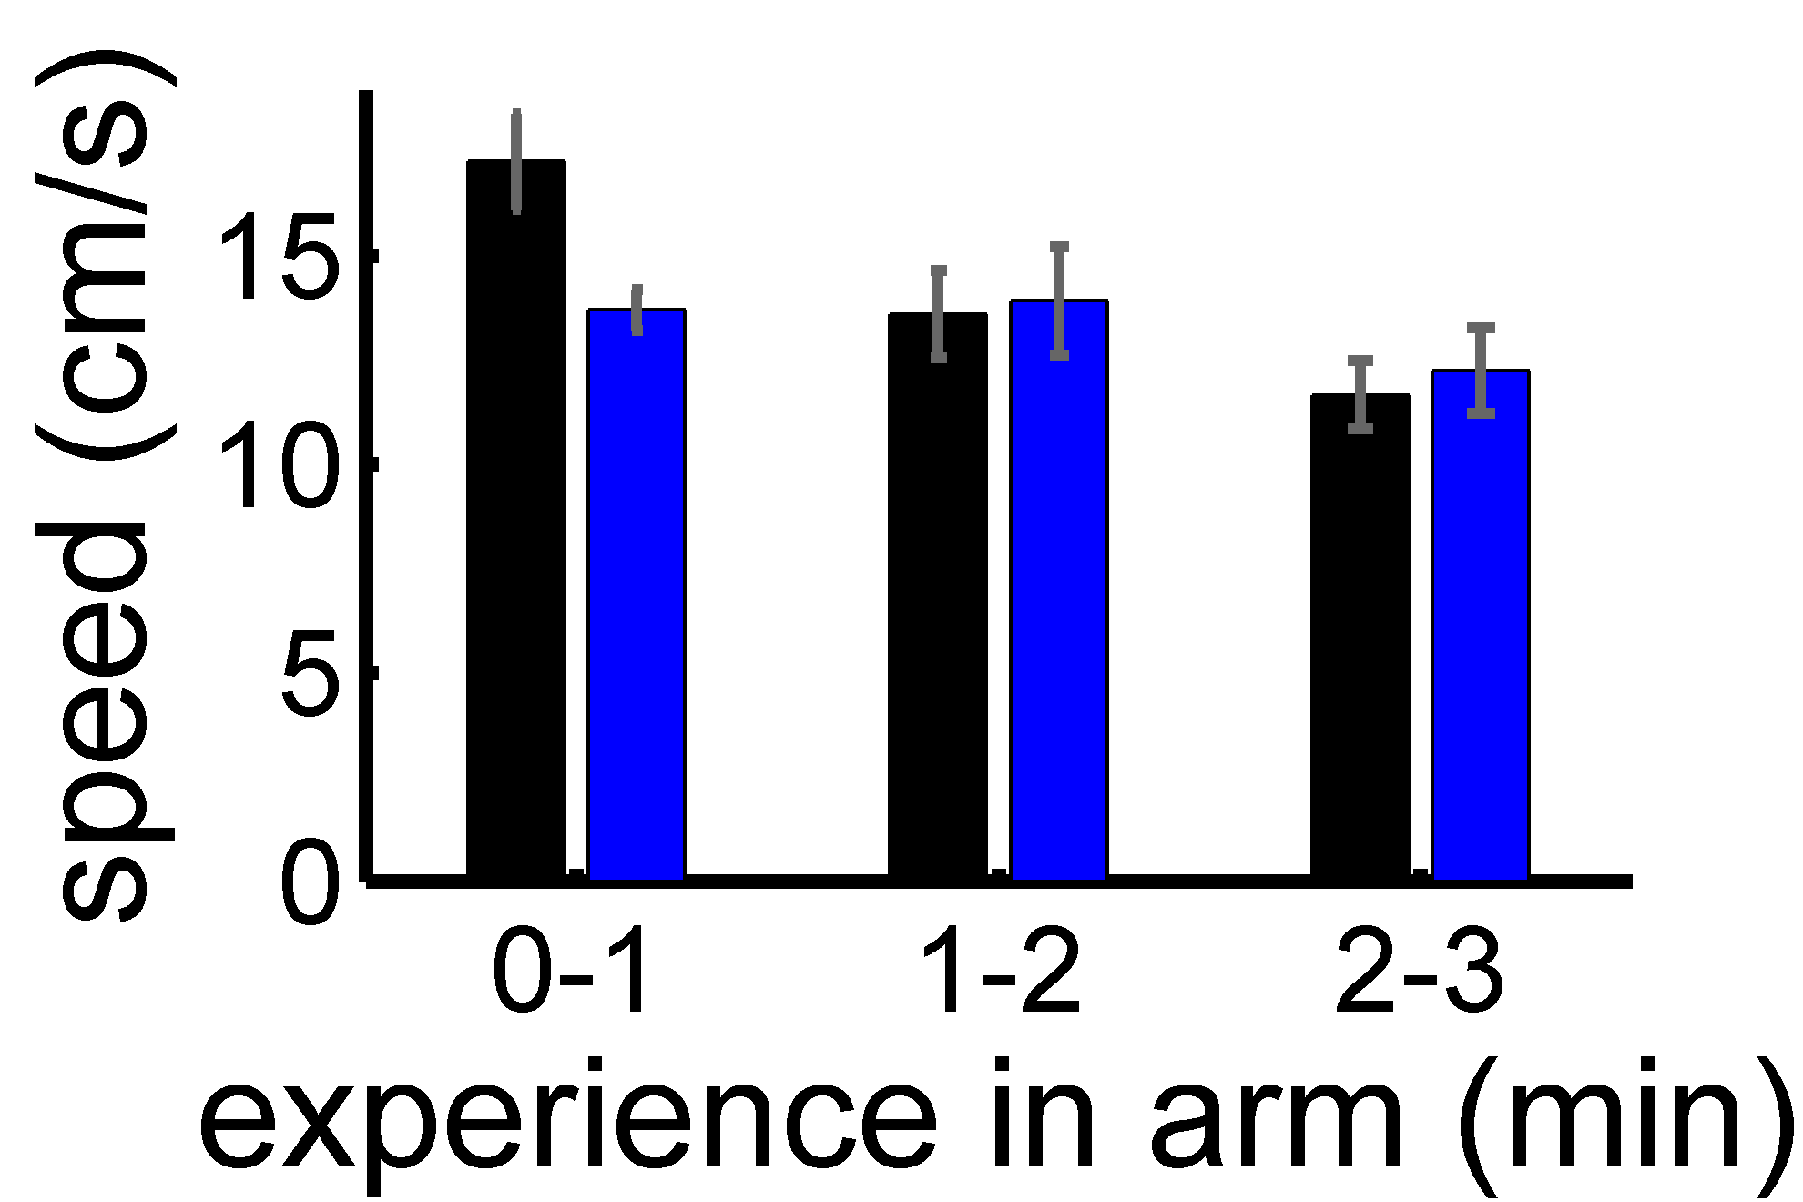
Do animals care? – Different behavior in novel arm
day 1
day 2
day 3
Notes:
explain velocity

Slide 28
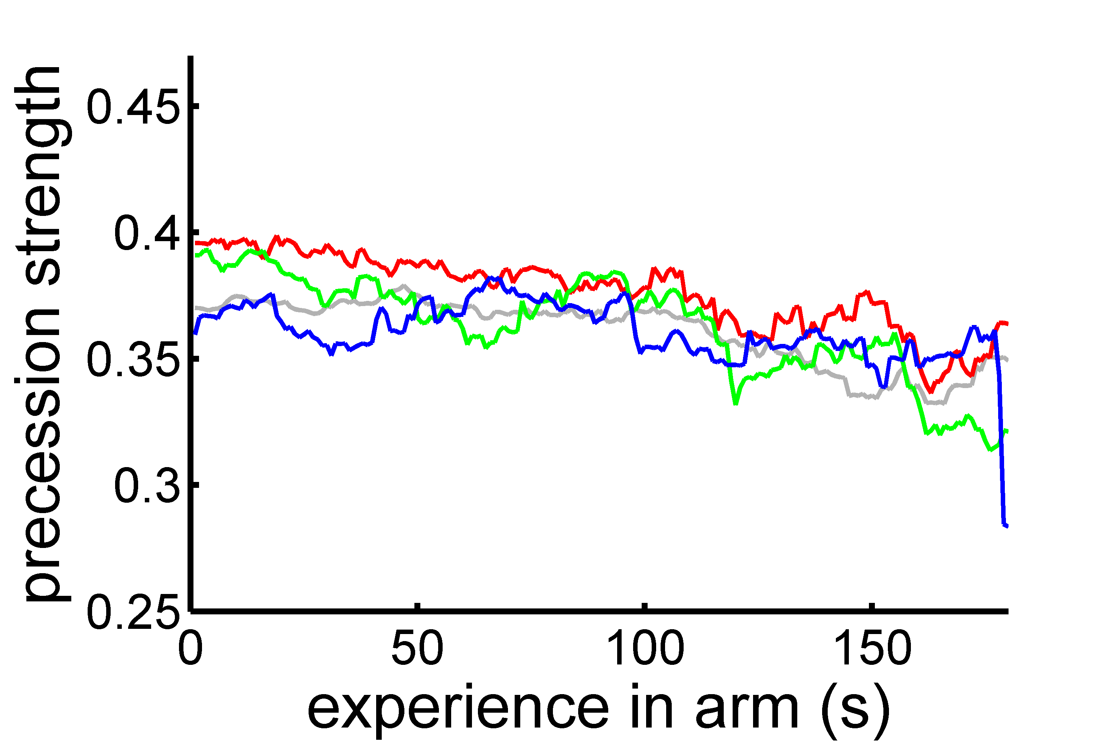
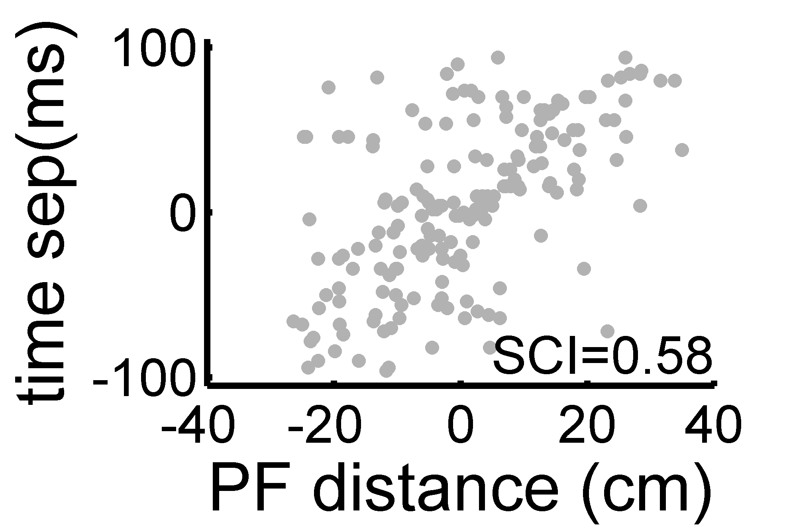
Neural activity in familiar arm remains stable
fam arm, day1
training conf.
novel arm, day1
sequence
compression
training conf.
fam. arm, day 1
fam. arm, day 2
fam. arm, day 3

Slide 29
More examples of CCG with excess correlations

Slide 30
Most HFEs occur during running
 | familiar arm | novel arm
day 1 | 487/621 (78%) | 1310/1555 (84%)
day 2 | 438/544 (81%) | 599/728 (82%)
day3 | 154/182 (85%) | 376/444 (85%)

Slide 31
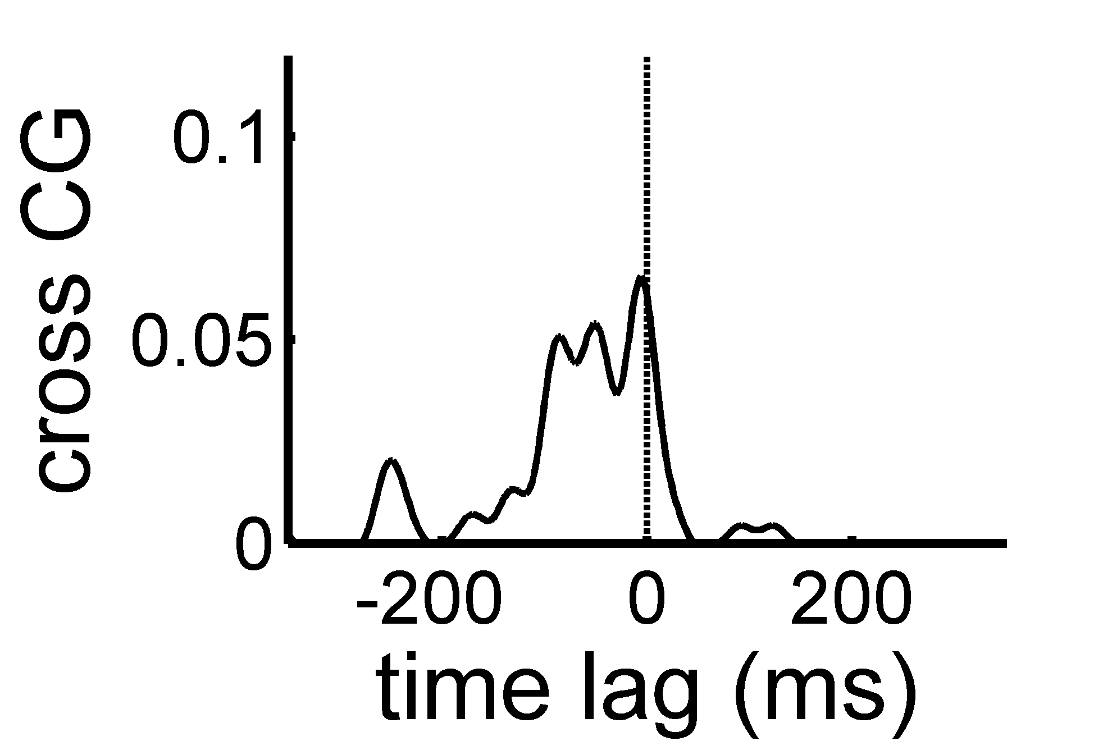
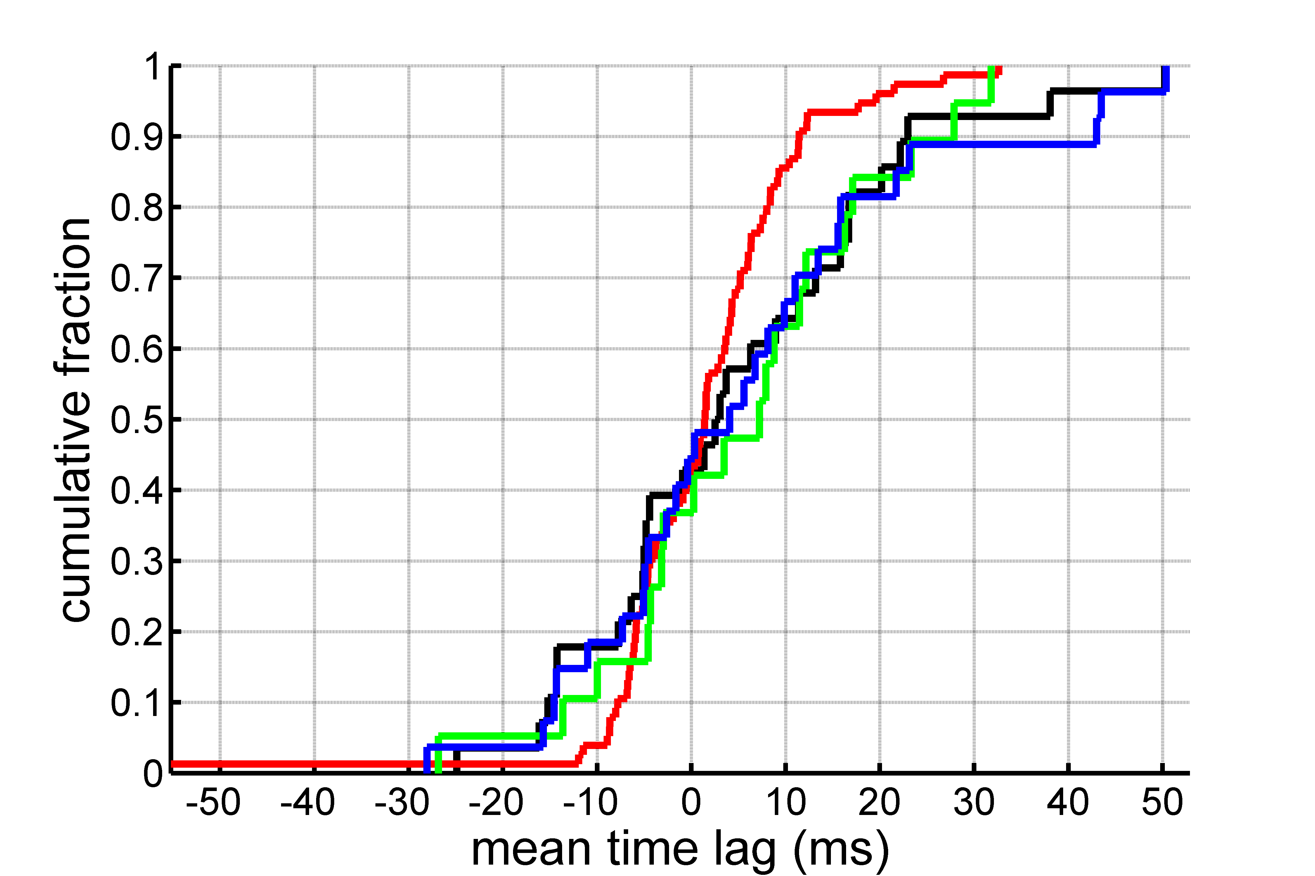
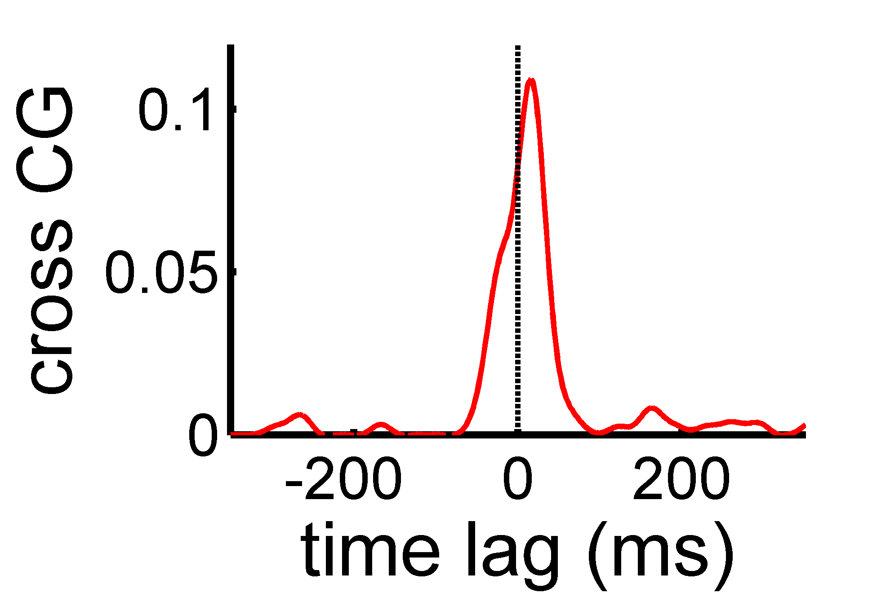
Symmetry of cross correlations during ripples
fam arm
day 1
day 2
day 3
Notes:
def mean CCG: +/- 100ms
none are significantly asymmetric

Slide 32
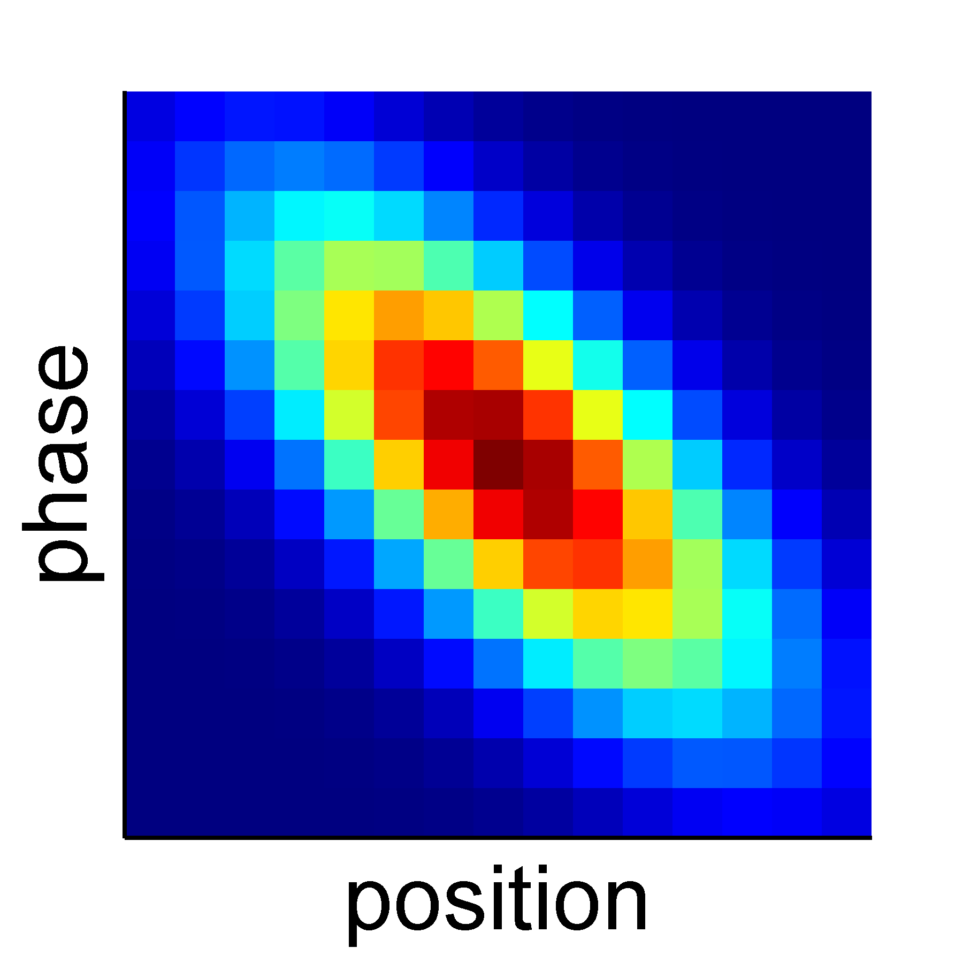
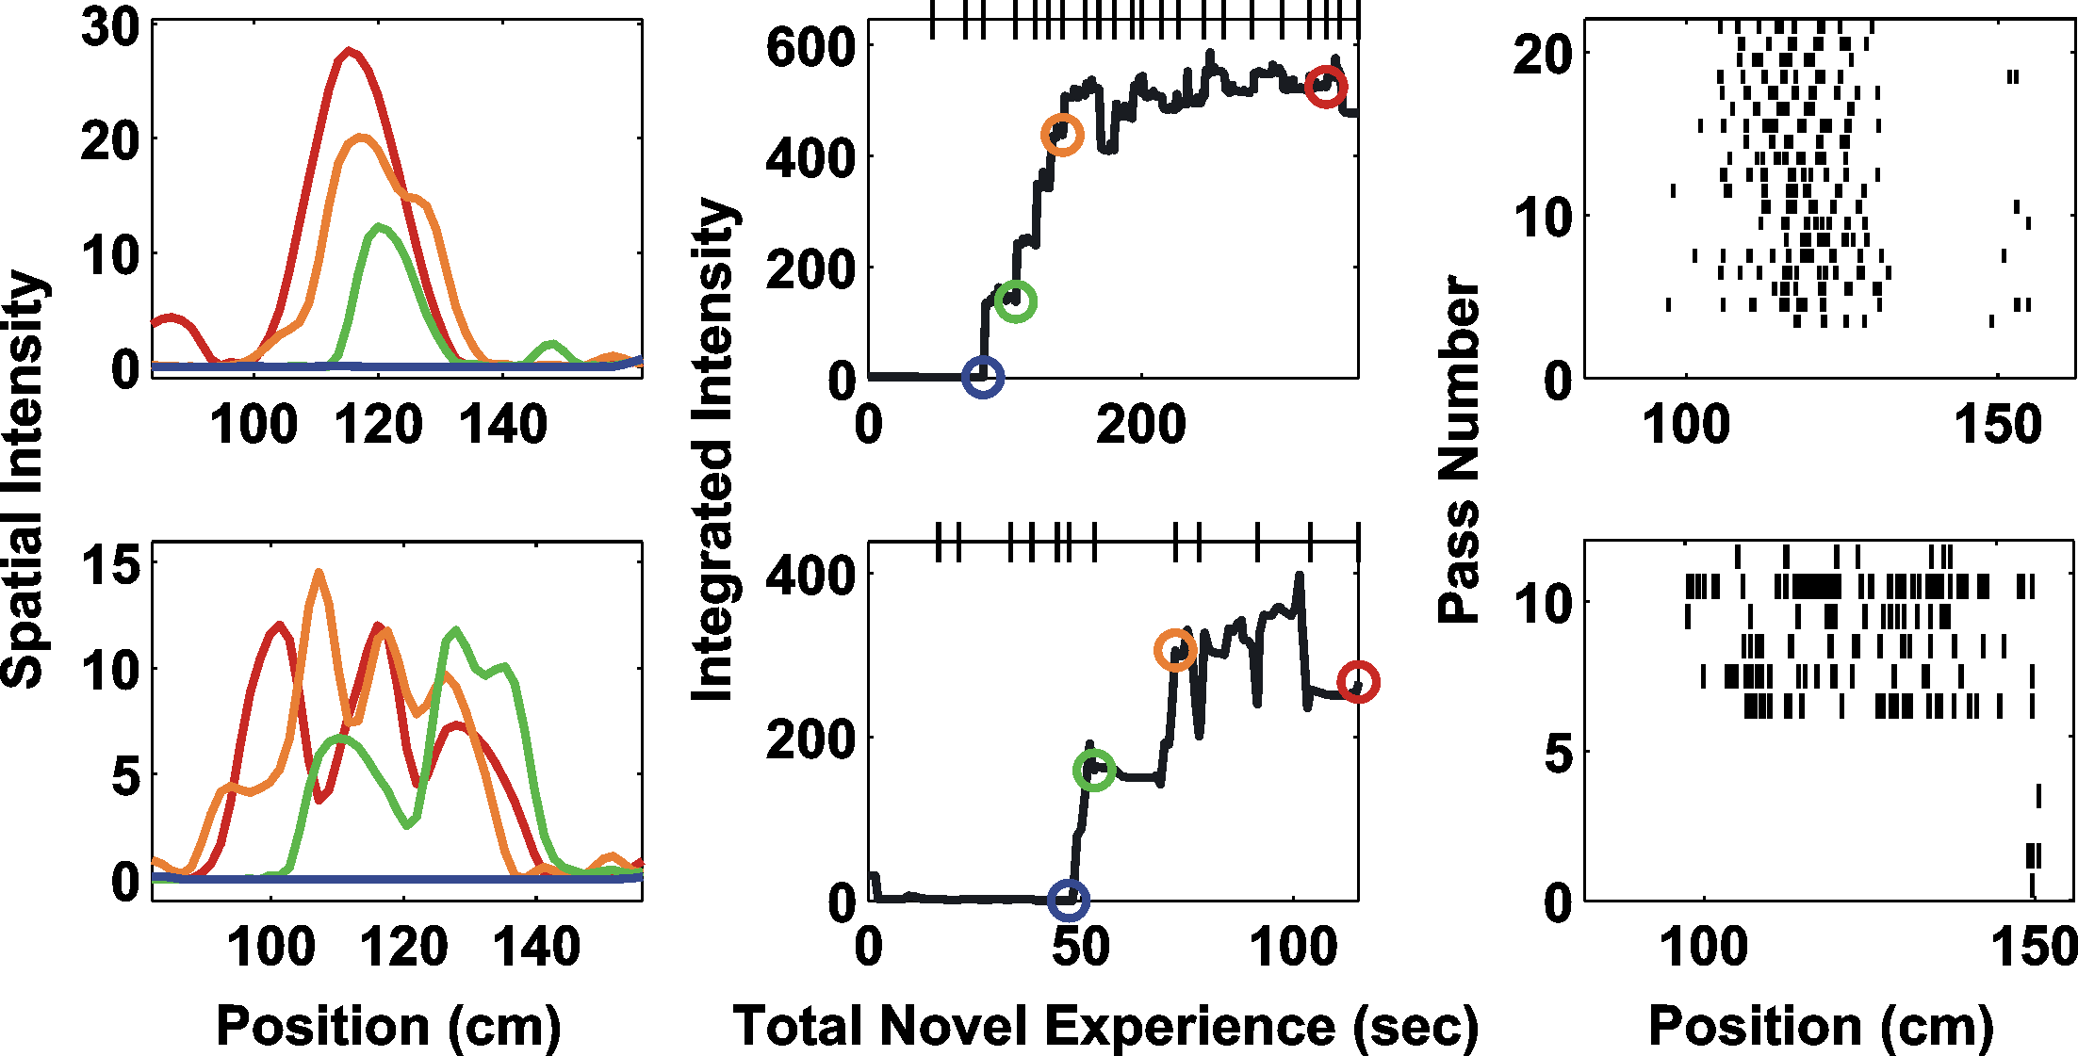
Histogram cannot resolve dynamics
traditional histogram method cannot track dynamics here
plasticity is very rapid (on the order of a few passes)
variability across neurons is high
interspike interval structure (e.g. bursts)
Notes:
Need: moment-by-moment estimate of phase precession for single neurons

Slide 33
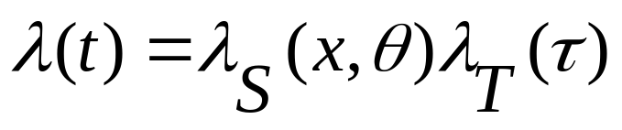
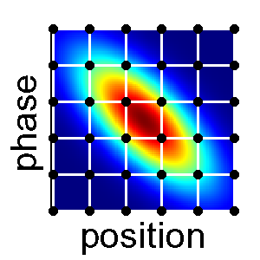
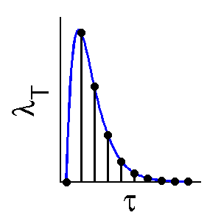

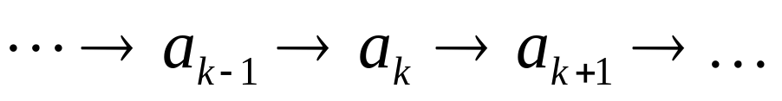
Adaptive filtering
Brown et al. (2001), Frank et al. (2002)
Spiking model:
functions are parametrized by cardinal splines with parameters
Dynamics model:
Adaptive Filter:

Slide 34
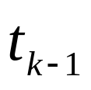

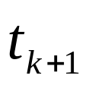
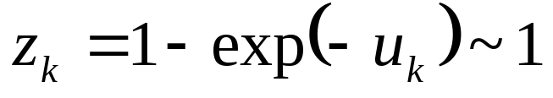
Goodness-of-fit – Time rescaling
Brown et al., Neural Comp (2002)
Kolmogorov-Smirnov plot
| | | | | |
 | 99%-CI
session 1 (n=185) | 131 (71%)
session 2 (n=191) | 104 (55%)

Slide 35
theta phase (rad)
distance (cm)
Notes:
activity of single cell!
ter_8_4_25_4_nr_xp6_t005
[finish explaining before starting the movie]

Slide 36
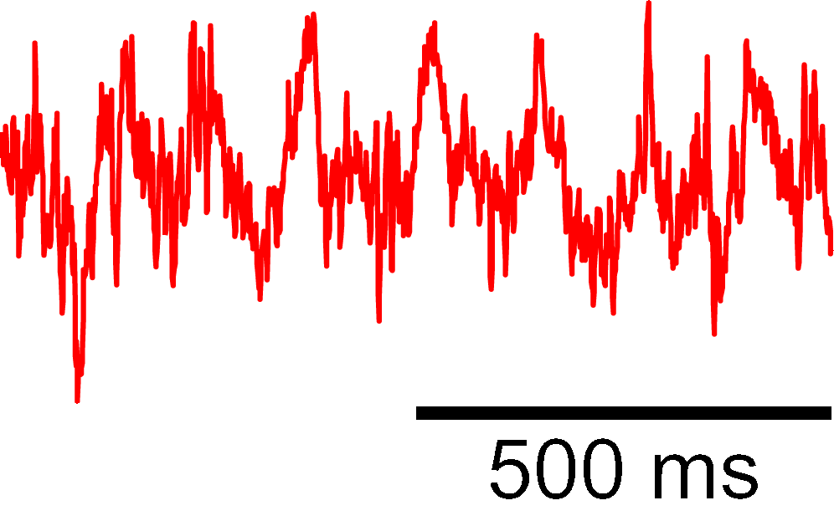
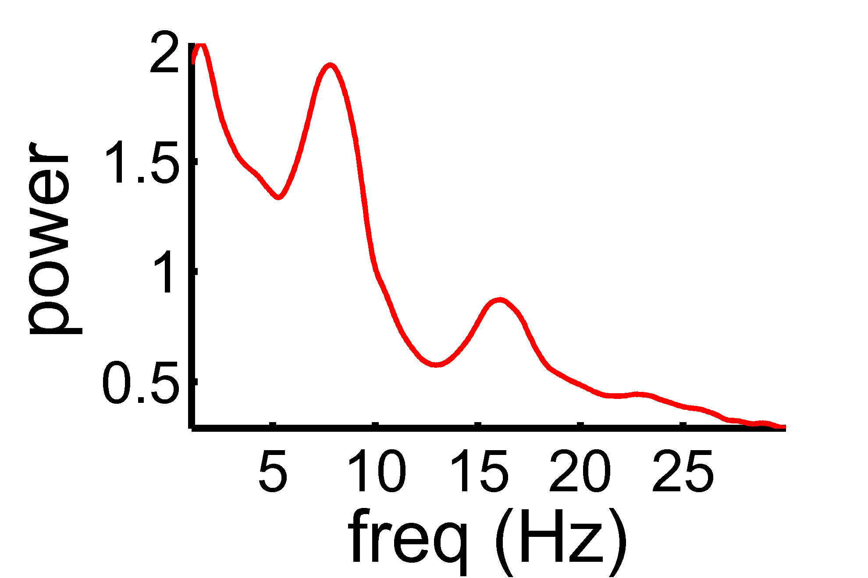


Theta oscillations in novel environment
day 1
day 2
day 3

Slide 37
Lower power is not cause of precession difference
fam arm | novel arm
p= 0.49 | p= 0.024, r²= 0.079
Notes:
no relation in fam arm, weak in novel arm

Slide 38
Normal theta modulation of auto-correlations
day 1
day 2
day 3

Slide 39
Normal theta modulation of cross-correlations
day 1
day 2
day 3

Slide 40
Place field dynamics in novel environments
Frank et al., J Neurosci (2004)

Slide 41
Place field plasticity across days - Novel arm
Plasticity on day 2 depends on the amount of experience on day 1.

Slide 42
Dynamics of place field properties
Spatial Measures
Temporal Measures

Slide 43
Inhibitory activity

Slide 44

Inhibitory activity – Summary
Inhibitory changes also follow a three day time course.

