Slide 1

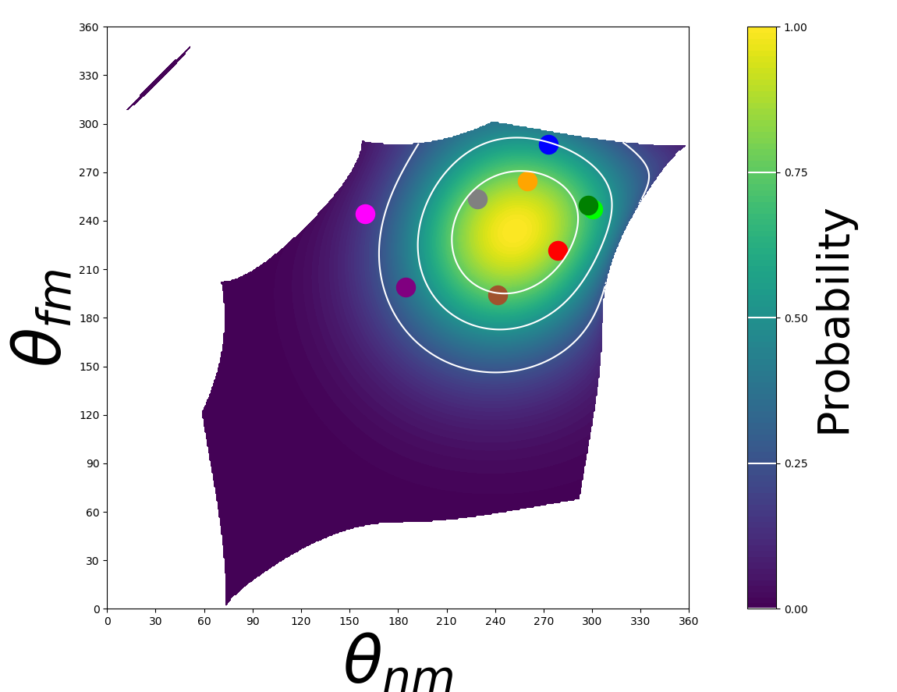
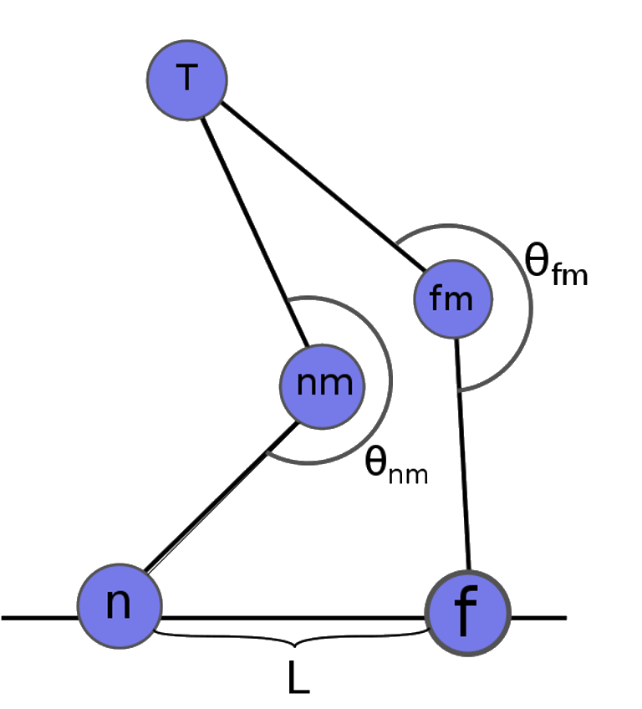
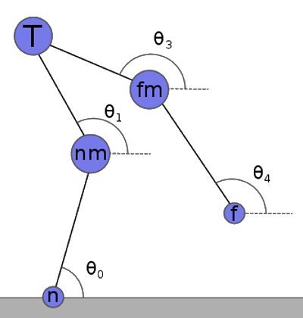
Simulating the Walk of the Dynein Motor Protein
Jin Kiatvongcharoen, John Waczak, Eliott Capek, and David Roundy
Department of Physics, Oregon State University, Corvallis, OR 97331
Dynein
Simulation
Both Bound Monte-Carlo (MC)
Dynein is one of the three motor proteins that are responsible for the cell’s ability to move, divide, and spatially organize itself. They walk with cellular cargo along protein highways (microtubules) in order to convert the cargo’s ATP into mechanical work.
However, it walks drunk. Its two feet can act independently from each other causing erratic steps that vary in distances, directions and time.
We simulate the both bound state with Monte-Carlo (MC) methods by using repeated random sampling of dynein configurations to generate a distribution of probabilities for the dynein to unbind.
Randomly pick
a set of
motor angles
Unbinding Probability Distribution
Goal
Calculate
total energy
of the system
Our goal is to explore the mechanical nature of dynein and simulate its walk with a simple 2-D model. Being able to predict its motion will be advantageous for medical research and beyond.
Model
Determine
probability
of unbinding
We model dynein as a point-particle system with five spherical domains that are held together by massless rigid-rods. The domains are the tail domain, the two motor domains, and the two binding domains. We separate dynein into two states: both bound and one bound.
Start one bound
simulation if
unbinding is
successful
One Bound Brownian
Future Work
We simulate the one bound state using Brownian dynamics, in which the domains randomly interact with molecules to cause diffusion within the system. This leads to chaotic motion in the leg until the binding probability is high enough for it to land.
Improve and simplify one bound simulation
Analyze error in MC and compare it to older simulations
Compare results to experimental data and further refine model
Collect data
and
make statistics
References:
^{[1]} Hirokawa, N., et al. (1998). Kinesin and Dynein Superfamily Proteins and the Mechanism of Organelle Transport. Science. 279
^{[2]} Carter, A.P., et al. (2013). Crystal clear insights into how the dynein motor moves. Journal of Cell Science. 126

Slide 2
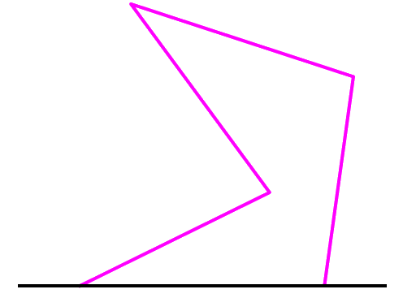
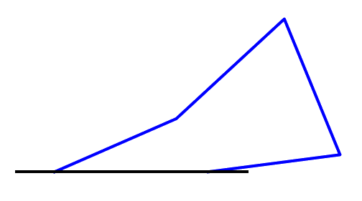
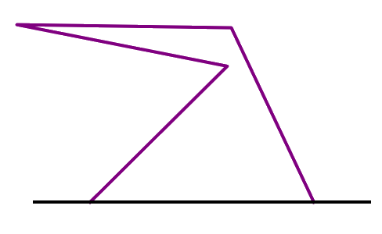
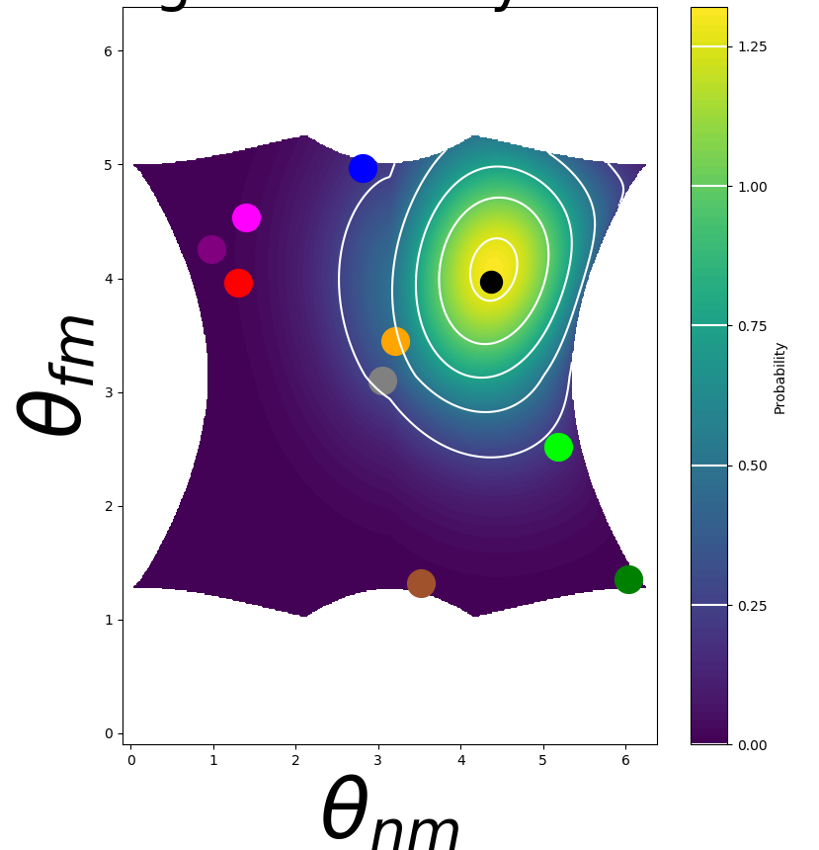
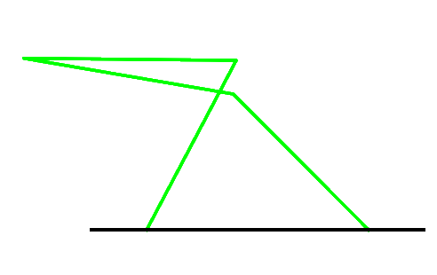
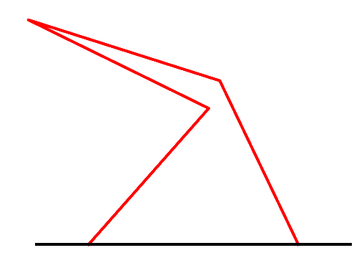
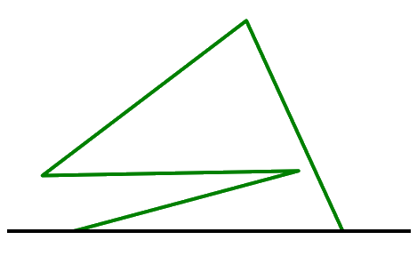
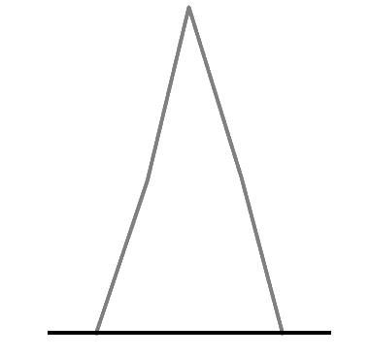
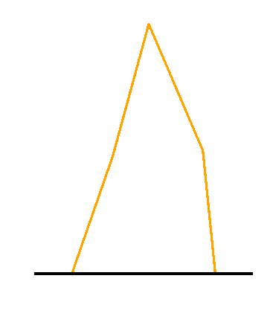
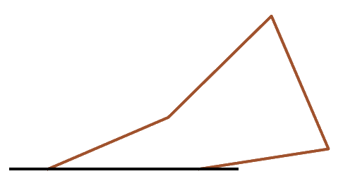
Simulating the Walk of the Dynein Motor Protein
Jin Kiatvongcharoen, John Waczak, Eliott Capek, and David Roundy
Dynein
Simulation
Both Bound Monte-Carlo (MC)
Dynein is one of the three motor proteins that are responsible for the cell’s ability to move, divide, and spatially organize itself. They walk with cellular cargo along protein highways (microtubules) in order to convert the cargo’s ATP into mechanical work.
However, it walks drunk. Its two feet can act independently from each other causing erratic steps that vary in distances, directions and time.
We simulate the both bound state with Monte-Carlo (MC) methods by using repeated random sampling of dynein configurations to generate a distribution of probabilities for the dynein to unbind.
Randomly pick
a set of
motor angles
Unbinding Probability Distribution
Calculate
total energy
of the system
Goal
Our goal is to explore the mechanical nature of dynein and simulate its walk with a simple model.
Model
Determine
probability
of unbinding
We model dynein as a point-particle system with five spherical domains that are held together by massless rigid-rods. The domains are the tail domain, the two motor domains, and the two binding domains. We separate dynein into two states: both bound and one bound.
Start one bound
simulation if
unbinding is
successful
One Bound Brownian
Future Work
We simulate the one bound state using Brownian dynamics, in which the domains randomly interact with molecules to cause diffusion within the system. This leads to chaotic motion in the leg until the binding probability tells it to land.
Improve and simplify one bound simulation
Analyze error in MC and compare it to older simulations
Compare results to experimental data and further refine model
Collect data
and
make statistics

Slide 3
Simulating the Walk of the Dynein Motor Protein
Jin Kiatvongcharoen, John Waczak, Eliott Capek, and David Roundy
Oregon State University
Dynein
Monte Carlo (MC) Method
Dynein is one of the three motor proteins that are responsible for the cell’s ability to move, divide, and spatially organize itself. They walk with cellular cargo along protein highways (microtubules) in order to convert the cargo’s ATP into mechanical work.
However, it walks drunk. Its two feet can act independently from each other causing erratic steps that vary in distances, directions and time.
Monte-Carlo (MC) methods uses repeated random sampling of configurations to output a distribution of results depending on their probability of happening.
Randomly pick
a set of
motor angles
Calculate
total energy
of the system
Determine
probability
of unbinding
Start one bound
simulation if
unbinding is
successful
Collect data
and
make statistics
Goal
Unbinding Probability Distribution
One Bound Brownian
Our goal is to explore the mechanical nature of dynein and simulate its walk with a simple model.
We simulate the one bound state using Brownian dynamics, in which the domains randomly interact with molecules to cause diffusion within the system. This leads to chaotic motion in the leg until the binding probability tells it to land.
Model and Simulation
We model dynein as a point-particle system with five spherical domains that are held together by massless rigid-rods. There are the tail domain, two motor domains, and two binding domains. We separate dynein into two states: both bound and one bound.
Future Work
Improve and simplify one bound simulation
Analyze error in MC and compare it to older simulations
Compare results to experimental data and further refine model

