Slide 1
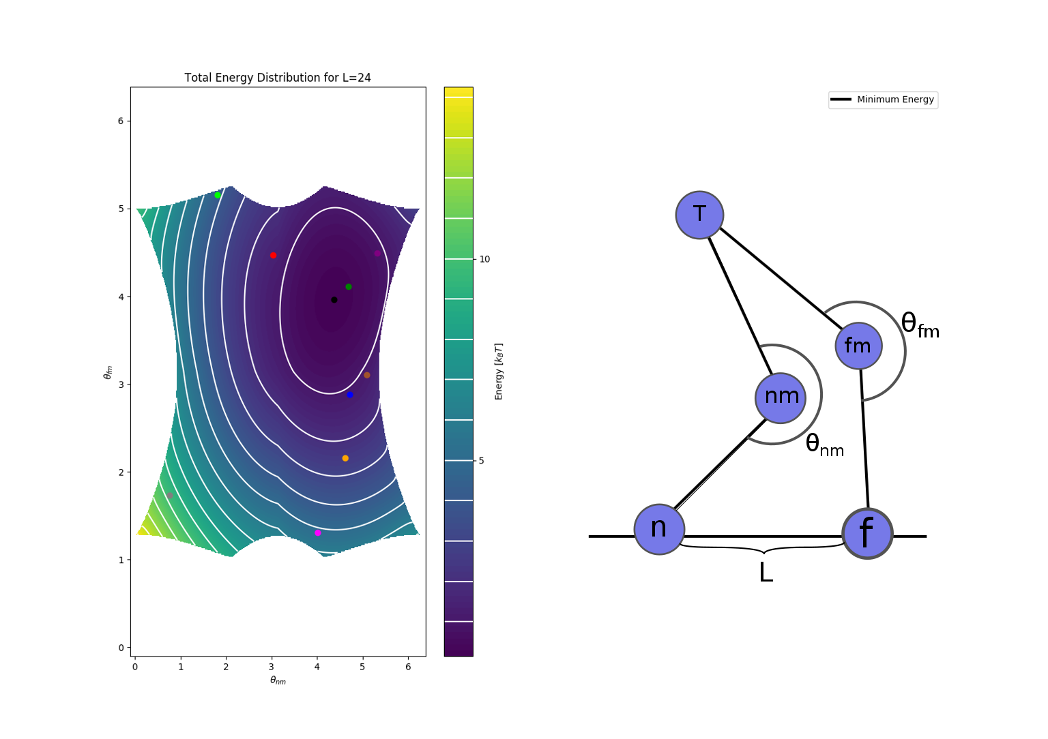
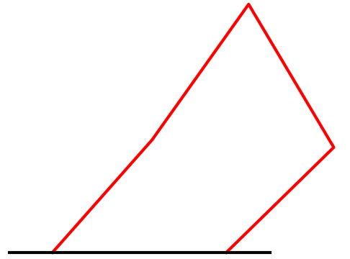
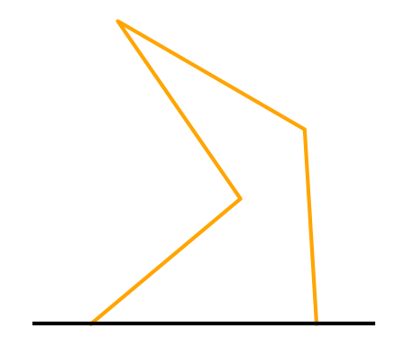
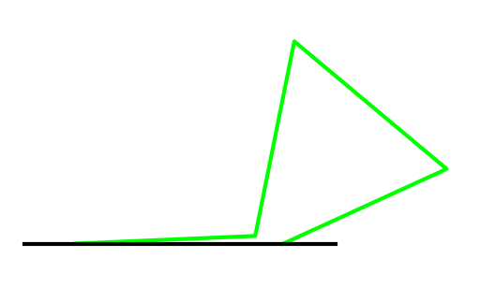
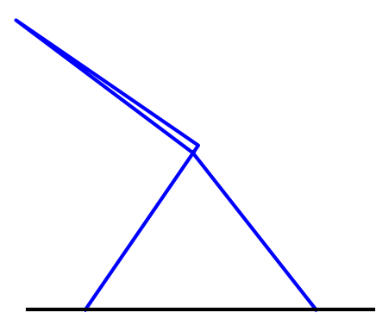
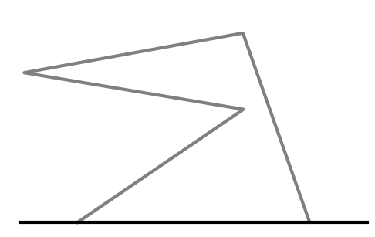
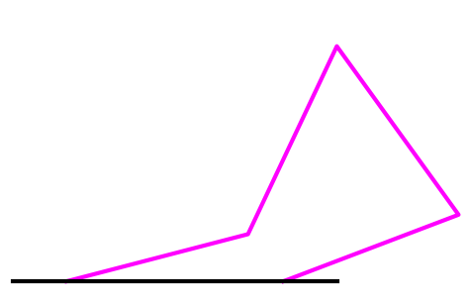
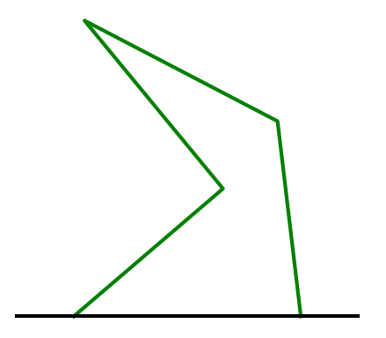
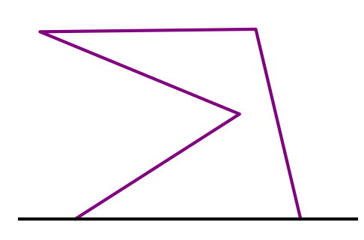
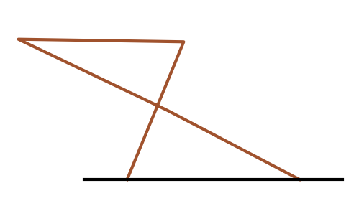
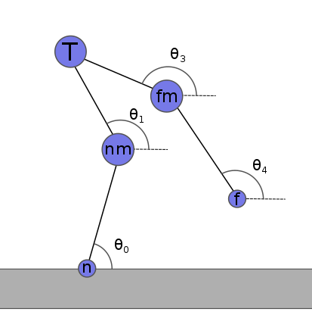
Simulating the Walk of the Dynein Motor Protein
Jin Kiatvongcharoen, John Waczak, Elliott Capek, and David Ruondy
Oregon State University
Motivation
Simulation
We aim to create a simple 2-D model of the motor protein dynein as it walks along the microtubule. The model will be simulated with Monte-Carlo methods in order to replicate its stepping behavior. The simulation’s goal is to display the mechanical nature of dynein and deepen our understanding on motor proteins.
Our model is separated into two states: both bound and one bound. They are both point-particle systems that involves one tail domain, two motor domains and two binding domains. We are able to create a configuration of dynein and predict its unbinding probability if two angles and an initial distance (L) are known. (Should take out “predict unbinding prob.” ?)
Both Bound
Randomly pick
a set of
motor angles
Calculate
total energy
of the system
Determine
probability
of unbinding
Start one bound
simulation
if unbinding
is successful
Dynein
Dynein is one of the three motor proteins that are responsible for the cell’s ability to move, divide, and spatially organize itself. They convey cargo along a protein highway (microtubule) by using ATP to step. Its two feet can act independently from each other causing erratic and stochastic steps, allowing us to model its walk with a Monte-Carlo simulation.
$P\left(A\right)=$
Monte-Carlo (MC) Method
Monte-Carlo (MC) methods encompasses algorithms that uses repeated random sampling of configurations to output a distribution of results depending on their probability of happening. We calculate the probability of a variable in a specific configuration, A_{s}, as:
With this, we can also calculate an average:
where β is the thermodynamic beta
and E_{s} is the energy of the system. We use a MC in order to generate probability distributions of dynein’s step length and step time for different initial configurations.
One Bound
Brownian Motion
Data Collection
Unlike the both bound state, the probability of binding is not angle dependent. We simulate the one bound state in a fluid, where random forces of the molecules against the domains causes diffusion for its lifted leg to land, and thus, taking a step.
After dynein takes a step, the final displacement of the landing foot and the time it took for the step would be recorded and the simulation would run again. This data would allow us to make histograms for various configurations of dynein.
$P\left(A_{s}\right)=A_{s}e^{−βE_{s}}$
$\left\langle A_{s}\right\rangle =\frac{\sum_{s}{P}\left(A_{s}\right)}{\sum_{s}{e^{−βE_{s}}}}$
Future Work
Improve and simplify our one bound simulation due to probability of dynein’s binding not being angle dependent like the both bound state.
Analyze the error from MC simulation and compare it to older simulations done entirely with Brownian dynamics.
Compare our results to experimental data and further improve in order to infer the most accurate model for dynein’s motion.
$\frac{1}{k_{b}T}$

