Slide 1
Data Analysis Report
Source: Sample Audit Report v1.xlsx

Slide 2
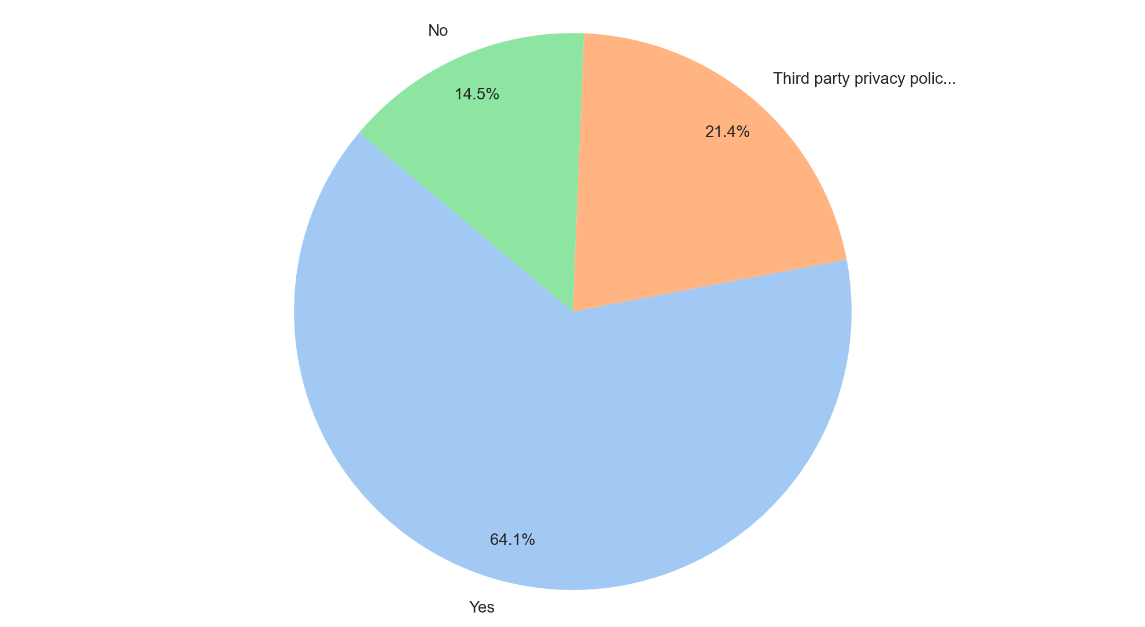
Analysis of Privacy Policy
Summary Insight:
Understanding and improving privacy policy adherence is crucial, as a substantial minority of respondents indicate either explicit non-compliance or reliance on potentially problematic third-party policies.
Investigate the "Third party privacy policy" category to determine which third-party policies are being utilized and assess their alignment with our standards and legal obligations.
Implement a targeted communication and training program to address the "No" responses and reinforce the importance of adhering to the company's privacy policy.
Key Metrics:
Adherence Rate (Yes): 63.3% (75 out of 117 total entries)
Potentially Non-Compliant Rate (No + Third party privacy policy): 36.7% (42 out of 117 total entries)
Most Frequent: Yes (75)
Least Frequent: No (17)

Slide 3
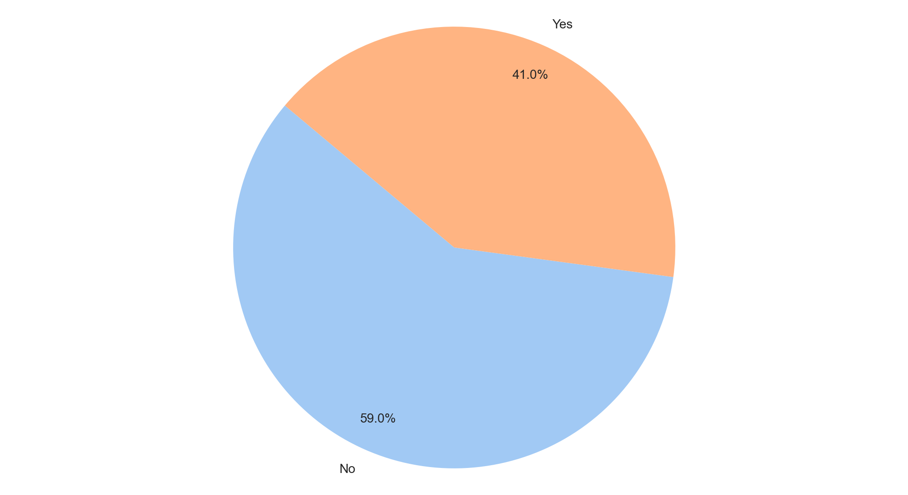
Analysis of Cookie Banner Deployed
Summary Insight:
Deployment of the cookie banner is incomplete, potentially exposing the organization to legal and reputational risks associated with non-compliance.
Prioritize completing cookie banner deployment across all remaining properties to ensure legal compliance and maintain user trust.
Investigate the reasons for non-deployment in the 'No' category to identify potential roadblocks and allocate resources effectively.
Key Metrics:
* Cookie Banner Deployed:
Most Frequent: No
Least Frequent: Yes
* Deployment Ratio:
Yes: 41% (48/117)
No: 59% (69/117)
* Total Count:
Average: N/A (Categorical Data)
Median: N/A (Categorical Data)
Max: 69 (Count of "No")
Min: 48 (Count of "Yes")

Slide 4
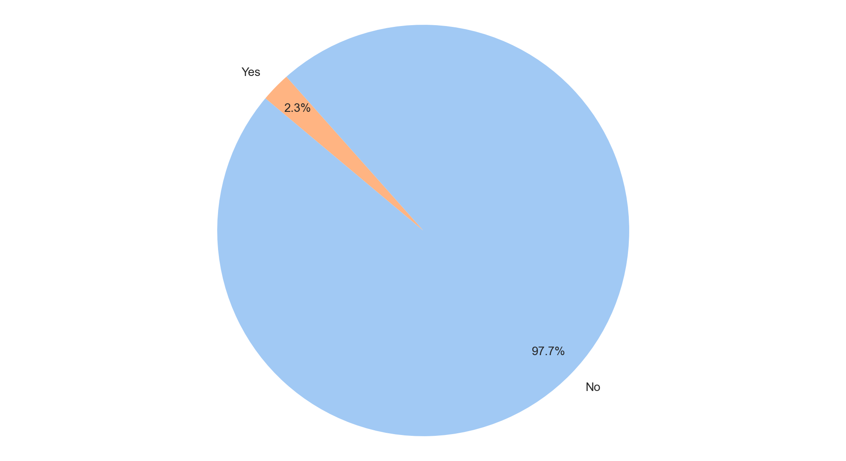
Analysis of User Consent Choices Honored
Summary Insight:
User consent is overwhelmingly *not* being honored, representing a significant legal and reputational risk that demands immediate action.
Immediately investigate the system and code responsible for processing user consent to identify the root cause of this failure.
Develop and implement a remediation plan with a clear timeline and ownership to ensure 100% compliance with user consent choices.
Conduct a legal review to assess potential liabilities and prepare appropriate communication strategies.
Key Metrics:
Total Records: 43
- Honoring Consent:
Most Frequent: No (42)
Least Frequent: Yes (1)
- Count of "Yes":
Average: 1 (since there's only one value)
Median: 1 (since there's only one value)
Max: 1
Min: 1

Slide 5
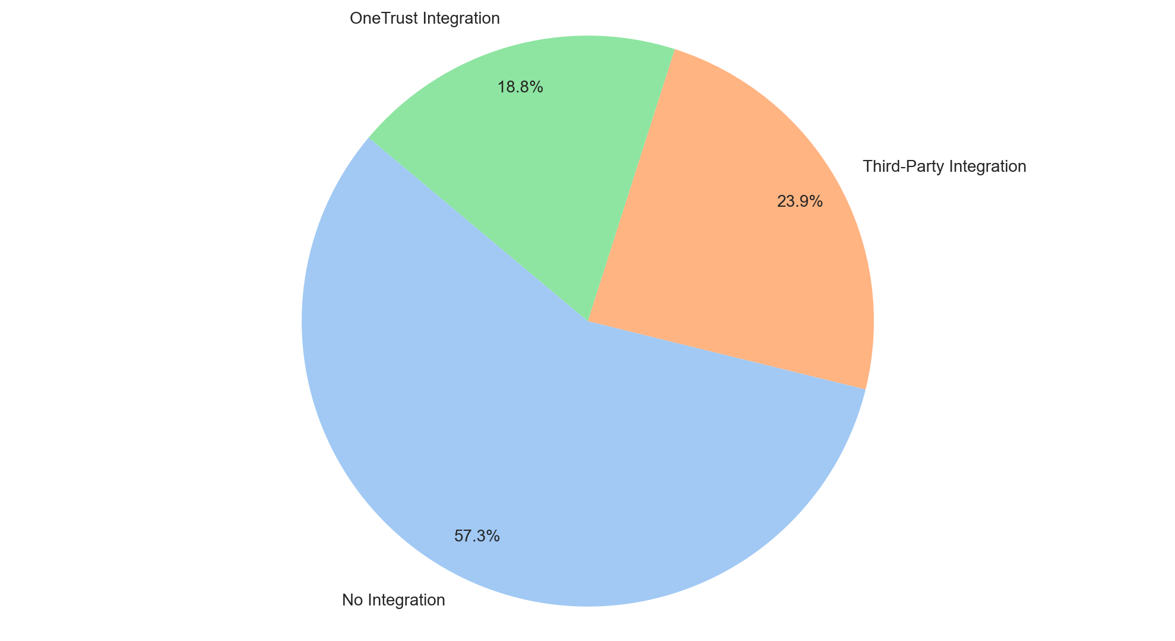
Analysis of OneTrust Integration
Slide Title: OneTrust Integration Status and Opportunities
Summary Insight:
Only a minority of systems leverage OneTrust integration, presenting a significant opportunity to improve data privacy compliance and operational efficiency.
Prioritize a phased rollout plan for OneTrust integration across systems currently lacking it.
Investigate the "Third-Party Integration" usage to determine compatibility and potential migration paths to native OneTrust functionality.
Evaluate the costs and benefits of full OneTrust integration compared to current solutions to justify investment.
Key Metrics:
* Integration Count (Categorical Data):
Most Frequent: No Integration (67)
Least Frequent: OneTrust Integration (22)
* Integration Status Distribution:
No Integration: 58% (67/115)
Third-Party Integration: 24% (28/115)
OneTrust Integration: 19% (22/115)
* Count of Integration Types:
Average: 38.33 (rounded up from 115/3)
Median: 28
Max: 67
Min: 22

Slide 6
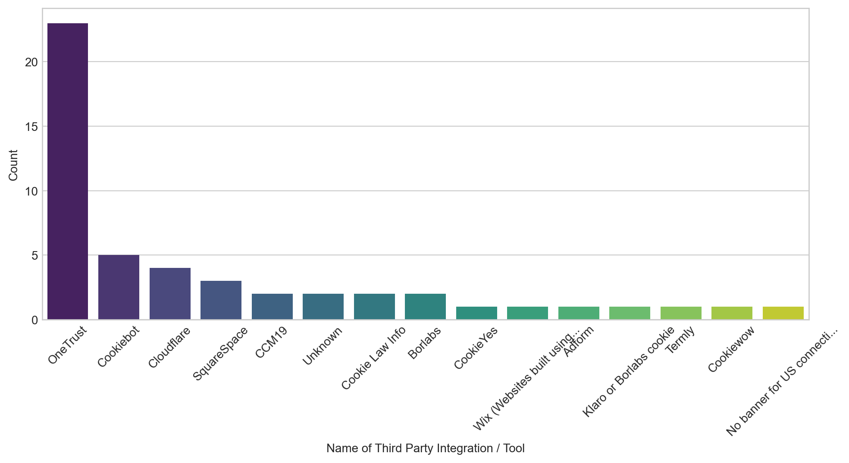
Analysis of Name of Third Party Integration / Tool
Summary Insight:
OneTrust dominates third-party integration usage for cookie consent and privacy compliance, suggesting a potential dependency risk and opportunity to optimize integration costs.
Evaluate the rationale behind the widespread OneTrust adoption versus other alternatives to identify potential cost savings or functionality gaps.
Investigate integrations labeled "Unknown" to determine their purpose and potential compliance implications.
Explore consolidating less frequently used tools like CookieYes, Wix, and others onto a standardized platform to reduce management overhead.
Key Metrics:
Number of Unique Integrations/Tools: 10
Most Frequent Integration: OneTrust (23)
Least Frequent Integrations: CookieYes, Wix (1 each)
Average Usage per Integration (excluding 'Unknown'): 4.56 (Total uses of named integrations / Number of named integrations, (23+5+4+3+2+2+2+1+1) / 9)

Slide 7
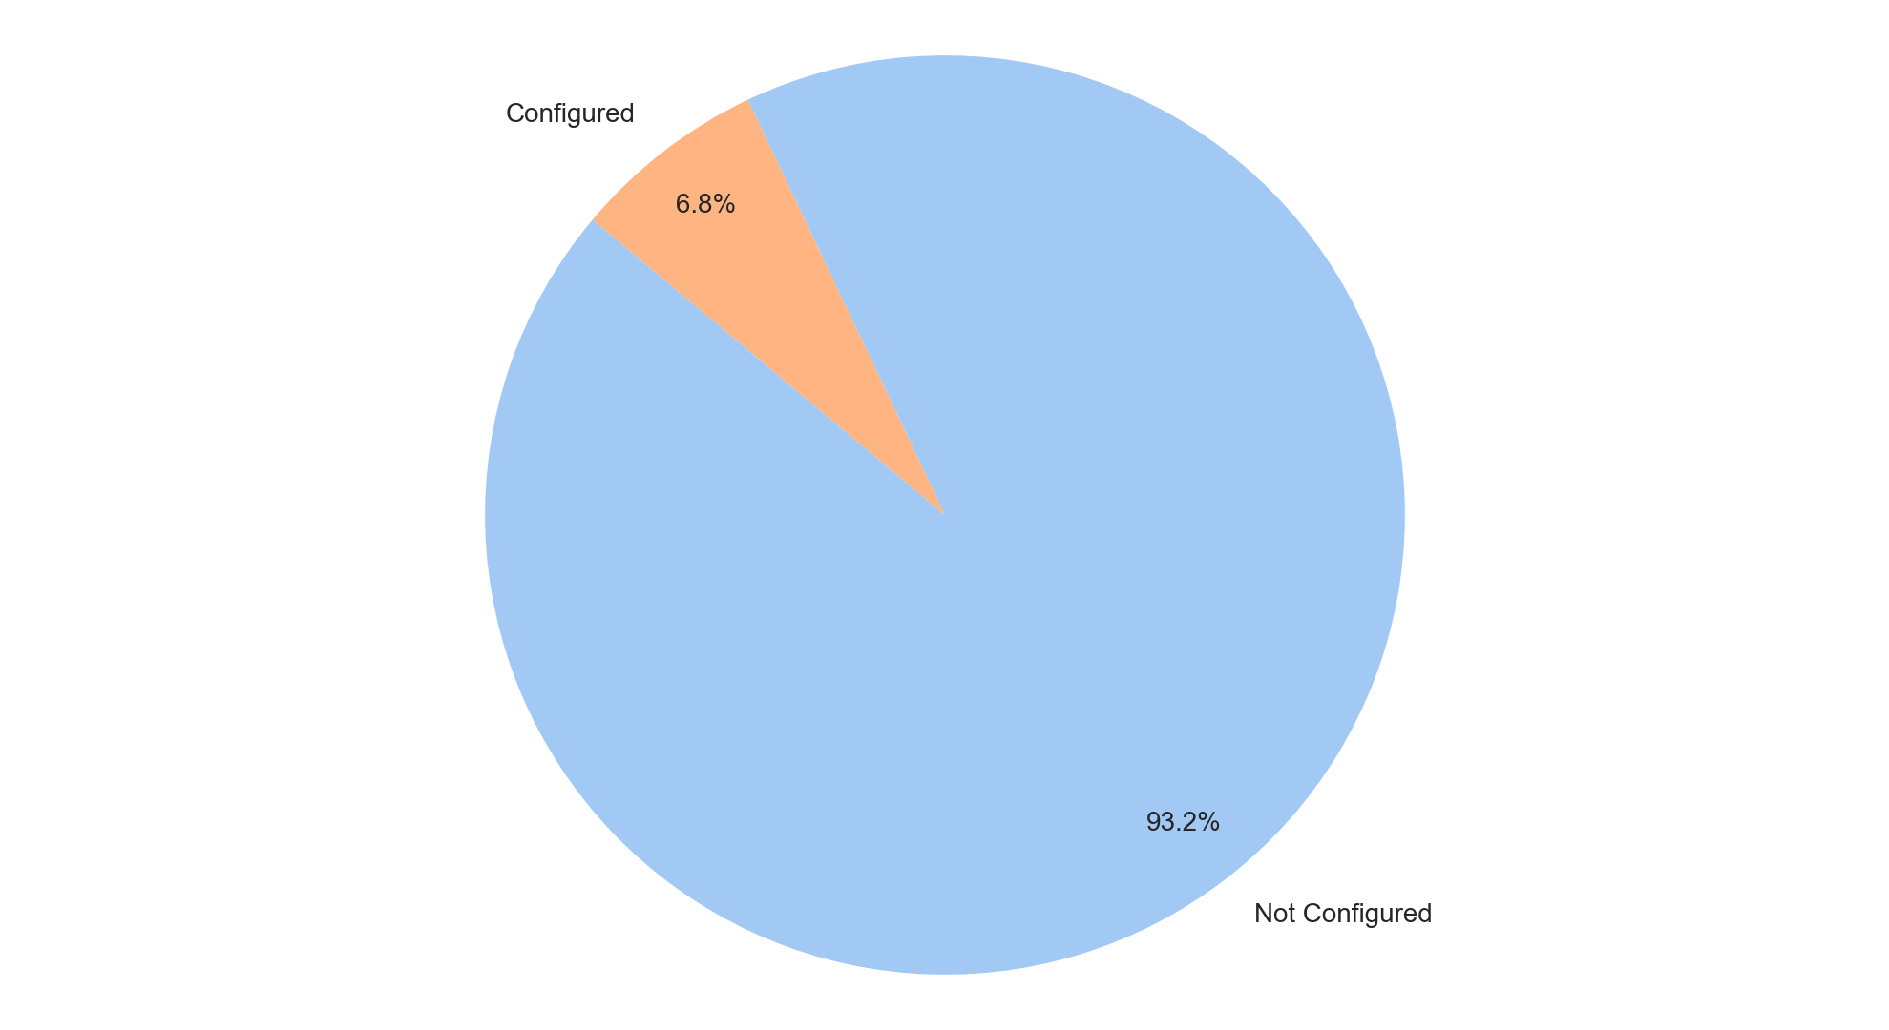
Analysis of GPC Configuration
Slide Title: GPC Configuration Analysis
Summary Insight:
The significant disparity between 'Not Configured' and 'Configured' GPC settings indicates a substantial opportunity to improve privacy posture and potentially reduce legal risks by accelerating GPC adoption.
Prioritize immediate investigation into the reasons for the low configuration rate (e.g., lack of awareness, technical hurdles, resource constraints).
Develop and execute a targeted campaign to encourage and simplify GPC configuration across the organization.
Establish a monitoring dashboard to track GPC configuration progress and identify areas lagging behind.
Key Metrics:
Most Frequent: Not Configured (109)
Least Frequent: Configured (8)
Total Records: 117
Configuration Rate: 6.84% (8/117)

Slide 8
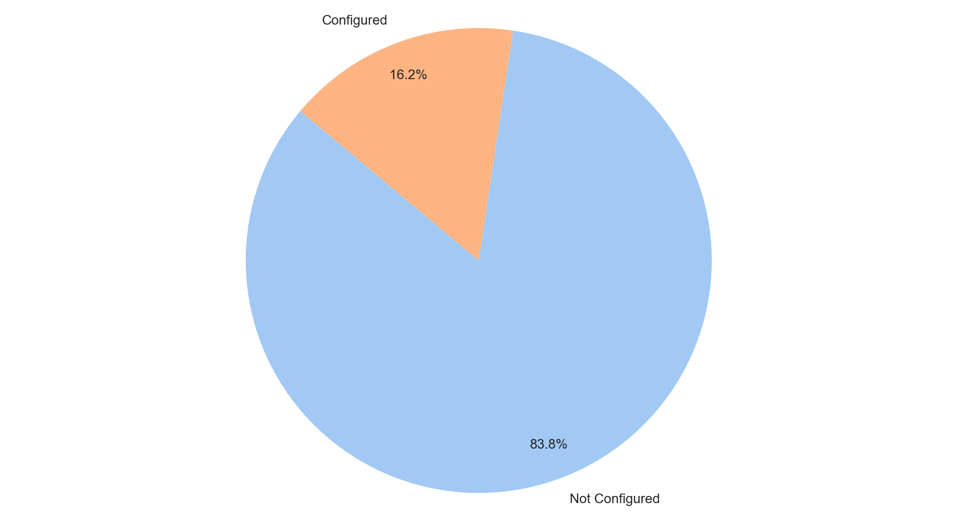
Analysis of Geolocation Rules
Summary Insight:
A significant majority of our geolocation rules are not configured, indicating a potential missed opportunity to leverage location-based strategies for improved user experience, targeted offers, or optimized content delivery.
Prioritize configuring geolocation rules for key user segments or high-traffic areas to enhance user engagement and personalization.
Investigate the reasons behind the high percentage of "Not Configured" rules; determine if it's due to a lack of awareness, technical complexity, or resource constraints.
Evaluate the impact of configured geolocation rules on key performance indicators (KPIs) such as conversion rates and user retention.
Key Metrics:
Geolocation Rule Configuration Rate: 16.3% (19 configured / 117 total).
Average (Categorical): N/A - Categorical data.
Median (Categorical): N/A - Categorical data.
Max (Categorical): N/A - Categorical data.
Min (Categorical): N/A - Categorical data.
Most Frequent: Not Configured (98 instances).
Least Frequent: Configured (19 instances).

Slide 9
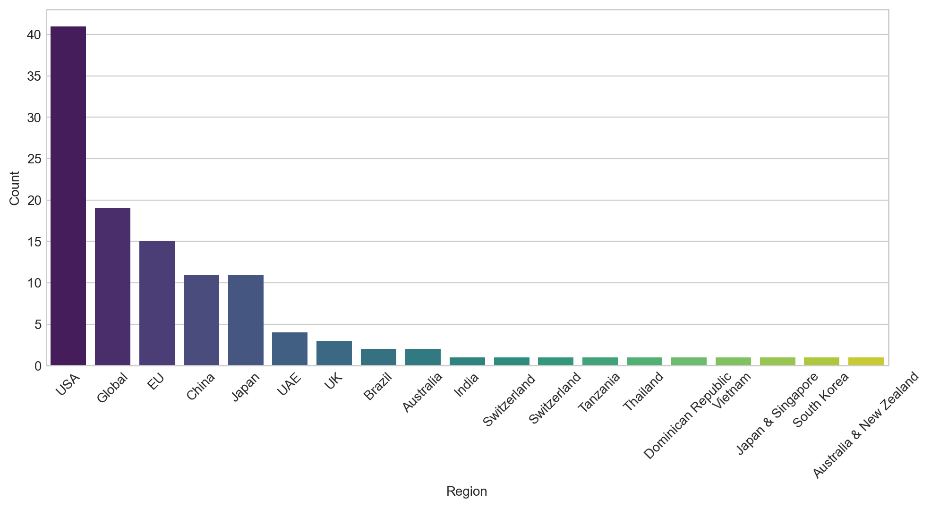
Analysis of Region
Summary Insight:
The USA is our dominant market, representing a disproportionate share of our activity, suggesting both opportunity and potential risk in over-reliance.
Evaluate strategies to capitalize on the USA's strong performance while diversifying into other regions to mitigate risk.
Investigate the reasons for lower performance in regions like India, Brazil, and Australia to identify potential barriers or opportunities for growth.
Key Metrics:
Average Region Frequency: 10.8 (Total Regions Counted: 108, distinct regions: 10)
Median Region Frequency: 7.5 (after sorting ascending: 1, 2, 2, 3, 4, 11, 11, 15, 19, 41)
Max Region Frequency: 41 (USA)
Min Region Frequency: 1 (India)
Most Frequent Region: USA
Least Frequent Region: India

Slide 10
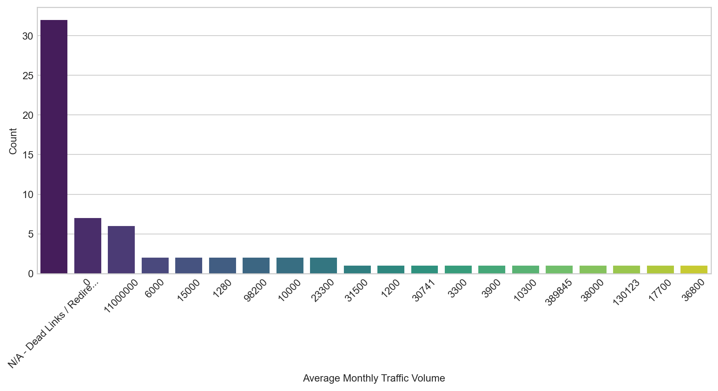
Analysis of Average Monthly Traffic Volume
Summary Insight:
The 'Average Monthly Traffic Volume' data exhibits significant data quality issues, hindering accurate performance assessment and strategic decision-making.
Investigate the root cause of "N/A - Dead Links/Redirects" and implement a process for proactive link maintenance and validation.
Further analysis is required to determine the validity of the '11000000' traffic volume entries, as this outlier significantly skews the overall averages.
Key Metrics:
Average: The average traffic volume is heavily skewed by the '11000000' values, giving a misleading representation of typical website traffic.
Median: The median traffic volume provides a better representation of central tendency, but is less useful due to large data quality issues.
Max: 11000000 (requires validation)
Min: 0 (indicating potential data collection or website issues)
Most Frequent: N/A - Dead Links / Redirects (highlighting a critical issue requiring immediate attention)
Least Frequent: 31500 (indicating this is a unique value in the dataset)

Slide 11
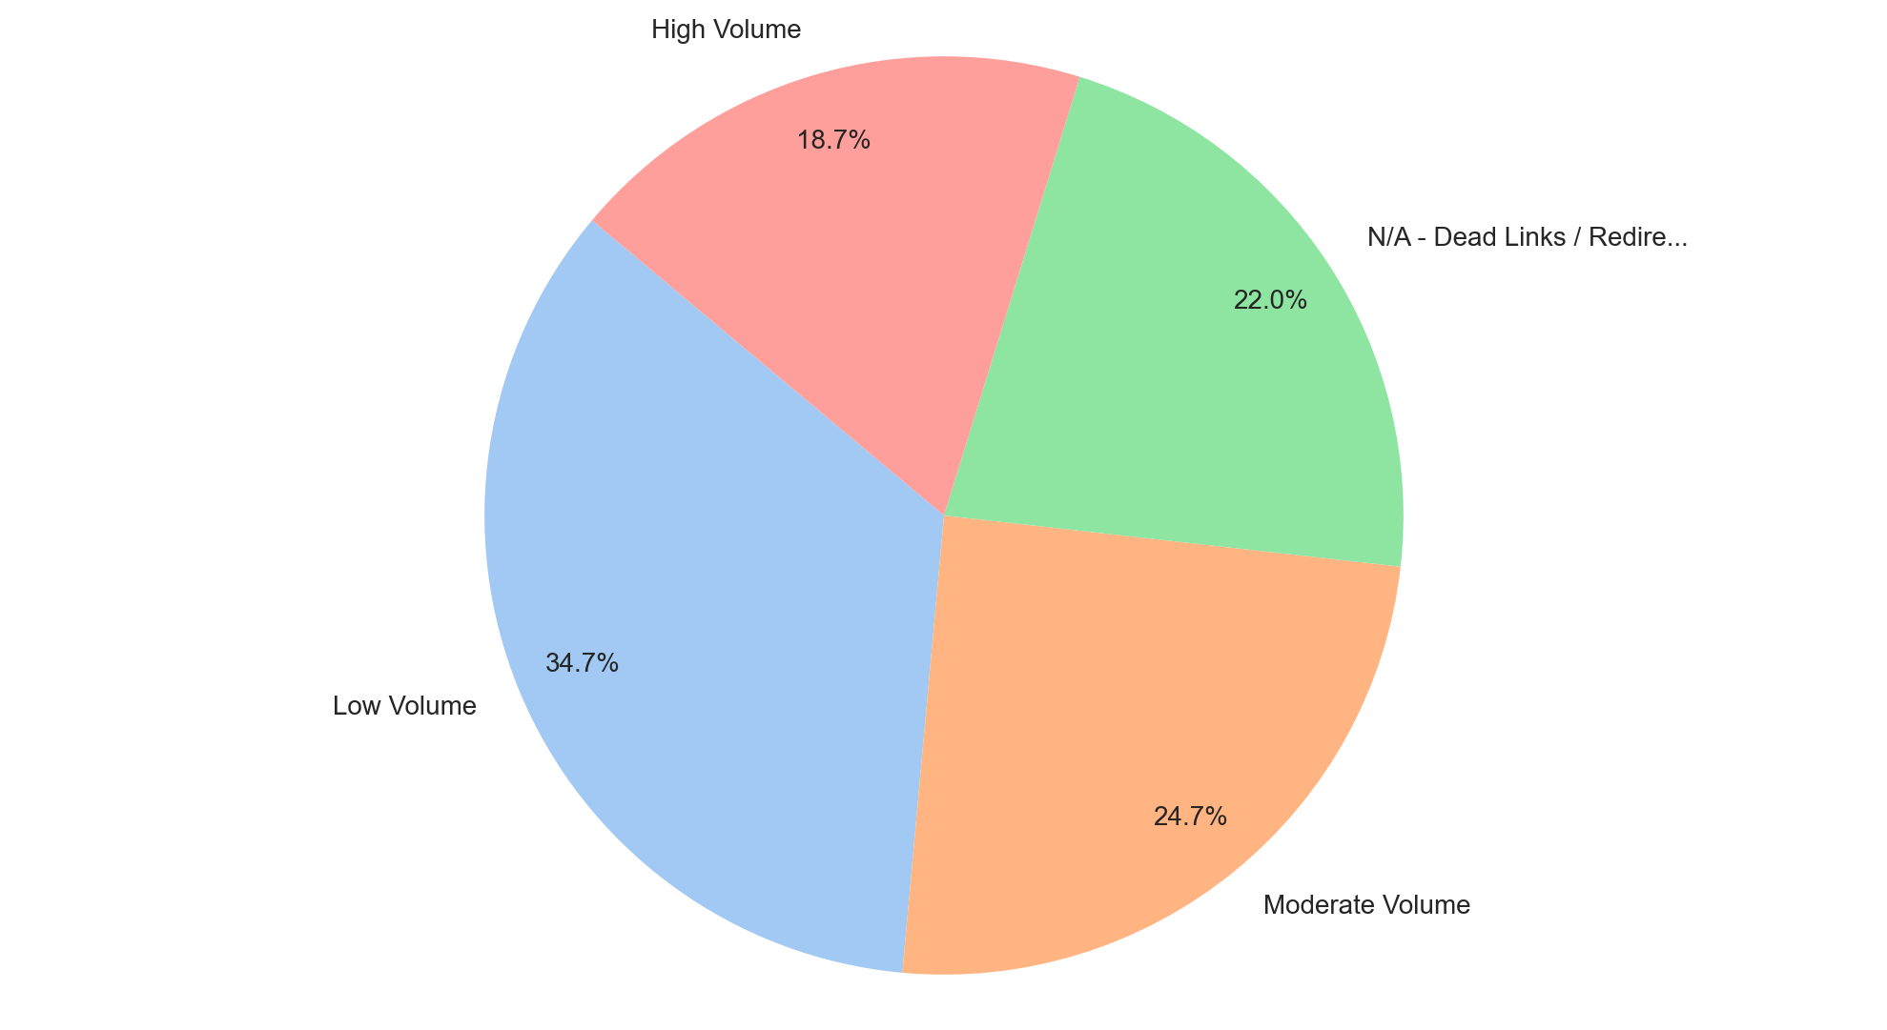
Analysis of Level of Traffic Volume
Summary Insight:
A significant portion of website traffic is either low or untracked due to dead links, indicating missed opportunities for engagement and potential revenue loss.
Prioritize fixing dead links and redirects immediately to capture lost traffic.
Investigate the reasons behind the high proportion of low volume pages and optimize for increased traffic.
Key Metrics:
Category Count: 4
Most Frequent Category: Low Volume (52)
Least Frequent Category: High Volume (28)
- Numerical Data (Approximation using the Category's Order, as true volume data is unavailable - requires caution):
Average: 2.5 (Categorical order: Low=1, Moderate=2, N/A=3, High=4)
Median: 2.5
Max: 4
Min: 1

Slide 12
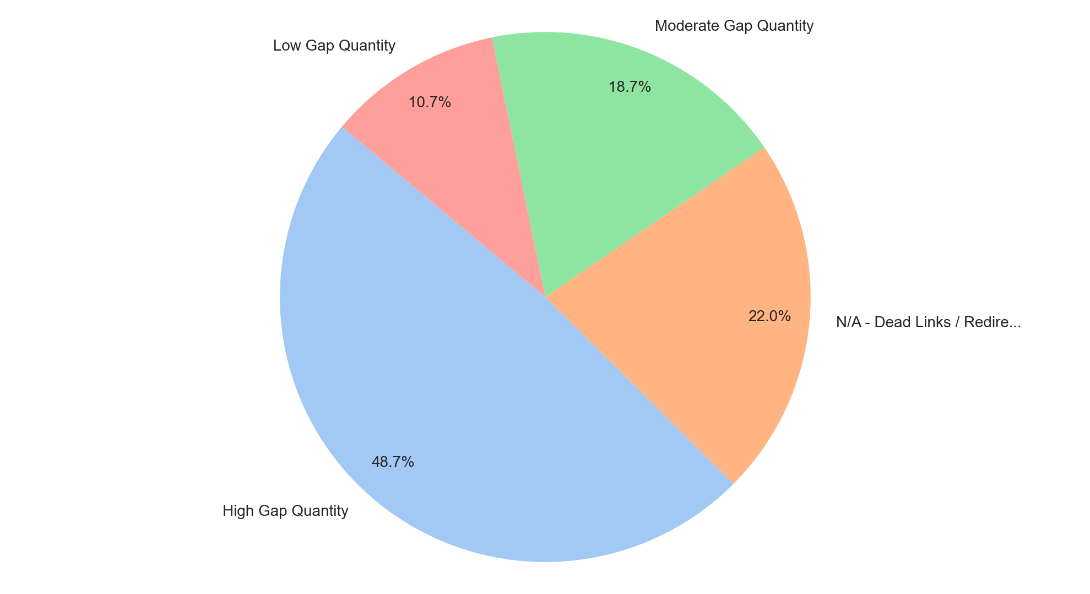
Analysis of Level of Gap Quantity
Slide Title: Gap Quantity Analysis - Prioritization and Action
Summary Insight:
The high prevalence of "High Gap Quantity" items requires immediate attention to mitigate potential business impact.
Prioritize investigation into the root causes contributing to "High Gap Quantity" instances to identify systemic issues.
Develop strategies to address "N/A - Dead Links / Redirects," focusing on content maintenance and SEO health.
Re-evaluate the criteria for categorizing gap quantities to ensure alignment with business priorities and potential risk.
Key Metrics:
Total Records: 150
Most Frequent: High Gap Quantity (49%)
Least Frequent: Low Gap Quantity (11%)
Average Gap Quantity Level (Categorical Assignment): *Unable to calculate a numerical average from categorical data.* *Further data transformation would be needed to assign numerical values to each category.*
Median Gap Quantity Level (Categorical Assignment): *Unable to calculate a numerical median from categorical data.* *Further data transformation would be needed to assign numerical values to each category.*

Slide 13
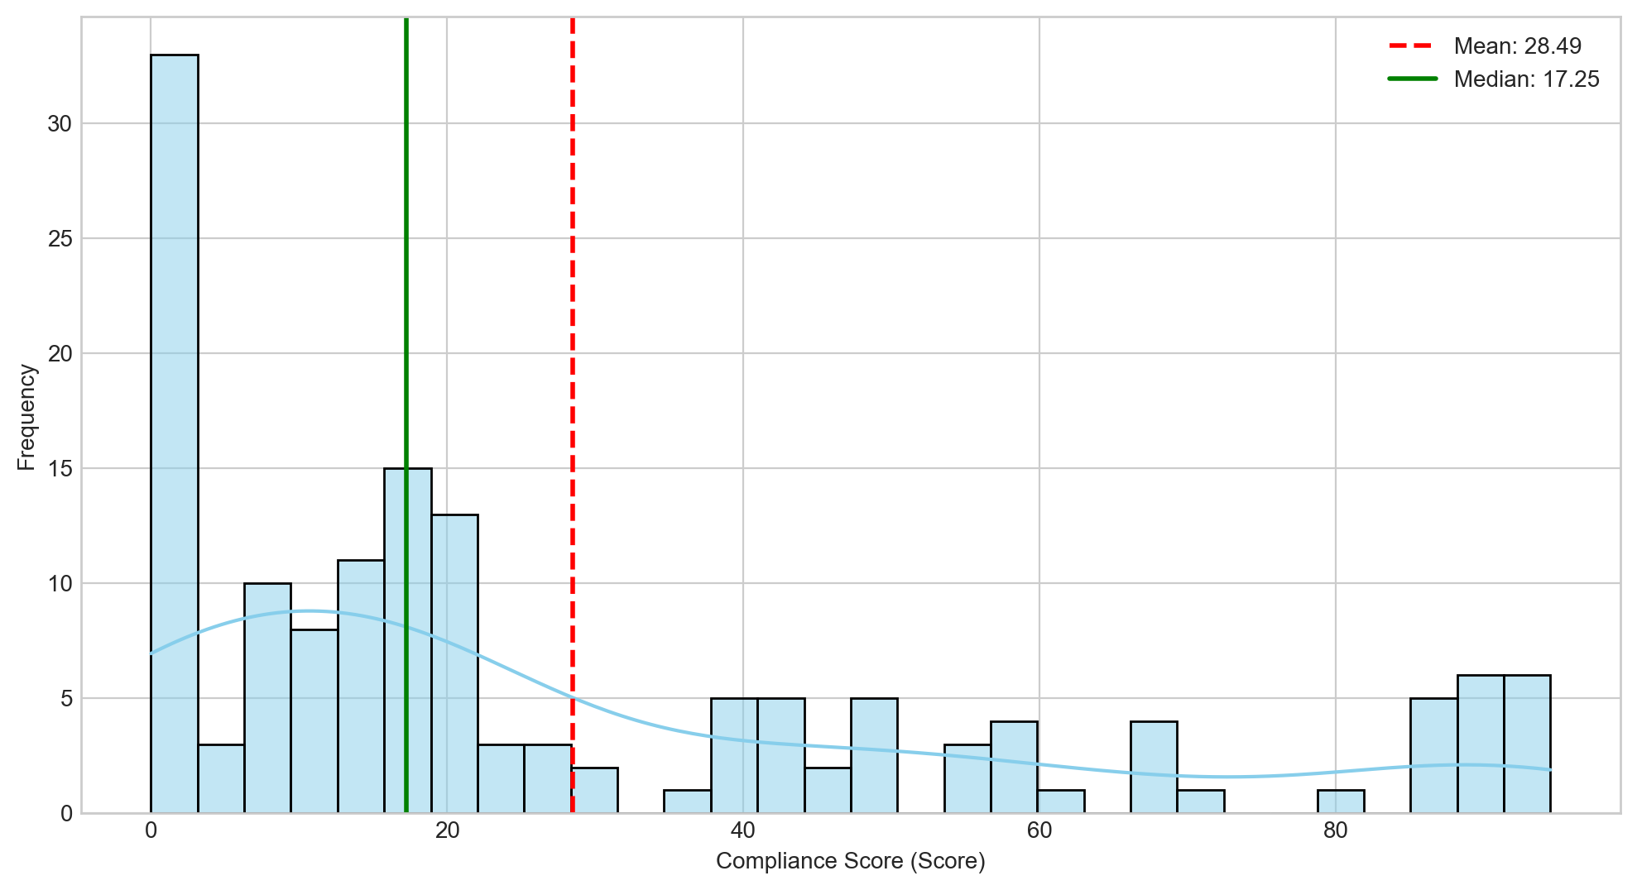
: Compliance Score Distribution
Slide Title: Compliance Score Analysis
Summary Insight:
The Compliance Score data reveals significant variability in compliance levels, requiring immediate attention to identify the root causes of both low and high scores.
Conduct a detailed investigation into the processes and factors contributing to scores below the 25th percentile to identify areas for improvement and prevent potential risks.
Analyze best practices among teams with scores above the 75th percentile to determine scalable strategies for improving overall compliance.
Key Metrics:
Average Compliance Score: 28.49
Median Compliance Score: 17.25
Maximum Compliance Score: 94.50
Minimum Compliance Score: 0.00

Slide 14
Thank You

