Slide 1
Data Analysis Report
Source: Sample Audit Report v1.xlsx

Slide 2
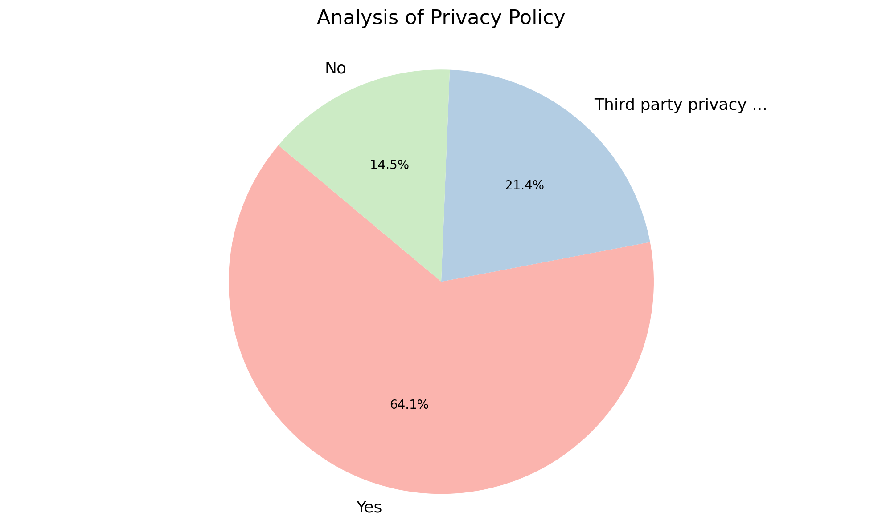
Analysis of Privacy Policy
Summary Insight:
The majority of respondents indicate having a privacy policy in place. However, a significant portion either rely on third-party policies or lack a privacy policy entirely, indicating a potential area for improvement.
Key Metrics:
Most Frequent Category: "Yes" with 75 entries.
Least Frequent Category: "No" with 17 entries.
Total Responses: 117 entries.
Percentage with Privacy Policy (Yes): 64.1% (75/117)

Slide 3
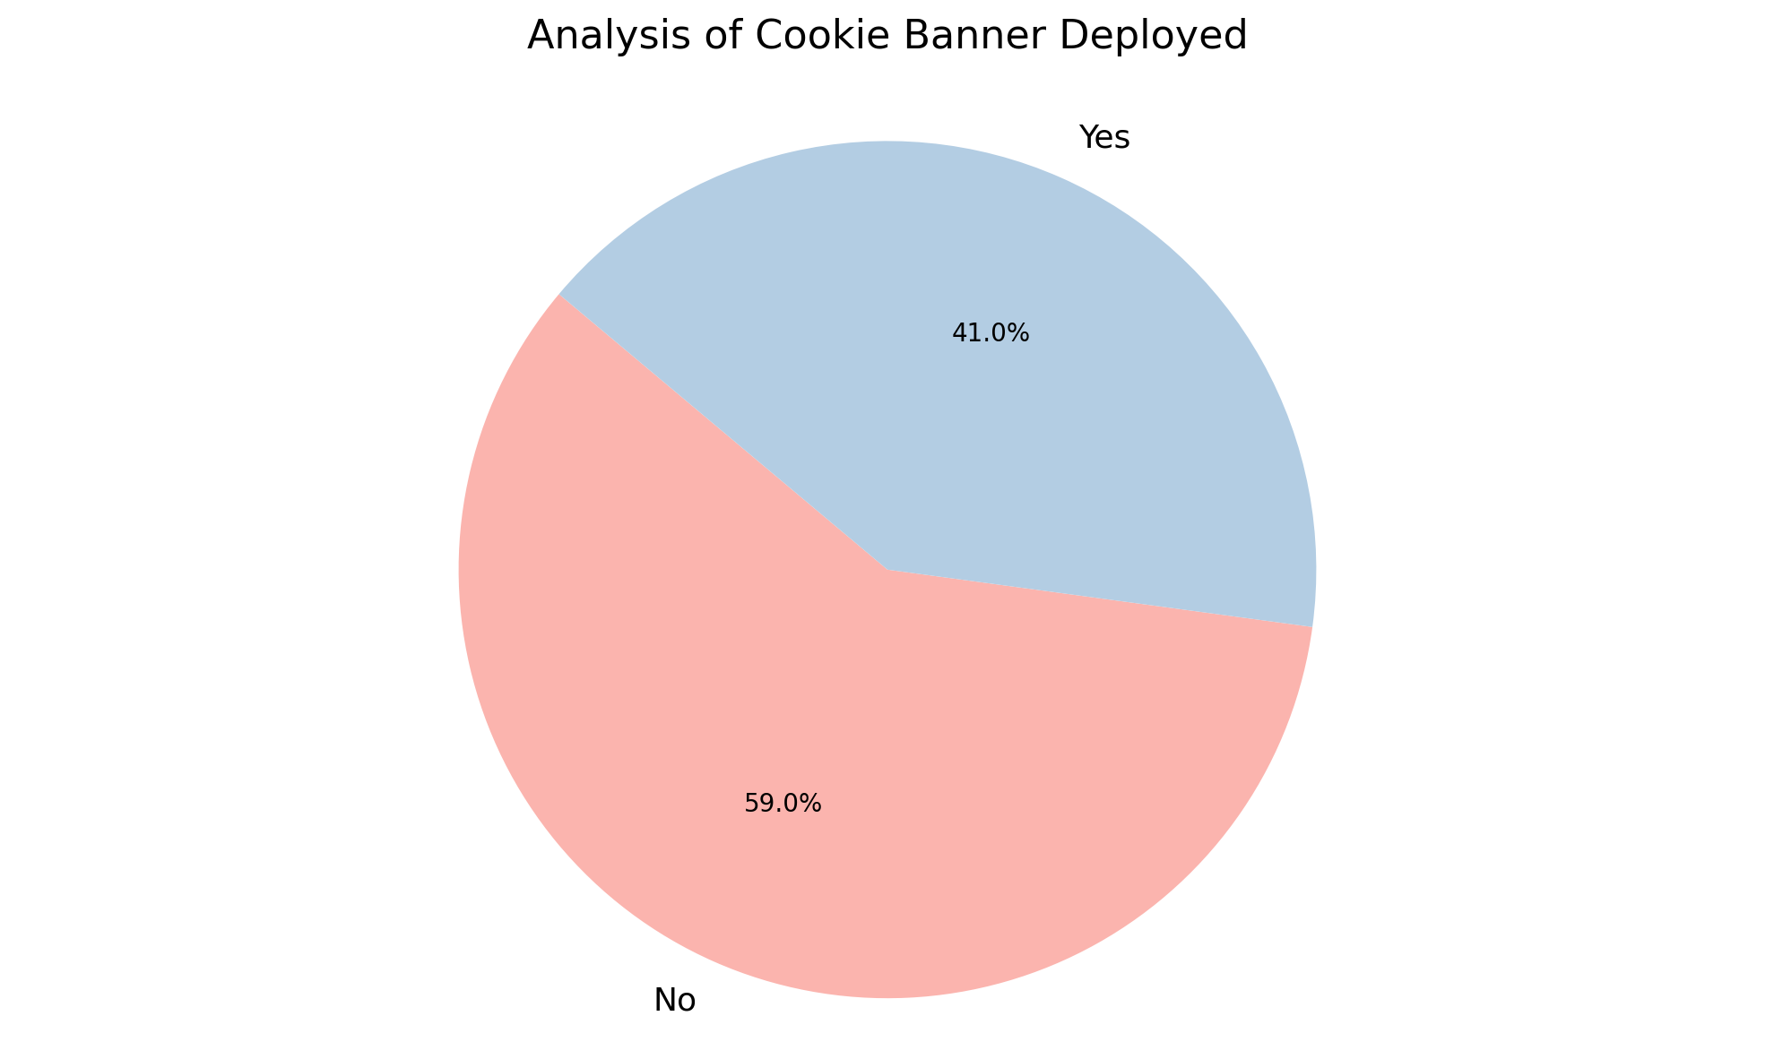
Analysis of Cookie Banner Deployed
Summary Insight:
The deployment of cookie banners is not universally adopted. More domains are lacking a cookie banner than have one implemented.
Key Metrics:
Total Entries: 117
- Cookie Banner Deployed:
Most Frequent: No (69)
Least Frequent: Yes (48)

Slide 4
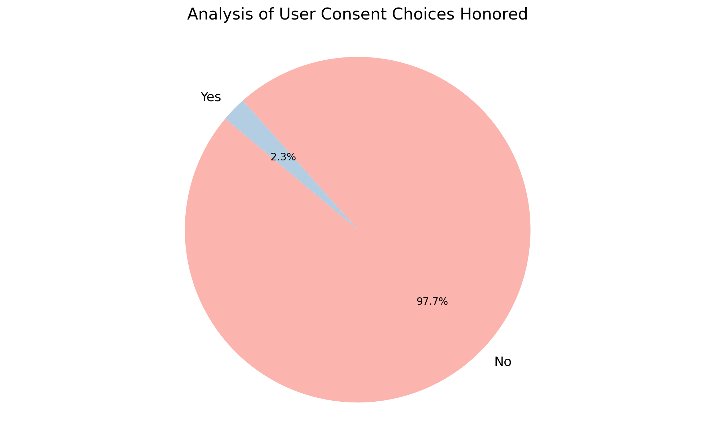
Analysis of User Consent Choices Honored
Summary Insight:
User consent choices are overwhelmingly not being honored. This indicates a potential compliance issue needing immediate investigation and remediation.
Key Metrics:
Most Frequent Category: No (Count: 42)
Least Frequent Category: Yes (Count: 1)
Total Entries: 43

Slide 5
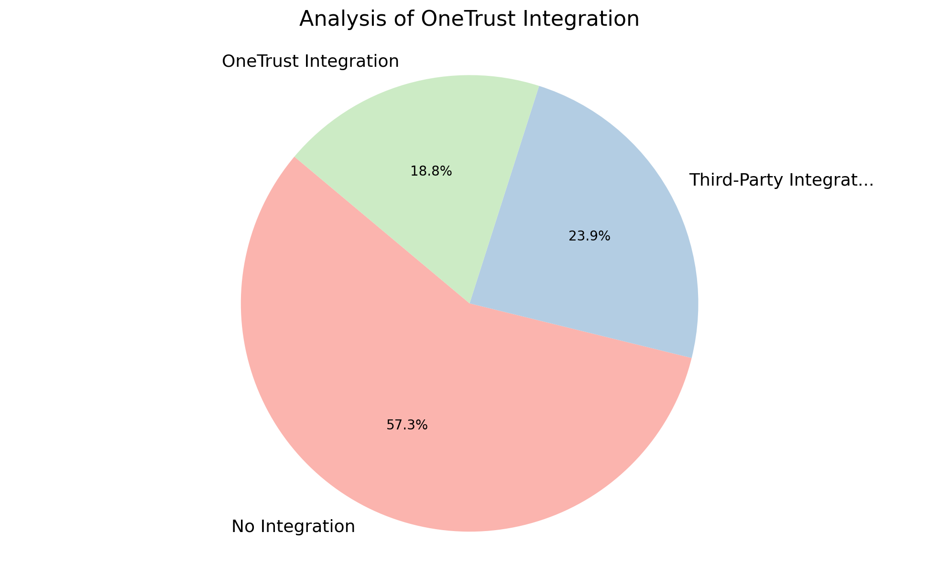
Analysis of OneTrust Integration
Summary Insight:
The majority of organizations are not currently leveraging any OneTrust integration for their privacy compliance. There is a significant opportunity to explore and implement OneTrust solutions to enhance data privacy management.
Key Metrics:
Most Frequent: No Integration (67)
Least Frequent: OneTrust Integration (22)
Count (Total Integrations): 117

Slide 6
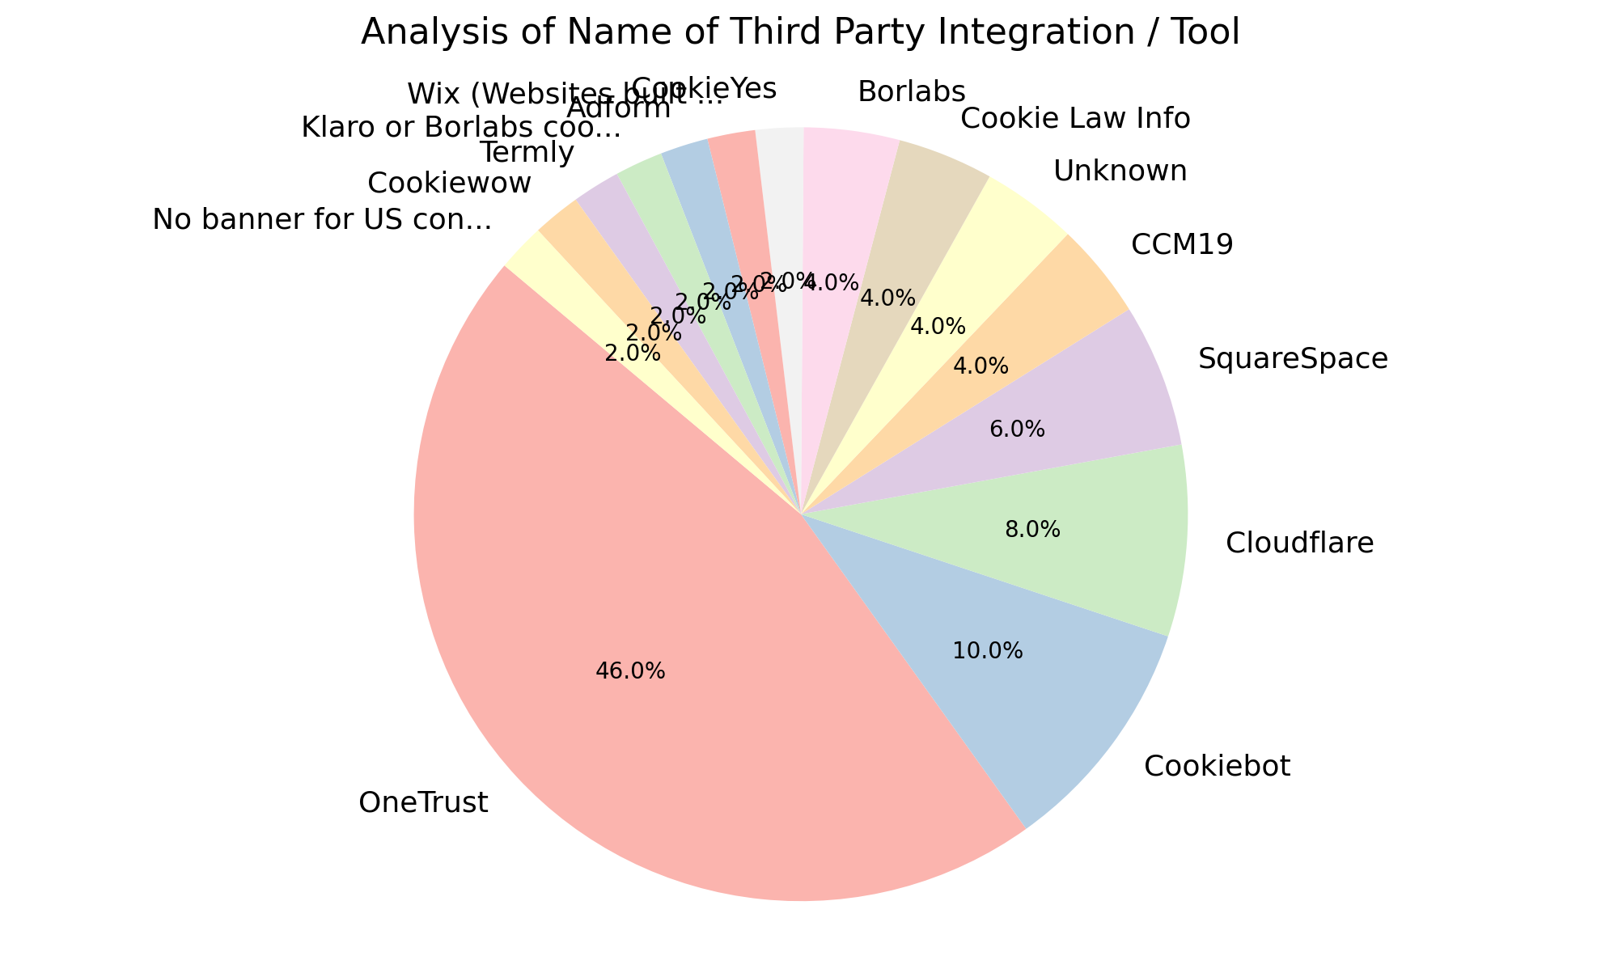
Analysis of Name of Third Party Integration / Tool
Summary Insight:
This data highlights a reliance on OneTrust as the dominant third-party integration for cookie consent management, but also demonstrates a fragmented landscape of alternative solutions. The long tail of less frequent tools indicates that specific business requirements are driving diverse implementation choices.
Key Metrics:
Most Frequent Integration: OneTrust (23)
Least Frequent Integrations: CookieYes, Wix, Adform, Klaro or Borlabs cookie, Termly, Cookiewow, No banner for US connection / TrustArc for EU connection (all with count of 1)
Total Count: 50
Number of Unique Integrations: 15

Slide 7
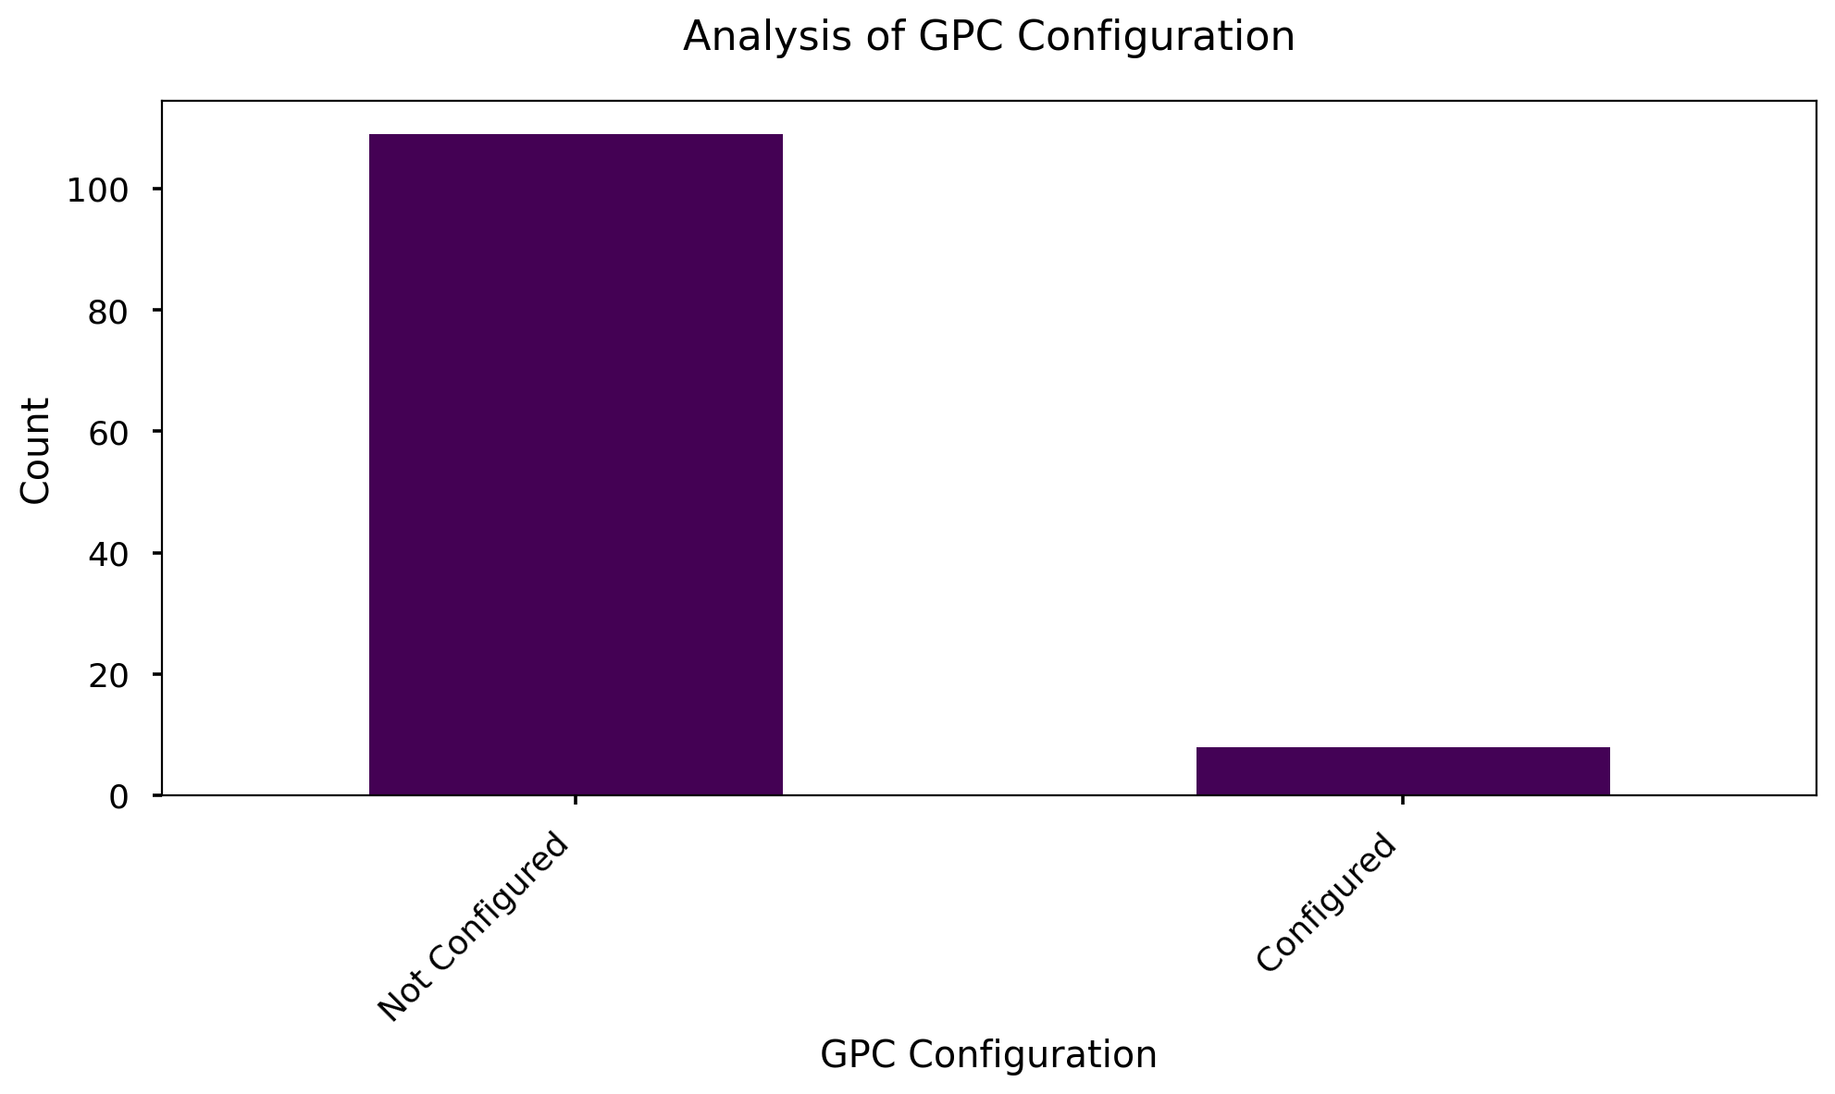
Analysis of GPC Configuration
Summary Insight:
The vast majority of systems are not configured with GPC (Global Privacy Control), indicating a significant area for improvement in privacy settings. Only a small fraction of systems have GPC properly configured.
Key Metrics:
Most Frequent Configuration: Not Configured (109)
Least Frequent Configuration: Configured (8)
Total Count: 117 entries

Slide 8
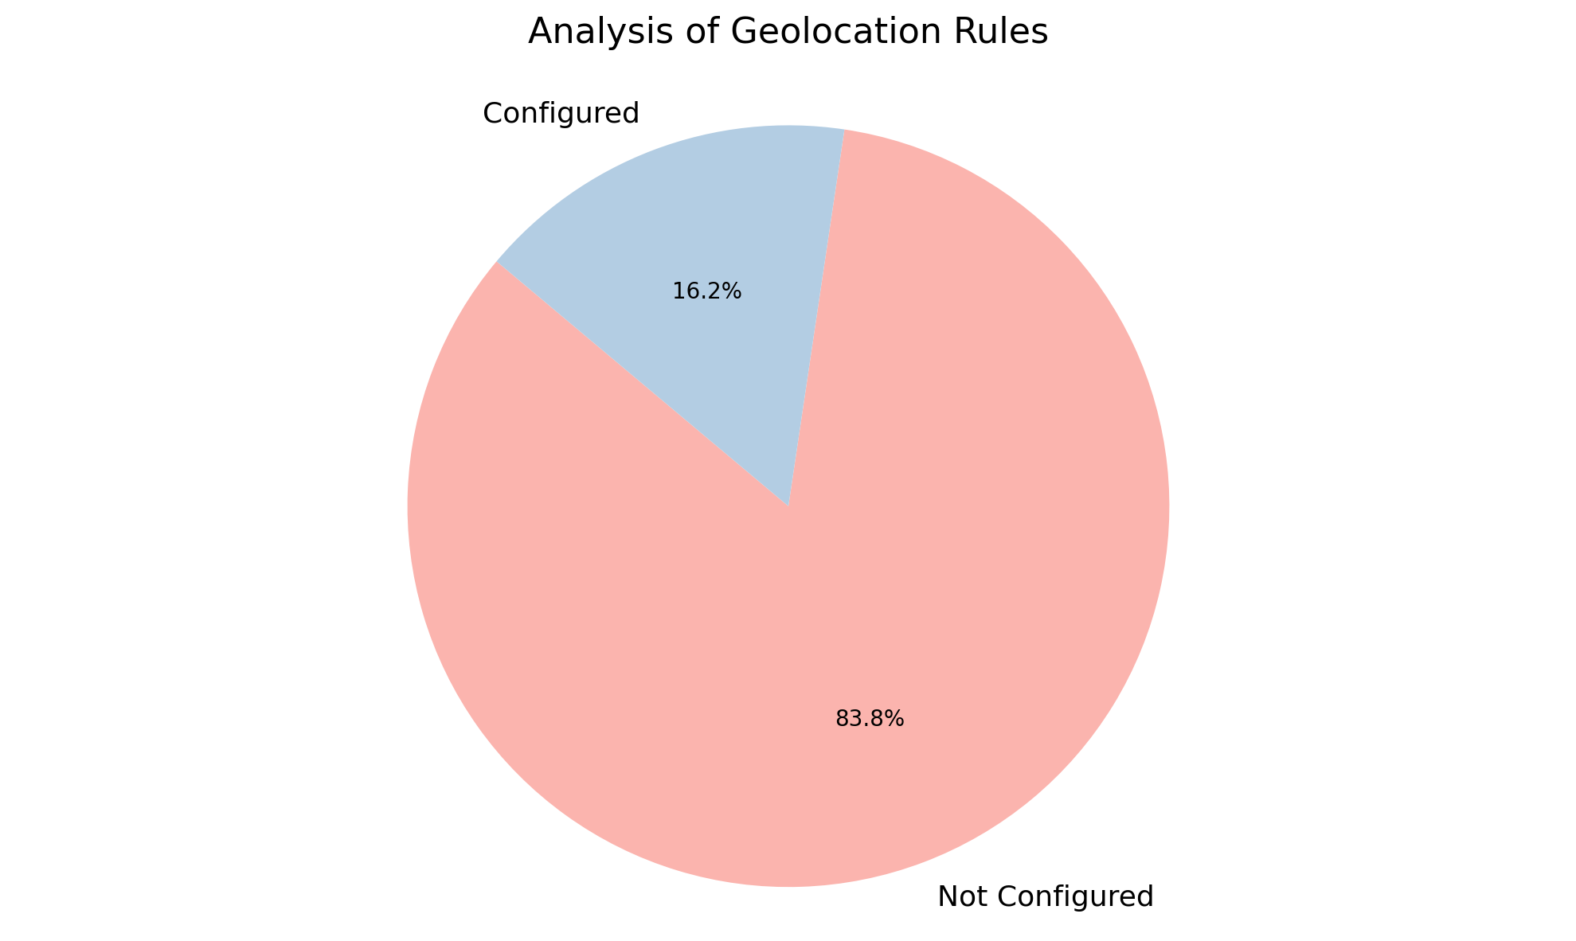
Analysis of Geolocation Rules
Summary Insight:
A significant majority (83.7%) of the system's geolocation rules are not configured, indicating a potential security or compliance gap. The low number of configured rules suggests that geolocation-based restrictions are not widely implemented.
Key Metrics:
Most Frequent Category: Not Configured (98)
Least Frequent Category: Configured (19)
Count: 117

Slide 9
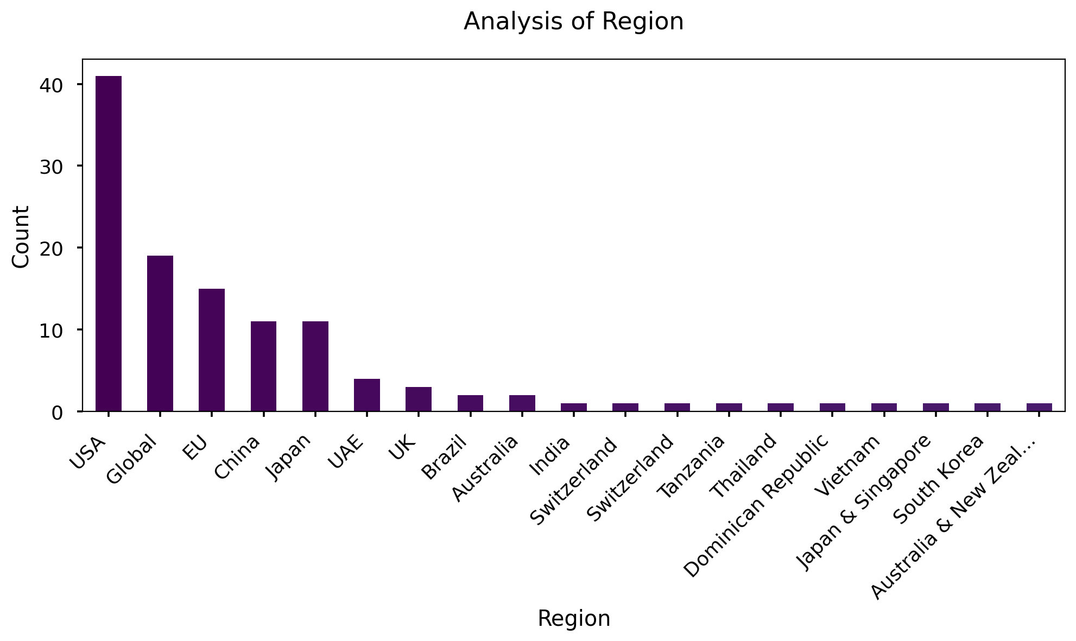
Analysis of Region
Summary Insight:
The 'Region' data highlights a strong concentration of data points originating from the USA, with a significant global presence. The data also includes multiple unique locations.
Key Metrics:
Number of Entries (Count): 120
Most Frequent Region: USA (41)
Least Frequent Regions: India, Switzerland, Tanzania, Thailand, Dominican Republic, Vietnam, Japan & Singapore, South Korea, Australia & New Zealand (all with a count of 1)
Number of Unique Regions: 19

Slide 10
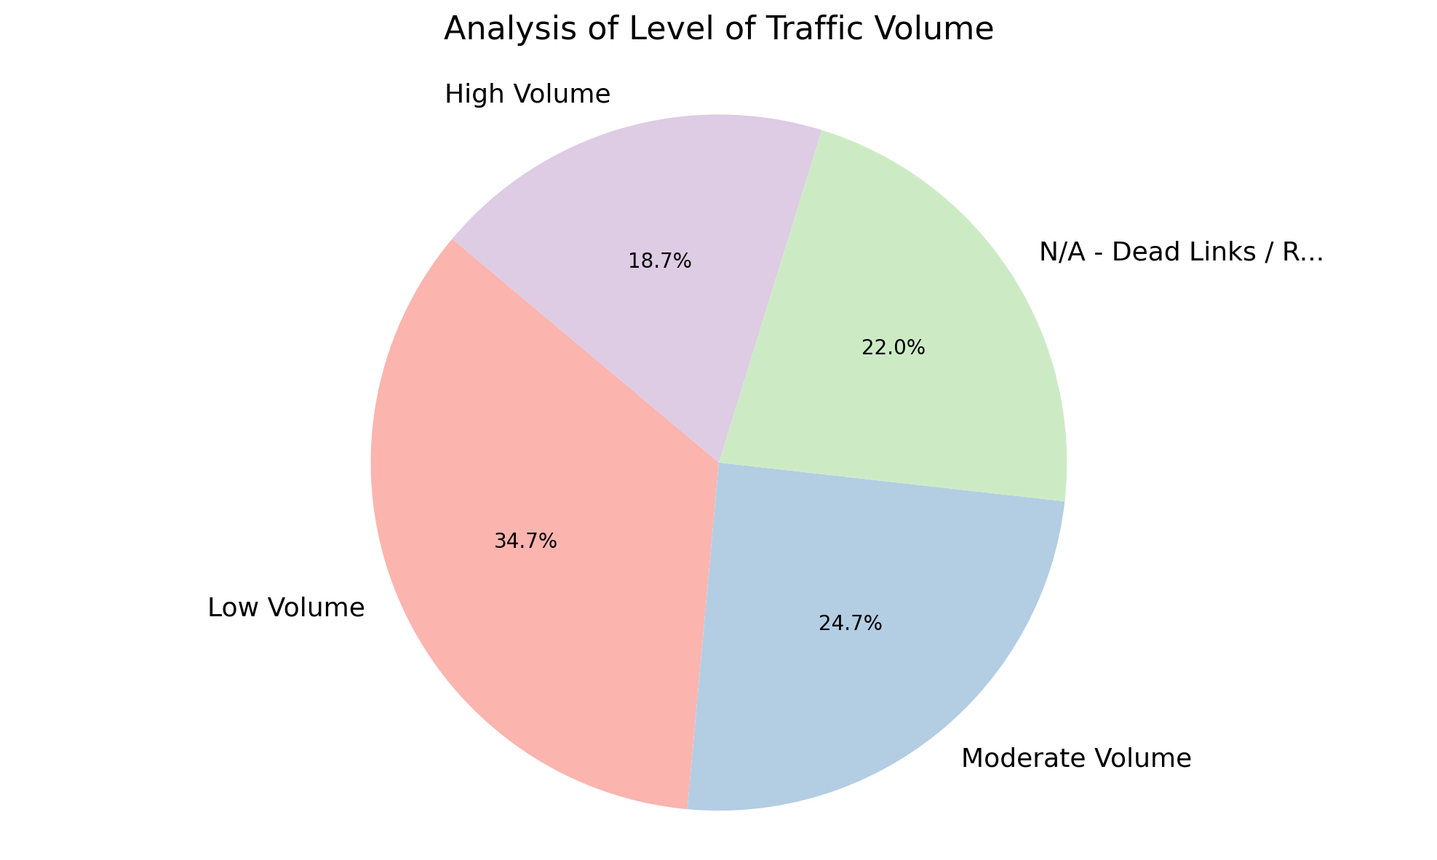
Analysis of Level of Traffic Volume
Summary Insight:
Traffic volume across the analyzed links varies significantly, with 'Low Volume' representing the largest segment. A considerable number of links are non-functional ('N/A - Dead Links / Redirects'), highlighting a potential need for link maintenance.
Key Metrics:
Most Frequent Volume: Low Volume (52 links)
Least Frequent Volume: High Volume (28 links)
Total Number of Links Analyzed: 150
Number of Dead/Redirected Links: 33

Slide 11
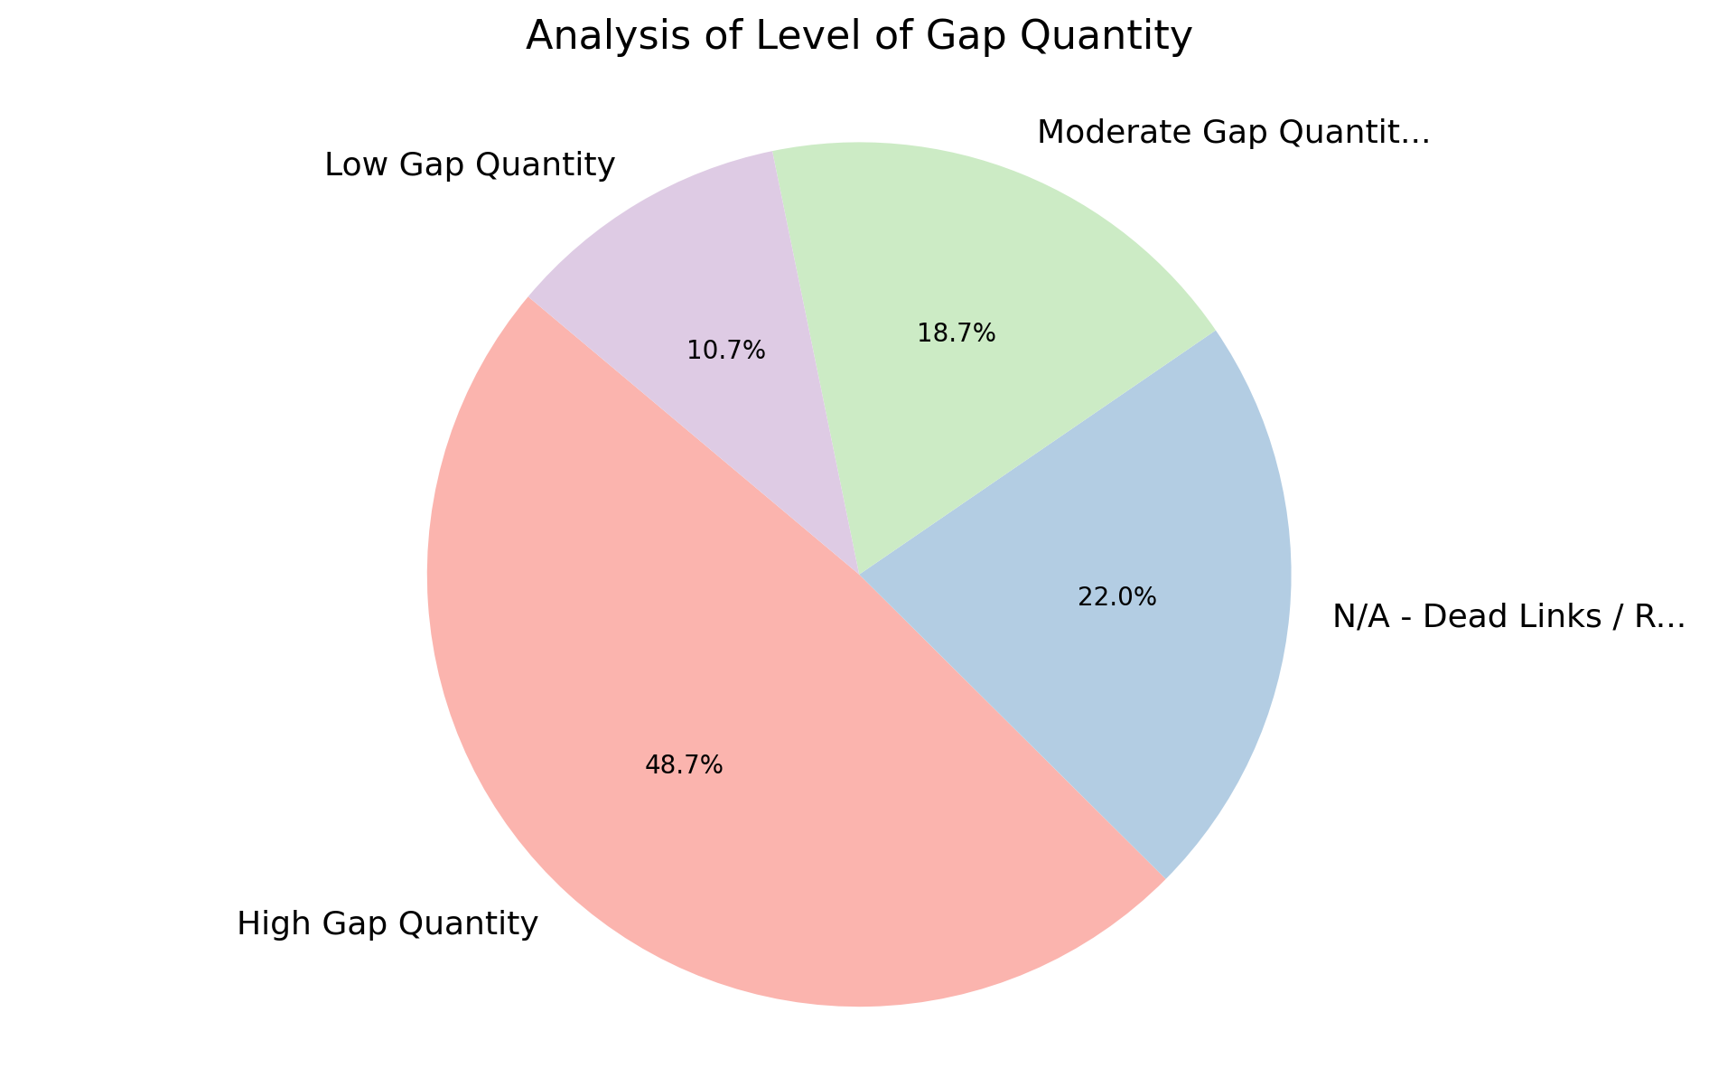
Analysis of Level of Gap Quantity
Summary Insight:
The majority of entries exhibit a high gap quantity, suggesting widespread deficiencies. A significant number of dead links and redirects also contribute to overall concerns.
Key Metrics:
Total Entries (Count): 150
Most Frequent Category: High Gap Quantity (73)
Least Frequent Category: Low Gap Quantity (16)
Entries With Gap Quantity (High, Moderate, Low): 117

Slide 12
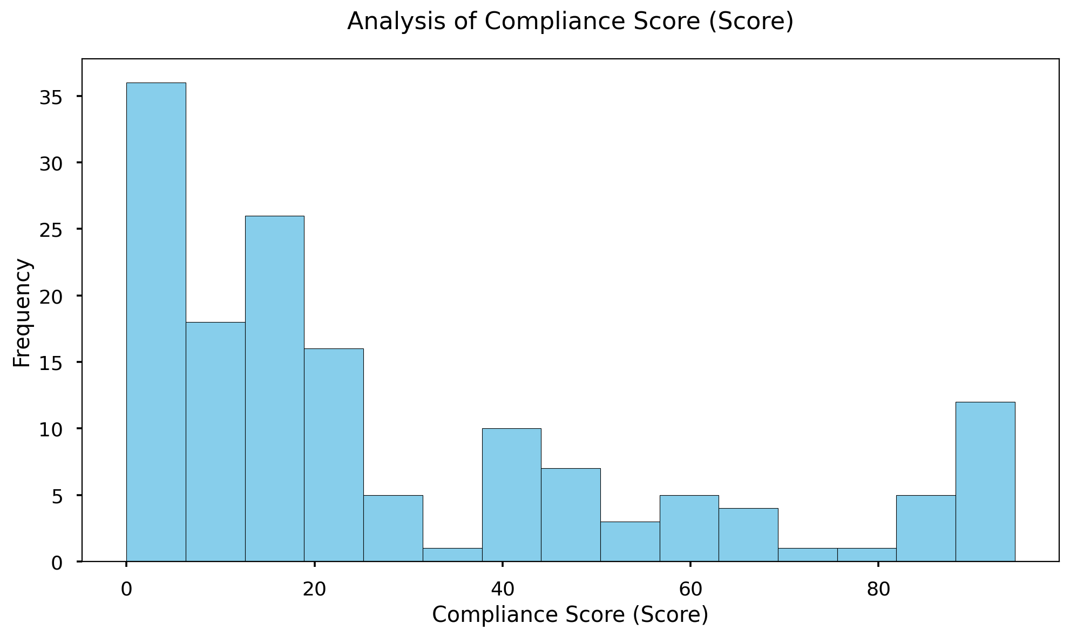
Analysis of Compliance Score (Score)
Summary Insight:
The 'Compliance Score (Score)' data shows a wide range of compliance levels, with the average score indicating room for improvement. The significant standard deviation suggests considerable variability across the dataset, warranting further investigation into specific compliance areas.
Key Metrics:
Count: 150 entries
Average Score: 28.49
Minimum Score: 0.00
Maximum Score: 94.50
25th Percentile: 7.63
75th Percentile: 44.38

Slide 13
Thank You

