Slide 1
Website Assessment Report
Source: Sample Audit Report v1.xlsx

Slide 2
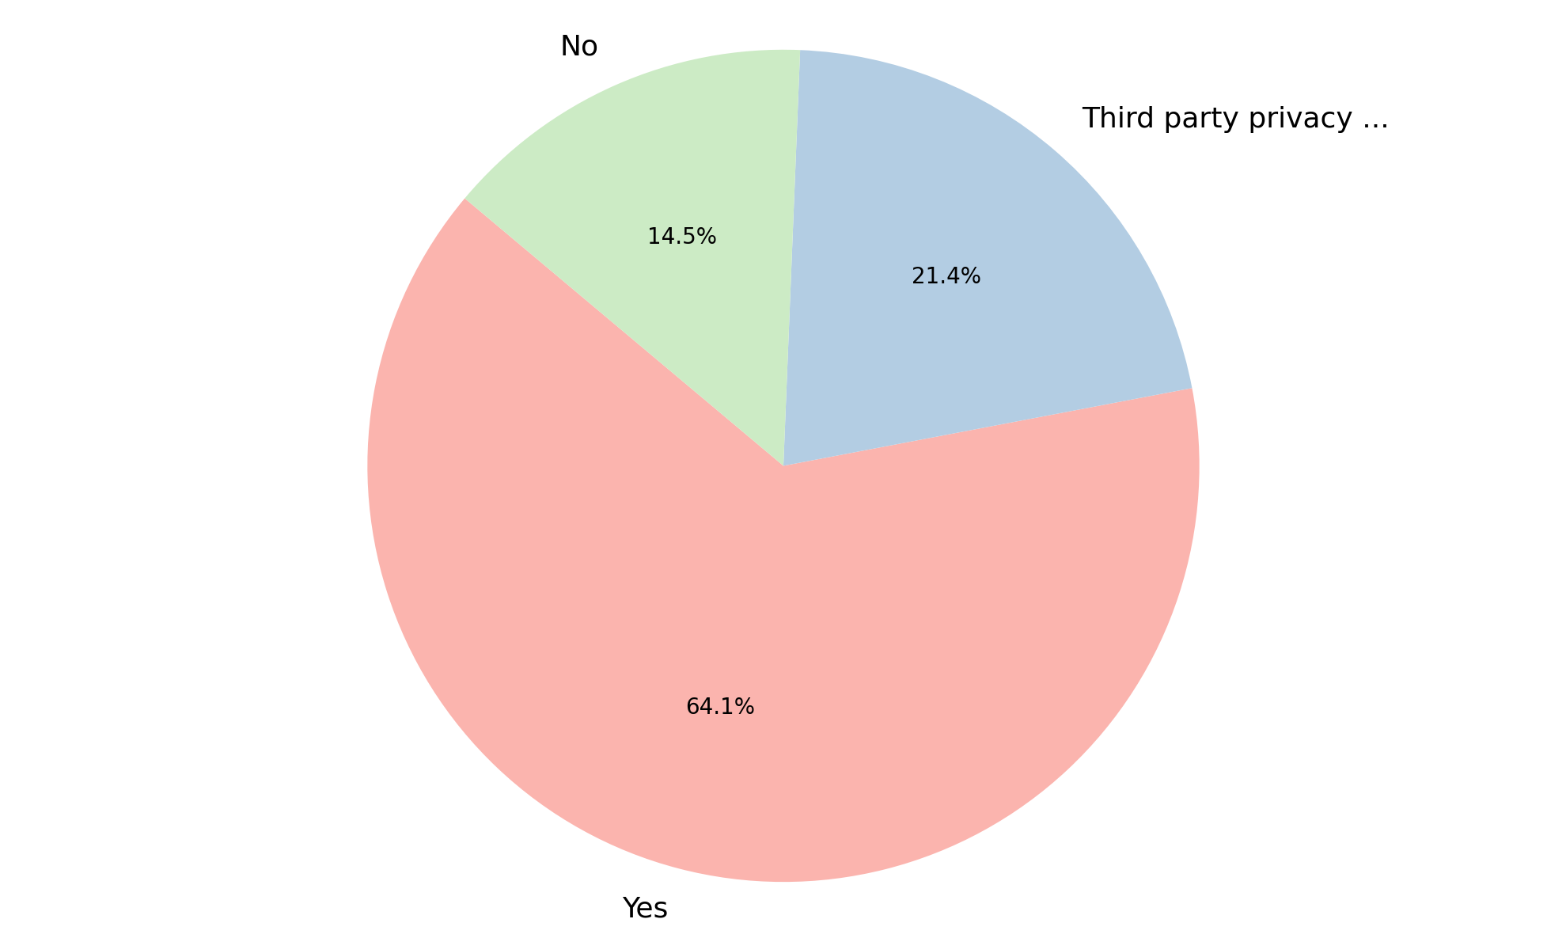
Analysis of Privacy Policy
Summary Insight:
A substantial majority (64.1%) of entities indicate having a privacy policy.
However, a significant portion (21.4%) relies on third-party privacy policies, which might introduce dependencies.
A concerning 14.5% of entities report having no privacy policy at all.
This indicates a diverse landscape with room for improving direct privacy policy ownership.
The data highlights varying levels of privacy policy implementation across the dataset.
Key Metrics:
Total Policies Reviewed: 117
Yes: 75 (64.1%)
Third party privacy policy: 25 (21.4%)
No: 17 (14.5%)

Slide 3
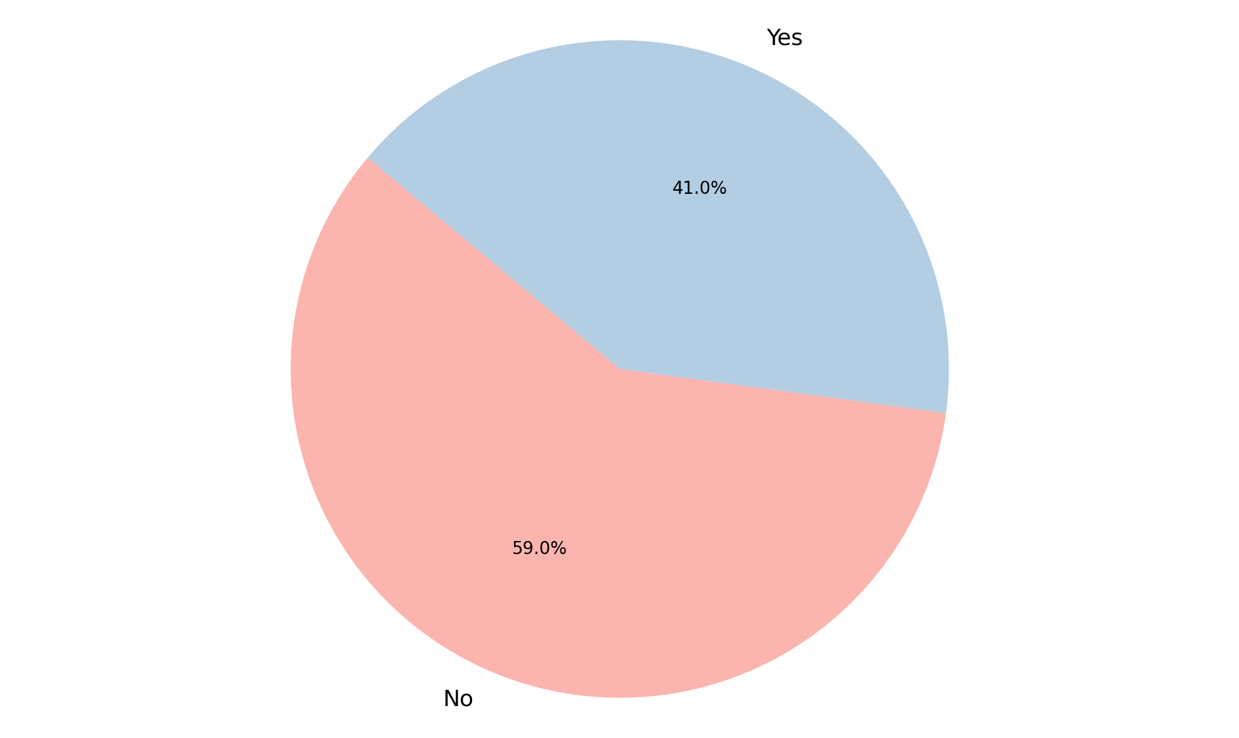
Analysis of Cookie Banner Deployed
Summary Insight:
The data reveals that a majority (59.0%) of entities have not deployed a cookie banner.
Only 41.0% of entities have successfully implemented a cookie banner.
This presents a significant compliance challenge, indicating many users may not be informed or able to consent to cookie usage.
The low deployment rate suggests a potential gap in meeting modern web privacy standards.
There is a clear need for increased focus on cookie banner implementation across the dataset.
Key Metrics:
Total Entities: 117
No: 69 (59.0%)
Yes: 48 (41.0%)

Slide 4
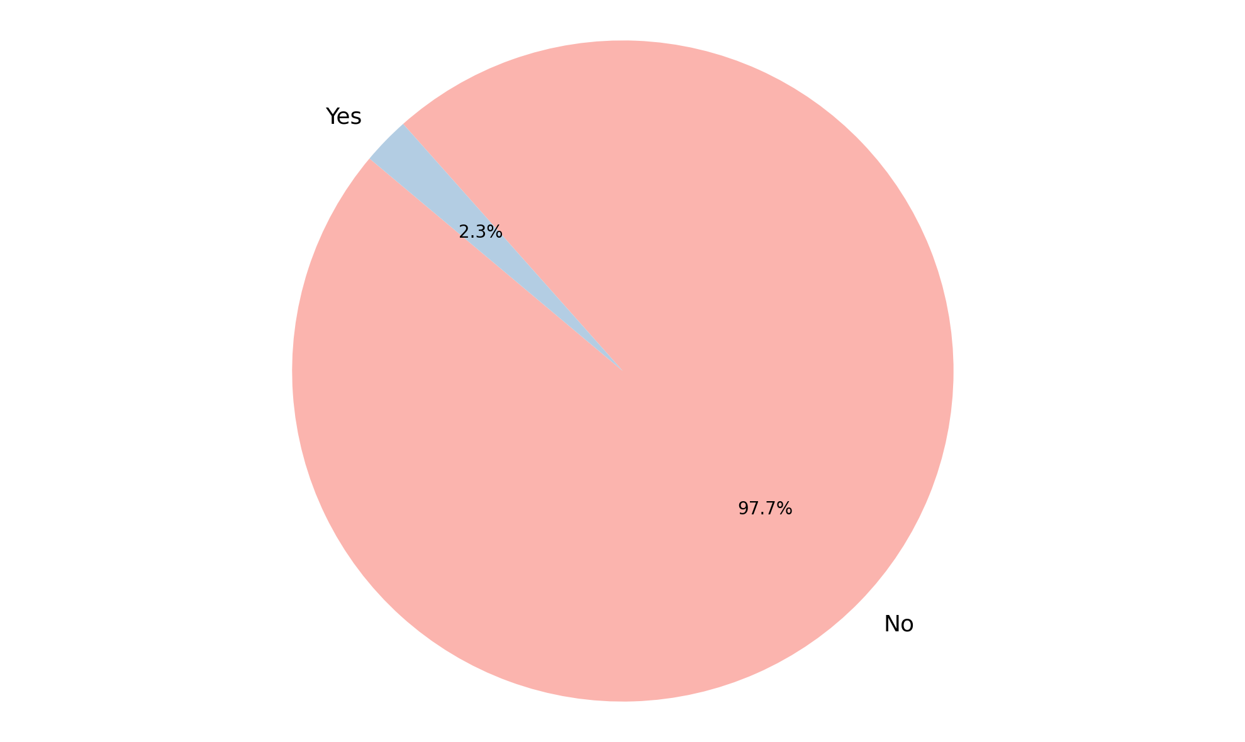
Analysis of User Consent Choices Honored
Summary Insight:
A striking 97.7% of entities are failing to honor user consent choices.
This represents a critical and widespread failure in respecting user privacy preferences.
Only a negligible 2.3% of entities are correctly implementing user-given consent.
This severe non-compliance indicates a fundamental issue in how user data privacy is managed post-consent.
Immediate and drastic measures are required to rectify this profound disregard for user consent.
Key Metrics:
Total Entries: 43
No: 42 (97.7%)
Yes: 1 (2.3%)

Slide 5
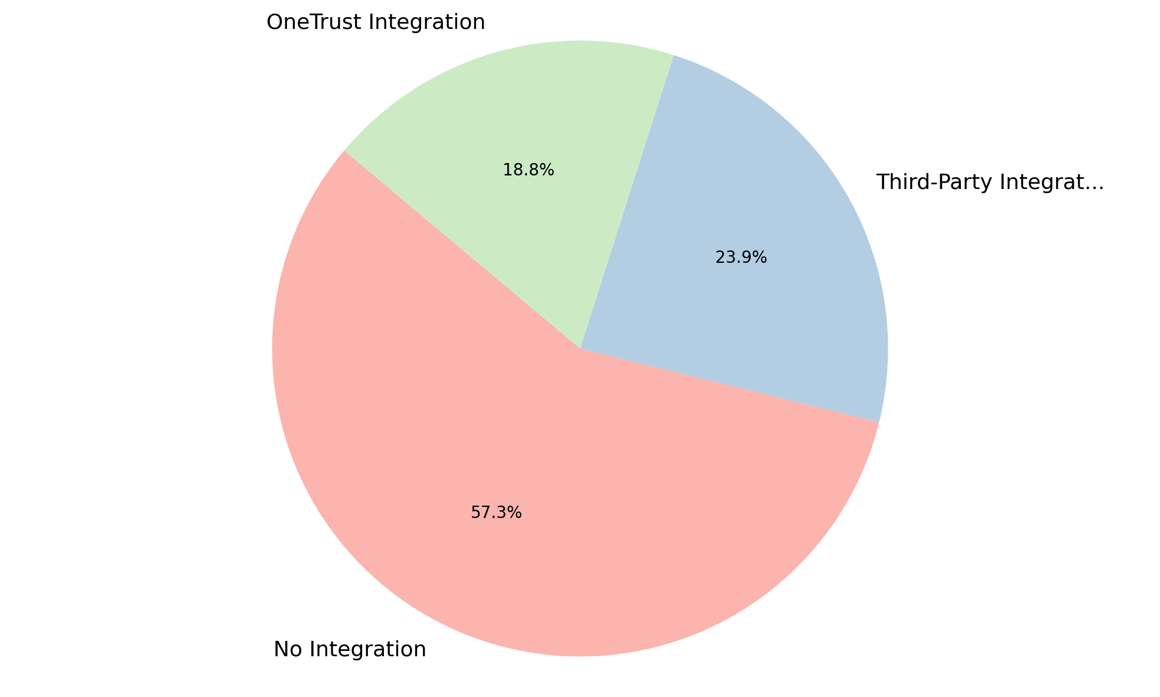
Analysis of OneTrust Integration
Summary Insight:
The majority of systems currently lack any direct OneTrust integration, indicating a significant potential area for development or consolidation.
Over half of the observed systems (57.3%) operate without any integration solution for privacy management.
Approximately one-quarter of the systems are utilizing a third-party integration, suggesting a varied landscape of existing solutions.
A smaller portion, less than 20%, have already adopted OneTrust Integration, highlighting a growth opportunity for standardization.
This data suggests a strong need for evaluating current integration strategies to enhance efficiency and compliance.
Key Metrics:
Total Systems: 117
No Integration: 67 (57.3%)
Third-Party Integration: 28 (23.9%)
OneTrust Integration: 22 (18.8%)

Slide 6
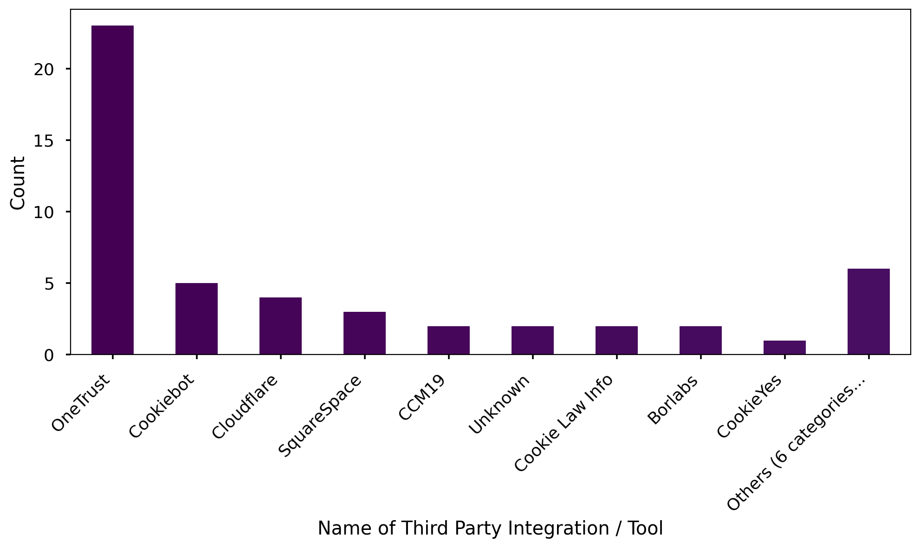
Analysis of Name of Third Party Integration / Tool
Summary Insight:
Among the systems using third-party or OneTrust integrations, OneTrust itself is the most frequently cited tool.
Nearly half of these integrations specifically name OneTrust, suggesting its prominence in the current integration landscape.
Other notable tools like Cookiebot and Cloudflare make up smaller, but significant, portions of the integrations.
A collection of various smaller groups, labeled as 'Others', indicates a diverse ecosystem of less common or niche tools being used.
This breakdown helps understand the varied tools and platforms users rely on for managing privacy or related functionalities.
Key Metrics:
Total Integrations/Tools Mentioned: 50
OneTrust: 23 (46.0%)
Cookiebot: 5 (10.0%)
Cloudflare: 4 (8.0%)
Others (6 categories): 6 (12.0%)

Slide 7
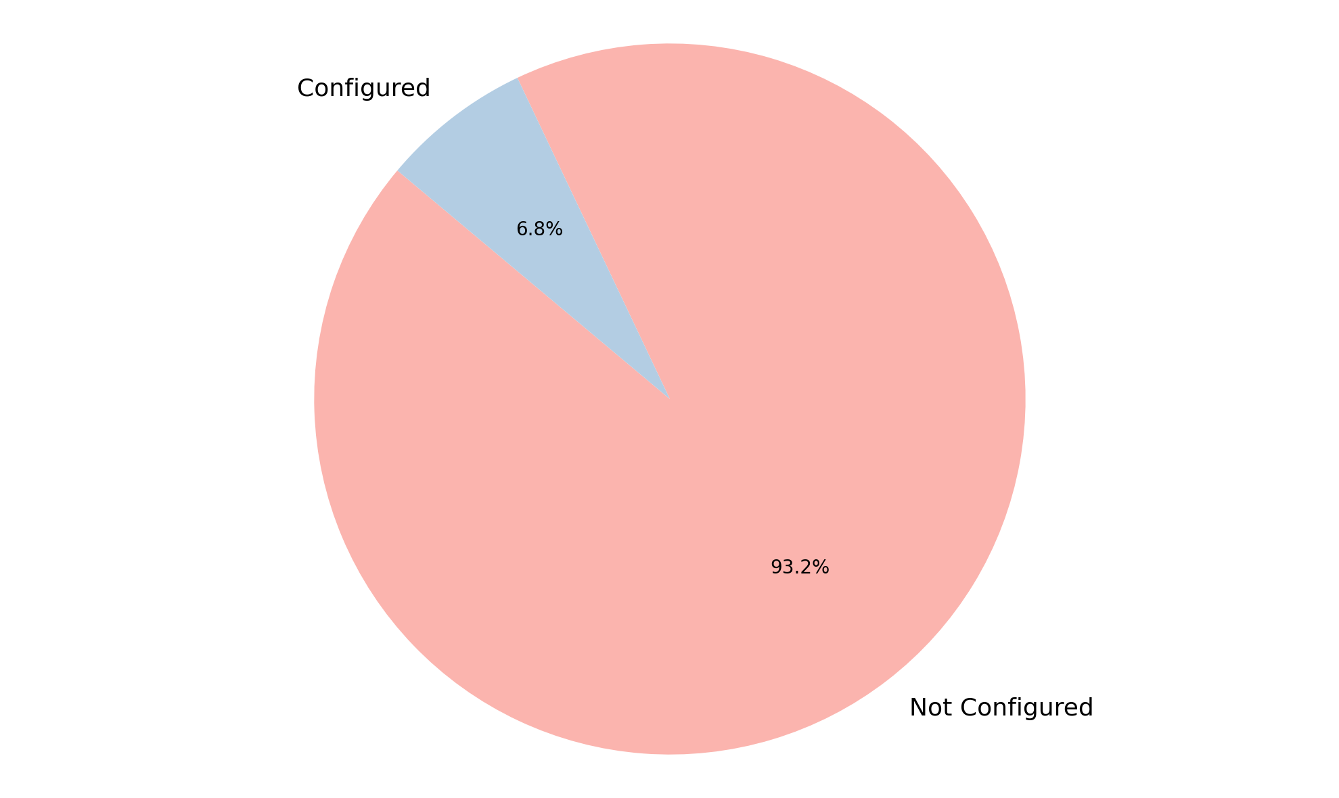
Analysis of GPC Configuration
Summary Insight:
The data clearly indicates that Global Privacy Control (GPC) is largely not configured across the surveyed systems.
A substantial majority, over 93% of systems, have not implemented GPC configuration.
This low adoption rate suggests a significant gap in leveraging GPC for enhanced user privacy and compliance.
Only a very small fraction of systems have GPC properly configured, pointing to a potential area for education or mandatory implementation.
The current state highlights an opportunity to improve privacy settings and adhere to emerging privacy standards.
Key Metrics:
Total Systems: 117
Not Configured: 109 (93.2%)
Configured: 8 (6.8%)

Slide 8
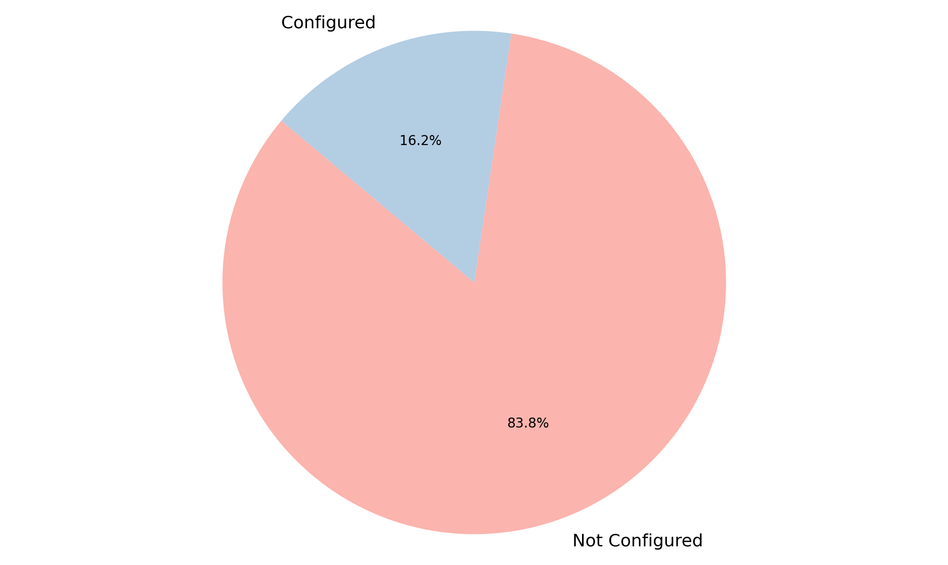
Analysis of Geolocation Rules
Summary Insight:
The vast majority of Geolocation Rules are currently not configured.
A significantly smaller portion of the rules have been configured.
Approximately 83.8% of the geolocation rules require configuration.
This indicates a substantial area where setup or activation is still pending across the dataset.
Key Metrics:
Total items: 117
Not Configured: 98 (83.8%)
Configured: 19 (16.2%)

Slide 9
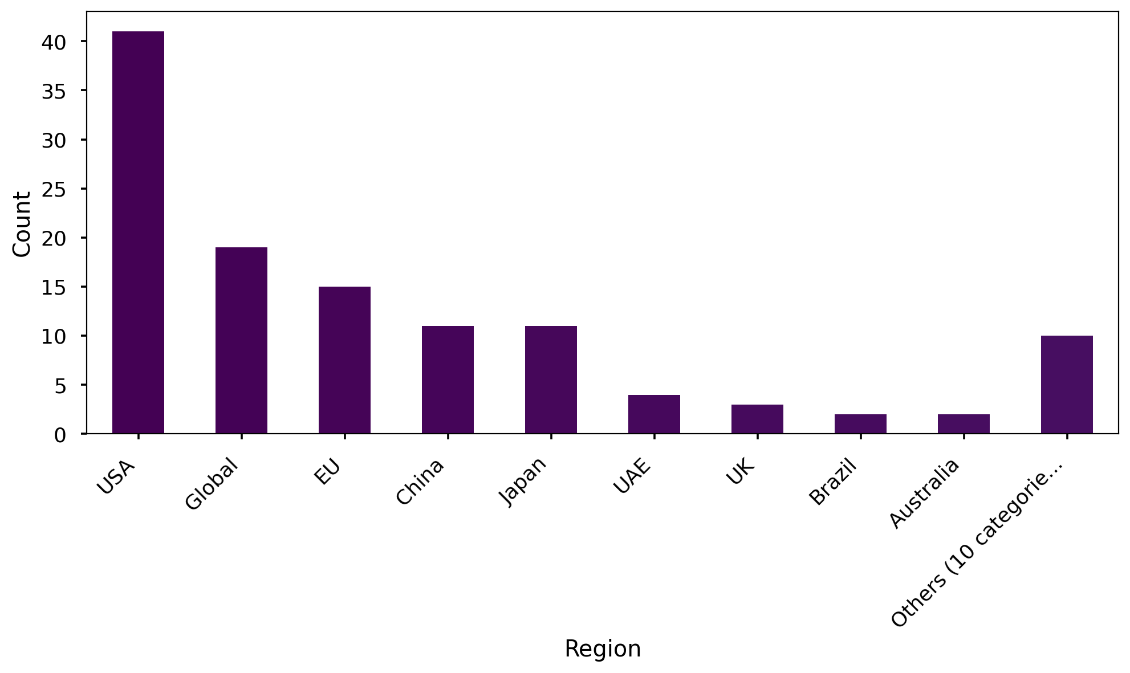
Analysis of Region
Summary Insight:
The USA represents the largest single geographical segment in the dataset, accounting for over one-third of the entries.
'Global' presence is the second most significant category, indicating a broad international reach beyond specific countries.
Europe (EU) holds a notable share, solidifying its position as a key region.
While China and Japan each have considerable individual representation, a diverse collection of ten smaller categories, collectively termed 'Others', accounts for a notable portion, highlighting wide geographical distribution.
Key Metrics:
Total items: 118
USA: 41 (34.7%)
Global: 19 (16.1%)
EU: 15 (12.7%)
Others (10 categories): 10 (8.5%)

Slide 10
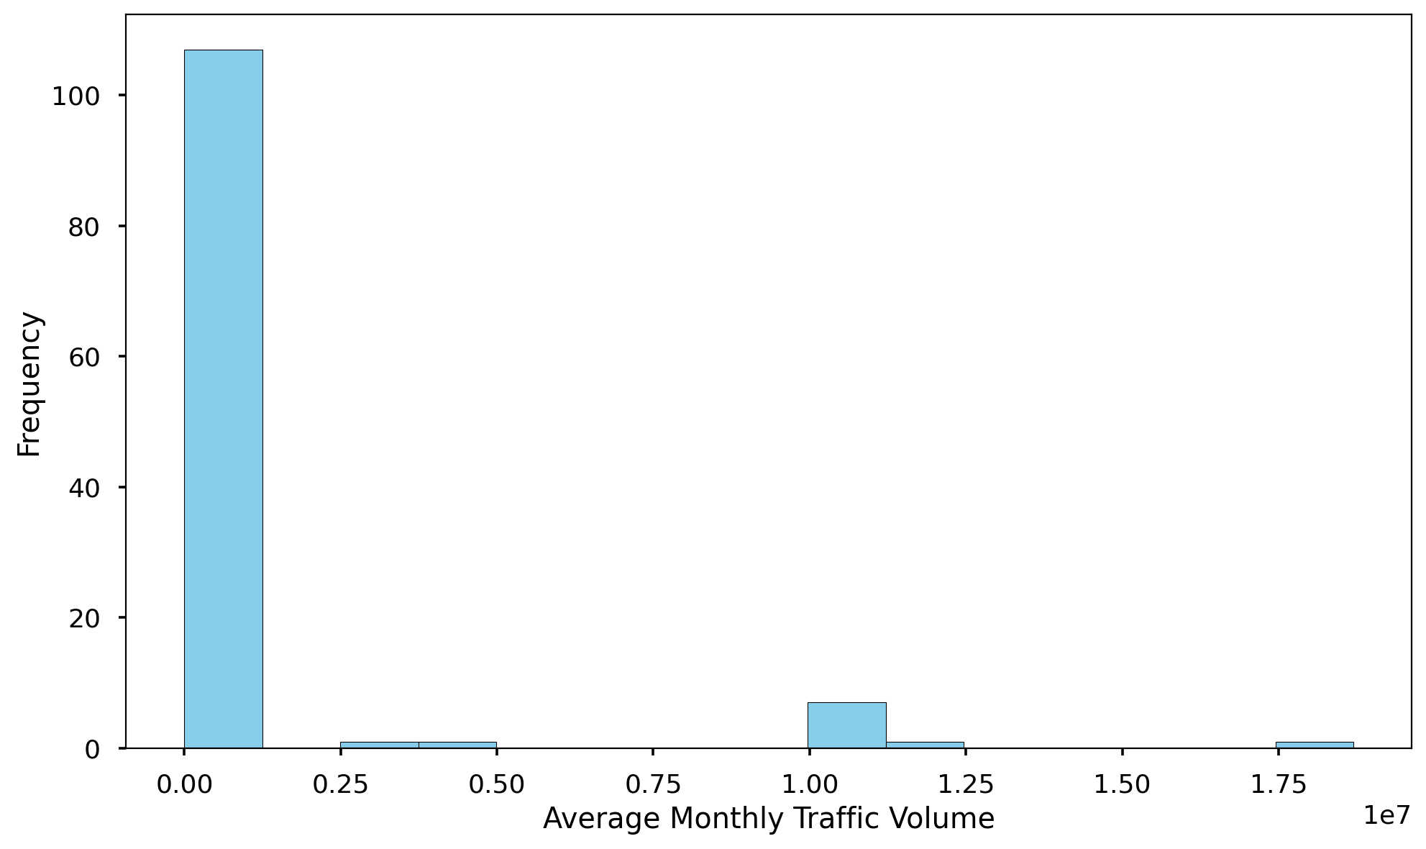
Analysis of Average Monthly Traffic Volume
Summary Insight:
The average monthly traffic volume is quite high, exceeding 1 million, suggesting a general trend of substantial traffic.
There is extreme variability in traffic volume, as indicated by a standard deviation far exceeding the mean, pointing to a wide spread of values.
A significant portion of entities (75%) have relatively low traffic volumes, with the 75th percentile at just over 40,000.
However, the presence of a few extremely high-traffic instances, with a maximum nearing 18.7 million, heavily skews the average upwards.
The median traffic volume is quite low at 11,500, highlighting that most entities have modest traffic despite the high overall average.
Key Metrics:
Total entries: 118
Average Traffic Volume: 1,017,830
Maximum Traffic Volume: 18,696,560
Minimum Traffic Volume: 0
Median Traffic Volume (50th percentile): 11,500

Slide 11
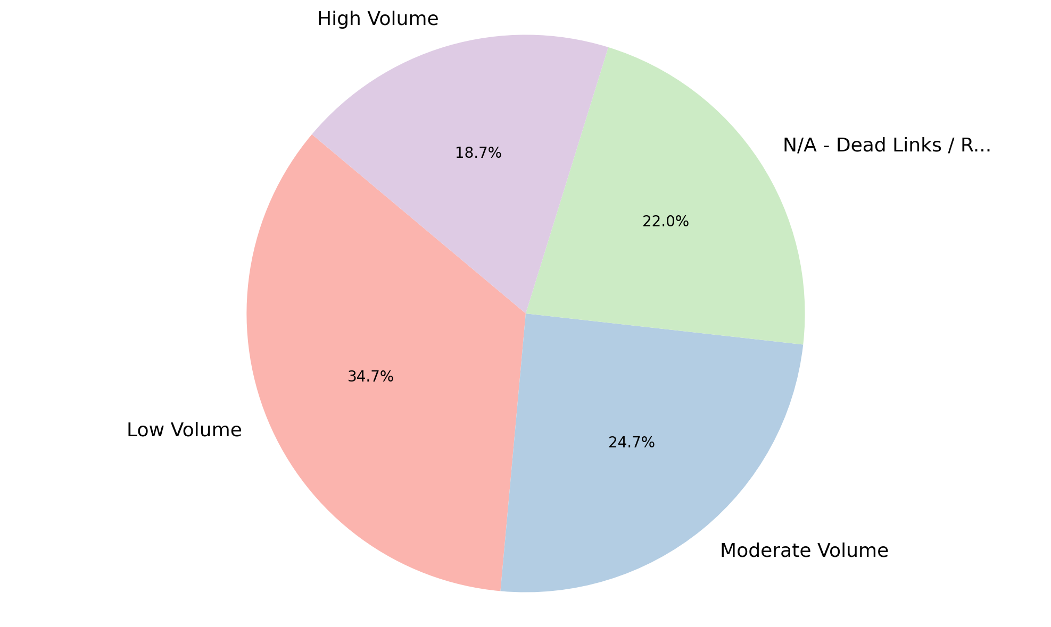
Analysis of Level of Traffic Volume
Summary Insight:
The majority of analyzed items experience low to moderate traffic volumes, indicating a potentially less active environment for a significant portion of the dataset.
'Low Volume' is the most prevalent category, accounting for over a third of the observations, suggesting a primary focus area for optimization.
A considerable portion of the data, nearly a quarter, is composed of 'N/A - Dead Links / Redirects', representing non-actionable or inaccessible entries.
This 'N/A' category suggests a substantial segment of the dataset requires cleanup or further investigation to understand why these links are not providing valid data.
Conversely, 'High Volume' traffic is the least common, observed in less than 20% of the cases.
Understanding this distribution is crucial for targeted resource allocation and content strategy.
Key Metrics:
Total Observations: 150
Low Volume: 52 (34.67%)
Moderate Volume: 37 (24.67%)
N/A - Dead Links / Redirects: 33 (22.00%)

Slide 12
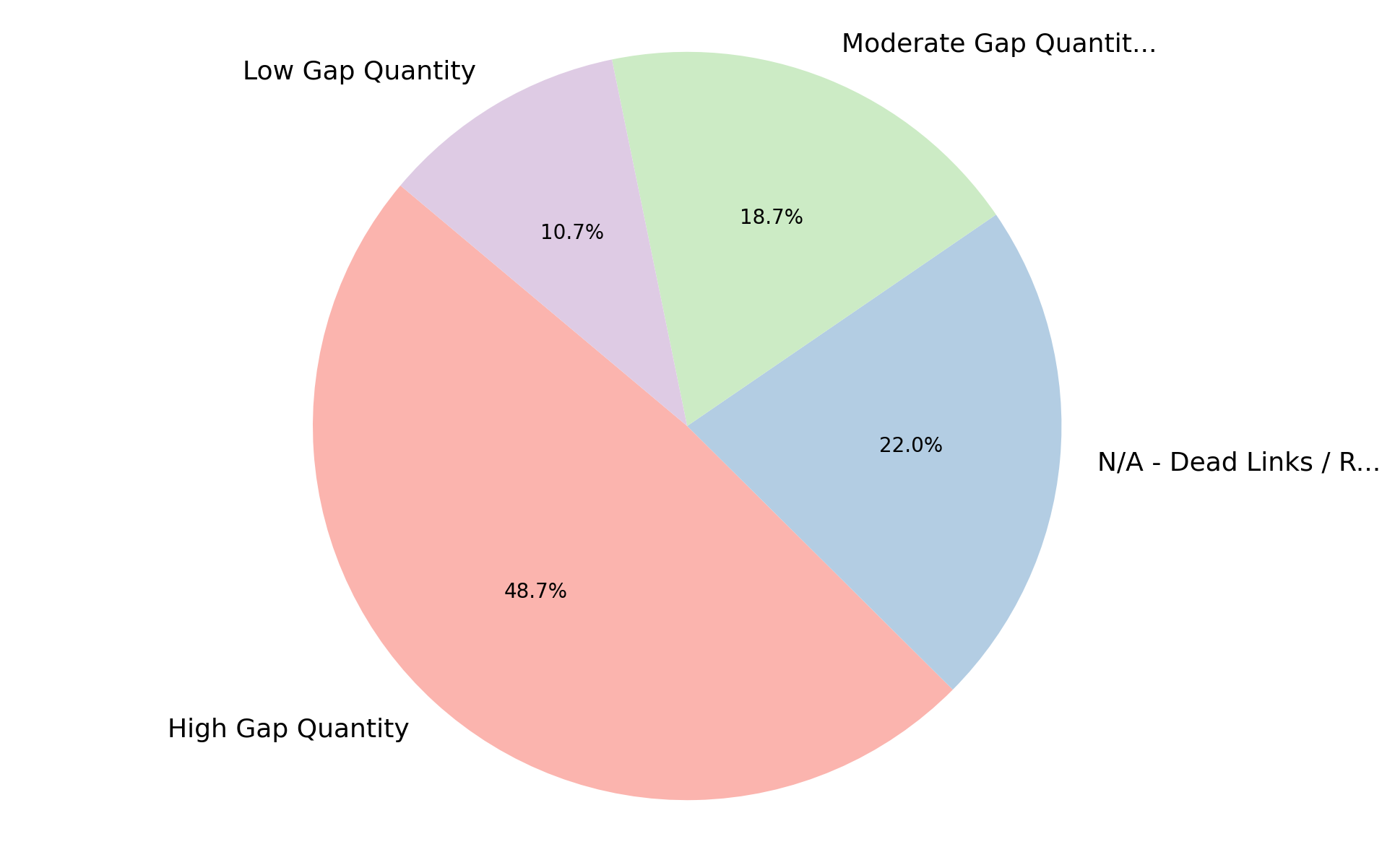
Analysis of Level of Gap Quantity
Summary Insight:
A significant challenge is highlighted by the 'High Gap Quantity' category, which represents nearly half of all observations, indicating pervasive data incompleteness.
This suggests a widespread issue with missing or incomplete data points across a large segment of the dataset, impacting data reliability.
Similar to traffic volume, 'N/A - Dead Links / Redirects' accounts for a notable portion of the data, pointing to underlying structural or access issues.
The combined presence of high gaps and dead links indicates that the dataset may require substantial data quality improvement initiatives.
'Low Gap Quantity' is the least common observation, occurring in just over 10% of the cases, reinforcing the prevalence of data completeness issues.
Addressing these gaps will be critical for improving the overall reliability and usability of the data.
Key Metrics:
Total Observations: 150
High Gap Quantity: 73 (48.67%)
N/A - Dead Links / Redirects: 33 (22.00%)
Moderate Gap Quantity: 28 (18.67%)

Slide 13
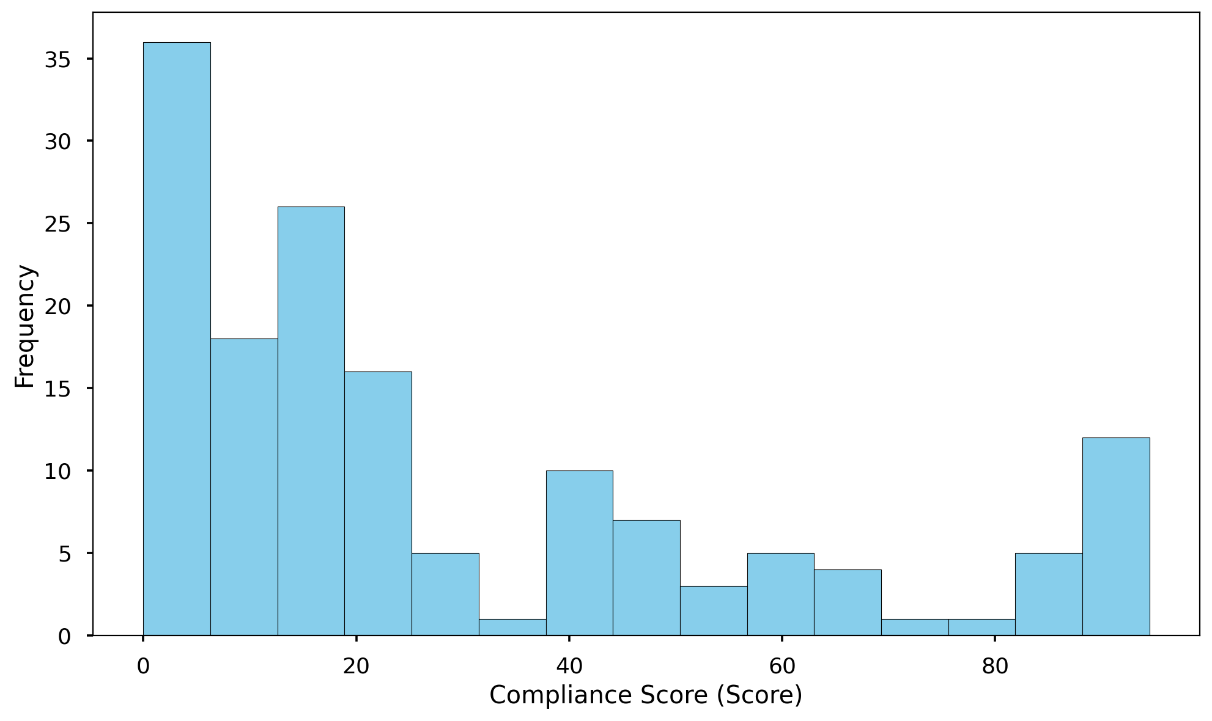
Analysis of Compliance Score (Score)
Summary Insight:
The Compliance Score data reveals a wide spectrum of performance, ranging from perfect non-compliance (0) to a high score of 94.5.
The average compliance score is approximately 28.5, which is relatively low compared to the maximum observed score, indicating significant room for overall improvement.
With a considerable standard deviation of about 29.2, there is a large spread in scores, suggesting that while some entities achieve high compliance, many others fall short.
The median score of 17.25 is notably lower than the mean, indicating a positive skew in the data where a larger number of entries exhibit lower compliance scores.
This distribution suggests that targeted interventions on low-scoring entities could significantly raise the overall average compliance.
Key Metrics:
Total Count: 150
Average Score: 28.488
Maximum Score: 94.50
Minimum Score: 0.00

Slide 14
Conclusion
The compliance assessment reveals a prevalent issue, with the majority of audited websites showing low overall compliance scores and a significant number exhibiting high quantities of identified gaps.
A critical finding is the near-complete failure across the portfolio to honor user consent choices, representing a fundamental risk to privacy and regulatory compliance.
Many digital properties lack essential foundational controls, with a large proportion missing deployed cookie banners and exhibiting inconsistent privacy policy implementations.
The implementation of advanced privacy signals, such as Global Privacy Control (GPC) and tailored geolocation rules, is notably absent across most websites, indicating a significant area for development.
While a portion of the assessed portfolio consists of non-operational links, the active websites present varied traffic volumes, meaning compliance risks are present across properties with different levels of public exposure.
These widespread gaps collectively indicate an urgent need for a centralized strategy and immediate remediation efforts to elevate the compliance posture across all digital properties.

Slide 15
Thank You

