Slide 1
Website Assessment Report
Source: Sample Audit Report v1.xlsx

Slide 2
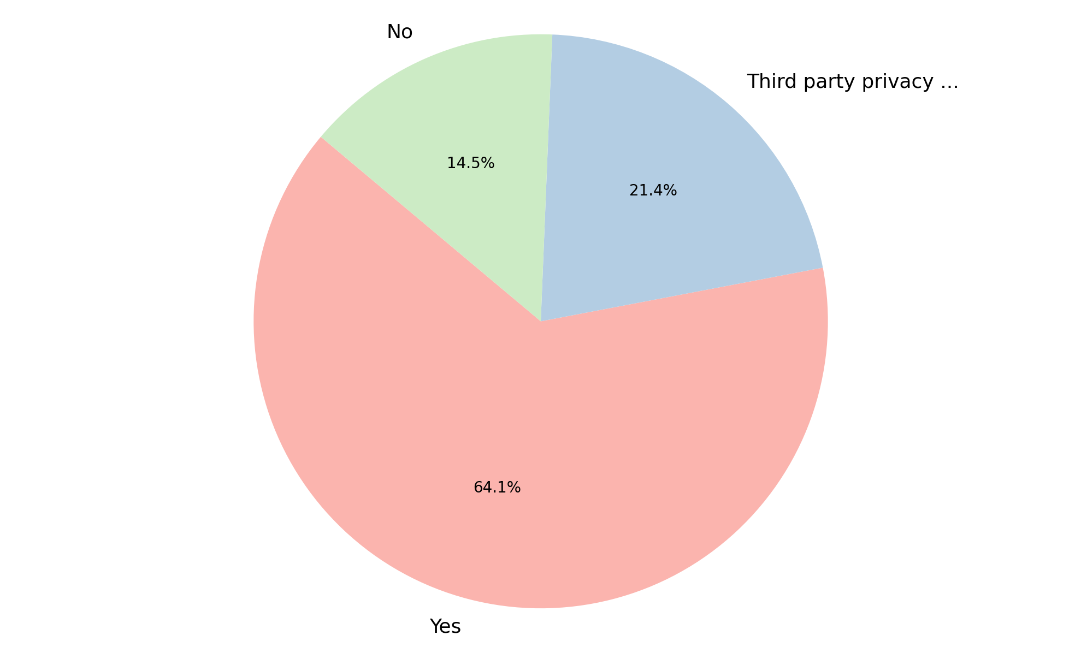
Analysis of Privacy Policy
Summary Insight:
The majority of entities (64.1%) have a privacy policy in place.
A notable portion (21.4%) utilizes a third-party privacy policy, indicating reliance on external services or shared policies.
Conversely, a significant segment (14.5%) currently lacks any form of privacy policy, which could pose a compliance risk.
This distribution highlights varied approaches to privacy policy management within the dataset.
Key Metrics:
Total records: 117
Yes: 75 (64.1%)
Third party privacy policy: 25 (21.4%)
No: 17 (14.5%)

Slide 3
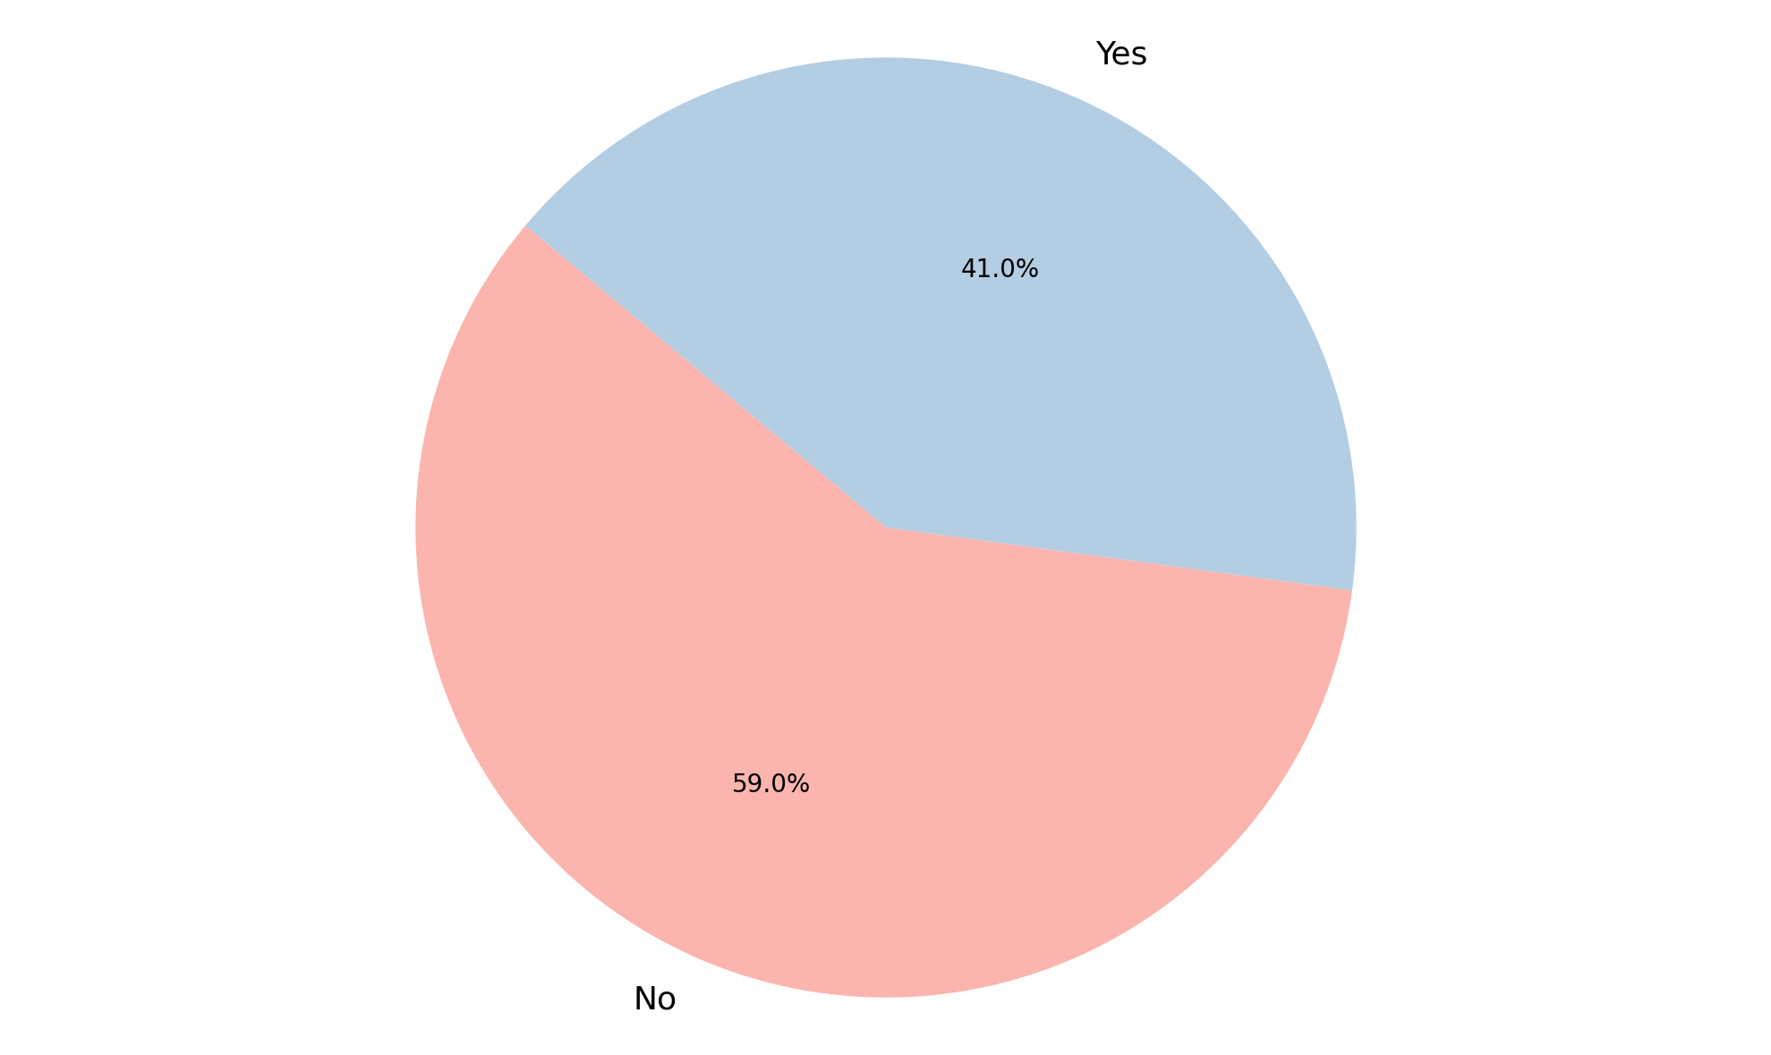
Analysis of Cookie Banner Deployed
Summary Insight:
A slight majority of the entities (59.0%) have not yet deployed a cookie banner.
A substantial proportion (41.0%) have successfully implemented a cookie banner.
This indicates that cookie banner deployment is not universal, with significant room for broader adoption across the dataset.
Efforts may be needed to encourage further deployment for enhanced compliance.
Key Metrics:
Total records: 117
No: 69 (59.0%)
Yes: 48 (41.0%)

Slide 4
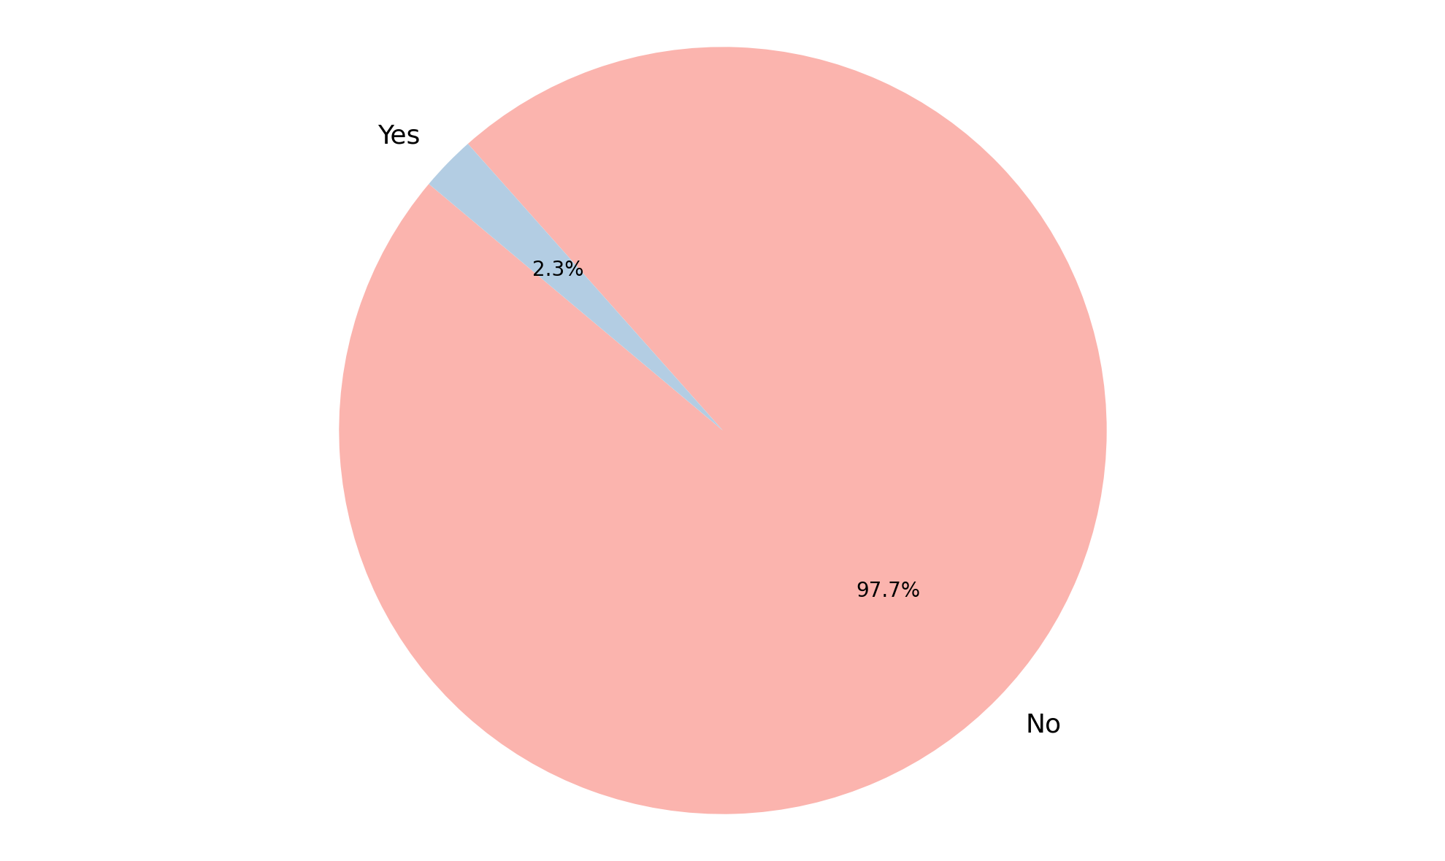
Analysis of User Consent Choices Honored
Summary Insight:
The data reveals a critical concern: an overwhelming majority (97.7%) of instances do not honor user consent choices.
Only a minuscule fraction (2.3%) of cases correctly respect user consent preferences.
This indicates a severe systemic issue in adhering to user privacy preferences within the dataset.
Urgent attention and remediation are necessary to address this significant compliance gap.
Key Metrics:
Total records: 43
No: 42 (97.7%)
Yes: 1 (2.3%)

Slide 5
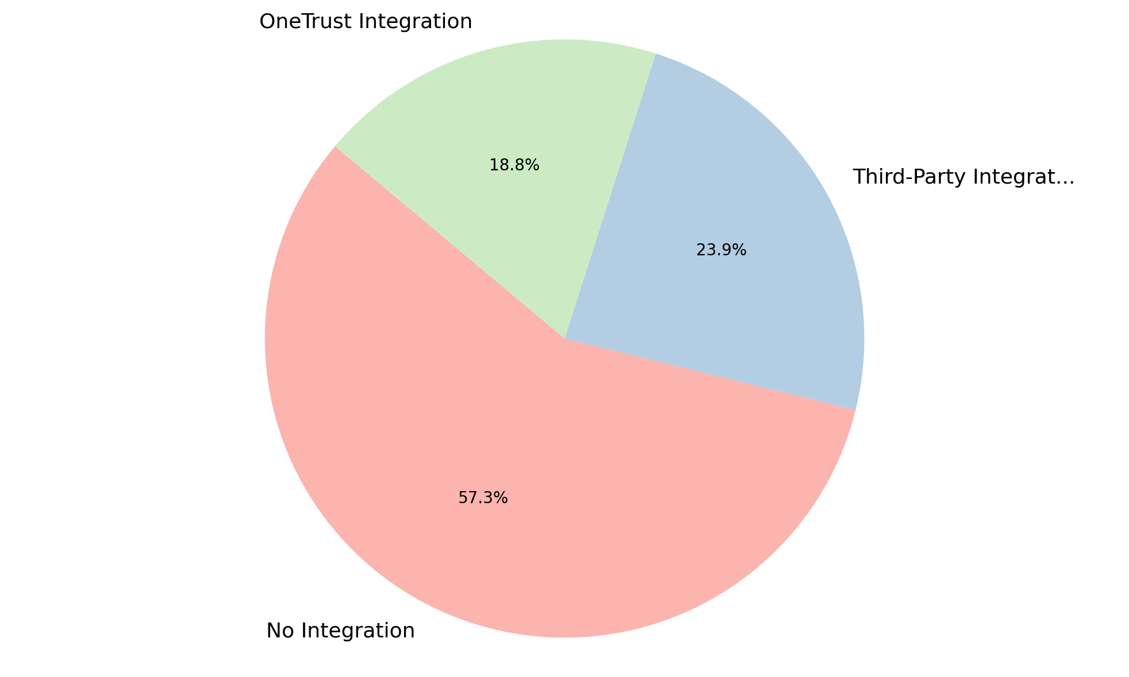
Analysis of OneTrust Integration
Summary Insight:
A significant majority of the entities, over half, currently have no OneTrust integration in place.
Around a quarter of the entities utilize a third-party integration, indicating a diverse approach to managing integrations.
Only a small portion directly uses OneTrust integration, suggesting potential for increasing direct adoption.
This data highlights a predominant lack of direct OneTrust integration across the dataset.
Key Metrics:
Total: 117
No Integration: 67 (57.3%)
Third-Party Integration: 28 (23.9%)
OneTrust Integration: 22 (18.8%)

Slide 6
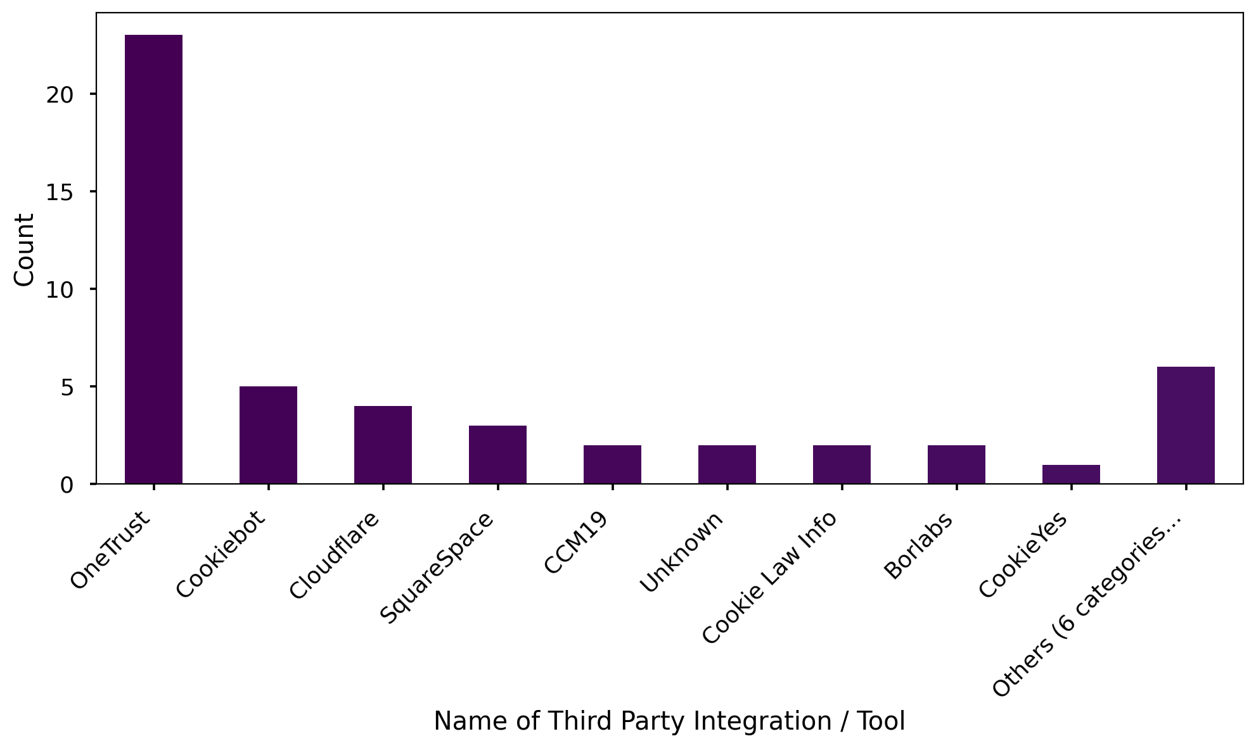
Analysis of Name of Third Party Integration / Tool
Summary Insight:
Among entities utilizing third-party integrations, OneTrust is the most frequently named tool, highlighting its widespread presence even in this context.
A considerable portion of integrations are attributed to various smaller, distinct third-party providers, collectively grouped as 'Others'.
Cookiebot and Cloudflare represent the next most common specific third-party tools after OneTrust.
This indicates a diverse ecosystem of integration tools, with OneTrust being a prominent player.
Key Metrics:
Total: 50
OneTrust: 23 (46.0%)
Others (6 categories): 6 (12.0%) - This represents a collection of smaller, distinct groups.
Cookiebot: 5 (10.0%)
Cloudflare: 4 (8.0%)

Slide 7
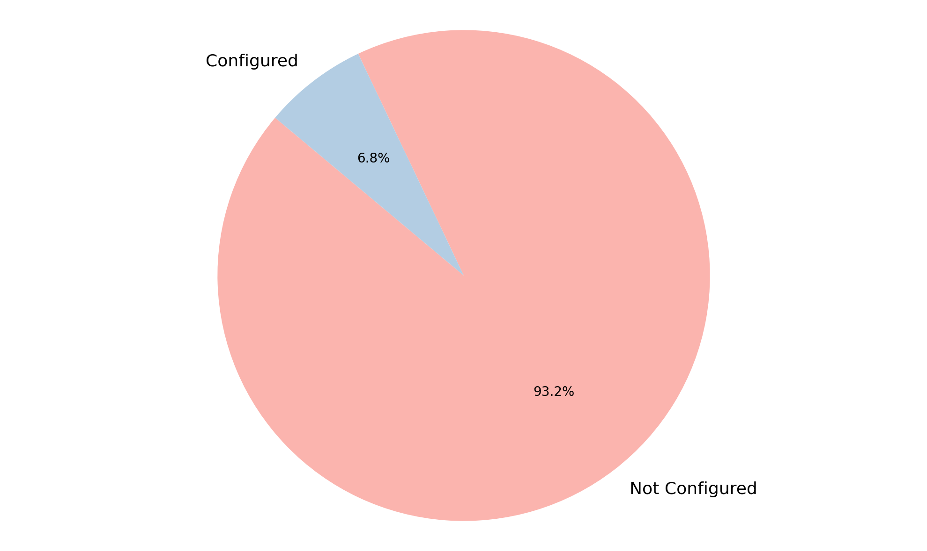
Analysis of GPC Configuration
Summary Insight:
An overwhelming majority, over 93%, of the entities are currently not configured for GPC (Global Privacy Control).
Only a very small fraction of entities have GPC configured, indicating a significant gap in adoption.
This suggests a widespread lack of GPC implementation or awareness across the dataset.
The data points to GPC configuration being a low priority or largely unaddressed for most entities.
Key Metrics:
Total: 117
Not Configured: 109 (93.2%)
Configured: 8 (6.8%)

Slide 8
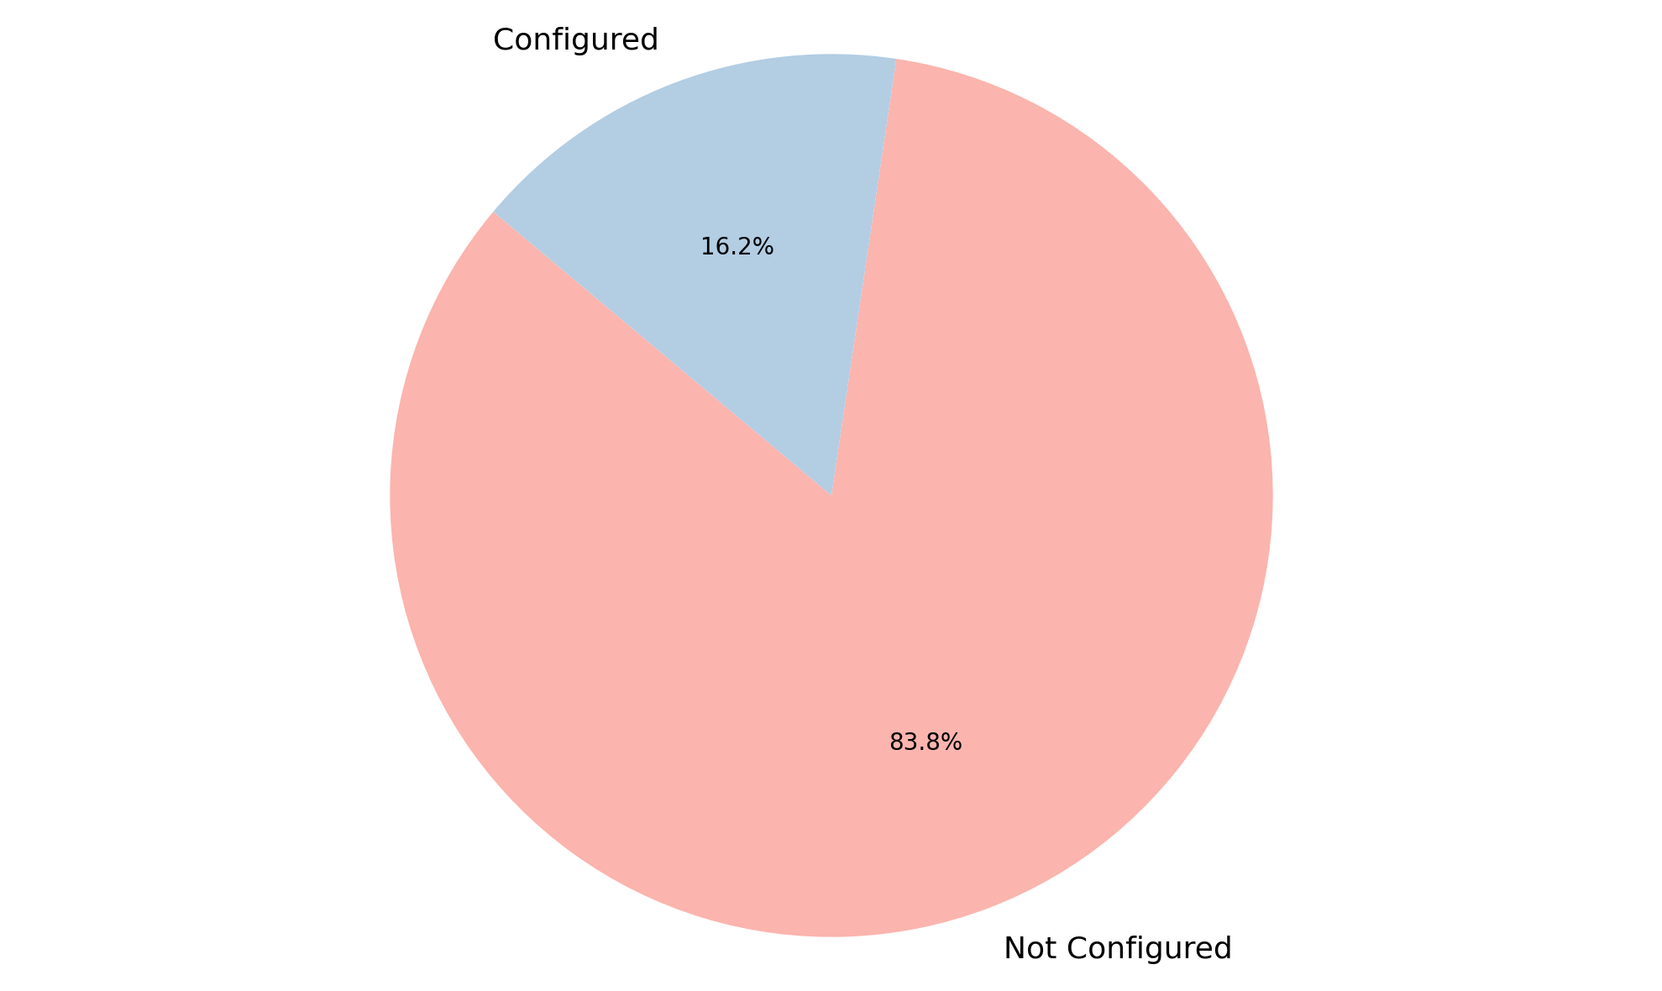
Analysis of Geolocation Rules
Summary Insight:
A substantial majority of geolocation rules are currently not configured, indicating a potential area for operational focus.
Only a small percentage of rules have been actively set up, suggesting that default settings are prevalent.
This data highlights that approximately five times more rules remain unconfigured compared to those that have been explicitly set.
Key Metrics:
Total Rules: 117
Not Configured: 98 (83.8%)
Configured: 19 (16.2%)

Slide 9
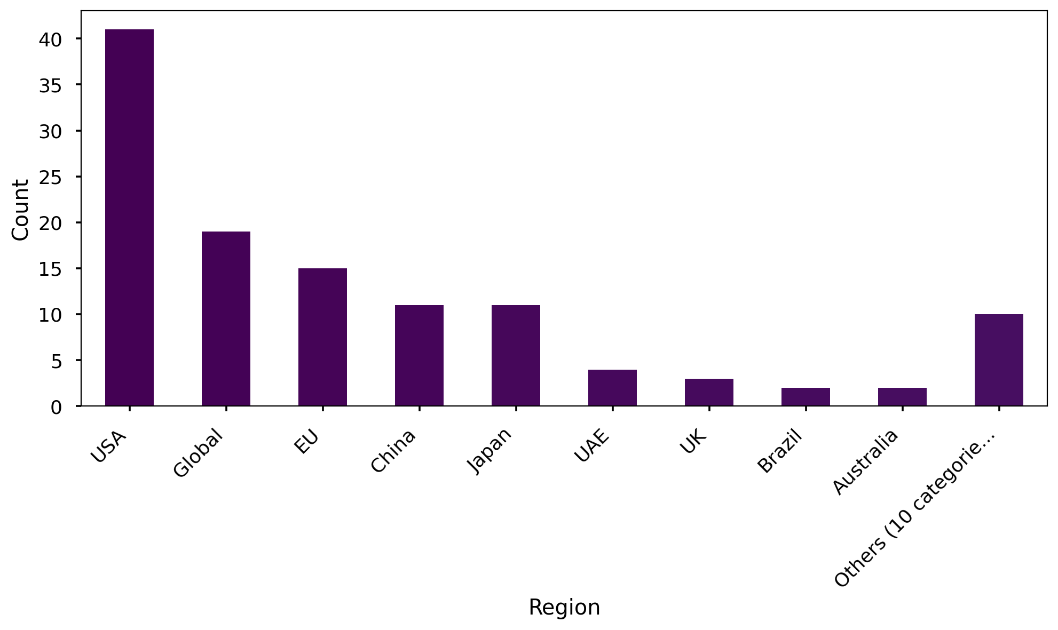
Analysis of Region
Summary Insight:
The United States represents the largest portion of entries, highlighting its primary importance in the dataset.
Global and European regions also show significant presence, indicating a diverse international reach beyond the US.
Asian markets, specifically China and Japan, are notably represented and contribute almost equally to the regional distribution.
The 'Others' category, encompassing 10 smaller categories, demonstrates the long tail of less frequent regional entries.
Key Metrics:
Total Entries: 118
USA: 41 (34.7%)
Global: 19 (16.1%)
EU: 15 (12.7%)
Others (10 categories): 10 (8.5%)

Slide 10
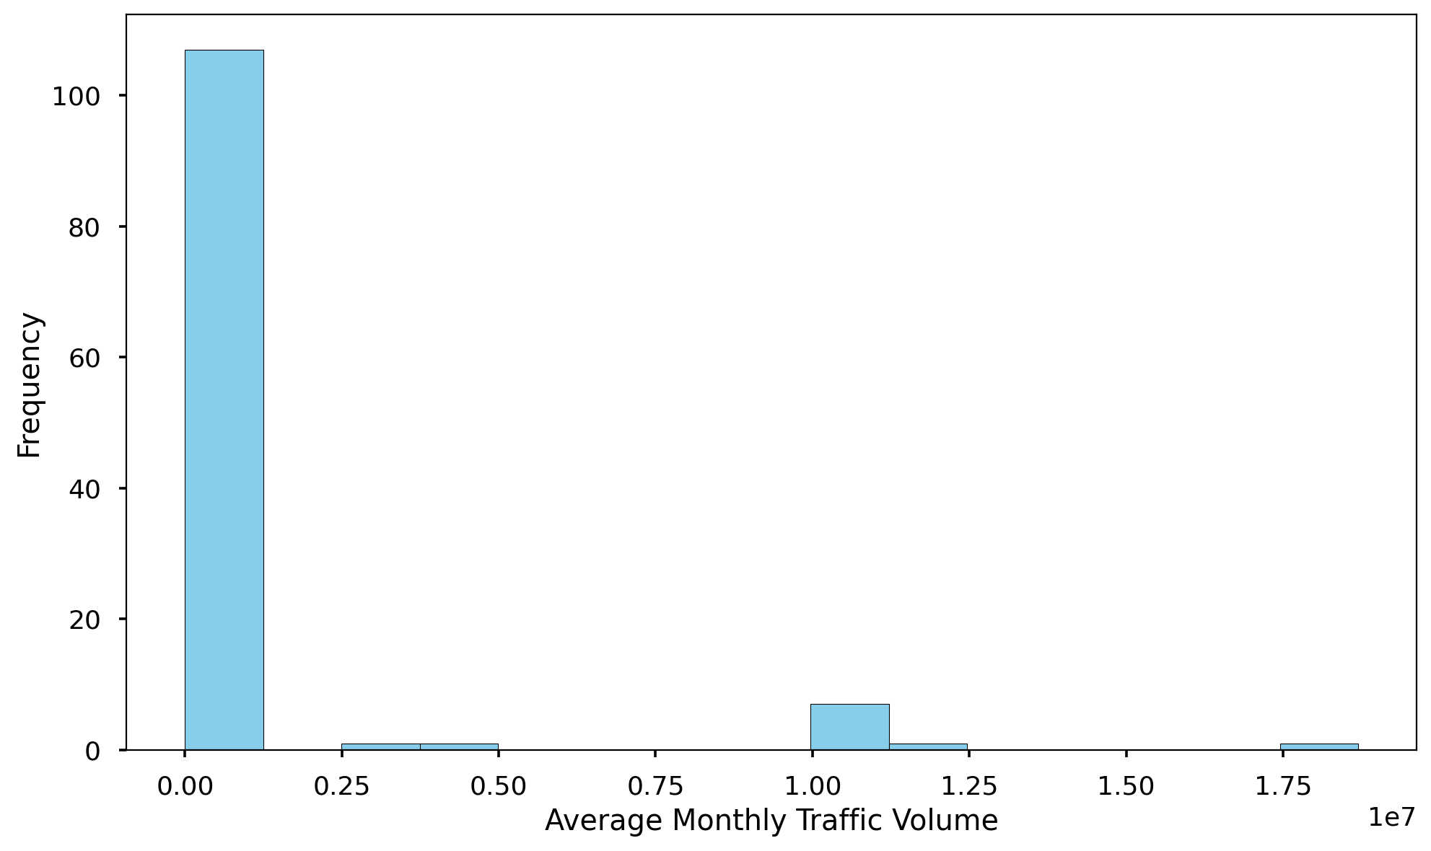
Analysis of Average Monthly Traffic Volume
Summary Insight:
The average monthly traffic volume is approximately 1 million, but this figure is heavily influenced by a few extremely high-volume instances.
There is an exceptionally wide range in traffic, spanning from zero up to nearly 18.7 million, indicating significant variability across the dataset.
The large standard deviation and the significant disparity between the mean and median (11,500) suggest that most entries have relatively low traffic volumes.
A substantial 75% of the traffic volumes fall below 40,925, confirming that the majority of instances are low-traffic, with a small number of outliers skewing the average.
Key Metrics:
Total Data Points: 118
Average Volume: 1,017,830
Maximum Volume: 18,696,560
Minimum Volume: 0
Median Volume (50th percentile): 11,500

Slide 11
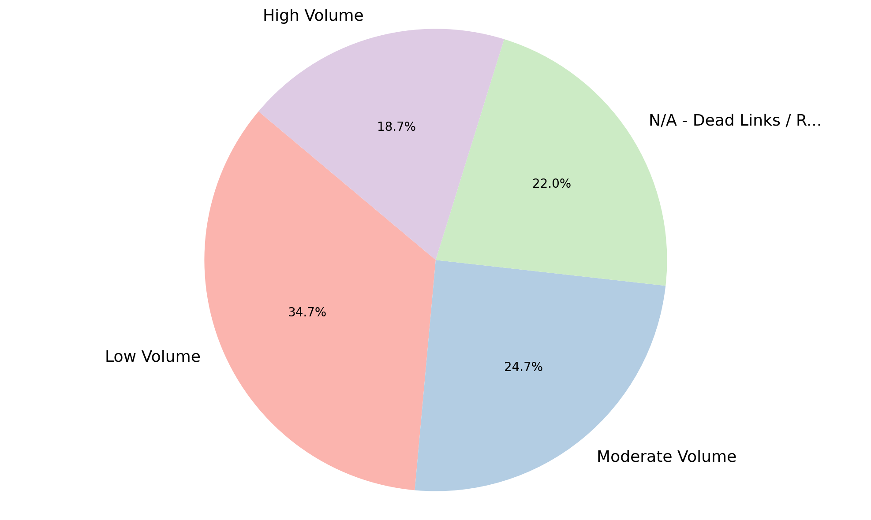
Analysis of Level of Traffic Volume
Summary Insight:
'Low Volume' is the most prevalent traffic level, accounting for over a third of the observations, indicating that a significant portion of the data falls into this category.
'Moderate Volume' follows as the second largest category, representing about a quarter of the traffic levels.
A notable percentage of entries are categorized as 'N/A - Dead Links / Redirects', which represents a collection of smaller, unclassified groups or data issues that need attention.
'High Volume' is the least common traffic level, suggesting fewer instances of highly trafficked links.
Key Metrics:
Total Observations: 150
Low Volume: 52 (34.7%)
Moderate Volume: 37 (24.7%)
N/A - Dead Links / Redirects: 33 (22.0%)
High Volume: 28 (18.7%)

Slide 12
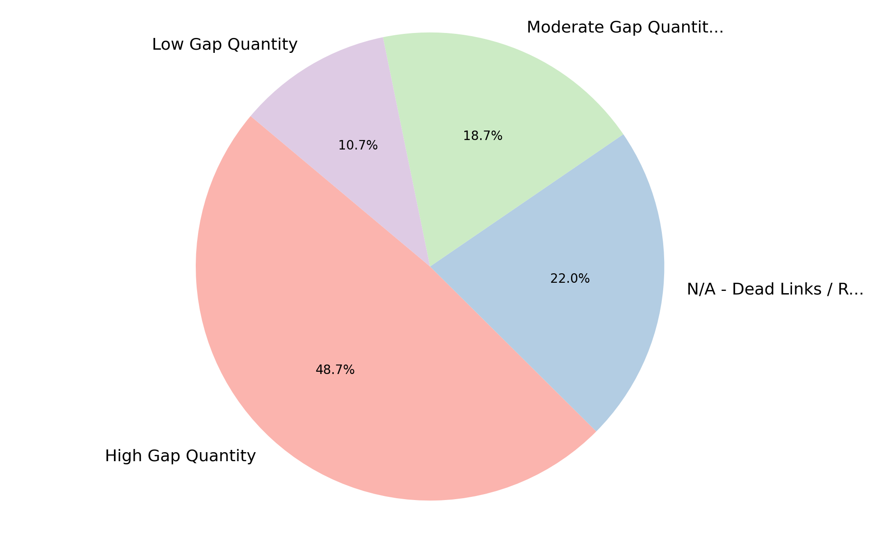
Analysis of Level of Gap Quantity
Summary Insight:
'High Gap Quantity' is the predominant category, making up nearly half of all observations, which could indicate a widespread issue with data completeness or quality.
Similar to traffic volume, 'N/A - Dead Links / Redirects' accounts for a substantial portion of the data, representing a collection of smaller groups or unresolved data points.
'Moderate Gap Quantity' and 'Low Gap Quantity' are significantly less common, suggesting that data gaps tend to be either extensive or unclassifiable.
The distribution indicates a skew towards higher gap quantities rather than lower ones.
Key Metrics:
Total Observations: 150
High Gap Quantity: 73 (48.7%)
N/A - Dead Links / Redirects: 33 (22.0%)
Moderate Gap Quantity: 28 (18.7%)
Low Gap Quantity: 16 (10.7%)

Slide 13
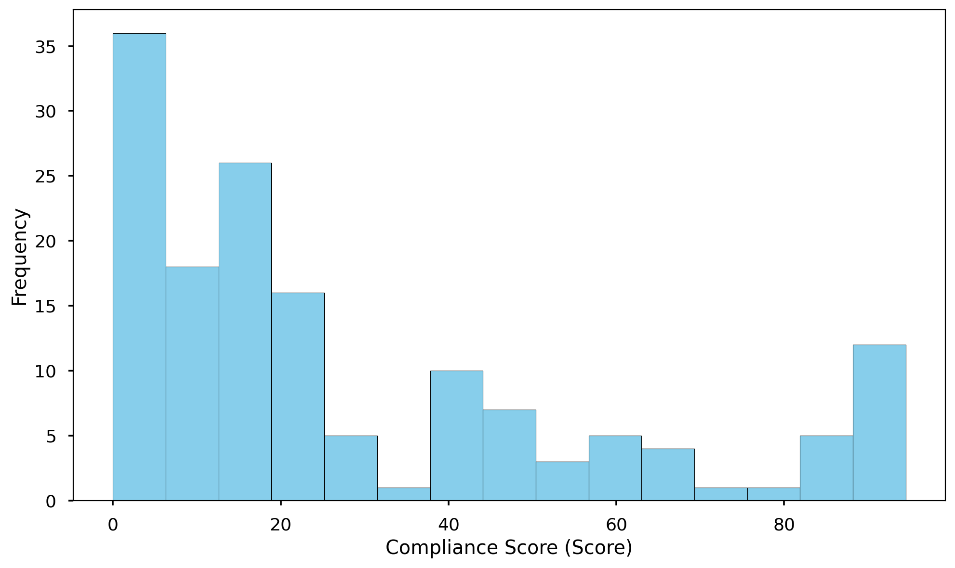
Analysis of Compliance Score (Score)
Summary Insight:
The average Compliance Score is relatively low, indicating a general area for improvement across the dataset.
Scores vary widely, ranging from 0 to 94.5, which points to a significant diversity in compliance performance among the observed entities.
The high standard deviation (29.19) further emphasizes the substantial spread and variability of scores, suggesting a non-uniform distribution.
The median score (17.25) being lower than the mean (28.49) suggests that a considerable portion of scores are clustered at the lower end, with some higher outliers pulling the mean up.
Key Metrics:
Total Count: 150
Average Score: 28.49
Maximum Score: 94.50
Minimum Score: 0.00
Median Score (50th percentile): 17.25
75th Percentile Score: 44.38

Slide 14
Conclusion
The overall compliance posture of the audited websites is concerning, with a significant majority exhibiting very low compliance scores, indicating widespread deficiencies against established standards.
A critical finding is the pervasive lack of properly deployed cookie banners and an alarming failure to honor user consent choices where assessed, representing fundamental gaps in user privacy management.
Most digital properties are currently not configured with modern privacy controls such as Global Privacy Control (GPC) or robust geolocation-based rules, limiting their ability to adapt to evolving privacy regulations.
A substantial portion of the active websites in the portfolio consistently show a high quantity of compliance gaps, pointing to systemic rather than isolated issues across our digital assets.
While traffic volumes vary, the widespread compliance issues affect both low and high-volume sites, posing potential risks to a significant user base across the portfolio.
A notable segment of the evaluated properties were identified as inactive (dead links or redirects), highlighting an opportunity for portfolio hygiene and focused resource allocation on active sites.

Slide 15
Thank You

