Slide 1
Website Assessment Report
Source: Sample Audit Report v1.xlsx

Slide 2
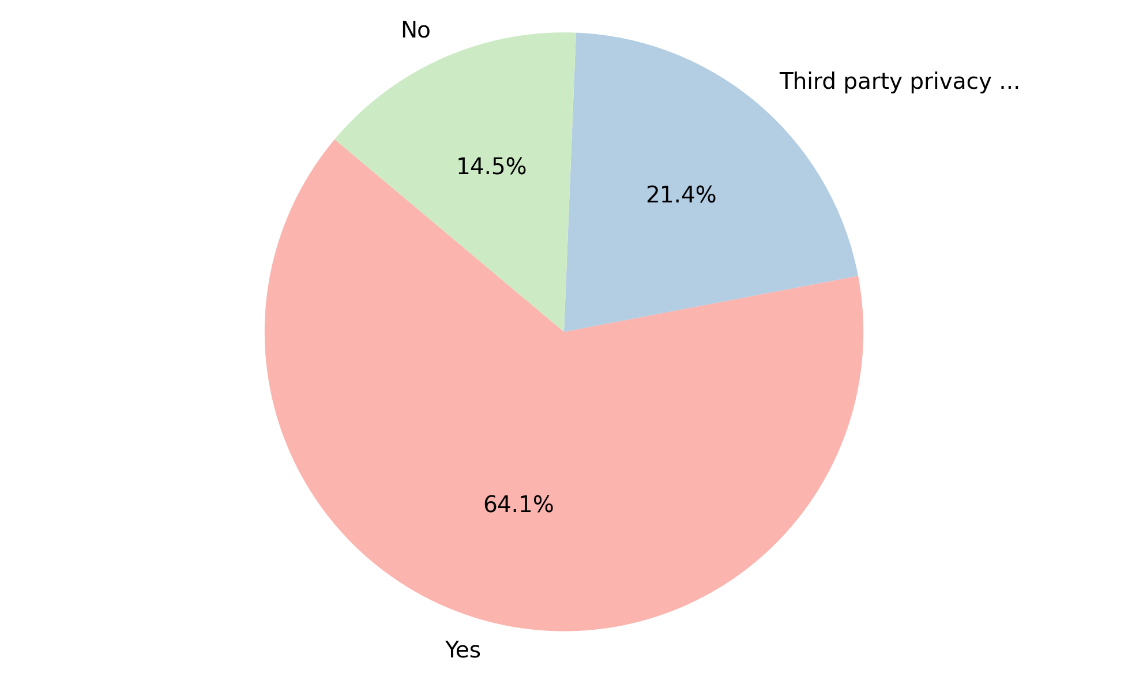
Analysis of Privacy Policy
Summary Insight:
A majority of websites indicate they have a privacy policy in place.
A substantial portion rely on third-party privacy policies, suggesting potential reliance on external frameworks.
A non-negligible number of websites appear to lack a privacy policy, raising potential compliance concerns.
Key Metrics:
Total: 117
Yes: 75 (64.1%)
Third party privacy policy: 25 (21.4%)
No: 17 (14.5%)

Slide 3
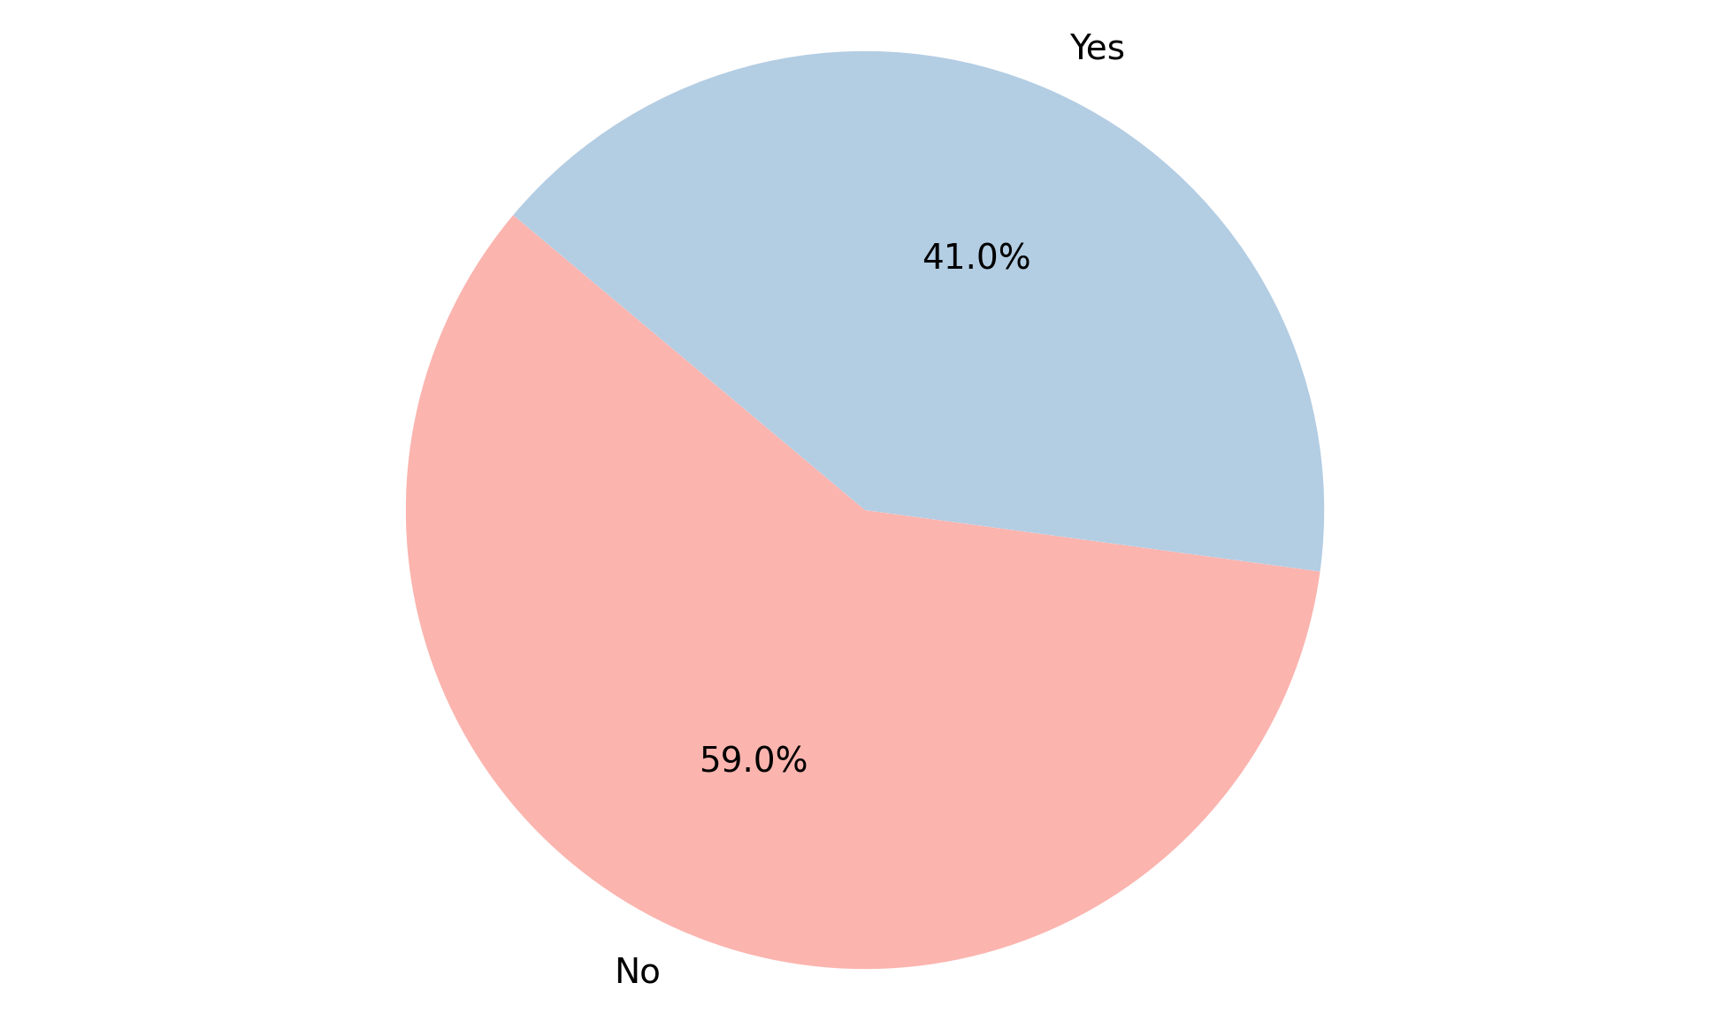
Analysis of Cookie Banner Deployed
Summary Insight:
The data reveals that more than half of the websites lack a cookie banner.
The absence of cookie banners on a considerable number of sites indicates a potential disregard for cookie consent regulations.
Key Metrics:
Total: 117
No: 69 (59.0%)
Yes: 48 (41.0%)

Slide 4
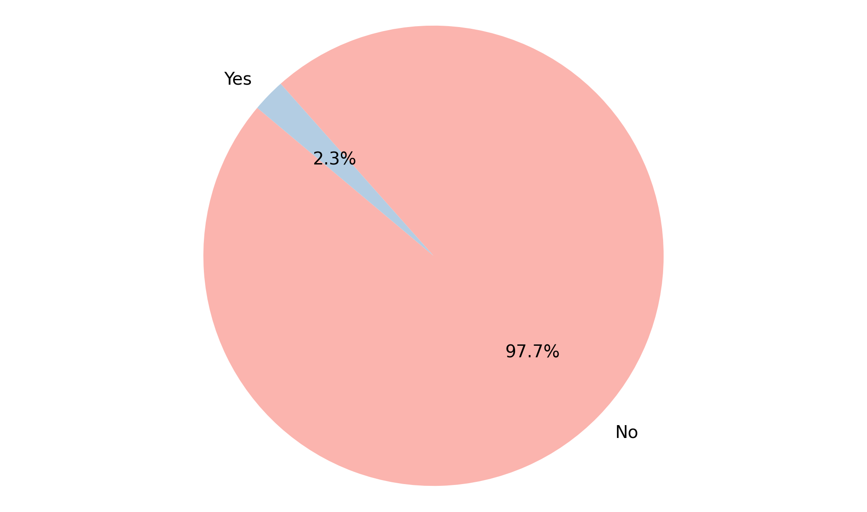
Analysis of User Consent Choices Honored
Summary Insight:
An overwhelming majority of sites do not honor user consent choices.
This suggests a significant failure to respect user privacy preferences related to data tracking and usage.
Key Metrics:
Total: 43
No: 42 (97.7%)
Yes: 1 (2.3%)

Slide 5
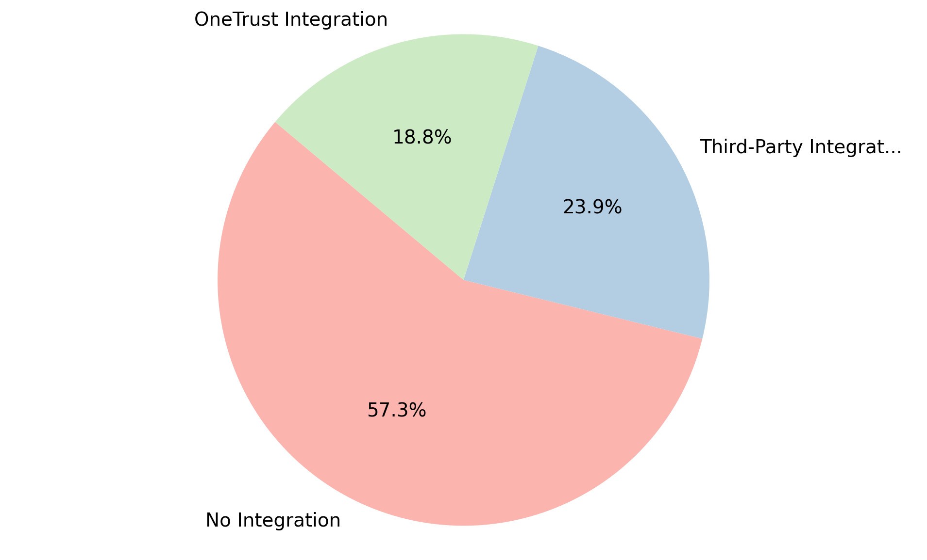
Analysis of OneTrust Integration
Summary Insight:
A significant portion of the observed entities do not have any OneTrust integration.
Third-party integrations are more prevalent than direct OneTrust integrations.
This suggests a diverse landscape of CMP adoption and potential opportunities to encourage more direct OneTrust usage.
Key Metrics:
Total: 117
No Integration: 67 (57.3%)
Third-Party Integration: 28 (23.9%)
OneTrust Integration: 22 (18.8%)

Slide 6
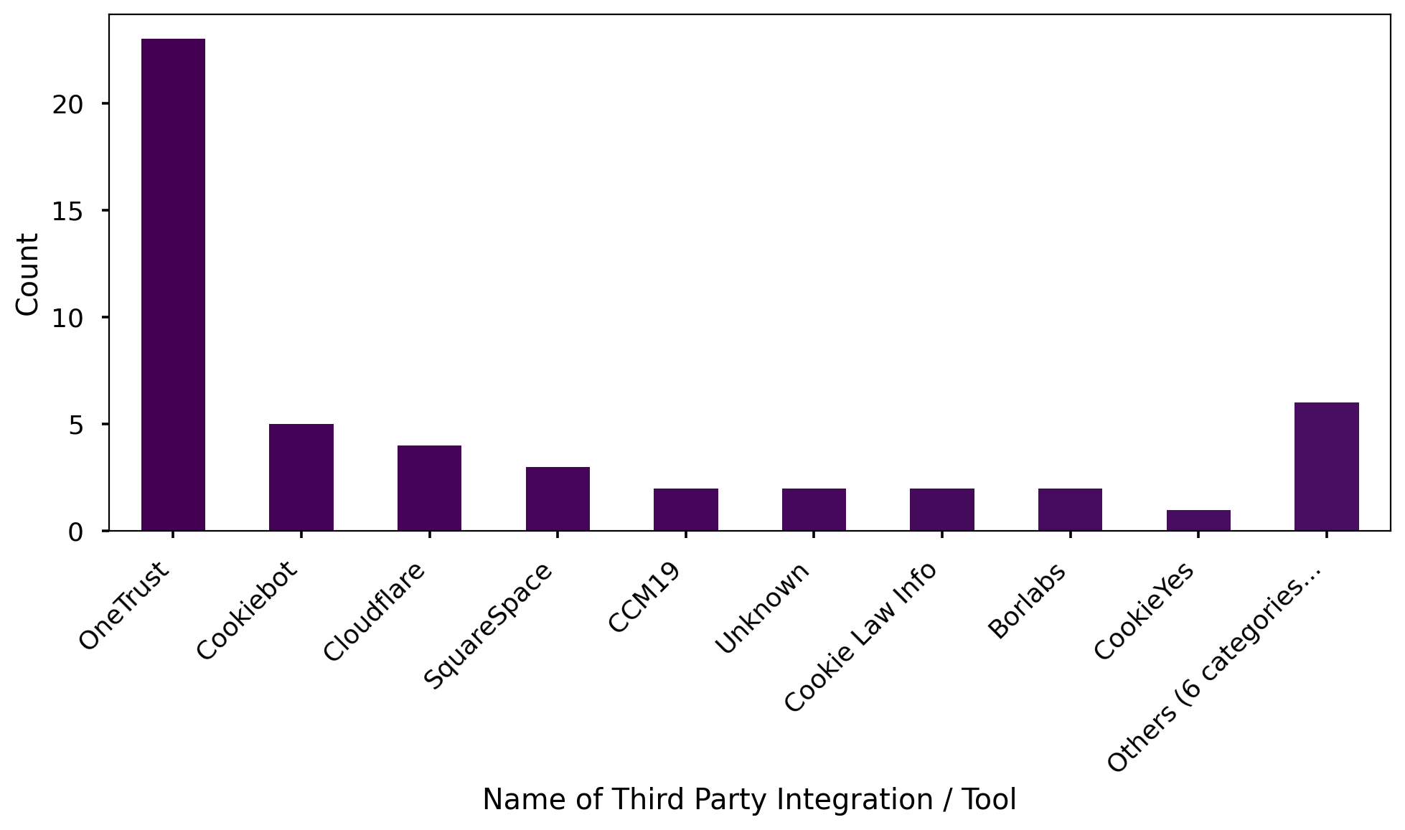
Analysis of Name of Third Party Integration / Tool
Summary Insight:
OneTrust is the most frequently identified third-party integration tool, suggesting it is a popular choice.
Cookiebot and Cloudflare also have a notable presence, indicating their relevance in the market.
The 'Others' category, while small, signifies a long tail of niche or less frequently used tools in the ecosystem.
Key Metrics:
Total: 50
OneTrust: 23 (46.0%)
Cookiebot: 5 (10.0%)
Cloudflare: 4 (8.0%)

Slide 7
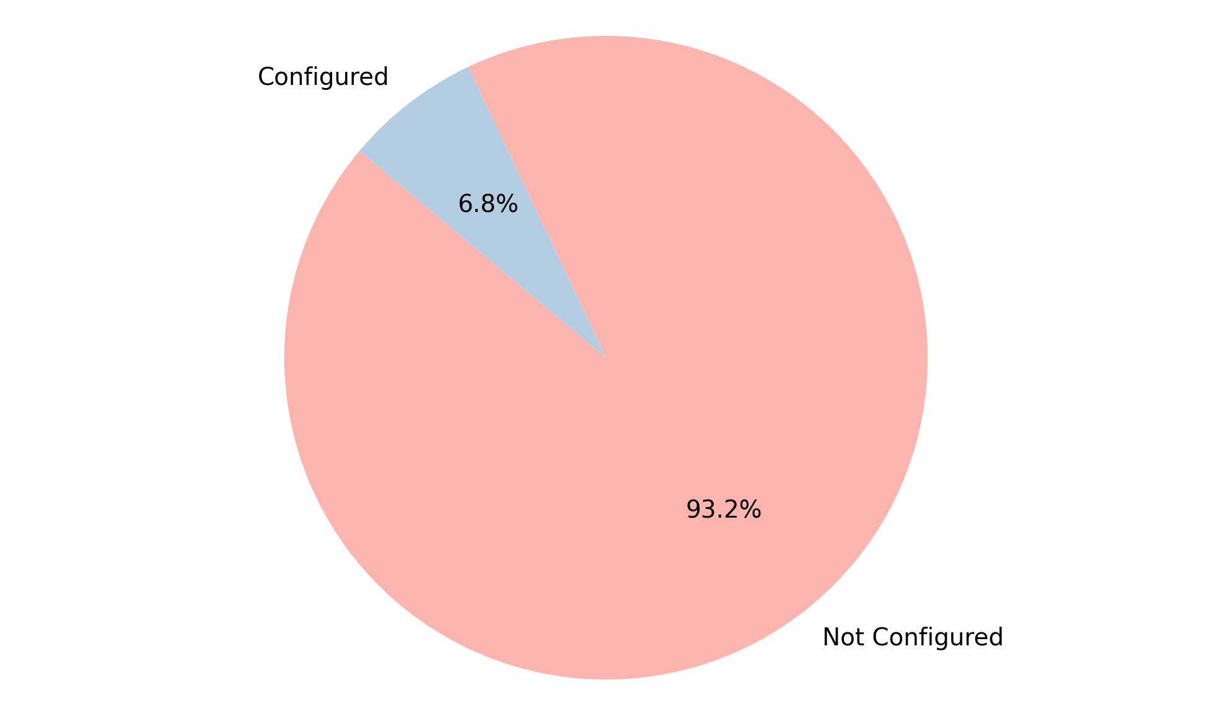
Analysis of GPC Configuration
Summary Insight:
The vast majority of observed instances are not configured for Global Privacy Control (GPC).
This indicates a potential lack of awareness or adoption of GPC as a privacy signal.
There is significant room for improvement in promoting and implementing GPC configurations.
Key Metrics:
Total: 117
Not Configured: 109 (93.2%)
Configured: 8 (6.8%)

Slide 8
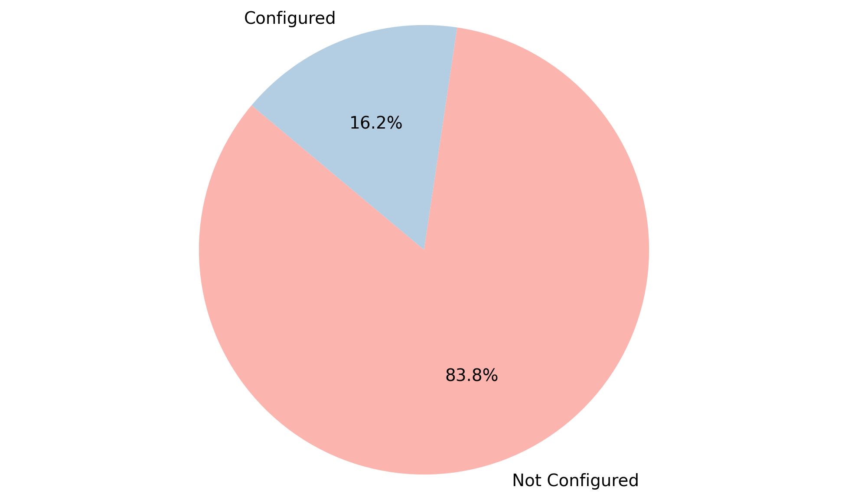
Analysis of Geolocation Rules
Summary Insight:
The vast majority of systems are not configured with geolocation rules.
This suggests a potential gap in security or regional compliance measures.
Key Metrics:
Total: 117
Not Configured: 98 (83.76%)
Configured: 19 (16.24%)

Slide 9
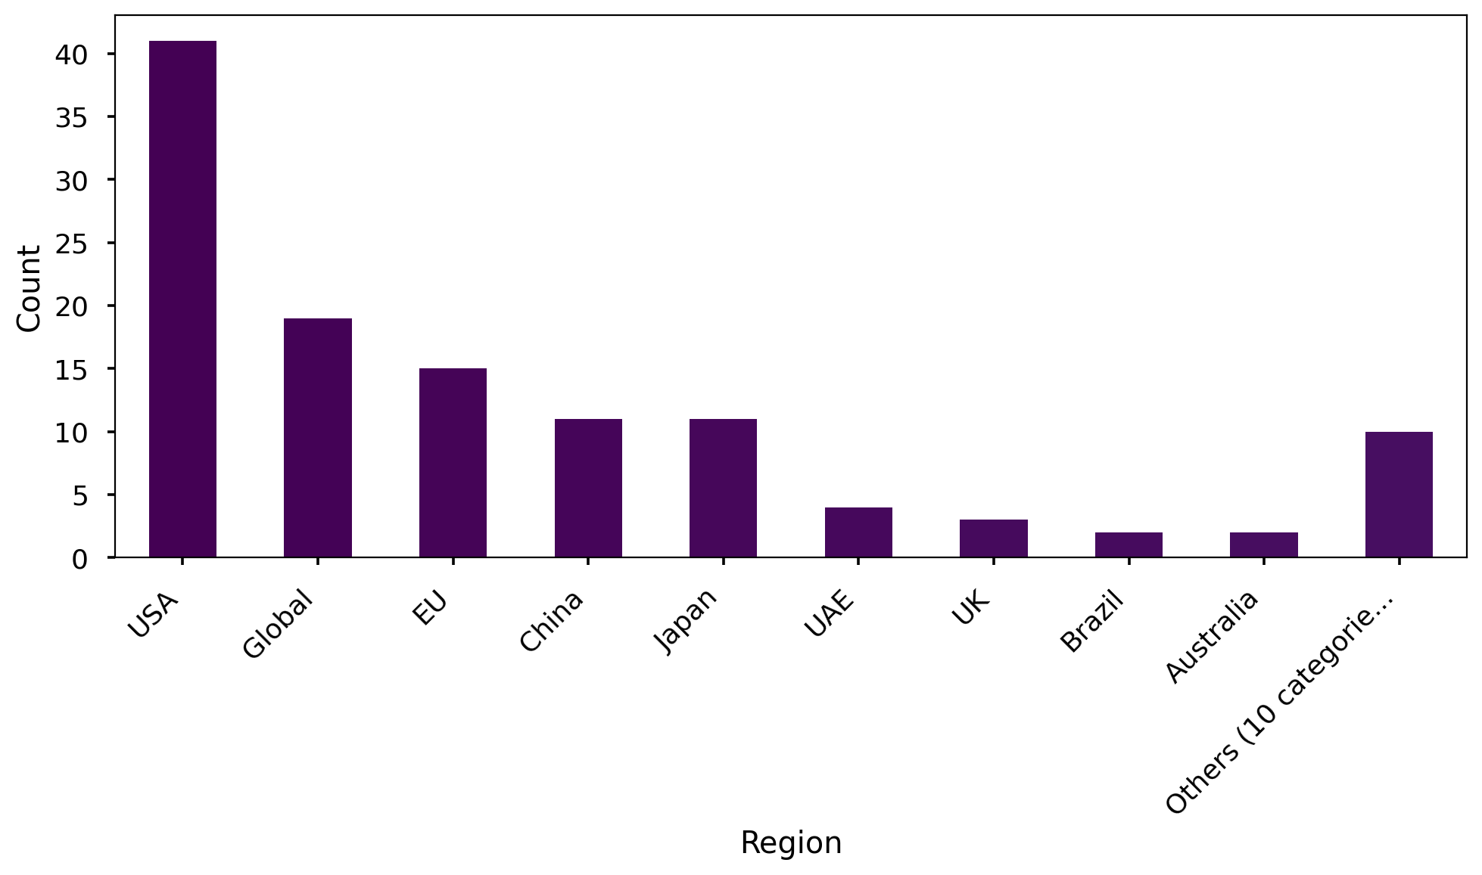
Analysis of Region
Summary Insight:
The primary focus is on the USA, with a substantial global presence also noted.
Several other regions are represented, but with smaller frequencies.
'Others' represents an aggregation of 10 different smaller regions.
Key Metrics:
Total: 118
USA: 41 (34.75%)
Global: 19 (16.10%)
EU: 15 (12.71%)

Slide 10
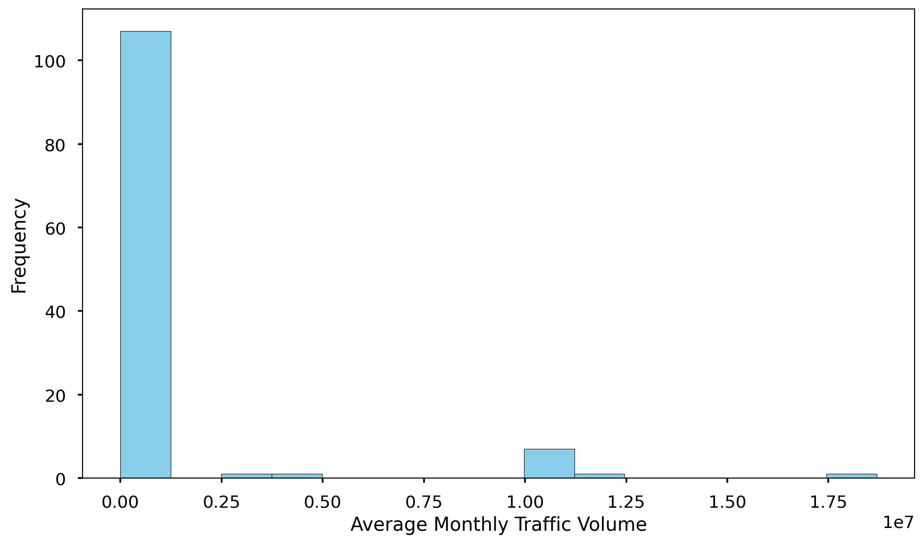
Analysis of Average Monthly Traffic Volume
Summary Insight:
The average monthly traffic volume is approximately 1 million.
However, there's significant variability in traffic volume, as indicated by the large standard deviation.
The range of traffic is very wide, from 0 to over 18 million.
Key Metrics:
Count: 118
Average: 1017830
Maximum: 18696560
Minimum: 0

Slide 11
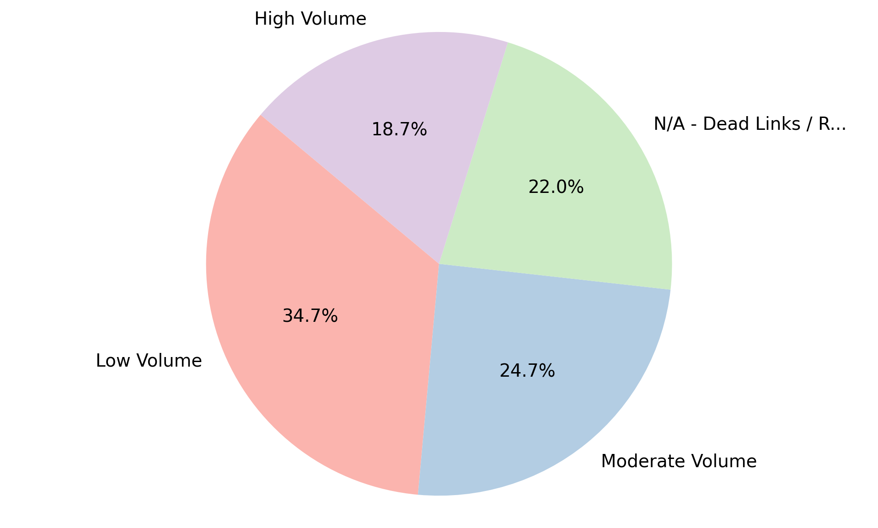
Analysis of Level of Traffic Volume
Summary Insight:
The data indicates that 'Low Volume' is the most frequent traffic level.
'Moderate Volume' is also quite prevalent.
A notable number of links are either dead or redirecting, suggesting potential website maintenance issues.
Key Metrics:
Total: 150
Low Volume: 52 (34.7%)
Moderate Volume: 37 (24.7%)
N/A - Dead Links / Redirects: 33 (22.0%)

Slide 12
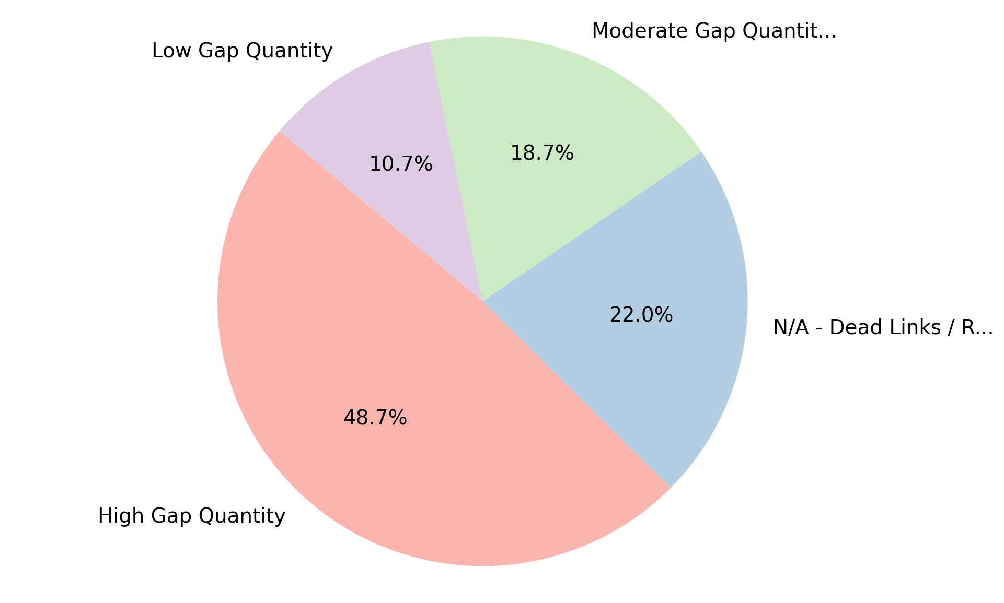
Analysis of Level of Gap Quantity
Summary Insight:
'High Gap Quantity' is the most frequent category.
The 'N/A - Dead Links / Redirects' category also appears with significant frequency.
'Low Gap Quantity' is the least common, suggesting gaps are generally a concern.
Key Metrics:
Total: 150
High Gap Quantity: 73 (48.7%)
N/A - Dead Links / Redirects: 33 (22.0%)
Moderate Gap Quantity: 28 (18.7%)

Slide 13
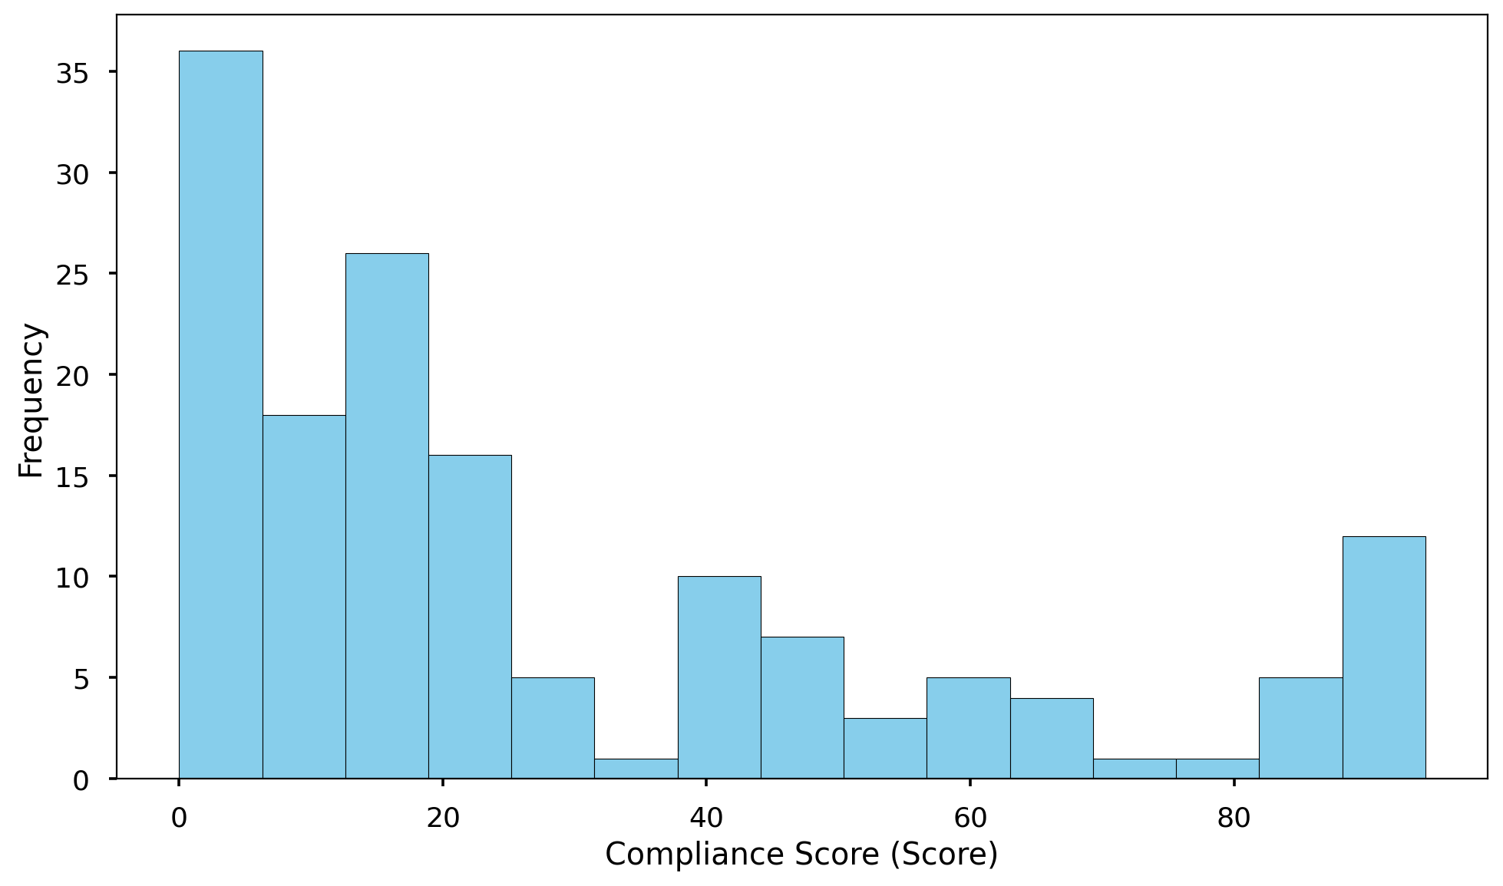
Analysis of Compliance Score (Score)
Summary Insight:
The average compliance score is below half of the maximum possible score, indicating substantial room for improvement.
There is considerable variability in compliance scores, as indicated by the standard deviation.
Some scores are at zero, highlighting potential areas of significant non-compliance.
Key Metrics:
Average Score: 28.488 out of 115 (24.8%)
Maximum Score: 94.5 out of 115
Minimum Score: 0.0 out of 115
Total Count: 150

Slide 14
Conclusion
The compliance assessment reveals considerable room for improvement across the audited websites, with an average compliance score indicating substantial gaps in meeting required standards.
A concerning number of digital properties lack essential privacy safeguards, including privacy policies and properly deployed cookie banners, raising potential legal and reputational risks.
User consent mechanisms are largely ineffective, with a significant majority of websites failing to honor user consent choices, signaling a critical failure in respecting user privacy preferences.
Global Privacy Control (GPC) adoption remains extremely low, indicating a missed opportunity to leverage a readily available mechanism for enhanced user privacy.
The prevalence of high compliance gap quantities highlights systemic issues requiring immediate and thorough remediation to avoid potential penalties and maintain user trust.
Geolocation rules are not widely configured, suggesting a lack of tailored data protection measures based on user location and applicable regional regulations.
These findings underscore the urgent need for comprehensive compliance training, standardized implementation guidelines, and ongoing monitoring to ensure all digital properties adhere to best practices and regulatory requirements.

Slide 15
Thank You

