Slide 1
Data Analysis Report
Analysis of Sample Audit Report v1.xlsx

Slide 2
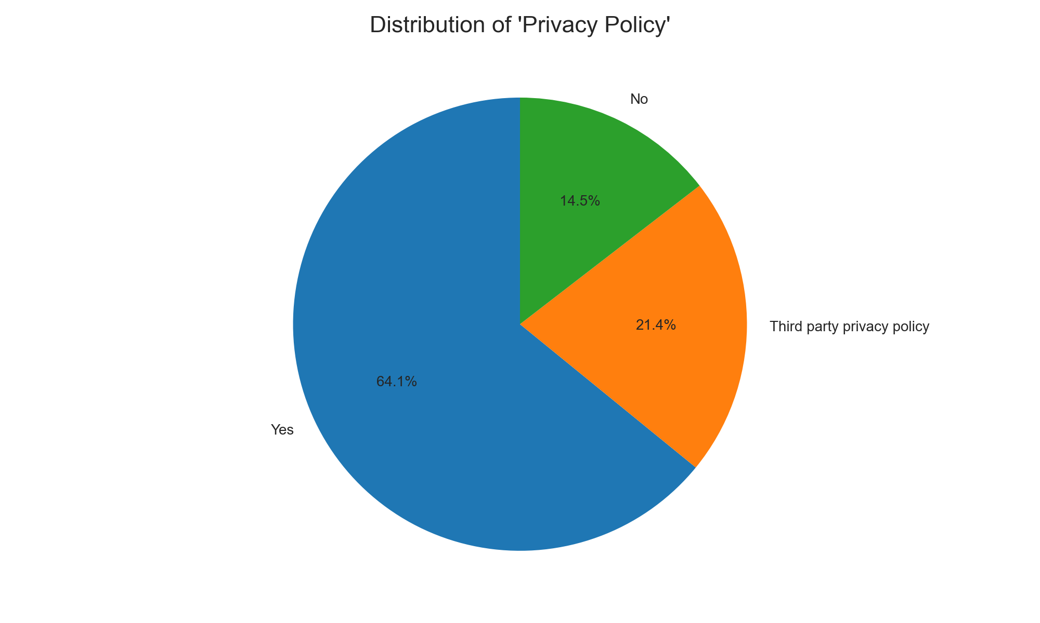
Analysis of: Privacy Policy

Slide 3
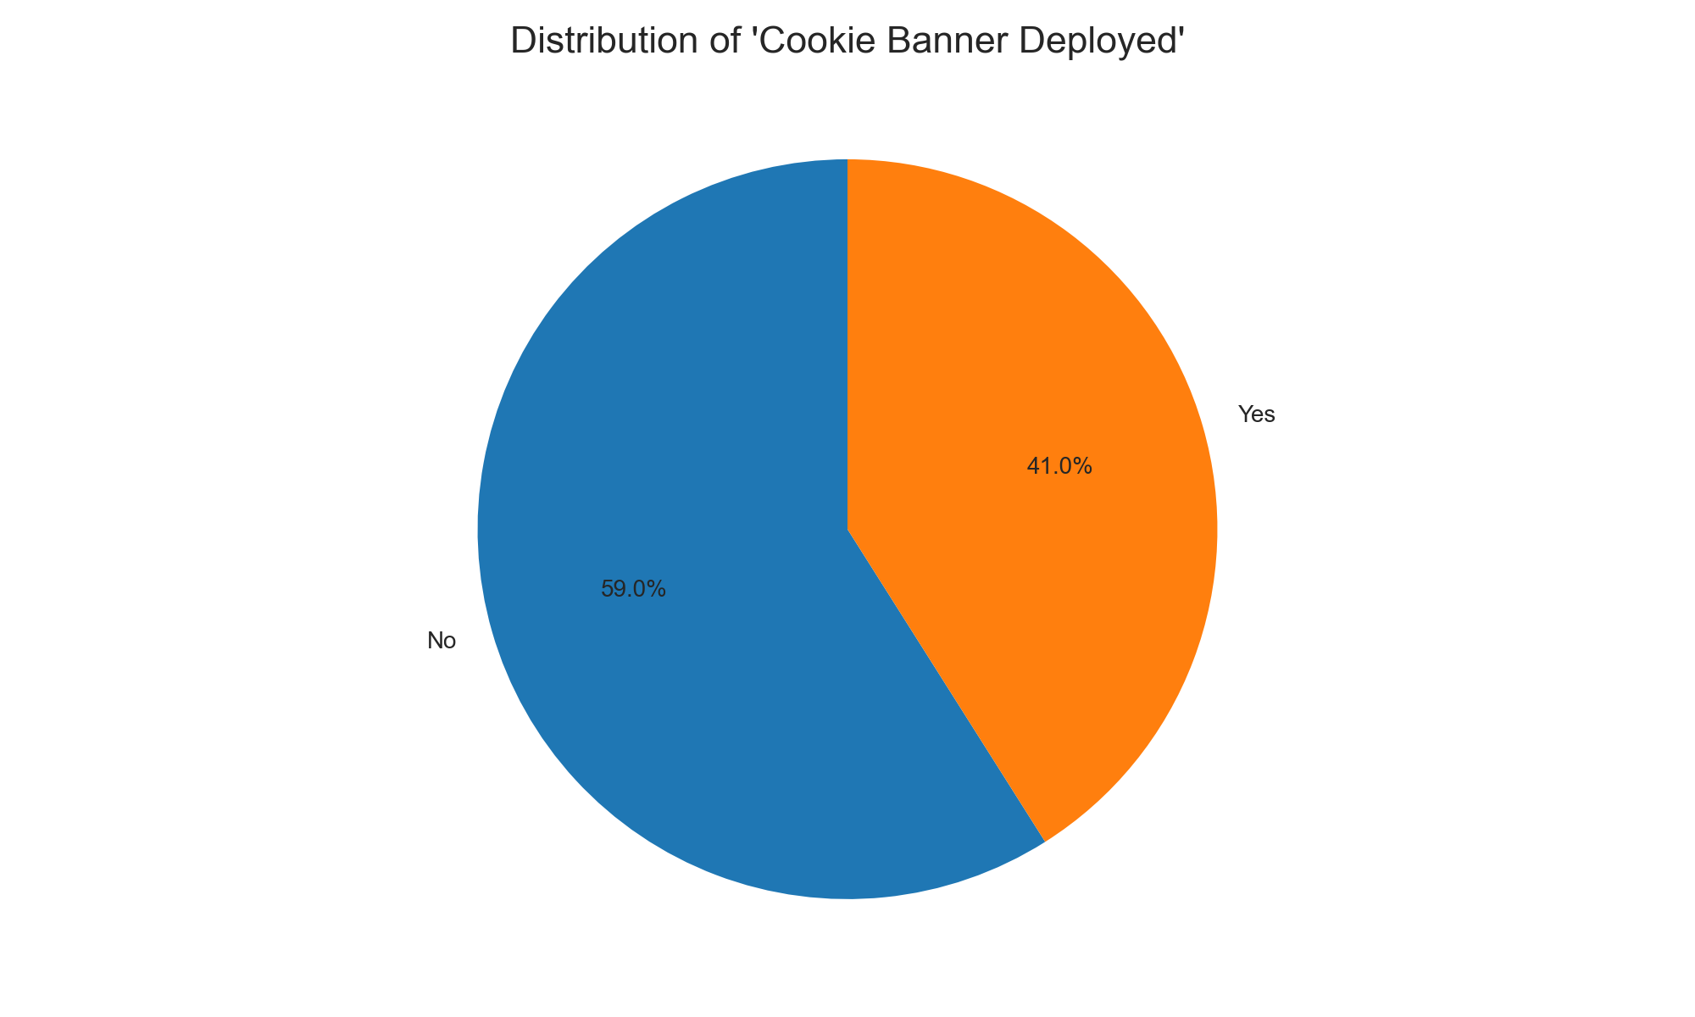
Analysis of: Cookie Banner Deployed

Slide 4
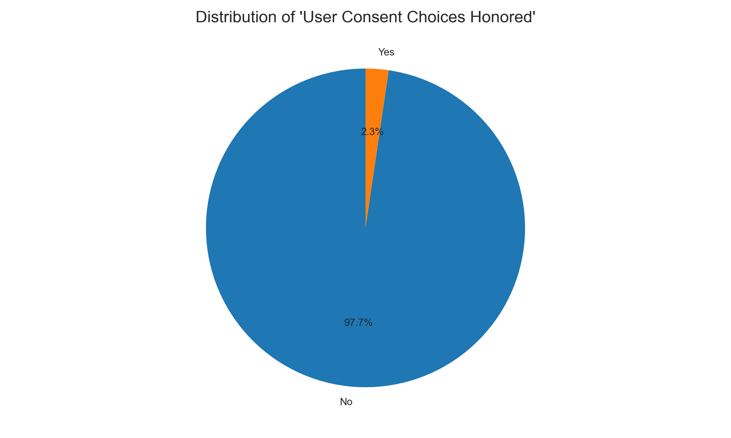
Analysis of: User Consent Choices Honored

Slide 5
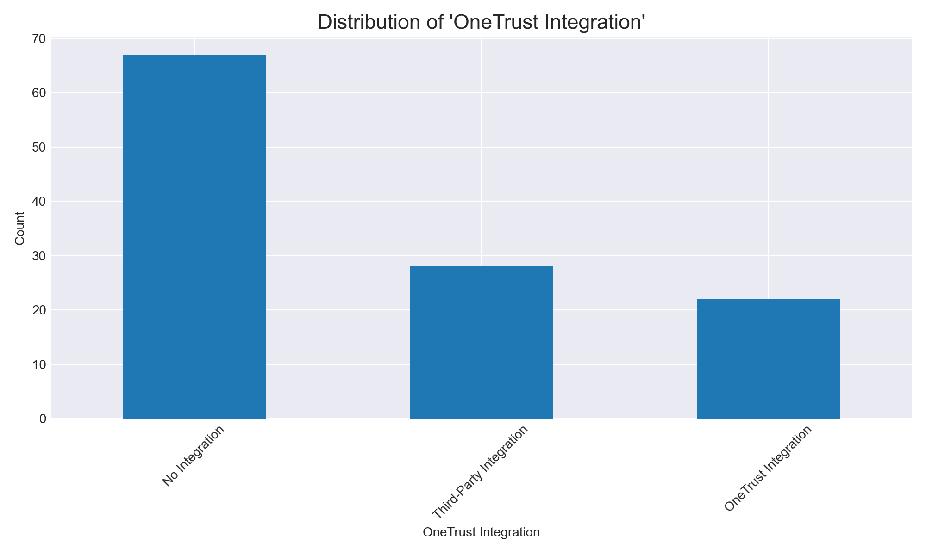
Analysis of: OneTrust Integration

Slide 6
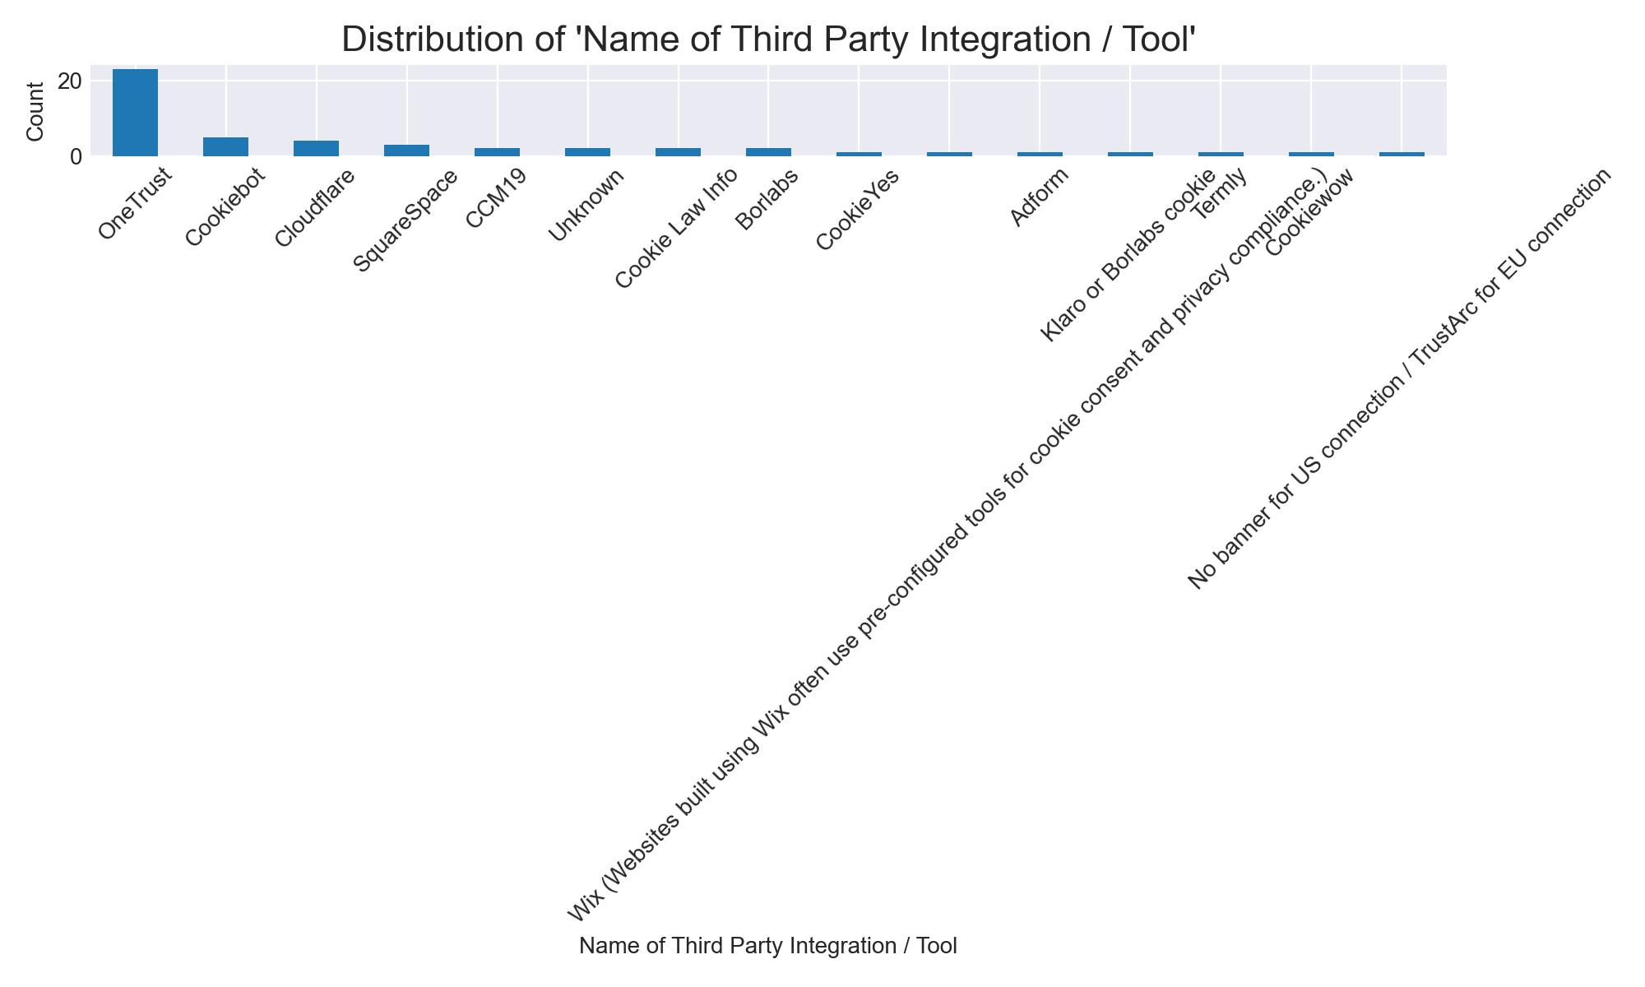
Analysis of: Name of Third Party Integration / Tool

Slide 7
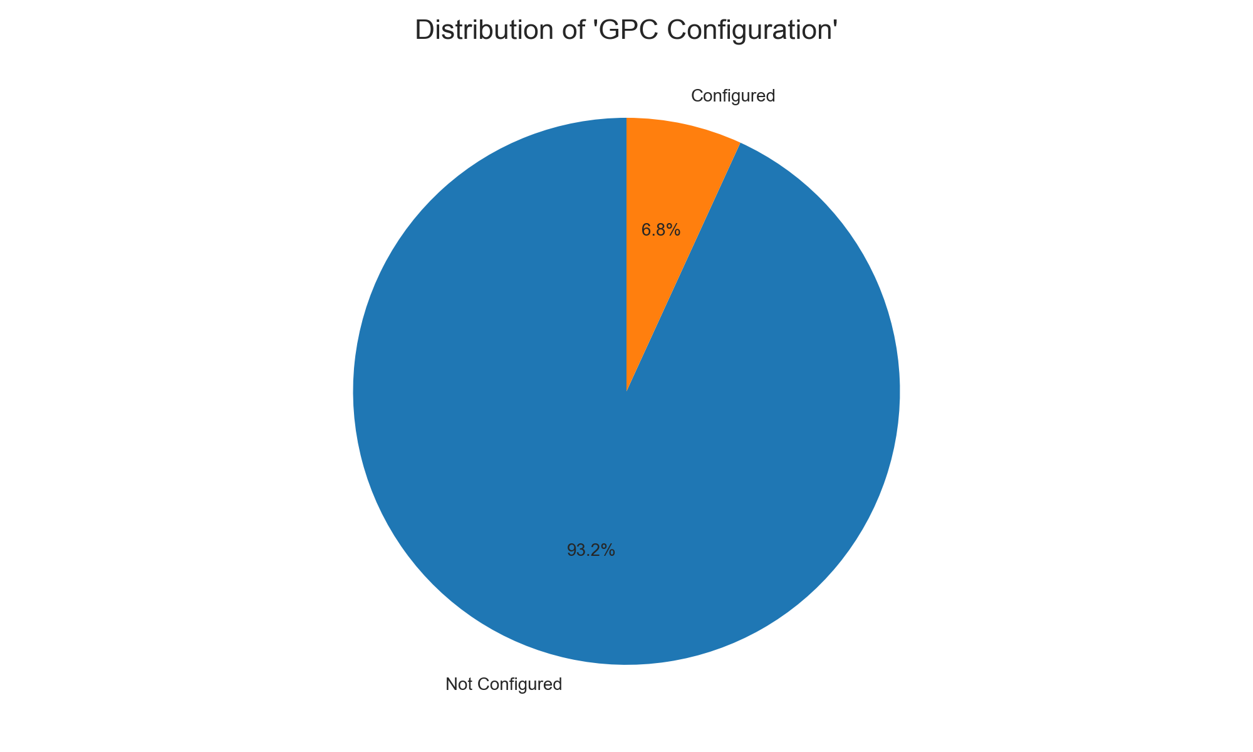
Analysis of: GPC Configuration

Slide 8
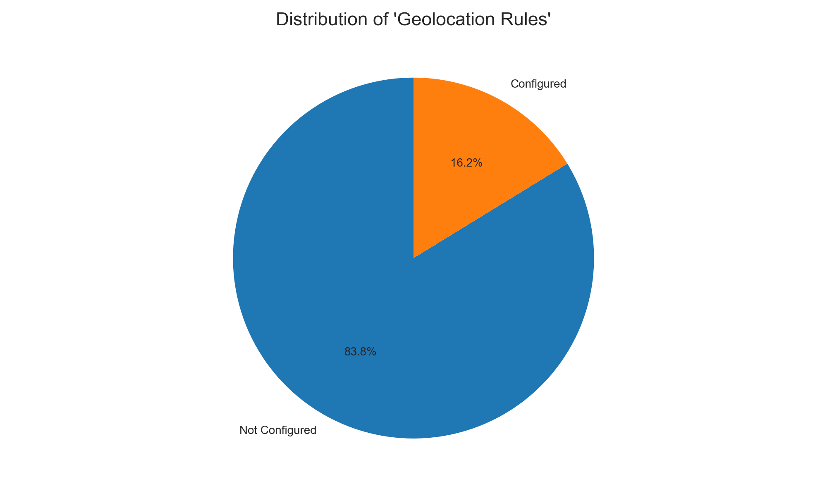
Analysis of: Geolocation Rules

Slide 9
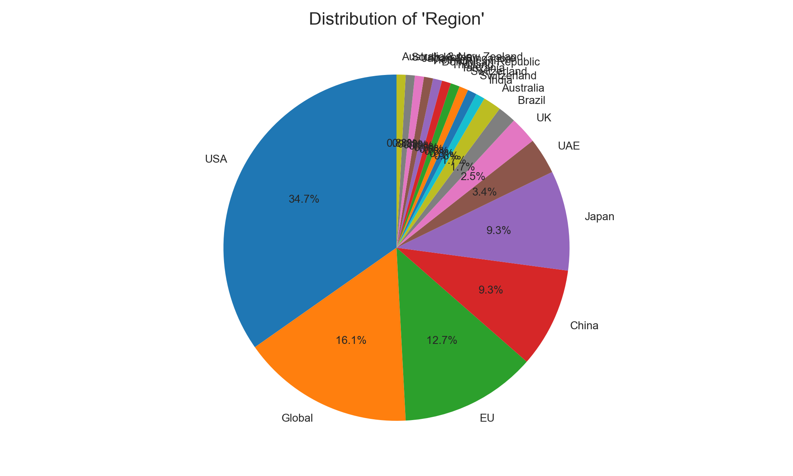
Analysis of: Region

Slide 10
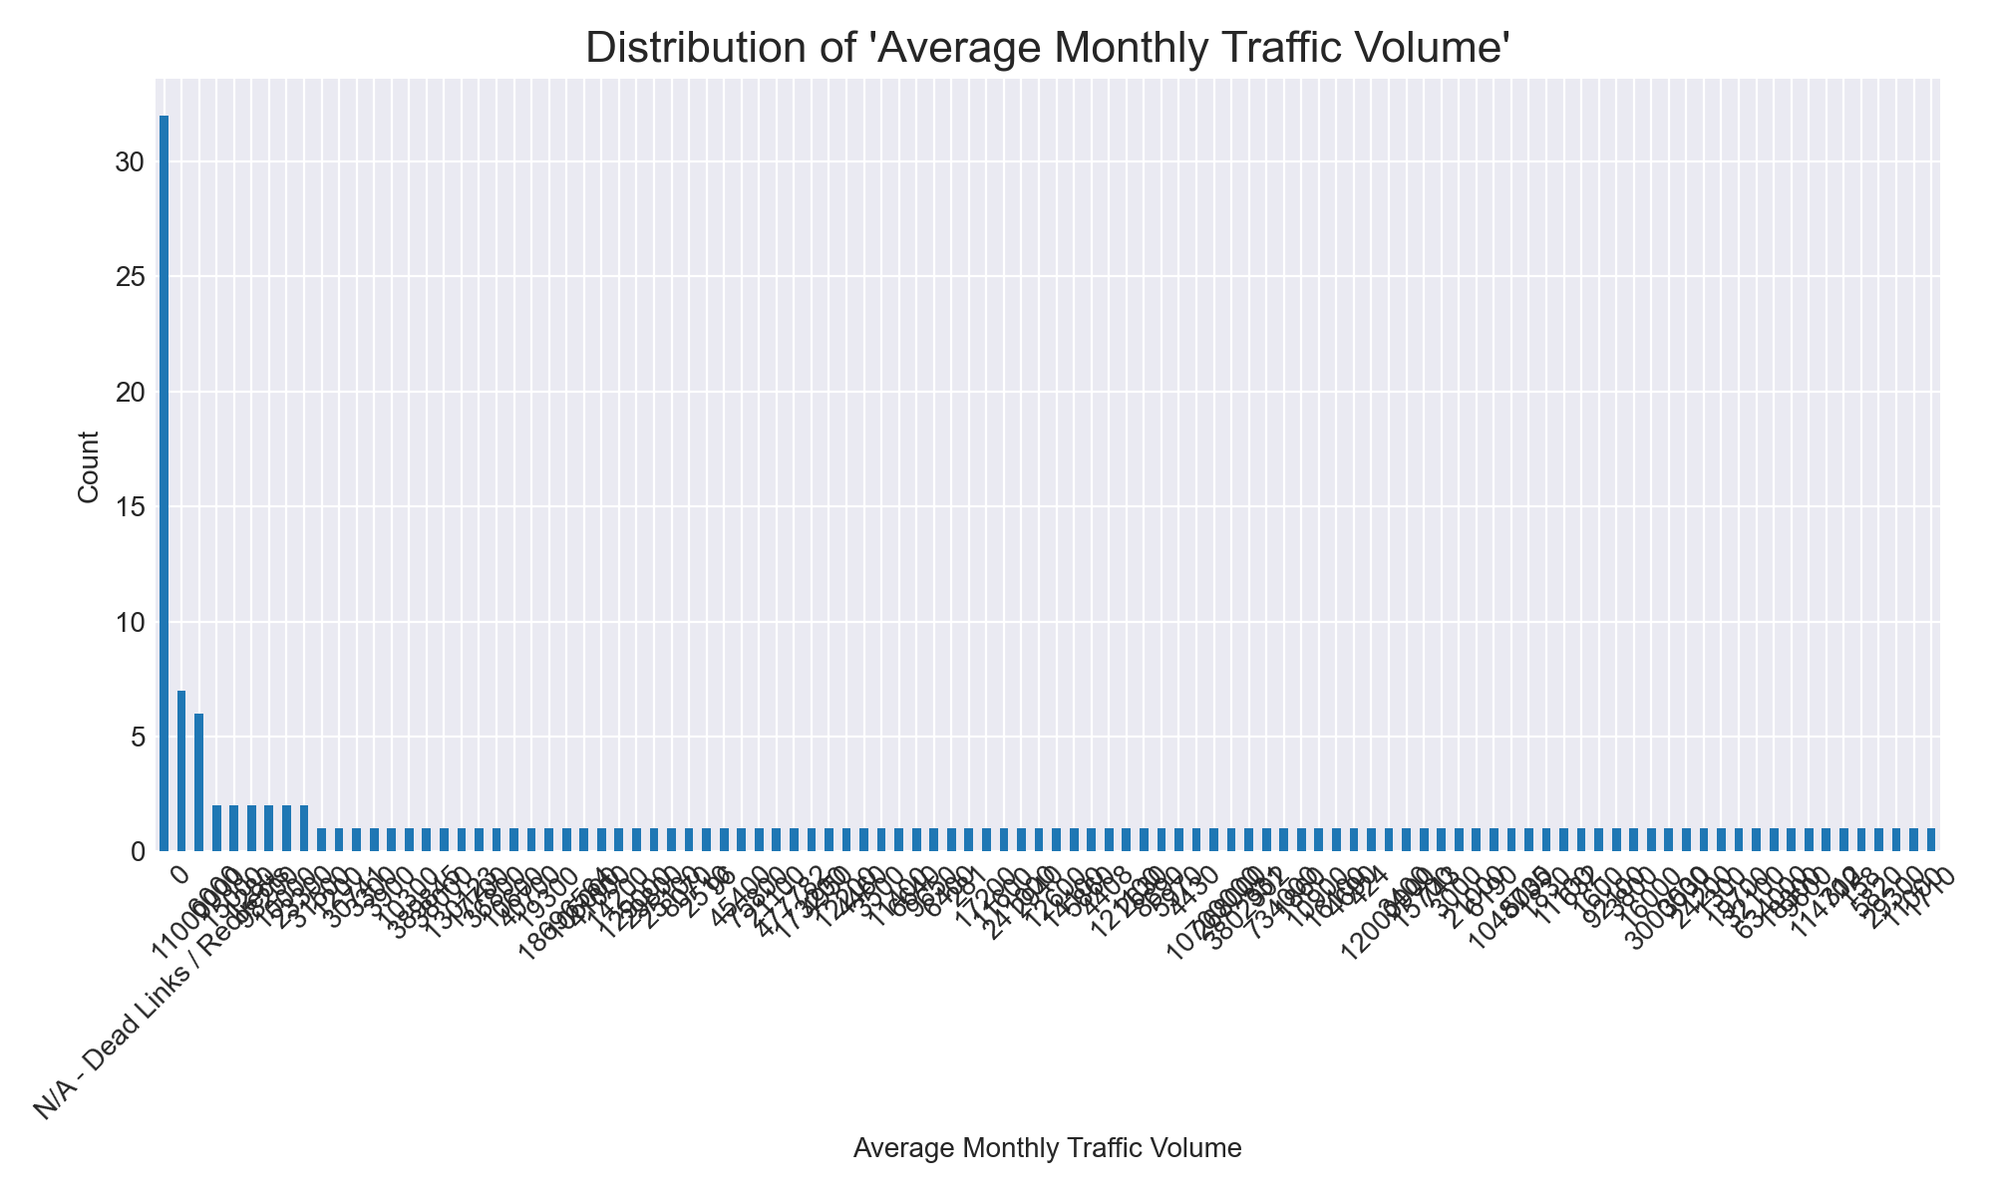
Analysis of: Average Monthly Traffic Volume

Slide 11
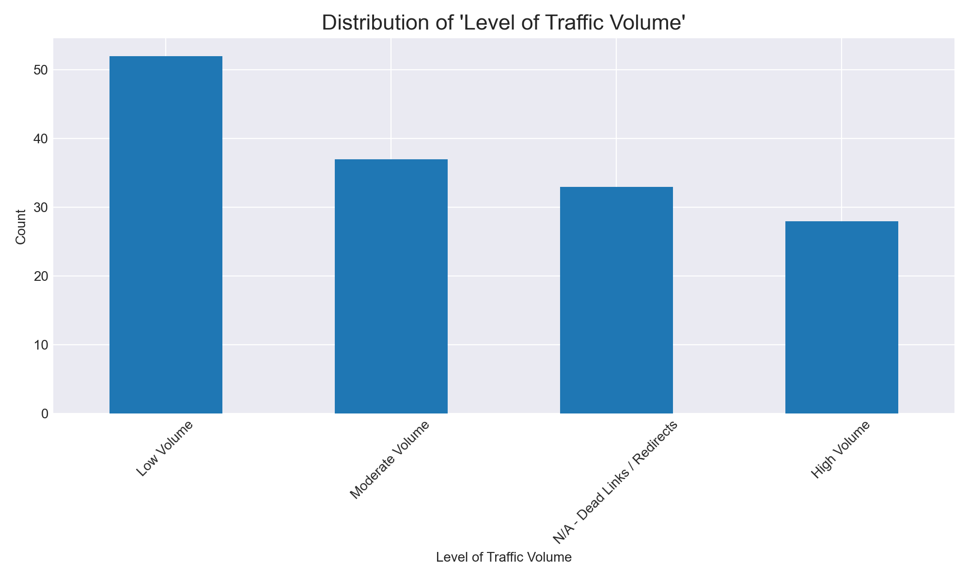
Analysis of: Level of Traffic Volume

Slide 12
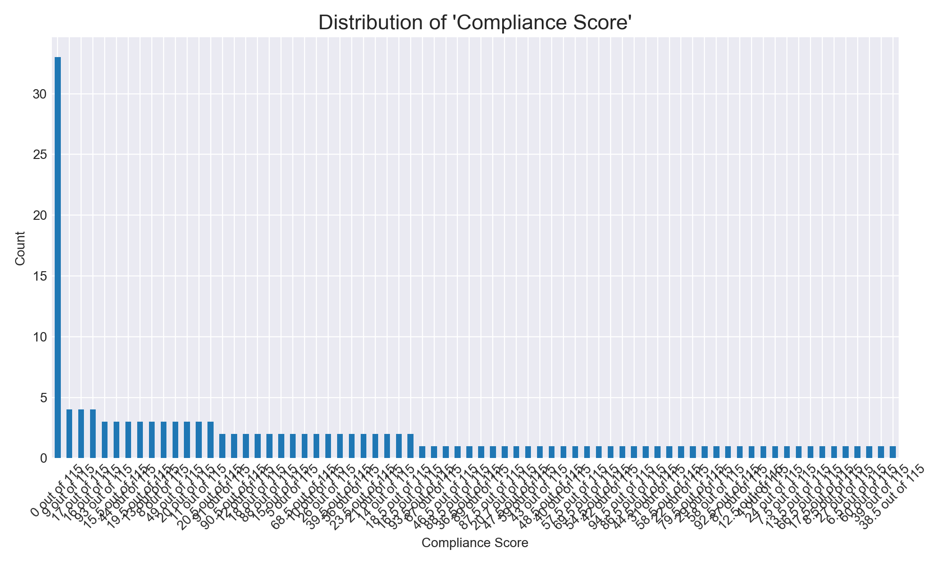
Analysis of: Compliance Score

Slide 13
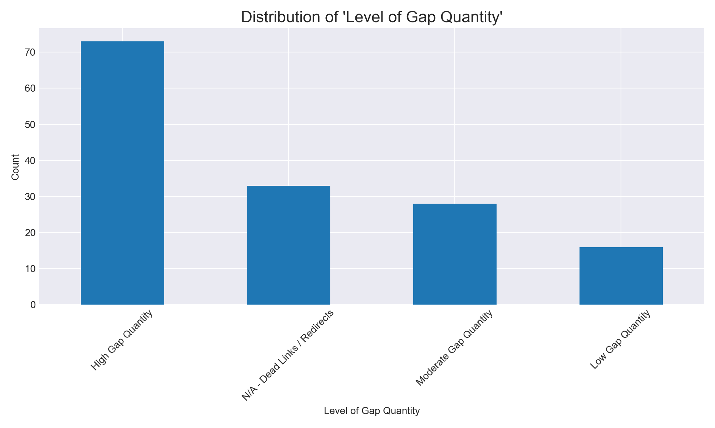
Analysis of: Level of Gap Quantity

