Slide 1
Data Analysis Report
Source: Sample Audit Report v1.xlsx

Slide 2
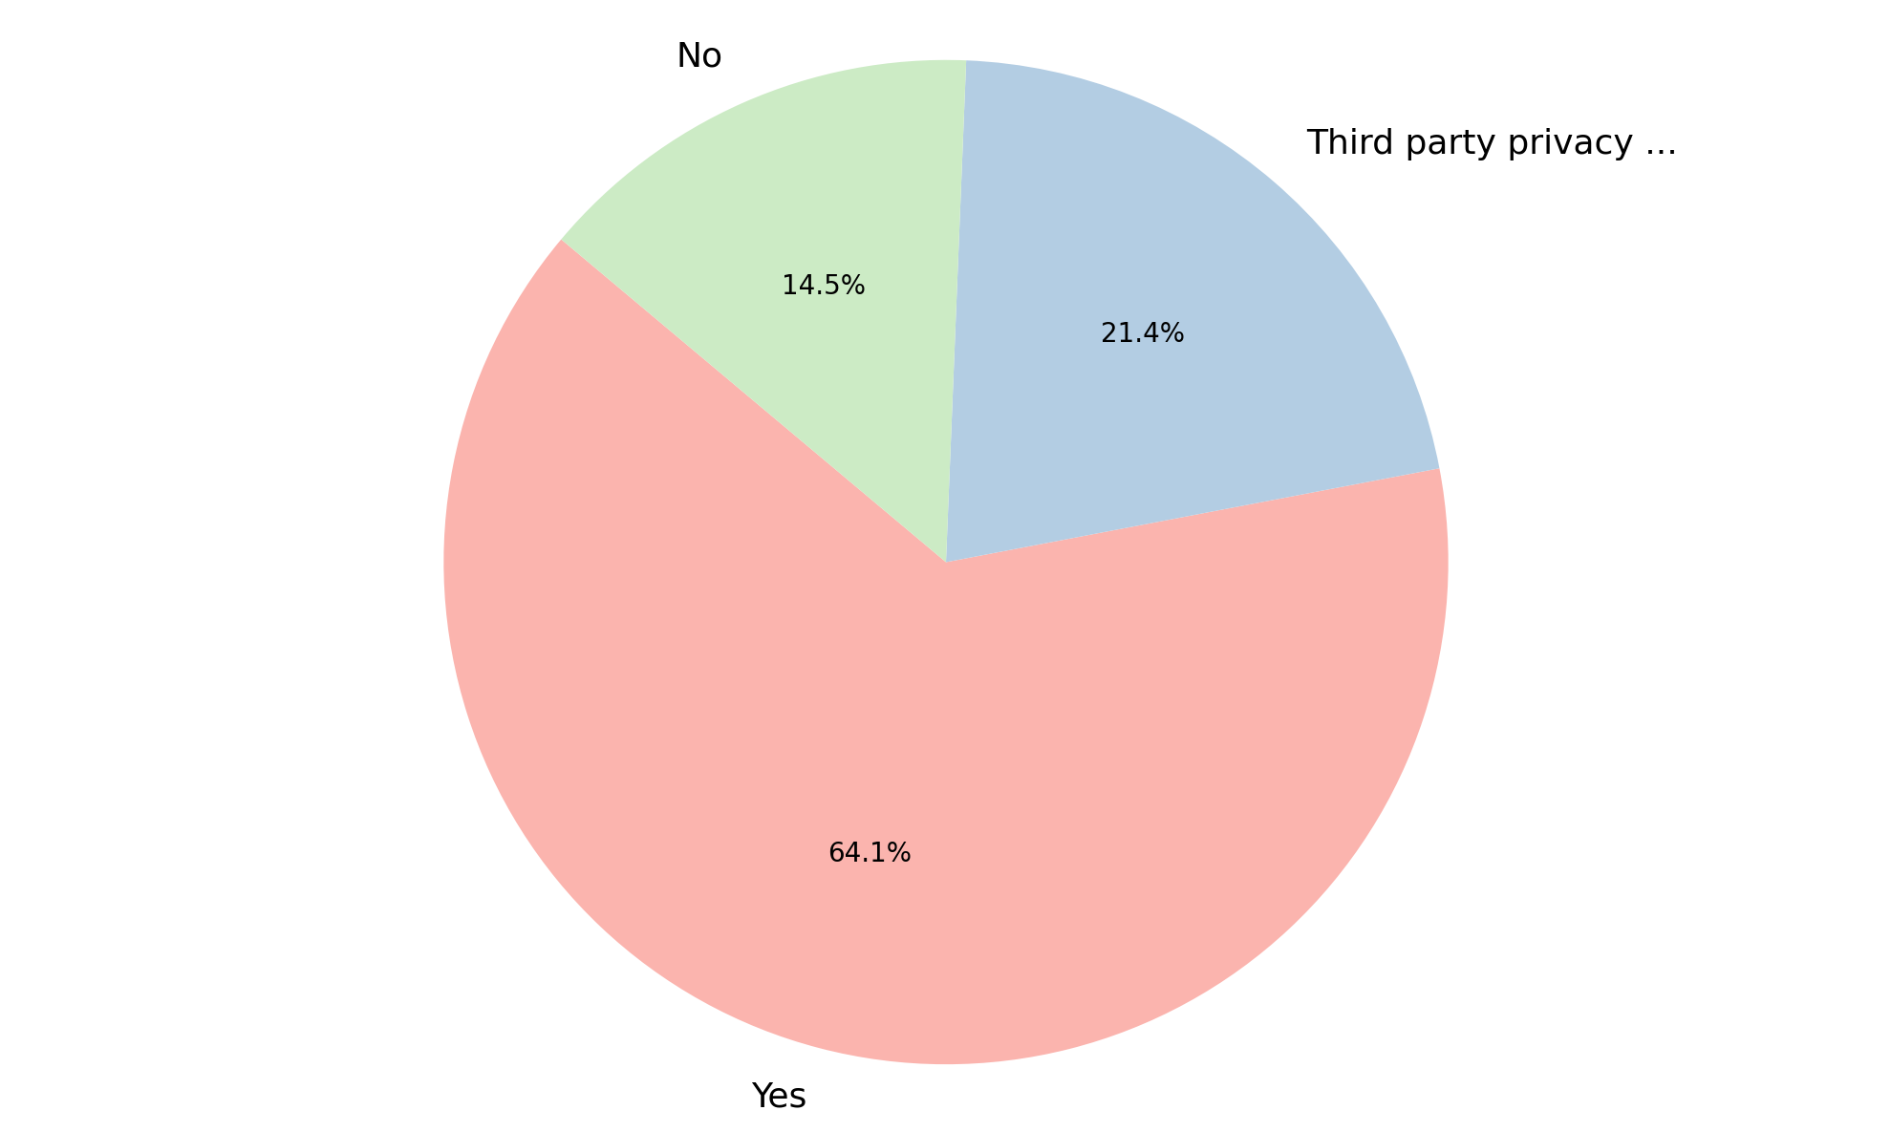
Analysis of Privacy Policy
Summary Insight:
The majority of the scanned websites claim to have a privacy policy. However, a notable portion either explicitly lack one or utilize a third-party policy, which could indicate varying levels of control and responsibility.
Key Metrics:
Total websites scanned: 117
'Yes' (Privacy Policy): 75
'No' (Privacy Policy): 17
'Third party privacy policy' (Privacy Policy): 25

Slide 3
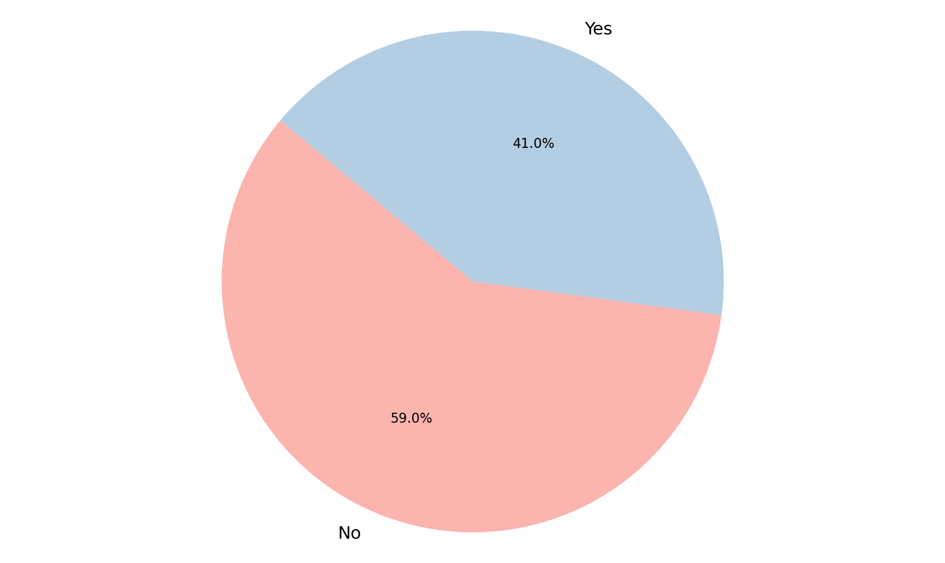
Analysis of Cookie Banner Deployed
Summary Insight:
More websites are not deploying cookie banners than are. This suggests a possible lack of awareness, compliance, or deliberate choice regarding user tracking and consent.
Key Metrics:
Total websites scanned: 117
'No' (Cookie Banner Deployed): 69
'Yes' (Cookie Banner Deployed): 48

Slide 4
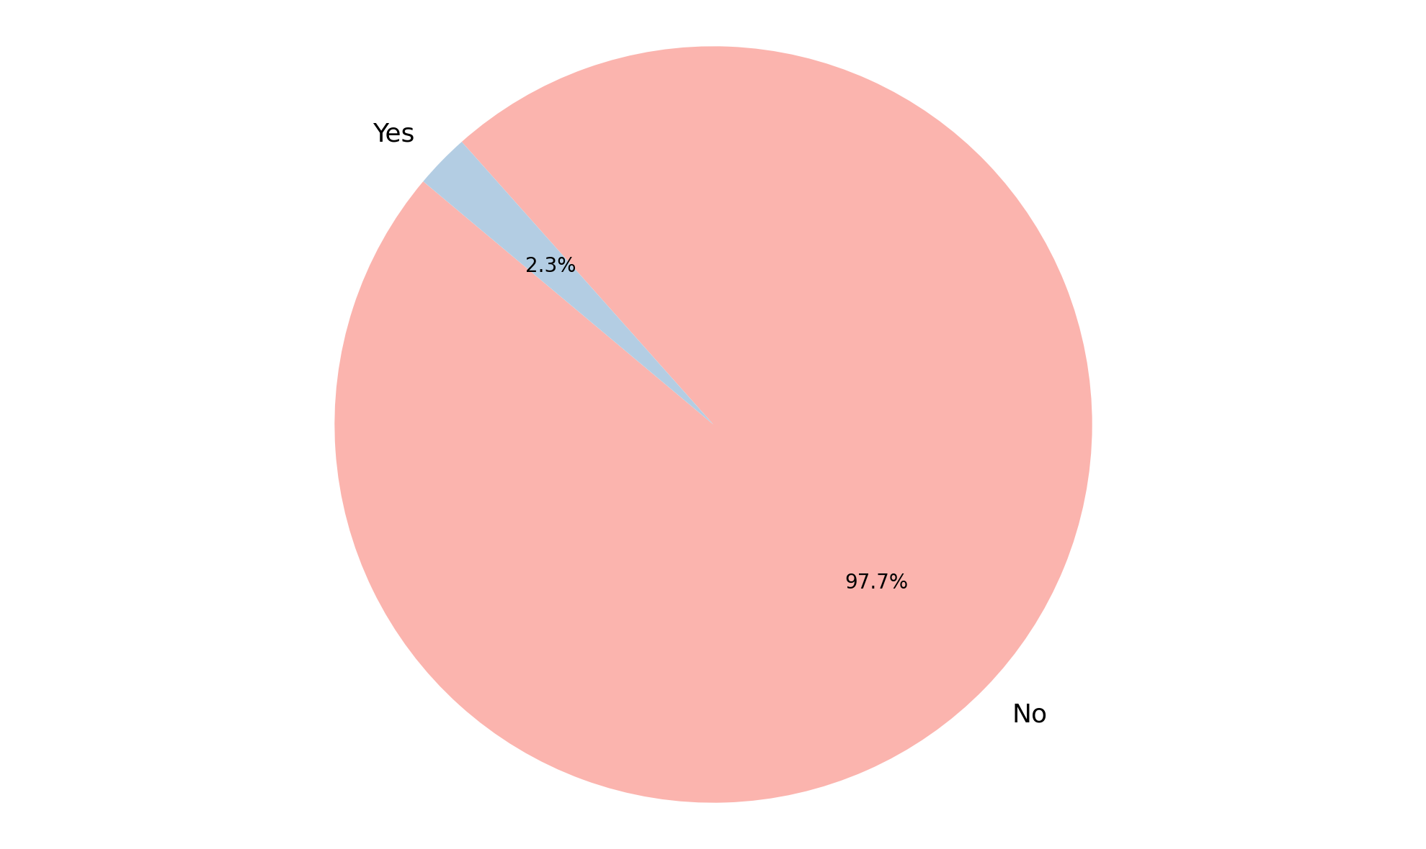
Analysis of User Consent Choices Honored
Summary Insight:
An overwhelming majority of websites do not appear to honor user consent choices, based on this data. This suggests a significant problem with website compliance regarding privacy regulations and respecting user preferences.
Key Metrics:
Total websites scanned: 43 (Only includes sites where a determination of consent honoring could be made.)
'No' (User Consent Choices Honored): 42
'Yes' (User Consent Choices Honored): 1

Slide 5
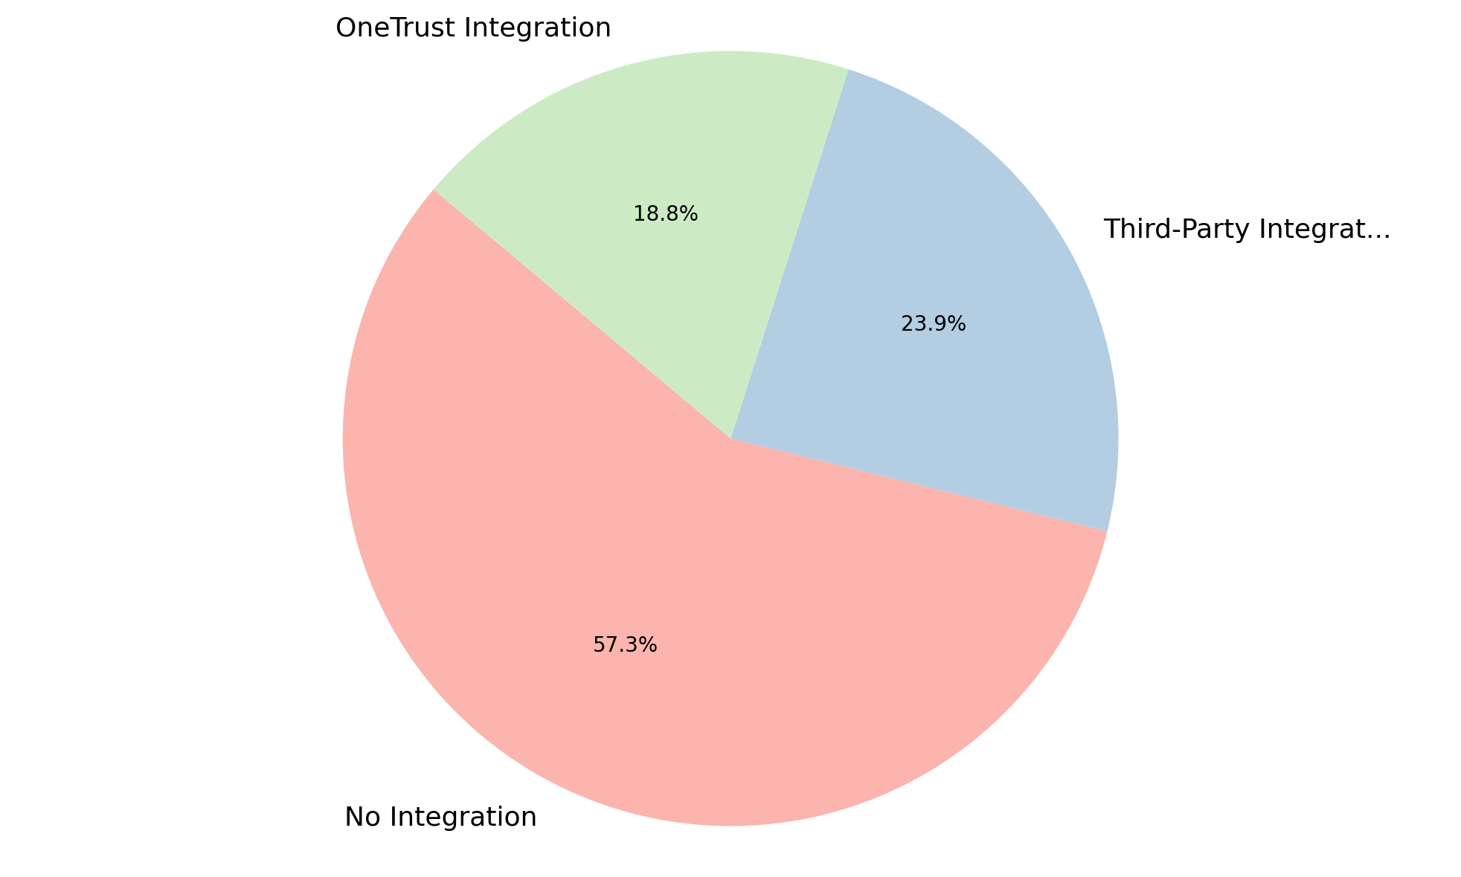
Analysis of OneTrust Integration
Summary Insight:
The majority of websites represented in this dataset do not have a OneTrust integration or a third-party consent management platform integration. While some use third-party solutions or OneTrust directly, there's a significant opportunity for increased consent management implementation.
Key Metrics:
Not Integrated: 67
Third-Party Integration: 28
OneTrust Integration: 22
Total: 117

Slide 6
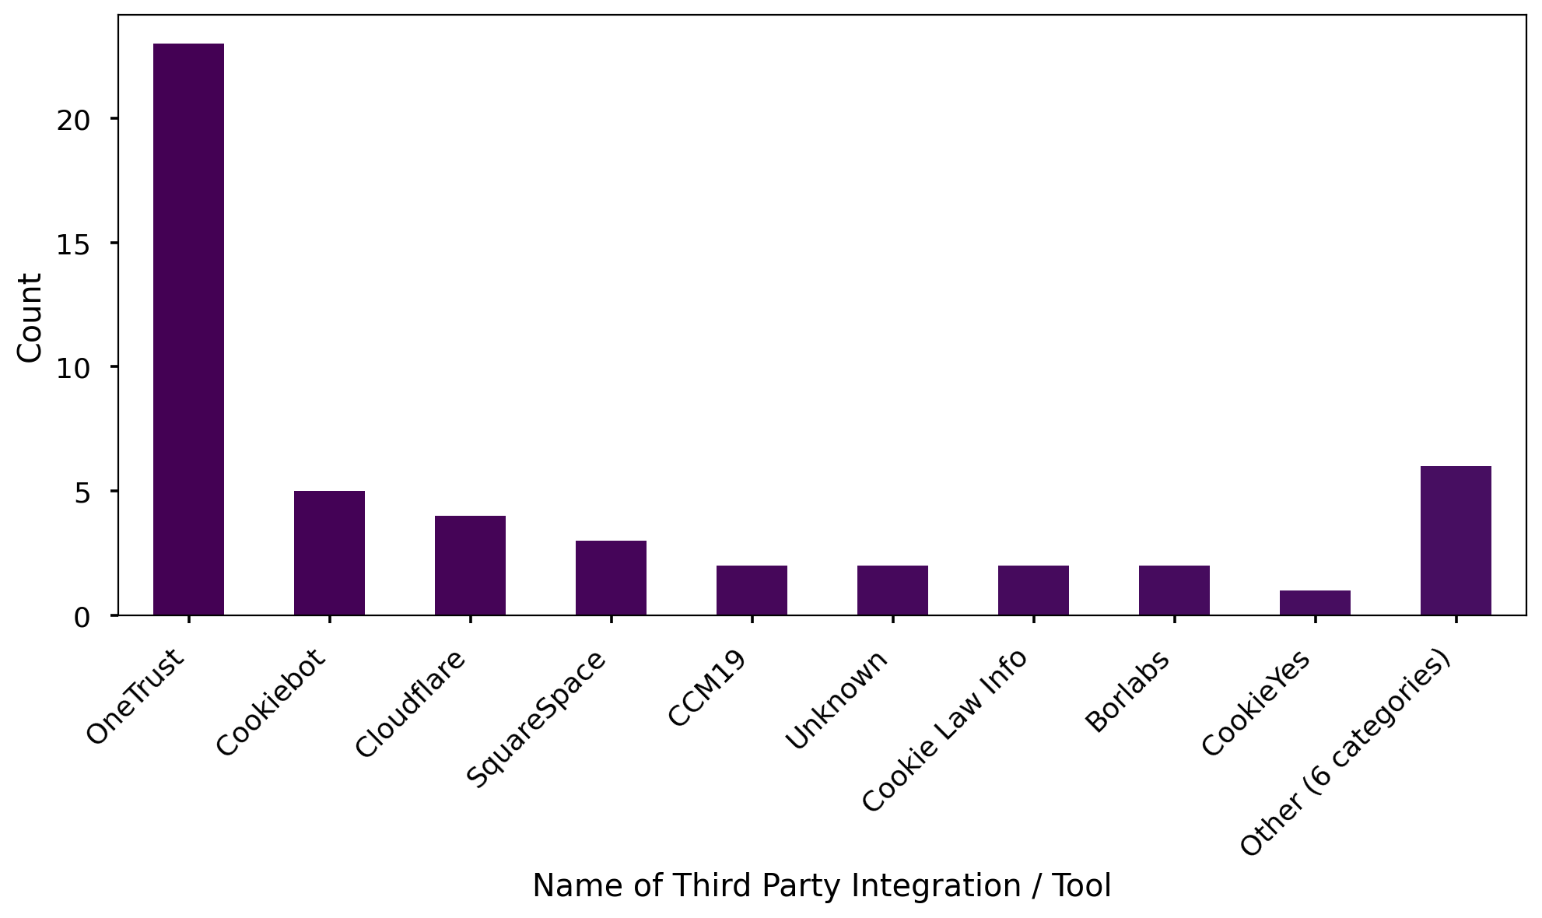
Analysis of Name of Third Party Integration / Tool
Summary Insight:
Among those using third-party tools, OneTrust is the most prevalent solution, followed by Cookiebot and Cloudflare. A long tail of other solutions exists, indicating a fragmented market with many smaller players.
Key Metrics:
OneTrust: 23
Cookiebot: 5
Cloudflare: 4
Other (6 categories): 6

Slide 7
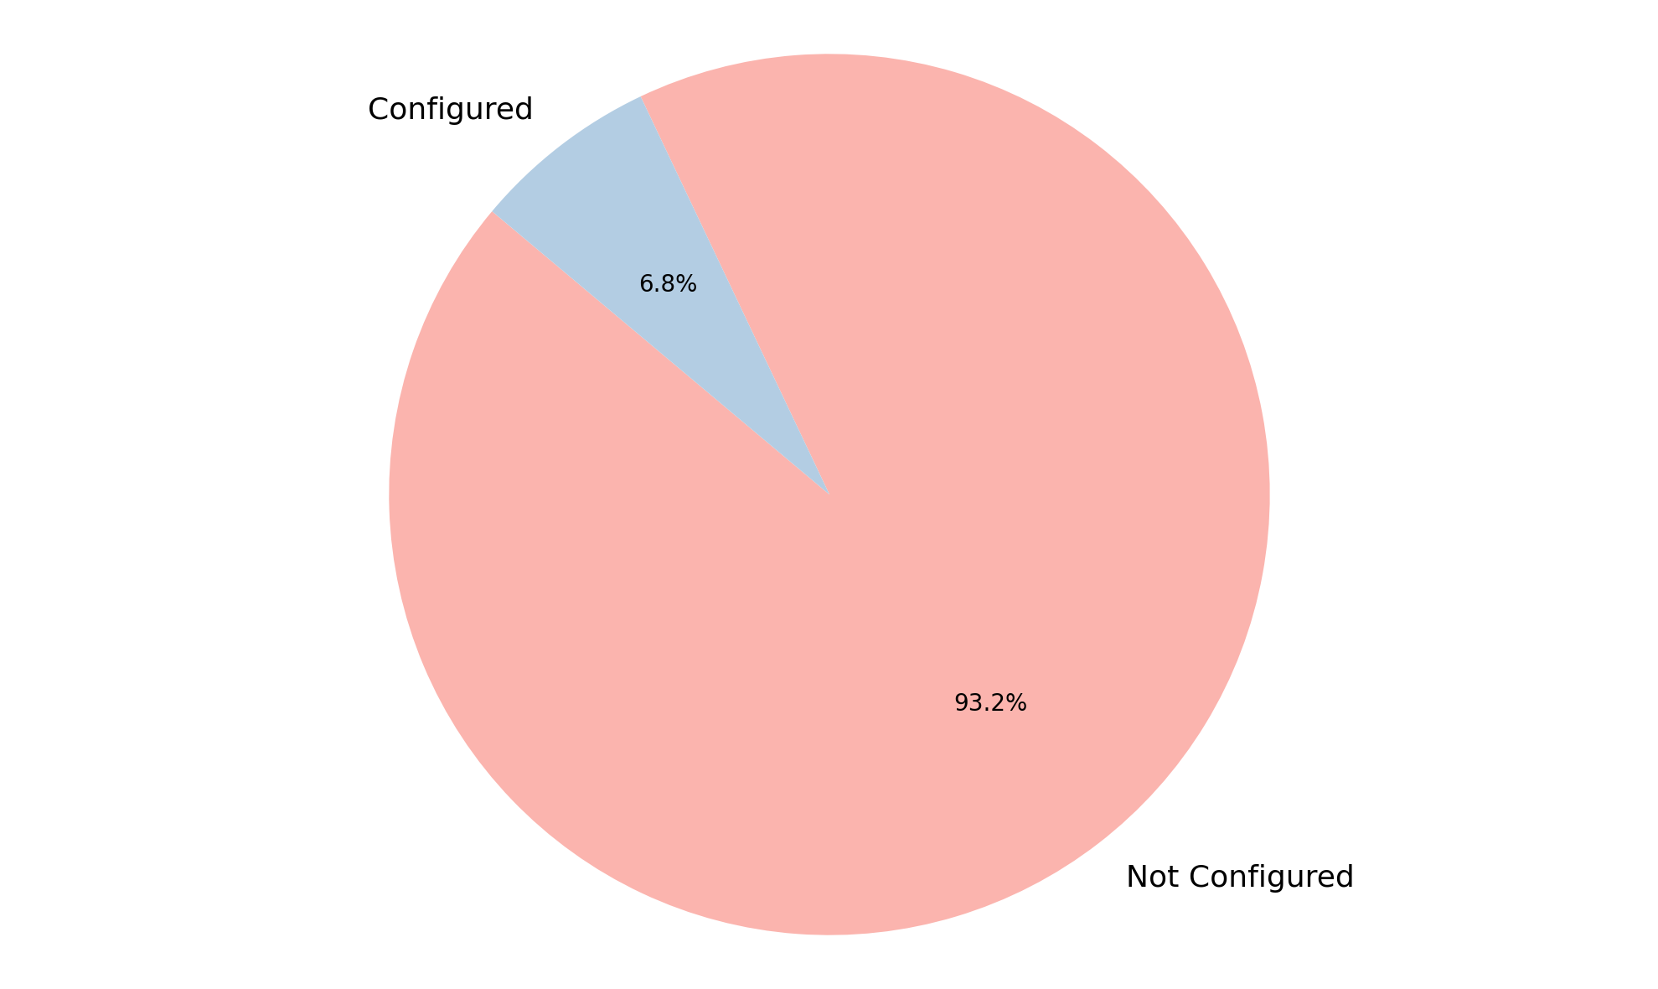
Analysis of GPC Configuration
Summary Insight:
The vast majority of websites in the dataset do not have GPC (Global Privacy Control) configured. This suggests low adoption of GPC or a lack of awareness/implementation.
Key Metrics:
Not Configured: 109
Configured: 8
Total: 117

Slide 8
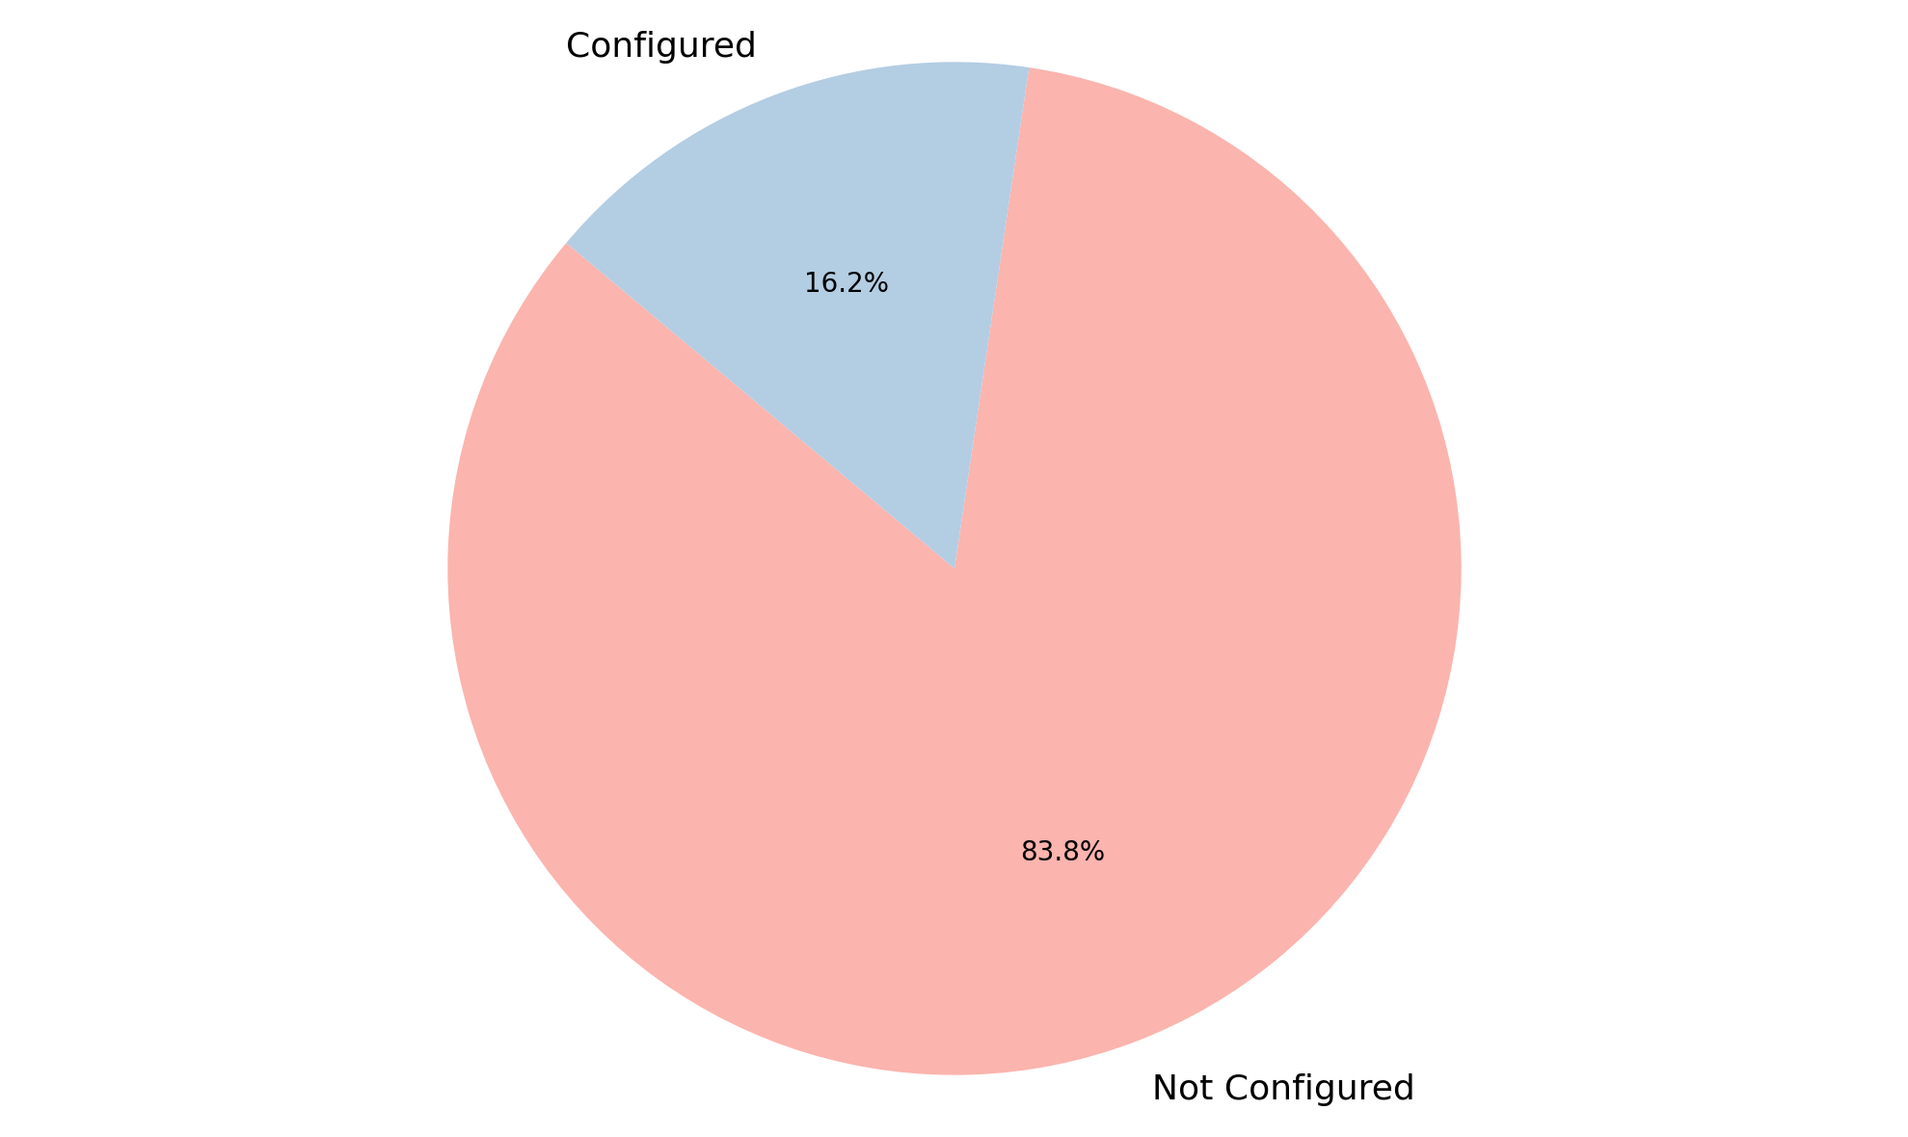
Analysis of Geolocation Rules
Summary Insight:
Geolocation rules are largely unconfigured in the dataset. This could indicate a lack of proactive geo-targeting or a reliance on default settings.
Key Metrics:
Not Configured: 98
Configured: 19
Total Count: 117

Slide 9
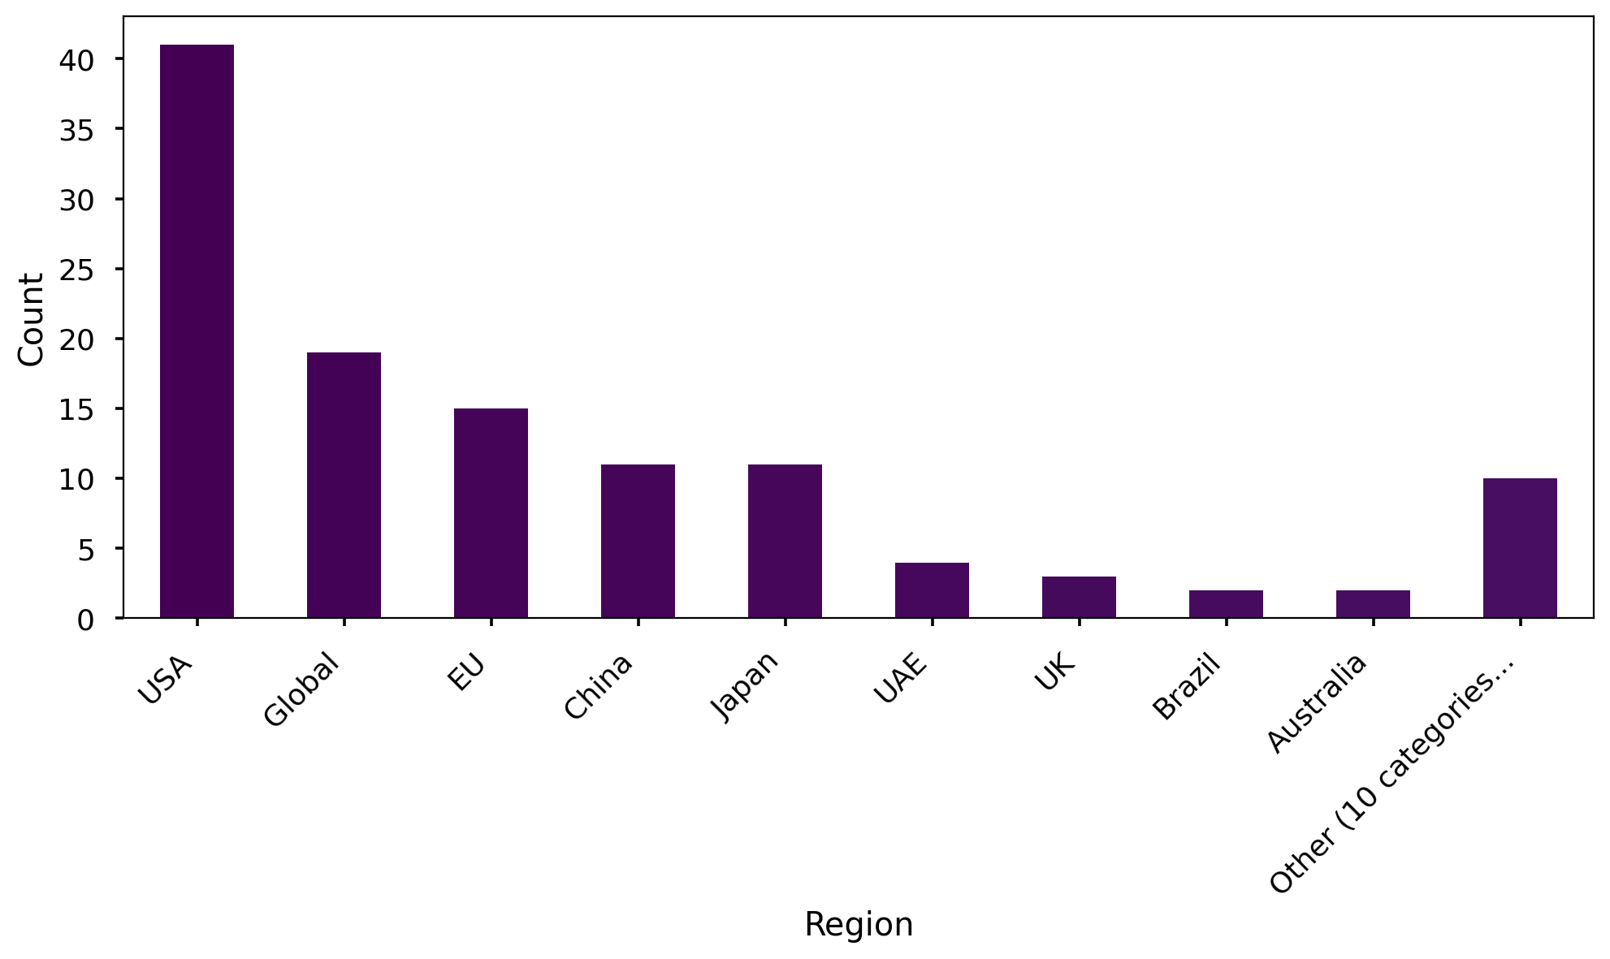
Analysis of Region
Summary Insight:
The USA is the dominant region represented in the dataset, followed by a significant presence from global entities. A variety of regions are included, with an 'Other' category representing a long-tail distribution of smaller regions.
Key Metrics:
USA: 41
Global: 19
Other (10 categories): 10
Australia & Brazil & UK: 2

Slide 10
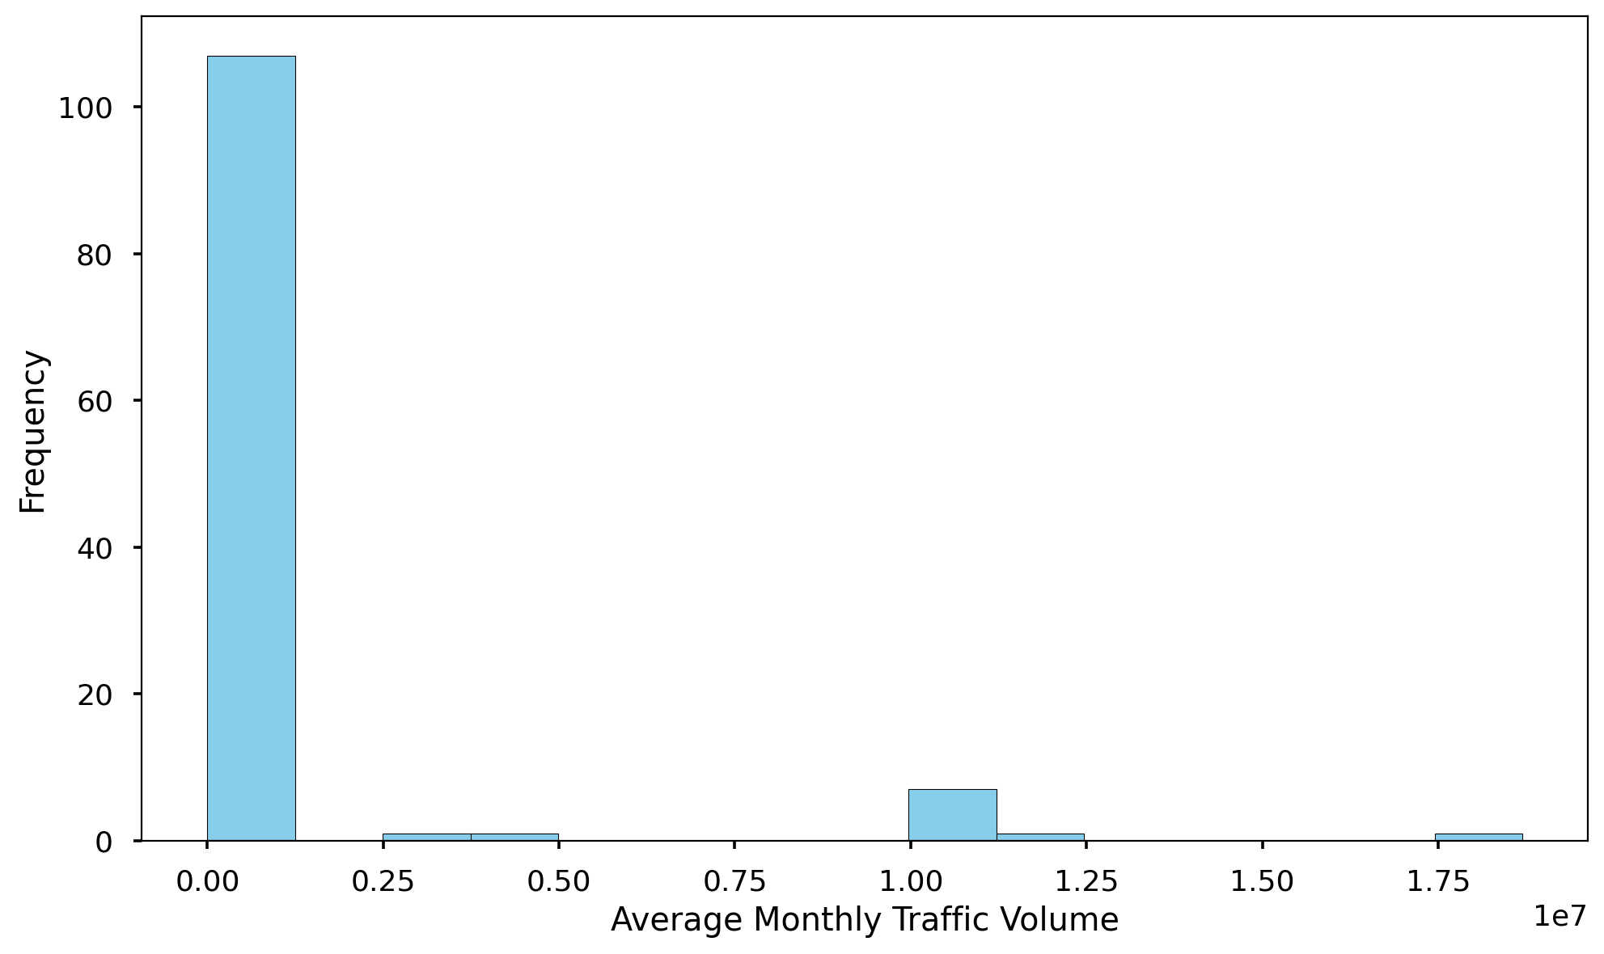
Analysis of Average Monthly Traffic Volume
Summary Insight:
The average monthly traffic volume varies greatly, indicated by the high standard deviation. While the mean is roughly 1 million, the median is significantly lower, suggesting a right-skewed distribution with a few very high-traffic instances.
Key Metrics:
Average: 1,017,830
Max: 18,696,560
Min: 0
Count: 118

Slide 11
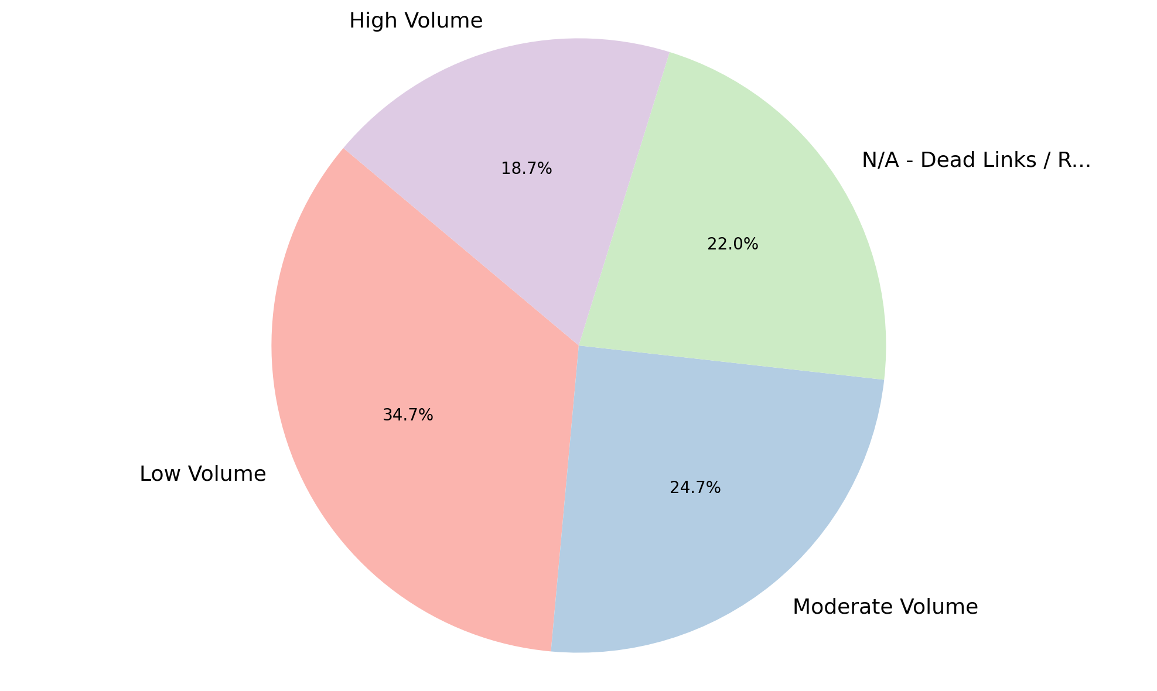
Analysis of Level of Traffic Volume
Summary Insight:
The majority of assessed items have low to moderate traffic volume. A significant portion are N/A, likely due to dead links or redirects.
Key Metrics:
Most Frequent: Low Volume (52)
Least Frequent: High Volume (28)
N/A - Dead Links / Redirects: 33

Slide 12
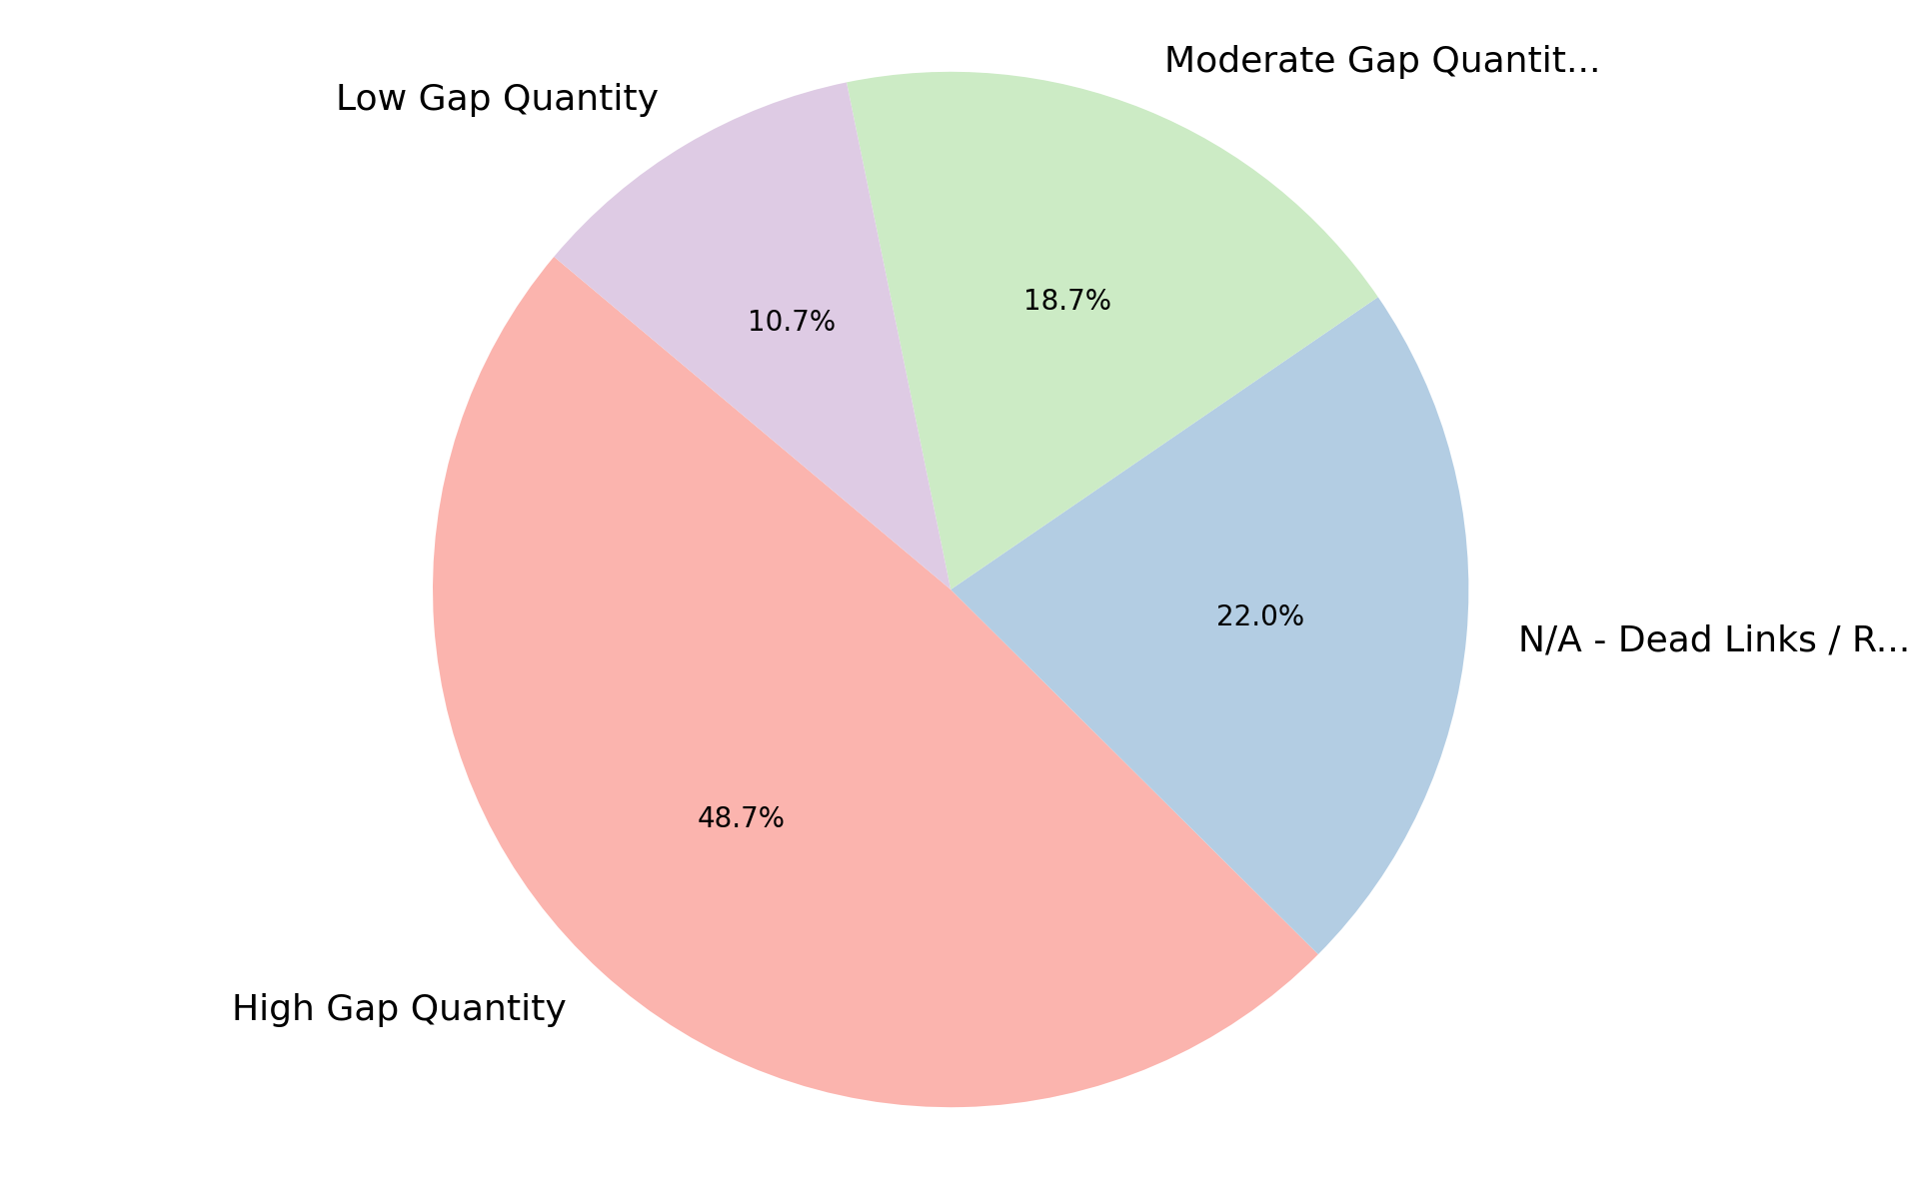
Analysis of Level of Gap Quantity
Summary Insight:
A large number of assessed items exhibit a high quantity of gaps, suggesting potential compliance issues. A considerable amount of data is also unavailable due to dead links or redirects.
Key Metrics:
Most Frequent: High Gap Quantity (73)
Least Frequent: Low Gap Quantity (16)
N/A - Dead Links / Redirects: 33

Slide 13
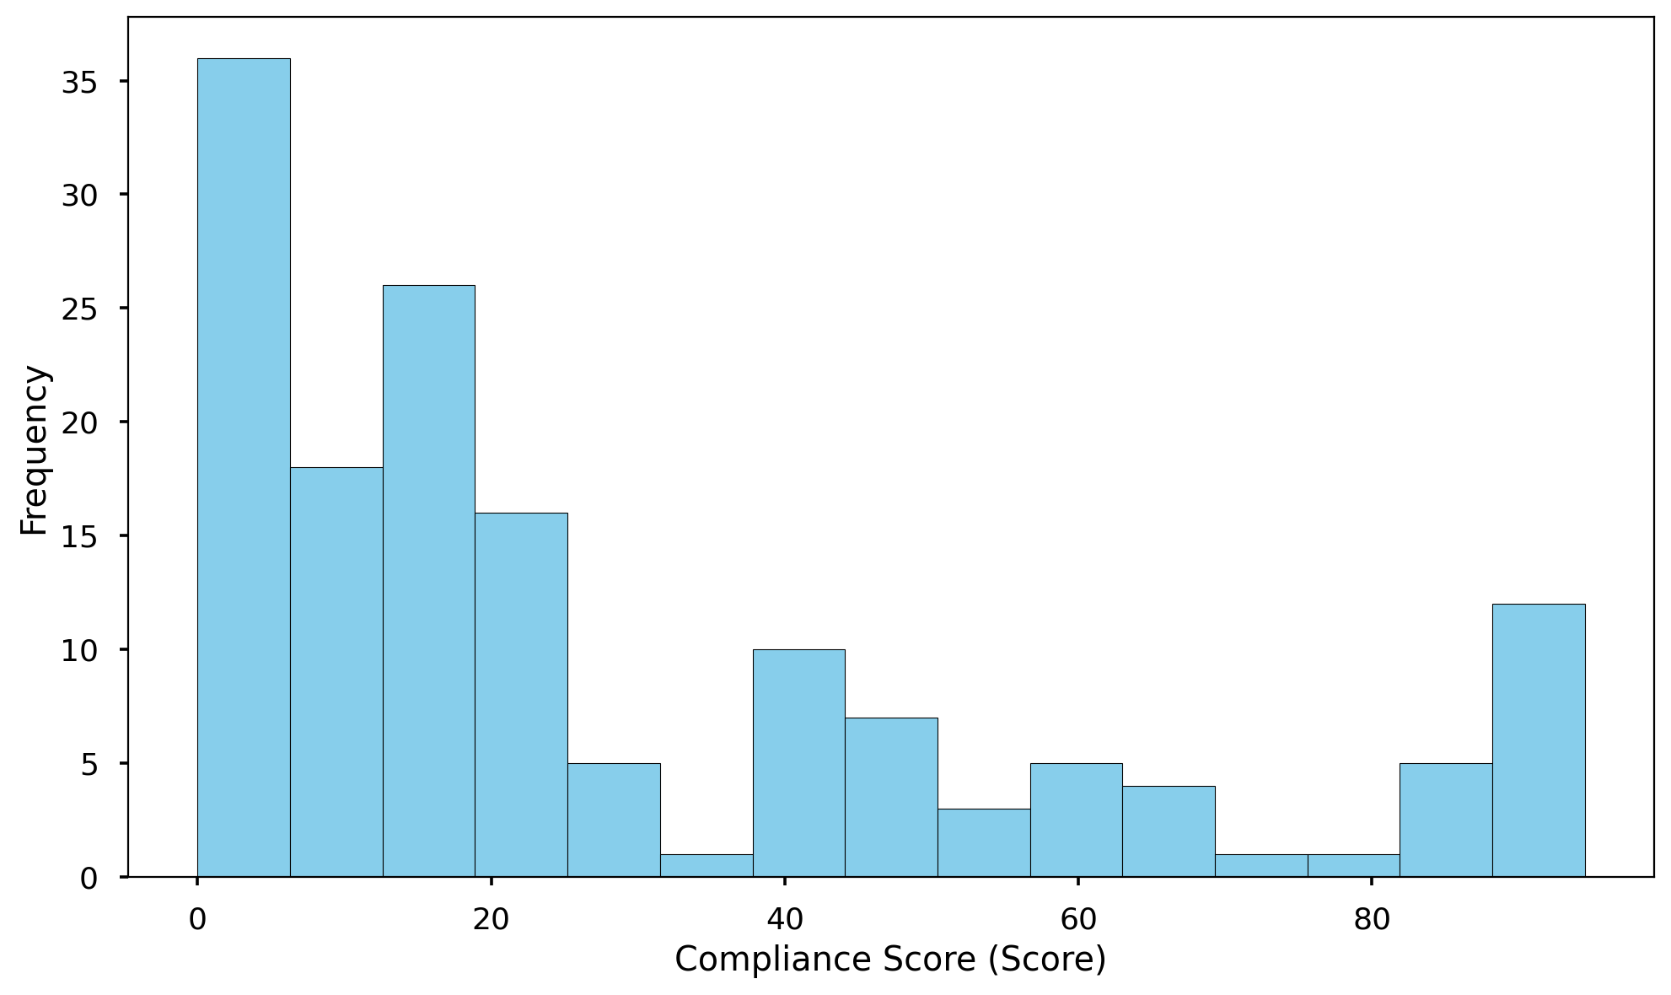
Analysis of Compliance Score (Score)
Summary Insight:
Compliance scores vary greatly, indicating inconsistent compliance levels. The average score is relatively low, suggesting widespread areas for improvement.
Key Metrics:
Count: 150
Average: 28.49
Max: 94.5
Min: 0.0

Slide 14
Thank You

