Slide 1
Data Analysis Report
Source: Sample Audit Report v1.xlsx

Slide 2
Key Findings & Observations
testdomain.net
examplepage.org
dummywebsite.info
fakedata.biz
mocksite.co
sampleweb.io
placeholder.tech
trythis.online
demoportal.store
randompage.net
trialsite.org
fictionalweb.info
testingdomain.biz
mimicpage.co
simulated.io
sandbox.tech
staging.online
preview.store
tempwebsite.com
testpage.net
dummyportal.org
mockdomain.info
demoaccount.biz
fakesite.co
placehold.io
prototype.tech
virtualpage.online
conceptsite.store
fillerwebsite.com
substitutepage.net
temporarydomain.org
trialweb.info
fakeportal.biz
testingspace.co
imaginarypage.io
unreal.tech
pretend.online
pseudo.store
testdrive.com
mocktrial.net
simulation.org
demonstration.info
replicasite.biz
ghostweb.co
mirage.io
illusion.tech
facsimile.online
surrogatesite.store
standinsite.com
duplicatesite.net
replacement.org
proxyweb.info
mimicsite.biz
shadowweb.co
alteredpage.io
variation.tech
fakecopy.online
dummyversion.store
freshconcepts.com
newtestsite.net
uniquesandbox.org
innovationspace.info
originalmockup.biz
trialversion.co
prototypeplatform.io
experimentalhub.tech
betaedition.online
pioneeringportal.store
firstattempt.com
untriedsite.net
rareweb.org
oneoffpage.info
customdemo.biz
tailormadeweb.co
distinctivepage.io
unusualtech.tech
singularportal.online
oneandonly.store
specialedition.com
freshstart.net
noveltrial.org
uniqueexperiment.info
innovationpage.biz
testdriveweb.co
breakthroughdemo.io
nextgen.tech
limitlesstrial.online
neverseen.store
unprecedented.com
discoverypage.net
frontierweb.org
newhorizon.info
cuttingedge.biz
groundbreakingtrial.co
revolutionarypage.io
emergingtech.tech
unveiledportal.online
undiscovered.store
freshwave.com
nextlevel.net
novelapproach.org
unchartedpath.info
unheardof.biz
untestedsite.co
boldexperiment.io
pushingboundaries.tech
redefinedportal.online
aheadoftime.store
nextwave.com
boldstep.net
trailblazer.org
visionaryhub.info
breakthrough.biz
gamechanger.co
newdimension.io
progressivetech.tech
futureportal.online
transformation.store
steppingstone.com
giantleap.net
nextchapter.org
excitingventure.info
milestone.biz
freshpath.co
unexplored.io
undiscoveredtech.tech
rebootportal.online
newpossibilities.store
pioneersite.com
unchartered.net
unchained.org
dreambig.info
limitless.biz
innovators.co
aheadtech.io
boldmoves.tech
revolution.online
creatingfuture.store
futurevision.com
nextfrontier.net
pioneeringidea.org
groundbreakinghub.info
boldinitiative.biz
unchartedspace.co
transformative.io
limitlesstech.tech
explorationportal.online
evolutionsite.store
progressivepath.com
newera.net

Slide 3
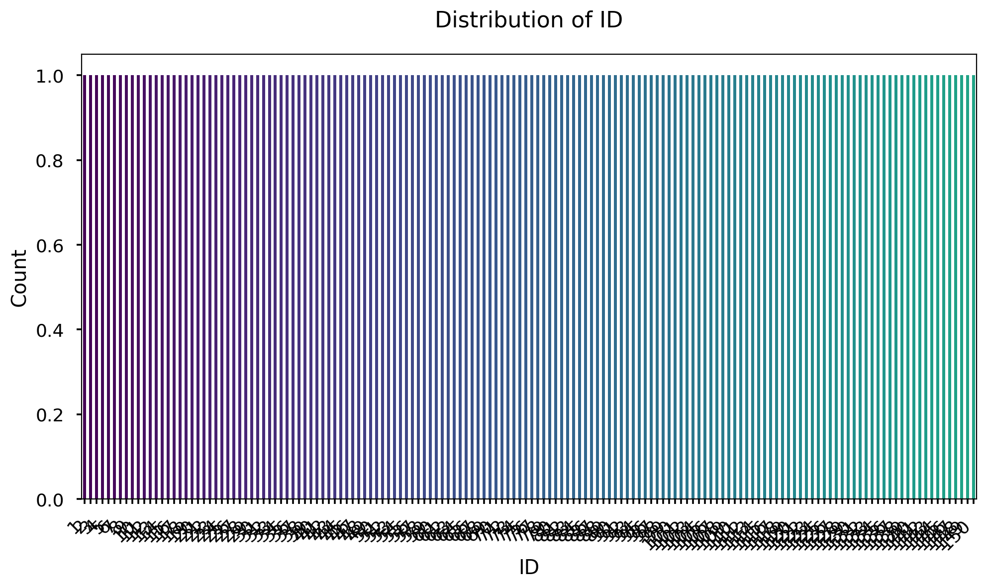
Distribution of ID

Slide 4
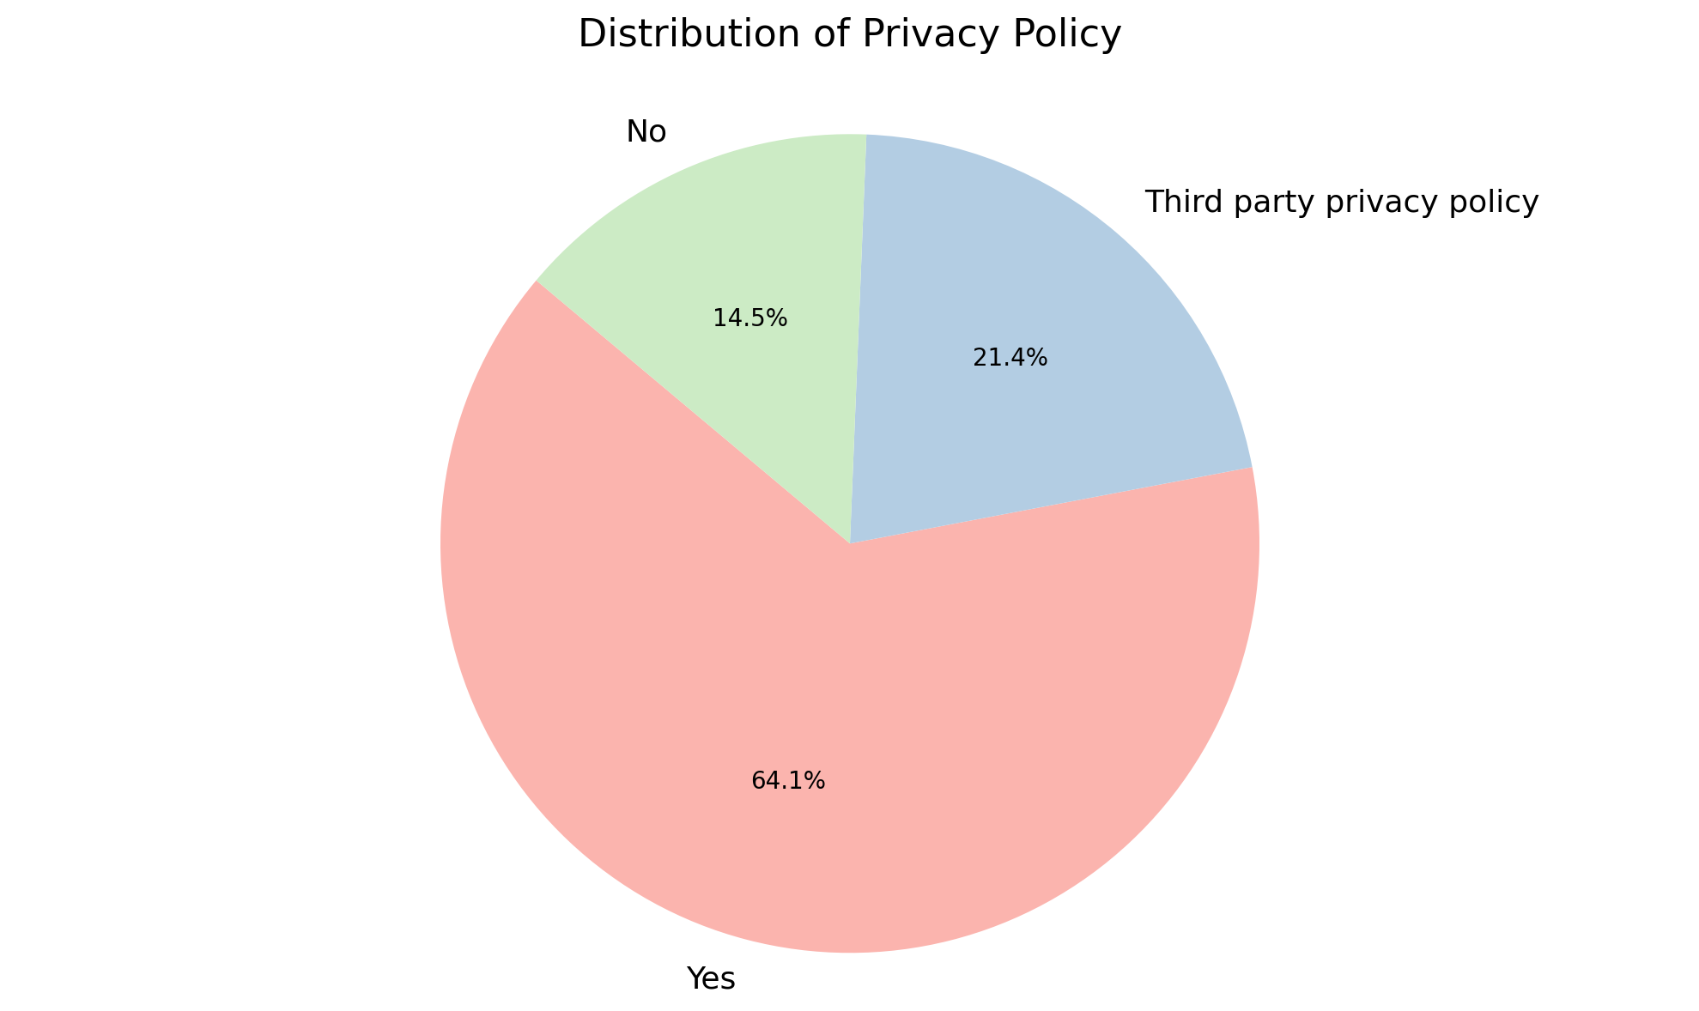
Distribution of Privacy Policy

Slide 5
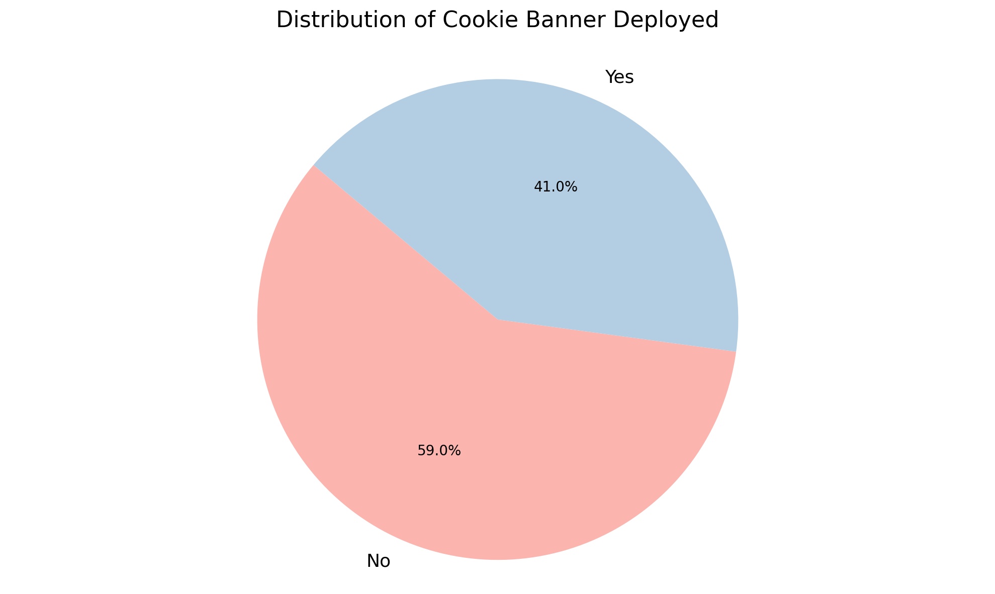
Distribution of Cookie Banner Deployed

Slide 6
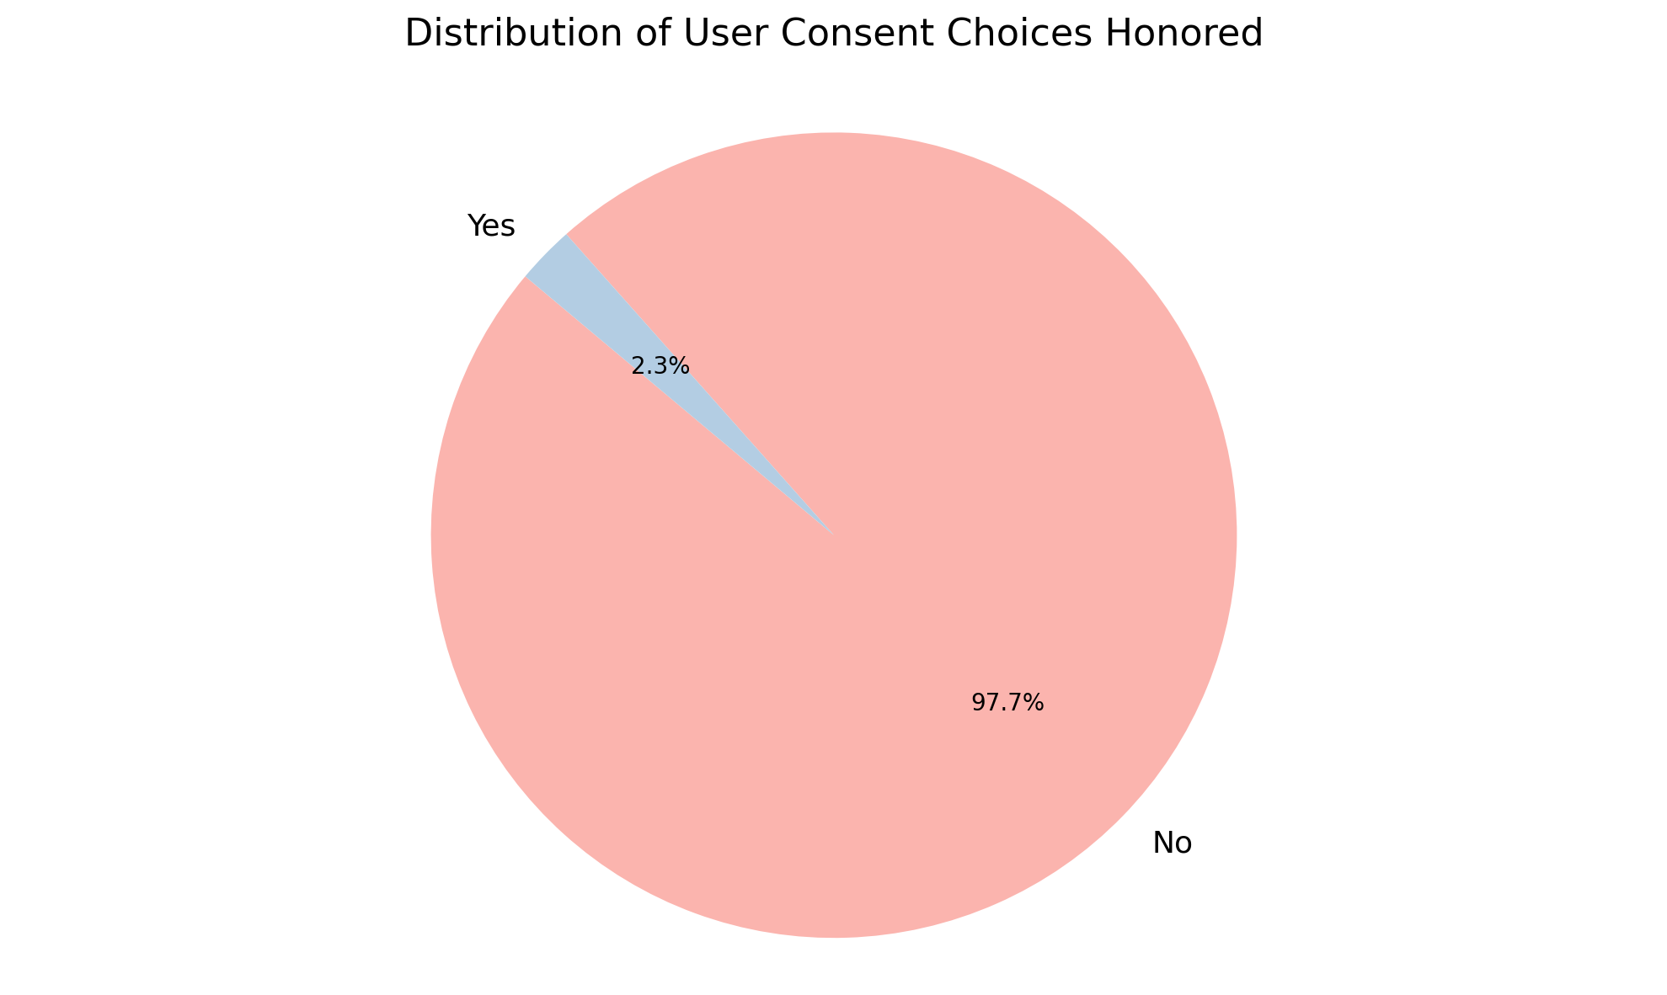
Distribution of User Consent Choices Honored

Slide 7
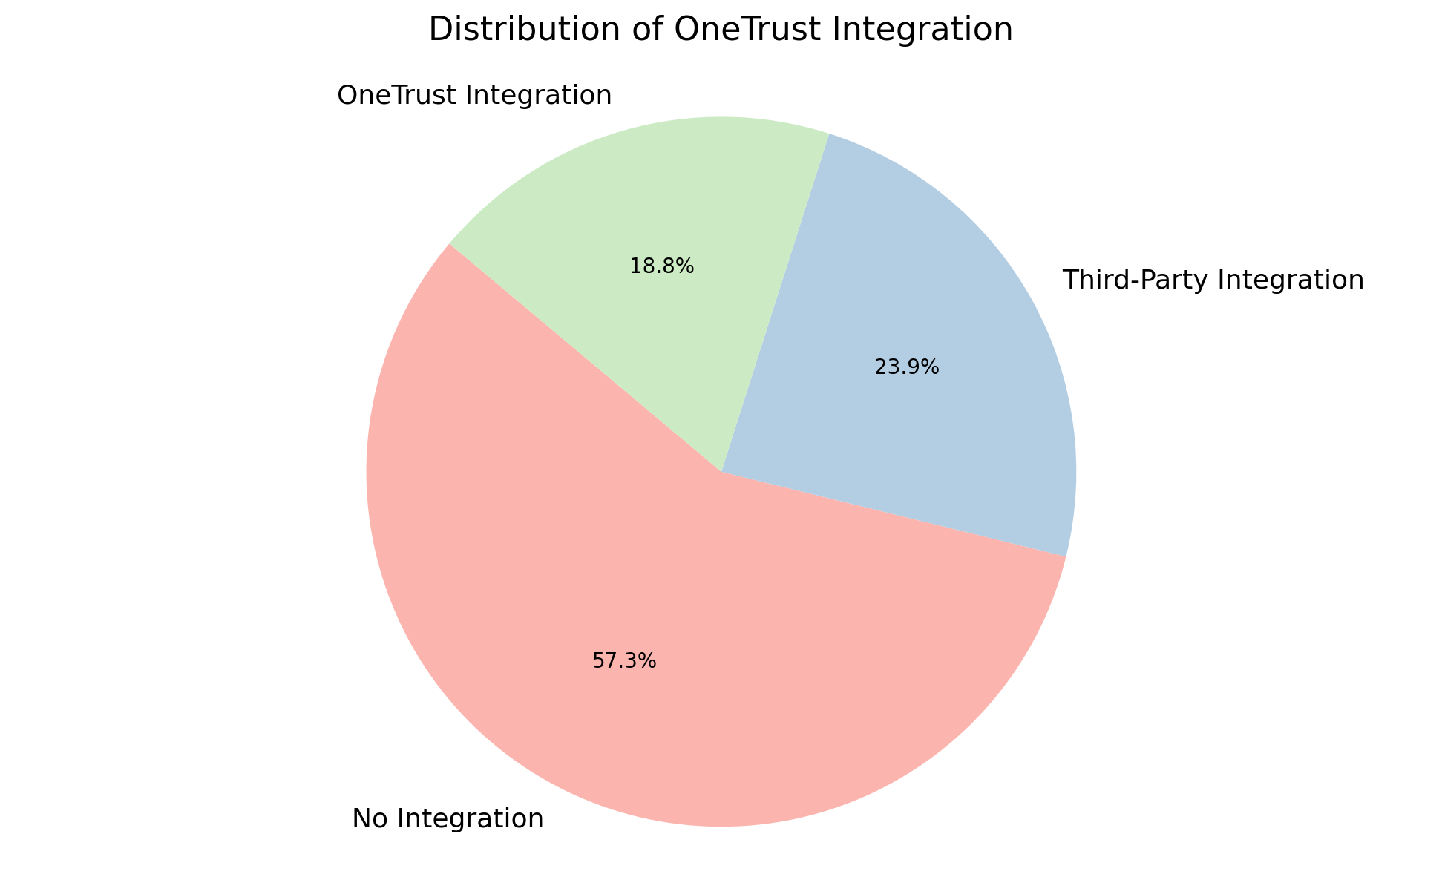
Distribution of OneTrust Integration

Slide 8
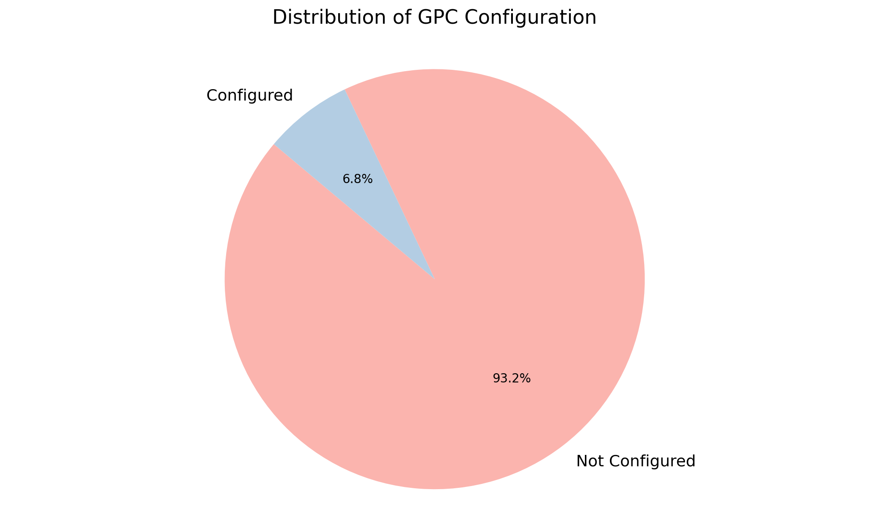
Distribution of GPC Configuration

Slide 9
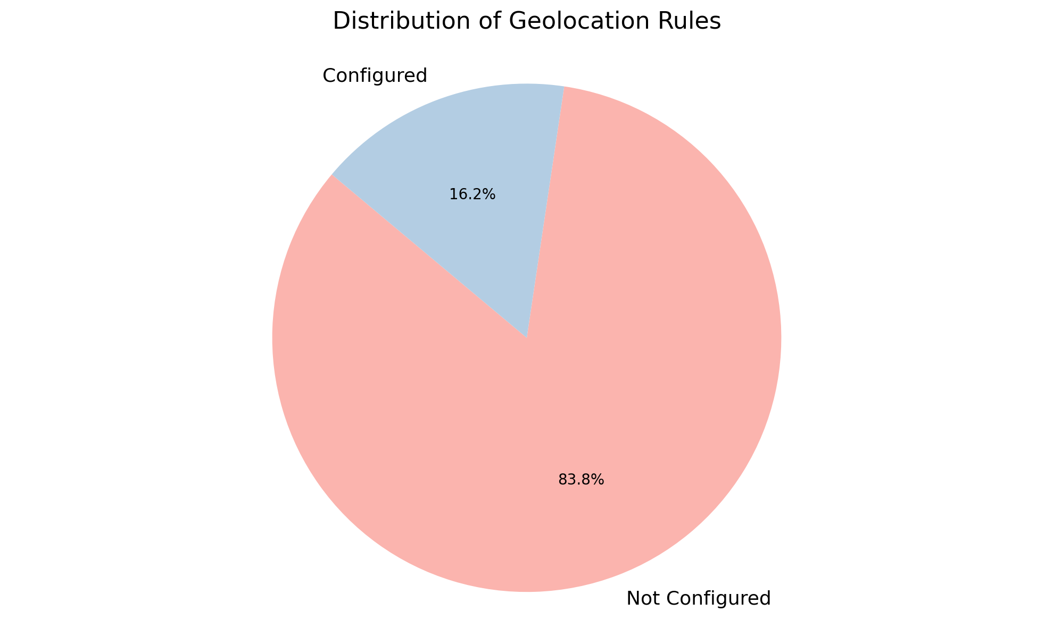
Distribution of Geolocation Rules

Slide 10
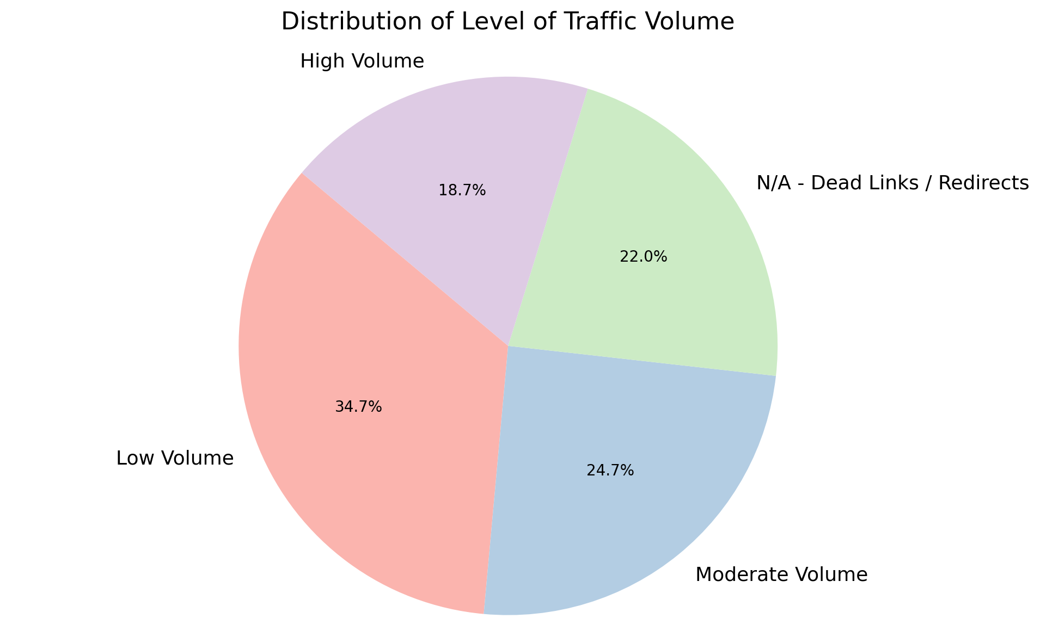
Distribution of Level of Traffic Volume

Slide 11
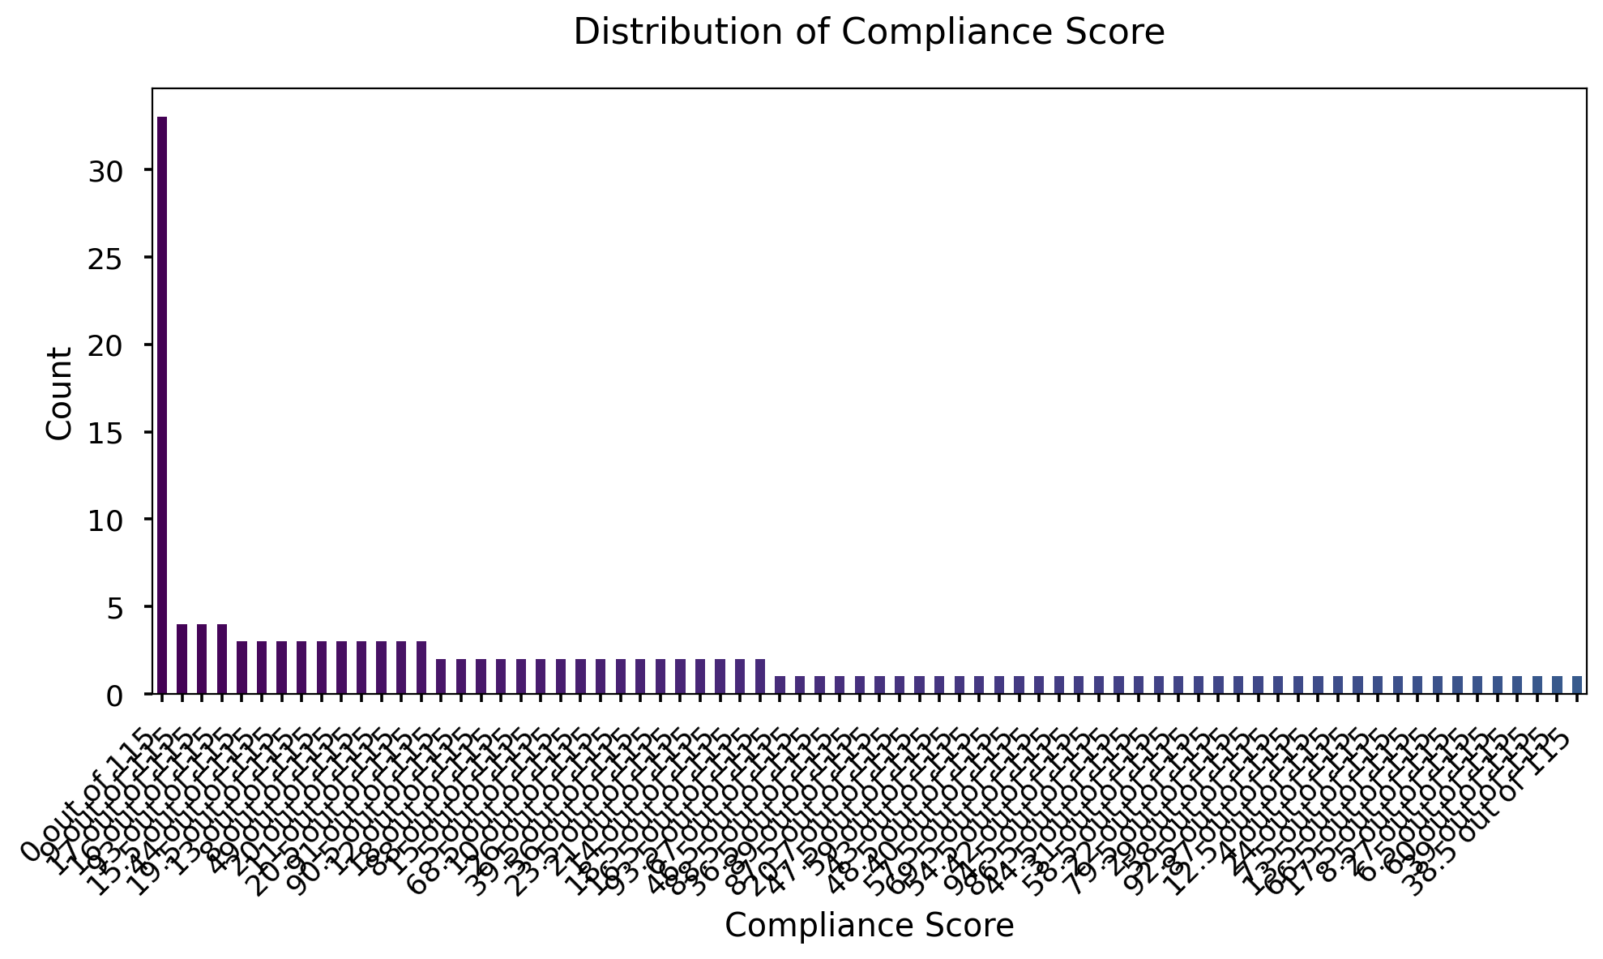
Distribution of Compliance Score

Slide 12
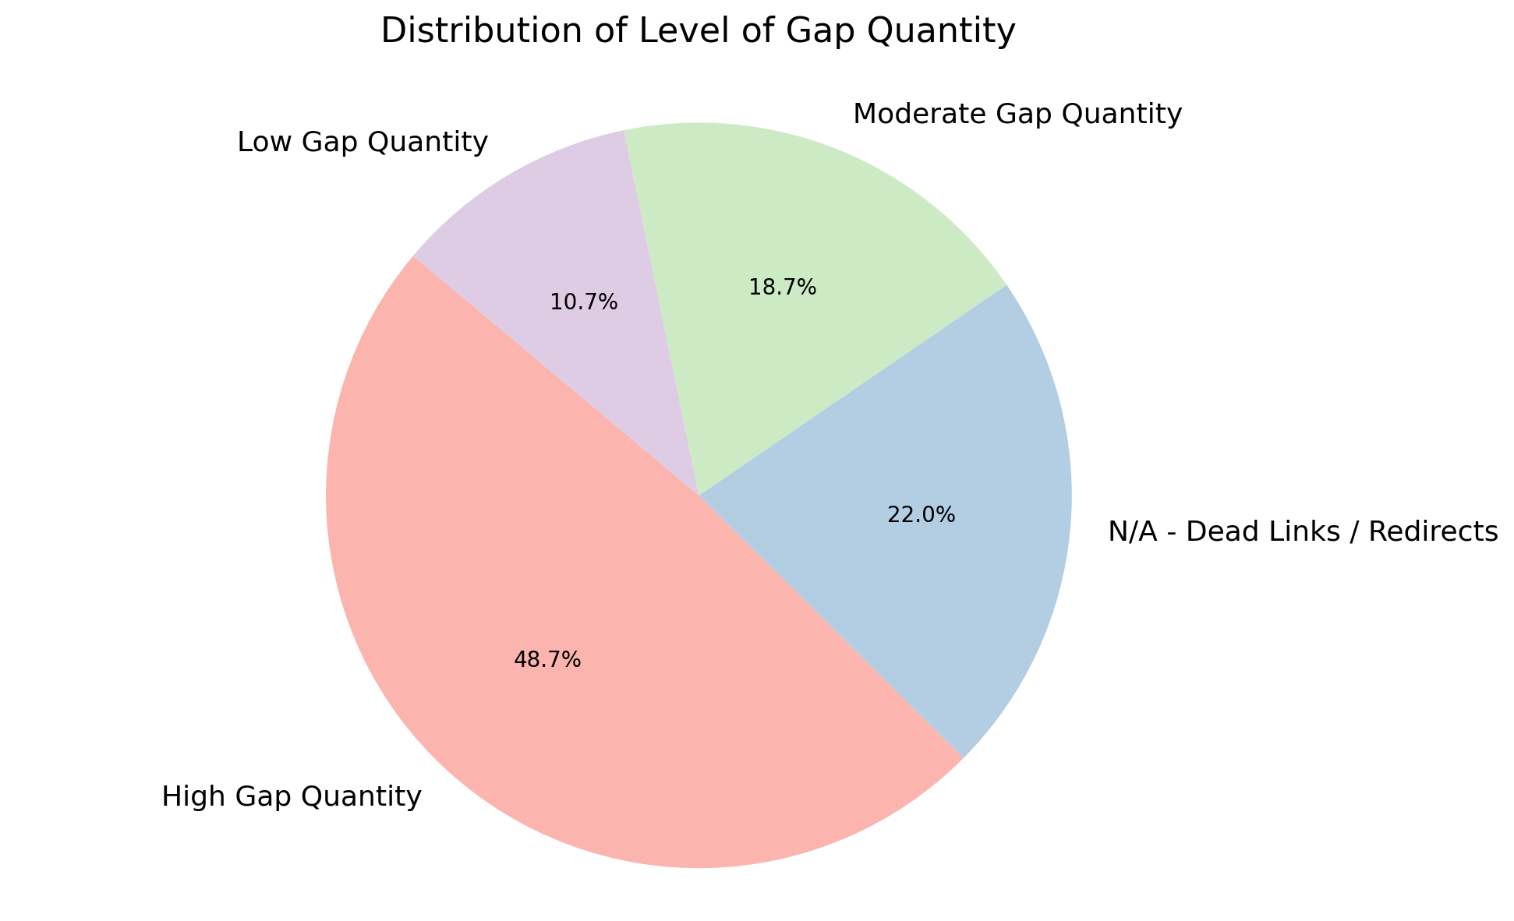
Distribution of Level of Gap Quantity

Slide 13
Thank You

