Slide 1


P2Pvalue Directory: using a unique open resource for research and networking
David Rozas (University of Surrey), Samer Hassan (Universidad Complutense de Madrid) and many others
This work was partially supported by the Framework
programme FP7-ICT-2013-10 of the European Commission through project P2Pvalue (grant no.: 610961).
www.p2pvalue.eu
CAPS 2015 (Brussels) – 07.07.2015
Notes:
So, yes, thank you Samer for the introduction! I will be now explaining some more details about the directory, and doing a quick demo.

Slide 2



Who am I?
Areas of interest: Free Software, Commons-Based Peer Production, social computing, Computer Supported Cooperative Work, Science and Technology Studies, etc.
Working as a Drupal developer for the past 5 years. Previously worked with other free software platforms
Previous background in Computer Science: @URJC (Spain), @NTNU (Norway)
Started PhD in Sociology @UniS (UK) in October 2013
Collaborating with the FP7 EU project P2Pvalue (www.p2pvalue.eu)
+info|contact:
  @drozas
  www.davidrozas.com || drozas@surrey.ac.uk
www.p2pvalue.eu
CAPS 2015 (Brussels) – 07.07.2015

Slide 3
Outline
Drupal and why using it?
Some key aspects of the architecture
How to explore and access the data
How to contribute: adding CBPP cases
Ideas for future work & questions
www.p2pvalue.eu
CAPS 2015 (Brussels) – 07.07.2015
Notes:
So, I will be quickly introducing first the free software that we used to build it: Drupal, an why we decided to choose it. Then, I will very briefly explain some key aspects of the architecture of the directory. And then, I will explain in bigger detail the functionalities of the directory while doing a demo.
Finally, we will have some time for ideas for future work and questions.

Slide 4
What is Drupal?
A free software framework to build web applications
A community of +1M users and +30k developers (Drupal.org stats)
+1M websites: whitehouse.gov, data.gov.uk, louvre.fr, mtv.co.uk, blogs.aljazeera.com, etc.
+info: https://drupal.org/about
Source: https://www.drupal.org/files/druplicon.small_.png
www.p2pvalue.eu
CAPS 2015 (Brussels) – 07.07.2015
Notes:
So, the directory is built using a Free/Libre Open Source framework called Drupal. Drupal is well-known for having an strong community, with more than 1M users and more than 30K developers. It is currently being used by more than 2% of the websites worldwide, and this includes highly complex and very high traffic websites such as whitehouse.gov, louvre.fr, etc.

Slide 5
Why using Drupal?
Robust architecture
Flexibility to perform changes
Modularity to extend with new functionalities: +25k contributed (non-core) modules
Flexibility quite critical, taking into account the research nature of the initiative
www.p2pvalue.eu
CAPS 2015 (Brussels) – 07.07.2015
Notes:
So, one of the main reasons to choose Drupal was the fact that provides a robust architecture, while still providing flexibility to perform changes. It provides a good balance on this. And, flexibility is really critical in a research project like this, since the requirements might change and need to be adapted quite rapidly.
Another of the reasons to choose Drupal between other Free Software, is the fact that has a very diverse ecosystem of contributed modules. You can think of them like plugins. So this, allows us not to having to re-invent the wheel.

Slide 6
3 key aspects of the architecture
Flexible way to:
  Manage permissions (who access what?): roles module
  To classify (and update) the cases. For example, adding a new type of activity: taxonomy module
  Display the contents in several formats: views module
www.p2pvalue.eu
CAPS 2015 (Brussels) – 07.07.2015
Notes:
So, I will explain very quickly 3 key aspects of the architecture in terms of these flexibility. First, the need for having a granular set of permissions. Next, a flexible system to classify the cases. And finally the need for flexibility in the way to display these contents.

Slide 7
Permissions and roles system
Flexible way to manage permissions, workflow and set a “wiki-like” system
Currently 3 main roles:
  Authenticated users (open registration): permissions to add new cases, edit details about them, see different revisions (versions) of the case, etc.
  Moderators: permissions to edit any kind of content, revert revisions in case of vandalism (post-moderation policy), add new terms to the vocabularies, etc.
  Administrators: full permissions to change all the configuration parameters
www.p2pvalue.eu
CAPS 2015 (Brussels) – 07.07.2015

Slide 8
Taxonomies
Taxonomy: the practice of “classifying things or concepts”
Using Drupal taxonomy system: a flexible way to classify and update the CBPP cases
Currently using 11 vocabularies
Each vocabulary has a set of “terms” that can be indexed and filtered:
  Via URLs: http://www.directory.p2pvalue.eu/explore/typologies/type-activity/open-education
  Via API (more details soon)
www.p2pvalue.eu
CAPS 2015 (Brussels) – 07.07.2015

Slide 9
Views
A GUI to a SQL builder: provides us a flexible way to fetch content from the database and display it in several formats:
  HTML
    E.g.: Use to expose the taxonomies as fields to
    filter by (Explore - http://directory.p2pvalue.eu/explore/cbpp-communities)
  JSON, XML
    E.g.: Use to create the API (http://directory.p2pvalue.eu/api-instructions)
www.p2pvalue.eu
CAPS 2015 (Brussels) – 07.07.2015

Slide 10

Exploring the data
Data gathered is licensed under a CC0 1.0 license (dedicated to Public domain -http://creativecommons.org/publicdomain/zero/1.0/)
Explore and filter it via web
Source: https://upload.wikimedia.org/wikipedia/commons/thumb/8/8c/CCzero.svg/220px-CCzero.svg.png
www.p2pvalue.eu
CAPS 2015 (Brussels) – 07.07.2015

Slide 11
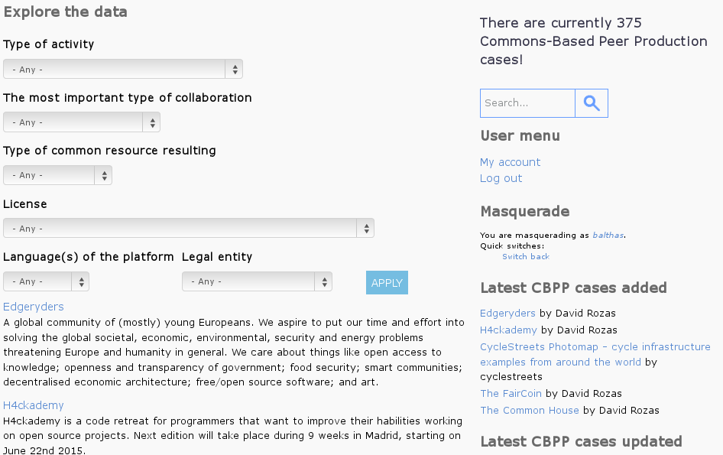
Exploring the data
Let's take a look: http://directory.p2pvalue.eu/explore/cbpp-communities
www.p2pvalue.eu
CAPS 2015 (Brussels) – 07.07.2015

Slide 12
Accessing the data: the “one-click”way
A batch process to create an “up-to-date” version of the data in CSV
Useful way to import it for statistical analysis
(R, Calc, SPSS, etc.)
www.p2pvalue.eu
CAPS 2015 (Brussels) – 07.07.2015

Slide 13
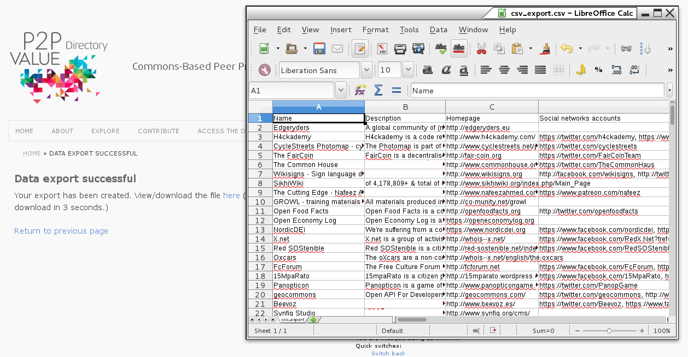
Accessing the data: the “one-click”way
Let's take a look http://www.directory.p2pvalue.eu/download/all-cbpp
www.p2pvalue.eu
CAPS 2015 (Brussels) – 07.07.2015

Slide 14
Accessing the data: the “geeky”way
REST (Representational state transfer) service: an architectural style designed by W3C applied to the development of web services
Currently supporting XML, JSON and PHP objects
Useful way to be used by other applications
www.p2pvalue.eu
CAPS 2015 (Brussels) – 07.07.2015

Slide 15
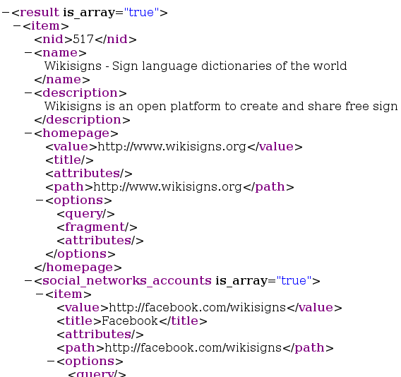
The “geeky”way: some examples
Accessing the data in different formats:
  XML (default): http://directory.p2pvalue.eu/rest/api (or .xml)
  JSON: http://directory.p2pvalue.eu/rest/api.json
  PHP: http://directory.p2pvalue.eu/rest/api.php
www.p2pvalue.eu
CAPS 2015 (Brussels) – 07.07.2015

Slide 16
The “geeky”way: some examples
You can also perform queries using the different values of the taxonomies by adding parameters to the URL
E.g.:http://directory.p2pvalue.eu/rest/api?languages=%22Spanish%22
“All the communities which include 'Spanish' as a Language of the platform”
www.p2pvalue.eu
CAPS 2015 (Brussels) – 07.07.2015

Slide 17
The “geeky”way: some examples
Several parameters can be combined: “AND” logic
E.g.:
http://directory.p2pvalue.eu/rest/api?languages=%22Spanish%22&legal_entity=%22public%20institution%22
“All the communities which include 'Spanish' as a Language of the platform AND which have a value of "public institution" for the field Legal entity”
www.p2pvalue.eu
CAPS 2015 (Brussels) – 07.07.2015

Slide 18
The “geeky”way: some examples
A concrete CBPP case can be selected using the NID (Node ID – Unique identifier)
E.g.: http://directory.p2pvalue.eu/rest/api.json?nid=250
All the information about the case 250 (Drupal) in JSON
+info : http://www.directory.p2pvalue.eu/api-instructions
www.p2pvalue.eu
CAPS 2015 (Brussels) – 07.07.2015

Slide 19
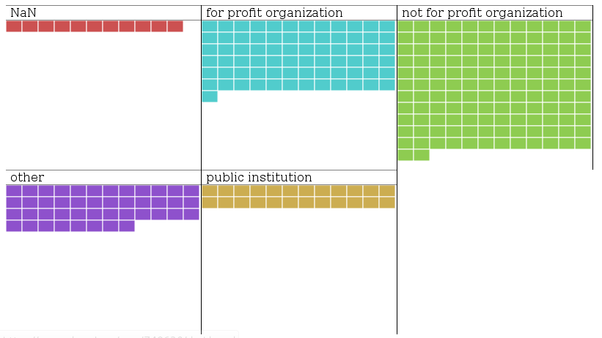
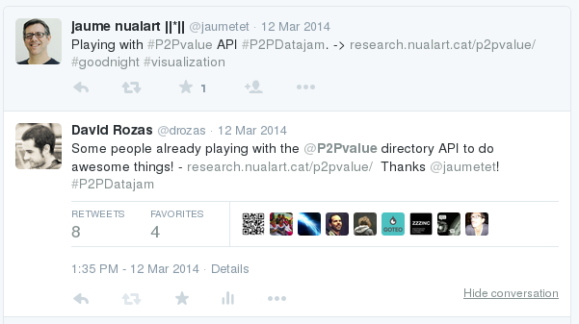
Example of use of API during #P2PDataJam
Source: screenshot from https://twitter.com/search?q=%40drozas%20p2pvalue&src=typd retrieved 22nd June 2015
Source: screenshot from http://research.nualart.cat/p2pvalue/ retrieved 22nd June 2015
http://research.nualart.cat/p2pvalue/
www.p2pvalue.eu
CAPS 2015 (Brussels) – 07.07.2015

Slide 20
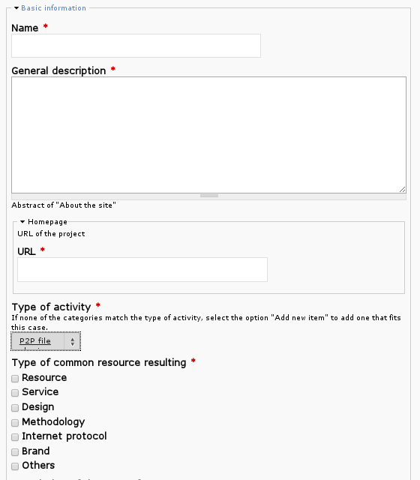
Contributing
Adding new cases or editing current ones
Let's take a look: http://directory.p2pvalue.eu/node/add/cbpp-community
www.p2pvalue.eu
CAPS 2015 (Brussels) – 07.07.2015

Slide 21
Ideas for future work
Automatic collection of data from P2Pvalue platform
Automatic collection of data from other sources: OpenHub of CBPP?
Data visualisation: maps of the communities, user actions, graphical statistics, etc.
User engagement mechanisms
Let us know if you are playing with the data:
http://www.directory.p2pvalue.eu/contact or @p2pvalue
www.p2pvalue.eu
CAPS 2015 (Brussels) – 07.07.2015

Slide 22
References (images)
http://caps-conference.eu/wp-content/uploads/2014/12/Logo-caps-2015-logo-no-back.png
  https://www.drupal.org/files/druplicon.small_.png
Screenshot from http://directory.p2pvalue.eu/node/add/cbpp-community retrieved 22nd June 2015 (not available unless logged in)
https://upload.wikimedia.org/wikipedia/commons/thumb/8/8c/CCzero.svg/220px-CCzero.svg.png
Screenshot from https://twitter.com/search?q=%40drozas%20p2pvalue&src=typd retrieved 22nd June 2015
Screenshot from http://research.nualart.cat/p2pvalue/ retrieved 22nd June 2015
www.p2pvalue.eu
CAPS 2015 (Brussels) – 07.07.2015

Slide 23
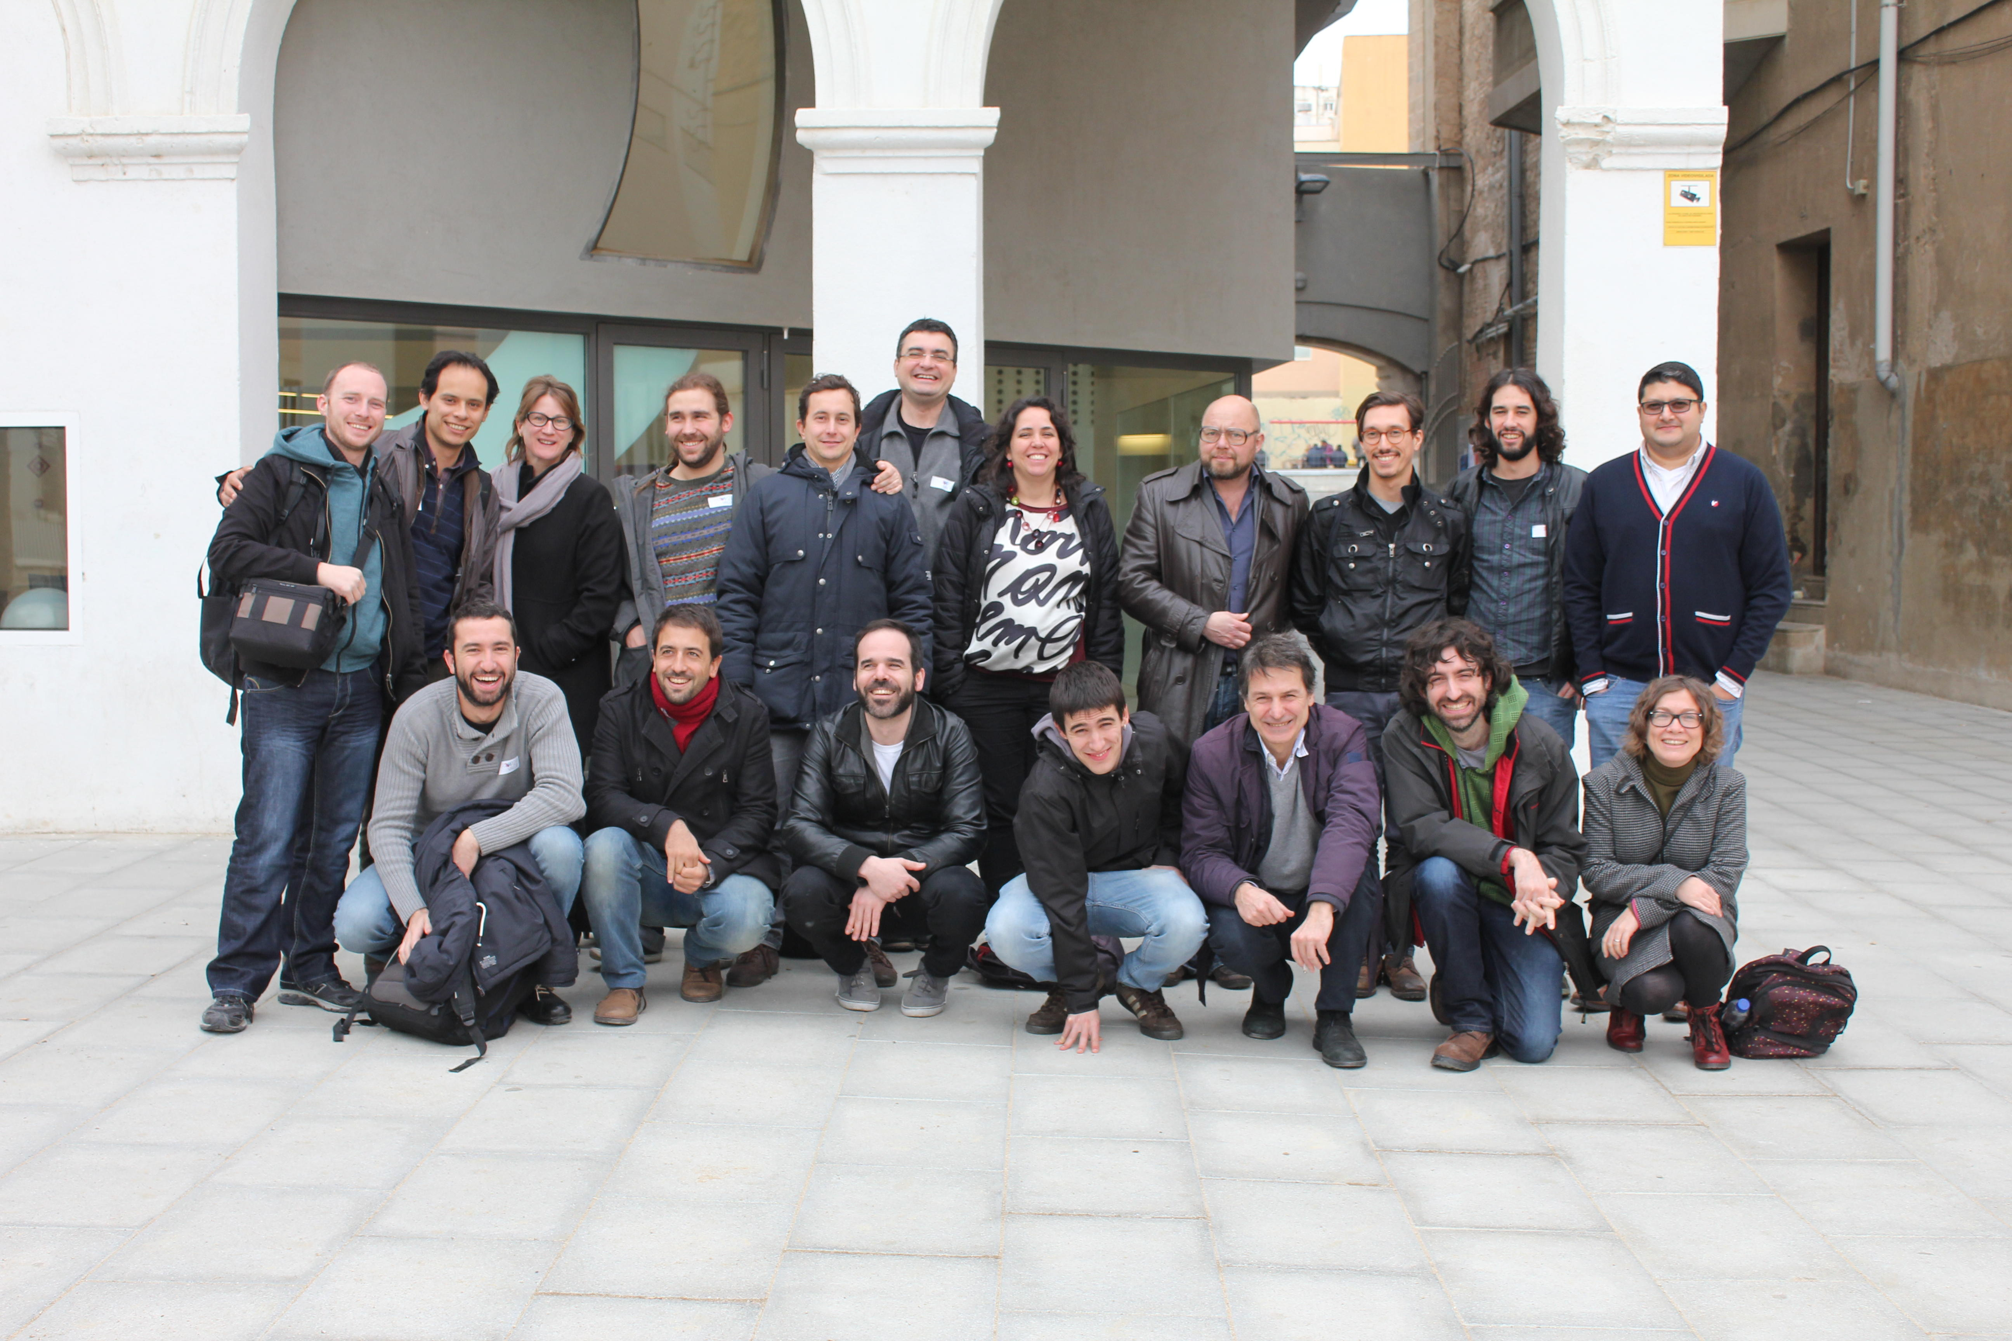



Any questions/feedback?
Thanks!
¡Gracias!
Ευχαριστώ!
Danke!
Grazie!
+info|contact:
    David Rozas:
      @drozas
      http://www.davidrozas.com
    P2P value:
      @p2pvalue
      http://www.p2pvalue.eu
[...]
[...]
This work is licensed under a Creative Commons
Attribution-ShareALike 4.0 Unported License
excerpt if otherwise noted. This presentation is a derivative
work from Mayo Fuster Morell's presentation on WP1
of the P2Pvalue project.
To view a copy of this license, please visit:
https://creativecommons.org/licenses/by-sa/4.0/
www.p2pvalue.eu
CAPS 2015 (Brussels) – 07.07.2015

