Slide 1


The value of (digital) social innovation: how to describe it and how to support its growth
David Rozas (University of Surrey), Mayo Fuster Morell (Universitat Autònoma de Barcelona) and many others
This work was partially supported by the Framework
programme FP7-ICT-2013-10 of the European Commission through project P2Pvalue (grant no.: 610961).
www.p2pvalue.eu
CAPS 2015 (Brussels) – 07.07.2015

Slide 2
Value creation in Commons-Based Peer Production: dimensions of value
www.p2pvalue.eu
CAPS 2015 (Brussels) – 07.07.2015

Slide 3

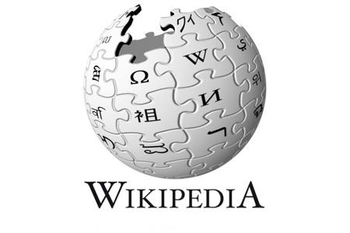
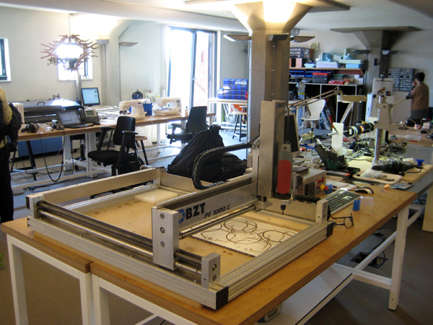
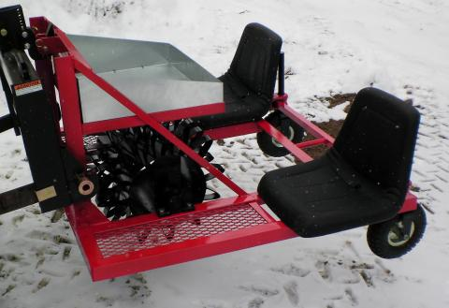
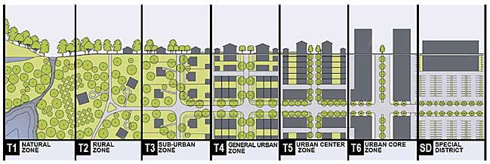
What is Commons-Based Peer Production (CBPP)?
Spreading to diverse areas: open science, open agriculture, Peer-to-peer urbanism, etc. (Fuster Morell et al., 2014)
  Collaborative process
  Peer-based: different levels of structure depending on the process, but not mainly based on contractual obligations nor coercion
  Commons-process: process driven by the general interest, results in openness of the resources
  Favouring reproducibility: via Free Software or Creative Commons licenses, exchange of practices, etc.
www.p2pvalue.eu
CAPS 2015 (Brussels) – 07.07.2015
Notes:
- Within your project you conducted an extensive work on the very definition of value in the P2P community based initiatives. Can you tell something about this? What is the value they generate? How do they perceive value?
- Yes! Thank you. I prepared some slides which might be helpful to illustrate them. So, let me first give really quickly the context of the research. P2P value is looking at Commons-Based Peer Production. During the first year, we developed a set of delimitation criteria, because in some cases, the line is a bit blurry with other concepts, such as market innovation. For example, think of AirBnB.
So, in our case we are looking at cases which are based on collaborative production, having P2P relationships, meaning that it is not based in a traditional hierarchical organisation and there is limited mercantile exchange, and finally the results are commons resources. For example, it allows its reproducibility.

Slide 4

Value creation in CBPP
Today, focus on one of the research sub-questions: how does value creation function in Commons-Based Peer Production?
Traditional theories of value do not apply to CBPP
Alternative strategies to assess value
What is valuable?
How to
measure value?
Value for whom?
Value captured - Who benefits from the created value
www.p2pvalue.eu
CAPS 2015 (Brussels) – 07.07.2015
Notes:
So, yes, coming back to your question, we have to ask ourselves: what is actually value, in Commons-Based Peer Production, when this is characterised by a limited presence of mercantile exchange? Traditional theories of value do not apply to Commons-Based Peer Production value. So we have to develop an alternative strategy to try to asses this value.

Slide 5
Dimensions of value
Value as a plural concept:
  Community building
  Mission accomplishment
  Monetary flow
  Social use value
  Reputation
www.p2pvalue.eu
CAPS 2015 (Brussels) – 07.07.2015
Notes:
So, that is what we were doing in P2Pvalue during the first year. Building an analytical framework to understand value in Commons-Based Peer Production communities. And we have relied in these five dimensions of value.

Slide 6
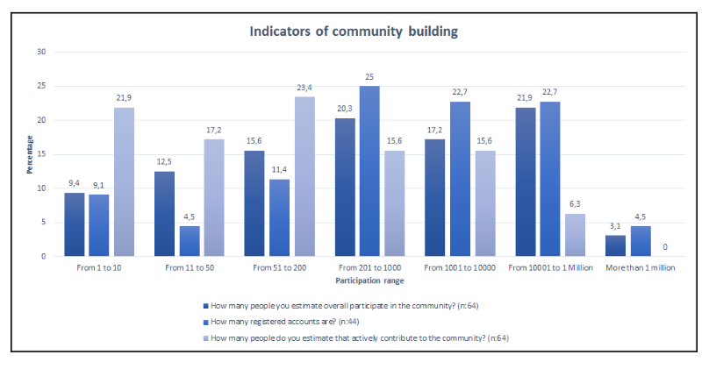
Dimensions of value: community building
Refers to the indicators of participation and interaction within the community
  As a productive result per se
  As implicit indicator of perceived value (Wenger et al., 2011; Kelty, 2008)
Results:
  Scale of the communities is
  extremely variable
  Power law (around 1/9/90) is
  present in the communities
www.p2pvalue.eu
CAPS 2015 (Brussels) – 07.07.2015
Notes:
So the first one refers to the level of participation. If there are many people participating in itself, if there are many interactions, this is valuable.
And just very quickly on the results of the analysis regarding this dimension is that the size of the communities is very diverse. But what it is present in most of the cases is what is known as Power Law. Meaning that there are different degrees of involvement. Typically, a 1% of people with a strong involvement, a 9% partially involved, and a 90% are weakly involved. [WIKIPEDIA EXAMPLE]

Slide 7
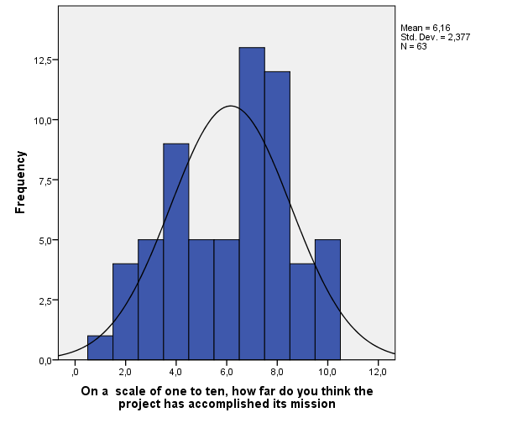
Dimensions of value: mission accomplishment
Refers to the self-evaluation of mission achievement
Results:
  Projects are quite satisfied
  Half the cases assign themselves a
  score between 7 and 10
www.p2pvalue.eu
CAPS 2015 (Brussels) – 07.07.2015
Notes:
The second level refers to if it is actually able to fulfill its mission. And we based this on the meanings of success for the community itself.
Again, very quickly on the results of the analysis, what we found is that the project in general are quite satisfied. Half of the cases assign themselves a score between 7 and 10. So this reflects that Commons-Based Peer Production is a mode which seems to be working for the cases.

Slide 8
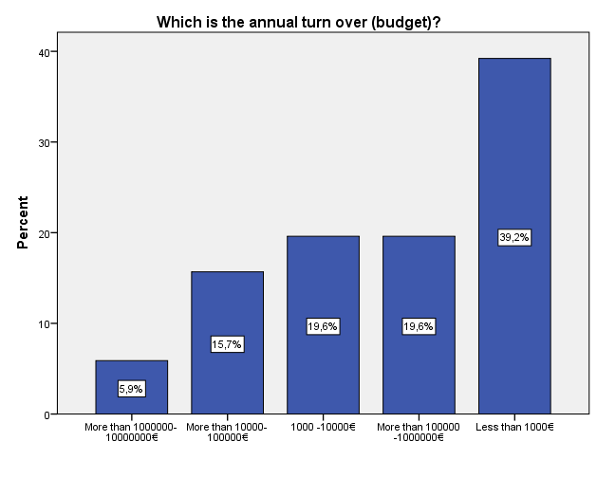
Dimensions of value: monetary flow
Although does not capture core value, necessary to consider (especially for hybrid cases)
Annual budget of the project
Results:
  39% of cases have budgets
  of less than 1,000€
www.p2pvalue.eu
CAPS 2015 (Brussels) – 07.07.2015
Notes:
Even if there is limited monetary exchange, still the budget was used as an indicator of value.
What we identified here is that the budget of the cases is very low. 39% of the cases have a budget of less than 1,000€. But still, they are satisfied with achieving their mission. So again, the monetary dimension is one that does not help to capture the core value of Commons-Based Peer Production

Slide 9
Dimensions of value: Value use & reputation distribution CBPP ecosystem
Social value: refers to its usage or adoption
Reputation: referring to external (and proprietary) indicators of reputation, such as Google Page Rank, Alexa, etc.
Results:
  CBPP cases have a typical range of value creation or “success” that is relatively high:
    50% at least 2.800 Twitter followers and 3.000 Facebook likes
    10% of the sample very successful (Rank lower than 3000 in Alexa)
www.p2pvalue.eu
CAPS 2015 (Brussels) – 07.07.2015

Slide 10
Dimensions of value: social use & reputation distribution
Indicators of reputation and social use (usage or adotion)
Google Page Rank, Alexa, Kred, Twitter followers, & Facebook likes
Strong correlation between them
Indicators available for all cases, but corporate based and non transparent
Urge an open CBPP oriented indicator of value
www.p2pvalue.eu
CAPS 2015 (Brussels) – 07.07.2015
Notes:
The last two ones are social use, how far has the commons resource has been used, and finally reputation.
One aspect, regarding the idea of measuring the level of reputation. We identified a limitation on this: all of them, such as Google Page Rank, Alexa, followers, likes, etc are proprietary and corporate. And, as a consequence, they are not transparent. So, there is a big gap on the need of having Commons Based Peer Production indicators of value which are open; which follow, let's say, Free/Libre Open Source Software principles. And what we found here is that there is a strong correlation between them: if you are good in Facebook, you are probably good in Google Page Rank or in Alexa. There is a coherence between them.
So yes, this has been a very quick summary. If you are interested, please check the deliverable. I attach the reference in the list. But I hope this answer your question.

Slide 11
New indicators of value: more in-depth example
www.p2pvalue.eu
CAPS 2015 (Brussels) – 07.07.2015
Notes:
Community is of course one of the conditio sine qua non for sustainability in the field of DSI. You conducted an interesting research on the Drupal community and its process of community building. Can you tell something more about this? In parallel P2P value also conducted a survey on CBP2P initiatives and their economic sustainability models. In many case they do not have any monetary exchange, but in other cases they have revenue streams. Can you tell something also about this?

Slide 12
New indicators of value: in-depth example
Previous results looking at these dimensions on CBPP cases as unit of analysis
But similar issue of need of new and open indicators of value within the communities themselves in individual level
More in-depth example of a FLOSS case study: Drupal
www.p2pvalue.eu
CAPS 2015 (Brussels) – 07.07.2015
Notes:
So, yes, in connection with the previous question, before I was discussing these dimensions of value on Commons-Based Peer Production cases as unit of analysis. But I would like to go a bit deeper on this need of open indicators of value within the communities themselves, with the case study I am researching for my PhD: Drupal. Concretely, in the idea of community-building value.

Slide 13

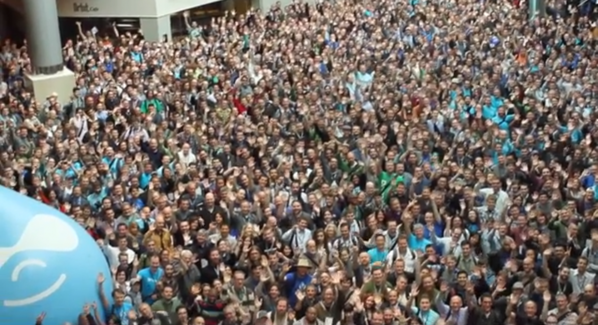
Case study: what is Drupal?
A free software framework to build web applications
More than 2% web (W3C, 2015). Including whitehouse.gov, data.gov.uk, louvre.fr, mtv.co.uk, blogs.aljazeera.com, etc.
Currently +1M users registered at Drupal.org, +30k code contributors(Drupal.org, 2014a)
Hundreds of local F2F events, dozens of camps and
cons in 4 continents (Drupal.org, 2014b)
www.p2pvalue.eu
CAPS 2015 (Brussels) – 07.07.2015
Notes:
So, let me introduce you really quickly what is Drupal. It is a Free Software content management framework. A free software to build websites and web applications. It is currently being used by more than 2% of all the websites worldwide. And this includes really high traffic websites, such as whitehouse.gov or mtv.co.uk, to give you some examples. But Drupal cannot be understood without its community. So, what started from a personal project of a PhD student 13 years ago, has become a community of more than 1M users. And these includes hundreds of local f2f events, and dozens of major events with thousands of people.

Slide 14

Contribution
A blurry notion: meanings constantly evolving as part of negotiation processes between the participants
Critical in CBPP communities focussed on digital commons: economy of contribution [not based on direct reciprocity]
rather than economy of gift [based on direct
reciprocity] (Wittel, 2013)
www.p2pvalue.eu
CAPS 2015 (Brussels) – 07.07.2015
Notes:
And, in connection with the idea of value, I was looking at the notion of contribution. Contribution in these communities can be understood as a set of meanings which are constantly evolving as part of negotiation processes between the participants in them. And this is a very critical notion, since as identified by Wittel, CBPP communities focussed on the digital commons typically rely on economies of contribution rather than economies of gift, meaning that they are not based on direct reciprocity.

Slide 15
Contribution: “code-centrism”
“Code-centrism”:
In FLOSS literature: typically looking at source code as main notion of contribution
In FLOSS communities: “Talk is silver, code is gold”
What about other contributions?
www.p2pvalue.eu
CAPS 2015 (Brussels) – 07.07.2015
Notes:
And what I found, both in the literature and in the communities themselves, is what I called code-centrism. Meaning that most of the studies which incorporate this notion of contribution typically look at source-code related activities. And this happens in the communities themselves, this motto: “talk is silver, code is gold” embodies quite well this idea. But what about other contributions? Other dimensions of value?

Slide 16
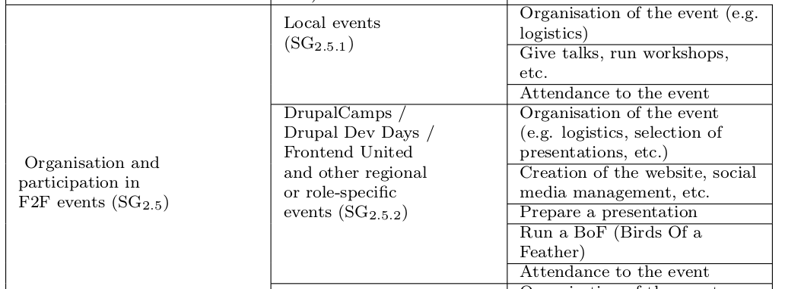
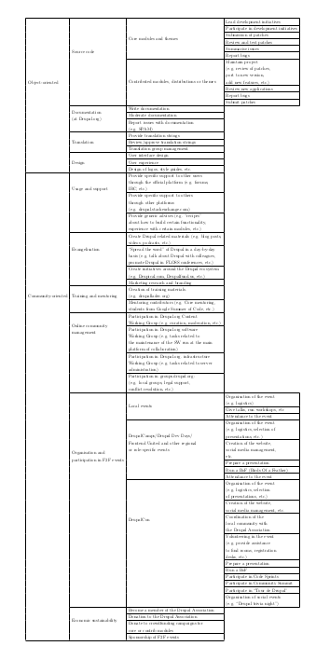
Contribution beyond source code
Two main types emerged, according to the
focus of action:
“Object-oriented”: source code,
documentation, translation, etc.
“Community-oriented”: usage & support, online community management, training & mentoring, organisation & participation in F2F events, etc.
Suggestive, not exhaustive, list
www.p2pvalue.eu
CAPS 2015 (Brussels) – 07.07.2015
Notes:
So, I will not go into much detail. But what I found is that there are certain contribution activities whose focus of action is directed towards the community, rather than the object that are less visible, but they play a relevant role to create the strong sense of community and foster collaboration.

Slide 17
Relevance of community-oriented contributions: newbies
“[...]indeed, the fact of attending these meetups, it was really good. Because you realise there are people behind the source code, right? There are
people behind the modules. And you meet people that can tell you this kind
of personal stories.[...] And then, it stops being something anonymous, it
becomes something yours.”
Drupal developer and devop, 1.5 years. Original reply in Spanish.
Drupal becomes a community, avoid barriers, increases the will for reciprocity, etc.
Also for experienced: increase of commitment, avoid to burnout, etc.
www.p2pvalue.eu
CAPS 2015 (Brussels) – 07.07.2015
Notes:
For example, for newbies, it is very important to avoid barriers, impostor syndrome, and to increase the will for reciprocity. For instance in these excerpt from a newbie, we see how Drupal is not a piece of software anymore, it is a community. [READ]
This embodies the idea of becoming a commoner through commoning, which other scholars have discussed.

Slide 18
Relevance of community-oriented contributions: scaling up
“Because the community is growing, then you have less of a sense of community. But I think the solution to that is to have smaller local communities.
So, you know, as the worldwide community grows, then you start finding, like whereas before it might have been 50 people worldwide, now you have like 50 people in your part of London, or wherever.”
Drupal themer and developer, 11 years.
Local activities help to scale up the sense of community, as it grows
www.p2pvalue.eu
CAPS 2015 (Brussels) – 07.07.2015
Notes:
Another example is how these kind of activities become very relevant to scale up this sense of community. Hence, being very relevant for them as the communities grow.

Slide 19
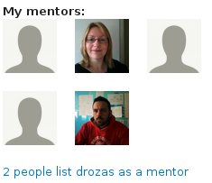
Example of community-building indicators
Drupal community working on that direction:
improve how these activities are represented in the user profiles at Drupal.org, to “[...] go beyond code creation activity and into more community-oriented stuff, since that’s also a huge part of what makes Drupal healthy.” (Drupal.org, 2014a)
Value of community-oriented
contributions reflected in platform
www.p2pvalue.eu
CAPS 2015 (Brussels) – 07.07.2015
Notes:
And, interestingly, what we are seeing is how the communities are progression themselves in trying to incorporate these dimensions of value. For example, the mentorship. This is an example of a community-building indicator, which has been incorporated and recently more highlighted within the Drupal community. This refers to the option of including in your Drupal profile, who were your mentors.

Slide 20
Conclusion
Example of adaptation of socio-technical systems to include new dimensions of value, by communities themselves.
Additional challenges and horizons of values systems: need to keep on exploring conceptualisation and incorporation of value in CBPP communities
Not only due to socio-cultural reasons, also technical limitations.
  Need for decentralised infrastructure
  Need for open indicators of value in CBPP
www.p2pvalue.eu
CAPS 2015 (Brussels) – 07.07.2015
Notes:
So, just very quickly to summarise. What I tried to show is how there is an urgent need to keep on exploring these horizons of value, and how to incorporate them into the socio-technical systems used to foster these commons-based peer production communities, using decentralised infrastructure. Specially, with regard to open indicators of value. Because, as in this case study, sometimes there are already certain indicators, but they are proprietary and corporate, and out of the reach of the communities themselves.
Regarding the question on revenue stream, I will go very quickly through it. So, again, what we found is that in generic terms, there is not a big monetary exchange in Commons-Base Peer Prodcution. Hence, this is a dimension which does not help to explore fully this phenomena. Nevertheless, to give you some examples, from my case study, what I have seeing is that as the community grows, there emerge certain forms of economic sustainability. For example, crowdfunding campaigns to support the work of “core” members, or more centralised campaigns to ask for the support of big companies. Nevertheless, even in this case, which is I would say an extreme one rather than a representative one, this does not help to explain the core of the value. Nevertheless, this is quite preliminary, and something to keep on exploring as well.

Slide 21
Economic sustainability in CBPP
www.p2pvalue.eu
CAPS 2015 (Brussels) – 07.07.2015
Notes:
In parallel P2P value also conducted a survey on CBP2P initiatives and their economic sustainability models. In many case they do not have any monetary exchange, but in other cases they have revenue streams. Can you tell something also about this?

Slide 22
Profitability vs non-profitability of infrastructure provision
57% of the cases are non-profits
Non-monetary contributions are considered relevant: 51% assign 10/10 value
Most of the work is voluntary, but people are hired when growing: 45.8% have hired people
Monetary exchange interactions are very low (only 4% often)
www.p2pvalue.eu
CAPS 2015 (Brussels) – 07.07.2015
Notes:
So, just very quickly to summarise. What I tried to show is how there is an urgent need to keep on exploring these horizons of value, and how to incorporate them into the socio-technical systems used to foster these commons-based peer production communities, using decentralised infrastructure. Specially, with regard to open indicators of value. Because, as in this case study, sometimes there are already certain indicators, but they are proprietary and corporate, and out of the reach of the communities themselves.
Regarding the question on revenue stream, I will go very quickly through it. So, again, what we found is that in generic terms, there is not a big monetary exchange in Commons-Base Peer Prodcution. Hence, this is a dimension which does not help to explore fully this phenomena. Nevertheless, to give you some examples, from my case study, what I have seeing is that as the community grows, there emerge certain forms of economic sustainability. For example, crowdfunding campaigns to support the work of “core” members, or more centralised campaigns to ask for the support of big companies. Nevertheless, even in this case, which is I would say an extreme one rather than a representative one, this does not help to explain the core of the value. Nevertheless, this is quite preliminary, and something to keep on exploring as well.

Slide 23
References
Benkler, Y. (2006). The wealth of networks: how social production transforms markets and freedom. Yale University Press.
Fuster Morell, M. et al. (2014). Theoretical synthesis: Final theoretical synthesis of WP1, including research reports on data collection. http://p2pvalue.eu/sites/default/files/u28/D12_31July_TheoreticalFindingsA%20%281%29.pdf
Wenger, E., Trayner, B. & Laat, M. de, 2011. Promoting and assessing value creation in communities and networks: A conceptual framework, Ruud de Moor Centrum The Netherlands.
Kelty, C. M. (2008) Two bits: The cultural significance of free software. Duke University Press.
Drupal.org (2014a). https://www.drupal.org/
Drupal.org (2014b). Drupal upcoming events. https://groups.drupal.org/events
Engeström, Y. (1987). Learning by expanding. An activity-theoretical approach to developmental research.
Wittel, A. (2013). Counter-commodification: The economy of contribution in the digital commons. Culture and Organization, 19 (4), 325, 327–328.
Marlow, J., Dabbish, L. & Herbsleb, J. (2013). Impression Formation in Online Peer Production: Activity Traces and Personal Profiles in Github. In Proceedings of the 2013 Conference on Computer Supported Cooperative Work (pp. 117–128). CSCW ’13. San Antonio, Texas, USA: ACM. doi:10.1145/2441776.2441792
Stewart, D. (2005, October). Social Status in an Open-Source Community. American Sociological Review, 70 (5), 823–842. Retrieved from http://search.proquest.com/docview/218806561?accountid=17256
Hardt, M. (1999). Affective labor. Boundary 2, 26 (2), 89–100.
Images:
http://caps-conference.eu/wp-content/uploads/2014/12/Logo-caps-2015-logo-no-back.png
http://upload.wikimedia.org/wikipedia/commons/a/af/Tux.png
http://upload.wikimedia.org/wikipedia/commons/5/53/Wikipedia-logo-en-big.png
http://upload.wikimedia.org/wikipedia/commons/d/d7/Amsterdam_Fab_Lab_at_The_Waag_Society.JPG
http://farmhack.net/sites/default/files/The%20Garlic%20Master%20001_0.JPG
http://www.colaborabora.org/wp-content/uploads/sites/7/2011/10/CBB_diapoPROCOMUN1.jpg
http://www.garfieldtech.com/presentations/sfsf2012-drupal8/images/lego-druplicon.jpg
http://www.siftdigital.co.uk/sites/default/files/drupal-community.png
https://www.drupal.org/files/druplicon.large_.png
http://blog.101financial.com/wp-content/uploads/2014/03/Making-A-Contribution-To-Society.png
Screenshot from https://drupal.org/contribute , retrieved 11th November 2014
Screenshot from https://www.drupal.org/user/, retrieved 24th March 2015 (not available unless logged in)
Screenshot from https://www.drupal.org/u/webchick, retrieved 5th November 2014
Screenshot from https://groups.drupal.org/user/8713, retrieved 5th November 2014.
Screenshot from https://www.drupal.org/user/740628/edit/Drupal, retrieved 22nd October 2014 (not available unless logged in)
Screenshot from https://www.drupal.org/u/lewisnyman, retrieved 5th November 2014
Screenshot from https://www.drupal.org/u/chandeepkhosa, retrieved 5th November 2014
www.p2pvalue.eu
CAPS 2015 (Brussels) – 07.07.2015

Slide 24
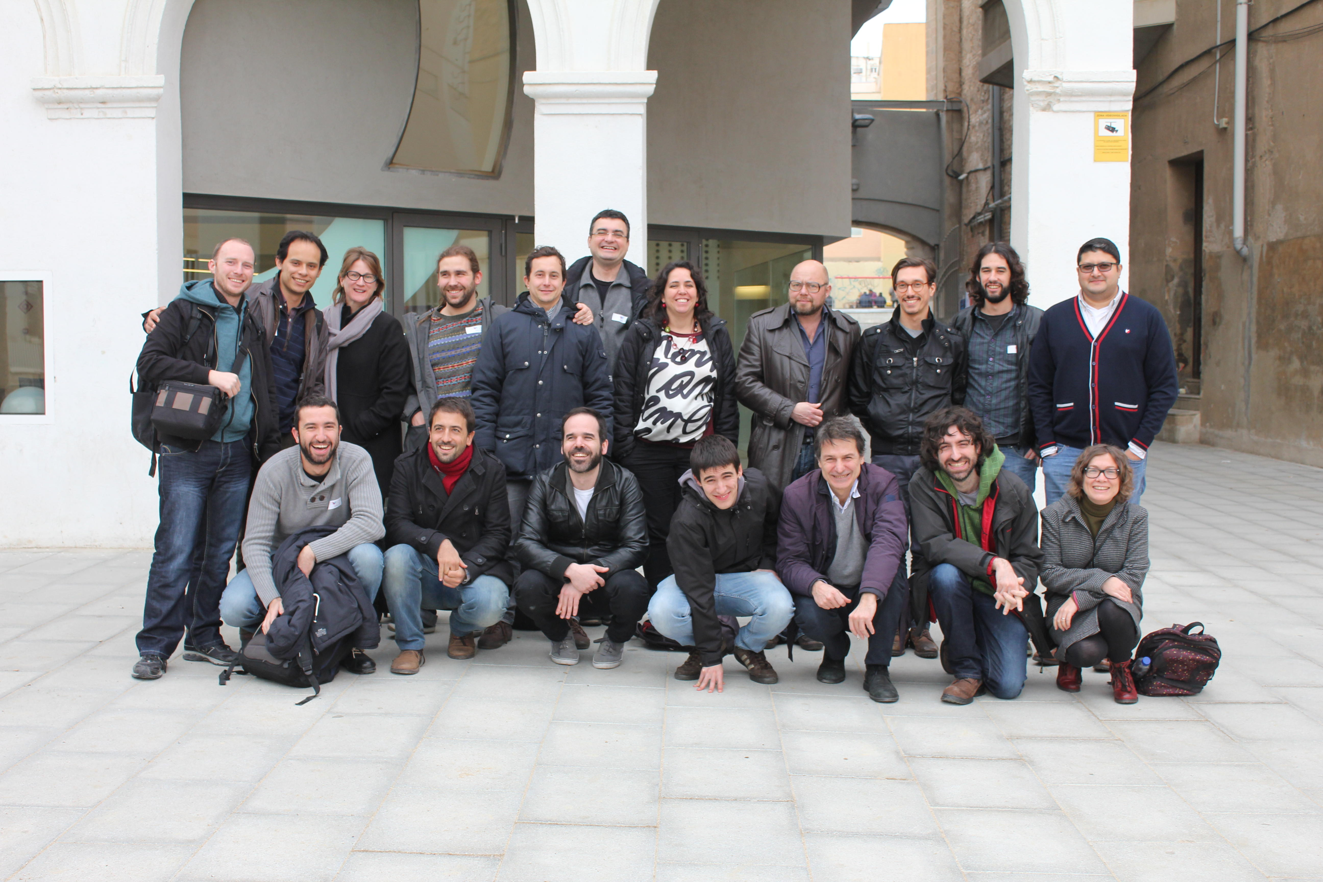





Any questions/feedback?
Thanks!
¡Gracias!
Ευχαριστώ!
Danke!
Grazie!
+info|contact:
    David Rozas:
      @drozas
      http://www.davidrozas.com
    P2P value:
      @p2pvalue
      http://www.p2pvalue.eu
[...]
[...]
This work is licensed under a Creative Commons
Attribution-ShareALike 4.0 Unported License
excerpt if otherwise noted. This presentation is a derivative
work from Mayo Fuster Morell's presentation on WP1
of the P2Pvalue project.
To view a copy of this license, please visit:
https://creativecommons.org/licenses/by-sa/4.0/
www.p2pvalue.eu
CAPS 2015 (Brussels) – 07.07.2015

