Slide 1


Drupal as a runaway object: conceptualisation of peer production activities through Activity Theory
Sub-theme #17: “Activity Theory and organizations”
David Rozas, Nigel Gilbert, Paul Hodkinson
University of Surrey
This work was partially supported by the Framework
programme FP7-ICT-2013-10 of the European Commission through project P2Pvalue (grant no.: 610961).
www.p2pvalue.eu
Notes:
Hello everyone, thank you very much for coming. My name is David Rozas, I am a PhD student at the University of Surrey. Today, I will be talking about how I am using Activity Theory for the study of a Commons-Based Peer Production community

Slide 2



Who am I?
@drozas
Areas of interest: Free Software, Commons-Based Peer Production, social computing, Computer Supported Cooperative Work, Science and Technology Studies, etc.
Working as a Drupal developer for the past 5 years. Previously worked with other free software platforms
Previous background in Computer Science: @URJC (Spain), @NTNU (Norway)
Started PhD in Sociology @UniS (UK) in October 2013
Collaborating with the FP7 EU project P2Pvalue (www.p2pvalue.eu)
+info|contact:
  @drozas
  www.davidrozas.com || drozas@surrey.ac.uk
www.p2pvalue.eu
EGOS 2015 (Athens) – 04.07.2015

Slide 3
Outline
@drozas
Introduction: Free/Libre Open Source Software, Commons-Based Peer Production and Drupal
Contribution activities as unit of analysis & Activity Theory in the study of peer production
Drupal as a runaway object and conceptualisation of peer production activities: development of source code and Face-to-face events
Future work
Conclusion and questions
www.p2pvalue.eu
EGOS 2015 (Athens) – 04.07.2015
Notes:
First of all, I will introduce some of the concepts, such as Free Software, Commons-Based Peer Production or Drupal, which is the case study I will be talking about.
I will later discuss the notion of contribution, and how I am drawing on Activity Theory for the study of contribution activities in this case study.
I will provide later a more detailed example of how I am planning to apply it for the study of two very diverse activities: the development of source code and the participation and organisation in F2F events.
I will finally go quickly through the Future work, and the conclusion; and then we will have time for questions.

Slide 4

What is Free/Libre Open Source Software (FLOSS)?
@drozas
Software which allows its use, copy, study and modification in any way
Source code released under a license which protects these rights (e.g. GNU General Public License)
Examples: GNU/Linux, Firefox, Apache, etc.
Huge increase in adoption and production
A new mode of software production and
practices (Raymond, 2001)
Deshpande and Riehle (2008)
www.p2pvalue.eu
EGOS 2015 (Athens) – 04.07.2015
Notes:
So, what is Free Software? Free Software refers to software which allows its use, copy, study and modification in any way. In order to do that, the source code, a set of computer instructions, is released under a license which protects these rights, such as the GPL. There are plenty of famous examples of Free Software, such as GNU/Linux, Firefox or Apache.
And, regarding the study of this phenomena, we can see how its production and adoption has been constantly increasing. For example, in the study of Desphande and Riehle, they concluded that its growth during the period 1995 to 2006 was exponential. But it is not only about the software. It is also about new ways of producing this software, which contrasted with the traditional software engineering practices. Fostered by the invention of the WWW, this imply practices such as peer reviewing, openness, transparency, and working on a project which has not an specific end.

Slide 5




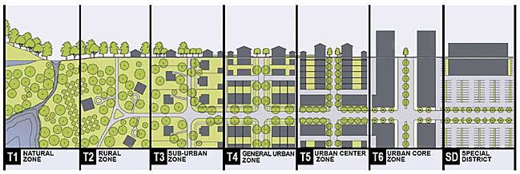
What is Commons-Based Peer Production (CBPP)?
@drozas
A new model of socio-economic production in which groups of loosely connected individuals cooperate with each other to produce meaningful products without a traditional hierarchical organisation (Benkler, 2006)
Spreading to diverse areas: open science, open agriculture, Peer-to-peer urbanism, etc. (Fuster Morell et al., 2014)
www.p2pvalue.eu
EGOS 2015 (Athens) – 04.07.2015
Notes:
And, some scholars started to frame this as part of a bigger phenomena. So, we all know things like Linux or Wikipedia. But what we are seeing is how these practices are spreading to different and very diverse areas, such as open science, open agriculture, hacklabs, fablabs, P2P urbanism, etc.
Professor Yochai Benkler, from Harvard Law School, was the pioneer coining the term Commons-Based Peer Production to refer to a new model of production in which individuals cooperate to produce meaningful products without following a traditional hierarchical organisation.

Slide 6
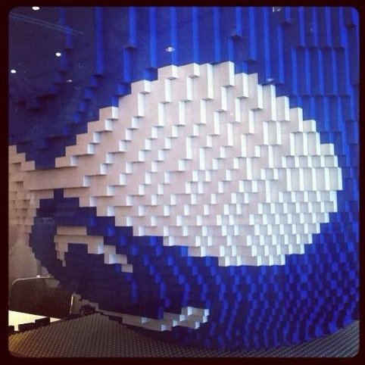
What is Drupal?
@drozas
Free software content management framework
Very modular: think of it as a “Lego”. Dozens of
core modules, +27k “contrib” modules
Powering 2% websites worldwide (W3Techs, 2014)
Employed in complex and high traffic websites: whitehouse.gov, mtv.co.uk, economist.com, etc.
www.p2pvalue.eu
EGOS 2015 (Athens) – 04.07.2015
Notes:
So let me now introduce very quickly Drupal, the case study I am looking at in my research. Drupal is a Free software content management framework, meaning that it is a software to build websites, web applications, etc. It is very modular, and you can think of it as a “Lego”. Drupal is composed of a set of modules, being a module a set of files containing source code. And we have two different ecosystems here. Core modules, which are the ones that you have by default when you download Drupal; and contributed modules, which extend the functionalities of the platform. You can think of them as plugins.
Drupal is currently powering more than 2% of the websites worldwide, and it is being used in complex and high traffic websites, such as the whitehouse.gov, or mtv.co.uk

Slide 7

What is Drupal?: the Drupal community
@drozas
Started as a personal project of a student
Code released in 2001 under a GNU General
Public License
Currently +1M users registered at Drupal.org, +30k code contributors (Drupal.org, 2014a)
Hundreds of local Face-to-face events, dozens of DrupalCamps and DrupalCons in 4 continents (Drupal.org, 2014b)
www.p2pvalue.eu
EGOS 2015 (Athens) – 04.07.2015
Notes:
But Drupal could not be understood without its community. I will give you some really quick facts about the history of the community, to contextualise. So, Drupal started as a personal project of a PhD student, who released the code in 2001. And nowadays, there are more than 1 million users registered at the main platform of collaboration (Drupal.org) and more than 30 thousand contributors of code. There are also hundreds of local F2F events. For example, in London, there is one event almost every week. They diverge, from very informal and social ones, such as Drupal and Beers, to some more oriented to presentations, or others which function as co-working spaces. Then, we have DrupalCamps. They have typically hundreds of participants, and are more formalised. Similar to academic conferences, but still self-organised by the local communities. And finally, we have DrupalCons. They have thousands of participants, for instance in the last European one there were more than 3,000 people. They are organised by the Drupal Association, the most formal type of institution within the Drupal community.

Slide 8
Drupal community as a CBPP community
@drozas
Drupal as a community whose mode of production (Fuster Morell, 2014) is:
  Collaborative process
  Peer-based: different levels of structure depending on the process, but not mainly based on contractual obligations nor coercion
  Commons-process: process driven by the general interest, results in openness of the resources
  Favouring reproducibility: via Free Software or Creative Commons licenses, exchange of practices, etc.
www.p2pvalue.eu
EGOS 2015 (Athens) – 04.07.2015
Notes:
So, after introducing all these concepts, we can then frame the Drupal community as a Commons-Based Peer Production community, meaning which is one whose mode of production is a collaborative process. It is peer based, and of course there are different levels of structure depending on the process, but it is not mainly based on contractual obligations nor coercion. It is a commons process, meaning that it is driven by the general interest. For example, in the case of digital commons, this results in the openness of the resources. And finally, it favours reproducibility. For example of the software or the documentation, using these free software or creative commons licenses; but also of for example the practices, due to culture of openness.

Slide 9
Contribution activities as unit of analysis
@drozas
@drozas
Previous studies looked either at the individuals or at the whole community (e.g.: motivations to contribute, structure of the community, etc.). Huang, Le & Panchal (2011), Sims, J. P. (2013), Nordin (2014)
Understand processes and dynamics: how do these communities organise themselves?
My approach is to look at contribution activities as unit of analysis. Drawing on Activity Theory (AT) and following an ethnographic approach
Implied to understand deeply what contribution means: stage 1
www.p2pvalue.eu
EGOS 2015 (Athens) – 04.07.2015
Notes:
So, when I was doing the literature review, I found that most of the studies were looking either at the individuals or at the whole community. For example, a typical question in the study of FLOSS is why do people contribute?, which will typically look at an individual level. Other studies are completely macro, for example doing Social Network Analysis of the networks of modules, or developers.
In my case, I am interested in improving our understanding on how these communities organise themselves, and for that I am looking at contribution activities as unit of analysis. I am drawing for that in Activity theory, and I am following an ethnographic approach. But let me go very quickly about the notion of contribution in these communities from the first stage of my PhD research. Because, although, this is a part of other paper, it is necessary to frame properly this presentation.

Slide 10

Contribution
@drozas
A blurry notion: meanings constantly evolving as part of negotiation processes between the participants
Critical in CBPP communities focussed on digital commons: economy of contribution [not based on direct reciprocity]
rather than economy of gift [based on direct
reciprocity] (Wittel, 2013)
www.p2pvalue.eu
EGOS 2015 (Athens) – 04.07.2015
Notes:
So, what is contribution? Contribution can be understood in these communities as a set of meanings which are constantly evolving as part of negotiation processes between the participants in them. And this is a very critical notion. Because, as identified by Wittel, Commons-Based Peer Production communities focussed on digital commons, they typically have an economy of contribution, rather than one of gift. Meaning that they are not based on direct reciprocity.

Slide 11
Contribution: “code-centrism”
@drozas
“Code-centrism” in FLOSS literature: typically looking at source code as main notion of contribution; and in FLOSS communities: “Talk is silver, code is gold”
Relevant role of less visible contribution activities. For example, organisation and participation in Face-to-face events (Rozas & Gilbert, in press)
Role of “affective labour” (Hardt, 1999) to foster collaboration: avoid barriers, increase commitment, generates and scale up the sense of community
www.p2pvalue.eu
EGOS 2015 (Athens) – 04.07.2015
Notes:
So, when I was doing the literature review, what I found is what I called in this other paper “code-centrism”, meaning that most of the research looking at contribution typically look at source-code related activities. And this is also happening in the communities themselves. For instance, this motto from the Drupal community: “Talk is silver, code is gold” embodies quite well this idea of code-centrism.
And, what I found during this first stage of my research is that there are other contribution activities, which are less visible, but are very critical for the sustainability of the community. For example, the participation and organisation of F2F events. I connected this through the literature on the commons through the concept of affecting labour of Hardt, which refers to the labour that creates or modifies emotional experiences of the participants, to show how these activities are very important to foster collaboration. For example, to avoid barriers for the newbies, or to generate and scale up the sense of community.

Slide 12
Activity Theory in the study of CBPP: challenges
@drozas
These communities, as being “difficult if not impossible to bound and close” and defining their formation as being in a constant living and expanding process (Engeström, 2007)
CBPP requires and creates “bounded hubs of concentrated coordination efforts” (Engeström, 2009, p. 310)
More concrete description through the concept of benign runaway object (Engeström, 2009):
  Intrinsic properties which transcend the utilitarian profit motive
  Object must yield useful intermediate products, yet remain an incomplete project
  Object must be visible, accessible and cumulable
  Effective feedback an exchange among the participants acting on object
www.p2pvalue.eu
EGOS 2015 (Athens) – 04.07.2015
Notes:
So then, drawing on Activity Theory to study Commons-Based Peer production, I bumped into a set of challenges. And these challenges were originally discussed for the first time by Professor Engeström. He described these communities as being difficult if not impossible to bound and close, and as being in a constant living and expanding process. But, these communities require and create bounded hubs of concentrated efforts in which is possible to apply the model of activity system. In this case, contribution activities. Finally, I am also drawing on Engeström's concept of benign runaway object acting as a hub for them. In “The Future of Activity Theory”, Engeström described more concretely the concept of runaway object to better conceptualised the nature of these communities.
[SKIP THIS PART IF GOING TOO LATE]
Here, he provided a set of more accurate characteristics of this object such as transcending the utilitarian profit motive. Being one in which the object must yield intermediate products, but still remain incomplete. The object must also be visible, accessible and cumulable. And also there must be effective feedback among the participants acting on the object.

Slide 13
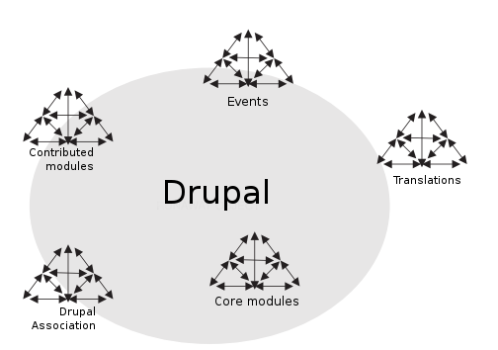
Drupal as a runaway object
@drozas
Studying self-organisation via
contribution activities, in which
the runaway object acts as a hub
Object pervasive, position of
activity systems ambiguous
Based on figure 19.2 of Engeström (2009)
www.p2pvalue.eu
EGOS 2015 (Athens) – 04.07.2015
Notes:
So, after introducing all these concepts, we can then frame Drupal as a runaway object, and studying self-organisation via these contribution activities, drawing on the model of activity system for this; while also drawing on the concept of runaway object as a hub of all these activity systems.
The distinctive thing about the concepts of this new generation of Activity Theory, is that recognises the pervasiveness of the object, and the fact that the position of the activity systems is ambiguous; which is something that clearly occurs when studying Commons-Based Peer Production.

Slide 14
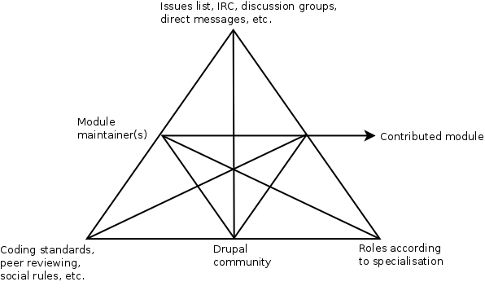
Development of “contrib” modules through AT
@drozas
www.p2pvalue.eu
EGOS 2015 (Athens) – 04.07.2015
Notes:
So, I will explain a couple of examples of how I am planning to apply the model of activity of some contribution activities. First, on the development of source code for contributed modules. So in this case, the object is clear, the module, composed of source code. Then, the subjects are the module maintainers, the developers responsible for the development of that module. The community, is the Drupal community. And then, we have the division of labour, which represents the different roles of the subjects according to the division of tasks between the developers. For example, back-end developers, specialised in let's say the Database part, themers, in the front-end, designers and User Experience experts, etc. The mediating artifacts are for example the issues list, which are task management systems integrated within the main platform of collaboration. For example, they allow other users to open new issues, submit code to solve bugs or add new functionalities, etc. Other examples are discussion groups, IRC, etc.
Finally, we have the rules. And we have here examples of explicit rules, like for instance the coding standards agreed in the community about how to write the code. But also implicit and less visible rules, like for instance the ones that maintainers have to decide if someone becomes or not a maintainer, for example based on social rules related to her or his social capital in the community, based on the contributions they have made, which is reflected in their user profile, another example of mediating artifact

Slide 15
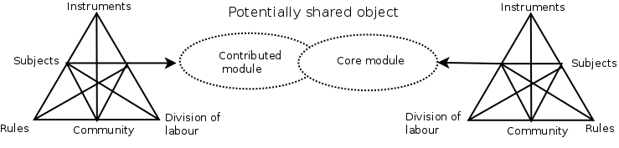
Development of “contrib” modules through AT: examples
@drozas
Relationship between profiles (mediating artefact), social capital (rules) and Drupal role (division of labour); or tensions between developers and designers (division of labour) from Zilouchian Moghaddam, Twidale and Bongen (2011)
Between activity systems through shared
objects (3GAT): between which “contrib”
modules “become core”; or differences
in dynamics and social practices
between these processes with similar
object (source code)
www.p2pvalue.eu
EGOS 2015 (Athens) – 04.07.2015
Notes:
So, following this approach, will enable the possibility of studying the relationship between these entities. For instances, as I was saying, between the profiles as a mediating artifact, the social capital and the division of labour. Furthermore, this enables the possibility of incorporating the notion of conflicts or tensions. For instance, the paper from Zilochuian Moghaddam, Twidale and Bongen, in which they discussed the tensions between the developers and themers, can be framed as one whose origin is the division of labour.
Additionally, we can draw on the third generation of Activity theory to explore the tensions between the activity systems themselves. For example, to see the tensions between which modules become core in a major release. It also allows to study the differences between the social practices and outcomes of contribution activities in which the object is the same, source code, but the dynamics are completely different, as I was explaining in these two ecosystems of contrib and core.

Slide 16
Development of modules through AT
@drozas
Also tensions between activity systems through shared objects (3GAT): between which “contrib” modules “become core”
Compare “contrib” with core. For example, differences in dynamics and social practices between these processes with similar object (source code)
www.p2pvalue.eu
EGOS 2015 (Athens) – 04.07.2015

Slide 17
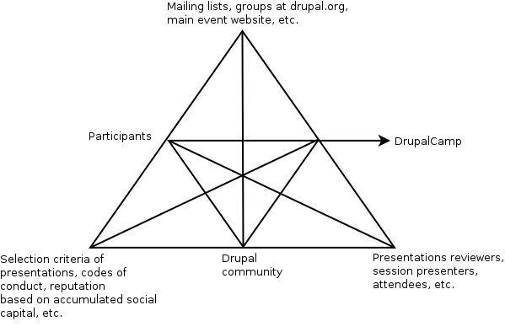
Participation in DrupalCamps through AT
@drozas
www.p2pvalue.eu
EGOS 2015 (Athens) – 04.07.2015
Notes:
Another example of the use of model of activity system for another contribution activity would be the participation in DrupalCamps. In this case, the subjects are the participants. The division of labour refers to the different roles that they have during the event. For instance, session presenters, session reviewers, attendees, etc. The community is the Drupal community, and the object would be the DrupalCamp event. Examples of mediating artifacts, are for instance the website used for the event, or the mailing lists or groups to organise it. Regarding rules, again we have explicit and implicit rules. Explicit rules are for instance the Code of Conduct or the selection criteria for the presentations. Examples of implicit rules are the ones related to the social capital of the participants.

Slide 18
Participation in Drupal F2F events through AT:examples
@drozas
Framing intangible outcomes such as affective labour (Hardt, 1999)
Tensions on more transparent processes: reflected in artefacts (inclusion of peer-reviewing tools), explicit and implicit rules (e.g. creation of specific criteria), etc.
Tensions between activity systems (3GAT): Cons vs Camps vs local events. Compare its outcomes
www.p2pvalue.eu
EGOS 2015 (Athens) – 04.07.2015
Notes:
So, this approach will enable us to study the relationships between these entities, as well as to frame and conceptualise intangible outcomes, like for instance the ones of affective labour I referred to before.
Also, with respect to tensions, it allows us to incorporate them. For example, the tensions due to having more transparent process for the selection of the presentations. This is reflected in the rules, in the creation of explicit and formal criteria; but also in the mediating artifacts, by including peer-reviewing tools in the main website of the event. It will also allows us to study the tensions between the different types of activity systems, such as DrupalCamps, DrupalCons and local events.

Slide 19
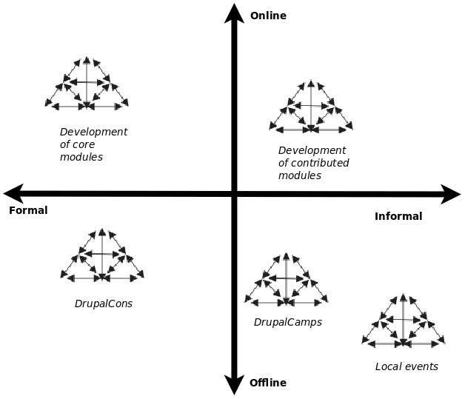
Future work
@drozas
Furthermore, emergence of dimensions: online/offline & formal/informal
Allows to study according to
these dimensions, even in
diverse contribution activities:
“object-oriented” vs
“community-oriented”
www.p2pvalue.eu
EGOS 2015 (Athens) – 04.07.2015
Notes:
So, just a brief slide about the future work. So, the use of contribution activities as at unit of analysis, helped us, through data, on the emergence of the dimensions I want to explore in the future; as well as to compare them, although their nature is very different and diverse. I won't go into big detail due to the time limitations, but this is the preliminary sampling of contribution activities which I am planning to explore, based on the online/offline dimension (which is blurry), and the level of formality of these activities.

Slide 20
Conclusion
@drozas
Lack of clear boundaries, distributed and blurred nature of CBPP represents a challenge for AT
Nevertheless, useful to untangle dense and multidirectional dynamics in CBPP communities, as in this case study:
  Applying model of activity system to diverse contribution activities
  Drawing on runaway object as a nexus of these efforts of coordination
www.p2pvalue.eu
EGOS 2015 (Athens) – 04.07.2015
Notes:
So, just to sum up: the conclusion. First, I wanted to expose the idea of the challenges that Activity Theory, as any other theoretical frameworks whose aim is to help on the study of a phenomena such as peer production have, due to its lack of clear boundaries and its distributed nature.
However, what I wanted to expose today is how remains very valuable in the study of peer production, thanks to concepts such as the one of runaway object, and enables the possibility of applying the model of activity systems to diverse contribution activities.

Slide 21
References
@drozas
Deshpande, A. & Riehle, D. (2008). The total growth of open source. In Open Source Development, Communities and Quality (pp. 197–209). Springer.
Raymond, E. S. (2001). The Cathedral and the Bazaar: Musings on Linux and Open Source by an Accidental Revolutionary. Sebastopol, CA, USA: O’Reilly.
Benkler, Y. (2006). The wealth of networks: how social production transforms markets and freedom. Yale University Press.
Fuster Morell, M. et al. (2014). Theoretical synthesis: Final theoretical synthesis of WP1, including research reports on data collection. Retrieved from http://p2pvalue.eu/sites/default/files/u28/D12_31July_TheoreticalFindingsA%20%281%29.pdf
W3Techs (2014). Usage of content management systems for websites. http://w3techs.com/technologies/overview/content_management/all
Drupal.org (2014a). https://www.drupal.org/
Drupal.org (2014b). Drupal upcoming events. https://groups.drupal.org/events
Huang, Le & Panchal. (2011). Analysis of the structure and evolution of an open-source community.
Sims, J. P. (2013). Interactive engagement with an open source community : a study of the relationships between organizations and an open source.
Nordin, D. (2014). Motivation and Collaboration in an Open Source Project: A Qualitative Study of the Drupal Community. (Master’s thesis, Bentley University).
Wittel, A. (2013). Counter-commodification: The economy of contribution in the digital commons. Culture and Organization, 19 (4), 325, 327–328.
Rozas, D. & Gilbert, N. (in press). Talk is silver, code is gold? Contribution beyond source code in Free/Libre Open
Source Software communities. Abstract: Contribution beyond source code in Free/Libre Open Source Software: the role of affective labour in the Drupal community. In BSA 2015 Annual Conference (pp. 73–74). British Sociological Association. Retrieved from http://www.britsoc.co.uk/media/84184/Programme%20full.pdf?1427305668398
www.p2pvalue.eu
EGOS 2015 (Athens) – 04.07.2015
Notes:
So these are the references...

Slide 22
References
@drozas
Engeström, Y. (2007). From communities of practice to mycorrhizae. Communities of practice: Critical perspectives. Retrieved from http://www.open.ac.uk/opencetl/files/opencetl/file/ecms/web-content/Engestrom-(2007)-From-communities-of-practice-to-mycorrhizae.pdf
Engeström, Y. (2009). The future of activity theory: A rough draft. In Learning and expanding with activity theory (pp. 303–328).
Zilouchian Moghaddam, R., Twidale, M. & Bongen, K. (2011). Open source interface politics: identity, acceptance, trust, and lobbying. In CHI’11 Extended Abstracts on Human Factors in Computing Systems (pp. 1723–1728). ACM.
Hardt, M. (1999). Affective labor. Boundary 2, 26 (2), 89–100.
Images:
  http://www.egosnet.org/jart/prj3/egos/images/img-db/1392376003635.jpeg
  http://upload.wikimedia.org/wikipedia/commons/a/af/Tux.png
  http://upload.wikimedia.org/wikipedia/commons/5/53/Wikipedia-logo-en-big.png
  http://upload.wikimedia.org/wikipedia/commons/d/d7/Amsterdam_Fab_Lab_at_The_Waag_Society.JPG
  http://farmhack.net/sites/default/files/The%20Garlic%20Master%20001_0.JPG
  https://rafaeldemiguel.files.wordpress.com/2010/10/about_new.jpg
  http://www.garfieldtech.com/presentations/sfsf2012-drupal8/images/lego-druplicon.jpg
  http://www.siftdigital.co.uk/sites/default/files/drupal-community.png
  http://blog.101financial.com/wp-content/uploads/2014/03/Making-A-Contribution-To-Society.png
www.p2pvalue.eu
EGOS 2015 (Athens) – 04.07.2015

Slide 23


Any questions/feedback?
Thanks!
¡Gracias!
Ευχαριστώ!
Obrigado!
Grazie!
@drozas
+info|contact:
    @drozas
    www.davidrozas.com || drozas@surrey.ac.uk
[...]
This work is licensed under a Creative Commons
Attribution-ShareALike 4.0 Unported License
excerpt if otherwise noted.
To view a copy of this license, please visit:
https://creativecommons.org/licenses/by-sa/4.0/
www.p2pvalue.eu
EGOS 2015 (Athens) – 04.07.2015
Notes:
And this is all. Thank you very much, and, as I was saying, this is a very preliminary presentation based on the work I am planning to carry out. So I would really appreciate your comments, suggestions, etc. about how I am conceptualising, the research design, etc. THANK YOU! :-)

