Slide 1
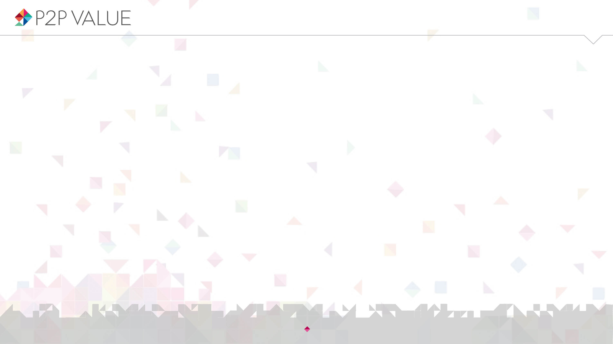

Talk is silver, code is gold? Contribution beyond source code in Drupal
- London
David Rozas
University of Surrey
This work was partially supported by the Framework
programme FP7-ICT-2013-10 of the European Commission through project P2Pvalue (grant no.: 610961).
www.p2pvalue.eu

Slide 2

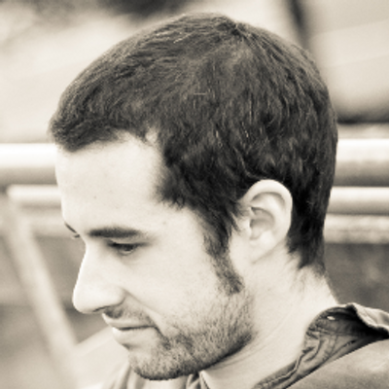


Who am I?
@drozas
Areas of interest: Free Software, Commons-Based Peer Production, social computing, etc.
Working as a Drupal developer for the past 5 years. Previously working with Django, Moodle, etc.
Previous background in Computer Science (@URJC [Spain], @NTNU [Norway])
Started PhD in Sociology @UniS [UK] in October 2013
Collaborating with the FP7 EU project P2Pvalue (www.p2pvalue.eu)
+info|contact:
  @drozas
  www.davidrozas.com || drozas@surrey.ac.uk
www.p2pvalue.eu
Drupal Show and Tell London – 21.05.2015

Slide 3
Outline
@drozas
Introduction: FLOSS and CBPP
Research questions
Data and methods
Findings
Discussion and conclusion
www.p2pvalue.eu
Drupal Show and Tell London – 21.05.2015

Slide 4

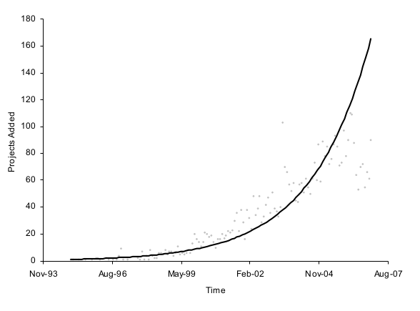
The growth and success of FLOSS
@drozas
Exponential growth in production: 1995-2006
E.g. Deshpande and Riehle (2008): #LoC & #projects
Deshpande and Riehle (2008)
www.p2pvalue.eu
Drupal Show and Tell London – 21.05.2015

Slide 5
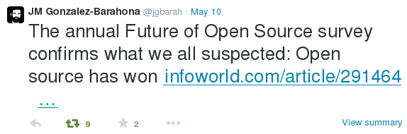
The growth and success of FLOSS
@drozas
Future of Open Source 2015 survey (Black Duck Software, 2015):
  1240 respondents
  78% running their businesses with FLOSS
  66% building software for customers with FLOSS
  Increment in participation in FLOSS communities: 50%->64%
  Drupal in the top most valued FLOSS projects
www.p2pvalue.eu
Drupal Show and Tell London – 21.05.2015

Slide 6
Not only about the software...
@drozas
New possibilities of collaborative production, fostered by the invention of the WWW
New models of development: “The Cathedral and the Bazaar” (Raymond, 2001)
  Source code publicly available at any time
  Public testing and experimentation: “given enough eyeballs, all bugs are shallow”
www.p2pvalue.eu
Drupal Show and Tell London – 21.05.2015

Slide 7




What is Commons-Based Peer Production?
@drozas
A new model of socio-economic production in which groups of loosely connected individuals cooperate with each other to produce meaningful products without a traditional hierarchical organisation (Benkler, 2006)
http://directory.p2pvalue.eu/ (currently +370 cases)
www.p2pvalue.eu
Drupal Show and Tell London – 21.05.2015

Slide 8
What are the commons?
@drozas
The commons: as a resource or good shared by a group of people that may be subject to social dilemmas, such as over-exploitation or free-riding. (Hess & E. Ostrom, 2007)
Classification of goods according to:
  Excludability: feasible to prevent its access to it
  Rivalry: its use or consumption prevents or affects
  the consumption by others
 | Rival | Non-Rival
Excludable | Private goods. E.g.: bread | Toll goods. E.g.: cable TV
Non-excludable | Common Pool Resources E.g.: fish taken from the ocean | Public goods E.g.: lighthouse, Free Software
V. Ostrom and E. Ostrom (1999)
www.p2pvalue.eu
Drupal Show and Tell London – 21.05.2015

Slide 9

What are the commons?
@drozas
Furthermore, some of these goods are anti-rival: the more people use them, the more utility each person receives (e.g.: Free software). Weber (2004)
One more dimension: the scope of the ownership: ”Those goods that belong to everyone and no one at the same time, therefore not following the rules of the market”
Lafuente et al. (2007)
www.p2pvalue.eu
Drupal Show and Tell London – 21.05.2015

Slide 10
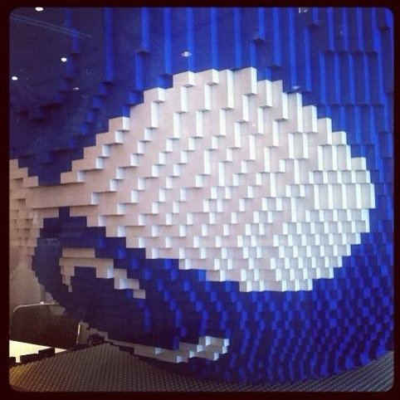
What is Drupal?
@drozas
Free software content management framework
Very modular: think of it as a “Lego”. Dozens of
“core modules”, +27k contributed modules
Powering 2% websites worldwide (W3Techs, 2014)
Employed in complex and high traffic websites: whitehouse.gov, mtv.co.uk, economist.com, etc.
www.p2pvalue.eu
Drupal Show and Tell London – 21.05.2015

Slide 11

Quick facts about the Drupal community
@drozas
Started as a personal project of a student
Code released in 2001 under a GPL
Currently +1M users registered at Drupal.org, +30k code contributors (Drupal.org, 2014a)
Hundreds of local F2F events, dozens of camps and
cons in 4 continents (Drupal.org, 2014b)
www.p2pvalue.eu
Drupal Show and Tell London – 21.05.2015

Slide 12
The Drupal goods as a commons
@drozas
Anti-rival: its use by a person increases the value for other users
Non-excludable: accessibility is protected as part of the licenses applied for the code, the contents created in the community, etc.
Global: the ownership does not belong
to any individual or state, as protected by the
licenses chosen (exception: the trademark)
www.p2pvalue.eu
Drupal Show and Tell London – 21.05.2015

Slide 13
Drupal as a CBPP community
@drozas
Ongoing discussion on the differences between CBPP, Peer Production, the delimitation criteria, etc.
Drupal as a community whose mode of production (Fuster Morell et al. 2014) is :
  Collaborative process
  Peer-based: different levels of structure depending on the process, but not mainly based on contractual obligations neither forms of coercion
  Commons-process: process driven by the general interest, results in openness of the resources
  Favouring reproducibility: via Free Software/CC licenses, exchange of practices, etc.
www.p2pvalue.eu
Drupal Show and Tell London – 21.05.2015

Slide 14
Contribution activities as unit of analysis
@drozas
@drozas
Understand processes and dynamics: how do these communities organise themselves?
Previous studies looked either at the individuals [e.g. motivations to contribute - Sims, J. P. (2013), Nordin (2014)] or at the whole community [e.g. structure of the community, Huang, Le & Panchal (2011)]
My approach is to look at contribution activities as unit of analysis [using Activity Theory (Engeström, 1987) as a framework], using an ethnographic approach
Implies to understand deeply what contribution means: stage 1
www.p2pvalue.eu
Drupal Show and Tell London – 21.05.2015

Slide 15

Contribution
@drozas
A blurry notion: meanings constantly evolving as part of negotiation processes between the participants
Critical in CBPP communities focussed on digital commons: economy of contribution [not based on direct reciprocity]
rather than economy of gift [based on direct
reciprocity] (Wittel, 2013)
www.p2pvalue.eu
Drupal Show and Tell London – 21.05.2015

Slide 16
Contribution: “code-centrism”
@drozas
“Code-centrism”:
  In FLOSS literature: typically looking at source code as main notion of contribution
  In FLOSS communities: “Talking is silver, coding is gold”
What about other contributions?
Affective labour as the “lifeblood” of the commons (Bollier, 2014): the inmaterial labour present in social interaction which creates or modifies emotional experiences (Hardt, 1999)
www.p2pvalue.eu
Drupal Show and Tell London – 21.05.2015

Slide 17
Research questions
@drozas
RQ1: What type of activities are perceived as contributions in the Drupal community? Do the “official” meanings match the ones of the members of the community?
RQ2: How are the identified activities represented in the main platform of collaboration in an individual level?
RQ3: Can some of these activities be understood as sources of affective labour and what relevance do they have? Are there any differences on how they are perceived between members with different degrees of experience?
www.p2pvalue.eu
Drupal Show and Tell London – 21.05.2015

Slide 18
Data and methods
@drozas
Ethnographic methodological approach: online and offline
Triangulation of data collection methods:
- Participant observation (6 months): online participation, 13 events, etc.
- Documentary analysis: Drupal Planet as “native” starting point. 2 years archive (3,266 documents). See http://www.davidrozas.com/lab/drupal_planet_archive.php
- Semi-structured qualitative interviews (4): London and Madrid
Analysis supported by CAQDAS
www.p2pvalue.eu
Drupal Show and Tell London – 21.05.2015

Slide 19

Findings: Contribution beyond source code (RQ1)
@drozas
“[...]organise talks, meetups or just hang out with Drupalistas to drink some beers and have a talk, are also very important activities, and very positive for the community.”
Drupal developer, 7 years. Original reply in Spanish.
www.p2pvalue.eu
Drupal Show and Tell London – 21.05.2015

Slide 20
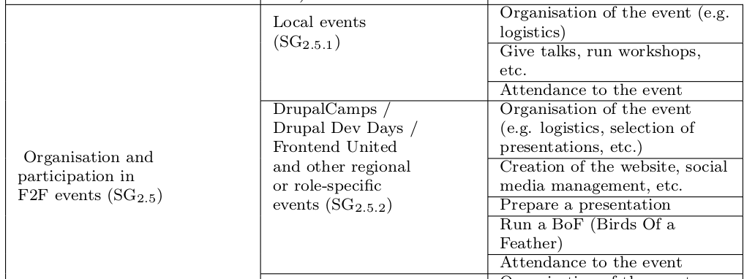

Findings: Contribution beyond source code (RQ1)
@drozas
Two main types emerged, according to the
focus of action:
  “Object-oriented”: source code,
  documentation, translation, etc.
  “Community-oriented”: usage & support, online community management, training & mentoring, organisation & participation in F2F events, etc.
Suggestive, not exhaustive, list
www.p2pvalue.eu
Drupal Show and Tell London – 21.05.2015

Slide 21
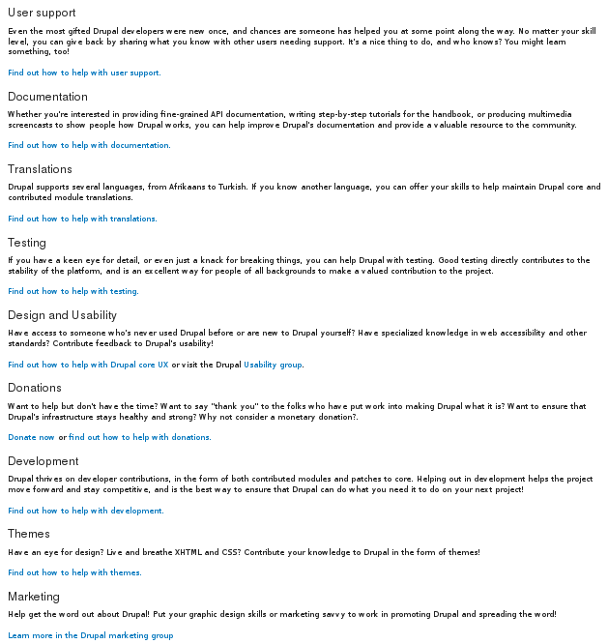
Findings: Contribution beyond source code (RQ1)
@drozas
Analysis of main platform shows that “community-oriented” ones are less visible
From them, this affects specially local/regional F2F events
www.p2pvalue.eu
Drupal Show and Tell London – 21.05.2015

Slide 22
Findings: Contribution beyond source code (RQ1)
@drozas
Offer empirical evidence of the need to widen understanding of contribution activities
This lack of visibility is also reflected in the main platform of collaboration
www.p2pvalue.eu
Drupal Show and Tell London – 21.05.2015

Slide 23

Findings: Contributions in user profiles (RQ2)
@drozas
Profiles are key elements in the generation of perceptions by other users in FLOSS (Marlow, Dabbish & Herbsleb, 2013)
Source of public references, significant role in the process of status attainment in FLOSS communities (Stewart, 2005)
www.p2pvalue.eu
Drupal Show and Tell London – 21.05.2015

Slide 24
Findings: Contributions in user profiles (RQ2)
@drozas
Not surprisingly, relevant for both, intrinsic (its own sake) and extrinsic (reward) motivations
Profiles from external platforms are also relevant (e.g. Stackexchange, GitHub, etc.)
But relevant, specially within the community
www.p2pvalue.eu
Drupal Show and Tell London – 21.05.2015

Slide 25
Findings: Contributions in user profiles (RQ2)
@drozas
“[..]She got her first core patch committed to core. She was very enthusiastically showing her friend her profile at Drupal.org because in the “Projects” section appears “Drupal core (1 commit)”.”
Drupal marketer and site builder, 2 years. Extracted from full field notes during the participant observation at DrupalCon Amsterdam 2014.
“[..]If we hire somebody then we will always look at profiles. And also, just to kind of get a sense of who people are, sometimes they will give it to you: “Go on and check my profile”.”
Drupal themer and developer, 11 years.
www.p2pvalue.eu
Drupal Show and Tell London – 21.05.2015

Slide 26
Findings: Contributions in user profiles (RQ2)
@drozas
Analysis:
  Inequality in the representation of “community-oriented” activities
  Affecting specially to “organisation and participation of local/regional F2F events”
  Some Drupalistas try to overcome these limitations
www.p2pvalue.eu
Drupal Show and Tell London – 21.05.2015

Slide 27


Findings: Contributions in user profiles (RQ2)
@drozas
Examples of “object-oriented” contributions reflected in the profiles
www.p2pvalue.eu
Drupal Show and Tell London – 21.05.2015

Slide 28


Findings: Contributions in user profiles (RQ2)
@drozas
Examples (the few) of “community-oriented” contributions reflected in the profiles
www.p2pvalue.eu
Drupal Show and Tell London – 21.05.2015

Slide 29

Findings: Contributions in user profiles (RQ2)
@drozas
Use of “open fields” to try to overcome these limitations
www.p2pvalue.eu
Drupal Show and Tell London – 21.05.2015

Slide 30
Findings: Contributions in user profiles (RQ2)
@drozas
Descriptive account of how identified activities are represented
Empirical evidence of the uneven representation of some contribution activities, affecting specially the “community-oriented” category
www.p2pvalue.eu
Drupal Show and Tell London – 21.05.2015

Slide 31
Findings: Role of affective labour (RQ3)
@drozas
Analysis focussed on organisation and participation in F2F events – most clear example of affective labour (creation and modification of emotional experiences)
These contribution activities play a relevant role in the sustainability of the community: “come for the software, stay for the community”
www.p2pvalue.eu
Drupal Show and Tell London – 21.05.2015

Slide 32
Findings: Role of affective labour (RQ3)
@drozas
“[...]indeed, the fact of attending these meetups, it was really good. Because you realise there are people behind the source code, right? There are
people behind the modules. And you meet people that can tell you this kind
of personal stories.[...] And then, it stops being something anonymous, it
becomes something yours.”
Drupal developer and devop, 1.5 years. Original reply in Spanish.
Drupal becomes a community, avoid barriers, increases the will for reciprocity, etc.
www.p2pvalue.eu
Drupal Show and Tell London – 21.05.2015

Slide 33
Findings: Role of affective labour (RQ3)
@drozas
“[...]friendships are developed, and seeing people in-person helps a lot. I
believe so, the idea of... having F2F meetups and get to know each other
in-person is essential.[...] In the IRC you will talk about certain things, but
after a day cycling 50 or 60 kilometres [referring to the “Tour de Drupal”],[...]there will be more interaction for sure, and a bigger friendship [...]”
Drupal developer, 7 years. Original reply in Spanish.
As the engagement with the commons increases, affection relationships develop (friendship). Commitment, sense of community, avoid to burnout, etc.
www.p2pvalue.eu
Drupal Show and Tell London – 21.05.2015

Slide 34
Findings: Role of affective labour (RQ3)
@drozas
“Because the community is growing, then you have less of a sense of community. But I think the solution to that is to have smaller local communities.
So, you know, as the worldwide community grows, then you start finding, like whereas before it might have been 50 people worldwide, now you have like 50 people in your part of London, or wherever.”
Drupal themer and developer, 11 years.
Local activities help to scale up the sense of community, as it grows
www.p2pvalue.eu
Drupal Show and Tell London – 21.05.2015

Slide 35
Findings: Role of affective labour (RQ3)
@drozas
Existence and relevance of affective labour
Different types of emotional experiences (which vary according to degree of experience), which foster collaboration
Not only understood as a type of contribution unequally represented; they are key for sustainability
www.p2pvalue.eu
Drupal Show and Tell London – 21.05.2015

Slide 36
Discussion
@drozas
Role of F2F in FLOSS and hacker culture (Coleman, 2013, p. 73), having “affective, moral, economic and political dimensions”
“[...] people embark on decisions and actions they probably would not have considered otherwise. Some hackers decide to formally apply to become a Debian developer, while longtime developers decide not to quit the project.” (Coleman, 2013, p. 71)
www.p2pvalue.eu
Drupal Show and Tell London – 21.05.2015

Slide 37
Discussion
@drozas
Additional evidence, but furthermore: framing them as contributions
Empirical evidence of lack of visibility in main platform of collaboration:
  Main sections related to encourage contribution
  In an individual level: user profiles
www.p2pvalue.eu
Drupal Show and Tell London – 21.05.2015

Slide 38
Discussion
@drozas
“metrics such as code commits used to gauge contribution by Open Source
literature and by Drupal.org itself paint an incomplete picture of the types of contributions that actually happen in the Drupal project” (Nordin, 2014, p. 43)
Filling the gap of Nordin (2014):
    The role of local events
    Scaling up the sense of community
Additional evidence of the lack of visibility
www.p2pvalue.eu
Drupal Show and Tell London – 21.05.2015

Slide 39
Discussion
@drozas
Connecting to major literature on commons, through affective labour.
The participation “transforms the local subjectivities” of Drupalistas, as in non-digital domain (Singh, 2013)
Becoming a “commoner” through “commoning”
www.p2pvalue.eu
Drupal Show and Tell London – 21.05.2015

Slide 40
Discussion
@drozas
Not only socio-cultural reasons:
  Need of exploring new dimensions of value in CBPP communities (e.g. P2Pvalue, Open Value Network)
  Incorporate them in socio-technical systems in concise, useful and distributed ways [e.g. Sabir, (De Filippi, P. & Hassan, S. (2014))]
www.p2pvalue.eu
Drupal Show and Tell London – 21.05.2015

Slide 41
Discussion
@drozas
Drupal community working on that direction:
  improve how these activities are represented in the user profiles at Drupal.org, to “[...] go beyond code creation activity and into more community-oriented stuff, since that’s also a huge part of what makes Drupal healthy.” (Drupal.org, 2014a)
www.p2pvalue.eu
Drupal Show and Tell London – 21.05.2015

Slide 42
Conclusion
@drozas
Need to broaden our understanding of contribution activities in FLOSS communities, beyond “object-centric” ones (both, as members of FLOSS communities, and as researchers)
Lack of visibility and relevance of “community-oriented” ones
Need to keep on exploring conceptualisation and incorporation of value in CBPP communities
www.p2pvalue.eu
Drupal Show and Tell London – 21.05.2015

Slide 43
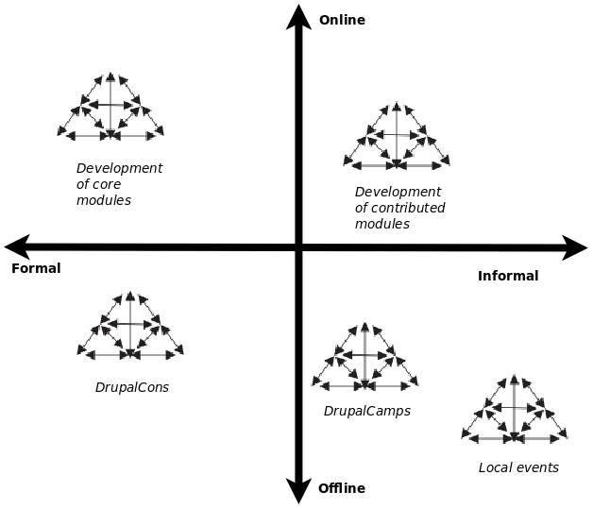
Future work
@drozas
Explore some of these contribution activities in depth drawing on Activity Theory (Engeström, 1987)
Giving back to the community: researching in “a Drupal way”:
  Network of “Drupal” researchers (Drupal Group),
  WikiPapers, etc.
  Dissemination, discussions, etc.
  (e.g. Bof @Dcon Amsterdam)
    From: Humans2Geeks Interface
    To: Academics2Geeks interface
www.p2pvalue.eu
Drupal Show and Tell London – 21.05.2015

Slide 44

Future work... I'd love to count on your help!
@drozas
Looking for Drupalistas to interview (around 1 hour) after summer
Feedback, thoughts, … ping me!
  @drozas
  drozas@surrey.ac.uk
www.p2pvalue.eu
Drupal Show and Tell London – 21.05.2015

Slide 45
References
@drozas
Deshpande, A. & Riehle, D. (2008). The total growth of open source. In Open Source Development, Communities and Quality (pp. 197–209). Springer.
Black Duck Software, F., North Bridge. (2015). The Ninth Annual Future of Open Source Survey. Retrieved 10th May 2015, from https://www.blackducksoftware.com/future-of-open-source
Raymond, E. S. (2001). The Cathedral and the Bazaar: Musings on Linux and Open Source by an Accidental Revolutionary. Sebastopol, CA, USA: O’Reilly.
Benkler, Y. (2006). The wealth of networks: how social production transforms markets and freedom. Yale University Press.
Hess, C. & Ostrom, E. (2007). Introduction: an overview of the knowledge commons.
Ostrom, V. & Ostrom, E. (1999). Public goods and public choices. In Polycentricity and local public economies. readings from the workshop in political theory and policy analysis (pp. 75–105). Ed. Michael McGinnis, Ann Arbor.-University of Michigan Press.
Weber, S. (2004). The success of open source. Cambridge Univ Press.
Lafuente, A. et al. (2007). Los cuatro entornos del procomún.
Fuster Morell, M. et al. (2014). Theoretical synthesis: Final theoretical synthesis of WP1, including research reports on data collection. http://www.p2pvalue.eu/sites/default/files/u28/D12_31July_TheoreticalFindingsA%20%281%29.pdf
Huang, Le & Panchal. (2011). Analysis of the structure and evolution of an open-source community.
Sims, J. P. (2013). Interactive engagement with an open source community : a study of the relationships between organizations and an open source.
Nordin, D. (2014). Motivation and Collaboration in an Open Source Project: A Qualitative Study of the Drupal Community. (Master’s thesis, Bentley University).
Engeström, Y. (1987). Learning by expanding. An activity-theoretical approach to developmental research.
Wittel, A. (2013). Counter-commodification: The economy of contribution in the digital commons. Culture and Organization, 19 (4), 325, 327–328.
www.p2pvalue.eu
Drupal Show and Tell London – 21.05.2015

Slide 46
References
@drozas
Bollier, D. (2014). Affective Labor as the Lifeblood of a Commons. Retrieved from http://www.bollier.org/blog/affective-labor-lifeblood-commons
Hardt, M. (1999). Affective labor. Boundary 2, 26 (2), 89–100.
Marlow, J., Dabbish, L. & Herbsleb, J. (2013). Impression Formation in Online Peer Production: Activity Traces and Personal Profiles in Github. In Proceedings of the 2013 Conference on Computer Supported Cooperative Work (pp. 117–128). CSCW ’13. San Antonio, Texas, USA: ACM. doi:10.1145/2441776.2441792
Stewart, D. (2005, October). Social Status in an Open-Source Community. American Sociological Review, 70 (5), 823–842. Retrieved from http://search.proquest.com/docview/218806561?accountid=17256
Coleman, E. G. (2013). Coding freedom: The ethics and aesthetics of hacking. Princeton University Press. Retrieved from http://gabriellacoleman.org/Coleman- Coding-Freedom.pdf
Singh, N. M. (2013, June). The affective labor of growing forests and the becoming of environmental subjects: Rethinking environmentality in Odisha, India. Geoforum, 47, 189–198. doi:10.1016/j.geoforum.2013.01.010
De Filippi, P. & Hassan, S. (2014). Measuring value in the commons-based ecosystem: bridging the gap between the commons and the market. Journal of Institutional and Theoretical Economics (JITE), 39, 5.
Drupal.org. (2014a). Decide on the list of user contributions to be included on user profiles. Retrieved 15th September 2014, from https://www.drupal.org/node/2305759#comment-9004949
Images:
  http://img1.wikia.nocookie.net/__cb20100921040122/logopedia/images/c/c5/London_Underground.png
  http://www.drupalshowandtell.com/
  https://twitter.com/jgbarah/status/597431817000636417
  http://upload.wikimedia.org/wikipedia/commons/a/af/Tux.png
  http://upload.wikimedia.org/wikipedia/commons/5/53/Wikipedia-logo-en-big.png
  http://upload.wikimedia.org/wikipedia/commons/d/d7/Amsterdam_Fab_Lab_at_The_Waag_Society.JPG
  http://farmhack.net/sites/default/files/The%20Garlic%20Master%20001_0.JPG
  http://www.colaborabora.org/wp-content/uploads/sites/7/2011/10/CBB_diapoPROCOMUN1.jpg
  http://www.garfieldtech.com/presentations/sfsf2012-drupal8/images/lego-druplicon.jpg
  http://www.siftdigital.co.uk/sites/default/files/drupal-community.png
  https://www.drupal.org/files/druplicon.large_.png
  http://blog.101financial.com/wp-content/uploads/2014/03/Making-A-Contribution-To-Society.png
  https://groups.drupal.org/files/drupalbeers.png
  Screenshot from https://drupal.org/contribute , retrieved 11th November 2014
  Screenshot from https://www.drupal.org/user/, retrieved 24th March 2015 (not available unless logged in)
  Screenshot from https://www.drupal.org/u/webchick, retrieved 5th November 2014
  Screenshot from https://groups.drupal.org/user/8713, retrieved 5th November 2014.
  Screenshot from https://www.drupal.org/user/740628/edit/Drupal, retrieved 22nd October 2014 (not available unless logged in)
  Screenshot from https://www.drupal.org/u/lewisnyman, retrieved 5th November 2014
  Screenshot from https://www.drupal.org/u/chandeepkhosa, retrieved 5th November 2014
  http://x-team.com/wp-content/uploads/2014/07/Drupal-ContributeX-640x444.jpg
www.p2pvalue.eu
Drupal Show and Tell London – 21.05.2015

Slide 47
References
@drozas
Deshpande, A. & Riehle, D. (2008). The total growth of open source. In Open Source Development, Communities and Quality (pp. 197–209). Springer.
Benkler, Y. (2006). The wealth of networks: how social production transforms markets and freedom. Yale University Press.
W3Techs (2014). Usage of content management systems for websites. http://w3techs.com/technologies/overview/content_management/all
Drupal.org (2014a). https://www.drupal.org/
Drupal.org (2014b). Drupal upcoming events. https://groups.drupal.org/events
Huang, Le & Panchal. (2011). Analysis of the structure and evolution of an open-source community.
Sims, J. P. (2013). Interactive engagement with an open source community : a study of the relationships between organizations and an open source.
Nordin, D. (2014). Motivation and Collaboration in an Open Source Project: A Qualitative Study of the Drupal Community. (Master’s thesis, Bentley University).
Engeström, Y. (1987). Learning by expanding. An activity-theoretical approach to developmental research.
Wittel, A. (2013). Counter-commodification: The economy of contribution in the digital commons. Culture and Organization, 19 (4), 325, 327–328.
Bollier, D. (2014). Affective Labor as the Lifeblood of a Commons. Retrieved from http://www.bollier.org/blog/affective-labor-lifeblood-commons
Hardt, M. (1999). Affective labor. Boundary 2, 26 (2), 89–100.
Marlow, J., Dabbish, L. & Herbsleb, J. (2013). Impression Formation in Online Peer Production: Activity Traces and Personal Profiles in Github. In Proceedings of the 2013 Conference on Computer Supported Cooperative Work (pp. 117–128). CSCW ’13. San Antonio, Texas, USA: ACM. doi:10.1145/2441776.2441792
www.p2pvalue.eu
Drupal Show and Tell London – 21.05.2015

Slide 48
References
@drozas
Stewart, D. (2005, October). Social Status in an Open-Source Community. American Sociological Review, 70 (5), 823–842. Retrieved from http://search.proquest.com/docview/218806561?accountid=17256
Singh, N. M. (2013, June). The affective labor of growing forests and the becoming of environmental subjects: Rethinking environmentality in Odisha, India. Geoforum, 47, 189–198. doi:10.1016/j.geoforum.2013.01.010
Images:
  http://www.britsoc.co.uk/media/73566/AC2015_header_final.jpg
  http://upload.wikimedia.org/wikipedia/commons/a/af/Tux.png
  http://upload.wikimedia.org/wikipedia/commons/5/53/Wikipedia-logo-en-big.png
  http://upload.wikimedia.org/wikipedia/commons/d/d7/Amsterdam_Fab_Lab_at_The_Waag_Society.JPG
  http://farmhack.net/sites/default/files/The%20Garlic%20Master%20001_0.JPG
  http://www.garfieldtech.com/presentations/sfsf2012-drupal8/images/lego-druplicon.jpg
  http://www.siftdigital.co.uk/sites/default/files/drupal-community.png
  http://blog.101financial.com/wp-content/uploads/2014/03/Making-A-Contribution-To-Society.png
  Screenshot from https://drupal.org/contribute , retrieved 11th November 2014
  Screenshot from https://www.drupal.org/user/, retrieved 24th March 2015 (not available unless logged in)
  Screenshot from https://www.drupal.org/u/webchick, retrieved 5th November 2014
  Screenshot from https://groups.drupal.org/user/8713, retrieved 5th November 2014.
  Screenshot from https://www.drupal.org/user/740628/edit/Drupal, retrieved 22nd October 2014 (not available unless logged in)
  Screenshot from https://www.drupal.org/u/lewisnyman, retrieved 5th November 2014
  Screenshot from https://www.drupal.org/u/chandeepkhosa, retrieved 5th November 2014
www.p2pvalue.eu
Drupal Show and Tell London – 21.05.2015

Slide 49


Any questions / feedback / thoughts?
Thanks!
¡Gracias!
Obrigado!
Danke!
Grazie!
@drozas
+info|contact:
    @drozas
    www.davidrozas.com || drozas@surrey.ac.uk
This work is licensed under a Creative Commons
Attribution-ShareALike 3.0 Unported License
excerpt if otherwise noted.
To view a copy of this license, please visit:
http://creativecommons.org/licenses/by-sa/3.0/
[...]
www.p2pvalue.eu
Drupal Show and Tell London – 21.05.2015

