Slide 1

Drupal as a case of Commons-Based Peer Production
David Rozas
University of Surrey
This work was partially supported by the Framework
programme FP7-ICT-2013-10 of the European Commission through project P2Pvalue (grant no.: 610961).
www.p2pvalue.eu

Slide 2



Who am I?
Free software enthusiast
Working as a Drupal site builder/developer for the past 4 years
Background in CS (@URJC [Spain], @NTNU [Norway])
Currently studying a PhD in Sociology @UniS [UK]: analysing the Drupal community from a sociological perspective, as part of the wider phenomena of CBPP
Collaborating with the FP7 EU project P2Pvalue
+info|contact:
  @drozas
  www.davidrozas.com
  drozas@surrey.ac.uk
www.p2pvalue.eu
Drupal Camp North East – 26.07.2014

Slide 3
Outline
The study of the Drupal community in Academia
Introducing the commons and CBPP
Drupal as a CBPP community
Conclusions
Questions
www.p2pvalue.eu
Drupal Camp North East – 26.07.2014

Slide 4
Academic research on Drupal
Rich literature on FLOSS (Free/Libre Open Source Software)
Krogh and Hippel (2006) identified three main research streams:
  Motivations for contributors
  Governance, organization and innovation process
  Competitive dynamics
Incremental interest in Drupal as a case study. Some compelling examples.
www.p2pvalue.eu
Drupal Camp North East – 26.07.2014

Slide 5
Academic research on Drupal: some examples
Huang, Le, and Panchal (2011):
  Social Network Analysis to study the structure of the Drupal community: networks of people and networks of modules
  Drupal community has the characteristics of a scale-free network (follows a power law)
  Underlying mechanism of preferential attachment to contribute to existing projects
www.p2pvalue.eu
Drupal Camp North East – 26.07.2014

Slide 6
Academic research on Drupal: some examples
Moghaddam, R. Z., Bailey, B., & Fu, W.-T. (2012)
  Interviews with Drupal and Ubuntu designers and developers + collection of online data to study how consensus is built (focusing on UI design discussions)
  Invitation of participants with strong social connections when consensus is not reached
  Key role of personal interactions to build consensus
  Comments from more experienced users and/or socially closer ones are more valued
www.p2pvalue.eu
Drupal Camp North East – 26.07.2014

Slide 7
Academic research on Drupal: some examples
Nordin and Meir (2013)
  Pilot study (surveys) to study the motivations of Drupal contributors
  Looking at the nature of contribution and barriers to contribute:
    Lack of coding skills
    Not clear how to do it
    Skills not related to coding not properly valued
New survey!: https://bentley.co1.qualtrics.com/SE/?SID=SV_867YnDNqpOkp6HX
www.p2pvalue.eu
Drupal Camp North East – 26.07.2014

Slide 8
Academic research on Drupal: some examples
Sims (2013)
  Combination of quantitative and qualitative methods to study relationships between firms and the Drupal community
  Firms using Drupal code are more productive
  Few “free-riders”: high correlation between taking and giving back (code, help)
  Giving code creates stronger social relationships than giving help
Blogging at DA: https://assoc.drupal.org/blog/jonsims/business-side-drupal-research-journey
www.p2pvalue.eu
Drupal Camp North East – 26.07.2014

Slide 9
Drupal as a CBPP community
What are the commons?
What is Commons-Based Peer Production?
Quick overview of my current research: pilot study
www.p2pvalue.eu
Drupal Camp North East – 26.07.2014

Slide 10

What are the commons?
A notion present in a wide range of cultures from all eras
E.g.:
  Corpvs iuris civilis (529-534, emp. Justinian I): Res Communis (cannot be owned) and Res Nullius (no owner)
  Siete Partidas (1252-1284, kingdom Alfonso X): “those goods that belong to all the creatures of the World [...], the city [...] or its residents [...]”
www.p2pvalue.eu
Drupal Camp North East – 26.07.2014

Slide 11
What are the commons?
Let's define it according to classical economics:
  Excludability: feasible to prevent its access to it
  Rivalry: its use or consumption prevents or affects the consumption by others
 | Rival | Non-Rival
Excludable | Private goods. E.g.: bread | Toll goods. E.g.: cable TV
Non-excludable | Common Pool Resources E.g.: fish taken from the ocean | Public goods E.g.: lighthouse, Free Software
V. Ostrom and E. Ostrom (1999)
www.p2pvalue.eu
Drupal Camp North East – 26.07.2014

Slide 12
What are the commons?
The commons: as a resource or good shared by a group of people that may be subject to social dilemmas, such as over-exploitation or free-riding. (Hess & E. Ostrom, 2007)
“The tragedy of the commons”, Hardin (1968) states how resources shared by individuals acting out of self-interest in order to maximise its own benefit produces the depletion of the common-resource
www.p2pvalue.eu
Drupal Camp North East – 26.07.2014

Slide 13
What are the commons?
However, the research of Ostrom showed that under certain conditions these resources can indeed be managed in a sustainable way by local communities of peers
Furthermore, some of these goods are anti-rival: the more people use them, the more utility each person receives (e.g.: Free software). Weber (2004)
www.p2pvalue.eu
Drupal Camp North East – 26.07.2014

Slide 14

What are the commons?
One more dimension: the scope of the ownership:
”those goods that belong to everyone and no one at the same time, therefore not following the rules of the market”
Lafuente et al. (2007)
www.p2pvalue.eu
Drupal Camp North East – 26.07.2014

Slide 15
The Drupal goods as a commons
Anti-rival: its use by a person increases the value for other users
Non-excludable: accessibility is protected as part of the licenses applied for the code, the contents created in the community, etc.
Global : the ownership does not belong
to any individual or state, as protected by the
licenses chosen (exception: the trademark)
www.p2pvalue.eu
Drupal Camp North East – 26.07.2014

Slide 16




What is Commons-Based Peer Production?
A new model of socio-economic production in which groups of loosely connected individuals cooperate with each other to produce meaningful products without a traditional hierarchical organisation (Benkler, 2006)
Emerging model (see http://directory.p2pvalue.eu/)
www.p2pvalue.eu
Drupal Camp North East – 26.07.2014

Slide 17
What is Commons-Based Peer Production?
Ongoing discussion on the differences between CBPP, Peer Production, the delimitation criteria, etc.
Criteria used in P2Pvalue project (P2Pvalue, 2014):
  Collaborative process
  Peer-based: not solely or mainly coordinated by contractual relationships, hierarchical command, large degree of self-assignment
  Commons-process: process driven by the general interest
  Favouring reproducibility: of the goods, practices, methodologies, etc.
www.p2pvalue.eu
Drupal Camp North East – 26.07.2014

Slide 18

Drupal as a CBPP community
Drupal as a community whose mode of production is:
  Collaborative process
  Peer-based: different levels of structure depending on the process, but not mainly based on contractual obligations neither forms of coercion
  Commons-process: process driven by the general interest, results in openness of the resources
  Favouring reproducibility: via Free Software/CC licenses, exchange of practices, etc.
www.p2pvalue.eu
Drupal Camp North East – 26.07.2014

Slide 19
Contribution activities as unit of analysis
Studies have traditionally looked either at the individuals or at the whole community (e.g.: motivations to contribute, structure of the community, etc.)
My approach is to look at activities as unit of analysis (using Activity Theory as a framework)
Implies to understand deeply what contribution means: pilot study
www.p2pvalue.eu
Drupal Camp North East – 26.07.2014

Slide 20
Pilot study
Attending Drupal events
Qualitative interviews to understand what activities are perceived as contributions and how
Looking for interviewees!: please ping me @drozas // drozas@surrey.ac.uk
Once the pilot finishes, look deeper into certain activities (using Activity Theory as a framework)
www.p2pvalue.eu
Drupal Camp North East – 26.07.2014

Slide 21
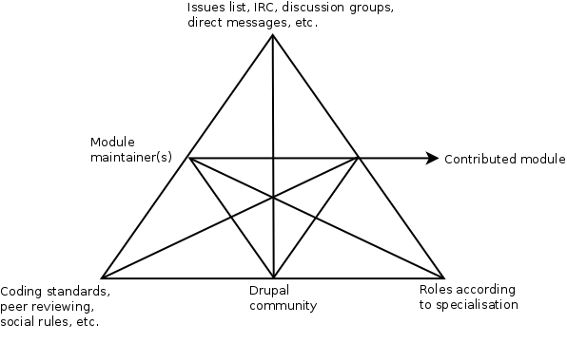
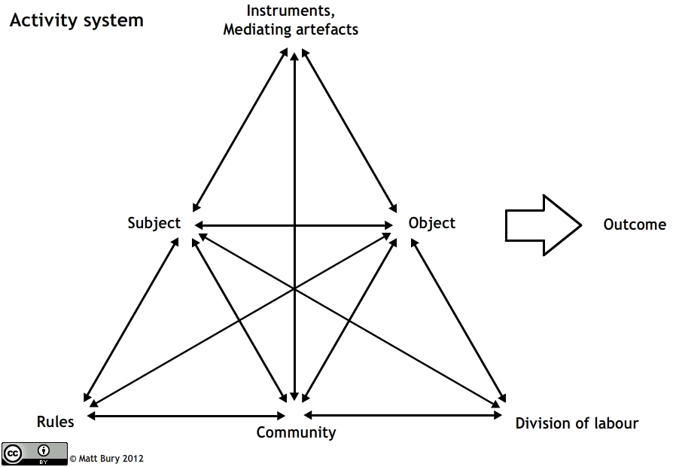
Example of AT: contributed modules
www.p2pvalue.eu
Drupal Camp North East – 26.07.2014

Slide 22
Conclusions
Drupal as part of a wider phenomena
As community, we can also benefit from the insights of these studies
How to improve it?... doing research in a “Drupal way”
www.p2pvalue.eu
Drupal Camp North East – 26.07.2014

Slide 23
Conclusions
Some ideas (proposal for Community Summit @Drupalcon Amsterdam)
  Increase contact between those interested in the study of the community
  Make the results available for discussion in the community
  E.g.: Group at Drupal.org: “Research about the Drupal Community”
www.p2pvalue.eu
Drupal Camp North East – 26.07.2014

Slide 24
References
Krogh, G. V. & Hippel, E. V. (2006). The promise of research on open source software.Management Science, 52 (7), pp. 975–983. Retrieved from http://www.jstor.org/stable/20110574
Huang, Le & Panchal. (2011). Analysis of the structure and evolution of an open-source community.
Moghaddam, R. Z., Bailey, B. P. & Fu, W.-t. (2012). Consensus building in open source user interface design discussions, 1491–1500.
Nordin and Meir (2013). Drupal community Pilot Survey. http://tzk-design.com/drupal-community-pilot-survey
Sims, J. P. (2013). Interactive engagement with an open source community : a study of the relationships between organizations and an open source.
Gevaber, G. C. & Spangenberg, G. A. (1776). Corpvs ivris civilis, 19–20. Retrieved from http://books.google.co.uk/books?id=Ll5EAAAAcAAJ&pg=PA19
Alfonso X. (1972). Las siete partidas del rey don alfonso el sabio, cotejados con varios códices antiguos por la real academia de la historia. Ed. Atlas, Lope de Vega.
Ostrom, V. & Ostrom, E. (1999). Public goods and public choices. In Polycentricity and local public economies. readings from the workshop in political theory and policy analysis (pp. 75–105). Ed. Michael McGinnis, Ann Arbor.-University of Michigan Press.
www.p2pvalue.eu
Drupal Camp North East – 26.07.2014

Slide 25
References
Hess, C. & Ostrom, E. (2007). Introduction: an overview of the knowledge commons.
Hardin, G. (1968). The tragedy of the commons. New York.
Weber, S. (2004). The success of open source. Cambridge Univ Press.
Lafuente, A. et al. (2007). Los cuatro entornos del procomún.
Benkler, Y. (2006). The wealth of networks: how social production transforms markets and freedom. Yale University Press.
P2Pvalue (2014). Report criteria of delimitation and typification common-based peer production (Version February 26 2014). Ongoing work.
Images:
  http://en.wikipedia.org/wiki/Siete_Partidas#mediaviewer/File:Partidas.jpg
  http://www.colaborabora.org/wp-content/uploads/sites/7/2011/10/CBB_diapoPROCOMUN1.jpg
  https://www.drupal.org/files/druplicon.large_.png
  http://upload.wikimedia.org/wikipedia/commons/a/af/Tux.png
  http://upload.wikimedia.org/wikipedia/commons/5/53/Wikipedia-logo-en-big.png
  http://upload.wikimedia.org/wikipedia/commons/d/d7/Amsterdam_Fab_Lab_at_The_Waag_Society.JPG
  http://farmhack.net/sites/default/files/The%20Garlic%20Master%20001_0.JPG
  http://www.siftdigital.co.uk/sites/default/files/drupal-community.png
  http://en.wikipedia.org/wiki/Activity_theory#mediaviewer/File:Activity_system.png
www.p2pvalue.eu
Drupal Camp North East – 26.07.2014

Slide 26


Any questions?
Thanks!
¡Gracias!
Obrigado!
Danke!
Grazie!
This work is licensed under a Creative Commons
Attribution-ShareALike 3.0 Unported License.
To view a copy of this license, please visit:
http://creativecommons.org/licenses/by-sa/3.0/
www.p2pvalue.eu
Drupal Camp North East – 26.07.2014

