Slide 1

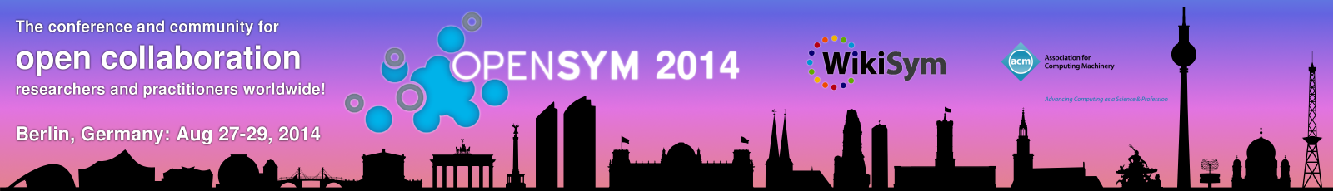
Drupal as a case of Commons-Based Peer Production community: a sociological perspective
David Rozas
University of Surrey
This work was partially supported by the Framework
programme FP7-ICT-2013-10 of the European Commission through project P2Pvalue (grant no.: 610961).
www.p2pvalue.eu

Slide 2



Who am I?
Areas of interest: FLOSS, CBPP, social computing, CSCW, etc
Working as a Drupal site builder/developer for the past 4 years. Previously working with Django, Moodle, etc.
Previous background in CS (@URJC [Spain], @NTNU [Norway])
Started PhD in Sociology @UniS [UK] in October 2013
Collaborating with the FP7 EU project P2Pvalue
+info|contact:
  @drozas
  www.davidrozas.com
  drozas@surrey.ac.uk
www.p2pvalue.eu
OpenSym 2014 – Doctoral Symposium – 26.08.2014

Slide 3
Outline
Drupal as a CBPP community
  What is Drupal and the Drupal community?
  What are the commons?
  What is CBPP?
www.p2pvalue.eu
OpenSym 2014 – Doctoral Symposium – 26.08.2014

Slide 4
Outline
Activity as unit of analysis and AT
  What is AT?
  Drupal as a run-away object and example of its application
Pilot Study: understanding contribution
Future work, summary and questions
www.p2pvalue.eu
OpenSym 2014 – Doctoral Symposium – 26.08.2014

Slide 5
What is Drupal?
Free software content management framework
Very modular: think of it as a “Lego”: +27k contributed modules
Powering 2% websites worldwide (W3Techs, 2014)
Employed in complex and high traffic websites: whitehouse.gov, mtv.co.uk, economist.com, etc.
www.p2pvalue.eu
OpenSym 2014 – Doctoral Symposium – 26.08.2014

Slide 6

What is Drupal?: the Drupal community
Started as a personal project of a student
Code released in 2001 under a GPL
Currently +1M users registered at Drupal.org, +30k code contributors (Drupal.org, 2014a)
Hundreds of local F2F events, dozens of camps and
cons in 4 continents (Drupal.org, 2014b)
www.p2pvalue.eu
OpenSym 2014 – Doctoral Symposium – 26.08.2014

Slide 7
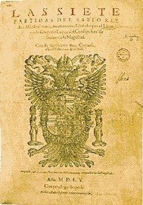
What are the commons?
A notion present in a wide range of cultures from all eras
E.g.:
  Corpvs iuris civilis (529-534, emp. Justinian I): Res Communis (cannot be owned) and Res Nullius (no owner)
  Siete Partidas (1252-1284, kingdom Alfonso X): “those goods that belong to all the creatures of the World [...], the city [...] or its residents [...]”
www.p2pvalue.eu
OpenSym 2014 – Doctoral Symposium – 26.08.2014

Slide 8
What are the commons?
Let's define it according to classical economics:
  Excludability: feasible to prevent its access to it
  Rivalry: its use or consumption prevents or affects the consumption by others
 | Rival | Non-Rival
Excludable | Private goods. E.g.: bread | Toll goods. E.g.: cable TV
Non-excludable | Common Pool Resources E.g.: fish taken from the ocean | Public goods E.g.: lighthouse, Free Software
V. Ostrom and E. Ostrom (1999)
www.p2pvalue.eu
OpenSym 2014 – Doctoral Symposium – 26.08.2014

Slide 9
What are the commons?
The commons: as a resource or good shared by a group of people that may be subject to social dilemmas, such as over-exploitation or free-riding. (Hess & E. Ostrom, 2007)
“The tragedy of the commons”, Hardin (1968) states how resources shared by individuals acting out of self-interest in order to maximise its own benefit produces the depletion of the common-resource
www.p2pvalue.eu
OpenSym 2014 – Doctoral Symposium – 26.08.2014

Slide 10
What are the commons?
However, the research of Ostrom showed that under certain conditions these resources can indeed be managed in a sustainable way by local communities of peers
Furthermore, some of these goods are anti-rival: the more people use them, the more utility each person receives (e.g.: Free software). Weber (2004)
www.p2pvalue.eu
OpenSym 2014 – Doctoral Symposium – 26.08.2014

Slide 11

What are the commons?
One more dimension: the scope of the ownership:
”Those goods that belong to everyone and no one at the same time, therefore not following the rules of the market”
Lafuente et al. (2007)
www.p2pvalue.eu
OpenSym 2014 – Doctoral Symposium – 26.08.2014

Slide 12
The Drupal goods as a commons
Anti-rival: its use by a person increases the value for other users
Non-excludable: accessibility is protected as part of the licenses applied for the code, the contents created in the community, etc.
Global : the ownership does not belong
to any individual or state, as protected by the
licenses chosen (exception: the trademark)
www.p2pvalue.eu
OpenSym 2014 – Doctoral Symposium – 26.08.2014

Slide 13




What is Commons-Based Peer Production?
A new model of socio-economic production in which groups of loosely connected individuals cooperate with each other to produce meaningful products without a traditional hierarchical organisation (Benkler, 2006)
Emerging model (see http://directory.p2pvalue.eu/)
www.p2pvalue.eu
OpenSym 2014 – Doctoral Symposium – 26.08.2014

Slide 14
What is Commons-Based Peer Production?
Ongoing discussion on the differences between CBPP, Peer Production, the delimitation criteria, etc.
Criteria used in P2Pvalue project (P2Pvalue, 2014):
  Collaborative process
  Peer-based: not solely or mainly coordinated by contractual relationships, hierarchical command, large degree of self-assignment
  Commons-process: process driven by the general interest
  Favouring reproducibility: of the goods, practices, methodologies, etc.
www.p2pvalue.eu
OpenSym 2014 – Doctoral Symposium – 26.08.2014

Slide 15
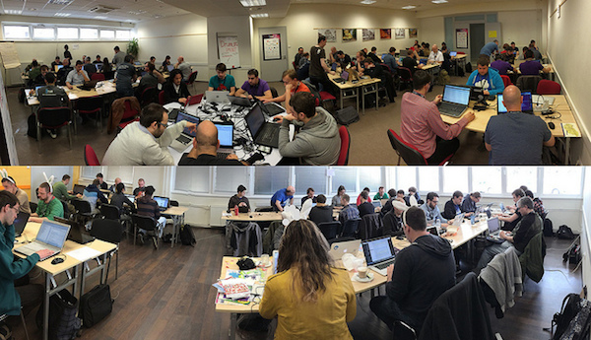
Drupal as a CBPP community
Drupal as a community whose mode of production is:
  Collaborative process
  Peer-based: different levels of structure depending on the process, but not mainly based on contractual obligations neither forms of coercion
  Commons-process: process driven by the general interest, results in openness of the resources
  Favouring reproducibility: via Free Software/CC licenses, exchange of practices, etc.
www.p2pvalue.eu
OpenSym 2014 – Doctoral Symposium – 26.08.2014

Slide 16
Contribution activities as unit of analysis
Previous studies looked either at the individuals or at the whole community (e.g.: motivations to contribute, structure of the community, etc.). Huang, Le & Panchal (2011), Nordin and Meir (2013), Sims, J. P. (2013)
My approach is to look at activities as unit of analysis (using Activity Theory as a framework), using a virtual ethnographic approach.
Understand processes and dynamics
Implies to understand deeply what contribution means: pilot study
www.p2pvalue.eu
OpenSym 2014 – Doctoral Symposium – 26.08.2014

Slide 17
What is Activity Theory?
Historical roots in the idea of object-oriented activity and relationship between object and subject (Marx, 1845): subject produces herself by producing the object
1st AT generation [1920s]: Soviet Cultural-historical psychology - Vygotsky, Leont'ev,..
“Mediated action”: by collaborating in the development of activities with other humans, meanings, social norms, artifacts, etc. are internalised by the individuals. (Vygotsky, 1979).
www.p2pvalue.eu
OpenSym 2014 – Doctoral Symposium – 26.08.2014

Slide 18
What is Activity Theory?
2nd AT generation [1980s]: Engeström and the AT Scandinavian school
  Human activity system as unit of analysis: dynamic, culturally-mediated, specific to human-beings, analysable in its context. (Engeström, 1987).
  Extends Leont'ev's model: adding the rules that regulate the activity, community sharing the interest and division of labour. (Engeström, 1987).
www.p2pvalue.eu
OpenSym 2014 – Doctoral Symposium – 26.08.2014

Slide 19
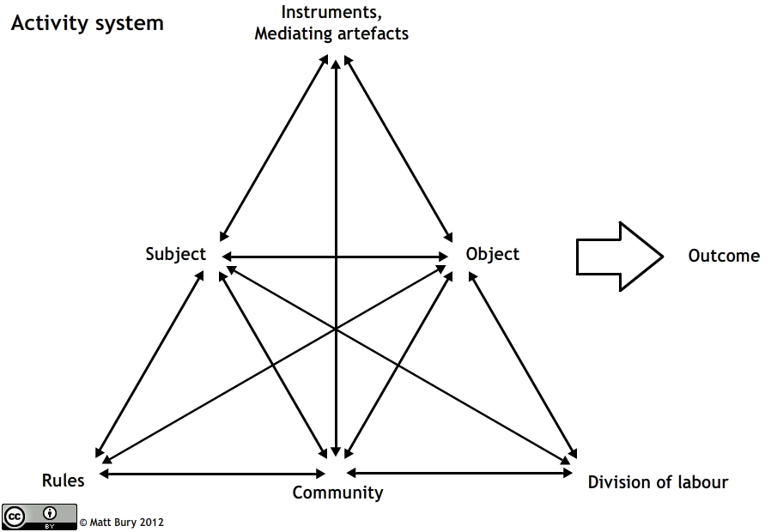
What is Activity Theory?
Subject: the actors that performed the activity and who are subjected to the internalisation process.
Instruments, mediating artifacts: the tools employed by the actors in the system. Influence on actors, structure and change
Object: the element to which activity is directed towards. Transformed as the activity progresses, possesses social and cultural properties.
Rules: they are the explicit and implicit rules which regulate the activity in the system.
Community: they are all the actors involved in the system.
Division of labour : it represents the distribution
of processes between the actors of the system.
www.p2pvalue.eu
OpenSym 2014 – Doctoral Symposium – 26.08.2014

Slide 20
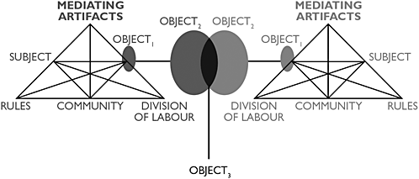
What is Activity Theory?
3rd (4th?) generation [1999-nowadays]:
  Objects shared between several systems and its tensions can be studied
  “Runaway objects” (Engeström, 2009): new ways of social production requires to rethink the model
  – boundaries and structures
  are not so clear and
  subsumed by the object
Engeström (2009)
www.p2pvalue.eu
OpenSym 2014 – Doctoral Symposium – 26.08.2014

Slide 21
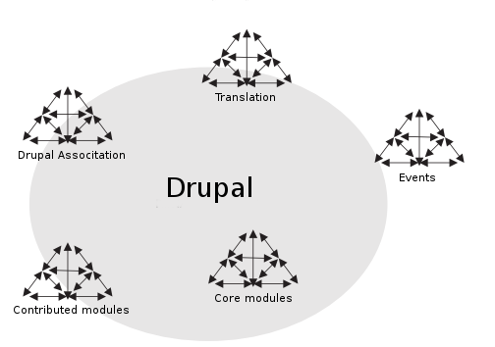
Drupal as a “run-away” object
Run-away object properties (Engeström, 2009)
They must have intrinsic properties that transcend the utilitarian profit motive.
The object must yield useful intermediate products, yet remain an incomplete project.
The object must be visible, accessible and cumulable.
There must be effective feedback from and exchange among the participants acting on the object.
www.p2pvalue.eu
OpenSym 2014 – Doctoral Symposium – 26.08.2014

Slide 22
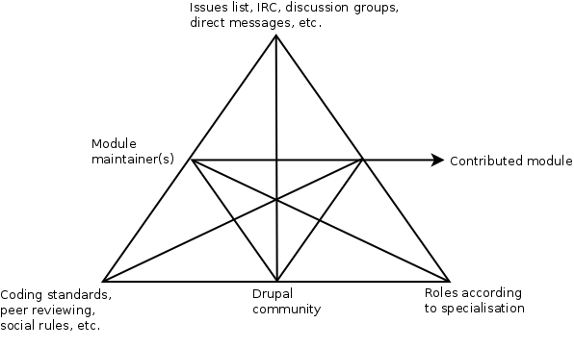
Dev. Of contrib modules under AT lenses
www.p2pvalue.eu
OpenSym 2014 – Doctoral Symposium – 26.08.2014

Slide 23
Pilot study: understanding contribution
Pilot study (ongoing) understand what activities are perceived as contributions and how
Virtual ethnographic perspective (Hine, 2000): study of online communities and its culture. Online and offline. Qualitative. Inductive approach.
What activities are perceived as contributions? Do the “official” meanings match the perceptions of the members of the community? Do perceptions vary according to degree of experience? And the role/speciality?
www.p2pvalue.eu
OpenSym 2014 – Doctoral Symposium – 26.08.2014

Slide 24
Pilot study: methods and data outcomes
Participant-observation: online and offline (local, national, international events). Full-field notes
Qualitative interviews: Drupal community members, following a strategic sampling. Transcriptions.
Content-analysis: selection and pre-coding of materials from Drupal Planet (+5k links), including blog posts, podcasts, videos, etc.
www.p2pvalue.eu
OpenSym 2014 – Doctoral Symposium – 26.08.2014

Slide 25
Pilot study: preliminary insights
Contribution beyond source code, in a code-centric community
Role of affective labour (Hardt, 1999) as outcomes of some of the activities: inmaterial labour in human interaction that creates or modifies emotional experiences
The lifeblood of the commons (Bollier, 2014)
Unevenly represented in the main platform of collaboration?
www.p2pvalue.eu
OpenSym 2014 – Doctoral Symposium – 26.08.2014

Slide 26
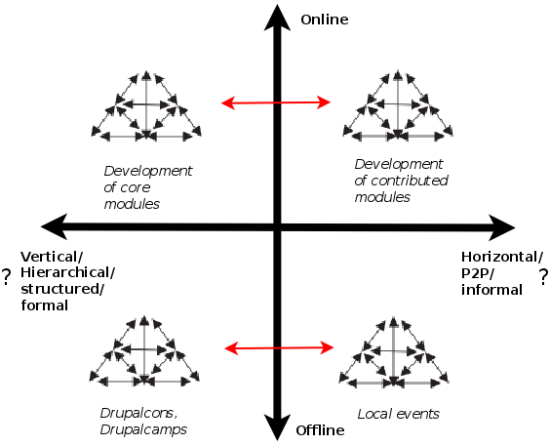
Future work
Select and deeply study some
of the activities identified
in the pilot study
(preliminary proposal)
www.p2pvalue.eu
OpenSym 2014 – Doctoral Symposium – 26.08.2014

Slide 27
Summary
Drupal community (diverse, complex, etc.) as a case study of CBPP, to study processes and dynamics
AT as lenses, using a virtual ethnographic approach
Preliminary insights of the pilot study and thoughts on possible future work
www.p2pvalue.eu
OpenSym 2014 – Doctoral Symposium – 26.08.2014

Slide 28
References
W3Techs (2014). Usage of content management systems for websites. http://w3techs.com/technologies/overview/content_management/all
Drupal.org (2014a). https://www.drupal.org/
Drupal.org (2014b). Drupal upcoming events. https://groups.drupal.org/events
Huang, Le & Panchal. (2011). Analysis of the structure and evolution of an open-source community.
Nordin and Meir (2013). Drupal community Pilot Survey. http://tzk-design.com/drupal-community-pilot-survey
Sims, J. P. (2013). Interactive engagement with an open source community : a study of the relationships between organizations and an open source.
Gevaber, G. C. & Spangenberg, G. A. (1776). Corpvs ivris civilis, 19–20. Retrieved from http://books.google.co.uk/books?id=Ll5EAAAAcAAJ&pg=PA19
Alfonso X. (1972). Las siete partidas del rey don alfonso el sabio, cotejados con varios códices antiguos por la real academia de la historia. Ed. Atlas, Lope de Vega.
Ostrom, V. & Ostrom, E. (1999). Public goods and public choices. In Polycentricity and local public economies. readings from the workshop in political theory and policy analysis (pp. 75–105). Ed. Michael McGinnis, Ann Arbor.-University of Michigan Press.
Hess, C. & Ostrom, E. (2007). Introduction: an overview of the knowledge commons.
Hardin, G. (1968). The tragedy of the commons. New York.
Weber, S. (2004). The success of open source. Cambridge Univ Press.
Lafuente, A. et al. (2007). Los cuatro entornos del procomún.
Benkler, Y. (2006). The wealth of networks: how social production transforms markets and freedom. Yale University Press.
P2Pvalue (2014). Report criteria of delimitation and typification common-based peer production (Version February 26 2014). Ongoing work.
www.p2pvalue.eu
OpenSym 2014 – Doctoral Symposium – 26.08.2014

Slide 29
References
Marx, K. (1845). Theses on feuerbach. The Marx-Engels Reader, 2, 143–45
Vygotsky, L. (1978). Mind in society. the development of higher psychological processes.
Engeström, Y. (1987). Learning by expanding. an activity-theoretical approach to developmental research.
Engeström, Y. (2009). The future of activity theory: a rough draft. Learning and expanding with activity theory, 303–328.
C. Hine. Virtual ethnography. Sage, 2000.
Hardt, M. (1999). Affective labor. Boundary 2, 26 (2), 89–100.
Bollier, D. (2014). Affective Labor as the Lifeblood of a Commons. Retrieved from http://www.bollier.org/blog/affective-labor-lifeblood-commons
Images:
  http://www.opensym.org/wp-content/uploads/2014/02/cropped-largebanner.16000.02.png
  https://www.drupal.org/files/druplicon.large_.png
  http://www.siftdigital.co.uk/sites/default/files/drupal-community.png
  http://en.wikipedia.org/wiki/Siete_Partidas#mediaviewer/File:Partidas.jpg
  http://www.colaborabora.org/wp-content/uploads/sites/7/2011/10/CBB_diapoPROCOMUN1.jpg
  http://upload.wikimedia.org/wikipedia/commons/a/af/Tux.png
  http://www.amazeelabs.com/sites/default/files/13423501873_7fd1b4f2d9_z.jpg
  http://upload.wikimedia.org/wikipedia/commons/5/53/Wikipedia-logo-en-big.png
  http://upload.wikimedia.org/wikipedia/commons/d/d7/Amsterdam_Fab_Lab_at_The_Waag_Society.JPG
  http://farmhack.net/sites/default/files/The%20Garlic%20Master%20001_0.JPG
  http://en.wikipedia.org/wiki/Activity_theory#mediaviewer/File:Activity_system.png
www.p2pvalue.eu
OpenSym 2014 – Doctoral Symposium – 26.08.2014

Slide 30


Any questions/feedback?
Thanks!
¡Gracias!
Obrigado!
Danke!
Grazie!
This work is licensed under a Creative Commons
Attribution-ShareALike 3.0 Unported License
excerpt if otherwise noted.
To view a copy of this license, please visit:
http://creativecommons.org/licenses/by-sa/3.0/
www.p2pvalue.eu
OpenSym 2014 – Doctoral Symposium – 26.08.2014

