Slide 1

Automating Drupal Development with Patterns
David Rozas, Liao Hao and many others

Slide 2
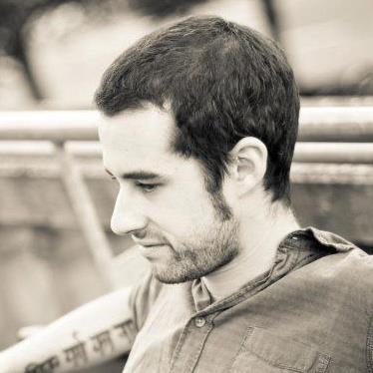
A brief presentation of us...
David Rozas Domingo (drozas)
2+ years working with Drupal.
Recently joined CRESS (Centre for Research in Social Stimulation) at University of Surrey (UK).
Interest areas: free software, education and technology, distributed systems programming, CSCW, collaborative learning, socially intelligent information systems, …
+info: http://www.davidrozas.com
20-10-2012
DrupalCamp Spain 2012
www.qlectives.eu

Slide 3
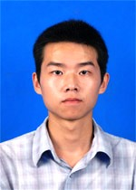
A brief presentation of us...
Liao Hao
1+ Years working with Drupal
Ph.D candidate in TIP Group(Theoretical Interdisciplinary Physics) of University of Fribourg, Switzerland
20-10-2012
DrupalCamp Spain 2012
www.qlectives.eu

Slide 4
the others…
Stefano Balietti (ETH)
Xiao Rui 肖锐 (Uni Science & Tech. China)
Dengcheng Yan 颜登程 (Uni Science & Tech. China)
Matus Medo (Uni Fribourg)
Zhou Yanbo 周艳波 (Uni Fribourg)
Dirk Helbing (ETH)
Vahe Tshitoyan (ETH)
Vahan Hovhannisyan (ETH)
Christoph Schwirzer (ETH)
Christian Schulz (ETH)
Sasa Tomic (ETH)
Mark Jelasity (Uni Szeged)
Kornél Csernai (Uni Szeged)
Tamas Kojedzinszky (Uni Szeged)
Nigel Gilbert (Uni Surrey)
Alastair Gill (Uni Surrey)
20-10-2012
DrupalCamp Spain 2012
www.qlectives.eu

Slide 5
Outline
The big picture: Qlectives and QScience
Patterns:
  Patterns overview: components and Patterns files
  Differences between Patterns and other modules
20-10-2012
DrupalCamp Spain 2012
www.qlectives.eu

Slide 6
Outline
Patterns:
  The Future?
  What can I do with Patterns?
  How can I do it?
  Future Work
Demo
Q&A
20-10-2012
DrupalCamp Spain 2012
www.qlectives.eu

Slide 7
The big picture: QLectives
What is quality?
If half a million people give a YouTube video the thumbs up, does that mean is good?
Perhaps... but you would probably rather watch a recommendation from a friend
Can we do it in a “P2P” way?
20-10-2012
DrupalCamp Spain 2012
www.qlectives.eu

Slide 8
The big picture: QLectives
Take features of social networking to help groups of people share resources: from home videos to scientific papers
Quality ratings in a distributed way
20-10-2012
DrupalCamp Spain 2012
www.qlectives.eu

Slide 9
The big picture: QLectives
Two application domains:
QMedia: P2P media distribution fully decentralized
QScience: distributed platform for scientists allowing them to locate or form new communities and quality reviewing mechanisms
20-10-2012
DrupalCamp Spain 2012
www.qlectives.eu

Slide 10
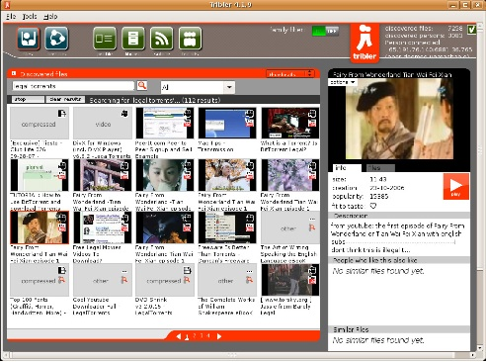
Qmedia: Tribler
BitTorrent client fully decentralized: no need of servers to locate and download the .torrent
Developed in Python (available for GNU/Linux, Windows and Mac OS X)
http://www.tribler.org
20-10-2012
DrupalCamp Spain 2012
www.qlectives.eu

Slide 11
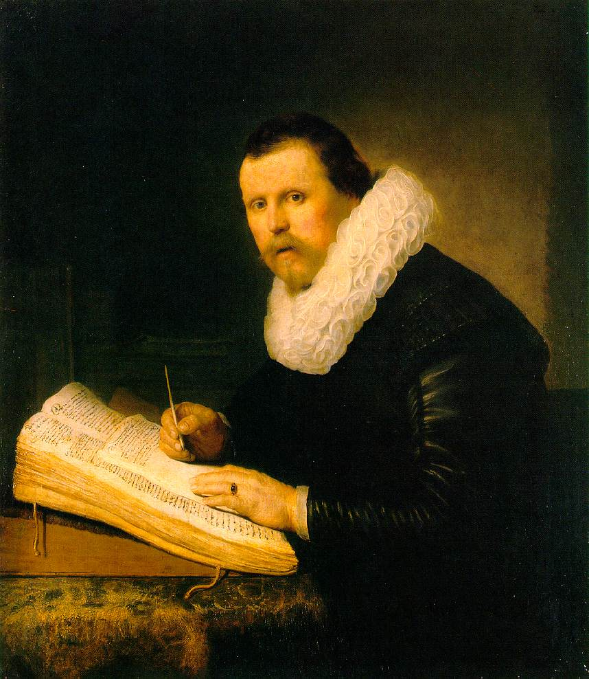
QScience: Science today
From...
Rembrandt, “A Scholar” (1631)
20-10-2012
DrupalCamp Spain 2012
www.qlectives.eu

Slide 12
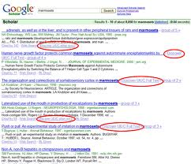
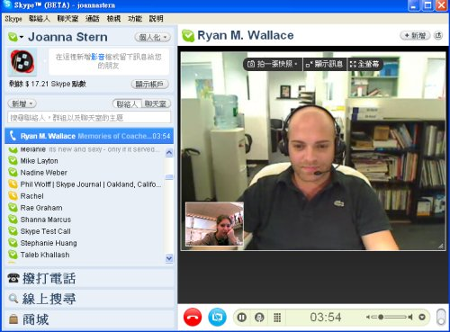
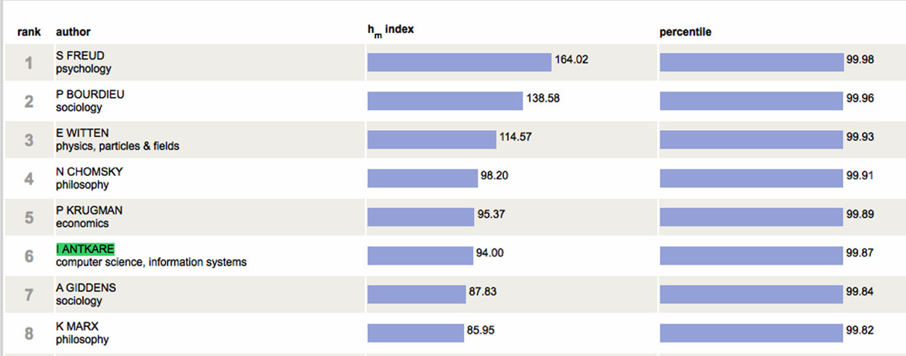

QScience: Science today
To...
Indexes of scientific
productivity
Trends discovery
Communication
20-10-2012
DrupalCamp Spain 2012
www.qlectives.eu

Slide 13
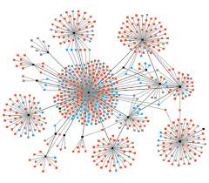



QScience: Science today
Community
Networks
Big Data
20-10-2012
DrupalCamp Spain 2012
www.qlectives.eu

Slide 14

Can we have it all?
Many software packages are available that fit one (or more) of those needs, but not all.
QScience is an attempt to pull them all together in a modular fashion: a Drupal distribution
EconoPhysics forum:
  http://www.unifr.ch/econophysics/ (old version)
  http://134.21.2.151/drupal-7.14/ (new Drupal version)
20-10-2012
DrupalCamp Spain 2012
www.qlectives.eu

Slide 15
QScience: contributing back
Patterns: configuration management
D2D (DrupalToDrupal): secure exchange of information between different Drupal instances (to be released soon)
Living Science: Drupal based search and visualization tool (to be released soon)
20-10-2012
DrupalCamp Spain 2012
www.qlectives.eu

Slide 16
QScience Patterns
What we want: reuse and share modules configuration
The main issue: configuration and data are mixed up in the DB
20-10-2012
DrupalCamp Spain 2012
www.qlectives.eu

Slide 17
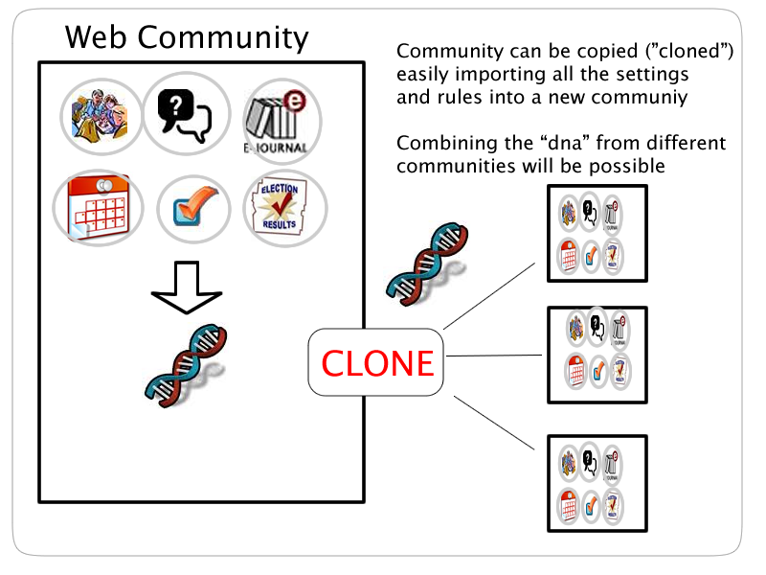
QScience Patterns
20-10-2012
DrupalCamp Spain 2012
www.qlectives.eu

Slide 18
QScience Patterns
Patterns is built to bypass this bottleneck by managing and automating site configuration
Patterns' approach to solve it:
  Components (“Software driver concept”)
  Storage the configuration in files – decoupled architecture
20-10-2012
DrupalCamp Spain 2012
www.qlectives.eu

Slide 19

Patterns Components
Node
Taxonomy
…
…
User
Variables
…
20-10-2012
DrupalCamp Spain 2012
www.qlectives.eu

Slide 20
Patterns Components
Each Drupal module can have a corresponding component, e.g. Blocks, Nodes, Taxonomy, Users, System settings.
The component handles tasks directed at the module, acts much like a software driver.
20-10-2012
DrupalCamp Spain 2012
www.qlectives.eu

Slide 21
Patterns Components
It has to define a set of hooks which are accessed by the Patterns core during the different phases: prepare, validate, callbacks, execution, cleanup...
Actions are preprocessed and reformatted so that they can be the input of one or more Drupal forms.
20-10-2012
DrupalCamp Spain 2012
www.qlectives.eu

Slide 22
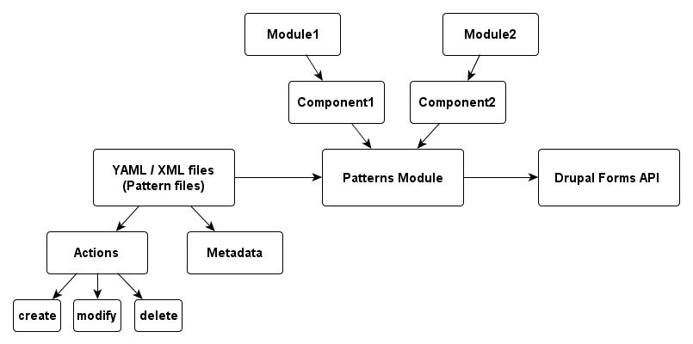
Patterns Overview
20-10-2012
DrupalCamp Spain 2012
www.qlectives.eu

Slide 23
Patterns Files
Store configuration in files
There is not any dependency with any specific format: hook_patterns_parser(): http://drupal.org/node/1545346
Currently supported formats
  YAML: easy to read and write (human-readable data serialization format)
  XML: interoperability
  PHP arrays: performance
20-10-2012
DrupalCamp Spain 2012
www.qlectives.eu

Slide 24
Patterns Files: structure
Divided in sections:
  Metadata: author, category,
  Sub-sections:
    Actions: create, modify, delete, include
20-10-2012
DrupalCamp Spain 2012
www.qlectives.eu

Slide 25
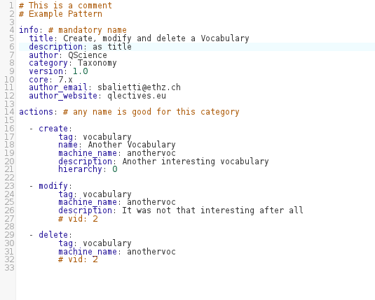
Patterns Files
Demo: taking a look to a couple of patterns examples in YAML
20-10-2012
DrupalCamp Spain 2012
www.qlectives.eu

Slide 26
So, what ¡s the difference
between Patterns and...?
Distribution/Installation Profile:
  Granularity: the configuration can be split into smaller definitions
  Simplicity: easier to write YAML files than an installation profile
  Can be used in existing sites
20-10-2012
DrupalCamp Spain 2012
www.qlectives.eu

Slide 27
So, what ¡s the difference
between Patterns and...?
Features+Strongarm:
  Paradigm: Features is 'use case oriented', Patterns is 'CM oriented'
  (Interesting blog post from Tom Friedhof about this at http://activelamp.com/blog/new-way-manage-configuration-your-site)
20-10-2012
DrupalCamp Spain 2012
www.qlectives.eu

Slide 28
So, what ¡s the difference
between Patterns and...?
Features+Strongarm:
  “Don’t get me wrong, I love the features module, but I have to admit that I’ve run into my share of issues using features module for configuration management and deployment. Fortunately others in the community have ran into these issues too and have released modules such as features override, features plumber, and Features Tools. Not to mention entire workflows have been created around how to use Features to manage configuration for deployment that don’t even come close to creating KIT compliant features. Features module is really being misused, it’s not being used to create features, it’s being used to manage configuration and deployment.”
  Tom Friedhof (“A new way to manage configuration on your site”)
20-10-2012
DrupalCamp Spain 2012
www.qlectives.eu

Slide 29
So, what ¡s the difference
between Patterns and...?
Features+Strongarm:
  Storage: Features stores the configuration in Drupal modules, patterns stores it in files as D8 will
  (see D8 Config Management Initiative)
20-10-2012
DrupalCamp Spain 2012
www.qlectives.eu

Slide 30
So, what ¡s the difference
between Patterns and...?
Features+Strongarm :
  Implementation: Features uses module specific APIs (e.g: Views API), Patterns uses mostly FAPI (although can use specific ones as well).
    The “trick” is drupal_form_submit()
    Advantage: Validation for free!
    Disadvantage: Performance
20-10-2012
DrupalCamp Spain 2012
www.qlectives.eu

Slide 31
The future...?
20-10-2012
DrupalCamp Spain 2012
www.qlectives.eu

Slide 32
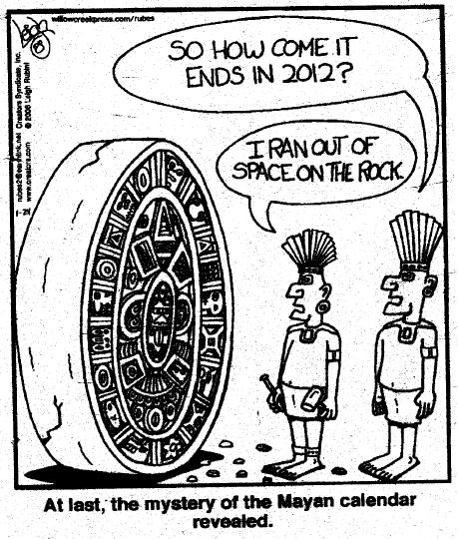
The future...?
30.03.2012
DrupalCamp Spain 2012
www.qlectives.eu

Slide 33
The future...?
Configuration Management Initiative (D8):
  http://groups.drupal.org/build-systems-change-management/cmi
  http://drupal.org/community-initiatives/drupal-core#cmi
Can Patterns concepts be useful for it?. Proof of concept?
20-10-2012
DrupalCamp Spain 2012
www.qlectives.eu

Slide 34
The future...?
Posted by laurencefass on October 5, 2012 at 12:45pm
The CM management for Drupal 8 is being backported to D7 in the CM module, and (apparently) features is going to be re-written on top of it. From what I understand (so far) Patterns looks more suited to the configuration management use case and source control than Features (in its present form as it was not intended for CM). Patterns may already provide some of the solutions proposed Features/CM integration.
[…]
http://groups.drupal.org/node/259013
20-10-2012
DrupalCamp Spain 2012
www.qlectives.eu

Slide 35
Ok... so what can I do with Patterns for the moment?
Module ported from D6 to D7:
  From spaghetti code to modular code
  Improved GUI
  Drush support
  Added automatic export API
  Parser Module
  Simple test battery
  More powerful syntax
  Include patterns
  Settings page
  Patterns D2D
20-10-2012
DrupalCamp Spain 2012
www.qlectives.eu

Slide 36
Ok... so what can I do with Patterns for the moment?
Components already developed for:
  Content Types
  Fields
  Menus, Menu Items
  Blocks
  Content
  Users
  Vocabularies, Terms
  Pathauto
  System settings (eg.: enable modules)
  Permissions/Roles
  Color
  Toolbar and Shortcut
20-10-2012
DrupalCamp Spain 2012
www.qlectives.eu

Slide 37

Ok... so what can I do with Patterns for the moment?
First Release Candidate: 7.x-1.0-rc1 (Sept. 9th)
Write or re-use patterns using the already developed components
Share your patterns (set public patterns page)
Make your module “Patterns Ready”
20-10-2012
DrupalCamp Spain 2012
www.qlectives.eu

Slide 38
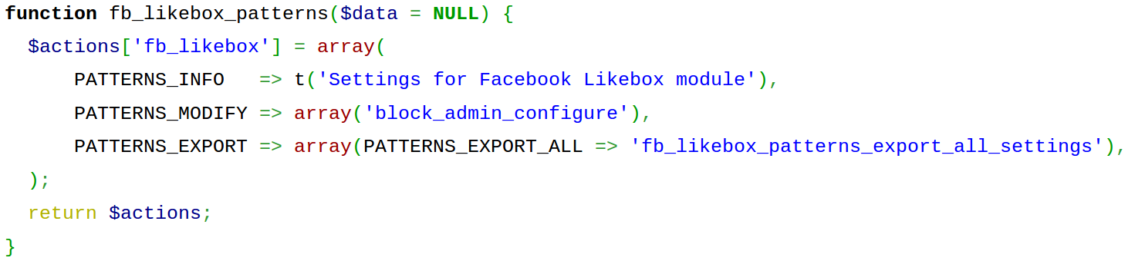
How to make a module “Patterns Ready”?
You need to implement hook_patterns to declare which actions your module is able to handle:
20-10-2012
DrupalCamp Spain 2012
www.qlectives.eu

Slide 39
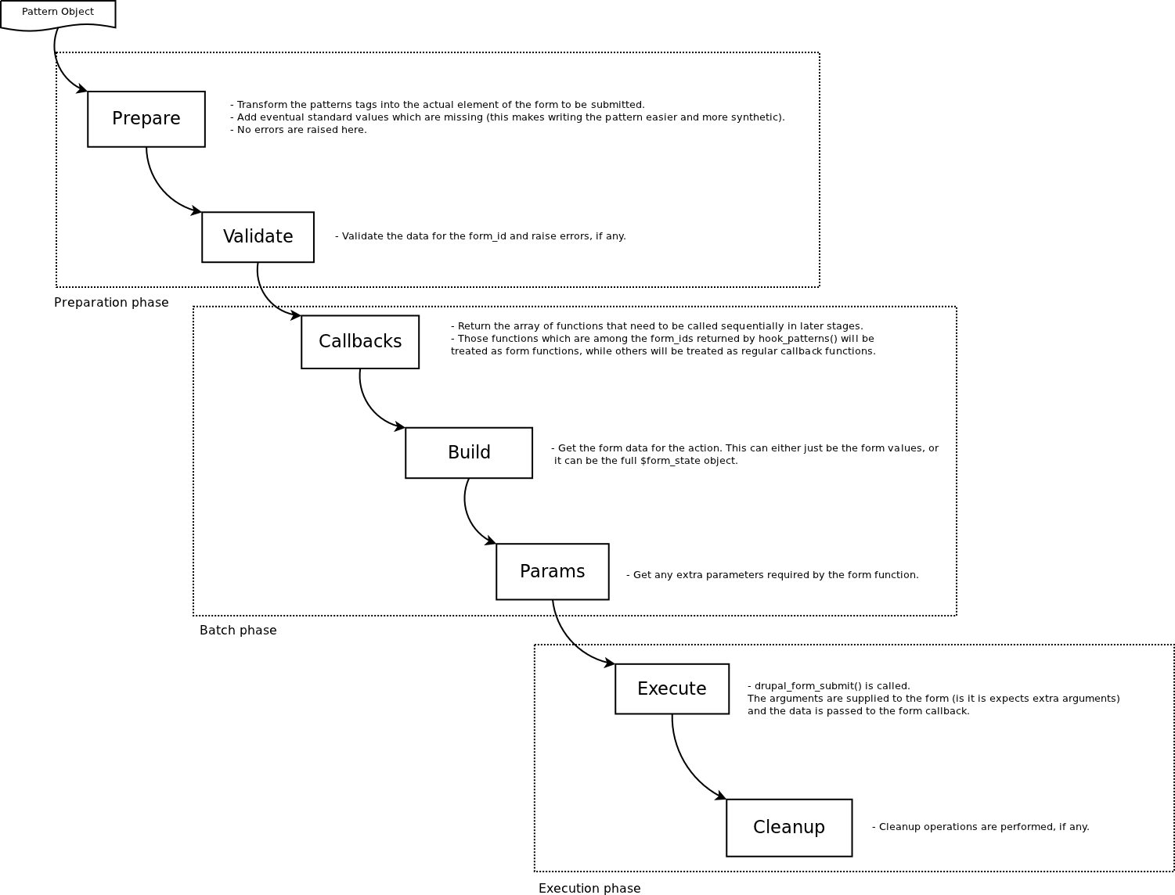
Patterns Execution Flow
Source: https://github.com/QScience/patterns-flowcharts/blob/master/running-pattern-workflow.dia
20-10-2012
DrupalCamp Spain 2012
www.qlectives.eu

Slide 40
How to make a module “Patterns Ready”?
Hooks available to interact on each phase:
  hook_patterns_prepare($action, $tag, &$data)
  hook_patterns_validate($action, $tag, &$data)
  hook_patterns_callbacks($action, $tag, &$data)
  hook_patterns_build($action, $form_id, &$data, &$action_state)
  hook_patterns_params($action, $form_id, &$data &$action_state)
  hook_patterns_cleanup($action, $tag, &$data)
20-10-2012
DrupalCamp Spain 2012
www.qlectives.eu

Slide 41
How to make the settings exportable?
You need to declare in hook_patterns() a function that will gather the data
Write that function: can be more or less complex depending on the component
20-10-2012
DrupalCamp Spain 2012
www.qlectives.eu

Slide 42
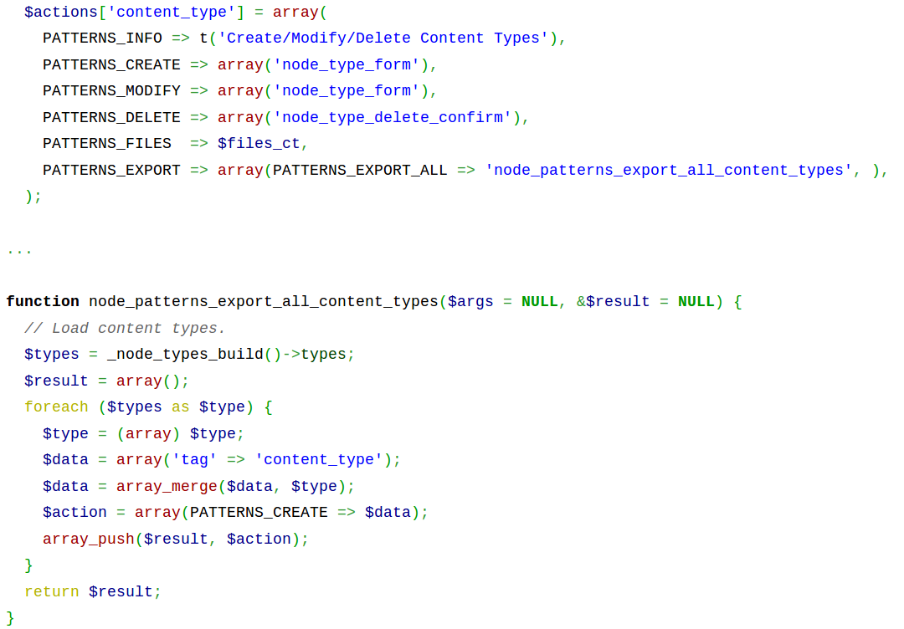
How to make the settings exportable?
20-10-2012
DrupalCamp Spain 2012
www.qlectives.eu

Slide 43
Future Work
Improve the automatic extraction of configuration (pattern files): WIP
  Issues with some core components (e.g.: block)
  The extracted patterns may require minor corrections
20-10-2012
DrupalCamp Spain 2012
www.qlectives.eu

Slide 44
Future Work
Write components for QScience custom modules
Write components for the most important contrib modules:
    Views
    Rules
    OG
    Context
    ...
20-10-2012
DrupalCamp Spain 2012
www.qlectives.eu

Slide 45
Future Work
Documentation (D7):
  Almost 30 pages already published at Drupal.org: http://drupal.org/node/1464118
  Patterns guide: “Step by Step tour on the code”: WIP, to be released very soon
  Screencasts, more tutorials, etc.
20-10-2012
DrupalCamp Spain 2012
www.qlectives.eu

Slide 46
Ideas
E.g.:Collect Statistics about “the most popular patterns”...
  Possible to do it in a P2P way?/
  Drupal2Drupal module?
Thanks for your ideas/suggestions/patches!
Patterns group at: http://groups.drupal.org/patterns
20-10-2012
DrupalCamp Spain 2012
www.qlectives.eu

Slide 47

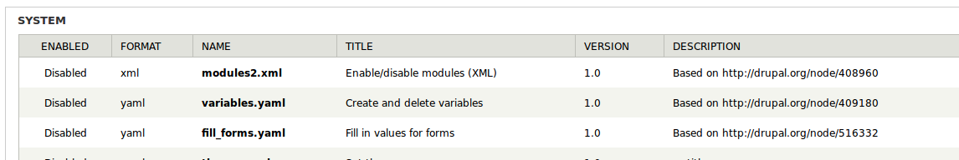
Time for the demo!
20-10-2012
DrupalCamp Spain 2012
www.qlectives.eu

Slide 48
Links
Qlectives:
  Main site: http://www.qlectives.eu/
  Deliverable 4.2.3:http://www.qlectives.eu/wiki/images/9/91/Qd4-2-3.pdf
  Econophysics Forum: http://www.unifr.ch/econophysics/
20-10-2012
DrupalCamp Spain 2012
www.qlectives.eu

Slide 49
Links
Patterns:
  Main Page: http://drupal.org/project/patterns
  Documentation: http://drupal.org/node/346509
  Group: http://groups.drupal.org/patterns
Configuration Management Initiative:
  http://groups.drupal.org/build-systems-change-management/cmi
  http://drupal.org/community-initiatives/drupal-core#cmi
20-10-2012
DrupalCamp Spain 2012
www.qlectives.eu

Slide 50
Thanks!
謝謝
¡Gracias!
20-10-2012
DrupalCamp Spain 2012
www.qlectives.eu

