Slide 1
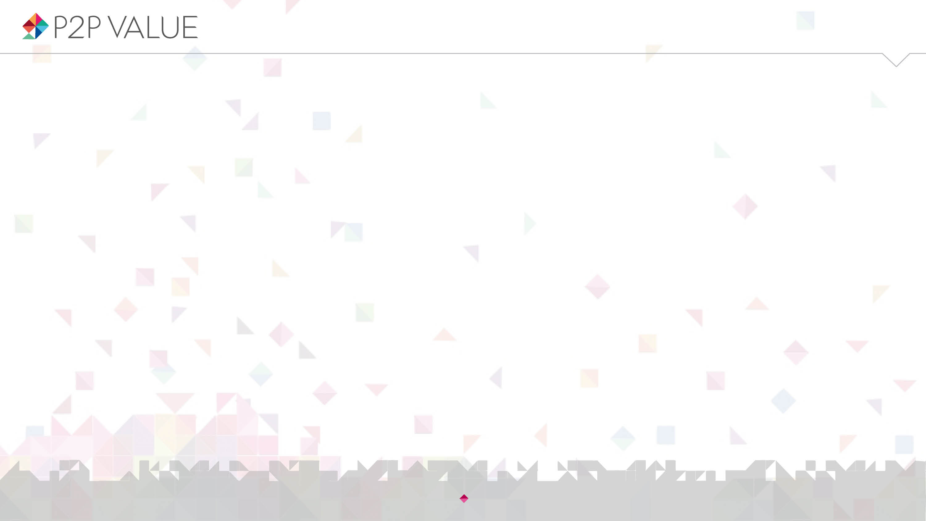

Talk is silver, code is gold? Contribution beyond source code in Drupal
David Rozas
University of Surrey
This work was partially supported by the Framework
programme FP7-ICT-2013-10 of the European Commission through project P2Pvalue (grant no.: 610961).
www.p2pvalue.eu
DrupalCon 2015 (Barcelona) – 24.09.2015
Notes:
Hello everyone! Thank you so much for coming, and thank you for this opportunity to share the first set of findings of my PhD with the community. I feel incredibly honoured and happy, this is a dream coming true for me. So, today I will be talking about contribution, about the notion of contribution in the Drupal community.

Slide 2

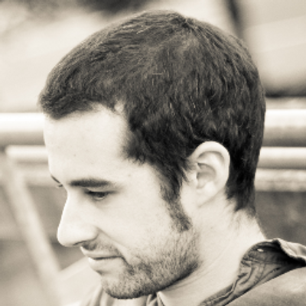


Who am I?
@drozas // #DCRozas
Areas of interest: Free Software, Commons-Based Peer Production,
social computing, Computer Supported Cooperative Work, Science
and Technology Studies etc.
Working as a Drupal developer for the past 5 years. Previously working with Django, Moodle, etc.
Previous background in Computer Science (@URJC [Spain], @NTNU [Norway])
Started PhD in Sociology @UniS [UK] in October 2013
Collaborating with the FP7 EU project P2Pvalue (www.p2pvalue.eu)
+info|contact:
  @drozas
  www.davidrozas.com || drozas@surrey.ac.uk
[...]
www.p2pvalue.eu
DrupalCon 2015 (Barcelona) – 24.09.2015
Notes:
So, just very quickly about myself. My name is David. I am PhD student at the University of Surrey in the UK, although I am originally from Madrid, Spain, as you probably noticed already because of my strong accent :-)
I have been working with Drupal during the past 5 years, and I have always been very interested in Free Software. In both the technical side, but also on the social side. And that is probably why I have ended up doing a PhD in Sociology, although my previous background is in Computer Science. I am also currently collaborating with a EU research project called P2P value, which is looking at the phenomena of Commons-Based Peer Production, which I will be explaining today, in a multi-disciplinary way.

Slide 3
Outline
@drozas // #DCRozas
Introduction: Drupal as a CBPP community
Research questions
Data and methods
Findings
Discussion
Conclusion and future work
www.p2pvalue.eu
DrupalCon 2015 (Barcelona) – 24.09.2015
Notes:
So, a brief outline of the presentation. I will be first introducing some of the concepts, such as Commons-Based Peer Production, the commons, etc. to frame the research. I will then very quickly go through the research questions and the methods. And then, I will go deeper into the findings, which I think is the most interesting part. And then we will have time for the discussion, the conclusion and future work. I am going to have to rush a bit, because we only have 25 minutes, so I apologise in advanced for that. But if there is anything unclear, we will have time for questions or you can ping me later on.

Slide 4

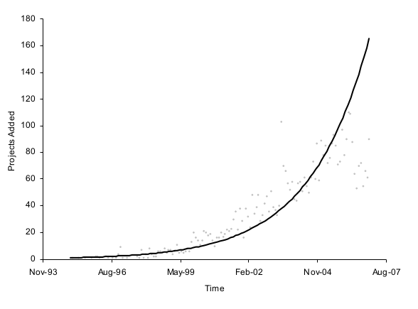
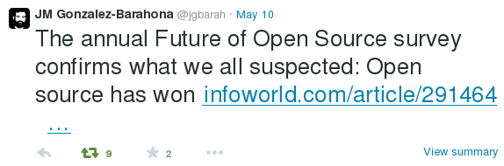
The growth and success of FLOSS
@drozas // #DCRozas
Exponential growth in production of Free/Libre Open Source Software (FLOSS)
E.g. Deshpande and Riehle (2008):
#LoC & #projects, period 1995-2006
Increasing adoption of FLOSS, abundance
of organisations participating (Future of
Open Source 2015 survey)
Deshpande and Riehle (2008)
www.p2pvalue.eu
DrupalCon 2015 (Barcelona) – 24.09.2015
Notes:
So, I would like to start talking about the growth and success of Free Software. I think in this audience we are all aware of this success. But just two give you a couple of examples. For instance, this study from Deshpande and Riehle concluded that the growth in the production of Free Software in the period 1995-2006 was exponential. A more recent example is the Future of Open Source 2015 survey, which found that there is an increasing adoption of Free Software and an abundance of organisations participating on it. I think this tweet from Professor Barahona summarises quite well this idea: “The annual future of Open Source survey confirms what we all suspected, Open Source has won”

Slide 5
The growth and success of FLOSS
@drozas
Increasing adoption of FLOSS, abundance
of organisations participating
Future of Open Source 2015 survey (Black
Duck Software, 2015):
  78% running their businesses with FLOSS, 66% building software for customers with FLOSS
  Increment in participation in FLOSS communities: 50%->64%
  Drupal in the top most valued FLOSS projects (3rd)
www.p2pvalue.eu
DrupalCon 2015 (Barcelona) – 24.09.2015

Slide 6
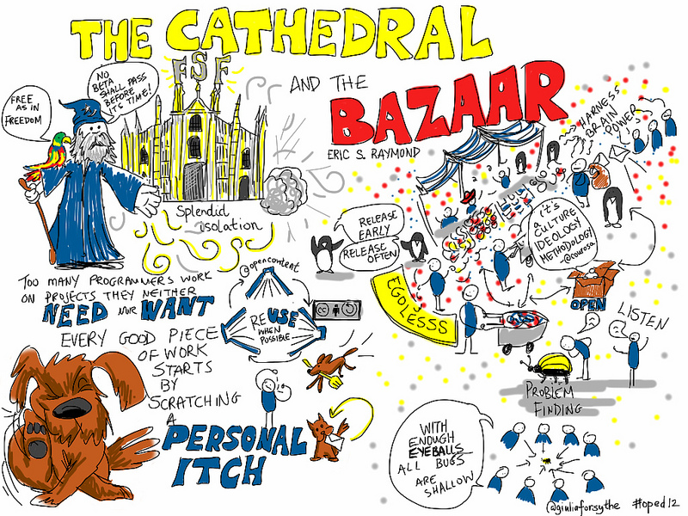
Not only about the software...
@drozas // #DCRozas
New ways of organising to produce software, in comparison with traditional software engineering practices (Raymond, 2001):
    Source code publicly
    available at any time
    Public testing, scrutiny
    and experimentation
www.p2pvalue.eu
DrupalCon 2015 (Barcelona) – 24.09.2015
Notes:
But today I would like to put the focus not on the software, but on the ways that have emerged to produce this software. In a very famous essay, Raymond explained what he called the “bazaar” model, in which some of the characteristics in comparison with more traditional software engineering practices were that the source code is publicly available at any time; and there is a continuous process of public testing, scrutiny and experimentation.

Slide 7




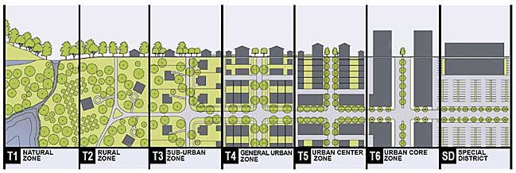
What is Commons-Based Peer Production (CBPP)?
@drozas // #DCRozas
Spreading to diverse areas: open science, open agriculture, Peer-to-peer urbanism, etc. (Fuster Morell et al., 2014). See http://directory.p2pvalue.eu
A new model of socio-economic production in which groups of loosely connected individuals cooperate with each other to produce meaningful products without a traditional hierarchical organisation (Benkler, 2006)
www.p2pvalue.eu
DrupalCon 2015 (Barcelona) – 24.09.2015
Notes:
And, what we are seeing, is how this phenomenon is extending to many different areas of production. We all know things like Free Software or Wikipedia. But, what we are seeing is what certain scholars argue is a new mode of production. And this is appearing in very diverse areas, such as open science, open agriculture or P2P urbanism, to give you some examples. And, the pioneer in coining this term to refer to this new model was professor Yochai Benkler, from Harvard, who defined it as a new model of socio-economic production in which groups of individuals cooperate with each other to produce meaningful products without following a traditional hierarchical organisation.

Slide 8
What are the commons?
@drozas // #DCRozas
The commons: as a resource or good shared by a group of people that may be subject to social dilemmas, such as over-exploitation or free-riding. (Hess & E. Ostrom, 2007)
Classification of goods according to:
  Excludability: feasible to prevent its access to it
  Rivalry: its use or consumption prevents or affects
  the consumption by others
 | Rival | Non-Rival
Excludable | Private goods. E.g.: bread | Toll goods. E.g.: cable TV
Non-excludable | Common Pool Resources E.g.: fish taken from the ocean | Public goods E.g.: lighthouse, Free Software
V. Ostrom and E. Ostrom (1999)
www.p2pvalue.eu
DrupalCon 2015 (Barcelona) – 24.09.2015
Notes:
So, let me then introduce very quickly the concept of the commons. What are the commons? Hess and Elinor Ostrom defined the commons as a resource or good shared by a group of people which might be subject to social dilemmas, such as over-exploitation or free-riding. And Vincent and Elinor Ostrom provided this classification of goods according to two characteristics: excludability and rivalry. Excludability, meaning if it is possible or not to prevent its access to it, and rivalry if the use or consumption affects the consumption by others. Having defined these two dimensions, then we can think of Free Software as an example of public goods, being non-rival and non-excludable. And I think this goes quite in line with last year's presentation of Dries at DrupalCon Amsterdam

Slide 9

What are the commons?
@drozas // #DCRozas
Furthermore, some of these goods are anti-rival: the more people use them, the more utility each person receives (e.g.: Free software). Weber (2004)
One more dimension, the scope of the ownership: “Those goods that belong to everyone and no one at the same time, therefore not following the rules of the market”
Lafuente et al. (2007)
www.p2pvalue.eu
DrupalCon 2015 (Barcelona) – 24.09.2015
Notes:
But, furthermore, according to some scholars, some of these goods are anti-rival. Meaning that, the more people use them, the more utility each person receives. Free Software is an example of this. But we could think also of Wikipedia, the more people use it, the more valuable it becomes.
So, let me just define one last dimension: the scope of the ownership. The Spanish sociologist Antonio Lafuente defines the commons, or procomún in Spanish, as those goods that belong to everyone and no one at the same time, therefore not following the rules of the market.

Slide 10
The Drupal goods as a commons
@drozas // #DCRozas
Anti-rival: its use by a person increases the value for other users
Non-excludable: accessibility is protected as part of the licenses applied for the code, the contents created in the community, etc.
Global: the ownership does not belong
to any individual or state, as protected by the
licenses chosen (exception: the trademark)
www.p2pvalue.eu
DrupalCon 2015 (Barcelona) – 24.09.2015
Notes:
So, with all these concepts in mind, we can think of the Drupal goods as a set of commons, which are: anti-rival, meaning that its use by a person increase the value for other users. They are non-excludable, thanks to the licenses. For example, GPL for the source code, or creative commons for the documentation. An they are global, meaning that that ownership does not belong to any individual or state.

Slide 11
Drupal community as a CBPP community
@drozas // #DCRozas
Ongoing discussion on the differences between CBPP, peer production, the delimitation criteria, etc.
Drupal as a community whose mode of production (Fuster Morell et al., 2014) is:
  Collaborative process
  Peer-based: different levels of structure depending on the process, but not mainly based on contractual obligations nor coercion
  Commons-process: process driven by the general interest, results in openness of the resources
  Favouring reproducibility: via Free Software or Creative Commons licenses, exchange of practices, etc.
www.p2pvalue.eu
DrupalCon 2015 (Barcelona) – 24.09.2015
Notes:
So then, we can think of the Drupal community as a Commons-Based Peer Production community. There is an ongoing discussion on academia about the differences between peer production, commons-based peer production, what are the delimitation criteria, etc. I will not enter today on that, but I will explain that I am drawing on the delimitation criteria we develop as part of the P2Pvalue project. Then, we can think of the Drupal community as one whose mode of production is a collaborative process, this is obviously pretty clear. It is peer based meaning that, of course there are different levels of structure depending on the process, but it is not mainly based on contractual obligations or coercion. It is a commons process, meaning that it is a process driven by the general interest. For example, in the case of digital commons, this results in the openness of these resources. And finally, it favours reproducibility. For example of the source code or the documentation, thanks to the licenses. But also, for instance of social practices, thanks to the creation of a culture based on openness and freedom

Slide 12
Contribution activities as unit of analysis
@drozas // #DCRozas
Understand processes and dynamics: how do these communities organise themselves?
Previous studies looked either at the individuals or at the whole community (e.g.: motivations to contribute, structure of the community, etc.). Huang, Le & Panchal (2011), Sims, J. P. (2013), Nordin (2014)
Looking at contribution activities as unit of analysis,drawing on Activity Theory (Engeström, 1987) as a framework
Implies to understand deeply what contribution means: stage 1
www.p2pvalue.eu
DrupalCon 2015 (Barcelona) – 24.09.2015
Notes:
And, as a big picture of my research, what I am interesting in understanding is the organisational dynamics: how do these communities organise themselves. And, when we look at the literature on research on free software what we find is that many of the studies would typically look either at an individual level, or at a very macro level. To give you some examples, one of the most tackled questions in Free Software studies is looking at motivations: why do people contribute? And these studies would typically look at an individual level. On the other hand, we have studies on a more macro level. For instance, social network analysis of the projects structure of the Drupal community.
And, my approach, is slightly different. I am looking at contribution activities as unit of analysis. For that, I am drawing on Activity Theory. And I will not go deeper into that today, but I would like to explain that it is a framework which puts the focus on activities, in my case contribution activities. And that meant, that I have to understand deeply what does it mean to contribute. And that is in what I would be putting the focus today.

Slide 13

Contribution
@drozas // #DCRozas
A blurry notion: meanings constantly evolving as part of negotiation processes between the participants
Critical in CBPP communities focussed on digital commons: economy of contribution [not based on direct reciprocity]
rather than gift economy [based on direct
reciprocity] (Wittel, 2013)
www.p2pvalue.eu
DrupalCon 2015 (Barcelona) – 24.09.2015
Notes:
So, what is contribution? We can think of contribution as a blurry notion, in which there are a set of meanings which are constantly evolving as part of negotiation processes between the participants in these communities. And, it is a very critical notion. Because, as identified by Wittel, Commons-Based Peer Production communities focussed on digital commons will typically have an economy of contribution, rather than an economy of gift. Meaning, that they are not based on direct reciprocity.

Slide 14
Contribution: “code-centrism”
@drozas // #DCRozas
“Code-centrism”:
  In FLOSS literature: typically looking at source code as main notion of contribution
  In FLOSS communities: “Talk is silver, code is gold”
What about other contributions?
Affective labour as the “lifeblood” of the commons (Bollier, 2014): the immaterial labour present in social interaction which creates or modifies emotional experiences (Hardt, 1999)
www.p2pvalue.eu
DrupalCon 2015 (Barcelona) – 24.09.2015
Notes:
And when I was doing the literature review, what I found is that in most of the cases, while discussing the notion of contribution, they will typically look at source code related activities, as its main notion. And this notion of, what I called code-centrism, it is also present in the communities themselves. For instance, in the case of Drupal, if you think about this motto: “Talk is silver, code is gold”, I think it embodies quite clearly this idea of code-centrism that we have in both: in the communities, but also in the literature. And I thought about... what happens with some other contributions? So, I got inspired by an online article by David Bollier, in which he was talking about affective labour as the lifeblood of the commons. So, what is affective labour? Affective labour is a term coined by Hardt, which he defines as the immaterial labour present in social interaction which creates or modifies the emotional experiences of the participants, in this case.

Slide 15
Research questions
@drozas // #DCRozas
RQ1: What type of activities are perceived as contributions in the Drupal community? Do the “official” meanings match the ones of the members of the community?
RQ2: How are the identified activities represented in the main platform of collaboration in an individual level?
RQ3: Can some of these activities be understood as sources of affective labour and what relevance do they have? Are there any differences on how they are perceived between members with different degrees of experience?
www.p2pvalue.eu
DrupalCon 2015 (Barcelona) – 24.09.2015
Notes:
So, what all this in mind, I defined the following research questions. Firstly, what type of activities are perceived as contributions, and if the meanings of the participants match the ones represented in the main platform of collaboration. Secondly, how are the identified activities represented in the main platform of collaboration? And for that, I looked at user profiles at drupal.org, and all the subsystems within it. And finally, if some of these activities could be understood as sources of affective labour, what relevance do they have; and if there are differences in the outcomes according to the different degree of experience.

Slide 16
Data and methods
@drozas // #DCRozas
Ethnographic methodological approach: online and offline
Triangulation of data collection methods:
- Participant observation (6 months): online participation, 13 events, etc.
- Documentary analysis: Drupal Planet as “native” starting point. 2 years archive (3,266 documents). See http://www.davidrozas.com/lab/drupal_planet_archive.php
- Semi-structured qualitative interviews (4): London and Madrid
Analysis supported by CAQDAS (Computer Assisted Qualitative Data AnalysiS)
www.p2pvalue.eu
DrupalCon 2015 (Barcelona) – 24.09.2015
Notes:
So, very quickly about data and methods. I am following an ethnographic methodological approach, both online and offline. And the findings are a result of a triangulation of data collection methods: participant observation, online, but also offline in events like DrupalCamps, local events or DrupalCons like this. Then, documentary analysis. And for that, my starting point was Drupal Planet. If you are interested about it, you can check the archive at this address. And then I was conducting some semi-structured qualitative interviews in London and Madrid. And the analysis is supported by CAQDAS, which is software to help on the analysis of qualitative data.

Slide 17

Findings: Contribution beyond source code (RQ1)
@drozas // #DCRozas
“[...]organise talks, meetups or just hang out with Drupalistas to drink some beers and have a talk, are also very important activities, and very positive for the community.”
Drupal developer, 7 years. Original reply in Spanish.
www.p2pvalue.eu
DrupalCon 2015 (Barcelona) – 24.09.2015
Notes:
So, let's start with the findings. Regarding the first research question, what kind of activities are perceived as contributions, I think this excerpt illustrates quite well the idea of the diversity of notions of contribution that we can find in the community. During an interview, this Drupalista was saying: [READ EXCERPT]

Slide 18
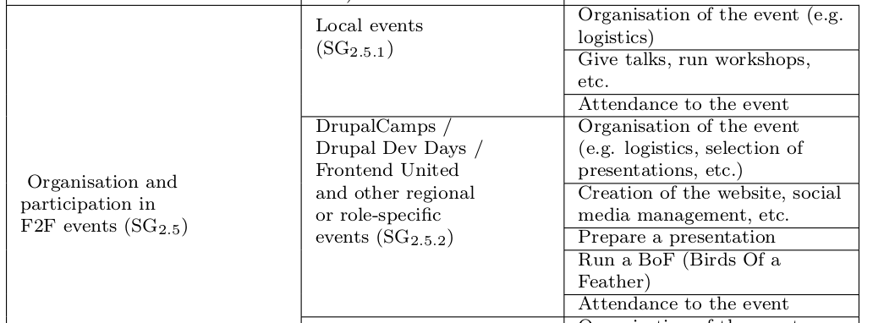

Findings: Contribution beyond source code (RQ1)
@drozas // #DCRozas
Two main types emerged, according to the
focus of action:
  “Object-oriented”: source code,
  documentation, translation, etc.
  “Community-oriented”: usage & support, online community management, training & mentoring, organisation & participation in F2F events, etc.
Suggestive, not exhaustive, list
www.p2pvalue.eu
DrupalCon 2015 (Barcelona) – 24.09.2015
Notes:
So, after the analysis, I ended up with this huge list, which you will not be able to see :-) But this is an example of one of the sub-sets. And two types of contribution activities emerged: object-oriented ones and community-oriented ones. The first one, referring to those activities whose main focus of action is directed towards some type of object, typically a digital commons. For example, source code, documentation, translation, etc. The other category is community-oriented ones, meaning that are those whose main focus of action is directed towards the community. Examples of them are usage and support, community management, training and mentoring, or the organisation and participation in F2F events like this one.
And, as I was saying, I am not arguing this is an exhaustive list. It would be impossible, taking into account the idea that this notion is evolving and constantly socially constructed. But rather, a suggestive one to show that there are other types of contributions beyond the most well-known ones, such as source code related activities.

Slide 19
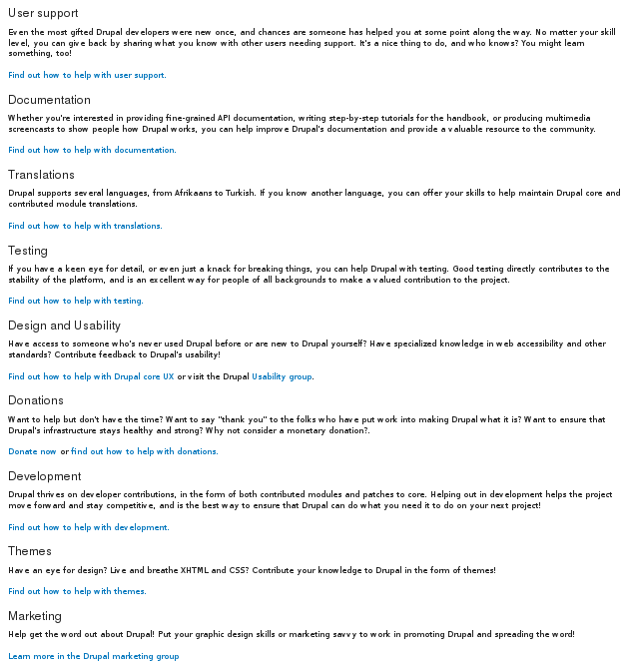
Findings: Contribution beyond source code (RQ1)
@drozas // #DCRozas
Analysis of main platform shows that “community-oriented” ones are less visible
From them, this affects especially local/regional F2F events
www.p2pvalue.eu
DrupalCon 2015 (Barcelona) – 24.09.2015
Notes:
And, in the second part of this initial set of questionsI looked at how this is represented in an “official level”. And for that, I looked at the main platform of collaboration. And what I found is that community-oriented activities are the ones less visible, and this is affecting specially local/regional F2F events. So, for example, in the main contribution page in Drupal.org at the time you could find references to all the types of object-oriented ones. For source code for instance, even in a more specific way. For example, backend, theming, testing, etc. But those related to community-oriented ones were less visible, and accessible only after several levels of browsing, if present.

Slide 20
Findings: Contribution beyond source code (RQ1)
@drozas // #DCRozas
Offer empirical evidence of the need of widening our understanding of contribution activities
This lack of visibility is also reflected in the main platform of collaboration
www.p2pvalue.eu
DrupalCon 2015 (Barcelona) – 24.09.2015
Notes:
So, the first of the findings of this chapter refers to offer empirical evidence of the need of widening our understanding of contribution activities beyond “object-centric” activities, and show how this lack of visibility is actually reflected in the main platform of collaboration.

Slide 21

Findings: Contributions in user profiles (RQ2)
@drozas // #DCRozas
Profiles are key elements in the generation of perceptions by other users in FLOSS (Marlow, Dabbish & Herbsleb, 2013)
Source of public references, significant role in the process of status attainment in FLOSS communities (Stewart, 2005)
www.p2pvalue.eu
DrupalCon 2015 (Barcelona) – 24.09.2015
Notes:
Going deeper into this, I wanted to look at how this is actually reflected on an individual level, in research question two. And for that, I looked into user profiles. And, in the academic literature, we can see that user profiles are key elements in the generation of perceptions by other users in FLOSS. For example, as a source of public references, playing a significant role in the process of status attainment in the communities.

Slide 22
Findings: Contributions in user profiles (RQ2)
@drozas
Not surprisingly, relevant for both, intrinsic (its own sake) and extrinsic (reward) motivations
Profiles from external platforms are also relevant (e.g. Stackexchange, GitHub, etc.)
But relevant, specially within the community
www.p2pvalue.eu
DrupalCamp North (Sunderland, UK) – 25.07.2015

Slide 23
Findings: Contributions in user profiles (RQ2)
@drozas
“[..]She got her first core patch committed to core. She was very enthusiastically showing her friend her profile at Drupal.org because in the “Projects” section appears “Drupal core (1 commit)”.”
Drupal marketer and site builder, 2 years. Extracted from full field notes during the participant observation at DrupalCon Amsterdam 2014.
“[..]If we hire somebody then we will always look at profiles. And also, just to kind of get a sense of who people are, sometimes they will give it to you: “Go on and check my profile”.”
Drupal themer and developer, 11 years.
www.p2pvalue.eu
DrupalCamp North (Sunderland, UK) – 25.07.2015

Slide 24
Findings: Contributions in user profiles (RQ2)
@drozas // #DCRozas
Inequality in the representation of “community-oriented” activities
Affecting specially to “organisation and participation in local/regional F2F events”
Some Drupalistas try to overcome these limitations
www.p2pvalue.eu
DrupalCon 2015 (Barcelona) – 24.09.2015
Notes:
So, after carrying out the analysis, what I found again is an inequality in the representation of “community-oriented” activities. And again, this is affecting specially the organisation and participation in F2F events. I will show you now some examples of this, and how some Drupalistas are actually trying to overcome these limitations.

Slide 25


Findings: Contributions in user profiles (RQ2)
@drozas // #DCRozas
Examples of “object-oriented” contributions reflected in the profiles
www.p2pvalue.eu
DrupalCon 2015 (Barcelona) – 24.09.2015
Notes:
So, in the case of object-oriented contribution activities we can find how they are quite well represented in the profiles. For example, regarding code we have the number of commits for each project. Regarding documentation the number of edits. Or with respect to translation, the number of strings approved. These are just some of the examples, but as I was saying, in general terms they are quite well represented, with even several indicators in some of the cases.

Slide 26


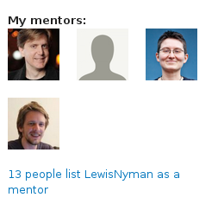
Findings: Contributions in user profiles (RQ2)
@drozas // #DCRozas
Examples (the few) of “community-oriented” contributions reflected in the profiles
(after the study)
www.p2pvalue.eu
DrupalCon 2015 (Barcelona) – 24.09.2015
Notes:
Nevertheless, it is really hard to find with respect to community-oriented ones. And, these are some of the few examples. So, for instance, regarding the participation or organisation of DrupalCons there are checkboxes for the organisation or attendance. But we have no indicators regarding DrupalCamps or local events, for example.
And this, is for me a very good example of the kind of indicators which could be develop. Mentorship. So, in Drupal, you can indicate who are or were your mentors. And, interestingly, this was even more highlighted after the study, including the pictures and the reverse indicator: whom I am a mentor of. So, is this kind of P2P indicators which could be useful to visibilise this kind of contributions.

Slide 27

Findings: Contributions in user profiles (RQ2)
@drozas // #DCRozas
Use of “open fields” to try to overcome these limitations
www.p2pvalue.eu
DrupalCon 2015 (Barcelona) – 24.09.2015
Notes:
And finally, another interesting finding was that actually some Drupalistas using some open fields, such as bio, to refer to these contributions. For instance, this Drupalista refers to training and mentoring, organising local events or speaking at camps as examples of contributions. So, what we see here, is that there is a need for some Drupalistas to visibilise these contribution activities.

Slide 28
Findings: Contributions in user profiles (RQ2)
@drozas // #DCRozas
Descriptive account of how identified activities are represented
Empirical evidence of the uneven representation of some contribution activities, affecting specially the “community-oriented” category
www.p2pvalue.eu
DrupalCon 2015 (Barcelona) – 24.09.2015
Notes:
So, very quickly, the second contribution of this paper refers to provide a descriptive account of how the identified activities are represented on an individual level, and to show empirical evidence of the uneven representing of some of them, affecting specially the “community-oriented” category.

Slide 29
Findings: Role of affective labour (RQ3)
@drozas // #DCRozas
Analysis focussed on organisation and participation in F2F events – most clear example of affective labour (immaterial, creation and modification of emotional experiences)
These contribution activities play a relevant role in the sustainability of the community: “come for the software, stay for the community”
www.p2pvalue.eu
DrupalCon 2015 (Barcelona) – 24.09.2015
Notes:
And, finally, the last of the research questions was focussed on affective labour. And for that, I focussed my analysis on the organisation and participation in F2F events, since it emerged as the most clear example of affective labour. And, what we can see here, is that actually these activities play a very relevant role in the sustainability of the community, with different outcomes depending on the degree of experience. So, when we think about the Drupal motto: “you come for the software, but you stay for the community”, the question then becomes... what makes this community? This strong sense of community?

Slide 30
Findings: Role of affective labour (RQ3)
@drozas // #DCRozas
“[...]indeed, the fact of attending these meetups [referring to local events], it was really good. Because you realise there are people behind the source code, right? There are people behind the modules. And you meet people that can tell you this kind of personal stories.[...] And then, it stops being something anonymous, it becomes something yours.”
Drupal developer and devop, 1.5 years. Original reply in Spanish.
Drupal becomes a community, avoid barriers, increases the will for reciprocity, etc.
www.p2pvalue.eu
DrupalCon 2015 (Barcelona) – 24.09.2015
Notes:
And I found there are different outcomes for this, depending on the level of experience. So, for instance, this Drupalista, who was relatively new to the community was saying: [READ EXCERPT].
So what we can see here is how these activities play a very relevant role to create the sense of community. It was very interesting to see in the interviews how, at some point, people do not talk about Drupal as a piece of software any more. They talk about it as a community. And these events play a very relevant role to humanise the community. Other common outcomes for newbies were to avoid barriers, such as impostor syndrome, to increase their will for reciprocity, etc.

Slide 31
Findings: Role of affective labour (RQ3)
@drozas // #DCRozas
“[...]friendships are developed, and seeing people in-person helps a lot. I
believe so, the idea of... having F2F meetups and get to know each other
in-person is essential.[...] In the IRC you will talk about certain things, but
after a day cycling 50 or 60 kilometres [referring to the “Tour de Drupal”],[...]there will be more interaction for sure, and a bigger friendship [...]”
Drupal developer, 7 years. Original reply in Spanish.
As the engagement with the commons increases, affective relationships develop (friendship). Commitment, sense of community, avoid to burnout, etc.
www.p2pvalue.eu
DrupalCon 2015 (Barcelona) – 24.09.2015
Notes:
But it is also very relevant for more experienced Drupalistas. For instance, in this case I was talking with this Drupalista about friendship relationships being developed in Drupal, and the Drupalista explained: [READ EXCERPT].
I am sure many of you are familiar with Tour de Drupal, but for those who don't, very quickly: it is a local initiative which started last year to cycle together to DrupalCon Amsterdam, and which was repeated again this year in Barcelona.
So, what we can see here is how these contribution activities play a very relevant role to increase the engagement with the commons, resulting even in affective relationships, which some times some Drupalistas consider even as friendships, etc. Other outcomes in the case of more experienced Drupalistas is an increment in commitment, in the sense of community, it is helpful for some people in order to not burnout, etc.

Slide 32
Findings: Role of affective labour (RQ3)
@drozas // #DCRozas
“Because the community is growing, then you have less of a sense of community. But I think the solution to that is to have smaller local communities.
So, you know, as the worldwide community grows, then you start finding, like whereas before it might have been 50 people worldwide, now you have like 50 people in your part of London, or wherever.”
Drupal themer and developer, 11 years.
Local activities help to scale up the sense of community, as it grows
www.p2pvalue.eu
DrupalCon 2015 (Barcelona) – 24.09.2015
Notes:
But, furthermore, in a community as Drupal, which has been constantly growing, it is very important to scale up this sense of community. So, for instance, this veteran Drupalista explained: [READ EXCERPT].
So, we see how these local activities play a very key relevant role in order to scale up the sense of community as the community grows.

Slide 33
Findings: Role of affective labour (RQ3)
@drozas // #DCRozas
Existence and relevance of affective labour
Different types of emotional experiences which foster collaboration. Vary according to degree of experience
Not only understood as a type of contribution; not only unequally represented; they are key for sustainability
www.p2pvalue.eu
DrupalCon 2015 (Barcelona) – 24.09.2015
Notes:
So, yes... very quickly to summarise the findings from this last subset: the contribution is to show the existence and relevance of affective labour. .And finally, to show how different types of emotional experiences are created and modified, which vary according to the degree of experience, but foster collaboration.
So, to sum up. It is not only that some of these activities are considered a type of contribution. It is not only that they are unequally represented... it is also that they are very important for the sustainability of the community.

Slide 34
Discussion
@drozas // #DCRozas
Role of F2F in FLOSS and hacker culture (Coleman, 2013, p. 73), having “affective, moral, economic and political dimensions”
“[...] people embark on decisions and actions they probably would not have considered otherwise. Some hackers decide to formally apply to become a Debian developer, while longtime developers decide not to quit the project.” (Coleman, 2013, p. 71)
www.p2pvalue.eu
DrupalCon 2015 (Barcelona) – 24.09.2015
Notes:
So, I will discuss very briefly these findings with respect to the literature. And, the role that F2F events play in Free Software community was also pointed out by Gabriela Coleman. She did an ethnographic study of Free Software and hacker culture, and she argued that F2F events have an affective, moral, economic and political dimension. She explained: [READ EXCERPT]
So, we can identify a similar set of outcomes here.

Slide 35
Discussion
@drozas // #DCRozas
Additional evidence, but furthermore: framing them as contributions
Empirical evidence of lack of visibility in main platform of collaboration:
  Main sections related to encourage contribution
  In an individual level: user profiles
www.p2pvalue.eu
DrupalCon 2015 (Barcelona) – 24.09.2015
Notes:
The contribution of this paper, in this case, is to provide additional evidence, but also to show how they are understood as contributions by their participants. And also, to show empirical evidence of their lack of visibility in the main platform of collaboration, in this case in Drupal.org. In both, the main sections related to encourage contribution, but also in an individual level regarding profiles.

Slide 36
Discussion
@drozas // #DCRozas
“metrics such as code commits used to gauge contribution by Open Source
literature and by Drupal.org itself paint an incomplete picture of the types of contributions that actually happen in the Drupal project” (Nordin, 2014, p. 43)
Filling Nordin's (2014) gap:
    The role of local events
    Scaling up the sense of community
Additional evidence of the lack of visibility
www.p2pvalue.eu
DrupalCon 2015 (Barcelona) – 24.09.2015
Notes:
Also, the research carried out by Danielle Nordin as part of her Master Thesis. She was doing an etnographic study of the Drupal community as well, in which she focussed on the barriers that Drupalistas were facing when trying to contribute. But she also had to tackle the question of what does it mean to contribute, concluding something similar: [READ EXCERPT].
My contribution, in this case, is to fill one of Nordin's limitations, the one related to local events, and the relevance they play to scale up the sense of community. Additionally, again showing empirical evidence of the lack of visibility.

Slide 37
Discussion
@drozas // #DCRozas
Connecting to major literature on commons, through affective labour.
The participation “transforms the local subjectivities” of Drupalistas, as in non-digital domain: community-based forest in Odisha (Singh, 2013)
Shaping subjectivity: becoming a “commoner” through “commoning”
www.p2pvalue.eu
DrupalCon 2015 (Barcelona) – 24.09.2015
Notes:
And finally, I connected this to the major literature on the commons, through the concept of affective labour. So, coming back to the initial online article of David Bollier, he referred to a study by Neera Singh in which she looked at the notion of affective labour in a self-organised community-based forest in Odisha, India. So, interestingly, we find a similar set of dynamics in completely different domains: a digital and a non-digital one. And, this goes in line with the idea of shaping subjectivity through the participation. The idea of becoming a commoner through commoning, or in this case a Drupalista.

Slide 38
Discussion
@drozas // #DCRozas
Not only socio-cultural reasons:
  Need of exploring new dimensions of value in CBPP communities (e.g. P2Pvalue, Open Value Network)
  Incorporate them in socio-technical systems in concise, useful and distributed ways [e.g. Sabir, (De Filippi, P. & Hassan, S. (2014))]
www.p2pvalue.eu
DrupalCon 2015 (Barcelona) – 24.09.2015
Notes:
Finally, I would like to indicate that the lack of visibility cannot only be understood due to socio-cultural reasons, such as code-centrism. This relates also to the need of exploring new dimensions of value in Commons-Based Peer Production communities, in which, because of its nature, monetary dimensions of value are not good enough. And it also relates to the need of incorporate them in the socio-technical systems that these communities use to self-organise, in concise, useful and distributed ways. If you have further interest on this, I would recommend you to read this paper by some colleagues on proposals to incorporate them, using blockchain, the technology behind bitcoin.

Slide 39
Discussion
@drozas // #DCRozas
Drupal community working on that direction:
  improve how these activities are represented in the user profiles at Drupal.org, to “[...] go beyond code creation activity and into more community-oriented stuff, since that’s also a huge part of what makes Drupal healthy.” (Drupal.org, 2014a)
www.p2pvalue.eu
DrupalCon 2015 (Barcelona) – 24.09.2015
Notes:
And, the Drupal community is actually aware of this, and trying to work on this direction. For example, in order to improve how these activities are represented in the profiles at Drupal.org. For instance, this is quite well reflected in this comment from an issue about the changes in the profile, in order to [READ EXCERPT].

Slide 40
Conclusion
@drozas // #DCRozas
Need to broaden our understanding of contribution activities in FLOSS communities, beyond “object-centric” ones
Lack of visibility of “community-oriented” ones and its relevance
Need to keep on exploring conceptualisation and incorporation of value in CBPP communities
www.p2pvalue.eu
DrupalCon 2015 (Barcelona) – 24.09.2015
Notes:
So, those are the findings. And just very quickly to summarise, three main ideas. First, the need to broaden our understanding of contribution activities beyond the “object-centric” ones. Both, in the communities, but also as researchers in academia. Then, I tried to show the relevant role that some of them play, although they are less visible. And finally, make a call for the need on keeping on exploring the conceptualisation of value in Commons-Based Peer Production communities, as well as its incorporation in the socio-technical systems employed for its self-organisation.

Slide 41
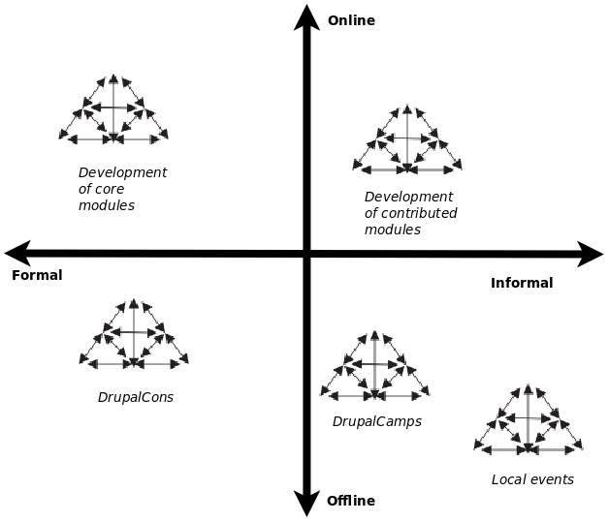
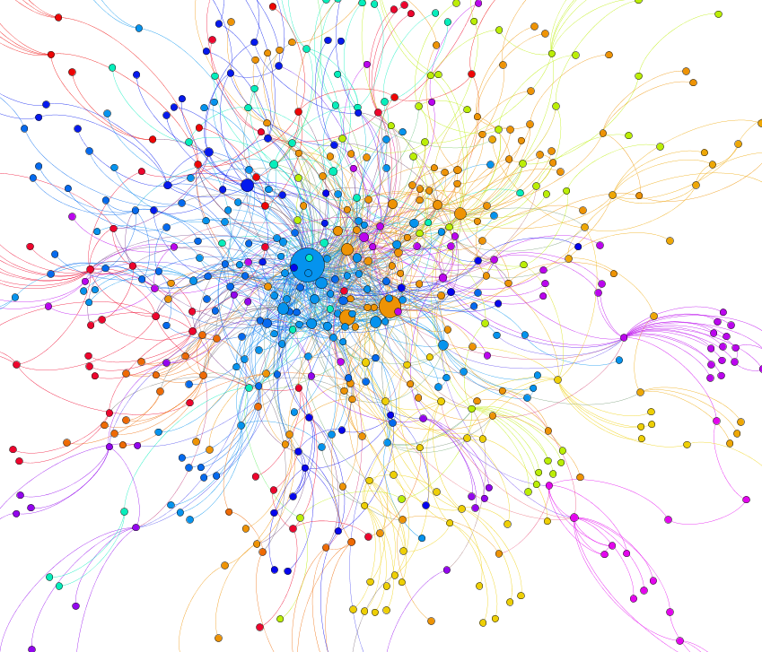
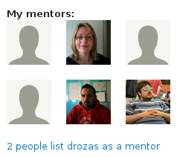
Future work
@drozas // #DCRozas
Exploring some of these contribution activities in depth, drawing on Activity Theory (Engeström, 1987) to understand organisational dynamics: decentralisation, formalisation
Tensions between entities and activity system
Understanding better “community-oriented” contributions using digital methods
https://github.com/drozas/drupal-org-api
www.p2pvalue.eu
DrupalCon 2015 (Barcelona) – 24.09.2015
Notes:
So, this is one of the findings chapters of my thesis. My plan now to explore some of these contributions activities in depth, in order to improve our understanding of certain organisational dynamics, such as decentralisation or formalisation. For that, I will draw on Activity Theory as a framework, which incorporates as well the notion of tensions between these activities.
Additionally, I am also planning to do some more quantitative work with a colleague, in order to understand better these community-oriented contribution. So, for example, as a first step I was doing some very preliminary social network analysis of the networks of mentorship in Drupal, using data from the Drupal.org API.

Slide 42
Parallel research work
@drozas
Understanding better “community-oriented” contributions using digital methods. E.g.: SNA of mentorship relationships, using D.org API: https://github.com/drozas/drupal-org-api
Furthermore: can we measure them?
How many people contribute in them?
How much time?
www.p2pvalue.eu
DrupalCon 2015 (Barcelona) – 24.09.2015

Slide 43

Future work... researching in a “Drupal way”
@drozas // #DCRozas
Giving back to the community as researchers:
  List of publications, dissemination, discussions, BoFs, etc.
  Network of “Drupal researchers”
  (https://groups.drupal.org/research-about-drupal-community)
I would love to count on your help!
  Looking for Drupalistas to interview (around 1 hour)
  Surveys
Feedback, thoughts, please ping me!
  @drozas
  drozas@surrey.ac.uk
www.p2pvalue.eu
DrupalCon 2015 (Barcelona) – 24.09.2015
Notes:
And yes, to finish, letting you know that I am trying to research in what I call “a Drupal way”, trying to open everything and collaborate as much as possible. Last year I run a BoF, and yesterday I run another one, and we created a Drupal group, to try to create a network of Drupal researchers: people interested in the study of the Drupal community, not only academics. To give you an example, when I was doing the literature review I had to go through tons of papers, and then I realised for instance having a wiki with the research papers looking at Drupal could be actually valuable for other people, and we could do it collaboratively. So, I just put it there.
And finally, I will be looking for Drupalistas to interview, and also running some surveys... so if you are interested on this research, you would like to collaborate, or to give some feedbacks or thoughts, please ping me. These are my contact details.

Slide 44
References
@drozas // #DCRozas
Deshpande, A. & Riehle, D. (2008). The total growth of open source. In Open Source Development, Communities and Quality (pp. 197–209). Springer.
Duck Software, F., North Bridge. (2015). The Ninth Annual Future of Open Source Survey. Retrieved 10th May 2015, from https://www.blackducksoftware.com/future-of-open-source
Raymond, E. S. (2001). The Cathedral and the Bazaar: Musings on Linux and Open Source by an Accidental Revolutionary. Sebastopol, CA, USA: O’Reilly.
Benkler, Y. (2006). The wealth of networks: how social production transforms markets and freedom. Yale University Press.
Fuster Morell, M. et al. (2014). Theoretical synthesis: Final theoretical synthesis of WP1, including research reports on data collection. http://www.p2pvalue.eu/sites/default/files/u28/D12_31July_TheoreticalFindingsA%20%281%29.pdf
Hess, C. & Ostrom, E. (2007). Introduction: an overview of the knowledge commons.
Ostrom, V. & Ostrom, E. (1999). Public goods and public choices. In Polycentricity and local public economies. readings from the workshop in political theory and policy analysis (pp. 75–105). Ed. Michael McGinnis, Ann Arbor.-University of Michigan Press.
Weber, S. (2004). The success of open source. Cambridge Univ Press.
Lafuente, A. et al. (2007). Los cuatro entornos del procomún.
Huang, Le & Panchal. (2011). Analysis of the structure and evolution of an open-source community.
Sims, J. P. (2013). Interactive engagement with an open source community : a study of the relationships between organizations and an open source.
Nordin, D. (2014). Motivation and Collaboration in an Open Source Project: A Qualitative Study of the Drupal Community. (Master’s thesis, Bentley University).
Engeström, Y. (1987). Learning by expanding. An activity-theoretical approach to developmental research.
Wittel, A. (2013). Counter-commodification: The economy of contribution in the digital commons. Culture and Organization, 19 (4), 325, 327–328.
Bollier, D. (2014). Affective Labor as the Lifeblood of a Commons. Retrieved from http://www.bollier.org/blog/affective-labor-lifeblood-commons
Hardt, M. (1999). Affective labor. Boundary 2, 26 (2), 89–100.
Marlow, J., Dabbish, L. & Herbsleb, J. (2013). Impression Formation in Online Peer Production: Activity Traces and Personal Profiles in Github. In Proceedings of the 2013 Conference on Computer Supported Cooperative Work (pp. 117–128). CSCW ’13. San Antonio, Texas, USA: ACM. doi:10.1145/2441776.2441792
www.p2pvalue.eu
DrupalCon 2015 (Barcelona) – 24.09.2015
Notes:
And... these are the references...

Slide 45
References
@drozas // #DCRozas
Stewart, D. (2005, October). Social Status in an Open-Source Community. American Sociological Review, 70 (5), 823–842. Retrieved from http://search.proquest.com/docview/218806561?accountid=17256
Coleman, E. G. (2013). Coding freedom: The ethics and aesthetics of hacking. Princeton University Press. Retrieved from http://gabriellacoleman.org/Coleman- Coding-Freedom.pdf
Singh, N. M. (2013, June). The affective labor of growing forests and the becoming of environmental subjects: Rethinking environmentality in Odisha, India. Geoforum, 47, 189–198. doi:10.1016/j.geoforum.2013.01.010
De Filippi, P. & Hassan, S. (2014). Measuring value in the commons-based ecosystem: bridging the gap between the commons and the market. Journal of Institutional and Theoretical Economics (JITE), 39, 5.
Drupal.org. (2014a). Decide on the list of user contributions to be included on user profiles. Retrieved 15th September 2014, from https://www.drupal.org/node/2305759#comment-9004949
Images:
  Screenshot from https://events.drupal.org/barcelona2015 , retrieved 7th September 2015
  https://twitter.com/jgbarah/status/597431817000636417
  http://forums.juniper.net/t5/image/serverpage/image-id/10303i6074079CEA9E0A1E/image-size/original?v=mpbl-1&px=-1
  http://upload.wikimedia.org/wikipedia/commons/a/af/Tux.png
  http://upload.wikimedia.org/wikipedia/commons/5/53/Wikipedia-logo-en-big.png
  http://upload.wikimedia.org/wikipedia/commons/d/d7/Amsterdam_Fab_Lab_at_The_Waag_Society.JPG
  http://farmhack.net/sites/default/files/The%20Garlic%20Master%20001_0.JPG
  https://rafaeldemiguel.files.wordpress.com/2010/10/about_new.jpg
  http://www.colaborabora.org/wp-content/uploads/sites/7/2011/10/CBB_diapoPROCOMUN1.jpg
  https://www.drupal.org/files/druplicon.large_.png
  http://blog.101financial.com/wp-content/uploads/2014/03/Making-A-Contribution-To-Society.png
  https://groups.drupal.org/files/drupalbeers.png
  Screenshot from https://drupal.org/contribute , retrieved 11th November 2014
  Screenshot from https://drupal.org/u/drozas , retrieved 24th March 2015 (not available unless logged in)
  Screenshot from https://www.drupal.org/u/webchick, retrieved 5th November 2014
  Screenshot from https://groups.drupal.org/user/8713, retrieved 5th November 2014.
  Screenshot from https://www.drupal.org/user/740628/edit/Drupal, retrieved 22nd October 2014 (not available unless logged in)
  Screenshot from https://www.drupal.org/u/lewisnyman, retrieved 5th November 2014
  Screenshot from https://www.drupal.org/u/lewisnyman, retrieved 14th July 2015
  Screenshot from https://www.drupal.org/u/chandeepkhosa, retrieved 5th November 2014
  Screenshot from https://drupal.org/u/drozas , retrieved 14th July 2015 (not available unless logged in)
  http://x-team.com/wp-content/uploads/2014/07/Drupal-ContributeX-640x444.jpg
www.p2pvalue.eu
DrupalCon 2015 (Barcelona) – 24.09.2015

Slide 46


Any questions/feedback?
Thanks!
¡Gracias!
Ευχαριστώ!
Danke!
¡Gràcies!
@drozas // #DCRozas
+info|contact:
    @drozas
    www.davidrozas.com || drozas@surrey.ac.uk
[...]
This work is licensed under a Creative Commons
Attribution-ShareALike 4.0 Unported License
excerpt if otherwise noted.
To view a copy of this license, please visit:
https://creativecommons.org/licenses/by-sa/4.0/
www.p2pvalue.eu
DrupalCon 2015 (Barcelona) – 24.09.2015
Notes:
And... that is all. Thank you very much! Grácies! :-)

