Slide 1
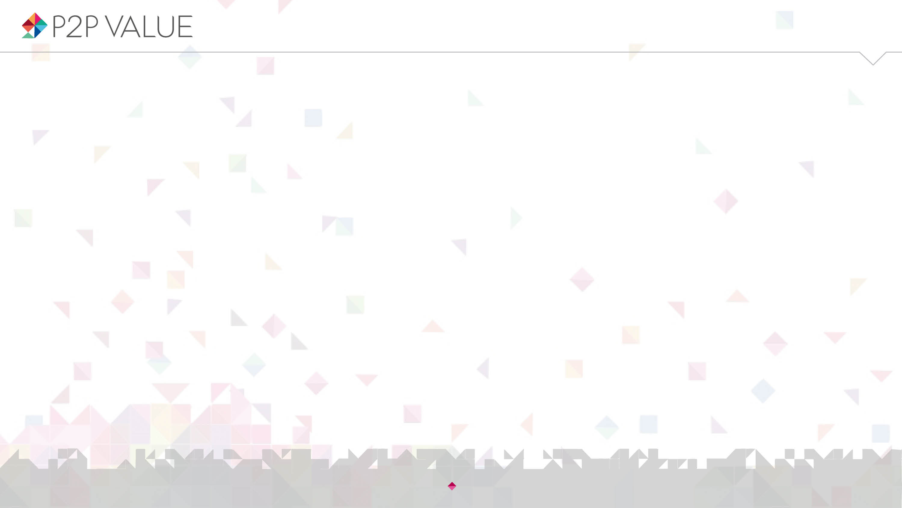


Talk is silver, code is gold? Contribution beyond source code in Free/Libre Open Source Software
David Rozas, Nigel Gilbert
University of Surrey
This work was partially supported by the Framework
programme FP7-ICT-2013-10 of the European Commission through project P2Pvalue (grant no.: 610961).
www.p2pvalue.eu
Seminar @LaStatale & @Viralbeat (Milan) – 16.07.2015

Slide 2



Who am I?
@drozas
Areas of interest: Free Software, Commons-Based Peer Production, social computing, Computer Supported Cooperative Work, Science and Technology Studies, etc.
Working as a Drupal developer for the past 5 years. Previously worked with other free software platforms
Previous background in Computer Science: @URJC (Spain), @NTNU (Norway)
Started PhD in Sociology @UniS (UK) in October 2013
Collaborating with the FP7 EU project P2Pvalue (www.p2pvalue.eu)
+info|contact:
  @drozas
  www.davidrozas.com || drozas@surrey.ac.uk
www.p2pvalue.eu
Seminar @LaStatale & @Viralbeat (Milan) – 16.07.2015

Slide 3
Outline
@drozas
Introduction: Free Software, Commons-Based Peer Production and Drupal
Research questions
Data and methods
Findings
Discussion
Conclusion and future work
www.p2pvalue.eu
Seminar @LaStatale & @Viralbeat (Milan) – 16.07.2015

Slide 4
Outline
@drozas
Introduction: CBPP, FLOSS and Drupal
Research questions
Data and methods
Findings
Conclusion and future work
www.p2pvalue.eu
Seminar @LaStatale & @Viralbeat (Milan) – 16.07.2015

Slide 5

What is Free/Libre Open Source Software (FLOSS)?
@drozas
Software which allows its use, copy, study and modification in any way
Source code released under a license which protects these rights (e.g. GNU General Public License)
Examples: GNU/Linux, Firefox, Apache, etc.
Huge increase in adoption and production
A new mode of software development,
fostered by the Web: public testing and
experimentation, unfinished product, etc.
(Raymond, 2001)
Deshpande and Riehle (2008)
www.p2pvalue.eu
Seminar @LaStatale & @Viralbeat (Milan) – 16.07.2015

Slide 6




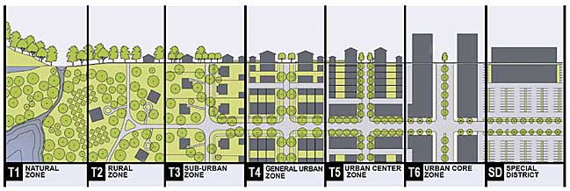
What is Commons-Based Peer Production (CBPP)?
@drozas
A new model of socio-economic production in which groups of loosely connected individuals cooperate with each other to produce meaningful products without a traditional hierarchical organisation (Benkler, 2006)
Spreading to diverse areas: open science, open agriculture, Peer-to-peer urbanism, etc. (Fuster Morell et al., 2014)
www.p2pvalue.eu
Seminar @LaStatale & @Viralbeat (Milan) – 16.07.2015

Slide 7
What are the commons?
@drozas
The commons: as a resource or good shared by a group of people that may be subject to social dilemmas, such as over-exploitation or free-riding. (Hess & E. Ostrom, 2007)
Classification of goods according to:
  Excludability: feasible to prevent its access to it
  Rivalry: its use or consumption prevents or affects
  the consumption by others
 | Rival | Non-Rival
Excludable | Private goods. E.g.: bread | Toll goods. E.g.: cable TV
Non-excludable | Common Pool Resources E.g.: fish taken from the ocean | Public goods E.g.: lighthouse, Free Software
V. Ostrom and E. Ostrom (1999)
www.p2pvalue.eu
Seminar @LaStatale & @Viralbeat (Milan) – 16.07.2015

Slide 8

What are the commons?
@drozas
Furthermore, some of these goods are anti-rival: the more people use them, the more utility each person receives (e.g.: Free software). Weber (2004)
One more dimension: the scope of the ownership: “Those goods that belong to everyone and no one at the same time, therefore not following the rules of the market”
Lafuente et al. (2007)
www.p2pvalue.eu
Seminar @LaStatale & @Viralbeat (Milan) – 16.07.2015

Slide 9
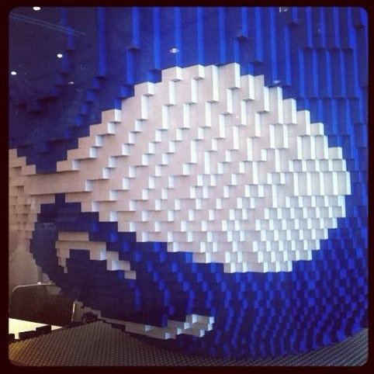
What is Drupal?
@drozas
Free software content management framework
Very modular: think of it as a “Lego”. Dozens of
“core modules”, +27k contributed modules
Powering 2% websites worldwide (W3Techs, 2014)
Employed in complex and high traffic websites: whitehouse.gov, mtv.co.uk, economist.com, etc.
www.p2pvalue.eu
Seminar @LaStatale & @Viralbeat (Milan) – 16.07.2015

Slide 10

What is Drupal?: the Drupal community
@drozas
Started as a personal project of a student
Code released in 2001 under a GPL
Currently +1M users registered at Drupal.org, +30k code contributors (Drupal.org, 2014a)
Hundreds of local F2F events, dozens of camps and
cons in 4 continents (Drupal.org, 2014b)
www.p2pvalue.eu
Seminar @LaStatale & @Viralbeat (Milan) – 16.07.2015

Slide 11
The Drupal goods as a commons
@drozas
Anti-rival: its use by a person increases the value for other users
Non-excludable: accessibility is protected as part of the licenses applied for the code, the contents created in the community, etc.
Global: the ownership does not belong
to any individual or state, as protected by the
licenses chosen (exception: the trademark)
www.p2pvalue.eu
Seminar @LaStatale & @Viralbeat (Milan) – 16.07.2015

Slide 12
Drupal community as a CBPP community
@drozas
Ongoing discussion on the differences between CBPP, peer production, the delimitation criteria, etc.
Drupal as a community whose mode of production (Fuster Morell et al., 2014) is:
  Collaborative process
  Peer-based: different levels of structure depending on the process, but not mainly based on contractual obligations nor coercion
  Commons-process: process driven by the general interest, results in openness of the resources
  Favouring reproducibility: via Free Software or Creative Commons licenses, exchange of practices, etc.
www.p2pvalue.eu
Seminar @LaStatale & @Viralbeat (Milan) – 16.07.2015

Slide 13
Contribution activities as unit of analysis
@drozas
@drozas
Understand processes and dynamics: how do these communities organise themselves?
Previous studies looked either at the individuals or at the whole community (e.g.: motivations to contribute, structure of the community, etc.). Huang, Le & Panchal (2011), Sims, J. P. (2013), Nordin (2014)
My approach is to look at contribution activities as unit of analysis [using Activity Theory (Engeström, 1987) as a framework], using an ethnographic approach
Implies to understand deeply what contribution means: stage 1
www.p2pvalue.eu
Seminar @LaStatale & @Viralbeat (Milan) – 16.07.2015

Slide 14
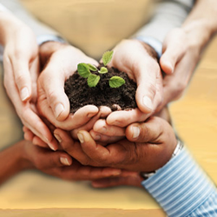
Contribution
@drozas
A blurry notion: meanings constantly evolving as part of negotiation processes between the participants
Critical in CBPP communities focussed on digital commons: economy of contribution [not based on direct reciprocity]
rather than economy of gift [based on direct
reciprocity] (Wittel, 2013)
www.p2pvalue.eu
Seminar @LaStatale & @Viralbeat (Milan) – 16.07.2015

Slide 15
Contribution: “code-centrism”
@drozas
“Code-centrism”:
  In FLOSS literature: typically looking at source code as main notion of contribution
  In FLOSS communities: “Talk is silver, code is gold”
What about other contributions?
Affective labour as the “lifeblood” of the commons (Bollier, 2014): the inmaterial labour present in social interaction which creates or modifies emotional experiences (Hardt, 1999)
www.p2pvalue.eu
Seminar @LaStatale & @Viralbeat (Milan) – 16.07.2015

Slide 16
Research questions
@drozas
RQ1: What type of activities are perceived as contributions in the Drupal community? Do the “official” meanings match the ones of the members of the community?
RQ2: How are the identified activities represented in the main platform of collaboration in an individual level?
RQ3: Can some of these activities be understood as sources of affective labour and what relevance do they have? Are there any differences on how they are perceived between members with different degrees of experience?
www.p2pvalue.eu
Seminar @LaStatale & @Viralbeat (Milan) – 16.07.2015

Slide 17
Data and methods
@drozas
Ethnographic methodological approach: online and offline
Triangulation of data collection methods:
- Participant observation (6 months): online participation, 13 events, etc.
- Documentary analysis: Drupal Planet as “native” starting point. 2 years archive (3,266 documents). See http://www.davidrozas.com/lab/drupal_planet_archive.php
- Semi-structured qualitative interviews (4): London and Madrid
Analysis supported by CAQDAS
www.p2pvalue.eu
Seminar @LaStatale & @Viralbeat (Milan) – 16.07.2015

Slide 18

Findings: Contribution beyond source code (RQ1)
@drozas
“[...]organise talks, meetups or just hang out with Drupalistas to drink some beers and have a talk, are also very important activities, and very positive for the community.”
Drupal developer, 7 years. Original reply in Spanish.
www.p2pvalue.eu
Seminar @LaStatale & @Viralbeat (Milan) – 16.07.2015

Slide 19
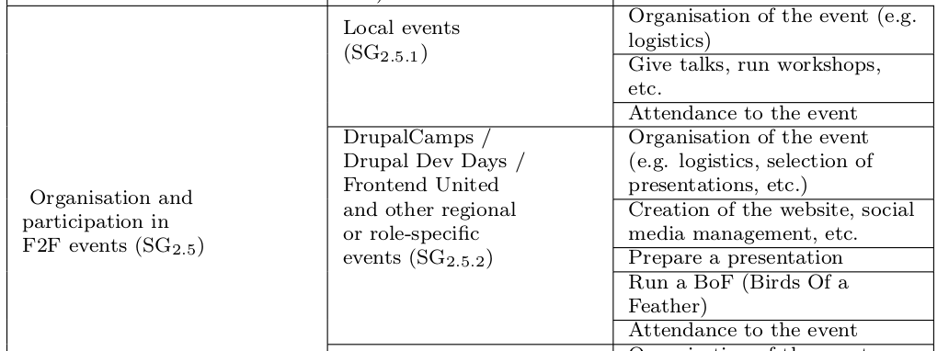

Findings: Contribution beyond source code (RQ1)
@drozas
Two main types emerged, according to the
focus of action:
  “Object-oriented”: source code,
  documentation, translation, etc.
  “Community-oriented”: usage & support, online community management, training & mentoring, organisation & participation in F2F events, etc.
Suggestive, not exhaustive, list
www.p2pvalue.eu
Seminar @LaStatale & @Viralbeat (Milan) – 16.07.2015

Slide 20
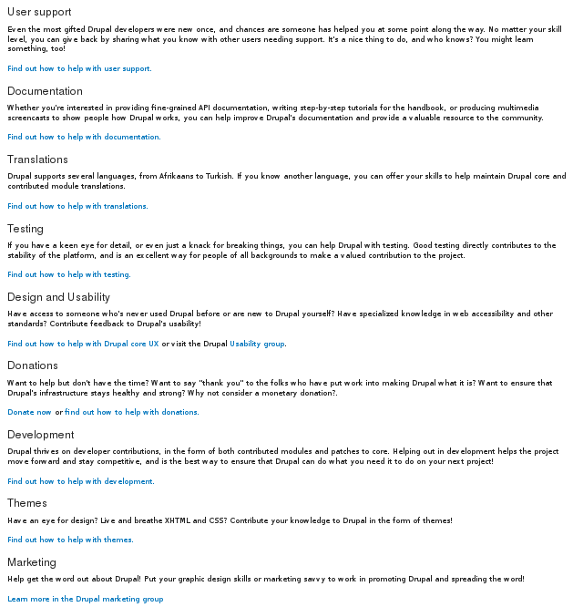
Findings: Contribution beyond source code (RQ1)
@drozas
Analysis of main platform shows that “community-oriented” ones are less visible
From them, this affects specially local/regional F2F events
www.p2pvalue.eu
Seminar @LaStatale & @Viralbeat (Milan) – 16.07.2015

Slide 21
Findings: Contribution beyond source code (RQ1)
@drozas
Offer empirical evidence of the need of widening our understanding of contribution activities
This lack of visibility is also reflected in the main platform of collaboration
www.p2pvalue.eu
Seminar @LaStatale & @Viralbeat (Milan) – 16.07.2015

Slide 22

Findings: Contributions in user profiles (RQ2)
@drozas
Profiles are key elements in the generation of perceptions by other users in FLOSS (Marlow, Dabbish & Herbsleb, 2013)
Source of public references, significant role in the process of status attainment in FLOSS communities (Stewart, 2005)
www.p2pvalue.eu
Seminar @LaStatale & @Viralbeat (Milan) – 16.07.2015

Slide 23
Findings: Contributions in user profiles (RQ2)
@drozas
“[..]She got her first core patch committed to core. She was very enthusiastically showing her friend her profile at Drupal.org because in the “Projects” section appears “Drupal core (1 commit)”.”
Drupal marketer and site builder, 2 years. Extracted from full field notes during the participant observation at DrupalCon Amsterdam 2014.
“[..]If we hire somebody then we will always look at profiles. And also, just to kind of get a sense of who people are, sometimes they will give it to you: “Go on and check my profile”.”
Drupal marketer and site builder, 2 years Drupal themer and developer, 11 years.
www.p2pvalue.eu
Seminar @LaStatale & @Viralbeat (Milan) – XX.07.2015

Slide 24
Findings: Contributions in user profiles (RQ2)
@drozas
Inequality in the representation of “community-oriented” activities
Affecting specially to “organisation and participation of local/regional F2F events”
Some Drupalistas try to overcome these limitations
www.p2pvalue.eu
Seminar @LaStatale & @Viralbeat (Milan) – 16.07.2015

Slide 25


Findings: Contributions in user profiles (RQ2)
@drozas
Examples of “object-oriented” contributions reflected in the profiles
www.p2pvalue.eu
Seminar @LaStatale & @Viralbeat (Milan) – 16.07.2015

Slide 26


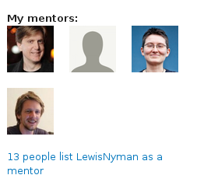
Findings: Contributions in user profiles (RQ2)
@drozas
Examples (the few) of “community-oriented” contributions reflected in the profiles
(after the study)
www.p2pvalue.eu
Seminar @LaStatale & @Viralbeat (Milan) – 16.07.2015

Slide 27

Findings: Contributions in user profiles (RQ2)
@drozas
Use of “open fields” to try to overcome these limitations
www.p2pvalue.eu
Seminar @LaStatale & @Viralbeat (Milan) – 16.07.2015

Slide 28
Findings: Contributions in user profiles (RQ2)
@drozas
Descriptive account of how identified activities are represented
Empirical evidence of the uneven representation of some contribution activities, affecting specially the “community-oriented” category
www.p2pvalue.eu
Seminar @LaStatale & @Viralbeat (Milan) – 16.07.2015

Slide 29
Findings: Role of affective labour (RQ3)
@drozas
Analysis focussed on organisation and participation in F2F events – most clear example of affective labour (creation and modification of emotional experiences)
These contribution activities play a relevant role in the sustainability of the community: “come for the software, stay for the community”
www.p2pvalue.eu
Seminar @LaStatale & @Viralbeat (Milan) – 16.07.2015

Slide 30
Findings: Role of affective labour (RQ3)
@drozas
“[...]indeed, the fact of attending these meetups, it was really good. Because you realise there are people behind the source code, right? There are
people behind the modules. And you meet people that can tell you this kind
of personal stories.[...] And then, it stops being something anonymous, it
becomes something yours.”
Drupal developer and devop, 1.5 years. Original reply in Spanish.
Drupal becomes a community, avoid barriers, increases the will for reciprocity, etc.
www.p2pvalue.eu
Seminar @LaStatale & @Viralbeat (Milan) – 16.07.2015

Slide 31
Findings: Role of affective labour (RQ3)
@drozas
“[...]friendships are developed, and seeing people in-person helps a lot. I
believe so, the idea of... having F2F meetups and get to know each other
in-person is essential.[...] In the IRC you will talk about certain things, but
after a day cycling 50 or 60 kilometres [referring to the “Tour de Drupal”],[...]there will be more interaction for sure, and a bigger friendship [...]”
Drupal developer, 7 years. Original reply in Spanish.
As the engagement with the commons increases, affection relationships develop (friendship). Commitment, sense of community, avoid to burnout, etc.
www.p2pvalue.eu
Seminar @LaStatale & @Viralbeat (Milan) – 16.07.2015

Slide 32
Findings: Role of affective labour (RQ3)
@drozas
“Because the community is growing, then you have less of a sense of community. But I think the solution to that is to have smaller local communities.
So, you know, as the worldwide community grows, then you start finding, like whereas before it might have been 50 people worldwide, now you have like 50 people in your part of London, or wherever.”
Drupal themer and developer, 11 years.
Local activities help to scale up the sense of community, as it grows
www.p2pvalue.eu
Seminar @LaStatale & @Viralbeat (Milan) – 16.07.2015

Slide 33
Findings: Role of affective labour (RQ3)
@drozas
Existence and relevance of affective labour
Different types of emotional experiences (which vary according to degree of experience), which foster collaboration
Not only understood as a type of contribution unequally represented; they are key for sustainability
www.p2pvalue.eu
Seminar @LaStatale & @Viralbeat (Milan) – 16.07.2015

Slide 34
Discussion
@drozas
Role of F2F in FLOSS and hacker culture (Coleman 2013). Additional evidence, framing them as contributions, and empirical evidence of lack of visibility
Filling the gap of Nordin (2014), including also local events. Scale up sense of community
www.p2pvalue.eu
Seminar @LaStatale & @Viralbeat (Milan) – 16.07.2015

Slide 35
Discussion
@drozas
Connecting to major literature on commons, through affective labour. The participation “transforms the local subjectivities” of Drupalistas, as in non-digital domain (Singh, 2013)
Not only socio-cultural reasons: need of exploring new dimensions of value in CBPP communities (P2Pvalue, OVN, Sabir), and incorporate them in socio-technical systems
www.p2pvalue.eu
Seminar @LaStatale & @Viralbeat (Milan) – 16.07.2015

Slide 36
Conclusion
@drozas
Need to broaden our understanding of contribution activities in FLOSS communities, beyond “object-centric” ones
Lack of visibility and relevance of “community-oriented” ones
Need to keep on exploring conceptualisation and incorporation of value in CBPP communities
www.p2pvalue.eu
Seminar @LaStatale & @Viralbeat (Milan) – 16.07.2015

Slide 37
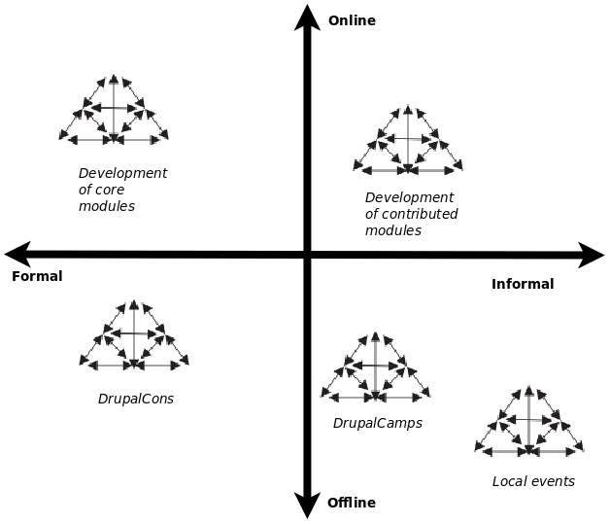
Future work
@drozas
Explore some of these contribution activities in depth (ethnographic approach), drawing on Activity Theory
  Two dimensions: online/offline & formal/informal
  Hybrid model of organisation?
www.p2pvalue.eu
Seminar @LaStatale & @Viralbeat (Milan) – 16.07.2015

Slide 38
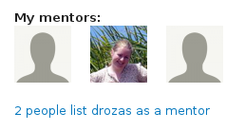
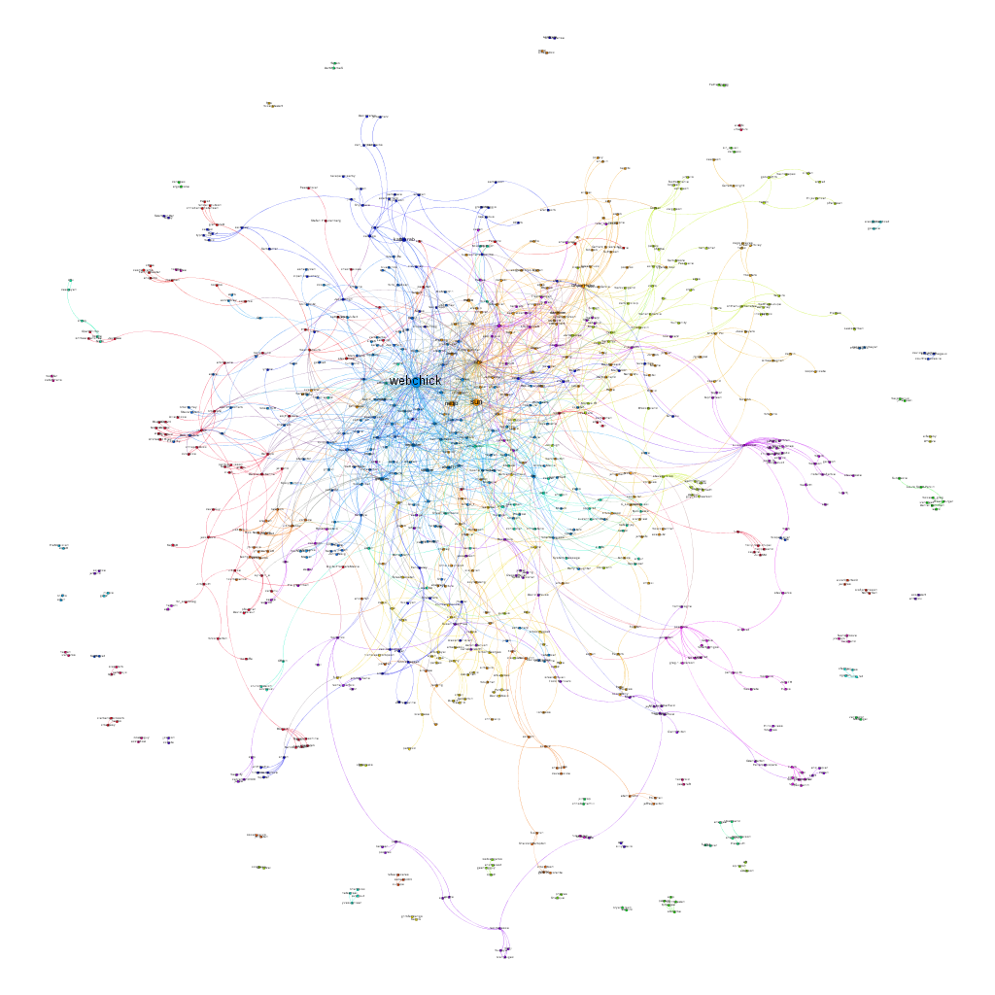
[Not so] future / parallel work
@drozas
Understanding better the implications of these “community-oriented” contributions using digital methods
SNA of mentorship relationships, using D.org API: https://www.drupal.org/api
https://github.com/drozas/drupal-org-api
www.p2pvalue.eu
Seminar @LaStatale & @Viralbeat (Milan) – 16.07.2015

Slide 39
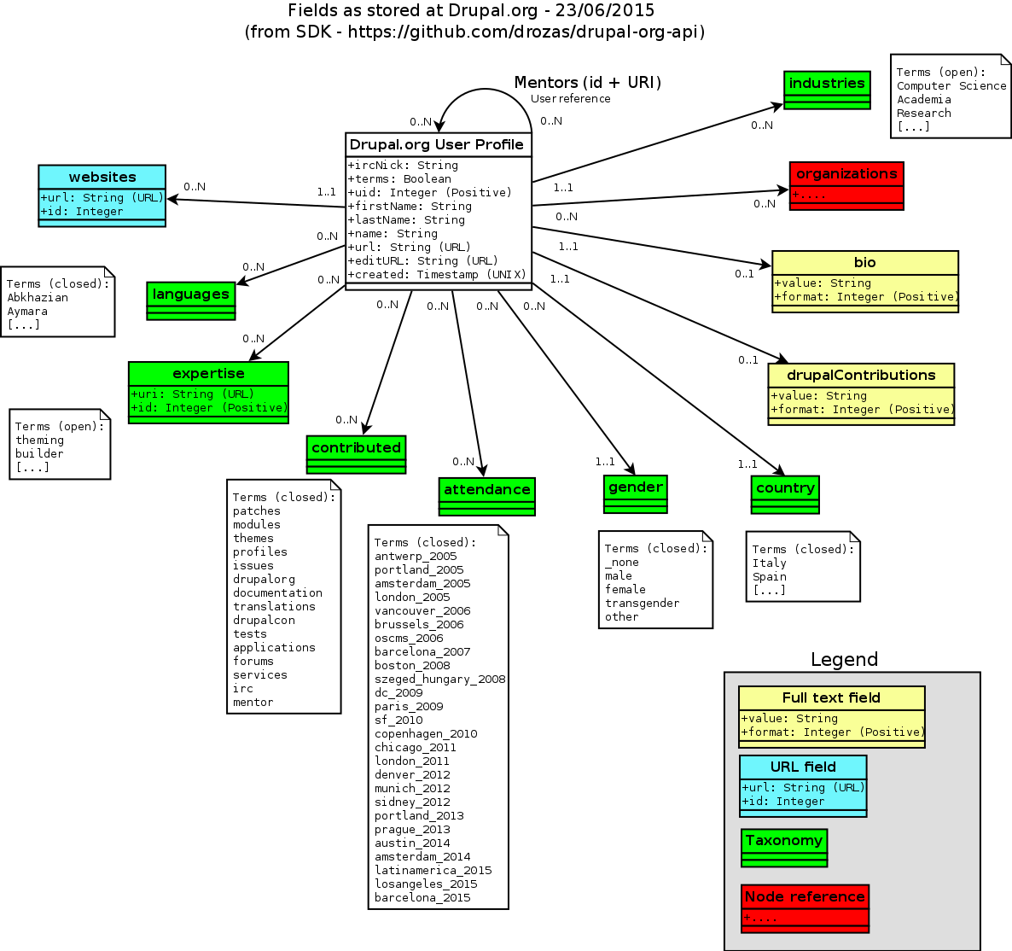
[Not so] future / parallel work
@drozas
3.5M profiles. Currently fetched almost
10%
See drupal_mentorship.gephi
  Women more influential than other
  FLOSS?
  Clusters (devs vs themers vs …)
Furthermore, this is just one indicator!
Collaboration?
www.p2pvalue.eu
Seminar @LaStatale & @Viralbeat (Milan) – 16.07.2015

Slide 40
References
@drozas
Deshpande, A. & Riehle, D. (2008). The total growth of open source. In Open Source Development, Communities and Quality (pp. 197–209). Springer.
Raymond, E. S. (2001). The Cathedral and the Bazaar: Musings on Linux and Open Source by an Accidental Revolutionary. Sebastopol, CA, USA: O’Reilly.
Benkler, Y. (2006). The wealth of networks: how social production transforms markets and freedom. Yale University Press.
Fuster Morell, M. et al. (2014). Theoretical synthesis: Final theoretical synthesis of WP1, including research reports on data collection. http://www.p2pvalue.eu/sites/default/files/u28/D12_31July_TheoreticalFindingsA%20%281%29.pdf
Hess, C. & Ostrom, E. (2007). Introduction: an overview of the knowledge commons.
Ostrom, V. & Ostrom, E. (1999). Public goods and public choices. In Polycentricity and local public economies. readings from the workshop in political theory and policy analysis (pp. 75–105). Ed. Michael McGinnis, Ann Arbor.-University of Michigan Press.
Weber, S. (2004). The success of open source. Cambridge Univ Press.
Lafuente, A. et al. (2007). Los cuatro entornos del procomún.
W3Techs (2014). Usage of content management systems for websites. http://w3techs.com/technologies/overview/content_management/all
Drupal.org (2014a). https://www.drupal.org/
Drupal.org (2014b). Drupal upcoming events. https://groups.drupal.org/events
Huang, Le & Panchal. (2011). Analysis of the structure and evolution of an open-source community.
Sims, J. P. (2013). Interactive engagement with an open source community : a study of the relationships between organizations and an open source.
Nordin, D. (2014). Motivation and Collaboration in an Open Source Project: A Qualitative Study of the Drupal Community. (Master’s thesis, Bentley University).
www.p2pvalue.eu
Seminar @LaStatale & @Viralbeat (Milan) – 16.07.2015

Slide 41
References
@drozas
Engeström, Y. (1987). Learning by expanding. An activity-theoretical approach to developmental research.
Wittel, A. (2013). Counter-commodification: The economy of contribution in the digital commons. Culture and Organization, 19 (4), 325, 327–328.
Bollier, D. (2014). Affective Labor as the Lifeblood of a Commons. Retrieved from http://www.bollier.org/blog/affective-labor-lifeblood-commons
Hardt, M. (1999). Affective labor. Boundary 2, 26 (2), 89–100.
Marlow, J., Dabbish, L. & Herbsleb, J. (2013). Impression Formation in Online Peer Production: Activity Traces and Personal Profiles in Github. In Proceedings of the 2013 Conference on Computer Supported Cooperative Work (pp. 117–128). CSCW ’13. San Antonio, Texas, USA: ACM. doi:10.1145/2441776.2441792
Stewart, D. (2005, October). Social Status in an Open-Source Community. American Sociological Review, 70 (5), 823–842. Retrieved from http://search.proquest.com/docview/218806561?accountid=17256
Coleman, E. G. (2013). Coding freedom: The ethics and aesthetics of hacking. Princeton University Press. Retrieved from http://gabriellacoleman.org/Coleman- Coding-Freedom.pdf
Singh, N. M. (2013, June). The affective labor of growing forests and the becoming of environmental subjects: Rethinking environmentality in Odisha, India. Geoforum, 47, 189–198. doi:10.1016/j.geoforum.2013.01.010
Images:
  https://upload.wikimedia.org/wikipedia/en/e/e4/University_of_Milan_logo.png
  http://www.viralbeat.com/wp-content/themes/viralblog/images/logo-viralbeat.gif
  http://upload.wikimedia.org/wikipedia/commons/a/af/Tux.png
  http://upload.wikimedia.org/wikipedia/commons/5/53/Wikipedia-logo-en-big.png
  http://upload.wikimedia.org/wikipedia/commons/d/d7/Amsterdam_Fab_Lab_at_The_Waag_Society.JPG
  http://farmhack.net/sites/default/files/The%20Garlic%20Master%20001_0.JPG
  https://rafaeldemiguel.files.wordpress.com/2010/10/about_new.jpg
  http://www.colaborabora.org/wp-content/uploads/sites/7/2011/10/CBB_diapoPROCOMUN1.jpg
  http://www.garfieldtech.com/presentations/sfsf2012-drupal8/images/lego-druplicon.jpg
  http://www.siftdigital.co.uk/sites/default/files/drupal-community.png
  https://www.drupal.org/files/druplicon.large_.png
  http://blog.101financial.com/wp-content/uploads/2014/03/Making-A-Contribution-To-Society.png
  Screenshot from https://drupal.org/contribute , retrieved 11th November 2014
  Screenshot from https://www.drupal.org/user/, retrieved 24th March 2015 (not available unless logged in)
  Screenshot from https://www.drupal.org/u/webchick, retrieved 5th November 2014
  Screenshot from https://groups.drupal.org/user/8713, retrieved 5th November 2014.
  Screenshot from https://www.drupal.org/user/740628/edit/Drupal, retrieved 22nd October 2014 (not available unless logged in)
  Screenshot from https://www.drupal.org/u/lewisnyman, retrieved 5th November 2014
  Screenshot from https://www.drupal.org/u/chandeepkhosa, retrieved 5th November 2014
www.p2pvalue.eu
Seminar @LaStatale & @Viralbeat (Milan) – 16.07.2015

Slide 42


Any questions/feedback?
Thanks!
¡Gracias!
Ευχαριστώ!
Obrigado!
Grazie!
@drozas
+info|contact:
    @drozas
    www.davidrozas.com || drozas@surrey.ac.uk
[...]
This work is licensed under a Creative Commons
Attribution-ShareALike 4.0 Unported License
excerpt if otherwise noted.
To view a copy of this license, please visit:
https://creativecommons.org/licenses/by-sa/4.0/
www.p2pvalue.eu
Seminar @LaStatale & @Viralbeat (Milan) – 16.07.2015

