Slide 1
XNA videogame focus on modifiability: A ”Super-Pang” clone
Group 17

Slide 2
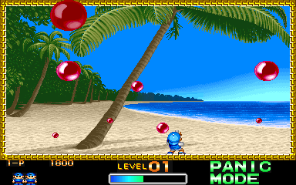
Goals
Develop a clone of ”Super Pang”
Focus on modifiability
Using XNA and Xquest

Slide 3
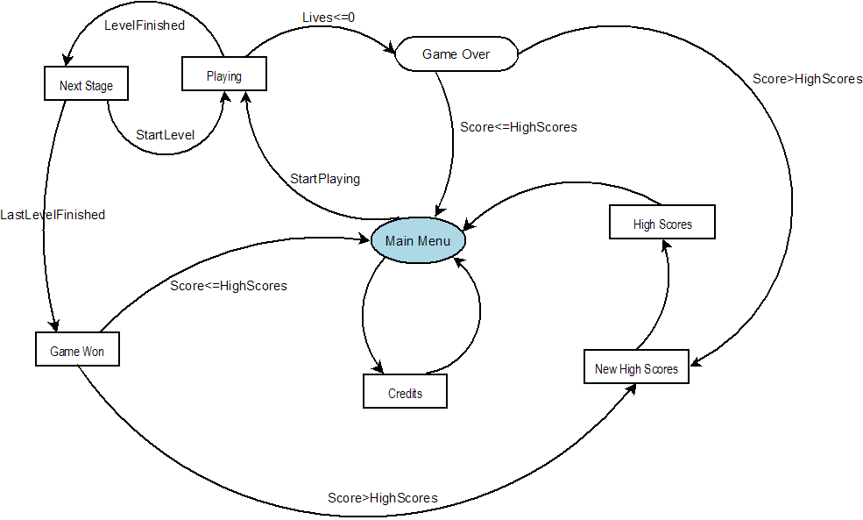
Understanding the logic of the game
A very important step was to design the main logic of the game
Represented by different stages and transitions:
  Menu
  Scores
  Playing
  Next stage
  ...

Slide 4
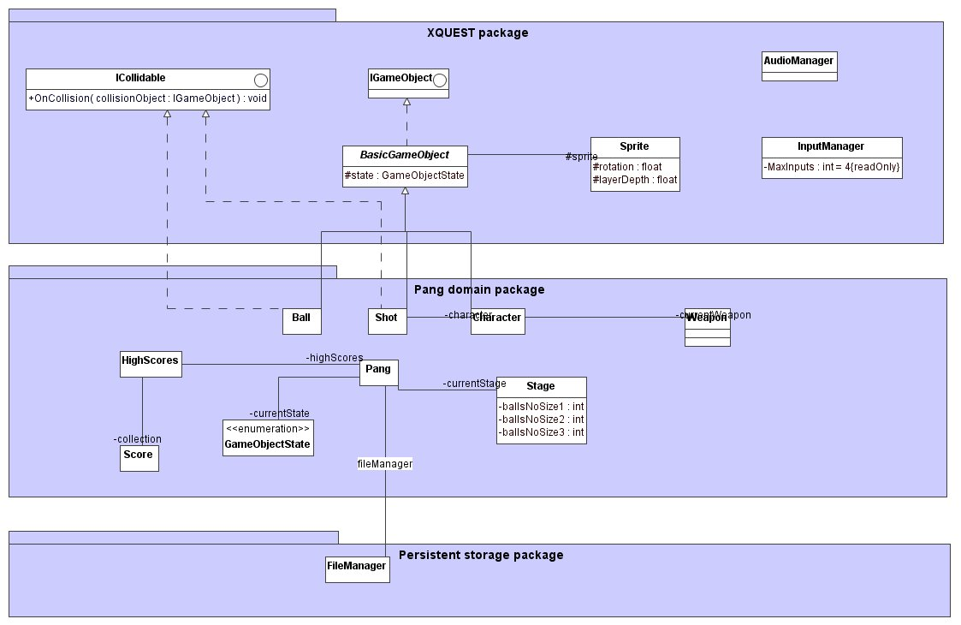
Architectural solution (I)
Classes in levels of abstraction:
  Pang domain: implements the logic of the game.
  Xquest: makes easy the implementation of the game.
  Storage: implements the methods to perform input/output in configuration files, stage files, etc.

Slide 5
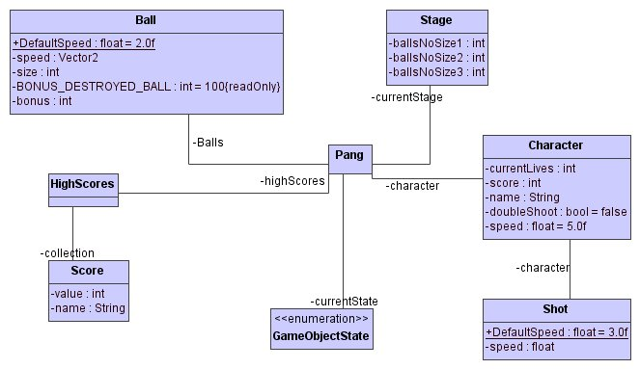
Architectural solution (II)
Most important: Pang domain
  Pang: states of the game, conditions for transitions, etc.
  Ball: detects if it has been hit, if it has hit a player, etc
  Character: how many lives, current score, etc.
  ...

Slide 6
Evaluation
Problems to design the architecture at the beginning.
Original description not very precise.
We were learning more about architecture during implementation, and we improved it during this phase.
Final solution satisfies the requirements, but many features can be added.
It is modifiable, so it would not suppose a problem to do it.

