Slide 1
Survey Research
Seminar #1: Introduction
David Rozas
(drozas@surrey.ac.uk // @drozas)

Slide 2
Outline
Introduction and presentation
First assignment
Practical exercise: to use or not to use a survey
Next week's seminar and Q&A

Slide 3
Goals of the seminars
Support the lecture programme: in-depth reading and thematic discussion
Support your learning with respect to key concepts from the lecture
Practical, in an interactive and participative way

Slide 4
Let's meet each other
What is your name?
Why did you decide to study sociology/criminology?

Slide 5
First assignment: goals
Experience to evaluate other people's survey
Evaluate the choices they made
Develop your critical skills

Slide 6
First assignment: process
Choose a survey from SurreyLearn
Part 1 (1,000w): evaluate it, select no more than 10 questions
  What is good?
  Are there any problems? How would you improve it?
  Ethical issues?
Use the literature to support your critiques [!]

Slide 7
First assignment: process
Part 2 (1,000w): critically explain and discuss:
  Mode of survey delivery
  Sampling procedure
Has benefited or limited to answer the research question? Any alternatives?
No worries: we will explore all these concepts in the lectures and in the seminars!

Slide 8
First assignment: assessment criteria
Not necessary an essay form, but well structured
We will be looking at your level of understanding, quality of your analysis, your use of literature, etc. (more on this in module guide)
Deadline: 17/11/2015, 4PM (via Surrey Learn)

Slide 9
Practical exercise
To use or not to use a survey
Discussion in groups of 4-6 people, different research topics for each group:
  Could you think of a research question?
  Would you use a deductive or an inductive approach?
  Do you think it would be appropriate to use a survey to tackle this question? Why?
Quick recap first!...

Slide 10
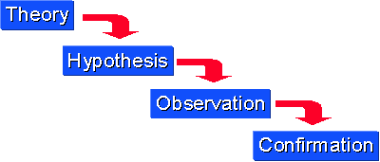
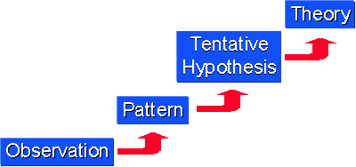
Practical exercise: deductive/inductive
Deductive: from the general to the specific (top-down)
Inductive: from the specific to the general (bottom up)
Source: http://www.socialresearchmethods.net/kb/dedind.php

Slide 11
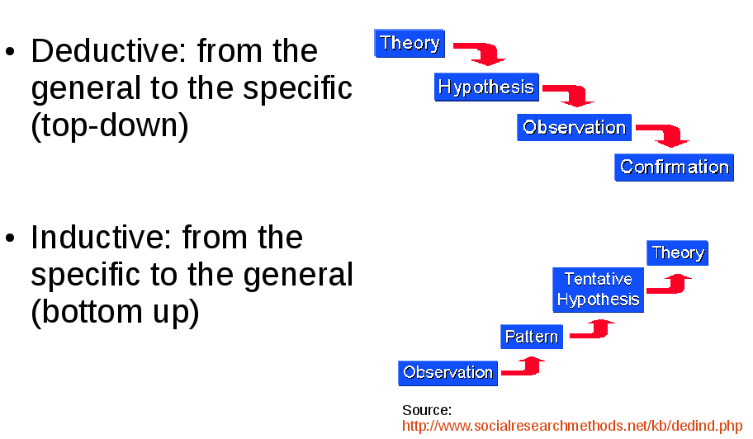
Practical exercise:
Could you think of a research question?
Would you use a deductive or an inductive approach? Why?
Do you think it would be appropriate to use a survey to tackle this question? Why?
Remember:

Slide 12
Next week's seminar
Choose one of the surveys. You will be working on it during the next seminars and use it for assignment #1
Advice: make notes on concepts from lectures (e.g. strategy, sample size or characteristics). Bring them to next seminar.
Working in groups, depending on survey you choose
Readings

Slide 13



That's all! Questions?
Thanks!
¡Gracias!
Obrigado!
Danke!
Grazie!
contact:
    drozas@surrey.ac.uk || www.davidrozas.com
    @drozas
This work is licensed under a Creative Commons
Attribution-ShareALike 4.0 Unported License
excerpt if otherwise noted.
To view a copy of this license, please visit:
http://creativecommons.org/licenses/by-sa/4.0/

