Slide 1
Survey Research
Seminar #2: Populations, samples and sampling
David Rozas
(drozas@surrey.ac.uk || @drozas || 26AD03)

Slide 2
Outline
Introduction and quick recap
Group discussion (A): key concepts
Class discussion (B): critical discussion of sampling strategy
Q&A

Slide 3
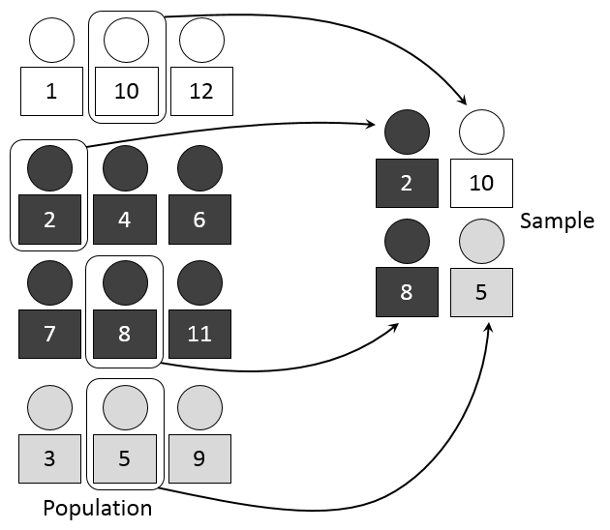
Quick recap: population vs sample
Population: the universe of units from which the sample is to be selected
Sample: segment of the population selected
Source: https://upload.wikimedia.org/wikipedia/commons/c/c4/Systematic_sampling.PNG

Slide 4
Probability vs non-probability sampling
Probability sample:
  Sample selected randomly
  Aims to keep sample error to a minimum
Non-probability sample:
  Sample not selected with a random selection method
  Some units more likely to be selected

Slide 5
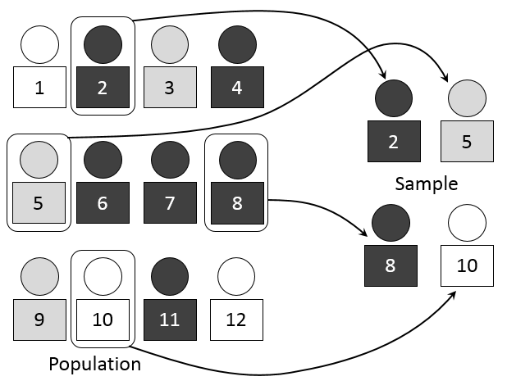
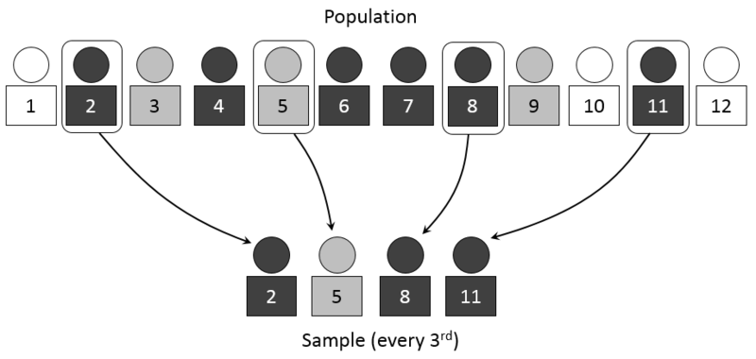
Probability sampling: some methods
Simple random sample (SRS):
each unit has an equal probability
Systematic sample:
select at intervals, given a random start
Source: https://en.wikipedia.org/wiki/File:Simple_random_sampling.PNG
Source: https://en.wikipedia.org/wiki/File:Systematic_sampling.PNG

Slide 6
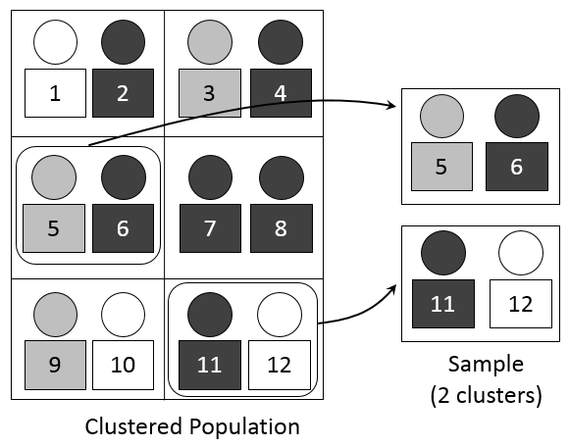
Probability sampling: some methods
Stratified random sampling:
organised by strata (e.g.: department),
then randomly selected
Multi-stage cluster sampling:
primary unit is not the population, but the
groups. For example: universities first, then
SRS for each of them
Source: https://en.wikipedia.org/wiki/File:Stratified_sampling.PNG
Source: https://en.wikipedia.org/wiki/File:Stratified_sampling.PNG

Slide 7
Non-probability sampling: some methods
Convenience sampling: based on relative ease of access
Snowball sampling: existing study subjects recruit future subjects from among their acquaintances
Quota sampling: according to certain categories, but not random!

Slide 8
Working in groups (A): key concepts
Groups of 4 people max
15-20 min. discussion per group
Discuss with all the class

Slide 9
Working in groups (A): key concepts
Work in groups: could you identify and discuss some of the key concepts from the lecture with regard to the design of a survey for this case study? For example:
  What would be the population?
  What type of sampling strategy would you use: probability or non-probability? More specifically (e.g. Simple random sample, stratified random sampling, … or combination of several)? Why?

Slide 10
Working in groups (B): critical discussion
Groups of 4 people max, according to the survey you selected
10 min. discussion per group
Discuss with all the class

Slide 11
Working in groups (B): critical discussion
For each group:
  Could you discuss the sampling strategy you decide to use?
Could you identify the possible limitations in your strategy or the ones proposed by other groups? For example:
  Might another strategy have been more appropriate?
  Could another sampling strategy have lead to different results?

Slide 12



That's all! Questions?
Thanks!
¡Gracias!
Obrigado!
Danke!
Grazie!
contact:
    drozas@surrey.ac.uk || www.davidrozas.com
    @drozas
This work is licensed under a Creative Commons
Attribution-ShareALike 4.0 Unported License
excerpt if otherwise noted.
To view a copy of this license, please visit:
http://creativecommons.org/licenses/by-sa/4.0/

