Slide 1
Survey Research
Seminar #3: Survey mode
David Rozas
(drozas@surrey.ac.uk || @drozas || 26AD03)

Slide 2
Outline
Quick recap
Group discussion (A): hypothetical research scenarios
Discussion in pairs (B): surveys for assignment 1
Q&A

Slide 3
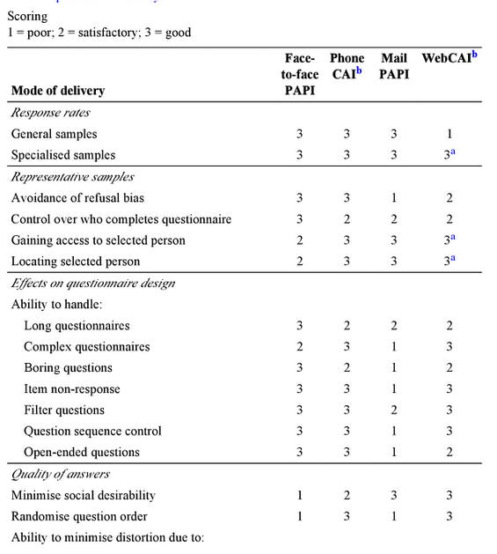
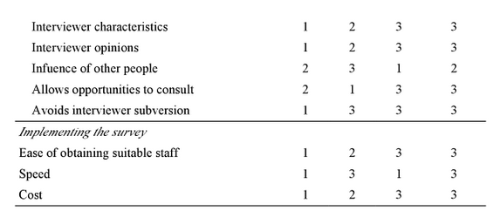
Quick recap: modes of delivery
De Vaus, D.A. (2002) Surveys in Social Research (5th edition). London: UCL Press. Chapter 8: ‘Administering Questionnaires’, pp. 132-133.

Slide 4
Quick recap: modes of delivery
Personal interviews usually higher response rate
… but, web-based approaches minimise impact of social desirability and interviewer characteristics and opinions
… but, personal or telephone interviews better for “boring questions”
… but, what about cost?
… but, In the end, strengths and weaknesses depend on characteristics of the survey

Slide 5
Quick recap: modes of delivery
In the end, strengths and weaknesses depend on characteristics of the survey
De Vaus, D.A. (2002) Surveys in Social Research (5th edition). London: UCL Press. Chapter 8: ‘Administering Questionnaires’, pp. 132-133.

Slide 6
Working in groups (A)
Groups of 4 people max.
15-20 min. per discussion, per group
Discussion with all the class

Slide 7
Working in groups (A)
Working in groups:
  Which mode of delivery would you employ?
  What are the strengths/limitations of your chosen mode of delivery?
  Do you think that using a different mode of delivery could have lead respondents to answer differently? Why?

Slide 8
Working in pairs (B)
Find someone who chose same survey for assignment #1
15-20 min. for discussion
Support discussion and solve doubts, not answers ;-)

Slide 9
Working in pairs (B)
Could you identify and critically discuss the sampling strategy and mode of delivery? For example:
  What is the population? What was the sampling strategy? Was the sample representative of the research population? Might another sampling strategy have been more appropriate?
  What mode of delivery was employed? What were the advantages/disadvantages of using this mode? Could a different one have lead respondents to answer differently?

Slide 10
Working in pairs (B)
For each group:
  Could you discuss the sampling strategy you decide to use?
Could you identify the possible limitations in your strategy or the ones proposed by other groups? For example:
  Might another strategy have been more appropriate?
  Could another sampling strategy have lead to different results?

Slide 11



That's all! Questions?
Thanks!
¡Gracias!
Obrigado!
Danke!
Grazie!
contact:
    drozas@surrey.ac.uk || www.davidrozas.com
    @drozas
This work is licensed under a Creative Commons
Attribution-ShareALike 4.0 Unported License
excerpt if otherwise noted.
To view a copy of this license, please visit:
http://creativecommons.org/licenses/by-sa/4.0/

