Slide 1


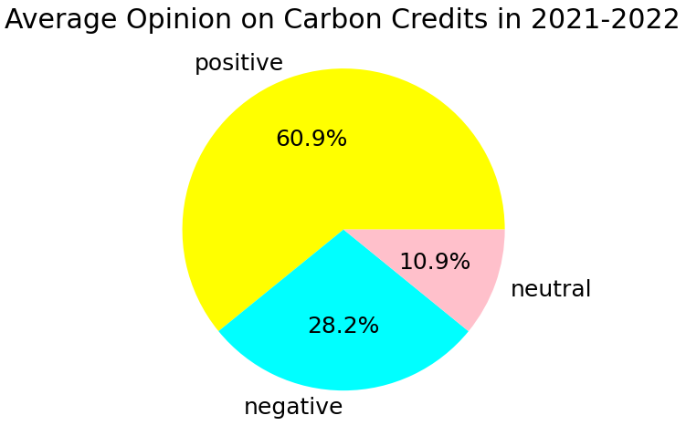
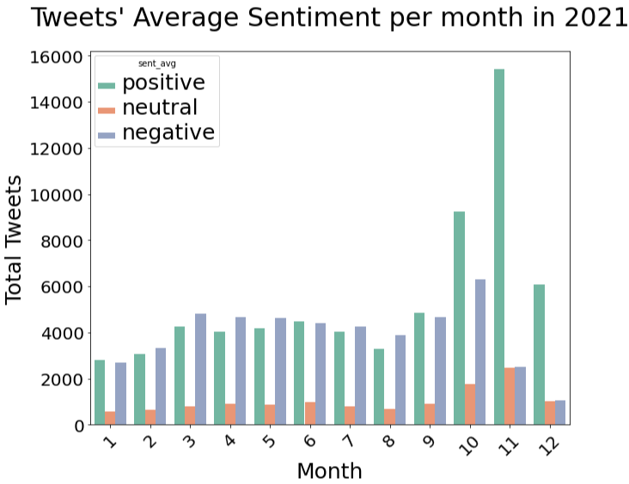
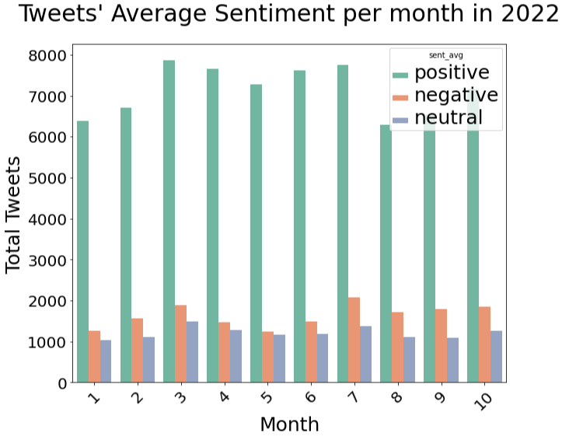

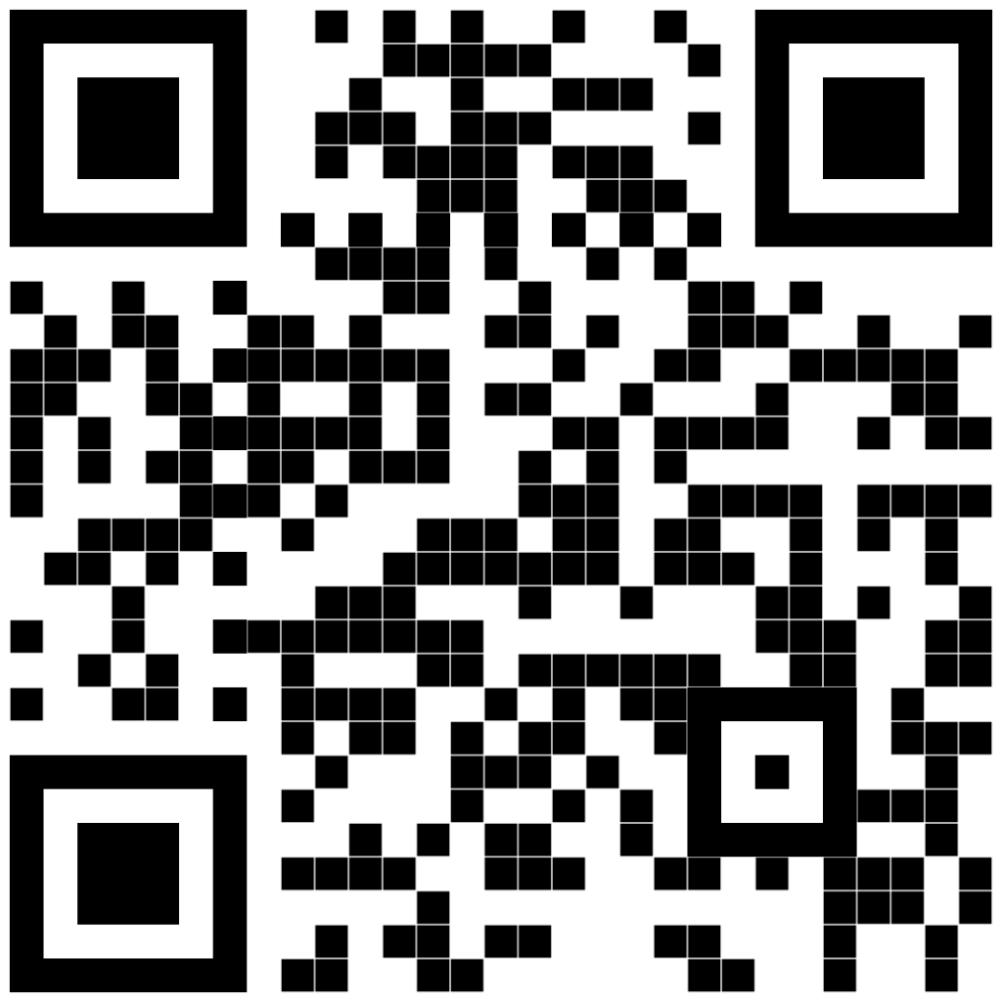
Top 3 Topics of 2021 (LDA model + СhatGPT):
Carbon-free energy sources can help reduce emissions and enable businesses and industries to achieve zero carbon goals
In order to achieve the net-zero emissions target by 2050, it is essential to commit to a plan that aims to reach the 2030 milestone
The transition towards new energy sources and the efforts to mitigate climate change require the UK's support and active participation.
Danila Rozhevskii
Student Research Fellow
M.S. Applied Data Science
drozhevs@syr.edu
Top 3 Topics of 2022 (LDA model + ChatGPT):
To achieve net-zero carbon emissions, it is essential to transition towards new, zero-carbon fuels and technologies, while also offsetting any remaining carbon emissions from fossil fuels.
The journey towards sustainability and achieving net-zero carbon emissions requires businesses to find ways to build and support initiatives that help reach these goals.
Businesses have the power to make a significant impact on the future by acting on climate change and working towards a smooth transition to a sustainable economy.
Analysis of public opinions on the blockchain approach for carbon credit markets on Twitter.
Background
Here, in Dynamic Sustainability Lab, we are trying to understand the public respond to recent innovations in carbon credits technologies, such as the use of blockchain. If we manage to figure out what affects people’s trust and perception over the last two years, we could create high quality recommendations for businesses in various fields.
Key findings:
71% of tweets come either from USA or UK. Also, 3 out of every 5 most active tweeters on carbon credits discussion are from Great Britain.
55% increase is in positive tweets in 2022 in comparison to 2021 year (Figure 2 and Figure 3). 21.8% of positive tweets in 2021. 74.9% of positive tweets in 2022.
#COP is one of the most popular hashtags, referring to United Nations Climate Conference. COP27 was held in early November 2021, which could explain the sudden discussion boost in the end of 2021, as indicated in Figure 3. The next conference, COP28, is scheduled to happen in November 2023, so I’d expect another increase in Twitter activity around the same time as last year.
AMP is the most popular word among the topics, which can refer to a lot of things: from word ampere to AMP as UK water management cycle. Considering NetZero as a renewable energy project, we can expect heavy use of that word. However, after researching I believe AMP and #AMP refer to the user @AMP_CleanEnergy, the British Energy & Renewables company aimed to help businesses achieve their decarbonization goals. They seem to be very active in the industry and on the platform.
From the topic modeling step, we can see that some topic correlate with each other in promoting new, zero-carbon technologies that can make companies more sustainable. AMP Clean Energy among others does exactly that very actively in the UK, that is why we can see it among the topics.
Figure 1. The average sentiment distribution of opinions on NetZero and Carbon Credits topics in 2021-2022.
Research Approach
In my research, I collect and analyze the contents of around 400k English tweets which discussed either the current general perception of carbon credits or the blockchain role in transition to net-zero carbon economy in the past 2 years (01/01/2021 – 10/31/2022).
After pre-processing and vectorizing the contents of the tweets using Word2vec model, I pass the data through 3 algorithms (custom-trained K-means clustering and pre-trained VADER and BERT algorithms) that calculate the sentiment polarity of the tweet: positive, negative, or neutral. I use 3 different techniques to get the average the result from them as the final sentiment. Tested on arbitrarily marked data, the approach had 60% accuracy.
I also investigated the common topics among the collected tweets over the years using the Gensim Linear Discriminant Analysis – LDA. The best model for each year exceeded 0.40 coherence score, which shows a relatively poor interpretability of the results. So as last step, I used ChatGPT to help generate complete topic sentences from LDA output.
Recommendations and Next Steps
Due to the new Twitter policy changes, I will have to modify the method for future tweets extraction. Alternatively, I planned to switch to another popular discussion board such as Reddit or Quora.
From the analysis, global events such as COP could trigger a lot of attention to discussion of sustainable topics and NetZero strategy on the internet. DSL needs to work on promoting those kind of events more.
Considering the high activity of AMP Clean Energy in UK, it would make sense to look for opportunities for DSL collaboration with them. I’m sure, we can find common ground.
For More Information
Go to www.DynamicsLab.org research tab to view many of our reports and technical bulletins.
Figure 2. The average sentiment distribution for tweets in 2021. It captures the spike in positive tweets at the end of the year.
Figure 3. The average sentiment distribution for tweets in 2022. Most discussions have a positive sentiment to them with increased interest in the topic.
www.DynamicsLab.org

