Slide 1
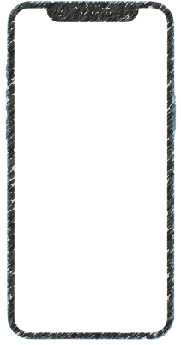
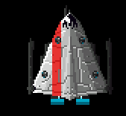




2x
$$↑$$
3x
$$←$$
$$↓$$
$$→$$
5x
control
fire
7x
9x

Slide 2
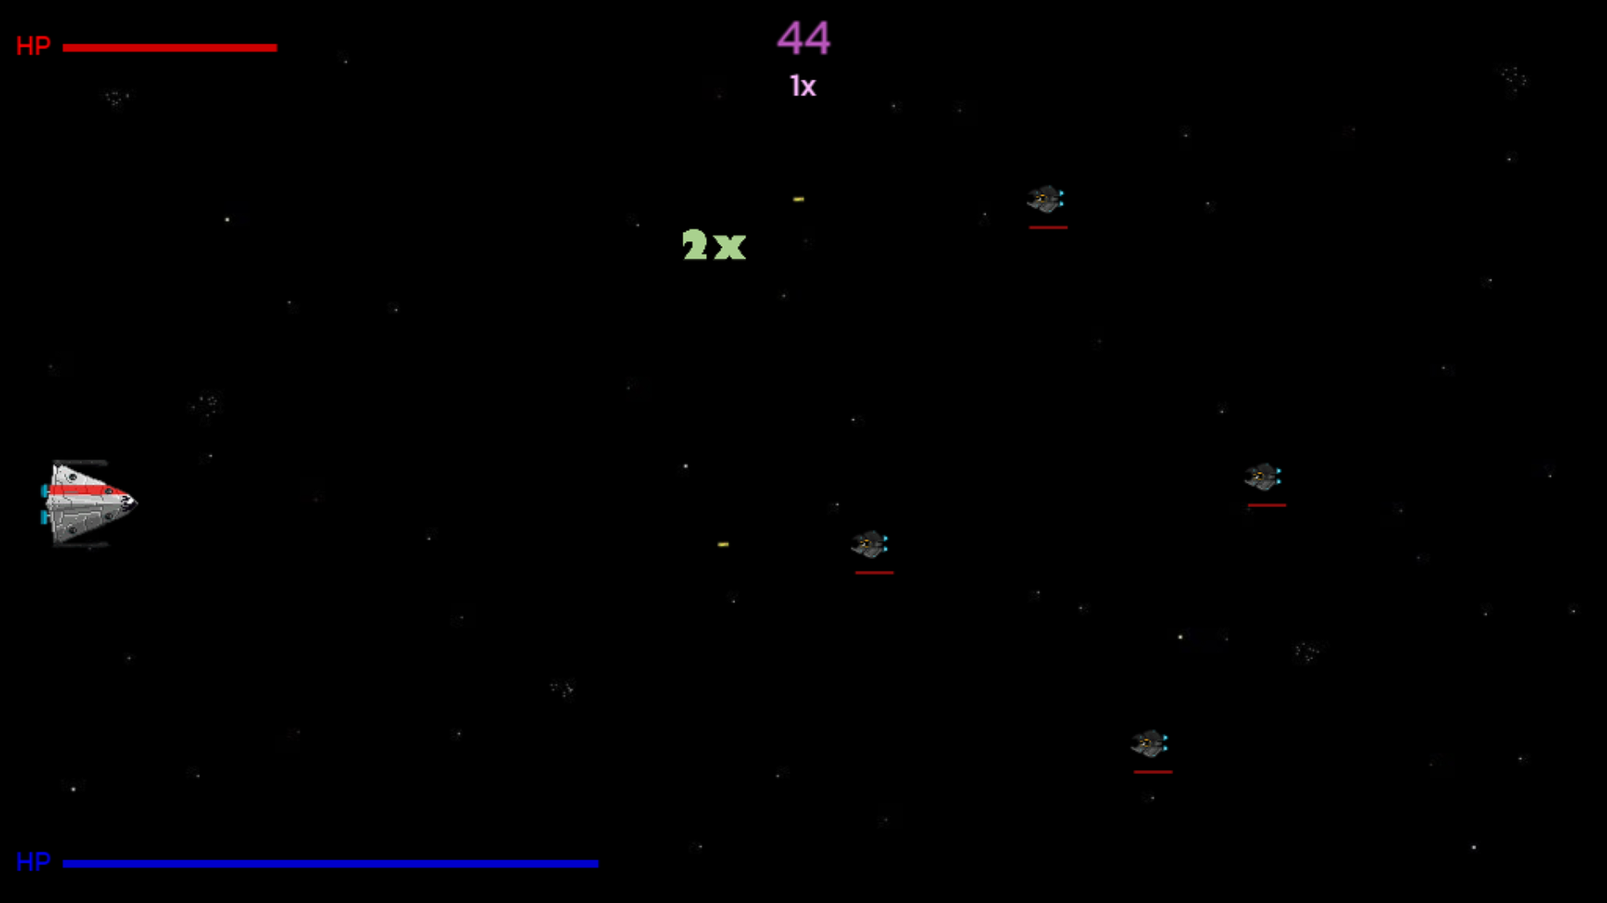

Your current score
Your health
Your current multiply bonus
If you play by PC:
use $←↑→↓$ for moving
use SPACE for shooting
If you play by touch device:
use left hand finger for ship control
use right hand finger for shooting
Collect bonuses
Destroy enemies and don't let them destroy your ally
Your ally health, don't let the enemies reach him

