Slide 1
Computing z-scores for 5-19 years
Abhijit P Pakhare

Slide 2
Anthropometric Indicators
Three key indicators
Weight-for-Age (up to 10 years)
Height-for-Age (5- 19 years)
BMI-for-Age (5-19 years)
Other indicators such as MUAC, Waist and Hip Circumference

Slide 3
Available tools
who2007: a Shiny app for children ages 5–19 years, based on the WHO growth reference
WHO AnthroPlus software - For 5-19 years children
R package- anthroplus

Slide 4
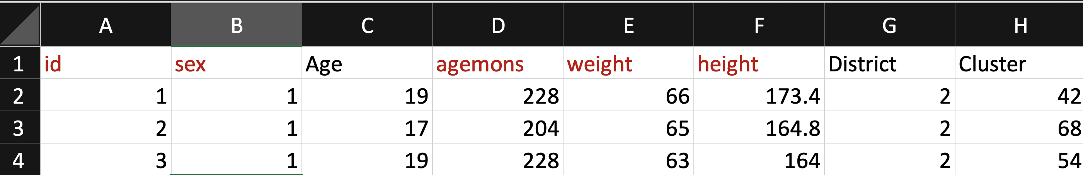
Practice Data set-3

Slide 5
Mandatory columns
id- Unique ID for each row
sex- Gender 1- Boys, 2-Girls
agemons- Age in months
weight- Weight in kgs and height- Height in cm
Other columns do not create problem

Slide 6
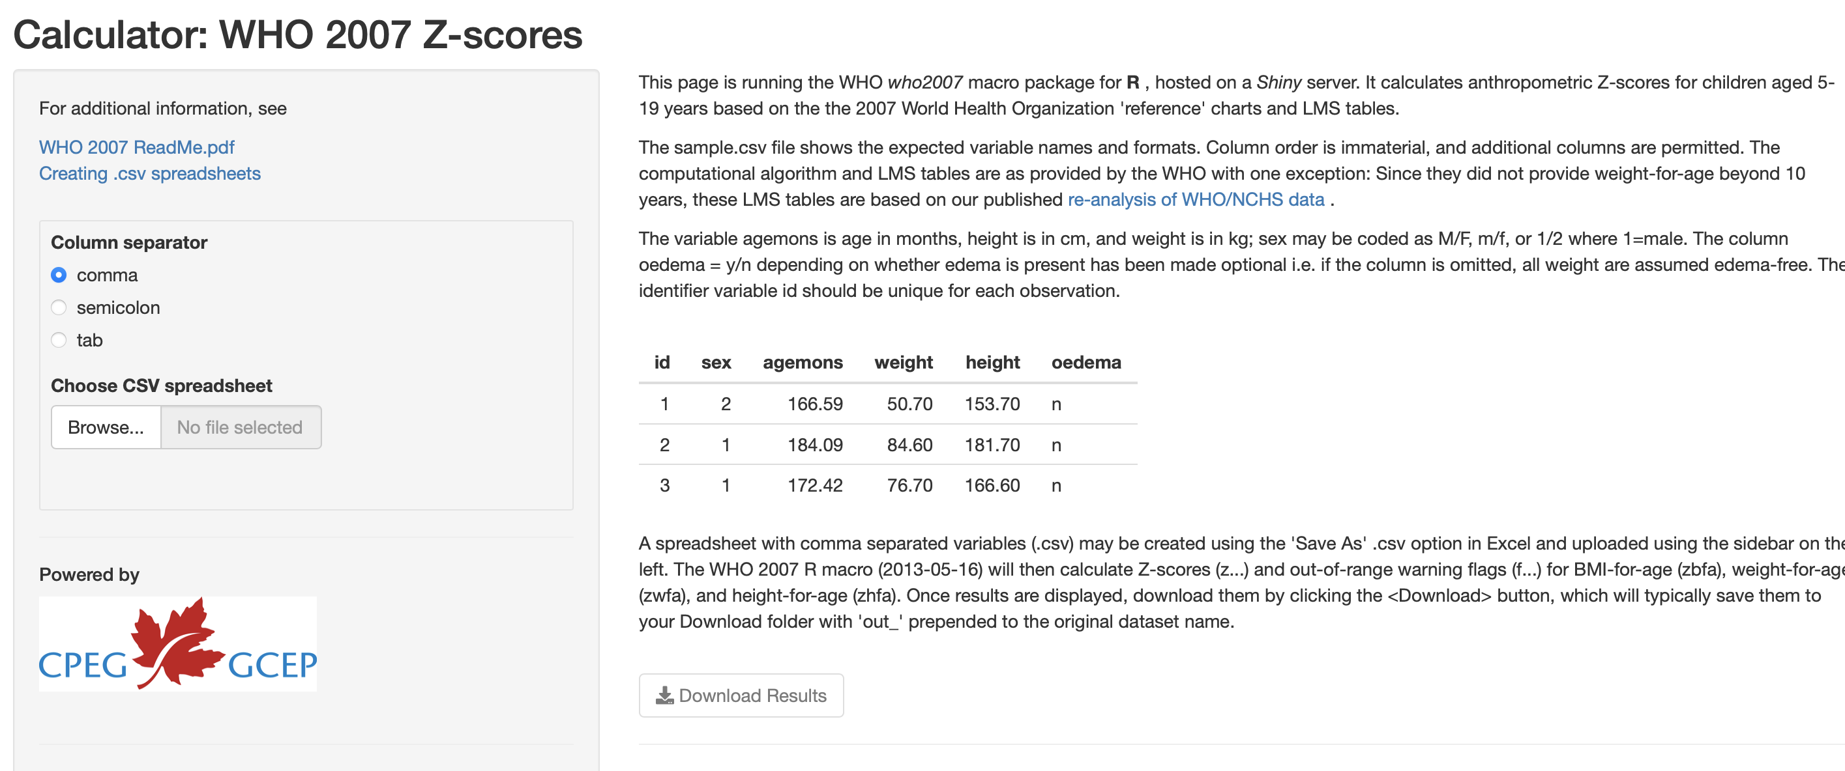
WHO 2007 z-score calculator (CPEG App)

Slide 7
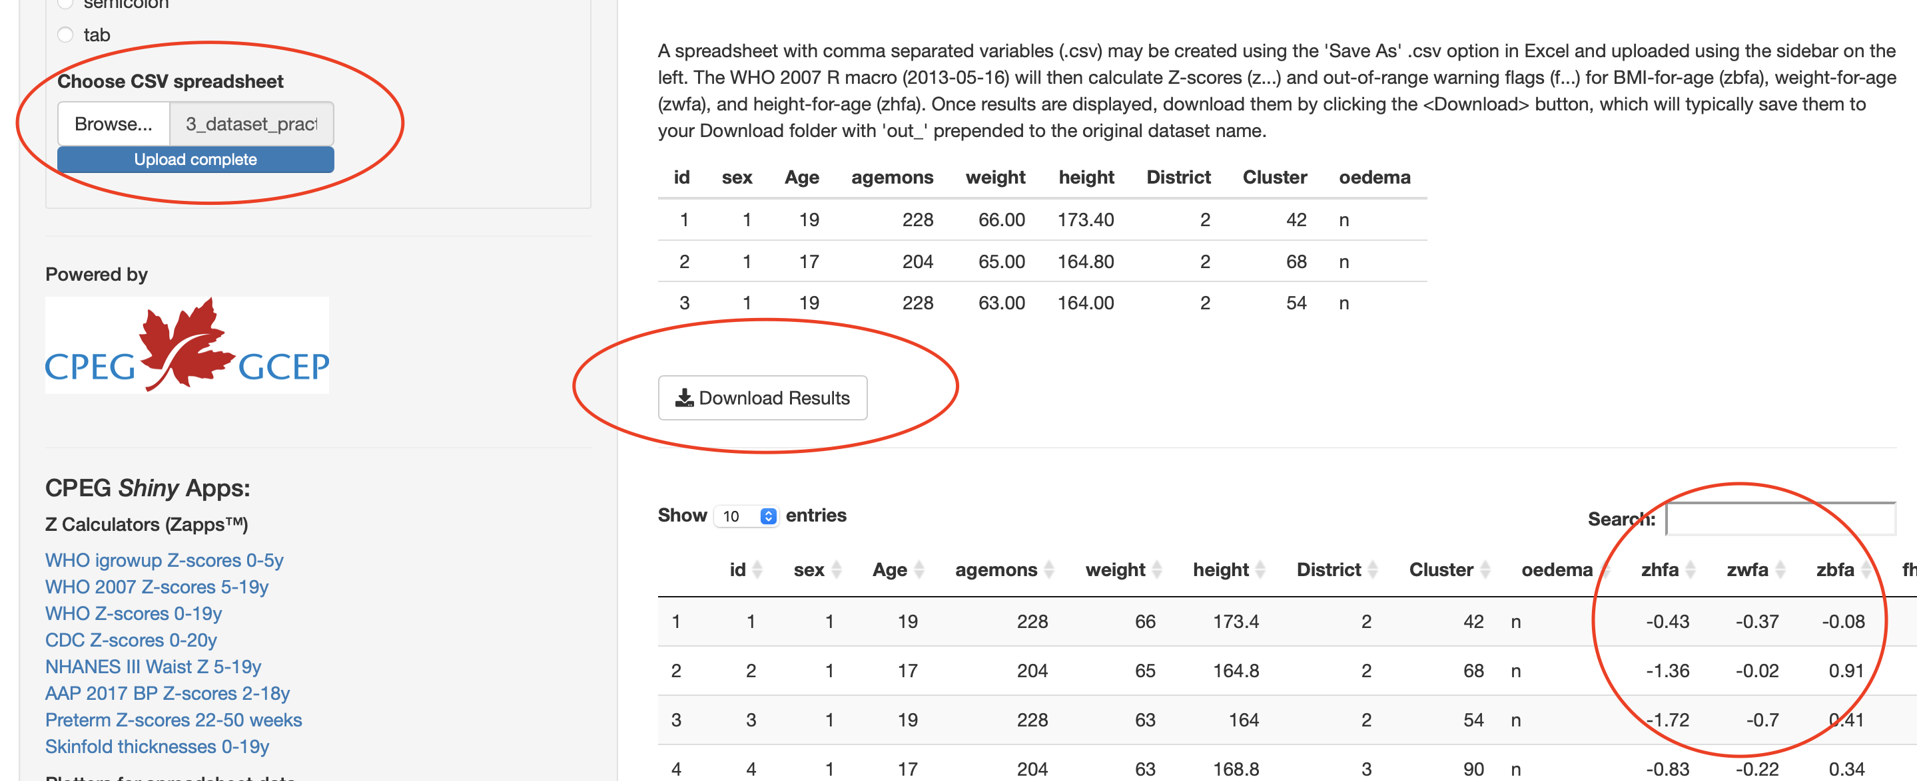
Upload csv dataset with preset names

Slide 8
z-score outputs
zhfa- Height-for-Age (5- 19 years) (Stunting)
zwfa- Weight-for-Age (up to 10 years) (Underweight)
zbfa- BMI-for-Age (5-19 years) (Thinness)
flags- fhfa, fwfa, fbfa - extreme and non-plausible values

Slide 9
BMI-for-Age: Interpretation of cut-offs
Overweight: >+1SD (equivalent to BMI 25 kg/m2 at 19 years)
Obesity: >+2SD (equivalent to BMI 30 kg/m2 at 19 years)
Thinness: <-2SD
Severe thinness: <-3SD

Slide 10
Weight-for-Age: Interpretation of cut-offs
Underweight: <-2SD
Severe Underweight: <-3SD

Slide 11
Height-for-Age: Interpretation of cut-offs
Stunting: <-2SD
Severe Stunting: <-3SD

Slide 12
Further analysis
Export z-scores through download button (adds columns as shown earlier)
Import in other program
Categorize indicators as per cut-offs
Do further analysis

Slide 13
Demonstration with R package anthroplus
Install R software and RStudio IDE
Open RStudio
Open the R script for demonstration
Install required packages

Slide 14
anthroplus demo on R
Import data
# Load required packages (You should install them first and then you can load) library(tidyverse) library(anthroplus) # Import dataset df_anthro_plus_practice <- read.csv("https://raw.githubusercontent.com/drpakhare/Workshop-NDA/master/datasets_practice/3_dataset_practice_anthro_plus.csv")
View data
head(df_anthro_plus_practice)
id sex Age agemons weight height District Cluster 1 1 1 19 228 66.0 173.4 2 42 2 2 1 17 204 65.0 164.8 2 68 3 3 1 19 228 63.0 164.0 2 54 4 4 1 17 204 63.0 168.8 3 90 5 5 1 18 216 61.5 164.0 3 84 6 6 1 18 216 61.0 163.1 2 64

Slide 15
z-score calculation
df_z_scores <- anthroplus_zscores( sex = df_anthro_plus_practice$sex, age_in_months = df_anthro_plus_practice$agemons, oedema = "n", height_in_cm = df_anthro_plus_practice$height, weight_in_kg = df_anthro_plus_practice$weight )
df_z_scores is a dataframe containing z-scores
head(df_z_scores)
age_in_months csex coedema cbmi zhfa zwfa zbfa fhfa fwfa fbfa 1 228 1 n 21.95057 -0.43 NA -0.08 0 NA 0 2 204 1 n 23.93310 -1.36 NA 0.91 0 NA 0 3 228 1 n 23.42356 -1.72 NA 0.41 0 NA 0 4 204 1 n 22.11035 -0.83 NA 0.34 0 NA 0 5 216 1 n 22.86585 -1.63 NA 0.39 0 NA 0 6 216 1 n 22.93094 -1.75 NA 0.42 0 NA 0

Slide 16
Export z-scores
write.csv(df_z_scores, file = "anthro_plus_z_scores.csv")

Slide 17
Prevalence calculations
df_results <- anthroplus_prevalence( sex = df_anthro_plus_practice$sex, age_in_months = df_anthro_plus_practice$agemons, oedema = "n", height_in_cm = df_anthro_plus_practice$height, weight_in_kg = df_anthro_plus_practice$weight, sw = NULL, cluster = NULL, strata = NULL )
Output or results are similar to Anthro Survey Analyser stored in a dataframe

Slide 18
Output details
The result columns are coded with a prefix, a prevalence indicator and a suffix:
Prefix:
HA - Height-for-Age, WA- Weight-for-Age and BMI- BMI-for-Age
Prevalence indicator:
_3 : Prevalence corresponding to < -3 SD
_2 : Prevalence corresponding to < -2 SD
2 : Prevalence corresponding to > +2 SD
3 :Prevalence corresponding to > +3 SD

Slide 19
Output details
Suffix:
_pop : Weighted sample size
_unwpop : Unweighted sample size
_r : Mean/prevalence
_ll : lower 95% confidence interval limit
_ul : upper 95% confidence interval limit
_stdev : Standard Deviation
_se : Standard error

Slide 20
Prevalence Calculations- View results
Group | Years | Months | HAZ_pop | HAZ_unwpop | HA_3_r | HA_3_se | HA_3_ll | HA_3_ul | HA_2_r | HA_2_se | HA_2_ll | HA_2_ul | HA_1_r | HA_1_se | HA_1_ll | HA_1_ul | HA1_r | HA1_se | HA1_ll | HA1_ul | HA2_r | HA2_se | HA2_ll | HA2_ul | HA3_r | HA3_se | HA3_ll | HA3_ul | HA_r | HA_se | HA_ll | HA_ul | HA_stdev | WAZ_pop | WAZ_unwpop | WA_3_r | WA_3_se | WA_3_ll | WA_3_ul | WA_2_r | WA_2_se | WA_2_ll | WA_2_ul | WA_1_r | WA_1_se | WA_1_ll | WA_1_ul | WA1_r | WA1_se | WA1_ll | WA1_ul | WA2_r | WA2_se | WA2_ll | WA2_ul | WA3_r | WA3_se | WA3_ll | WA3_ul | WA_r | WA_se | WA_ll | WA_ul | WA_stdev | BMIZ_pop | BMIZ_unwpop | BMI_3_r | BMI_3_se | BMI_3_ll | BMI_3_ul | BMI_2_r | BMI_2_se | BMI_2_ll | BMI_2_ul | BMI_1_r | BMI_1_se | BMI_1_ll | BMI_1_ul | BMI1_r | BMI1_se | BMI1_ll | BMI1_ul | BMI2_r | BMI2_se | BMI2_ll | BMI2_ul | BMI3_r | BMI3_se | BMI3_ll | BMI3_ul | BMI_r | BMI_se | BMI_ll | BMI_ul | BMI_stdev
All | Total (5-19) | (61-228) | 2025 | 2025 | 6.913580 | 0.5638834 | 5.8863107 | 8.104689 | 29.18519 | 1.010504 | 27.24369 | 31.20570 | 68.69136 | 1.030808 | 66.63519 | 70.67657 | 1.3333333 | 0.2549466 | 9.156241e-01 | 1.937875e+00 | 0.3456790 | 0.1304606 | 1.647809e-01 | 7.237291e-01 | 0.04938272 | 0.04938270 | 6.944298e-03 | 3.502649e-01 | -1.4760247 | 0.02367850 | -1.522461 | -1.4295879 | 1.0655324 | NA | NA | NA | NA | NA | NA | NA | NA | NA | NA | NA | NA | NA | NA | NA | NA | NA | NA | NA | NA | NA | NA | NA | NA | NA | NA | NA | NA | NA | NA | NA | 2011 | 2011 | 13.873695 | 0.7710190 | 12.429568 | 15.455993 | 35.90254 | 1.070001 | 33.832168 | 38.02679 | 69.31875 | 1.028639 | 67.26536 | 71.29829 | 0.5967181 | 0.1717853 | 3.390223e-01 | 1.048232e+00 | 0.1491795 | 0.0860858 | 4.807562e-02 | 4.619241e-01 | 0 | 0 | 2.889450e-10 | 2.911997e-10 | -1.664674 | 0.02646049 | -1.716567 | -1.612782 | 1.1865990
Sex: Female | Total (5-19) | (61-228) | 1149 | 1149 | 5.831158 | 0.6914776 | 4.6140196 | 7.344644 | 28.11140 | 1.326534 | 25.58458 | 30.78455 | 67.27589 | 1.384557 | 64.50506 | 69.93125 | 1.3925152 | 0.3457817 | 8.544460e-01 | 2.261693e+00 | 0.4351610 | 0.1942339 | 1.811067e-01 | 1.041880e+00 | 0.00000000 | 0.00000000 | 2.792300e-10 | 3.013311e-10 | -1.4315057 | 0.03073589 | -1.491783 | -1.3712284 | 1.0420474 | NA | NA | NA | NA | NA | NA | NA | NA | NA | NA | NA | NA | NA | NA | NA | NA | NA | NA | NA | NA | NA | NA | NA | NA | NA | NA | NA | NA | NA | NA | NA | 1147 | 1147 | 12.292938 | 0.9697741 | 10.514013 | 14.324669 | 32.86835 | 1.387325 | 30.207206 | 35.64421 | 66.34699 | 1.395558 | 63.55771 | 69.02682 | 0.6974717 | 0.2457926 | 3.489737e-01 | 1.389141e+00 | 0.1743679 | 0.1232196 | 4.356228e-02 | 6.952153e-01 | 0 | 0 | 2.792086e-10 | 3.013542e-10 | -1.568282 | 0.03447379 | -1.635890 | -1.500675 | 1.1677565
Sex: Male | Total (5-19) | (61-228) | 876 | 876 | 8.333333 | 0.9340502 | 6.6751520 | 10.357709 | 30.59361 | 1.557292 | 27.62745 | 33.72980 | 70.54795 | 1.540477 | 67.43947 | 73.47638 | 1.2557078 | 0.3763183 | 6.963857e-01 | 2.254068e+00 | 0.2283105 | 0.1612953 | 5.704048e-02 | 9.091587e-01 | 0.11415525 | 0.11411823 | 1.605148e-02 | 8.070122e-01 | -1.5344178 | 0.03693144 | -1.606845 | -1.4619902 | 1.0934254 | NA | NA | NA | NA | NA | NA | NA | NA | NA | NA | NA | NA | NA | NA | NA | NA | NA | NA | NA | NA | NA | NA | NA | NA | NA | NA | NA | NA | NA | NA | NA | 864 | 864 | 15.972222 | 1.2466496 | 13.676051 | 18.570976 | 39.93056 | 1.666594 | 36.711290 | 43.23925 | 73.26389 | 1.506067 | 70.20891 | 76.11218 | 0.4629630 | 0.2310020 | 1.737227e-01 | 1.227851e+00 | 0.1157407 | 0.1157023 | 1.627438e-02 | 8.181546e-01 | 0 | 0 | 2.757716e-10 | 3.051101e-10 | -1.792639 | 0.04080875 | -1.872670 | -1.712607 | 1.1999164
Age Group 1: 61-71 mo | 5 | (61-71) | 0 | 0 | NA | NA | NA | NA | NA | NA | NA | NA | NA | NA | NA | NA | NA | NA | NA | NA | NA | NA | NA | NA | NA | NA | NA | NA | NA | NA | NA | NA | NA | 0 | 0 | NA | NA | NA | NA | NA | NA | NA | NA | NA | NA | NA | NA | NA | NA | NA | NA | NA | NA | NA | NA | NA | NA | NA | NA | NA | NA | NA | NA | NA | 0 | 0 | NA | NA | NA | NA | NA | NA | NA | NA | NA | NA | NA | NA | NA | NA | NA | NA | NA | NA | NA | NA | NA | NA | NA | NA | NA | NA | NA | NA | NA
Age Group 1: 72-83 mo | 6 | (72-83) | 0 | 0 | NA | NA | NA | NA | NA | NA | NA | NA | NA | NA | NA | NA | NA | NA | NA | NA | NA | NA | NA | NA | NA | NA | NA | NA | NA | NA | NA | NA | NA | 0 | 0 | NA | NA | NA | NA | NA | NA | NA | NA | NA | NA | NA | NA | NA | NA | NA | NA | NA | NA | NA | NA | NA | NA | NA | NA | NA | NA | NA | NA | NA | 0 | 0 | NA | NA | NA | NA | NA | NA | NA | NA | NA | NA | NA | NA | NA | NA | NA | NA | NA | NA | NA | NA | NA | NA | NA | NA | NA | NA | NA | NA | NA
Age Group 1: 84-95 mo | 7 | (84-95) | 0 | 0 | NA | NA | NA | NA | NA | NA | NA | NA | NA | NA | NA | NA | NA | NA | NA | NA | NA | NA | NA | NA | NA | NA | NA | NA | NA | NA | NA | NA | NA | 0 | 0 | NA | NA | NA | NA | NA | NA | NA | NA | NA | NA | NA | NA | NA | NA | NA | NA | NA | NA | NA | NA | NA | NA | NA | NA | NA | NA | NA | NA | NA | 0 | 0 | NA | NA | NA | NA | NA | NA | NA | NA | NA | NA | NA | NA | NA | NA | NA | NA | NA | NA | NA | NA | NA | NA | NA | NA | NA | NA | NA | NA | NA
Age Group 1: 96-107 mo | 8 | (96-107) | 0 | 0 | NA | NA | NA | NA | NA | NA | NA | NA | NA | NA | NA | NA | NA | NA | NA | NA | NA | NA | NA | NA | NA | NA | NA | NA | NA | NA | NA | NA | NA | 0 | 0 | NA | NA | NA | NA | NA | NA | NA | NA | NA | NA | NA | NA | NA | NA | NA | NA | NA | NA | NA | NA | NA | NA | NA | NA | NA | NA | NA | NA | NA | 0 | 0 | NA | NA | NA | NA | NA | NA | NA | NA | NA | NA | NA | NA | NA | NA | NA | NA | NA | NA | NA | NA | NA | NA | NA | NA | NA | NA | NA | NA | NA
Age Group 1: 108-119 mo | 9 | (108-119) | 0 | 0 | NA | NA | NA | NA | NA | NA | NA | NA | NA | NA | NA | NA | NA | NA | NA | NA | NA | NA | NA | NA | NA | NA | NA | NA | NA | NA | NA | NA | NA | 0 | 0 | NA | NA | NA | NA | NA | NA | NA | NA | NA | NA | NA | NA | NA | NA | NA | NA | NA | NA | NA | NA | NA | NA | NA | NA | NA | NA | NA | NA | NA | 0 | 0 | NA | NA | NA | NA | NA | NA | NA | NA | NA | NA | NA | NA | NA | NA | NA | NA | NA | NA | NA | NA | NA | NA | NA | NA | NA | NA | NA | NA | NA
Age Group 1: 120-131 mo | 10 | (120-131) | 305 | 305 | 1.311475 | 0.6515843 | 0.4926827 | 3.443930 | 14.09836 | 1.993160 | 10.62241 | 18.47661 | 51.80328 | 2.861835 | 46.19169 | 57.36974 | 4.5901639 | 1.1985824 | 2.735835e+00 | 7.603095e+00 | 1.3114754 | 0.6515843 | 4.926827e-01 | 3.443930e+00 | 0.32786885 | 0.32741169 | 4.608989e-02 | 2.292838e+00 | -0.9690164 | 0.05976023 | -1.086214 | -0.8518185 | 1.0451248 | 305 | 305 | 10.819672 | 1.779094 | 7.792425 | 14.83377 | 50.81967 | 2.863313 | 45.21756 | 56.40128 | 83.27869 | 2.137270 | 78.65932 | 87.06261 | 1.3114754 | 0.6515843 | 0.4926827 | 3.443930 | 0 | 0 | 2.615422e-10 | 3.217098e-10 | 0 | 0 | 2.615422e-10 | 3.217098e-10 | -1.825377 | 0.06147733 | -1.945942 | -1.704812 | 1.075154 | 303 | 303 | 19.801980 | 2.2899288 | 15.689662 | 24.676677 | 45.54455 | 2.861704 | 40.011735 | 51.18959 | 72.60726 | 2.562675 | 67.30689 | 77.33764 | 0.6600660 | 0.4653090 | 1.649490e-01 | 2.602601e+00 | 0.0000000 | 0.0000000 | 2.614372e-10 | 3.218390e-10 | 0 | 0 | 2.614372e-10 | 3.218390e-10 | -1.894422 | 0.07346567 | -2.038499 | -1.750346 | 1.2805948
Age Group 1: 132-143 mo | 11 | (132-143) | 182 | 182 | 4.945055 | 1.6074756 | 2.5913582 | 9.233926 | 27.47253 | 3.309574 | 21.47505 | 34.41096 | 69.23077 | 3.421995 | 62.14921 | 75.50952 | 3.2967033 | 1.3238294 | 1.487497e+00 | 7.146763e+00 | 1.0989011 | 0.7729499 | 2.746798e-01 | 4.289941e+00 | 0.00000000 | 0.00000000 | 2.524969e-10 | 3.332345e-10 | -1.3808791 | 0.08318873 | -1.544023 | -1.2177347 | 1.1250956 | 0 | 0 | NA | NA | NA | NA | NA | NA | NA | NA | NA | NA | NA | NA | NA | NA | NA | NA | NA | NA | NA | NA | NA | NA | NA | NA | NA | NA | NA | NA | NA | 182 | 182 | 16.483516 | 2.7509487 | 11.768094 | 22.604325 | 39.56044 | 3.625456 | 32.713366 | 46.84294 | 71.97802 | 3.329820 | 65.01291 | 78.02522 | 1.6483516 | 0.9440331 | 5.320961e-01 | 4.988888e+00 | 0.5494505 | 0.5480742 | 7.721742e-02 | 3.799862e+00 | 0 | 0 | 2.524969e-10 | 3.332345e-10 | -1.719560 | 0.09674142 | -1.909283 | -1.529837 | 1.3083906
Age Group 1: 144-155 mo | 12 | (144-155) | 286 | 286 | 6.993007 | 1.5083910 | 4.5538614 | 10.593607 | 31.81818 | 2.754838 | 26.67500 | 37.44658 | 68.53147 | 2.746676 | 62.91403 | 73.65434 | 1.3986014 | 0.6945646 | 5.254751e-01 | 3.668999e+00 | 0.3496503 | 0.3491247 | 4.915049e-02 | 2.442473e+00 | 0.00000000 | 0.00000000 | 2.605055e-10 | 3.229901e-10 | -1.4565734 | 0.06312416 | -1.580368 | -1.3327784 | 1.0691338 | 0 | 0 | NA | NA | NA | NA | NA | NA | NA | NA | NA | NA | NA | NA | NA | NA | NA | NA | NA | NA | NA | NA | NA | NA | NA | NA | NA | NA | NA | NA | NA | 281 | 281 | 18.505338 | 2.3172190 | 14.383300 | 23.484656 | 43.77224 | 2.960253 | 38.076833 | 49.63668 | 77.22420 | 2.502462 | 71.95007 | 81.75808 | 0.3558719 | 0.3553258 | 5.002467e-02 | 2.485153e+00 | 0.0000000 | 0.0000000 | 2.602170e-10 | 3.233481e-10 | 0 | 0 | 2.602170e-10 | 3.233481e-10 | -1.901815 | 0.07024751 | -2.039580 | -1.764050 | 1.1793359
Age Group 1: 156-167 mo | 13 | (156-167) | 217 | 217 | 12.442396 | 2.2411774 | 8.6698164 | 17.541282 | 38.70968 | 3.307372 | 32.45542 | 45.35978 | 71.88940 | 3.052423 | 65.53771 | 77.47281 | 0.4608295 | 0.4598799 | 6.477010e-02 | 3.201155e+00 | 0.0000000 | 0.0000000 | 2.557727e-10 | 3.289667e-10 | 0.00000000 | 0.00000000 | 2.557727e-10 | 3.289667e-10 | -1.6488018 | 0.07584110 | -1.797537 | -1.5000672 | 1.1195160 | 0 | 0 | NA | NA | NA | NA | NA | NA | NA | NA | NA | NA | NA | NA | NA | NA | NA | NA | NA | NA | NA | NA | NA | NA | NA | NA | NA | NA | NA | NA | NA | 212 | 212 | 16.037736 | 2.5208838 | 11.685409 | 21.614379 | 40.09434 | 3.366780 | 33.705773 | 46.83828 | 75.47170 | 2.955732 | 69.22805 | 80.79986 | 1.8867925 | 0.9346845 | 7.093628e-01 | 4.921694e+00 | 0.4716981 | 0.4707004 | 6.629681e-02 | 3.274868e+00 | 0 | 0 | 2.553507e-10 | 3.295103e-10 | -1.781981 | 0.08509616 | -1.948866 | -1.615096 | 1.2415772
Age Group 1: 168-179 mo | 14 | (168-179) | 221 | 221 | 15.384615 | 2.4276105 | 11.2000314 | 20.767020 | 43.43891 | 3.335104 | 37.04765 | 50.05605 | 78.73303 | 2.753229 | 72.83840 | 83.63581 | 0.0000000 | 0.0000000 | 2.561007e-10 | 3.285453e-10 | 0.0000000 | 0.0000000 | 2.561007e-10 | 3.285453e-10 | 0.00000000 | 0.00000000 | 2.561007e-10 | 3.285453e-10 | -1.8318552 | 0.07164730 | -1.972365 | -1.6913451 | 1.0672573 | 0 | 0 | NA | NA | NA | NA | NA | NA | NA | NA | NA | NA | NA | NA | NA | NA | NA | NA | NA | NA | NA | NA | NA | NA | NA | NA | NA | NA | NA | NA | NA | 221 | 221 | 17.194570 | 2.5388444 | 12.768344 | 22.754923 | 43.43891 | 3.335104 | 37.047653 | 50.05605 | 72.85068 | 2.992315 | 66.60462 | 78.30897 | 0.0000000 | 0.0000000 | 2.561007e-10 | 3.285453e-10 | 0.0000000 | 0.0000000 | 2.561007e-10 | 3.285453e-10 | 0 | 0 | 2.561007e-10 | 3.285453e-10 | -1.785023 | 0.08207322 | -1.945979 | -1.624066 | 1.2225618
Age Group 1: 180-191 mo | 15 | (180-191) | 223 | 223 | 8.071749 | 1.8245806 | 5.1423460 | 12.450883 | 30.04484 | 3.070786 | 24.38490 | 36.38633 | 69.95516 | 3.070786 | 63.61367 | 75.61510 | 0.4484305 | 0.4475343 | 6.302837e-02 | 3.116965e+00 | 0.0000000 | 0.0000000 | 2.562617e-10 | 3.283389e-10 | 0.00000000 | 0.00000000 | 2.562617e-10 | 3.283389e-10 | -1.5757399 | 0.07326478 | -1.719422 | -1.4320577 | 1.0962673 | 0 | 0 | NA | NA | NA | NA | NA | NA | NA | NA | NA | NA | NA | NA | NA | NA | NA | NA | NA | NA | NA | NA | NA | NA | NA | NA | NA | NA | NA | NA | NA | 221 | 221 | 13.574661 | 2.3046026 | 9.653620 | 18.757664 | 31.67421 | 3.130086 | 25.875904 | 38.10390 | 64.70588 | 3.215393 | 58.17636 | 70.72892 | 0.0000000 | 0.0000000 | 2.561007e-10 | 3.285453e-10 | 0.0000000 | 0.0000000 | 2.561007e-10 | 3.285453e-10 | 0 | 0 | 2.561007e-10 | 3.285453e-10 | -1.588462 | 0.07955142 | -1.744473 | -1.432450 | 1.1849850
Age Group 1: 192-203 mo | 16 | (192-203) | 187 | 187 | 5.882353 | 1.7210656 | 3.2855080 | 10.312863 | 26.20321 | 3.216491 | 20.39733 | 32.97706 | 66.84492 | 3.443464 | 59.78394 | 73.22146 | 0.0000000 | 0.0000000 | 2.530158e-10 | 3.325511e-10 | 0.0000000 | 0.0000000 | 2.530158e-10 | 3.325511e-10 | 0.00000000 | 0.00000000 | 2.530158e-10 | 3.325511e-10 | -1.5120856 | 0.07151545 | -1.652337 | -1.3718341 | 0.9803425 | 0 | 0 | NA | NA | NA | NA | NA | NA | NA | NA | NA | NA | NA | NA | NA | NA | NA | NA | NA | NA | NA | NA | NA | NA | NA | NA | NA | NA | NA | NA | NA | 186 | 186 | 8.602151 | 2.0564691 | 5.334403 | 13.584404 | 30.10753 | 3.364367 | 23.944369 | 37.08356 | 63.97849 | 3.520859 | 56.82754 | 70.55864 | 0.5376344 | 0.5363195 | 7.555794e-02 | 3.720341e+00 | 0.0000000 | 0.0000000 | 2.529136e-10 | 3.326856e-10 | 0 | 0 | 2.529136e-10 | 3.326856e-10 | -1.476183 | 0.07850928 | -1.630150 | -1.322215 | 1.0733334
Age Group 1: 204-215 mo | 17 | (204-215) | 144 | 144 | 4.166667 | 1.6656302 | 1.8825350 | 8.968866 | 27.77778 | 3.733448 | 21.07393 | 35.65091 | 76.38889 | 3.539967 | 68.76614 | 82.62142 | 0.0000000 | 0.0000000 | 2.477866e-10 | 3.395692e-10 | 0.0000000 | 0.0000000 | 2.477866e-10 | 3.395692e-10 | 0.00000000 | 0.00000000 | 2.477866e-10 | 3.395692e-10 | -1.5947917 | 0.07363615 | -1.739202 | -1.4503812 | 0.8864780 | 0 | 0 | NA | NA | NA | NA | NA | NA | NA | NA | NA | NA | NA | NA | NA | NA | NA | NA | NA | NA | NA | NA | NA | NA | NA | NA | NA | NA | NA | NA | NA | 145 | 145 | 3.448276 | 1.5156683 | 1.441458 | 8.021617 | 24.13793 | 3.554557 | 17.860615 | 31.76820 | 60.00000 | 4.069385 | 51.82268 | 67.65563 | 0.6896552 | 0.6874425 | 9.690429e-02 | 4.736292e+00 | 0.6896552 | 0.6874425 | 9.690429e-02 | 4.736292e+00 | 0 | 0 | 2.479318e-10 | 3.393703e-10 | -1.315034 | 0.08497109 | -1.481674 | -1.148395 | 1.0264807
Age Group 1: 216-227 mo | 18 | (216-227) | 172 | 172 | 4.069767 | 1.5069730 | 1.9511984 | 8.294049 | 27.32558 | 3.398744 | 21.18505 | 34.46760 | 73.25581 | 3.375815 | 66.14404 | 79.34030 | 0.0000000 | 0.0000000 | 2.513980e-10 | 3.346912e-10 | 0.0000000 | 0.0000000 | 2.513980e-10 | 3.346912e-10 | 0.00000000 | 0.00000000 | 2.513980e-10 | 3.346912e-10 | -1.5012209 | 0.06434470 | -1.627410 | -1.3750323 | 0.8461279 | 0 | 0 | NA | NA | NA | NA | NA | NA | NA | NA | NA | NA | NA | NA | NA | NA | NA | NA | NA | NA | NA | NA | NA | NA | NA | NA | NA | NA | NA | NA | NA | 172 | 172 | 4.651163 | 1.6061326 | 2.341520 | 9.028389 | 19.18605 | 3.003163 | 13.969583 | 25.76700 | 61.04651 | 3.719174 | 53.55759 | 68.04827 | 0.0000000 | 0.0000000 | 2.513980e-10 | 3.346912e-10 | 0.0000000 | 0.0000000 | 2.513980e-10 | 3.346912e-10 | 0 | 0 | 2.513980e-10 | 3.346912e-10 | -1.289360 | 0.06960969 | -1.425875 | -1.152846 | 0.9153622
Age Group 1: 228-228 mo | 19 | (228-228) | 88 | 88 | 4.545455 | 2.2210216 | 1.7150761 | 11.500243 | 27.27273 | 4.748744 | 18.99468 | 37.48883 | 72.72727 | 4.748744 | 62.51117 | 81.00532 | 1.1363636 | 1.1301674 | 1.595822e-01 | 7.634704e+00 | 0.0000000 | 0.0000000 | 2.364184e-10 | 3.558975e-10 | 0.00000000 | 0.00000000 | 2.364184e-10 | 3.558975e-10 | -1.6006818 | 0.10709018 | -1.810700 | -1.3906634 | 1.0101028 | 0 | 0 | NA | NA | NA | NA | NA | NA | NA | NA | NA | NA | NA | NA | NA | NA | NA | NA | NA | NA | NA | NA | NA | NA | NA | NA | NA | NA | NA | NA | NA | 88 | 88 | 6.818182 | 2.6876066 | 3.093124 | 14.364370 | 15.90909 | 3.899986 | 9.650129 | 25.09979 | 57.95455 | 5.263433 | 47.43460 | 67.79838 | 0.0000000 | 0.0000000 | 2.364184e-10 | 3.558975e-10 | 0.0000000 | 0.0000000 | 2.364184e-10 | 3.558975e-10 | 0 | 0 | 2.364184e-10 | 3.558975e-10 | -1.317500 | 0.09194379 | -1.497814 | -1.137186 | 0.8672380
Age Group 2: 61-119 mo | Total (5-9) | (61-119) | 0 | 0 | NA | NA | NA | NA | NA | NA | NA | NA | NA | NA | NA | NA | NA | NA | NA | NA | NA | NA | NA | NA | NA | NA | NA | NA | NA | NA | NA | NA | NA | 0 | 0 | NA | NA | NA | NA | NA | NA | NA | NA | NA | NA | NA | NA | NA | NA | NA | NA | NA | NA | NA | NA | NA | NA | NA | NA | NA | NA | NA | NA | NA | 0 | 0 | NA | NA | NA | NA | NA | NA | NA | NA | NA | NA | NA | NA | NA | NA | NA | NA | NA | NA | NA | NA | NA | NA | NA | NA | NA | NA | NA | NA | NA
Age Group 2: 120-179 mo | Total (10-14) | (120-179) | 1211 | 1211 | 7.762180 | 0.7690976 | 6.3818041 | 9.411115 | 30.05780 | 1.317903 | 27.53816 | 32.70393 | 66.88687 | 1.352713 | 64.18255 | 69.48409 | 2.0644096 | 0.4086987 | 1.398201e+00 | 3.038269e+00 | 0.5780347 | 0.2178980 | 2.756401e-01 | 1.208156e+00 | 0.08257638 | 0.08256265 | 1.161159e-02 | 5.847097e-01 | -1.4253344 | 0.03219957 | -1.488482 | -1.3621867 | 1.1207125 | 305 | 305 | 10.819672 | 1.779094 | 7.792425 | 14.83377 | 50.81967 | 2.863313 | 45.21756 | 56.40128 | 83.27869 | 2.137270 | 78.65932 | 87.06261 | 1.3114754 | 0.6515843 | 0.4926827 | 3.443930 | 0 | 0 | 2.615422e-10 | 3.217098e-10 | 0 | 0 | 2.615422e-10 | 3.217098e-10 | -1.825377 | 0.06147733 | -1.945942 | -1.704812 | 1.073834 | 1199 | 1199 | 17.848207 | 1.1061229 | 15.781047 | 20.121450 | 42.86906 | 1.429569 | 40.091186 | 45.69260 | 74.14512 | 1.264766 | 71.58844 | 76.54711 | 0.8340284 | 0.2627056 | 4.490885e-01 | 1.543806e+00 | 0.1668057 | 0.1178801 | 4.167283e-02 | 6.651800e-01 | 0 | 0 | 2.797554e-10 | 3.007652e-10 | -1.829566 | 0.03592601 | -1.900022 | -1.759111 | 1.2442014
Age Group 2: 180-228 mo | Total (15-19) | (180-228) | 814 | 814 | 5.651106 | 0.8095246 | 4.2577897 | 7.464820 | 27.88698 | 1.572181 | 24.91046 | 31.07198 | 71.37592 | 1.584662 | 68.17013 | 74.38018 | 0.2457002 | 0.1735656 | 6.138569e-02 | 9.780156e-01 | 0.0000000 | 0.0000000 | 2.750453e-10 | 3.059158e-10 | 0.00000000 | 0.00000000 | 2.750453e-10 | 3.059158e-10 | -1.5514373 | 0.03410836 | -1.618328 | -1.4845462 | 0.9734921 | 0 | 0 | NA | NA | NA | NA | NA | NA | NA | NA | NA | NA | NA | NA | NA | NA | NA | NA | NA | NA | NA | NA | NA | NA | NA | NA | NA | NA | NA | NA | NA | 812 | 812 | 8.004926 | 0.9525551 | 6.324819 | 10.083292 | 25.61576 | 1.532227 | 22.727893 | 28.73413 | 62.19212 | 1.702111 | 58.80105 | 65.46799 | 0.2463054 | 0.1739925 | 6.153691e-02 | 9.804109e-01 | 0.1231527 | 0.1231072 | 1.731643e-02 | 8.702197e-01 | 0 | 0 | 2.750152e-10 | 3.059492e-10 | -1.421195 | 0.03684849 | -1.493459 | -1.348930 | 1.0504060
Age + Sex: Female.61-119 mo | Total (5-9) | (61-119) | 0 | 0 | NA | NA | NA | NA | NA | NA | NA | NA | NA | NA | NA | NA | NA | NA | NA | NA | NA | NA | NA | NA | NA | NA | NA | NA | NA | NA | NA | NA | NA | 0 | 0 | NA | NA | NA | NA | NA | NA | NA | NA | NA | NA | NA | NA | NA | NA | NA | NA | NA | NA | NA | NA | NA | NA | NA | NA | NA | NA | NA | NA | NA | 0 | 0 | NA | NA | NA | NA | NA | NA | NA | NA | NA | NA | NA | NA | NA | NA | NA | NA | NA | NA | NA | NA | NA | NA | NA | NA | NA | NA | NA | NA | NA
Age + Sex: Male.61-119 mo | Total (5-9) | (61-119) | 0 | 0 | NA | NA | NA | NA | NA | NA | NA | NA | NA | NA | NA | NA | NA | NA | NA | NA | NA | NA | NA | NA | NA | NA | NA | NA | NA | NA | NA | NA | NA | 0 | 0 | NA | NA | NA | NA | NA | NA | NA | NA | NA | NA | NA | NA | NA | NA | NA | NA | NA | NA | NA | NA | NA | NA | NA | NA | NA | NA | NA | NA | NA | 0 | 0 | NA | NA | NA | NA | NA | NA | NA | NA | NA | NA | NA | NA | NA | NA | NA | NA | NA | NA | NA | NA | NA | NA | NA | NA | NA | NA | NA | NA | NA
Age + Sex: Female.120-179 mo | Total (10-14) | (120-179) | 645 | 645 | 7.751938 | 1.0532005 | 5.9224218 | 10.086026 | 31.16279 | 1.824136 | 27.70214 | 34.84738 | 66.97674 | 1.852249 | 63.24866 | 70.50301 | 2.3255814 | 0.5935858 | 1.406152e+00 | 3.822880e+00 | 0.7751938 | 0.3454161 | 3.227826e-01 | 1.849935e+00 | 0.00000000 | 0.00000000 | 2.721480e-10 | 3.091725e-10 | -1.4182791 | 0.04479998 | -1.506138 | -1.3304202 | 1.1383790 | 173 | 173 | 12.716763 | 2.533599 | 8.518576 | 18.56408 | 54.33526 | 3.788048 | 46.86514 | 61.61534 | 83.23699 | 2.840653 | 76.91035 | 88.09837 | 1.7341040 | 0.9927116 | 0.5598307 | 5.241642 | 0 | 0 | 2.515118e-10 | 3.345397e-10 | 0 | 0 | 2.515118e-10 | 3.345397e-10 | -1.830867 | 0.08671229 | -2.000922 | -1.660812 | 1.141124 | 642 | 642 | 17.757009 | 1.5085996 | 14.988727 | 20.910806 | 42.36760 | 1.950697 | 38.594848 | 46.23149 | 73.52025 | 1.741807 | 69.96679 | 76.79272 | 1.0903427 | 0.4099591 | 5.203469e-01 | 2.270470e+00 | 0.1557632 | 0.1556803 | 2.190090e-02 | 1.098824e+00 | 0 | 0 | 2.720886e-10 | 3.092400e-10 | -1.801604 | 0.04945350 | -1.898589 | -1.704619 | 1.2537004
Age + Sex: Male.120-179 mo | Total (10-14) | (120-179) | 566 | 566 | 7.773852 | 1.1257556 | 5.8336797 | 10.288785 | 28.79859 | 1.903833 | 25.21322 | 32.67106 | 66.78445 | 1.980192 | 62.79396 | 70.54769 | 1.7667845 | 0.5538854 | 9.526976e-01 | 3.253663e+00 | 0.3533569 | 0.2494808 | 8.828794e-02 | 1.403073e+00 | 0.17667845 | 0.17656586 | 2.484103e-02 | 1.245044e+00 | -1.4333746 | 0.04625671 | -1.524090 | -1.3426589 | 1.1011836 | 132 | 132 | 8.333333 | 2.406220 | 4.672406 | 14.42852 | 46.21212 | 4.340506 | 37.88895 | 54.75192 | 83.33333 | 3.244546 | 75.97487 | 88.77113 | 0.7575758 | 0.7548869 | 0.1064389 | 5.185260 | 0 | 0 | 2.459279e-10 | 3.421355e-10 | 0 | 0 | 2.459279e-10 | 3.421355e-10 | -1.818182 | 0.08521821 | -1.985306 | -1.651057 | 0.979707 | 557 | 557 | 17.953321 | 1.6266063 | 14.981201 | 21.366892 | 43.44704 | 2.100813 | 39.381256 | 47.60295 | 74.86535 | 1.838469 | 71.09161 | 78.29686 | 0.5385996 | 0.3101986 | 1.736482e-01 | 1.657822e+00 | 0.1795332 | 0.1794162 | 2.524232e-02 | 1.264977e+00 | 0 | 0 | 2.702484e-10 | 3.113458e-10 | -1.861795 | 0.05223124 | -1.964228 | -1.759363 | 1.2334876
Age + Sex: Female.180-228 mo | Total (15-19) | (180-228) | 504 | 504 | 3.373016 | 0.8043597 | 2.1061006 | 5.360308 | 24.20635 | 1.908416 | 20.66244 | 28.14248 | 67.65873 | 2.084166 | 63.44464 | 71.60445 | 0.1984127 | 0.1982647 | 2.789613e-02 | 1.396660e+00 | 0.0000000 | 0.0000000 | 2.689117e-10 | 3.128933e-10 | 0.00000000 | 0.00000000 | 2.689117e-10 | 3.128933e-10 | -1.4484325 | 0.04027105 | -1.527410 | -1.3694556 | 0.9047560 | 0 | 0 | NA | NA | NA | NA | NA | NA | NA | NA | NA | NA | NA | NA | NA | NA | NA | NA | NA | NA | NA | NA | NA | NA | NA | NA | NA | NA | NA | NA | NA | 505 | 505 | 5.346535 | 1.0013039 | 3.690506 | 7.686361 | 20.79208 | 1.806320 | 17.471079 | 24.55652 | 57.22772 | 2.202145 | 52.86469 | 61.48116 | 0.1980198 | 0.1978725 | 2.784090e-02 | 1.393922e+00 | 0.1980198 | 0.1978725 | 2.784090e-02 | 1.393922e+00 | 0 | 0 | 2.689386e-10 | 3.128621e-10 | -1.271663 | 0.04320720 | -1.356399 | -1.186928 | 0.9716840
Age + Sex: Male.180-228 mo | Total (15-19) | (180-228) | 310 | 310 | 9.354839 | 1.6543095 | 6.5763938 | 13.142014 | 33.87097 | 2.688662 | 28.81350 | 39.32574 | 77.41935 | 2.375304 | 72.42572 | 81.73669 | 0.3225806 | 0.3221394 | 4.534680e-02 | 2.256459e+00 | 0.0000000 | 0.0000000 | 2.618006e-10 | 3.213923e-10 | 0.00000000 | 0.00000000 | 2.618006e-10 | 3.213923e-10 | -1.7189032 | 0.05990370 | -1.836383 | -1.6014239 | 1.0561581 | 0 | 0 | NA | NA | NA | NA | NA | NA | NA | NA | NA | NA | NA | NA | NA | NA | NA | NA | NA | NA | NA | NA | NA | NA | NA | NA | NA | NA | NA | NA | NA | 307 | 307 | 12.377850 | 1.8800419 | 9.136542 | 16.559492 | 33.55049 | 2.695462 | 28.485578 | 39.02454 | 70.35831 | 2.607037 | 65.00517 | 75.20492 | 0.3257329 | 0.3252822 | 4.578975e-02 | 2.278147e+00 | 0.0000000 | 0.0000000 | 2.616462e-10 | 3.215819e-10 | 0 | 0 | 2.616462e-10 | 3.215819e-10 | -1.667166 | 0.06426834 | -1.793205 | -1.541127 | 1.1276147

Slide 21

WHO Anthro-Plus Software
Works on Windows
Requires dot net framework to be installed
Available free and can be downloaded from here

Slide 22
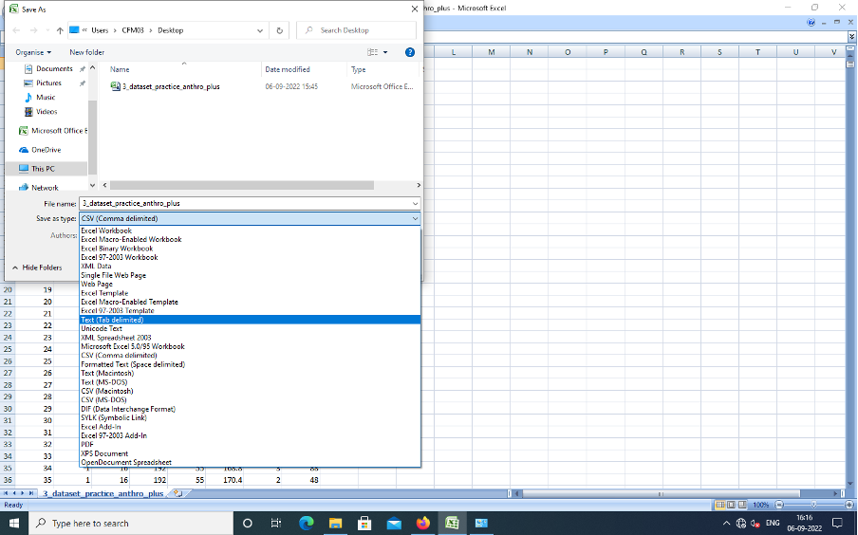
Anthro-Plus Data Format

Slide 23
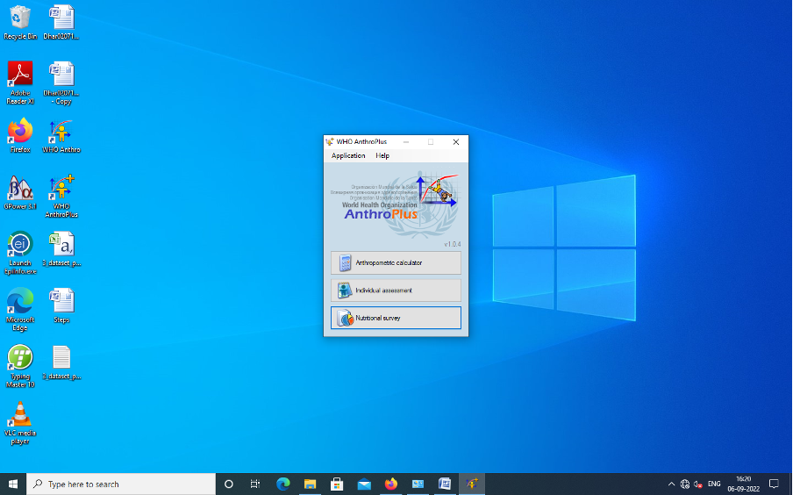
Anthro-Plus - Open Nutrition Survey

Slide 24
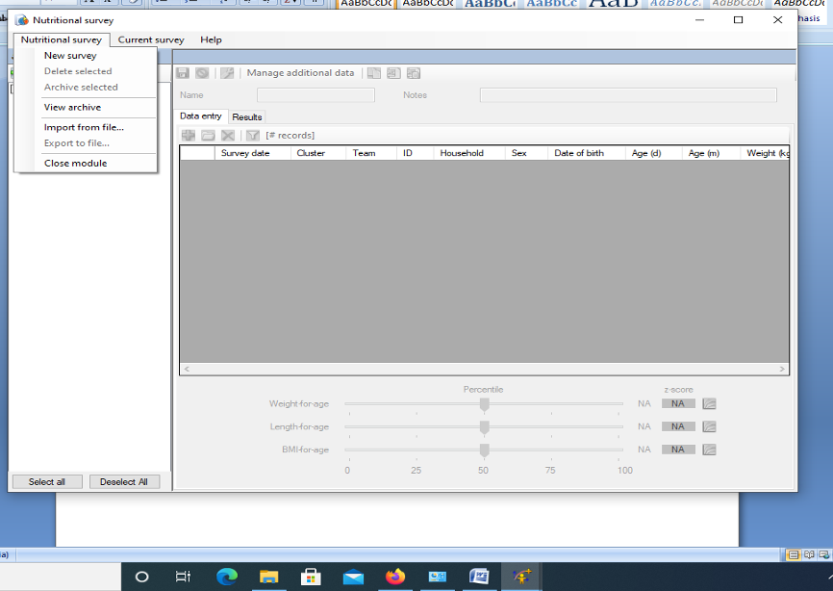
Anthro-Plus Import File

Slide 25
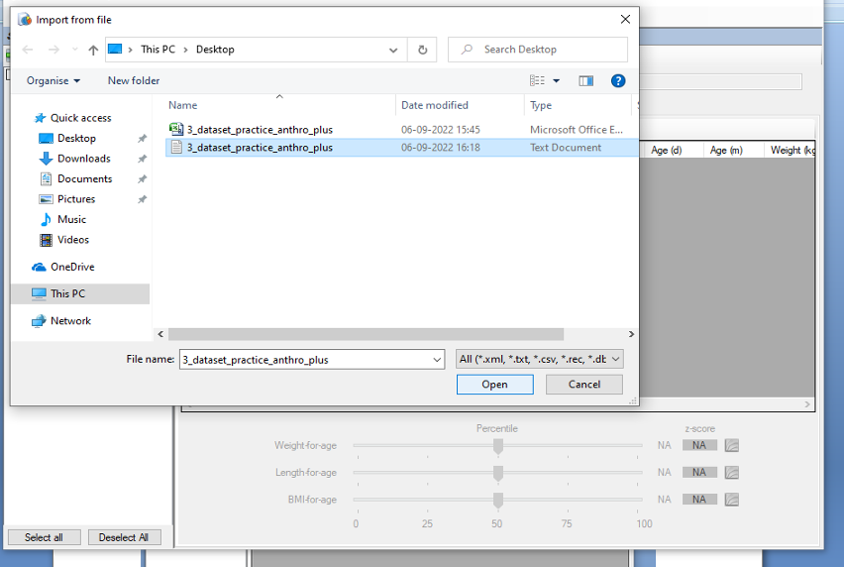
Anthro-Plus Import File

Slide 26
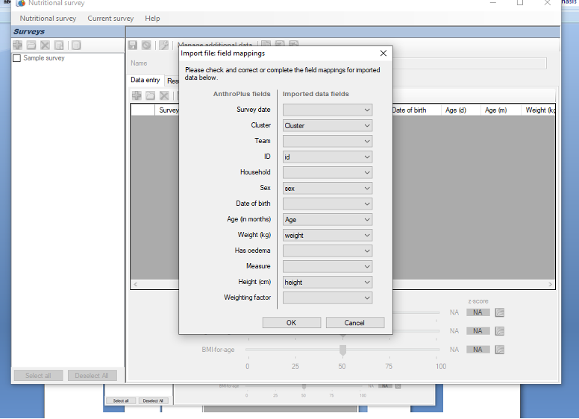
Anthro-Plus - Field mapping

Slide 27
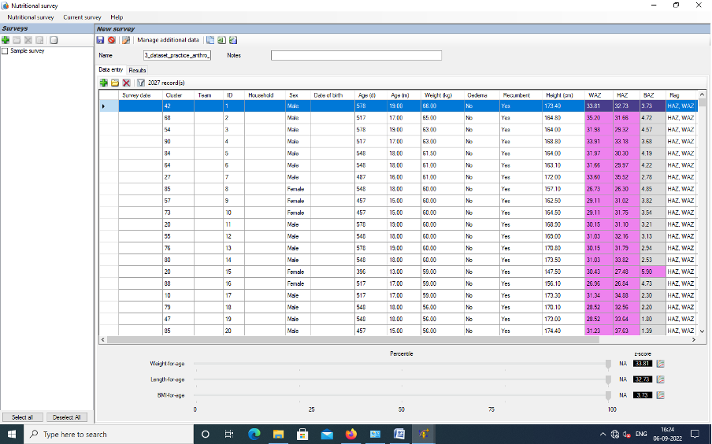
Anthro-Plus- z-scores and cluster report

Slide 28
Queries?
Thank You

