Slide 1
Generating summary report, exporting z-scores data
Abhijit P Pakhare

Slide 2
The Last Button
Template report for sharing results of anthropometric survey
Summarizes demographics, data filtering automatically
Word format - easy for editing
Includes data quality parameters as well

Slide 3
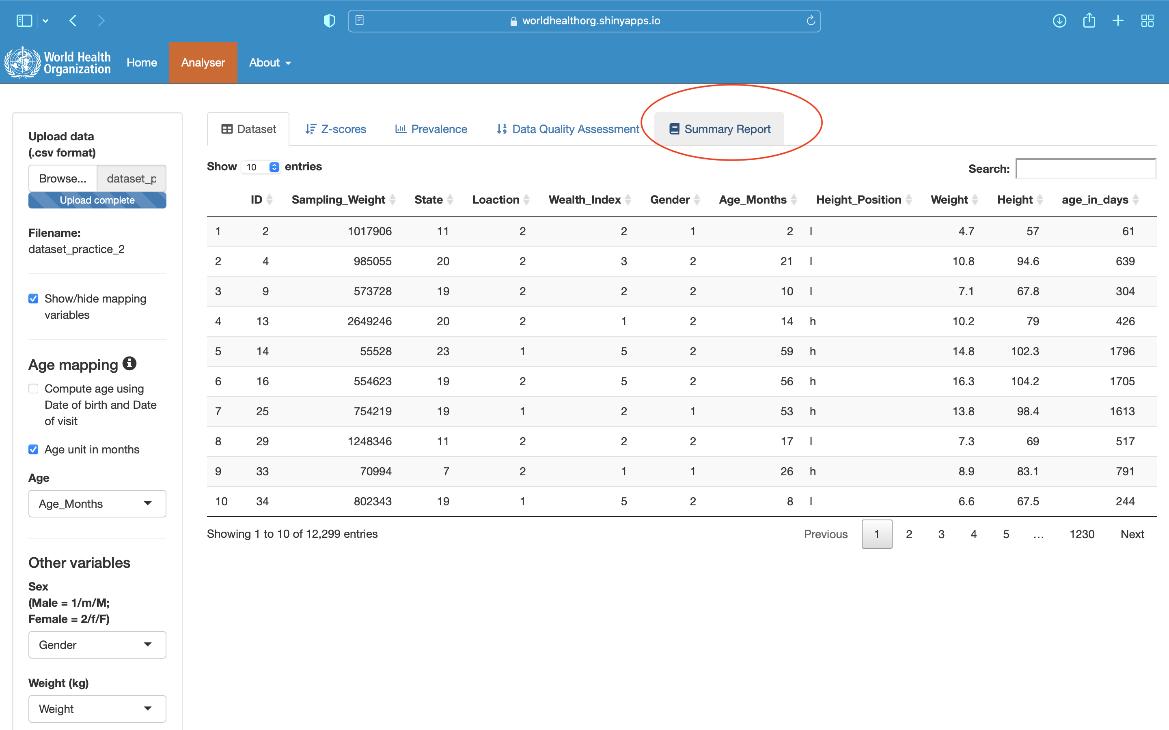
The Last Button

Slide 4
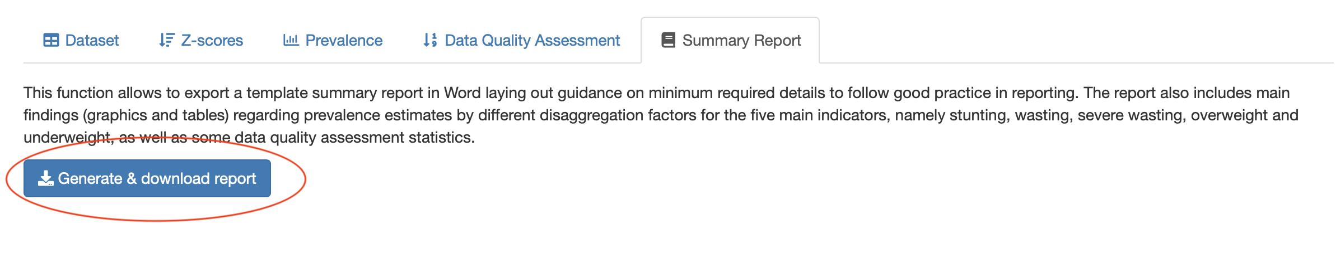
Generate and download summary report

Slide 5
It may take time if dataset is large
Saved as word file
Let’s see summary report for dataset_practice_2

Slide 6
Exporting z-scores
Many times only prevalence is not the objective
Nutritional status as predictor or associated factor with some outcome
Need raw z-scores
Need computation of anthropometric indicator for further stratification
For further detailed analysis

Slide 7
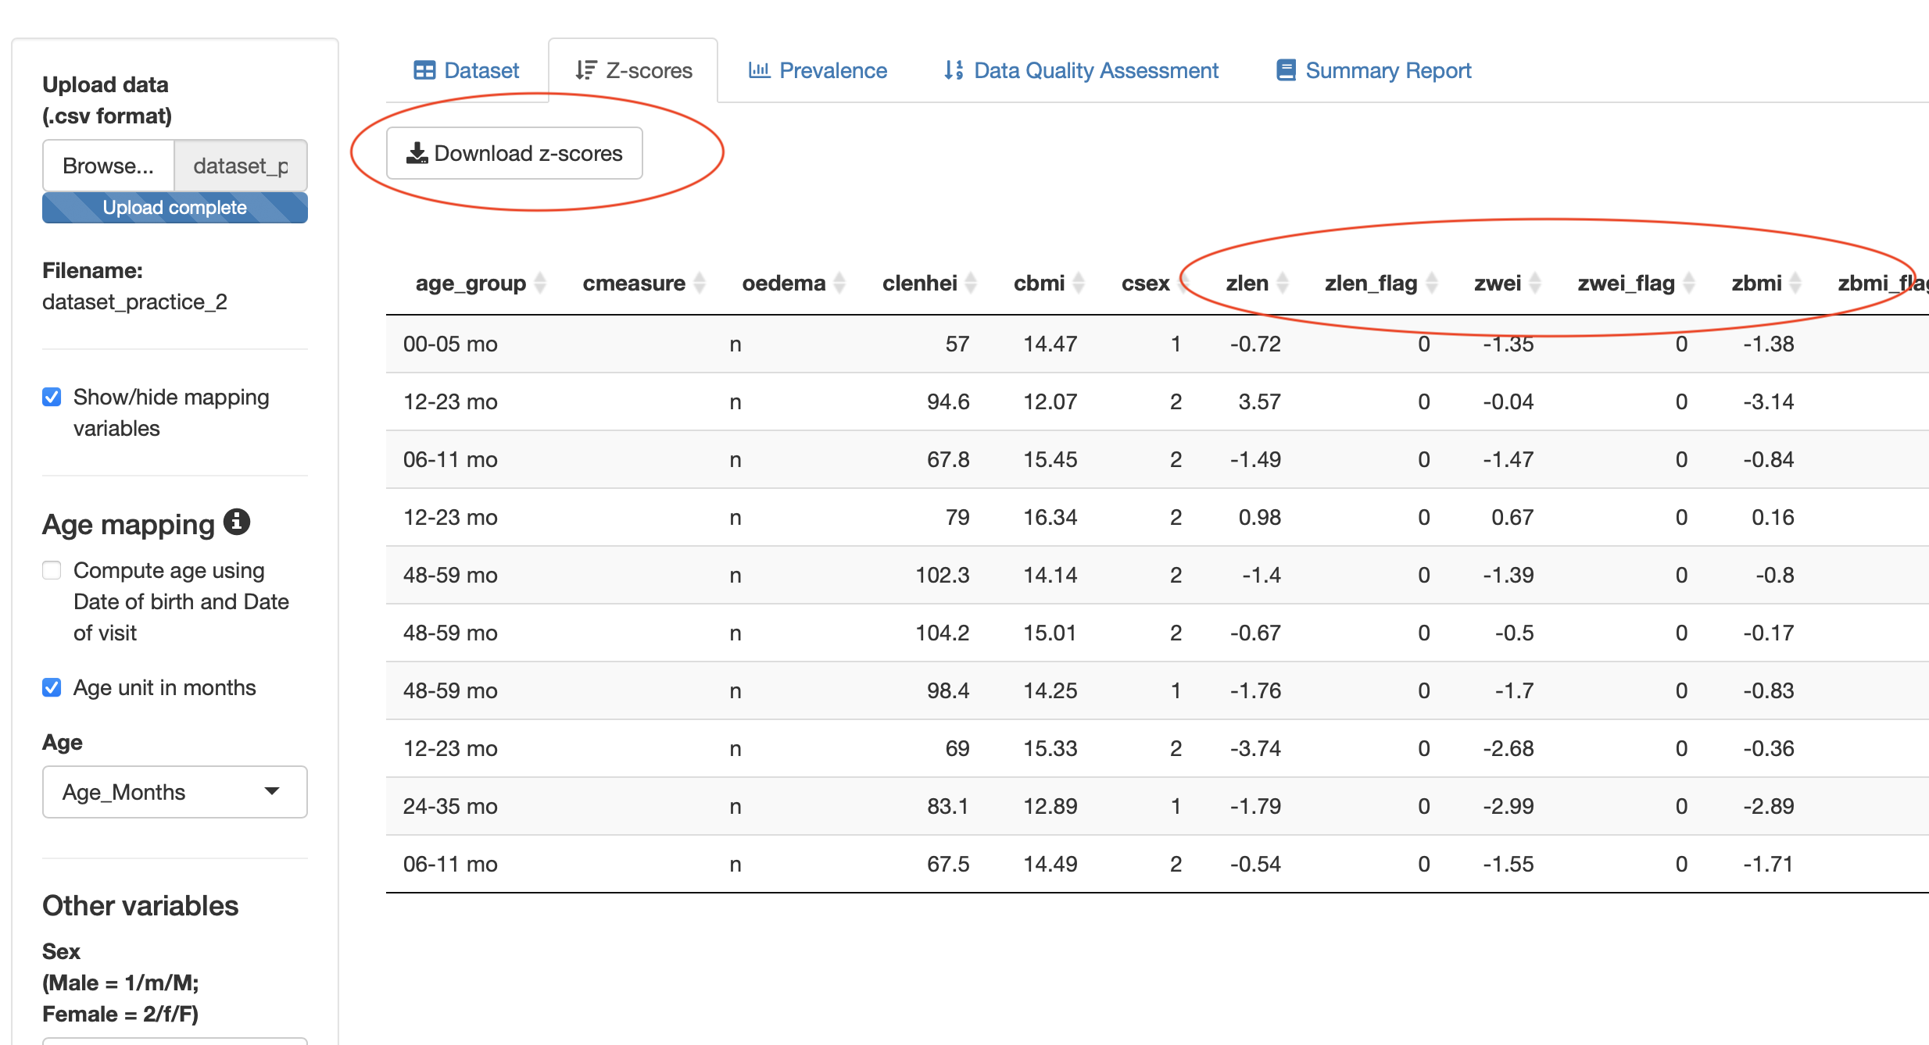
How to export z-scores?
Anthro Survey Analyser

Slide 8
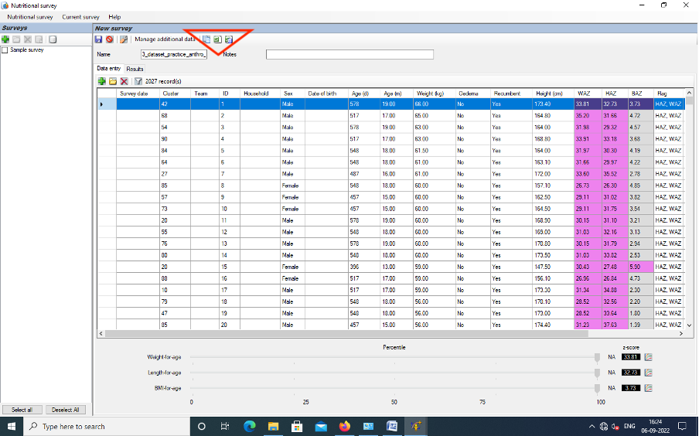
How to export z-scores?
Anthro and Anthro-Plus for Windows

Slide 9
Queries?
Thank You

