Slide 1

Recyclers
An all-inclusive waste management software that allows users to manage inventory and trading.

Slide 2
Problem at hand
Under any industry, disposal of waste is a huge concern.
Wastage from one industry can be used as raw material for others.
No common platform for organizations to get rid of this or for users to buy.

Slide 3
How this helps? (real-world examples)
Our solution is an interface between different organizations to properly manage the waste.
Huge amount of construction debris is one of the burning issues. Most of them are dumped into landfills.
Companies that make use of the recycled concrete are facing troubles in finding the debris.
Thousands of tonnes of crop waste is being burned in India.
Crop residual can be used in biofuel production, bedding material for livestock.

Slide 4
How this is different
Will come in handy for small-medium scale industries.
Provides a common platform for inventory management and trade.
Acts as a generic solution for all kinds of waste whether it is industrial, agricultural or electronic.
Helps in the tracking of the waste being generated for better planning of future projects.

Slide 5
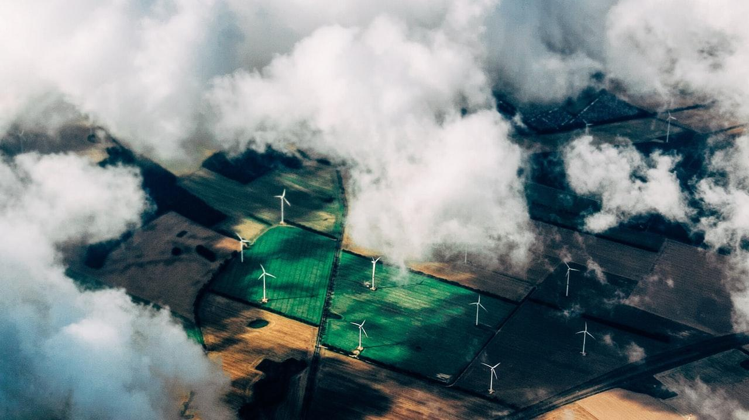
Application in action!!

