Slide 1
TACM: Task And charging manager
Breakdown by David Parsons

Slide 2
Setup
Mockup
Use Case
Class UML
Database UML
3NF Normalization

Slide 3
Feature Creation Path
Classes
Login
Table Display
Create Type
Create Task/Day
End Day - Summary
Database
Backup (asyncoronous)
Import existing day
Search
Database Setup
Python Ran
Table Creation (and reset)
Test Data

Slide 4
Progress
GUI
Classes DONE
Test Cases DONE
Data import and Fill
Data export
Database import and Fill
GUI Table Frame Fill
GUI task create
GUI Main Page
GUI Login
Website
Django Tutorial
HTML Pages
AWS cloud database
Integrate
Live
Google Analytics
Phone Version
Ads?
iOS
Tutorial
Port-over/integrate
Ads?

Slide 5
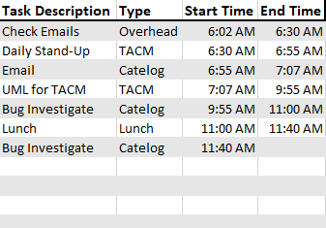

Mockup
TACM: Task and Charging Manager
File Edit Help
_
X
File Edit Help
Logout
New Type
Search
Summary Report
Exit
Stop Task
End Day
File Edit Help
Exit
Type
File Edit Help
Help
Useage
Submit Ticket
New Task

Slide 6
window
Frame 0,0
Frame2 0,1
Task Table 0,0 -> tsk
Button 0,0
Button 1,0
Frame3 2,0 (colspan 2)
Button 0,0

Slide 7
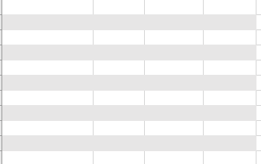
Mockup
TACM: Task and Charging Manager
_
X
TACM: Task and Charging Manager
_
X
File Edit Help
File Edit Help
Username
New Day
Password
Login
Create Account
Forgot Password

Slide 8
Mockup
TACM: Task and Charging Manager
_
X
TACM: Task and Charging Manager
_
X
File Edit Help
File Edit Help
Description:
Description
Description:
Description
Type:
Type
New Type
Type:
Type
New Type
Start Time
Start Time
End Time
03
:
05
AM
:
AM
AM
55
:
03
55
05
End Time?
:
03
:
05
55
:
PM
PM
PM
Create Task
Cancel
Create Task
Cancel

Slide 9
Class UML
Name
------------------------
+#-Attribute: Type
------------------------
+#-Operations()
------------------------
Comments
Main
------------------------
Name:String
Description:String
ChargeCode:String
Comments:String
------------------------
+#-Operations()
------------------------
Comments
Event
------------------------
Start: Time
End: Time
------------------------
+duration()
------------------------
Comments
Type
------------------------
Name:String
Description:String
ChargeCode:String
Comments:String
------------------------
+#-Operations()
------------------------
Comments
Day
------------------------
Date: Date
TaskArray:Task
------------------------
------------------------
Comments
Task
------------------------
Type: Type
Description: String
------------------------
------------------------
Comments

Slide 10
Use Case 1
Login
Loads User’s data from database (if there is a new day already)
If no new day then load from temp file (temp file is just 1 days information)
User data includes type (charge code)
Click New Day (if hadn’t already in previous session)
Creates Day -> object start time
Click New Task
Pop up
Required Name, Type (optional description, custom start time)
Click New Task
Ends running task before showing popup
Click End Day
End’s task if one open, displays table
Asynchronous thread database backup (if no connection then temp file)

Slide 11
Database Tables
Def find_user (input_username)
encrypt username
strip type and rounds from encrypt string
run query to find if exists:
return user ID
else:
throw error so GUI can handle DNE case
Group (Future Work)
GroupID PK
GroupName String
User
ID: Int PK
Name: String(?)
Username: SHA256 String(?)
Password: SHA256 String(?)
Def fill_type (userID)
run query to find if types exsist for user
run query to find all tasks IDs that have matching DAY_ID FK
for every ID, run query to fill task object with data
Def find_day (todays_date)
run query to find if date exists for user:
run query to find all tasks IDs that have matching DAY_ID FK
for every ID, run query to fill task object with data
TypeInGroup (Future Work)
TypeID FK
GroupID FK
(create procedure to copy Types to create new items for user in group, this allows user to add custom comments vs editing master reference)
Day
User_ID: Int FK
Day#: Int PK
Date: DateTime
StartTime
EndTime
Task
Day_ID: Int FK
Task#: Int PK
Date: DateTime
Start Time
End Time
Type_ID FK
Description
UserType
Type_ID int PK
Desc String
Charge string
Comment String
User_ID int FK
UserInGroup (Future Work)
UserID FK
GroupID FK

Slide 12
DATABASE NOTES
Tables
User -> Day -> Task
Create queries to address below with ability to input parameters.
Login
Verify Username SHA256 exists
Does Password SHA256 Match corresponding SHA256 for username
For User, Is there a day matching today’s date?
If so then pull tasks corresponding to that day
SW creating tasks and filling day
Runtime
Periodically check and push day and tasks to database
When update, update database (example change start time)
When create task/day then update database

