Slide 1


Cross-corpus Speech Emotion Recognition Based on Sparse Subspace Transfer Learning
Keke Zhao, Peng Song, Wenjing Zhang, Weijian Zhang, Shaokai Li, Dongliang Chen, and Wenming Zheng
School of Computer and Control Engineering, Yantai University
Sep. 10, 2021
CCBR 2021 Presentation

Slide 2
CONTENT
1
Introduction
2
The proposed SSTL method
3
Experiments and results
4
Conclusion

Slide 3
1 Introduction

Slide 4


Introduction
The goal of speech emotion recognition(SER) is to effectively recognize human emotions or emotional states from speech, e.g., anger, disgust, fear, happiness, and sadness.

Slide 5


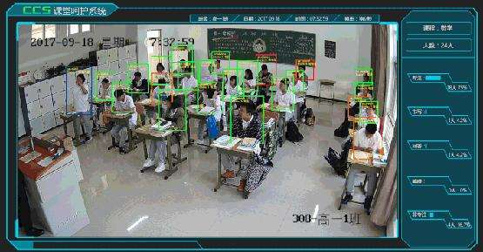
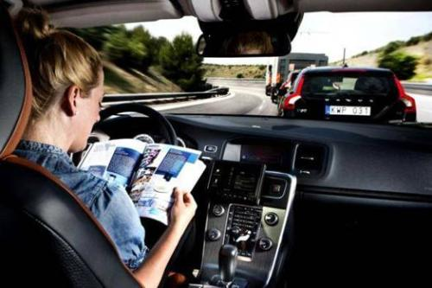
Application

Slide 6
Introduction
Problems in traditional SER
Traditional SER:the training and testing data follow the same feature distributions, does not often hold.
In actual situations, the training and testing data are often obtained in different scenarios, e.g., different languages, or different recording devices, where the recognition performance will be significantly reduced.

Slide 7
Introduction
In order to solve the above problems, with the rapid development of transfer learning, many transfer learning algorithms have been introduced for cross-corpus SER.
Feature subspace transfer learning(Deng 2014)
Domain adaptive least squares regression (Zong 2016)
PCANet based feature transfer algorithm(Huang 2017)
Adversarial discriminative domain generalization (Gideon 2019)
Transfer linear subspace learning approach(Song 2019)
Transfer sparse discriminant subspace learning (Zhang 2020)

Slide 8
Introduction
Most of the above-mentioned algorithms measure the distance discrepancy between source and target databases by using the maximum mean discrepancy (MMD). However, MMD can only narrow the probability distribution, neglecting the linear relationship between the source and target databases. This will make the samples from different databases cannot interweave well.
Different from the above-mentioned methods, we propose a novel transfer learning algorithm, called sparse subspace transfer learning (SSTL), for cross-corpus SER.

Slide 9
2 The proposed SSTL method

Slide 10
SSTL
Cross-corpus SER method based on sparse subspace transfer learning(SSTL)
Our method combines transfer learning, subspace learning, and feature selection to learn a domain invariant projection while transferring knowledge.
We aim to align the features of different corpora into a new common subspace so that the data of the target domain can be better represented by the data of the source domain, and the recognition performance can be improved.

Slide 11
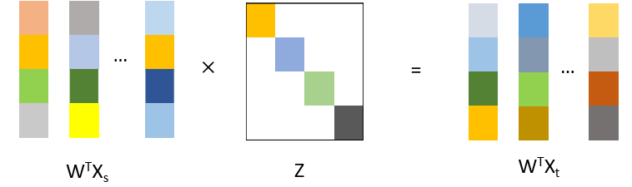

SSTL
Sparse subspace transfer learning for cross-corpus SER
Source domain X_{s}
Discriminant subspace learning
minTr(W^{T}(S_{w}-$μ$S_{b})W)
Projection
matrix W
Low dimensional
common subspace
Target domain X_{t}
Fig.1: SSTL framework.

Slide 12



SSTL
Sparse discriminant subspace learning
The main idea of linear discriminant subspace (LDA) is to learn a projection matrix, in which the samples in the same class are as close as possible, and the samples of different classes are as far away as possible.
Discriminant subspace learning
Feature selection

Slide 13

SSTL
Transfer feature representation
To reduce the difference of feature distributions between source and target databases, we introduce a data reconstruction strategy, in which the target data can be linearly reconstructed by the source data in the learned common subspace.
Transfer learning item
Coefficient reconstruction

Slide 14

SSTL
Objective function:
Constraint item
where µ is a small positive constant, α, β and γ are regularization parameters.

Slide 15
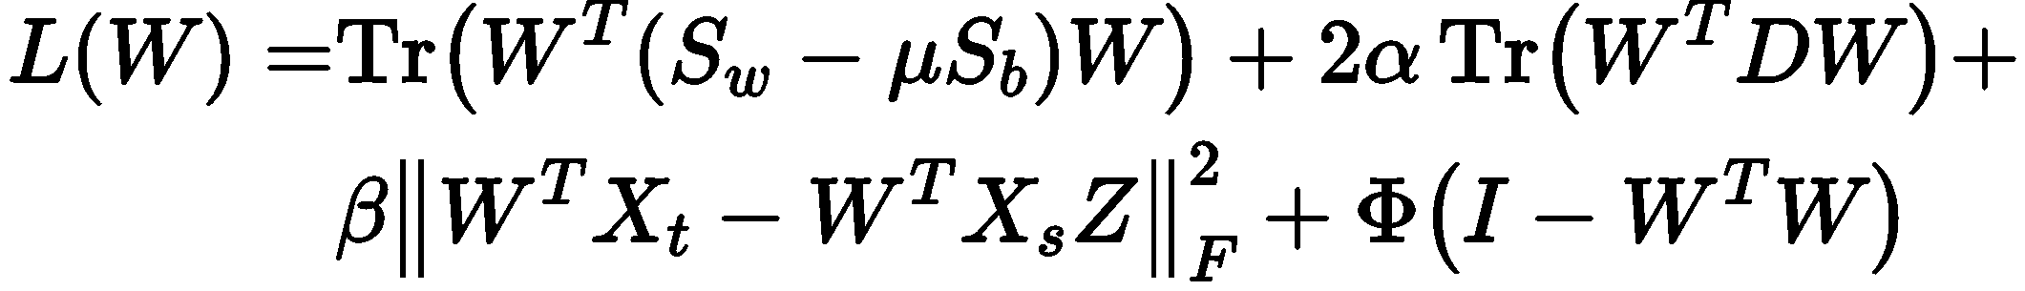
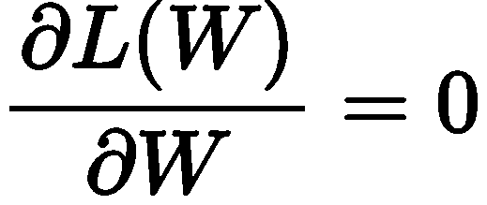
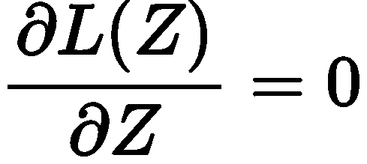
Optimization
Because the L_{2,1}norm not smooth, we convert the L_{2,1} norm into the form of trace according to previous experience.
Update W
The problem of solving W can be simplified as a eigen-decomposition problem.
Update Z

Slide 16
3 Experiments and results

Slide 17
Experimental environment
Emotional databases:
Berlin: The Berlin corpus includes 494 samplesof 10 professional German actors. It mainly contains seven emotions, i.e., happiness, anger, boredom, disgust, fear, sadness and neutrality.
eNTERFACE: The eNTERFACE corpus includes 1287samples of 42 subjects from 14 countries. It mainly contains six emotions, i.e., anger, disgust, fear, happiness, sadness and surprise.
RML: The RML corpus includes 720 samples of 8 subjects, using 6 different languages (English, Mandarin, Urdu, Punjabi, Persian, and Italian). It contains six emotions, i.e., anger, disgust, fear, happiness, sadness and surprise.

Slide 18
Experimental environment
Compared algorithms:
Principal component analysis (PCA)
Linear discriminant analysis (LDA)
Semi-supervised discriminant analysis (SDA)
Transfer component analysis (TCA)
Joint distribution adaptation (JDA)
Transfer linear discriminant analysis (TLDA)
Transfer joint matching (TJM)
Transfer sparse discriminant subspace learning (TSDSL)

Slide 19
Experimental environment
Implementation details:
We use the openSMILE toolbox to extract 1582 dimensions of effective features. In our experiment, the features of the source data set and the target data set are normalized to fall in the interval between 0 and 1.
We choose the classic linear classifier SVM. SVM is trained on a labeled source data set and tested on an unlabeled target data set.

Slide 20
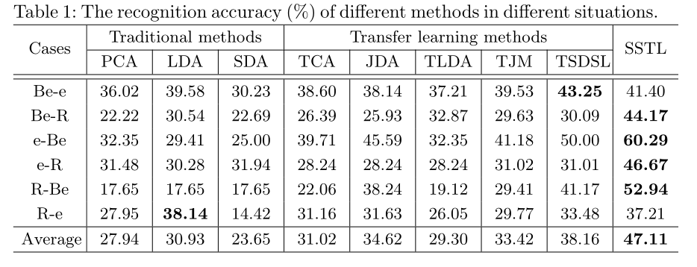
Results and analysis
Be: Berlin
e: eNTERFACE
R: RML

Slide 21
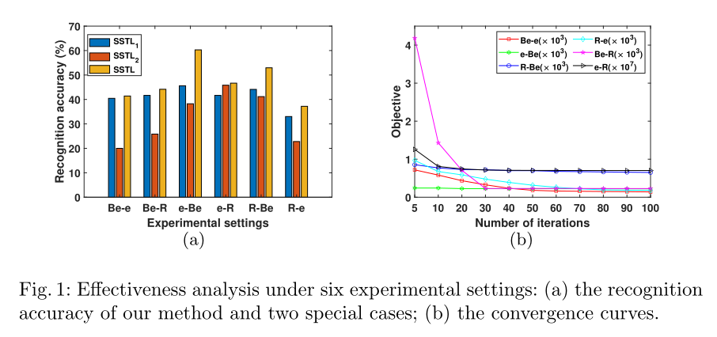
Results and analysis

Slide 22
4 Conclusion

Slide 23
Conclusion
并行算的概念
We combine transfer learning, subspace learning, and feature selection to learn a domain invariant projection while transferring knowledge.
We introduce the idea of sparse reconstruction, in which the data in target corpus can be linearly represented by the data in source corpus.
We use the L_{2,1}norm to constrain the projection matrix and reconstruction coefficients, which can obtain more effective features and avoid trivial solutions.

Slide 24
References
1.El Ayadi, M., Kamel, M.S., Karray, F.: Survey on speech emotion recognition:Features, classification schemes, and databases. Pattern Recognition44(3) (2011)572–587
2.Ak ̧cay, M.B., O ̆guz, K.: Speech emotion recognition: Emotional models, databases,features, preprocessing methods, supporting modalities, and classifiers. SpeechCommunication116(2020) 56–76
3. Song, P.: Transfer linear subspace learning for cross-corpus speech emotion recognition. IEEE Trans. Affect. Comput.10(2) (2019) 265–275
4. Pan, S.J., Tsang, I.W., Kwok, J.T., Yang, Q.: Domain adaptation via transfer component analysis. IEEE Transactions on Neural Networks22(2) (2010) 199–210
5. Zhang, J., Li, W., Ogunbona, P., Xu, D.: Recent advances in transfer learning forcross-dataset visual recognition: A problem-oriented perspective. ACM ComputingSurveys (CSUR)52(1) (2019) 1–38
6. Deng, J., Zhang, Z., Schuller, B.: Linked source and target domain subspace feature transfer learning–exemplified by speech emotion recognition. In: 2014 22ndInternational Conference on Pattern Recognition, IEEE (2014) 761–766
7. Zong, Y., Zheng, W., Zhang, T., Huang, X.: Cross-corpus speech emotion recog-nition based on domain-adaptive least-squares regression. IEEE Signal ProcessingLetters23(5) (2016) 585–589
8. Huang, Z., Xue, W., Mao, Q., Zhan, Y.: Unsupervised domain adaptation forspeech emotion recognition using pcanet. Multimedia Tools and Applications76(5)(2017) 6785–6799
9. Gideon, J., McInnis, M., Provost, E.M.: Improving cross-corpus speech emotionrecognition with adversarial discriminative domain generalization (addog). IEEETransactions on Affective Computing (2019)
10. Zhang, W., Song, P.: Transfer sparse discriminant subspace learning for cross-corpus speech emotion recognition. IEEE/ACM Transactions on Audio, Speech,and Language Processing28(2020) 307–318

Slide 25
Thank you！

