Slide 1
Comparison of Multivariable Fractional Polynomials with Splines and Penalised Splines
Aris Perperoglou¹, Daniela Dunkler², Matthias Schmid³ and Willi Sauerbrei⁴ for STRATOS TG2
¹Newcastle University, UK
²Medical University of Vienna, Austria
³Institute for Medicine Biometry, Informatics and Epidemiology, Bonn, Germany
⁴University of Freiburg, Germany

Slide 2
Outline
Observational studies
Variable selection with Fractional polynomials, Spline approaches and Penalised methods
Application to PIMA & PBC data
Simulations
Discussion

Slide 3
TG2 Focus: Observational Studies – Regression models
Typical situation: Several variables, mix of continuous and (ordered) categorical variables
Aim of a study has strong influence on the analysis strategy
Three conceptual modelling approaches:
Explanatory, descriptive, predictive
Interest here: descriptive model (aims to capture the data structure parsimoniously)
Main issues: (similar in different types of regression models )
Which variables to include? Which functional forms for continuous variables?
Use subject-matter knowledge for modelling... but for some variables, data-driven choice inevitable

Slide 4
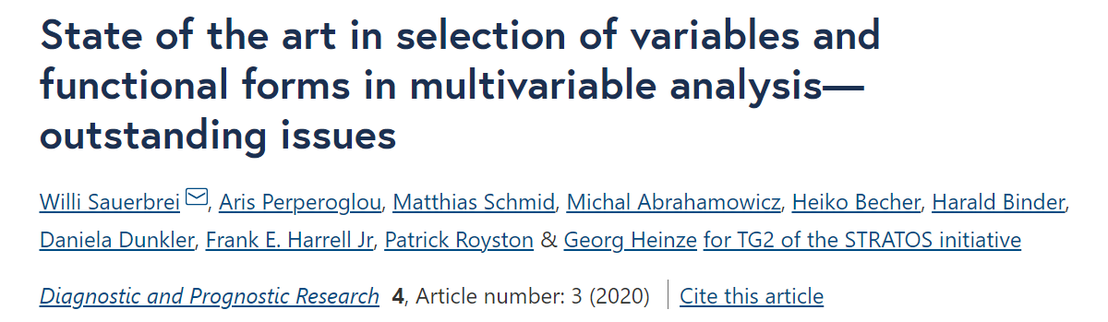
Variable selection & choice of functional forms
Variable selection in the presence of non-linear relationships of covariates is an even more complicated exercise. In fact, decisions regarding the inclusion/exclusion of specific variables and modelling of the functional forms of both these variables and potential confounders may depend on each other in a complex way.

Slide 5
Do we need variable selection?
…guided by principles such as the need for interpretability, reproducibility and transportability, we prefer a simple model unless the data indicate the need for greater complexity. (Royston & Sauerbrei, 2008)
(variable selection)… from a pragmatic point of view, aims at determining which covariates have the strongest effects on the response of interest, whereas from a statistical perspective it represents a means to achieve balance between goodness of fit and parsimony. By effectively identifying a subset of important covariates we can both enhance model interpretability and improve prediction accuracy. (Marra & Wood, 2012)

Slide 6
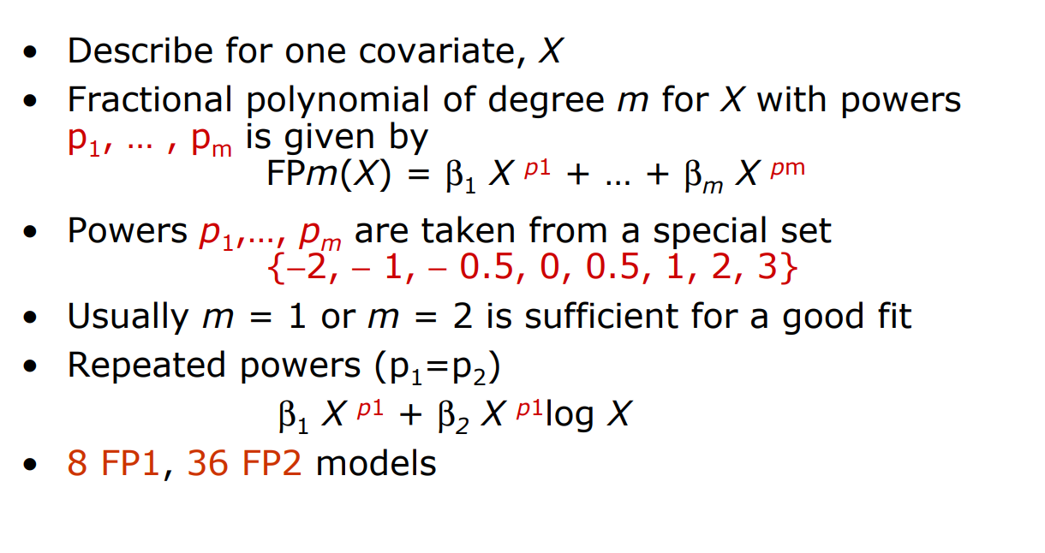
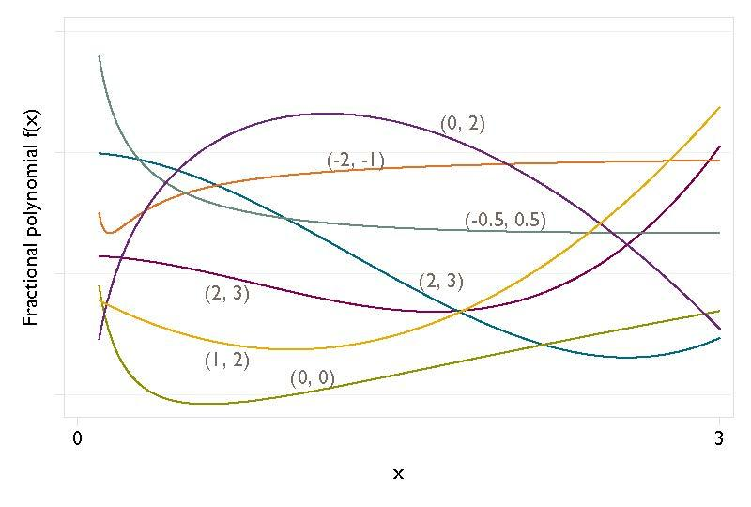
Fractional polynomial models

Slide 7
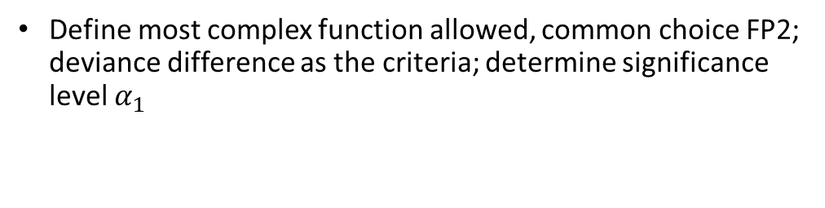
Function Selection Procedure and Multivariable FP
FSP
Combine backward elimination of weak variables with search for best FP functions
Determine fitting order from full linear model
Apply FSP selection procedure to each X in turn, fixing functions (but not βs) for other X’s
Cycle until FP functions (i.e. powers) and variables selected do not change
Significance level may be different for the two parts – selection of variables (α₂) and selection of variable forms (α₁)
 |  | df | p-value
Any effect? Best FP2 versus null |  | 4
Linear function suitable? Best FP2 versus linear |  | 3
FP1 sufficient? Best FP2 vs. best FP1 |  | 2

Slide 8
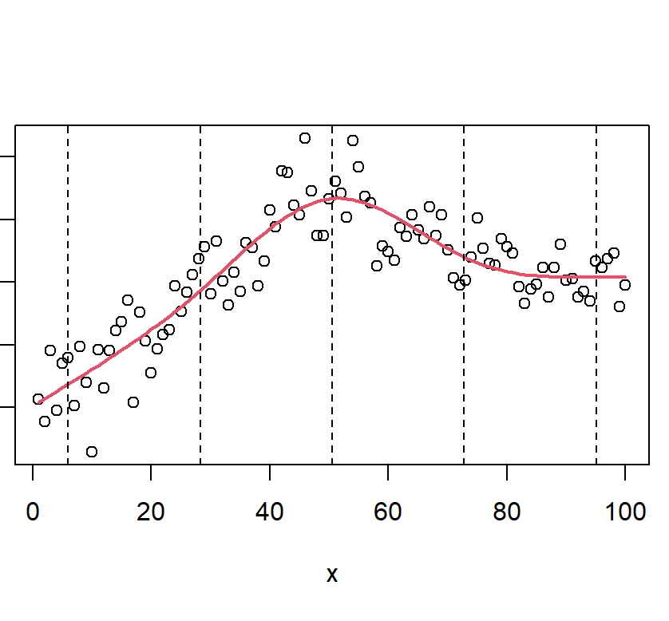

Splines are also simple polynomials
Set of piecewise polynomials, each of degree d
Joined together at a set of knots τ₁, …, τ_{κ}
Continuous in value and sufficiently smooth at the knots
A
A restricted cubic regression spline is defined by:
being a cubic function between the set of fixed knots τ₁, …, τ_{κ}
being a linear function for x < τ₁ and x > τ_{κ}
being continuous with continuous first and second derivative
Natural Splines are restricted cubic splines with cubic b-splines as functions between knots

Slide 9
Restricted Cubic Splines and Multivariable Regression Splines (MVRS)
SSP
Determine the most complex model in terms of knots “df(m)”; m often depends on sample size; knots are chosen at predetermined percentiles of distribution of x; deviance difference as criteria; determine significance level α₁
Predictors are considered in decreasing order of significance in a full linear model
The algorithm cycles over the predictors, updating the model
Procedure terminates when no further variables included in the model and df for splines are chosen for continuous variables
Royston, Sauerbrei suggested df(m=4,8)
Procedure can be easily adapted to other spline bases, eg b-splines, natural splines
MVSS also suggested for cubic smoothing splines (based on edf)
 |  | Df | p-value
Any effect? Best df(m) versus null |  | m+1
Linear function suitable? Best df(m) versus linear |  | m
df(m) needed? Best df(m) vs. df(1) …. |  | m-1 …

Slide 10
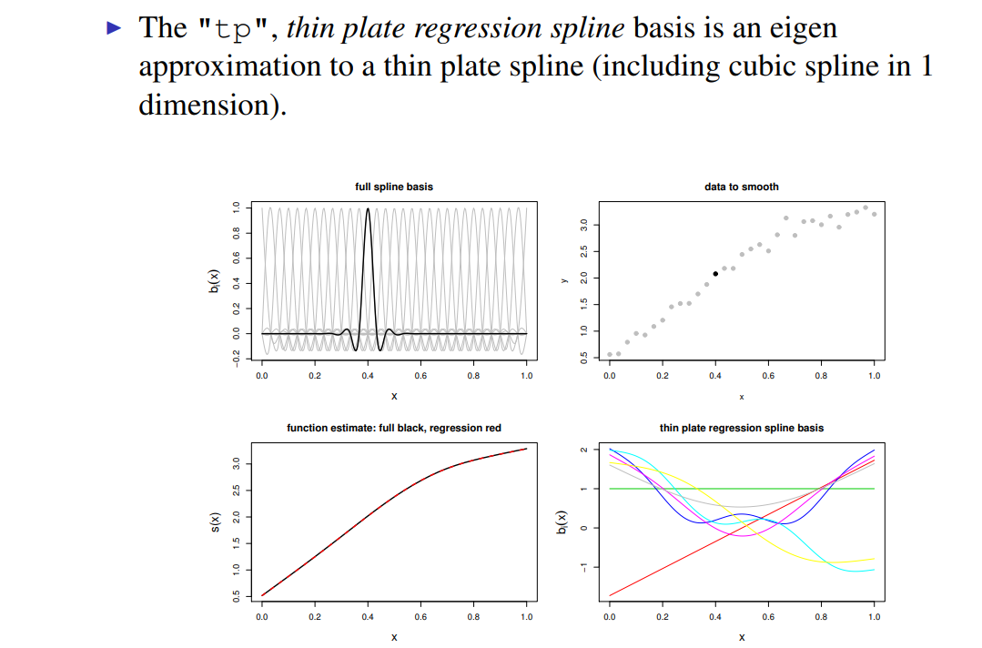
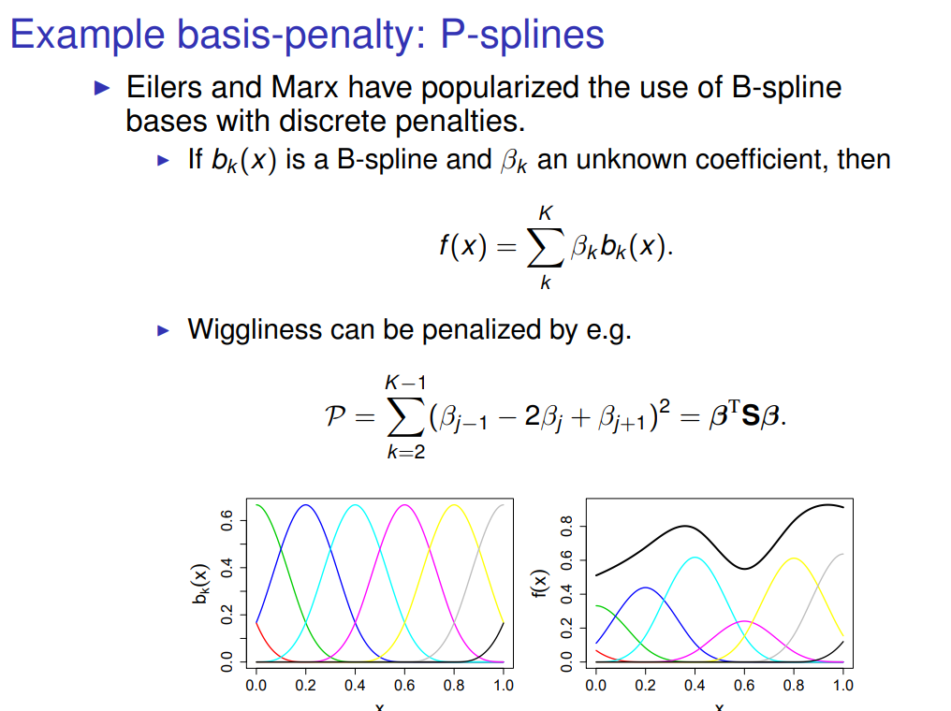
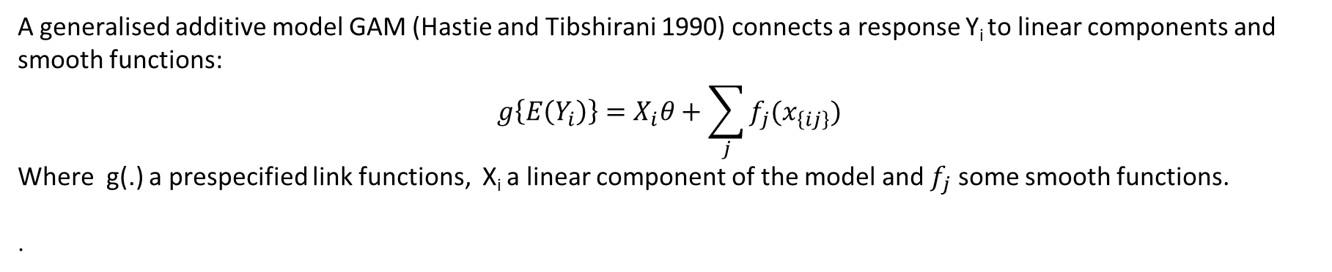
Generalised additive models and mgcv
A generalised additive model GAM (Hastie and Tibshirani 1990) connects a response Y_{i} to linear components and smooth functions:
$$g\left\{E\left(Y_{i}\right)\right\}=X_{i}θ+\sum_{j}{f_{j}(x_{\left\{ij\right\}})}$$
Where g(.) a prespecified link functions, X_{i} a linear component of the model and $f_{j}$ some smooth functions.
.
Example: eigen based spline “tp”
Example: P-splines “ps”

Slide 11
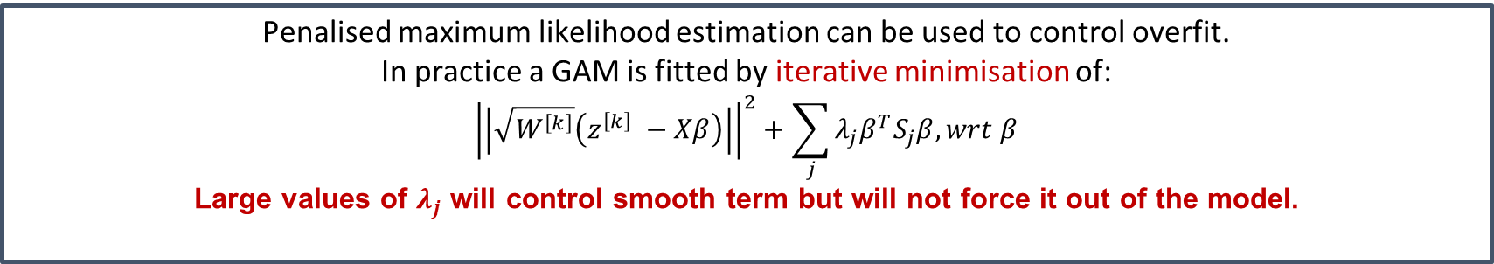
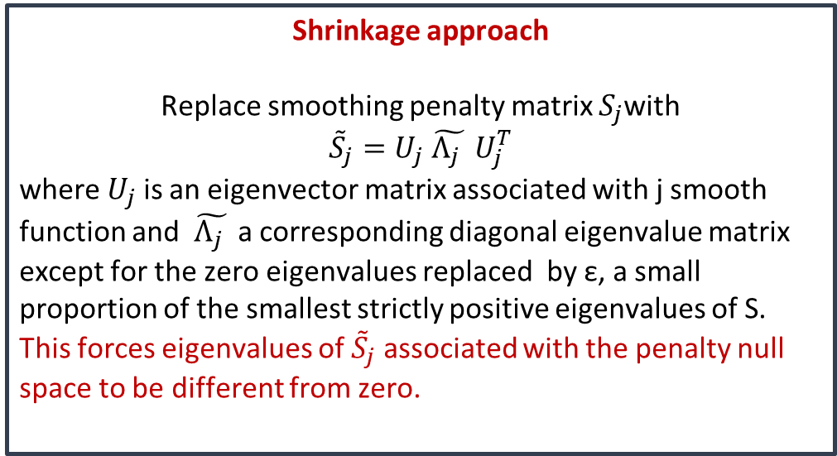
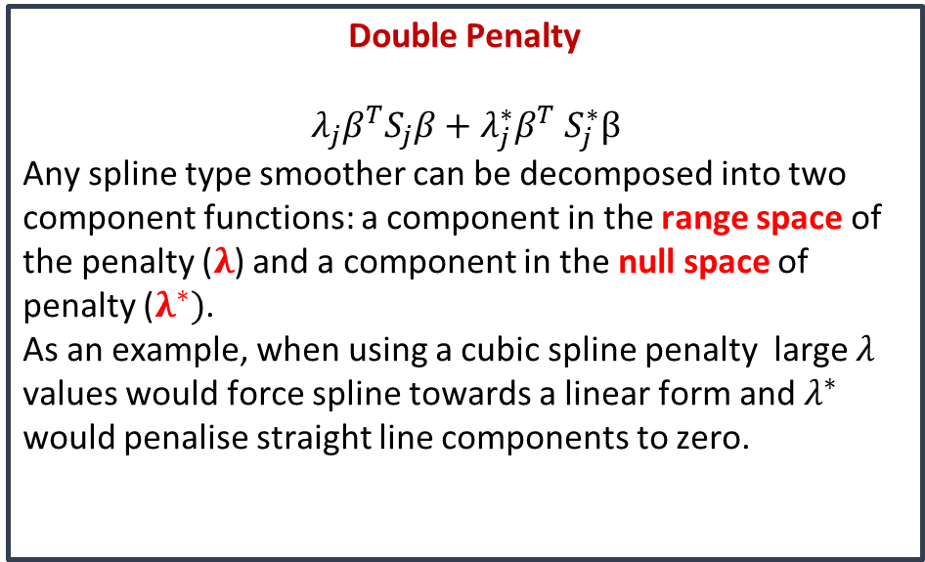
Practical Variable Selection for GAMs
Penalised maximum likelihood estimation can be used to control overfit.
In practice a GAM is fitted by iterative minimisation of:
$${\left|\left|\sqrt{W^{\left[k\right]}}\left(z^{\left[k\right]} −Xβ\right)\right|\right|}^{2}+\sum_{j}{λ_{j}β^{T}S_{j}β, wrt β}$$
Large values of $λ_{j}$ will control smooth term but will not force it out of the model.
(Marra & Wood, Comp Stat & Data Analysis 2011)
Double Penalty
$$λ_{j}β^{T}S_{j}β+λ_{j}^{∗}β^{T} S_{j}^{∗}β$$
Any spline type smoother can be decomposed into two component functions: a component in the range space of the penalty ($λ$) and a component in the null space of penalty ($λ^{∗})$.
As an example, when using a cubic spline penalty large $λ$ values would force spline towards a linear form and $λ^{∗}$ would penalise straight line components to zero.
Shrinkage approach
Replace smoothing penalty matrix $S_{j}$with
$${\tilde{S}}_{j}=U_{j} \tilde{Λ_{j} } U_{j}^{T}$$
where $U_{j}$ is an eigenvector matrix associated with j smooth function and $\tilde{Λ_{j} }$ a corresponding diagonal eigenvalue matrix except for the zero eigenvalues replaced by ε, a small proportion of the smallest strictly positive eigenvalues of S. This forces eigenvalues of ${\tilde{S}}_{j}$ associated with the penalty null space to be different from zero.

Slide 12
Prediction of diabetes onset
Datasets
Survival of PBC patients
Dataset from an investigation of potential predictors for the onset of diabetes in a cohort of 768 female Pima Indians, of whom 268 developed diabetes.
Response: binary outcome diabetes (0/1)
Continuous Predictors: number of times pregnant, plasma glucose concentration, diastolic blood pressure, triceps skin fold thickness, serum insulin, diabetes pedigree function, bmi and age
Substantial missing values imputed once by ice in STATA
Set available in http://biom131.imbi.uni-freiburg.de/biom/Royston-Sauerbrei-book/#datasets
Mayo Clinic trial in PBC conducted between 1974 and 1984. A total of 312 PBC patients randomized in a placebo controlled trial of the drug D-penicillamine.
Response: Survival time, 125 deaths
Continuous Predictors: age, serum albumin, serum bilirunbin, serum cholesterol, urine copper, triglycerides
Categorical/Ordinal: presence of ascites, spiders (malformations of the skin), edema (no, untreated or treated) histological stage of disease
Set available in R

Slide 13
Models
 | MFP | MVRS | NS | TS1 | TS2 | PS
function | Fractional polynomials | Natural splines | Natural splines | Thin plate regression splines | Thin plate regression splines | P-splines
maximum df | 4 df (2FPs) | 5 | 9 | 9 | 9 | 9
variable selection | BE + FSP | BE + SSP | shrinkage | shrinkage | double penalty | double penalty
R library | mfp | script | mgcv | mgcv | mgcv | mgcv

Slide 14
Results extract (PIMA data)
mfp
mgcv
mfp(formula = Outcome ~ fp(Pregnancies, df = 4) + …+ fp(Age, df = 4), family = "binomial", select = 0.01)
df.init slct alpha df.final pw1 pw2
Glucose 4 0.01 0.05 1 1 .
BMI 4 0.01 0.05 2 -2 .
Pregn 4 0.01 0.05 0 . .
Diab 4 0.01 0.05 1 1 .
Age 4 0.01 0.05 4 0 3
Blood 4 0.01 0.05 0 . .
Skin 4 0.01 0.05 0 . .
Insuln 4 0.01 0.05 0 . .
gam(Outcome ~ s(Pregnancies,bs = 'tp') + s(Age,bs = 'tp'), family = "binomial", select= TRUE, method="REML")
Approximate significance of smooth terms:
edf Ref.df Chi.sq p-value
s(Glucose) 0.989 9 89.347 < 2e-16
s(BMI) 3.665 9 30.695 < 2e-16
s(Pregnancies) 1.106 9 2.903 0.06618
s(DiabetesPed) 1.677 9 9.814 0.00183
s(Age) 3.098 9 28.168 < 2e-16
s(BloodPressure) 0.000 9 0.000 0.42658
s(SkinThickness) 0.000 9 0.000 0.99424
s(Insulin) 0.099 9 0.108 0.30852

Slide 15
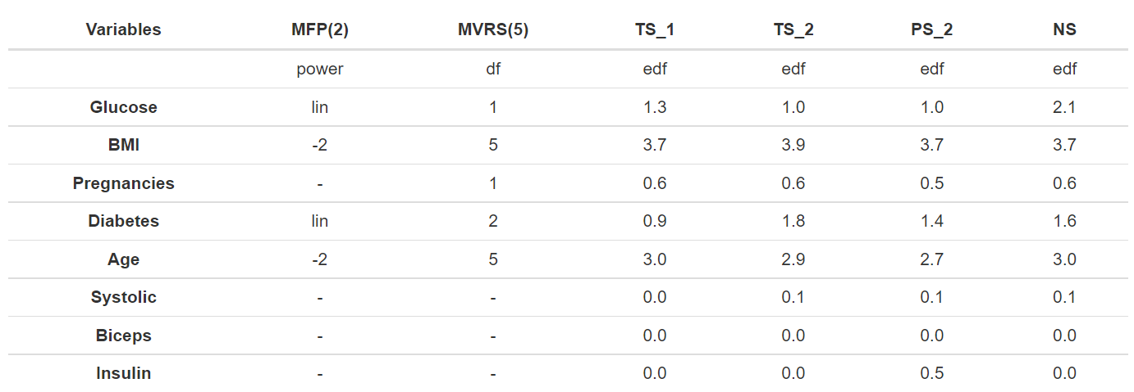
Variables included
All approaches seem to agree on variable inclusion bar MVRS that also included pregnancies .

Slide 16
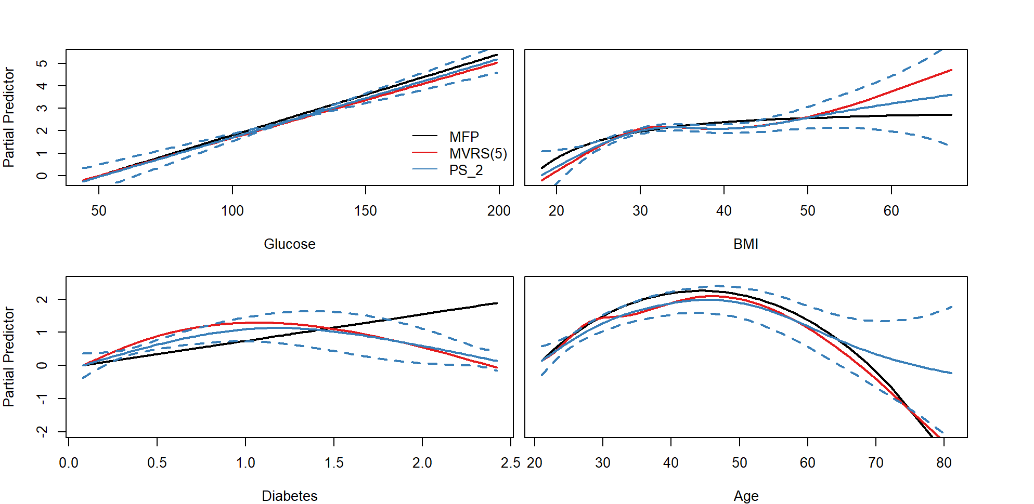
Functional Forms
- - - PS Confidence intervals

Slide 17
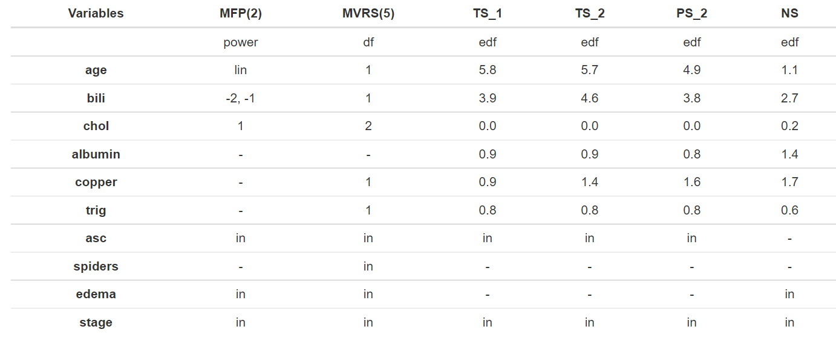
PBC data
Methods disagree on inclusion

Slide 18
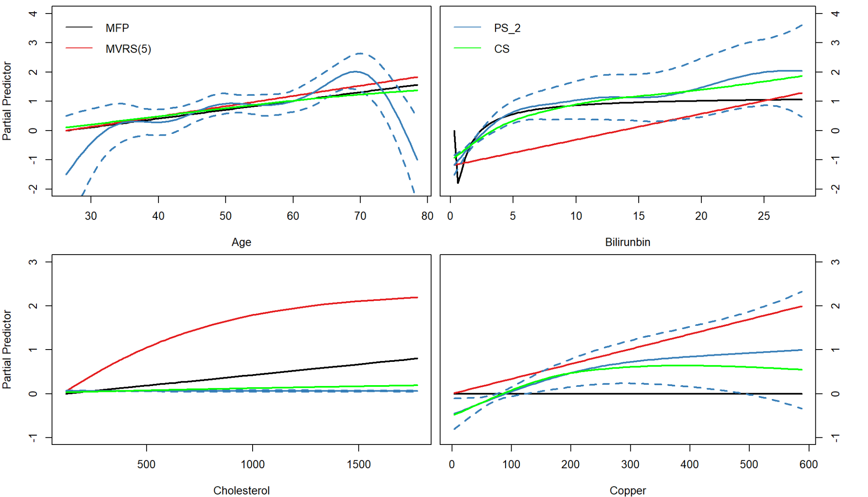
Functional forms
- - - PS Confidence intervals

Slide 19
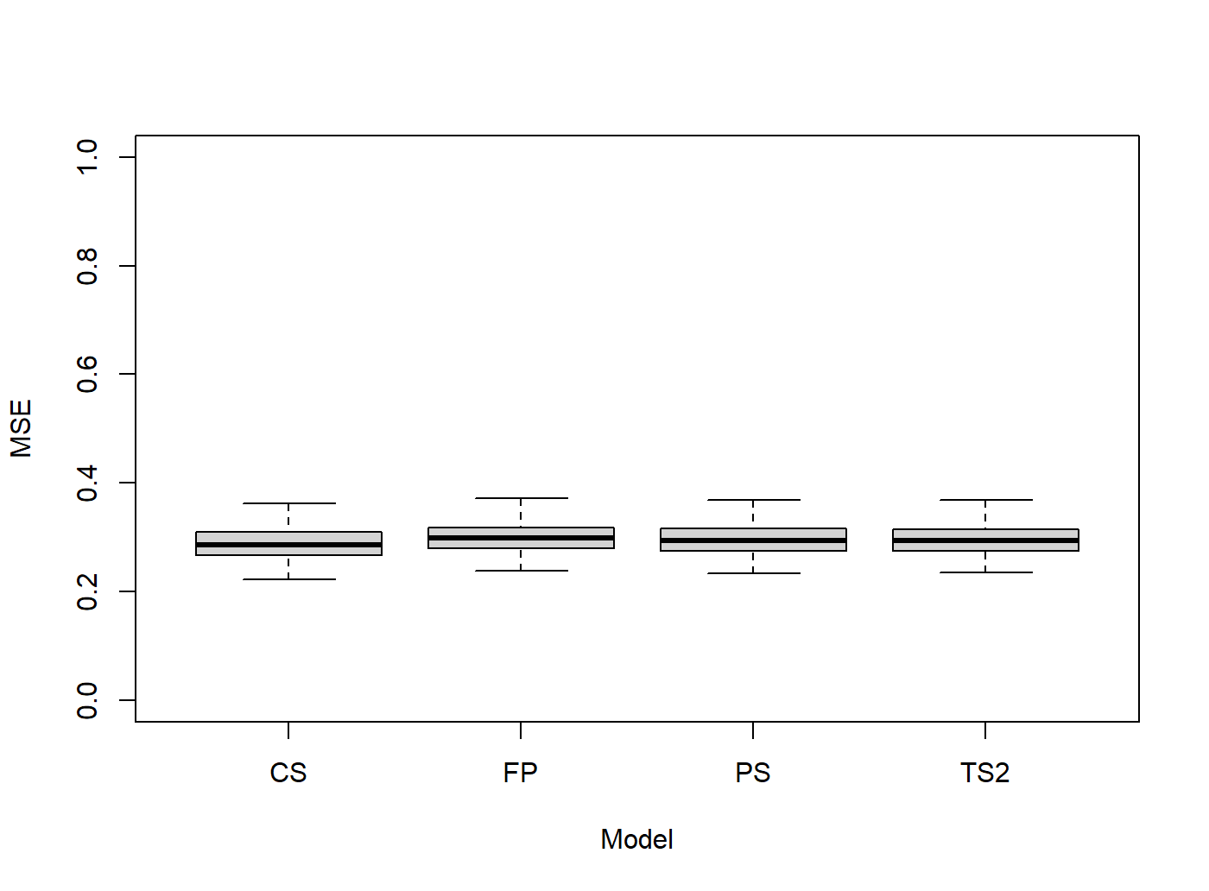
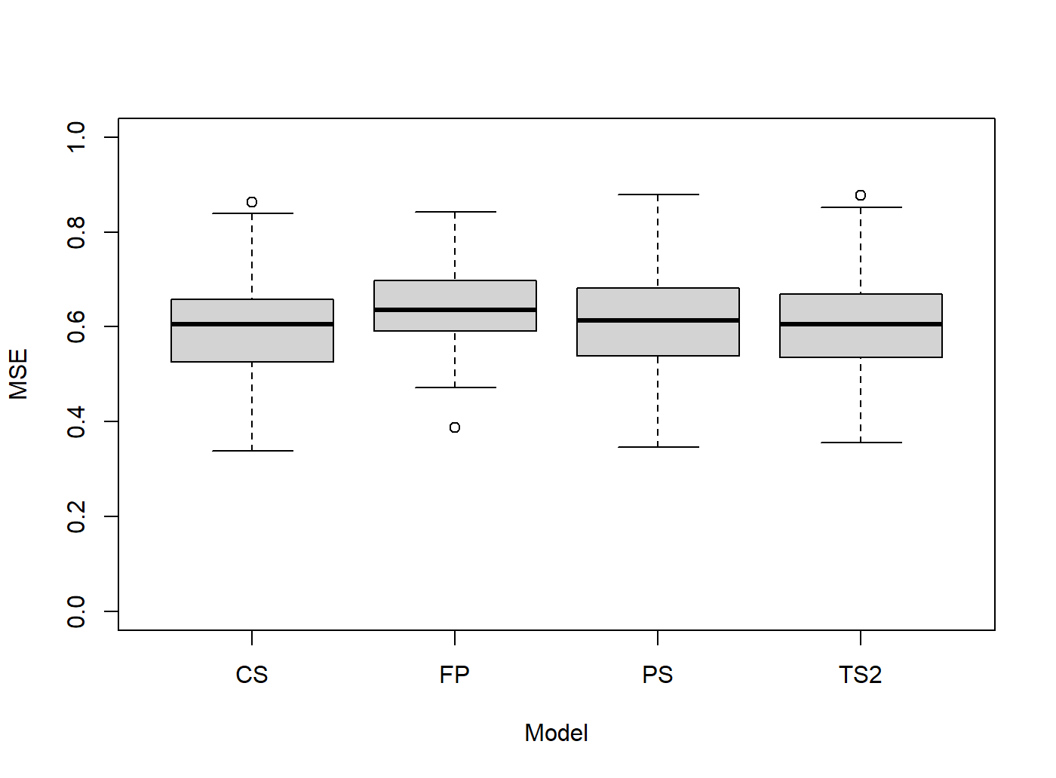
Prediction error
100 bootstrap samples for each dataset, leave 10% out for each sample.
PIMA data
PBC data

Slide 20
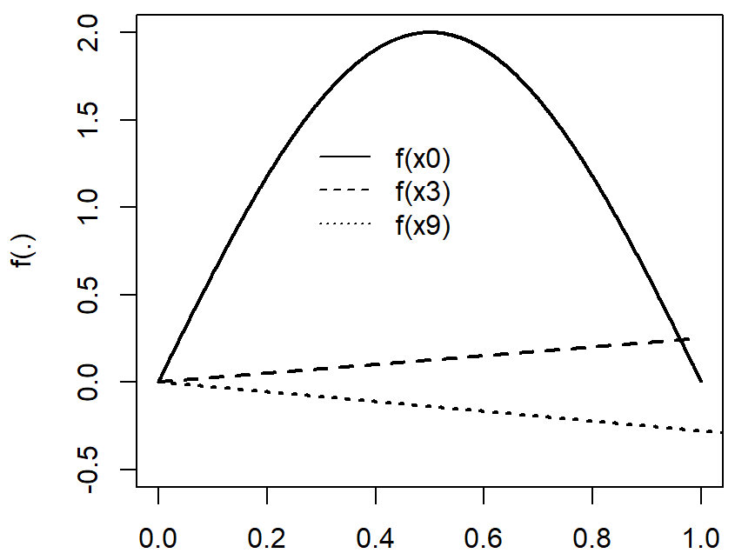
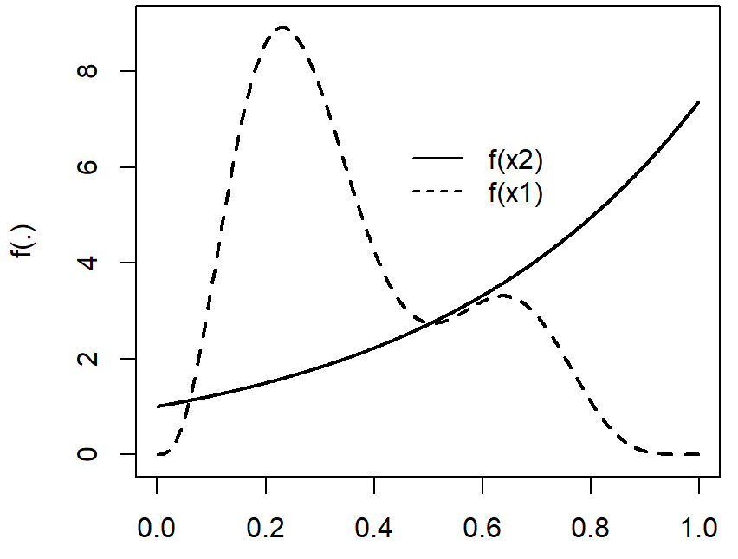
Simulation
200 iterations of n normal responses
n = 400, n=1200
8 continuous covariates
5 known functions (right) and 3 spurious (x₄-x₆)
2 binary covariates
1 spurious (x₇), 1 related to outcome (0.72*x8)
y= f(x₀) + f(x₁) + f(x₂) + f(x₃) + 0.72* x8 + f(x₉) + ε
Very limited setting similar to Gu and Wahba
(four univariate term example, from function gamSim in mgcv)
More interesting simulations to follow, with correlated variables,
and more features.
f(x₁)
f(x₂)

Slide 21
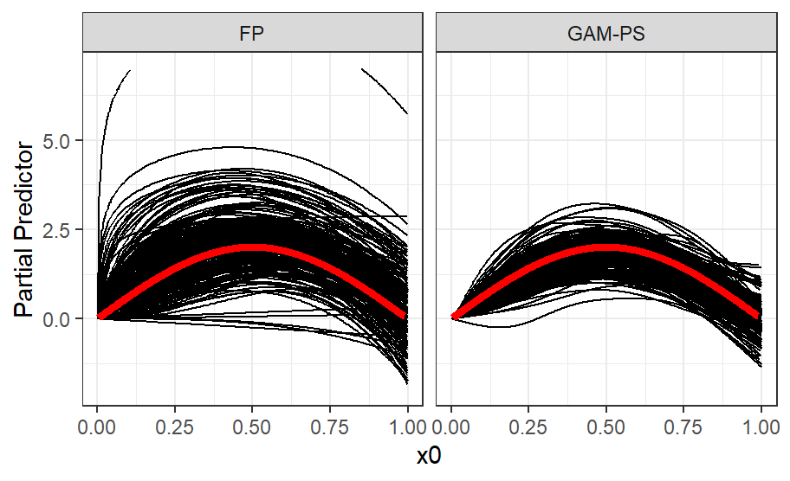
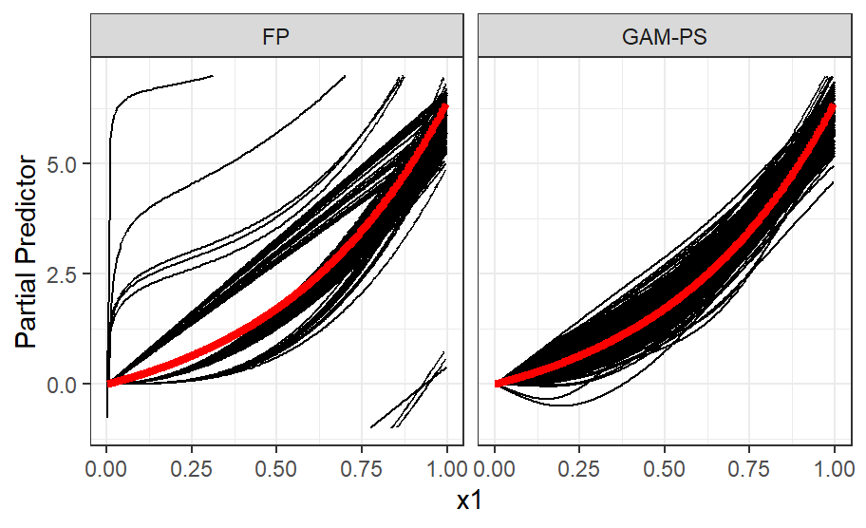
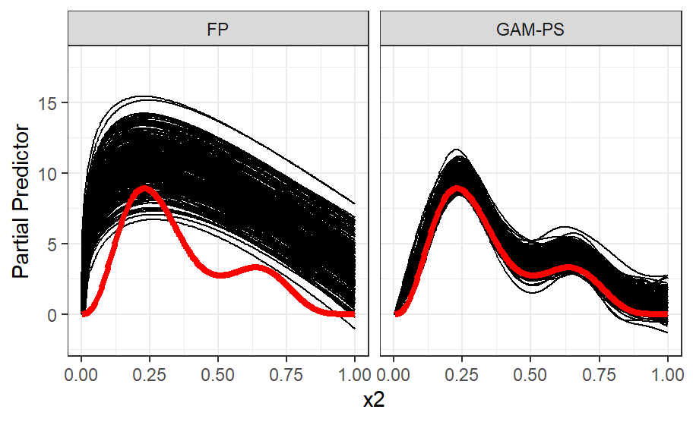
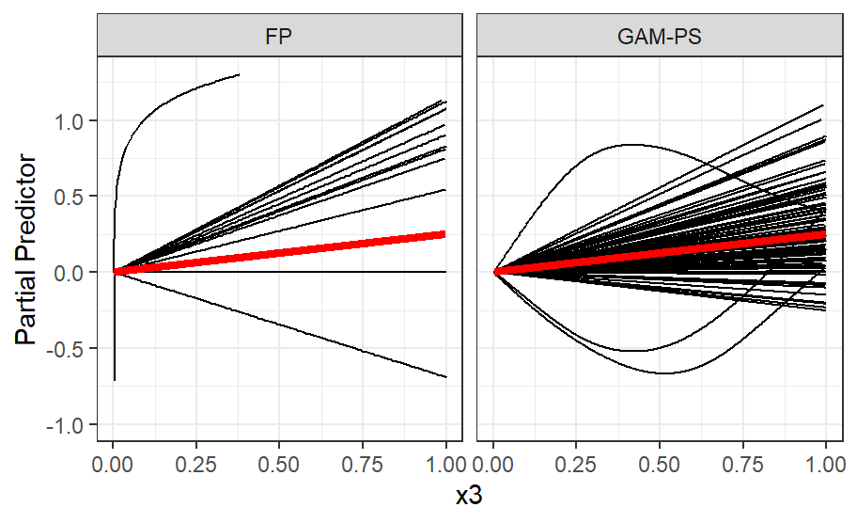
n = 400
Low power and BIC:
linear function selected
X FP PS TS TP CS
x0 200 200 200 200 200
x1 200 200 200 200 200
x2 200 200 200 200 200
x3 18 30 7 20 16
x4 11 25 3 17 16
x5 18 34 4 23 12
x6 19 27 3 16 8
x7 29 33 33 32 33
x8 178 193 192 192 192
x9 140 139 130 143 132

Slide 22
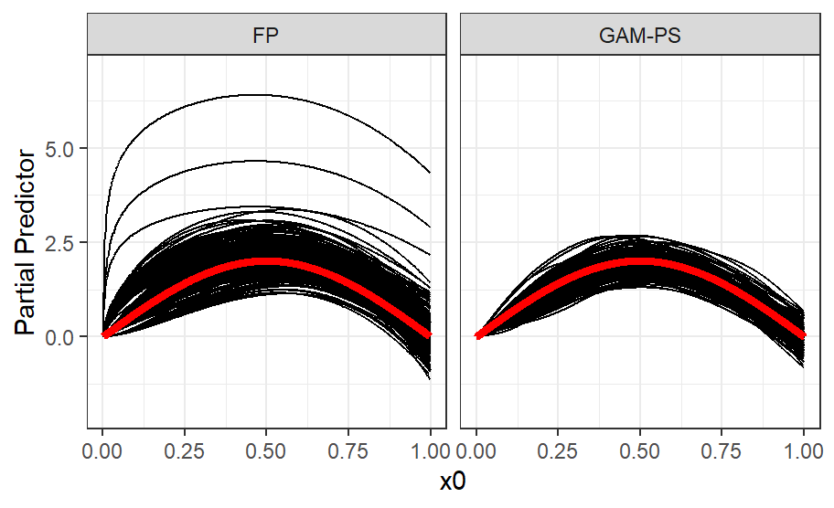
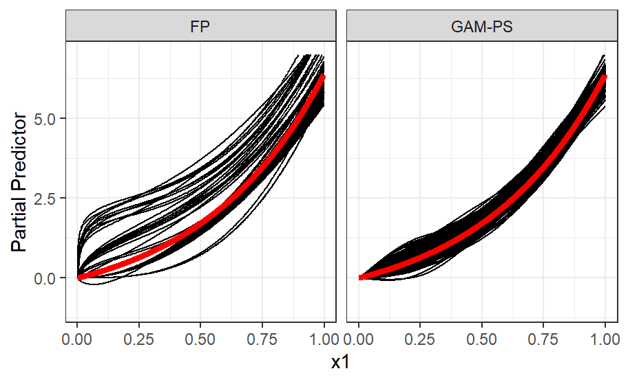
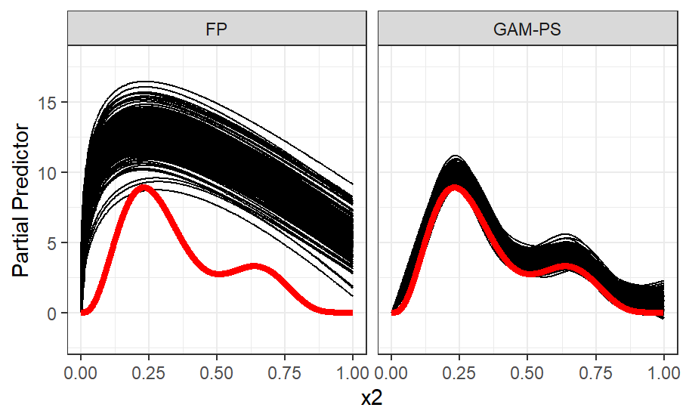
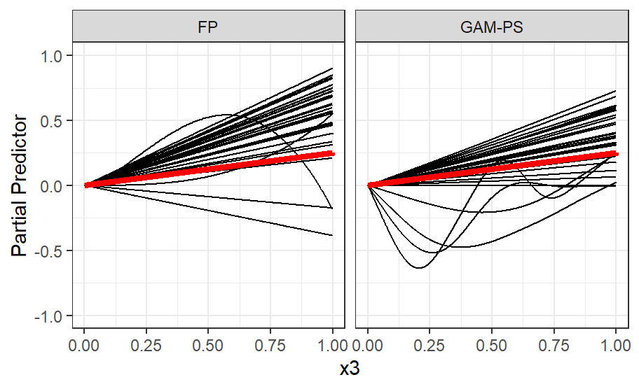
n=1200
FP PS TS1 TS2 CS
x0 200 200 200 200 200
x1 200 200 200 200 200
x2 200 200 200 200 200
x3 42 47 19 40 47
x4 27 29 2 15 12
x5 23 29 6 14 12
x6 13 25 3 11 6
x7 32 31 33 34 33
x8 200 200 200 200 200
x9 199 199 199 199 199

Slide 23
Discussion
Choice of parameters can alter effects (significance levels, AIC/BIC for MFP, maximum df for splines, choice of penalty, knots, etc). All results here produced at software default.
In agreement with Royston & Sauerbrei (2008), MFP and spline approaches provide roughly comparable models.
Approaches where closer in logistic regression setting with a fair sample size of 768 observations. Differences were more obvious in smaller sample size (survival model).
MSE from all models showed little difference between approaches. However, main interest here is in models for description.
In simulated data, where more flexibility is required, FP(2) may not be enough. Equally, penalised splines will not always correctly identify a linear relationship.
Penalised approaches (double penalty) can be computationally expensive but can still handle moderate sample sizes.
Limitation: simple simulation setting, small number of non-correlated variables.

Slide 24
References
Sauerbrei, Willi, et al. "State of the art in selection of variables and functional forms in multivariable analysis—outstanding issues." Diagnostic and prognostic research 4.1 (2020): 1-18.
Royston, Patrick, and Willi Sauerbrei. Multivariable model-building: a pragmatic approach to regression anaylsis based on fractional polynomials for modelling continuous variables. John Wiley & Sons, 2008.
Marra, Giampiero, and Simon N. Wood. "Practical variable selection for generalized additive models." Computational Statistics & Data Analysis 55.7 (2011): 2372-2387.
Perperoglou, Aris, et al. "A review of spline function procedures in R." BMC medical research methodology 19.1 (2019): 1-16.
Gu, Chong, and Grace Wahba. "Minimizing GCV/GML scores with multiple smoothing parameters via the Newton method." SIAM Journal on Scientific and Statistical Computing (1991): 383-398.

