Slide 1
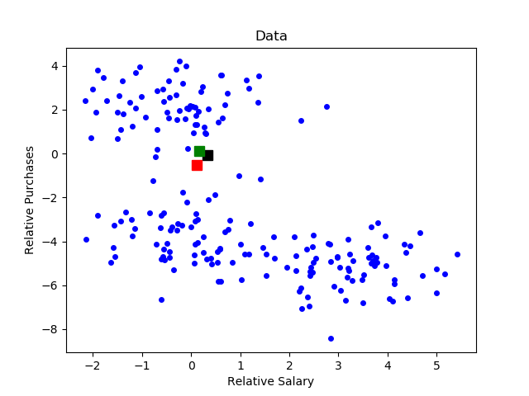
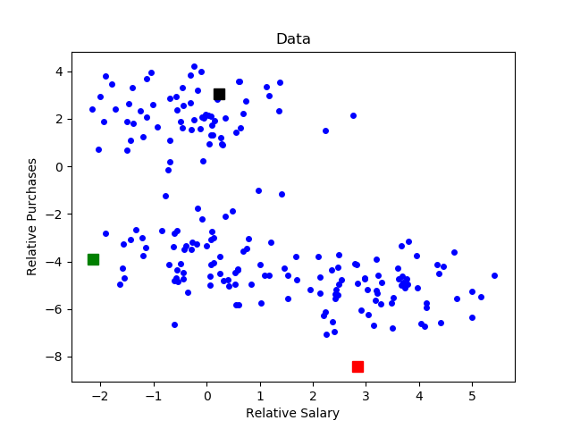
K Means++ Overview
Smarter and more reliable method for initializing centers in K-means algorithm.
Instead of initializing centers at random (left), initializes centers according to a weighted probability distribution (right).
more likely to select data point as new center if far away from currently selected centers.

Slide 2
K Means++ Algorithm
(1) Choose first center uniformly at random among the data points.
(2) For each data point X_{i} not yet considered, compute the squared distance between X_{i} and the nearest center that has already been chosen.
(3) Choose one new data point at random as a new center with probability proportional to the squared distance.
(4) Repeat Steps (2) and (3) until k centers have been chosen.
(5) When k centers have been chosen, proceed with K Means algorithm.

Slide 3
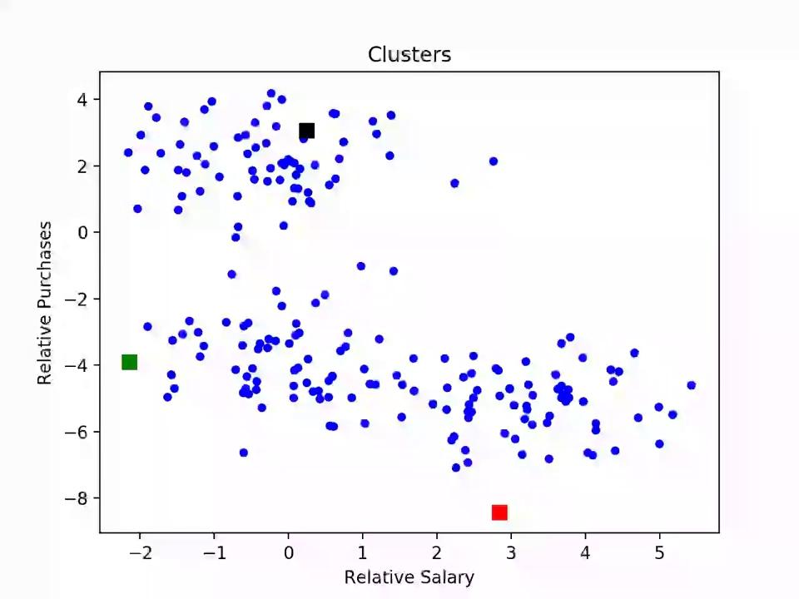
K Means++ Algorithm - Example
Movie shows the computation of clusters using K Means++

Slide 4
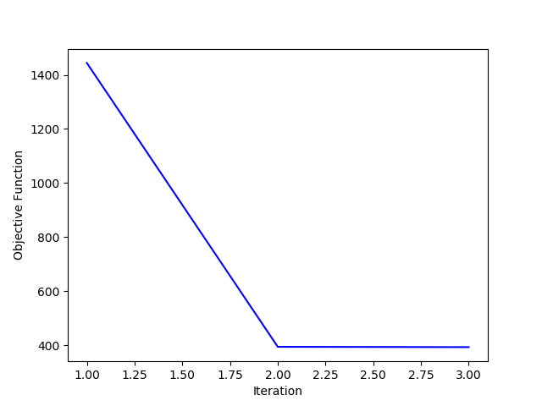
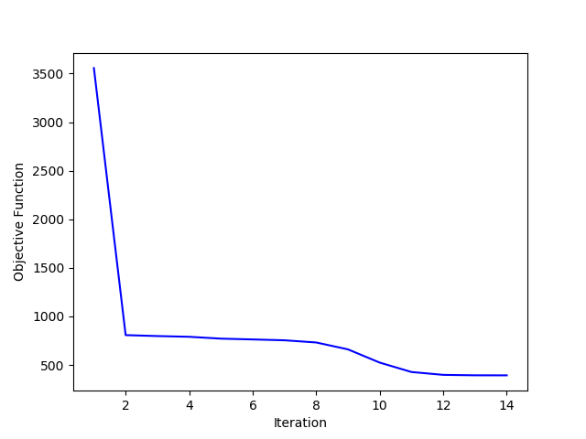
K Means++ vs K Means
Initializing centers using K Means++ more computationally expensive than initializing centers at random.
Results in faster convergence most of the time.
Usually improves quality of local optimum and overall runtime.
Figures below show an example of K Means++ (left) converging to an optimum with lower objective faster than K Means (right).

