Slide 1
Unsupervised Machine Learning

Slide 2
1.1 What is Unsupervised Machine Learning?

Slide 3
What is Machine Learning?
Definitions (adapted from Wikipedia page on Machine Learning)
Machine Learning is the study of algorithms and statistical models that computer systems use to perform a specific task without using explicit instructions, relying on patterns and inference instead
Machine Learning algorithms build a mathematical model based on training data in order to make predictions without being explicitly programmed for the task

Slide 4
Machine Learning:
Three broad areas of machine learning:
Reinforcement Learning
Informally: Learn strategies to maximize reward
Applications: game playing (tic-tac-toe, checkers, chess, go), industrial control
Supervised Machine Learning
Informally: Learn function that “fits” the data, then use for prediction
Applications: predicting house prices, spam filtering, image classification, language translation
Unsupervised Machine Learning
Informally: Learn patterns in data
Applications: finding clusters, data mining, anomaly detection

Slide 5
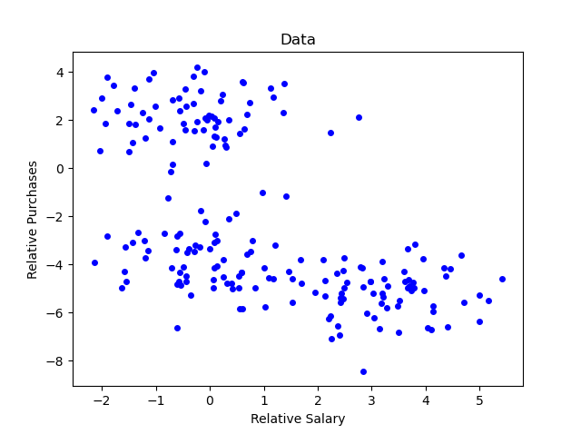
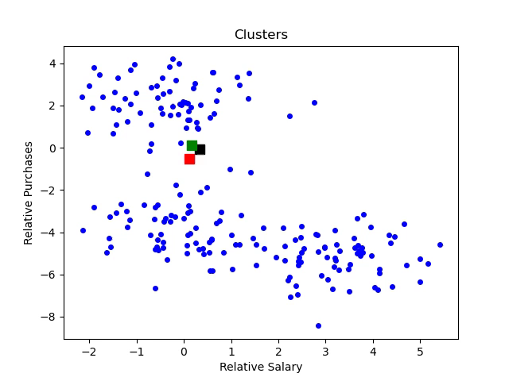
Unsupervised Learning: Example
Example: Finding clusters in customer data using K means algorithm

Slide 6
Types of Clustering
See Wikipedia page on Cluster Analysis for more details
Connectivity-Based
Combine nearby points to create clusters or nearby clusters to create larger clusters
Centroid-Based
Estimate the centroid/mean of clusters
Distribution-Based
Define clusters in terms of statistical distributions
Density-Based
Define set of points to be in cluster if density of data points exceeds specified threshold

Slide 7
What this Course Covers
Mathematics
Distance functions
Singular value decomposition
Algorithms
Detailed explanation of Hierarchical Clustering, K Means Clustering, DBScan, Gaussian Mixture Model, and PCA algorithms
Python Coding
Review of relevant functions in packages numpy, matplotlib, and pandas
Development and walkthrough of the Python codes for each of the clustering algorithms

Slide 8
1.2 About this Course

Slide 9
Course Prerequisites
Linear Algebra
Students should be familiar vectors and matrices
Probability and Statistics
Students should be familiar with basic probability and statistics, including normal distributions
Python Programming
Students should be able to write and run Python 3 programs in Jupyter notebooks and in the command window

Slide 10
Audience for this Course
This course is suitable for:
Students without any previous experience with machine learning
Students who have knowledge of the subject and would like a refresher and/or gain a more detailed understanding of the mathematical foundations, algorithms, and development of a machine learning framework in Python

Slide 11
Course Approach
Describe underlying mathematics in detail
Motivation and derivations for all the underlying mathematics provided
Describe algorithms in detail
In depth discussion of connection between math and algorithms
Use Jupyter notebooks
Examples in lectures are complemented by Jupyter notebook examples
Walk through code development
This course walks through development codes in Python for the various algorithms of unsupervised learning
Provide exercises
50+ problems (theory, Jupyter notebook, programming, research) with solutions provided

Slide 12
How to Get the Most from this Course
Learning is not a spectator activity. Active participation by students is required to get most from this course
Take notes as you go through the material and work out the mathematical derivations by yourself
Do the programming
Code walkthrough videos will start with objectives and high-level summary of the code structure, followed by video of code implementation
You may want to just review the objectives and then design and implement the code by yourself OR program after watching the walk throughs
Do the exercises
Solutions provided
Ask questions on forums

Slide 13
Why Code from Scratch?
My fundamental belief (and a reason for creating this course) is that to truly understand Unsupervised Learning algorithms one must review the underlying mathematics and write codes from scratch

Slide 14
Course Outline:
Chapter 1: Introduction
Chapter 2: Python Demos
Chapter 3: Review of Mathematical Concepts
Chapter 4: Hierarchical Clustering
Chapter 5: K Means Clustering
Chapter 6: Density Based Clustering
Chapter 7: Distribution Based Clustering
Chapter 8: Principal Component Analysis
Chapter 9: Applications
Chapter 10: Summary and Thank You

Slide 15
1.3 Resources and Set Up

Slide 16
Resources and Set Up
Instructor will use Windows 10 machine
Course material not specific to Windows – can use MacOS or Linux
All code examples written in Python
Course will run programs using
Jupyter Notebook
For demos
Command Window
For the machine learning framework
Should have text editor compatible with Python for writing and editing programs
Examples: Atom, Sublime, Notepad+, etc
Instructor will use Sublime, but you can use your favourite editor

Slide 17
Course Material
Course material located at:
https://github.com/satishchandrareddy/UnsupervisedML/
Folder: Code
Contains course machine learning framework and drivers
Folder: Examples
Jupyter notebooks that show python code examples complementing those presented in the lectures
Folder: Presentations
PDF files of presentations
Folder: Exercises
PDF file of exercises and solutions
Solutions files (Jupyter notebooks and python program files)

Slide 18
Packages used in Course
Component | Version | Description/Comments
Python | 3.8.3 | It is assumed that students have Python on their machine and have ability to run Jupyter notebooks. If you don’t have Python on your machine, it is probably best to install Python using the Anaconda package, which aims to simplify package management.
NumPy | 1.18.5 | Package for scientific computing. Fundamental building block underlying course codes is numpy array.
Matplotlib | 3.2.2 | Package for plotting
pandas | 1.0.5 | Package containing data structures and data analysis tools – will use to load data from csv file.
scikit-learn | 0.23.1 | Package for supervised and unsupervised learning
copy, csv, pathlib, time |  | These packages are part of the python release

Slide 19
1.3 Course Resources
Download resources from Github:
https://github.com/satishchandrareddy/UnsupervisedML/

