Slide 1
Unsupervised Learning

Slide 2
Section 2: Python Demos

Slide 3
Python Demos
Section | Title | Description
2.1 | NumPy Demo | Covers the principal numpy functions to be used in the course. Numpy array is building block underlying framework we will create.
2.2 | Matplotlib Demo Basic | Covers the basic matplotlib plotting functions
2.3 | Matplotlib Animation Demo | Covers how to create animations using matplotlib functions
2.4 | Pandas Demo | Covers how to use the basic pandas commands to read data from file and perform basic manipulations

Slide 4
Section 2.1: NumPy Demo

Slide 5
NumPy Demo
NumPy (Numpy/numpy) is a Python package for scientific computing
Key object is multi-dimensional numpy array
numpy functions manipulate these arrays
Can perform standard matrix and vector operations
Can perform operations on entire array without explicit looping
Course framework uses numpy array as fundamental building block
See following site for details: https://numpy.org/

Slide 6
Key Numpy Commands and Functions
Operation | numpy functions
Array creation | numpy.array()
Array indexing
Component-wise operations: addition, multiplication, scalar multiplication | +,*, * with scalar
Functions | numpy.exp(), numpy.absolute(), numpy.square()
Array of random numbers: setting seed, from uniform distribution, from normal distribution | numpy.random.seed(), numpy.random.rand(), numpy.random.randn()
Sum entries of array and mean of entries of array | numpy.sum()
Array of zeros, array of ones | numpy.zeros(), numpy.ones()

Slide 7
2.1 Numpy DEMO
Jupyter Notebook for demo:
UnsupervisedML/Examples/Chapter2/NumpyDemo.ipynb
Course Resources at:
https://github.com/satishchandrareddy/UnsupervisedML/

Slide 8
Section 2.2: Matplotlib Basic Demo

Slide 9
Matplotlib Basic Demo
Matplotlib is a Python package for plotting
See following site for details: https://matplotlib.org
Matplotlib has Matlab-like interface
This section has a demo of the basic plotting commands

Slide 10
Matplotlib Basics: Commands and Functions
Operation | matplotlib functions
Basic plotting using lists and numpy arrays and adding legends | figure(),plot(), legend(), title(), xlabel(), ylabel(),show()
Multiple plots | subplot()
Object oriented approach
Scatter plots | plot(), scatter()

Slide 11
2.2 Matplotlib DEMO
Jupyter Notebook for demo:
UnsupervisedML/Examples/Chapter2/MatplotlibBasicsDemo.ipynb
Course Resources at:
https://github.com/satishchandrareddy/UnsupervisedML/

Slide 12
Section 2.3: Matplotlib Animation Demo

Slide 13
Matplotlib Animation: Commands and Functions
Function | Notes
ArtistAnimation | Generate a list of frames each containing the matplotlib artists (curves, text, etc) to include in animation
FuncAnimation | Create a function to generate each frame of animation

Slide 14
2.3 Matplotlib Animation DEMO
Jupyter Notebook for demo:
UnsupervisedML/Examples/Chapter2/MatplotlibAnimationDemo.ipynb
Course Resources at:
https://github.com/satishchandrareddy/UnsupervisedML/

Slide 15
2.4 Pandas Demo

Slide 16
Pandas Demo
Pandas is a Python package containing data structures and analysis tools
Will use pandas functions to read data from csv file and process data for case studies
Key structure is data frame
See following site for details: https://pandas.pydata.org/

Slide 17
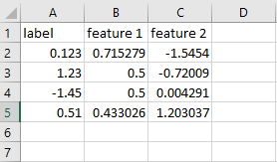
Reading From CSV
Typically csv file has columns of data with headings/names
Pandas reads data and puts into dataframe structure
Use column names to choose which data to manipulate

Slide 18
Key Pandas Commands and Functions
Operation | pandas functions
Read data from csv file and put into data frame | pandas.read_csv
List items in data frame | pandas.head(), pandas.tail()
Remove column from data frame | pandas.drop()
Map data | map attribute
Extract values from data frame in numpy array format | values attribute

Slide 19
2.4 Pandas DEMO
Jupyter Notebook for demo:
IntroML/Examples/Chapter2/PandasDemo.ipynb
Course Resources at:
https://github.com/satishchandrareddy/UnsupervisedML/

Slide 20
2.6 sklearn Demo

Slide 21
sklearn Demo
sklearn is shortened version of name of package scikit-learn
sklearn is a package for machine learning
Will use text processing functionality in CountVectorizer in sklearn for spam classification case study
See following site for details: https://scikit-learn.org/stable/index.html

Slide 22
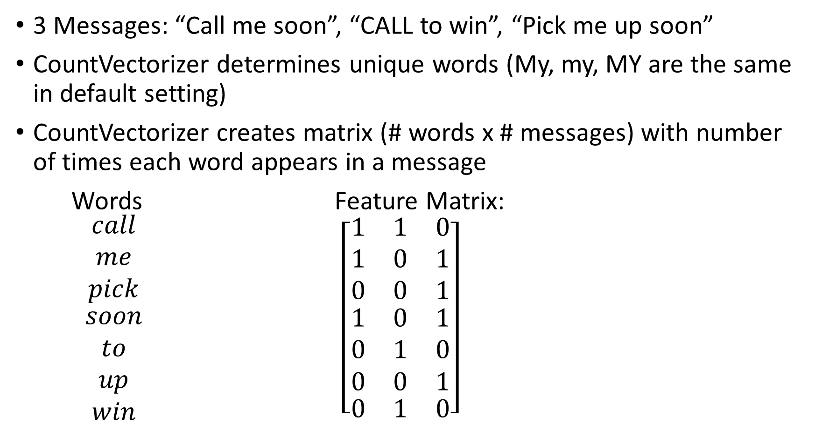
CountVectorizer - Example
3 Messages: “Call me soon”, “CALL to win”, “Pick me up soon”
CountVectorizer determines unique words (My, my, MY are the same in default setting)
CountVectorizer creates matrix (# words x # messages) with number of times each word appears in a message
Words Feature Matrix:
$\begin{matrix}\begin{matrix}call \\ me \\ pick\end{matrix} \\ \begin{matrix}soon \\ to \\ up\end{matrix} \\ win\end{matrix}$ $\left[\begin{matrix}\begin{matrix}1 & 1 & 0 \\ 1 & 0 & 1 \\ 0 & 0 & 1\end{matrix} \\ \begin{matrix}1 & 0 & 1 \\ 0 & 1 & 0 \\ 0 & 0 & 1\end{matrix} \\ \begin{matrix}0 & 1 & 0\end{matrix}\end{matrix}\right]$

Slide 23
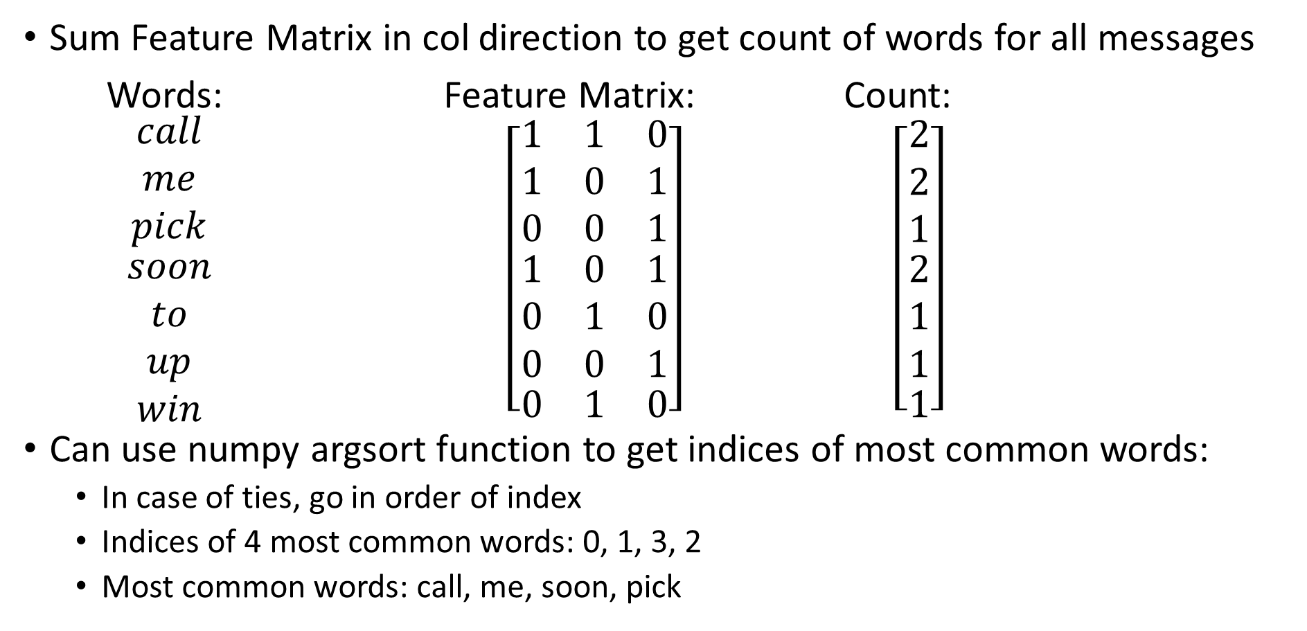
Most Common Words
Sum Feature Matrix in col direction to get count of words for all messages
Words: Feature Matrix: Count:
$\begin{matrix}\begin{matrix}call \\ me \\ pick\end{matrix} \\ \begin{matrix}soon \\ to \\ up\end{matrix} \\ win\end{matrix}$ $\left[\begin{matrix}\begin{matrix}1 & 1 & 0 \\ 1 & 0 & 1 \\ 0 & 0 & 1\end{matrix} \\ \begin{matrix}1 & 0 & 1 \\ 0 & 1 & 0 \\ 0 & 0 & 1\end{matrix} \\ \begin{matrix}0 & 1 & 0\end{matrix}\end{matrix}\right]$ $\left[\begin{matrix}\begin{matrix}2 \\ 2 \\ 1\end{matrix} \\ \begin{matrix}2 \\ 1 \\ 1\end{matrix} \\ 1\end{matrix}\right]$
Can use numpy argsort function to get indices of most common words:
In case of ties, go in order of index
Indices of 4 most common words: 0, 1, 3, 2
Most common words: call, me, soon, pick

Slide 24
2.6 sklearn DEMO
Jupyter Notebook for DEMO
IntroML/Examples/Chapter2/sklearnDemo.ipynb
Course Resources at:
https://github.com/satishchandrareddy/IntroML/

