Slide 1
Unsupervised Machine Learning

Slide 2
Section 3: Mathematical Concepts

Slide 3
Mathematical Concepts
Section | Contents
3.1 | What is Data in Unsupervised Learning?
3.2 | Singular Value Decomposition -Theory underlying principal component analysis for reducing number of dimensions in data
3.3 | Distance Measures -Review of formulas for distance between points and sets of points
3.4 | Computational Complexity -Discussion of how to measure how much work that an algorithm requires
3.5 | Normal Distributions

Slide 4
Section 3.1: What is Data in Unsupervised Learning?

Slide 5
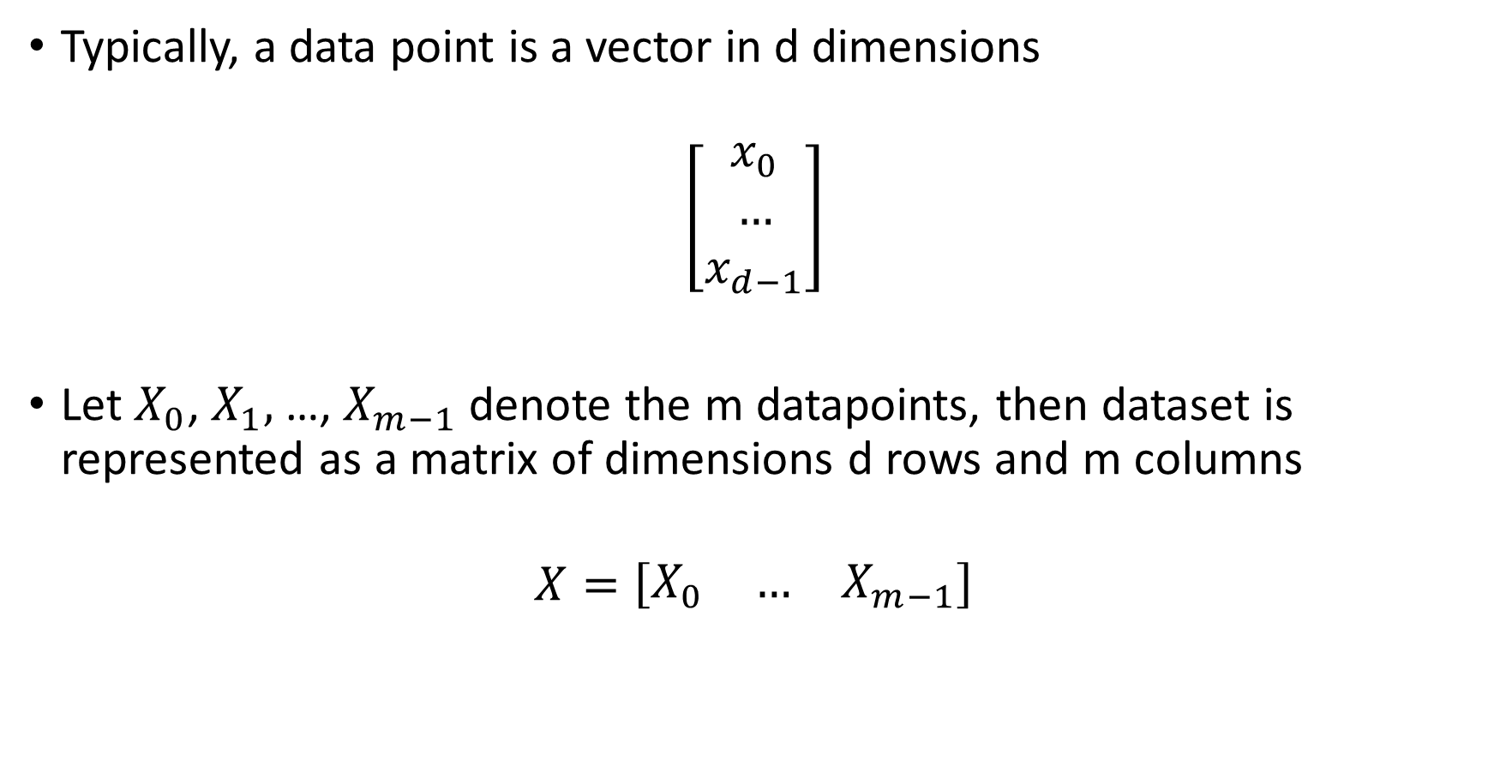
Data and Datasets
Typically, a data point is a vector in d dimensions
$$\left[\begin{matrix}x_{0} \\ … \\ x_{d−1}\end{matrix}\right]$$
Let $X_{0}$, $X_{1},$ …, $X_{m−1}$denote the m datapoints, then dataset is represented as a matrix of dimensions d rows and m columns
$$X=\left[\begin{matrix}X_{0} & … & X_{m−1}\end{matrix}\right]$$

Slide 6
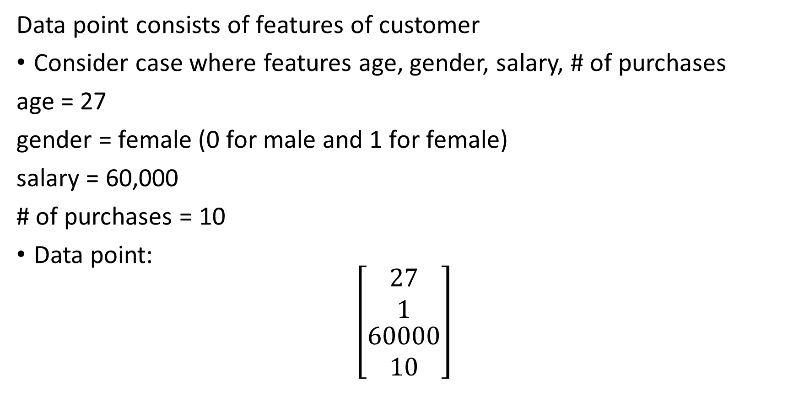
Example: Customer Segmentation
Data point consists of features of customer
Consider case where features age, gender, salary, # of purchases
age = 27
gender = female (0 for male and 1 for female)
salary = 60,000
# of purchases = 10
Data point:
$$\left[\begin{matrix}\begin{matrix}27 \\ 1\end{matrix} \\ \begin{matrix}60000 \\ 10\end{matrix}\end{matrix}\right]$$

Slide 7
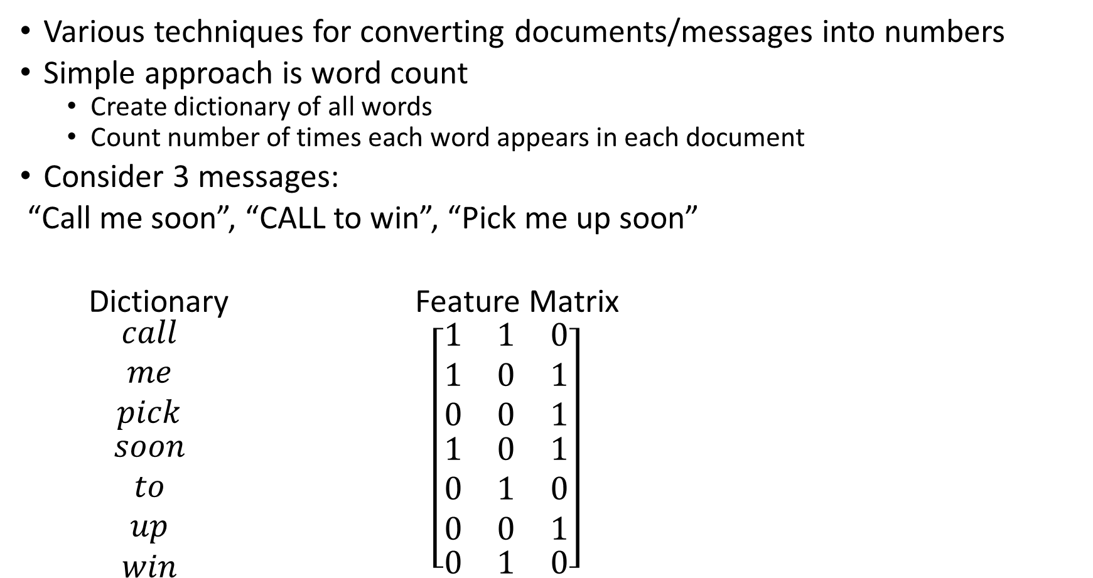
Example: Natural Language Processing
Various techniques for converting documents/messages into numbers
Simple approach is word count
Create dictionary of all words
Count number of times each word appears in each document
Consider 3 messages:
“Call me soon”, “CALL to win”, “Pick me up soon”
Dictionary Feature Matrix
$\begin{matrix}\begin{matrix}call \\ me \\ pick\end{matrix} \\ \begin{matrix}soon \\ to \\ up\end{matrix} \\ win\end{matrix}$ $\left[\begin{matrix}\begin{matrix}1 & 1 & 0 \\ 1 & 0 & 1 \\ 0 & 0 & 1\end{matrix} \\ \begin{matrix}1 & 0 & 1 \\ 0 & 1 & 0 \\ 0 & 0 & 1\end{matrix} \\ \begin{matrix}0 & 1 & 0\end{matrix}\end{matrix}\right]$

Slide 8
Example: Images
Images typically are composed of rectangular arrays of pixels
For black and white images, intensity of greyscale for each pixel is represented by a number (white = 0 to 255 = black)
Feature vector for image is vector of intensities for all pixels
For colour images, each pixel represented by 3 values – intensities of red, blue, and green components for that pixel – feature vector in colour case vector will be 3 times longer than in black and white case

Slide 9
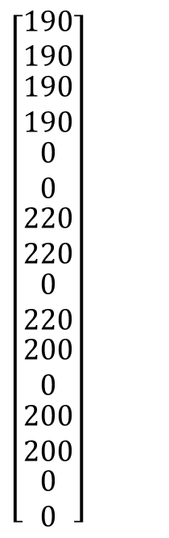
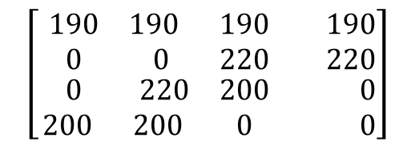
Converting Image to Matrix
Original Image:
Greyscale 4x4 =16 pixels
Intensity Matrix
4x4 (white=0 to 255=black)
Feature Vector 16x1
Standard to divide by 255
$$\left[\begin{matrix}\begin{matrix}190 & 190 \\ 0 & 0\end{matrix} & \begin{matrix}190 & 190 \\ 220 & 220\end{matrix} \\ \begin{matrix} 0 & 220 \\ 200 & 200\end{matrix} & \begin{matrix}200 & 0 \\ 0 & 0\end{matrix}\end{matrix}\right]$$
$\left[\begin{matrix}\begin{matrix}\begin{matrix}\begin{matrix}190 \\ 190\end{matrix} \\ \begin{matrix}190 \\ 190\end{matrix}\end{matrix} \\ \begin{matrix}\begin{matrix}0 \\ 0\end{matrix} \\ \begin{matrix}220 \\ 220\end{matrix}\end{matrix}\end{matrix} \\ \begin{matrix}\begin{matrix}\begin{matrix}0 \\ 220\end{matrix} \\ \begin{matrix}200 \\ 0\end{matrix}\end{matrix} \\ \begin{matrix}\begin{matrix}200 \\ 200\end{matrix} \\ \begin{matrix}0 \\ 0\end{matrix}\end{matrix}\end{matrix}\end{matrix}\right]$

Slide 10
Websites for Datasets
Kaggle
www.kaggle.com
Site for data science competitions (often with prize money)
Each competition comes with freely available data
Can learn from tutorials, practice competitions, and notebooks created by participants
University of California, Irvine Machine Learning Data Repository
https://archive.ics.uci.edu/ml/index.php
Contains 100s of machine learning datasets (supervised learning)

Slide 11
Section 3.2: Singular Value Decomposition

Slide 12
Looking at a Matrix
Consider a matrix A (d rows and m columns)
A is can considered as mapping from R^{m} (m dimensional space) to R^{d} (d dimensional space)
If y = Ax, then x point in R^{m} (m dimensional space) and y is a point in R^{d} (d dimensional space)
m cols
d rows
A

Slide 13
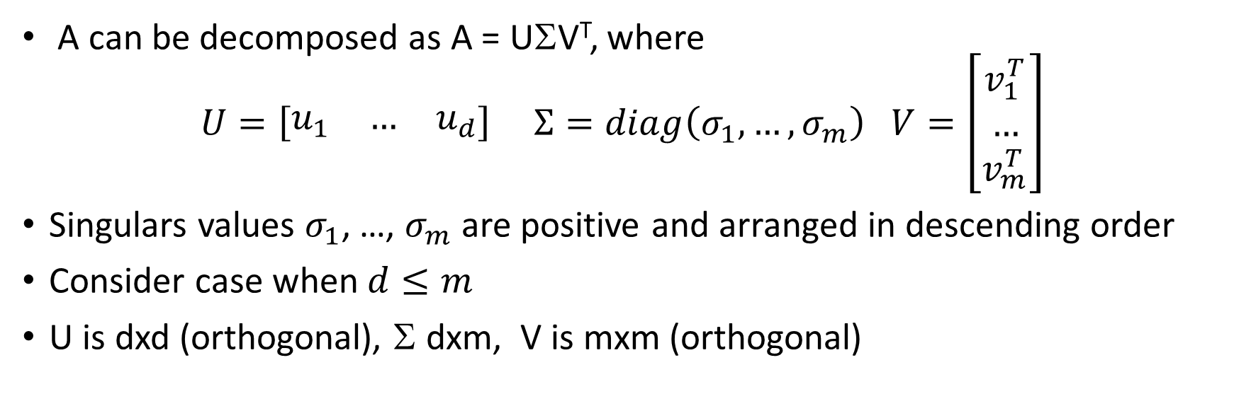
Singular Value Decomposition
A can be decomposed as A = UΣV^{T}, where
$$U=\left[\begin{matrix}u_{1} & … & u_{d}\end{matrix}\right] Σ=diag\left(σ_{1},…,σ_{m}\right) V=\left[\begin{matrix}v_{1}^{T} \\ … \\ v_{m}^{T}\end{matrix}\right]$$
Singulars values $σ_{1}$, …, $σ_{m}$ are positive and arranged in descending order
Consider case when $d≤m$
U is dxd (orthogonal), Σ dxm, V is mxm (orthogonal)
A
A
=
U
Σ
V^{T}

Slide 14
Matrix A as a Mapping
Consider y = Ax where A is 2x2
A maps v₁ to σ₁u₁
A maps v₂ to σ₂u₂
v₂
y
x
σ₂u₂
y=Ax
σ₁u₁
v₁

Slide 15
Matrix A as a Mapping
Consider y = Ax where A is 2x2
A maps v₁ to σ₁u₁
A maps v₂ to σ₂u₂
v₂
y
x
σ₂u₂
y=Ax
σ₁u₁
v₁

Slide 16
Singular Value Decomposition: Computation
Eigenvalues of A^{T}A are squares of singular values of A
Usually one computes singular values U and V using a numerical approach (function in numpy)

Slide 17
Section 3.3: Distance Measures

Slide 18
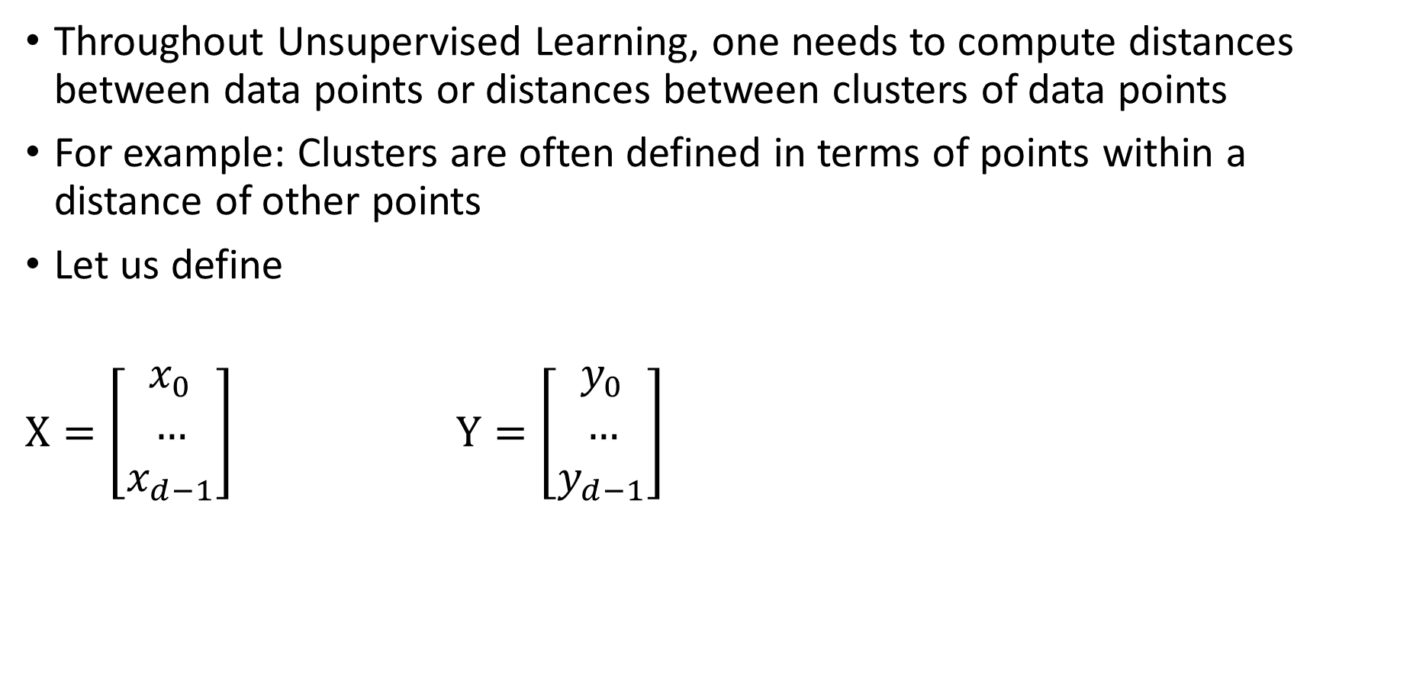
Why is a Distance Measure Needed?
Throughout Unsupervised Learning, one needs to compute distances between data points or distances between clusters of data points
For example: Clusters are often defined in terms of points within a distance of other points
Let us define
$X=\left[\begin{matrix}x_{0} \\ … \\ x_{d−1}\end{matrix}\right]$ $Y=\left[\begin{matrix}y_{0} \\ … \\ y_{d−1}\end{matrix}\right]$

Slide 19
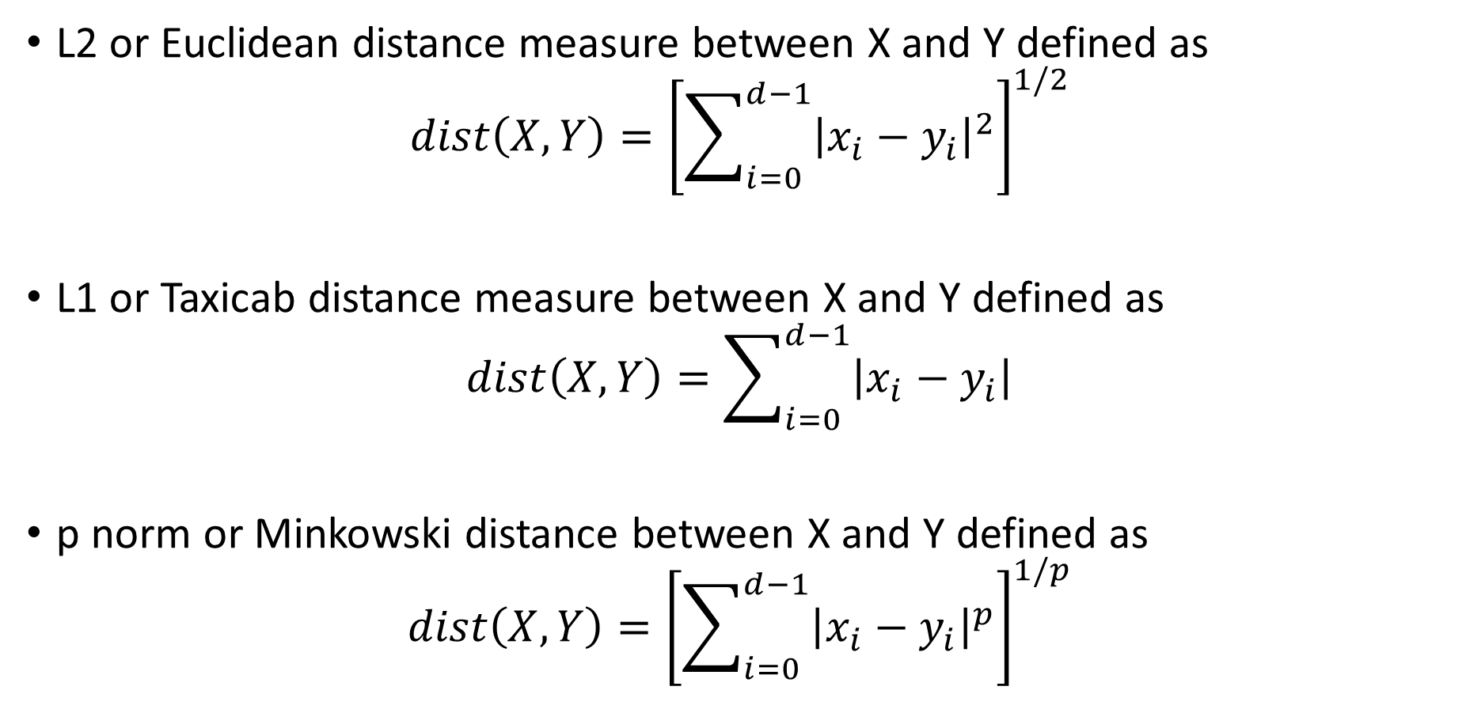
Examples of Distance Measure
L2 or Euclidean distance measure between X and Y defined as
$$dist\left(X,Y\right)={\left[\sum_{i=0}^{d−1}{{\left|x_{i}−y_{i}\right|}^{2}}\right]}^{1/2}$$
L1 or Taxicab distance measure between X and Y defined as
$$dist\left(X,Y\right)=\sum_{i=0}^{d−1}{\left|x_{i}−y_{i}\right|}$$
p norm or Minkowski distance between X and Y defined as
$$dist\left(X,Y\right)={\left[\sum_{i=0}^{d−1}{{\left|x_{i}−y_{i}\right|}^{p}}\right]}^{1/p}$$

Slide 20
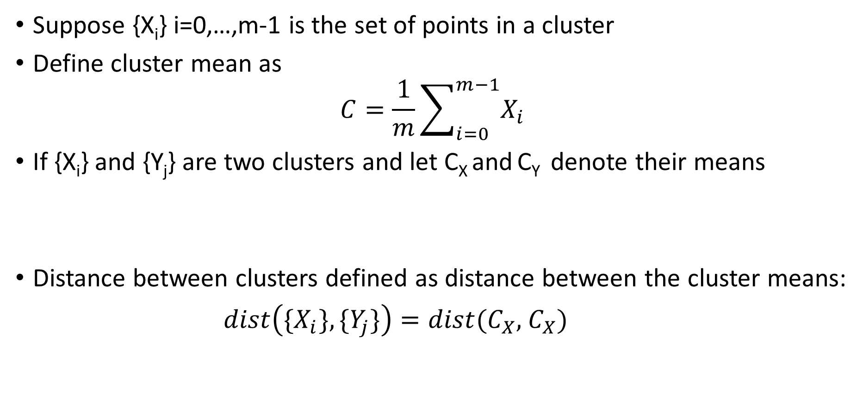
Distance Between Clusters
Suppose {X_{i}} i=0,…,m-1 is the set of points in a cluster
Define cluster mean as
$$C=\frac{1}{m}\sum_{i=0}^{m−1}{X_{i}}$$
If {X_{i}} and {Y_{j}} are two clusters and let C_{X} and C_{Y} denote their means
Distance between clusters defined as distance between the cluster means:
$dist\left(\{X_{i}\},\{Y_{j}\}\right)=dist(C_{X},$ $C_{X})$

Slide 21
Section 3.4: Computational Complexity

Slide 22
Section 3.5: Normal Distributions

